Slide 1

Successful Software Practice
How to successfully work as a team to create software
Chris Mendes, Chief Technology Officer
Sirca Limited
March 2012

Slide 2
About me...
  Graduated B.Sc in 1987 and B.E. in 1989
  Worked in lots of sectors: real time, finance, control systems, data warehouse, hi-tech R&D
  Was GM of a division of CISRA, Canon's R&D facility in Australia
  Now CTO of Sirca Ltd, the largest database of stock data in the world
Slide 2
Successful Software Practice
Date: 1/4/2011

Slide 3
I hate process
  I have never seen a prescriptive process that I liked!
  What I want to share with you today comes form learning the hard way
    Rules of thumb
    Practices, not processes
  I've done a lot of bad projects
  Now, I'm doing a whole lot of successful ones
    Measures:
      Happy customers
      Happy teams
      Software that is being used
Slide 4
Successful Software Practice
Date: 1/4/2011

Slide 4
Process vs Practice
Processes prevent the mediocre from making mistakes.
Practices make the professional exceptional.
Slide 5
Successful Software Practice
Date: 1/4/2011

Slide 5
Why are you here today?
Are there any concerns you have about how you are going to get your project done?
Slide 6
Successful Software Practice
Date: 1/4/2011

Slide 6
What do I want to cover?
  Planning
  Typical methodologies
  What does a successful software project look like?
  Roles
  Practices
  Bringing it together
Slide 7
Successful Software Practice
Date: 1/4/2011

Slide 7
What do I want to cover?
  Planning
  Typical methodologies
  What does a successful software project look like?
  Roles
  Practices
  Bringing it together
Slide 8
Successful Software Practice
Date: 1/4/2011

Slide 8
Planning
  It helps to know where you are going...
  How do I plan and estimate?
    Understand the goals
    Plan work to make the goals happen
    Think about risk and how to minimise it
    Write it down and share it
    Estimation...a problem
  Is it just an exercise in futility?
    Start with a broad brush and paint in detail as you go
    Invest the right amount in planning
Slide 9
Successful Software Practice
Date: 1/4/2011

Slide 9
What do I want to cover?
  Planning
  Typical methodologies
  What does a successful software project look like?
  Roles
  Practices
  Bringing it together
Slide 10
Successful Software Practice
Date: 1/4/2011

Slide 10
Typical Methodologies
  List:
    Waterfall, Iterative, Spiral, RAD
  We use Agile and here's why...
    It's a natural process
    It brings risk forward, rather than pushing it to the end
    It puts quality, value and end-user priority first
Slide 11
Successful Software Practice
Date: 1/4/2011

Slide 11
What do I want to cover?
  Planning
  Typical methodologies
  What does a successful software project look like?
  Roles
  Practices
  Bringing it together
Slide 12
Successful Software Practice
Date: 1/4/2011

Slide 12
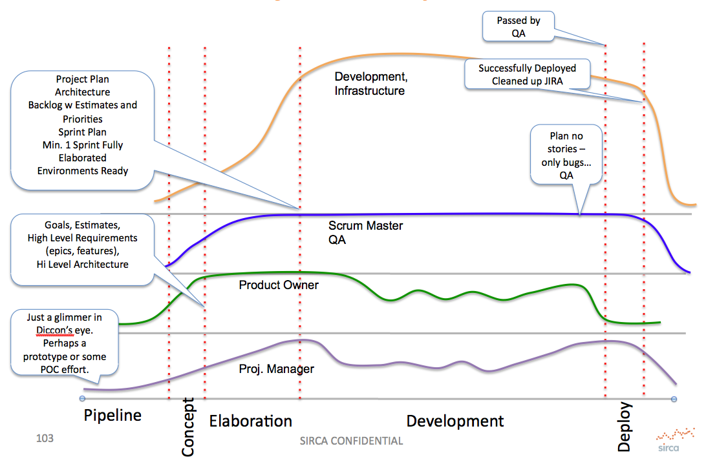
Project Shape
Slide 13
Successful Software Practice
Date: 1/4/2011

Slide 13
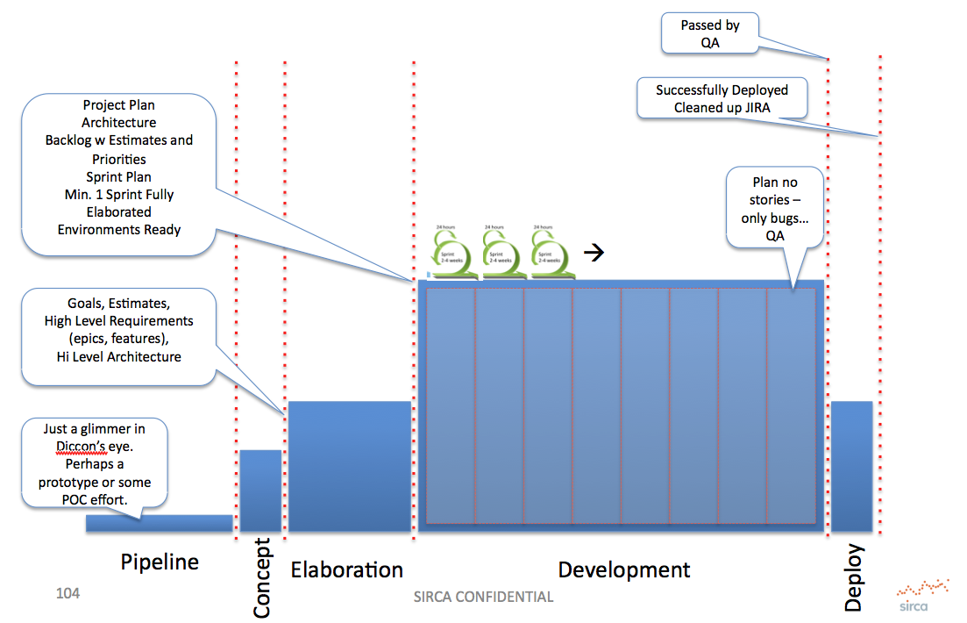
Project Shape
Slide 14
Successful Software Practice
Date: 1/4/2011

Slide 14
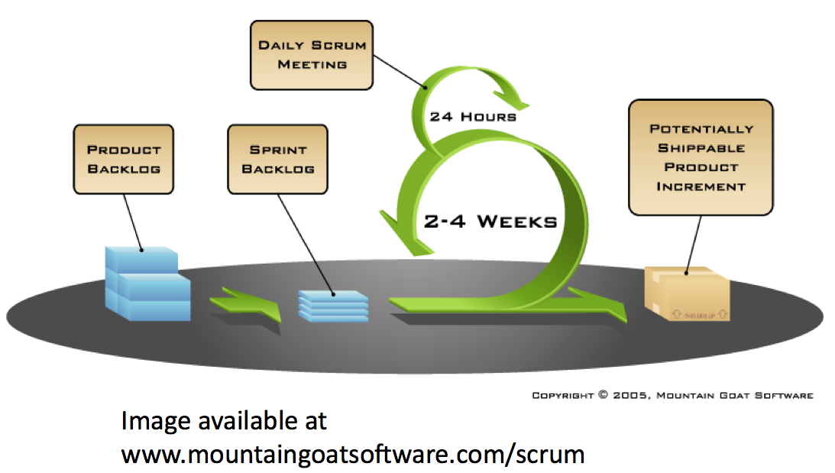
Project Shape - About Scrums
Slide 15
Successful Software Practice
Date: 1/4/2011

Slide 15
Epics, Stories, Backlogs...
  Your assignment is currently set up as Epics
  You need to break them into stories, prioritise them and elaborate them
  Start by elaborating just the story titles
    Estimate them...
  Before your first sprint, fully elaborate the stories for that sprint (at least)
Slide 16
Successful Software Practice
Date: 1/4/2011

Slide 16
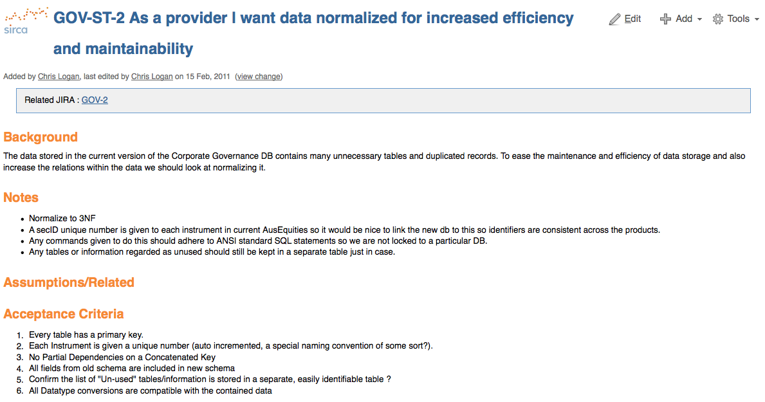
User Story Example
Slide 17
Successful Software Practice
Date: 1/4/2011

Slide 17
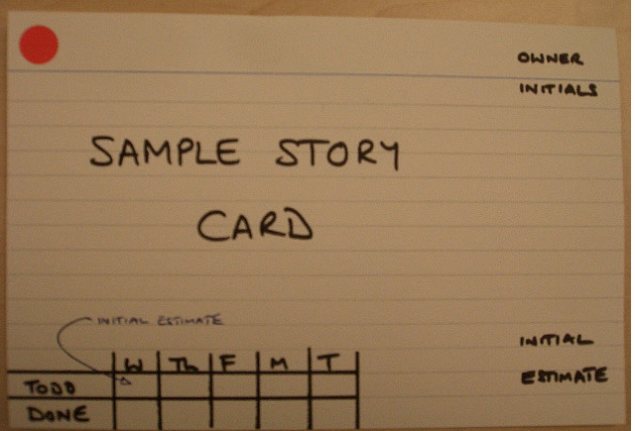
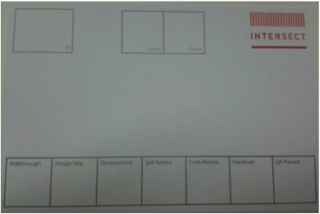
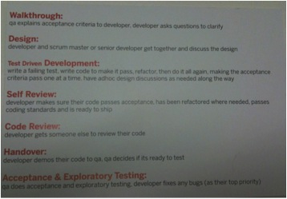
Agile Tools
  Story Cards
  Simple Tools - Spreadsheets, Whiteboards
Slide 18
Successful Software Practice
Date: 1/4/2011

Slide 18
What might your project look like?
Slide 19
Successful Software Practice
Date: 1/4/2011

Slide 19
What do I want to cover?
  Planning
  Typical methodologies
  What does a successful software project look like?
  Roles
  Practices
  Bringing it together
Slide 20
Successful Software Practice
Date: 1/4/2011

Slide 20
Roles
  Product Owner
  Project Manager
  Scrum Master
  Dev Tester
  Developer
Slide 21
Successful Software Practice
Date: 1/4/2011

Slide 21
Roles
  Assign them, assign them wisely
  Of course, there are many more roles but you don't need them in this case
  Roles:People is not 1:1. One person can have many roles, you can swap roles.
  You can not be the Dev-Tester for your own code - you can be a developer and a tester but only testing other people's code
  You can't review your own work
Slide 22
Successful Software Practice
Date: 1/4/2011

Slide 22
Product Owner
  Is a business analyst
  Consults with stakeholders and documents their input
  Creates stories that can be implemented
    Does enough analysis up front
    Sufficiently described
    Are not designs
  Works with QA and stakeholders to ensure acceptance criteria are right
  Owns the product backlog
  Prioritises all stories into backlog in consultation with the project sponsor
Slide 23
Successful Software Practice
Date: 1/4/2011

Slide 23
Scrum Master
  Ensures engineers have no roadblocks and are doing what they should be doing
  Keeps the PM updated re progress, risks, issues
  Has daily meetings with her team
  Provides technical leadership, design guidance, design review and code review
  Ensures quality is maintained at an appropriate level
  Helps his team to plan and estimate work
  Updates Sprint Board Daily
  Maintains backlog for the project, Updates backlog each Sprint
  Facilitates Showcase and Retrospectives each Sprint
Slide 22
Successful Software Practice
Date: 1/4/2011

Slide 24
Developer
  Understands the story and acceptance criteria
  Analyses problems
  Designs solutions
    in collaboration with architect, infrastructure etc
    let's us know if major re-design is needed on existing systems
  Plans and Estimates their own work
  Codes and Unit Tests
  Participates in design and code reviews
  Asks for review and assistance
  Tests their own work against acceptance criteria
Slide 25
Successful Software Practice
Date: 1/4/2011

Slide 25
Developmental Tester
  Understands requirements provided by PO and writes acceptance criteria
  Develops & maintains test scripts
  Updates API test harnesses
  Ensures unit testing happens
  Ensures Dev Testing happens
  Reports on progress, raises bugs, retests
  Regression tests
  Breaks stuff
  Monitors automated build and test
  Monitors code coverage
Slide 26
Successful Software Practice
Date: 1/4/2011

Slide 26
Project Manager
  Is a Communicator, Facilitator and Trouble Shooter
  Understands project goals and benefits and shares vision with the team
  Ensures work is prioritised and scheduled
  Ensures work is planned by the engineers and is carried out as scheduled
  Manages project risks and ensures mitigation is executed
  Helps make sure project stakeholders are communicated with and that goals are met
  Maintains schedules and other project documentation
Slide 27
Successful Software Practice
Date: 1/4/2011

Slide 27
What do I want to cover?
  Planning
  Typical methodologies
  What does a successful software project look like?
  Roles
  Practices
  Bringing it together
Slide 28
Successful Software Practice
Date: 1/4/2011

Slide 28
Practices
  Review (documents, code, design, architecture, test scripts, everything)
  Architecture - have one
  Design - everything
  Unit Testing - no excuses
  Regression Testing - automated
  Configuration Management (software & environments)
  Daily Check-in
Slide 29
Successful Software Practice
Date: 1/4/2011

Slide 29
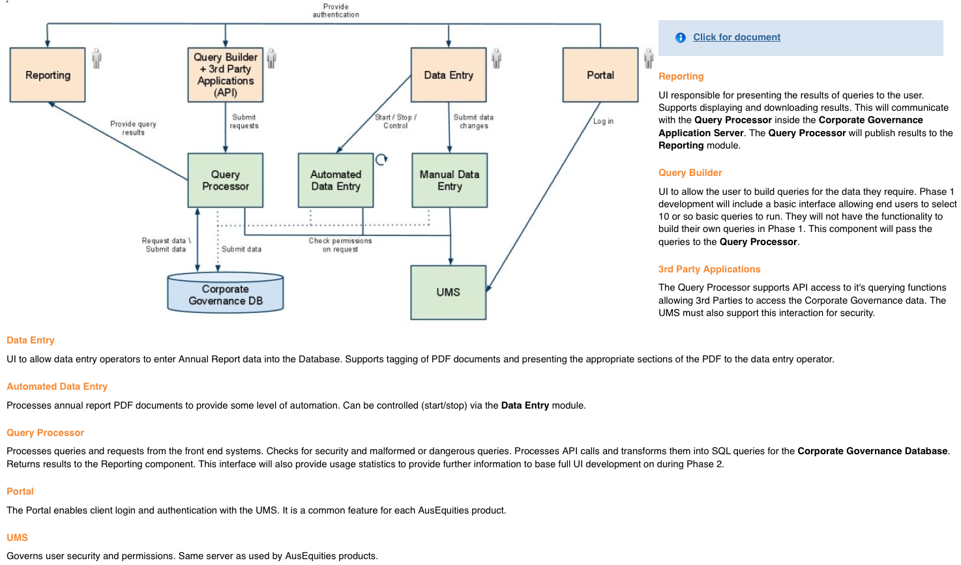
Architecture - logical
Slide 30
Successful Software Practice
Date: 1/4/2011

Slide 30
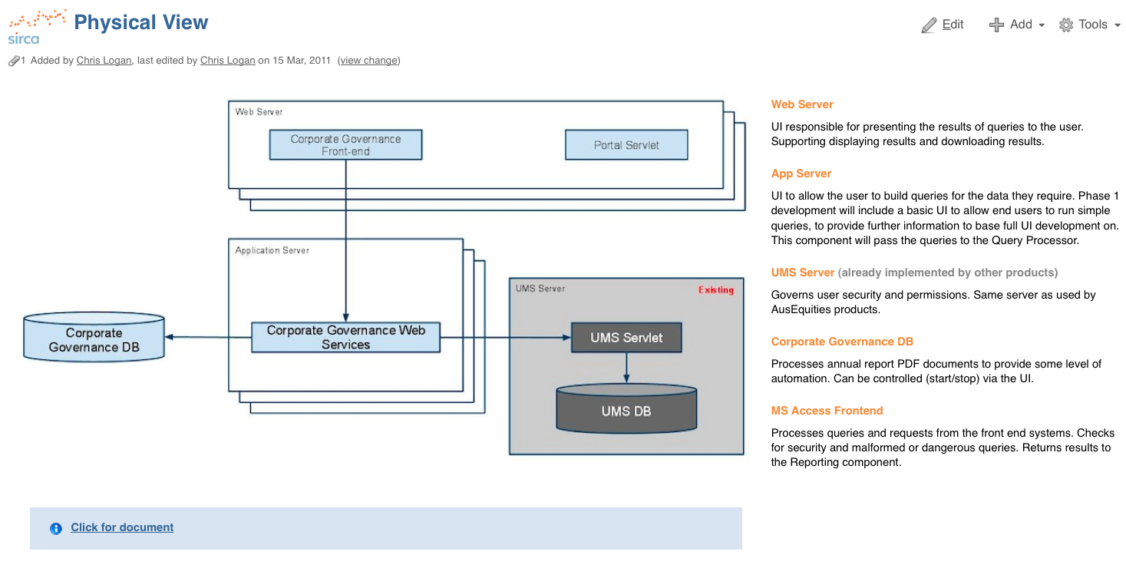
Architecture - Physical
Slide 31
Successful Software Practice
Date: 1/4/2011

Slide 31
A trick with Agile...
Story 1
Story 2
Story 3
Slide 32
Successful Software Practice
Date: 1/4/2011

Slide 32
Practices
  Automated Testing
  Automated Build
  Continuous Integration - at least daily
  Daily meetings...?
  Sprints (Momentum, Planning, Showcases, Retrospectives)
  Co-locate during development
Slide 33
Successful Software Practice
Date: 1/4/2011

Slide 33
We want you to work for us...
Send your resume and an academic transcript to...
      chris.mendes@sirca.org.au
Successful Software Practice
Date: 1/4/2011

Slide 34
Questions
Successful Software Practice
Date: 1/4/2011

Slide 35
Useful Links
  SCRUM Stuff:
    http://www.mountaingoatsoftware.com/presentations
    http://www.scrumalliance.org/
  Practices:
    http://www.martinfowler.com/articles/continuousIntegration.html
    http://martinfowler.com/design.html
    Just read martinfowler.com !
  Sirca Limited: http://www.sirca.org.au
Successful Software Practice
Date: 1/4/2011

Slide 36
Appendix Topics
  Estimation
  Burn Down Charts
Successful Software Practice
Date: 1/4/2011

