Slide 1



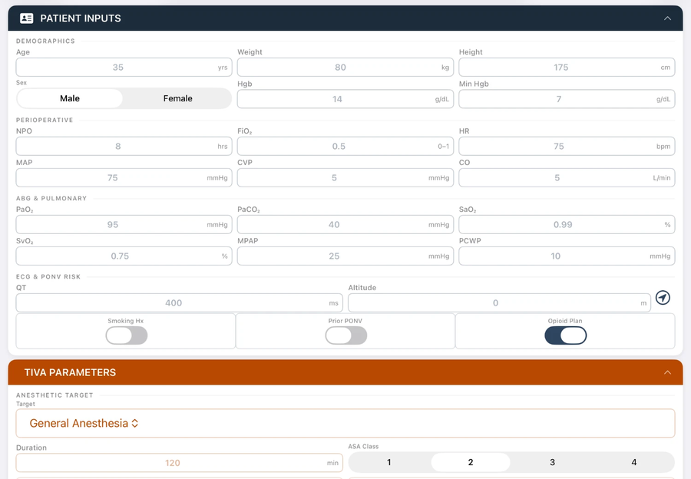
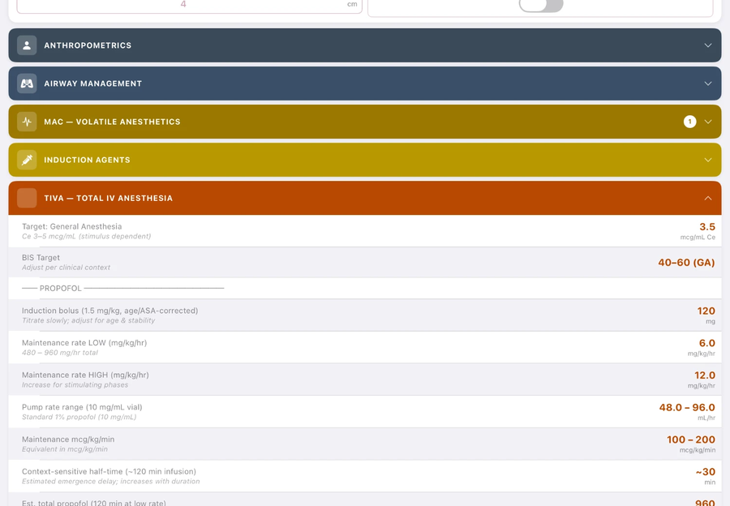
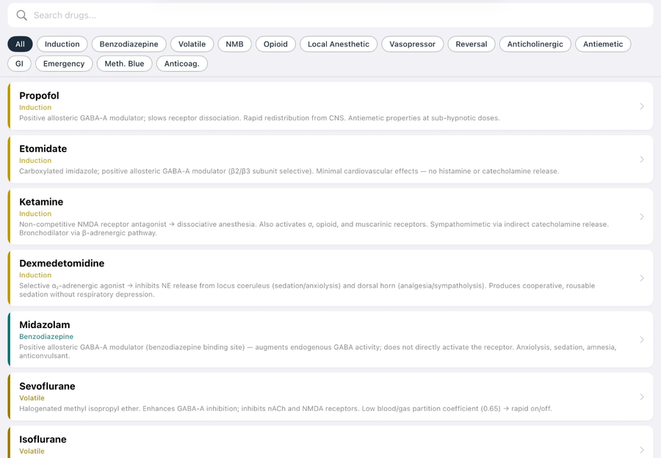






AI-Assisted “Vibe Coding” for Clinical Workflow Optimization
An Anesthesiology Use Case
Andrew Peace, BS, FP-C¹ · Alexander Morris, MS²
¹² Burrell College School of Osteopathic Medicine, Class of 2027 — ¹Las Cruces, NM ²Albuquerque, NM
BACKGROUND
WORKED EXAMPLE — ANESCALC, A NATIVE iOS ANESTHESIA CALCULATOR
BEYOND THIS APPLICATION
In the traditional software development pipeline, software engineering expertise often represents a bottleneck between ideation and a working prototype. Large language models (LLMs) have lowered this barrier, enabling end users, including clinicians, to translate novel ideas into functional applications tailored to their workflows through an emerging practice sometimes termed “vibe coding.” The following workflow was used to develop an iOS application providing point-of-care anesthetic reference values.
The workflow, not the app, is the transferable product. The same six steps apply to almost any clinical need:
• Custom calculators and order-set helpers inside the EMR
• Desktop widgets for rapid reference at the workstation
• Anesthetic plan generators from structured case data
• Custom case simulators for resident training
• Departmental protocol, checklist, and QI dashboards
DEVELOPMENT WORKFLOW
Patient inputs
Results dashboard
Drug reference cards
LIMITATIONS & FUTURE WORK
An iterative build loop with the AI assistant
Of AI-assisted development, generally
SCOPE — v1.0 SESSION → v2.0 TODAY
• LLMs reason in language, not graphics — visual and UI design still require human iteration
• Output is bounded by the model’s knowledge and the target platform’s Software Development Kit
• Hardware and OS compatibility must be verified on real devices
• Institutional IT and security policy may restrict custom software and PHI handling
1
Think of an application
User forms the idea
116 → 231
10 → 55
0 → 10
0 → 0
2
Define constraints
User gives the AI requirements
Live calculations
Drug reference cards
Clinical tools
Lines of code authored
Of this implementation
3
Create a prototype
AI builds a first version
• iOS only; not a regulated medical device — every output requires clinician verification
• Final product capability is constrained by the LLM’s tooling — user-defined feature scope is bounded by what the model can generate
FEATURES
4
Test the prototype
Try it, gather feedback
Application features
Future work
Dosing verification audit
• Prospective outcomes validation · FDA SaMD regulatory classification
• Clinician evaluation · formal usability review in training contexts
• App Store sponsorship · Android functionality
5
Define new features
Identify what to add
repeat
16
Clinical domains: MAC, NMB, TIVA, vasopressors, LAST, OB, peds
191
24
3
55
Drug reference cards: 14 classes, searchable
rows audited
sections
independent passes
6
Build the next version
AI updates the prototype
10
Bedside clinical tools: RSBI, RASS, Fick, driving pressure
An external reviewer independently audited every calculation. Each entry passed through triage, targeted deep dive, then full independent literature search — cross-referenced against UpToDate, Miller’s 9e, and Barash 8e.
All confirmed discrepancies were corrected before version finalized.
AI DISCLOSURE
Steps 4–6 repeat until the prototype meets requirements. No programming training needed — zero lines of code authored by hand.
100% OFFLINE — no data transmitted
A conversational LLM, Claude Sonnet 4.6 (Anthropic, PBC), was utilized for native code generation (“vibe coding”). The first author (AP) directed all prompt engineering, designed the system architecture, and verified compilation outputs. The AI assistant does not hold authorship status.
■ User ■ AI
Also: OB/regional protocols · unit conversions · PDF export
REFERENCES
ACKNOWLEDGMENTS / CONTACT
1. Gropper MA, Miller RD, Cohen NH, et al., eds. Miller’s Anesthesia. 9th ed. Philadelphia, PA: Elsevier; 2020.
2. Barash PG, et al., eds. Clinical Anesthesia. 8th ed. Philadelphia, PA: Wolters Kluwer; 2017.
3. Eger EI 2nd. Age, minimum alveolar anesthetic concentration, and minimum alveolar anesthetic concentration-awake. Anesth Analg. 2001;93(4):947-953.
4. Gan TJ, Diemunsch P, Habib AS, et al. Consensus guidelines for the management of postoperative nausea and vomiting. Anesth Analg. 2014;118(1):85-113.
5. Panchal AR, Bartos JA, Cabañas JG, et al. Part 3: Adult Basic and Advanced Life Support: 2020 American Heart Association Guidelines for CPR and Emergency Cardiovascular Care. Circulation. 2020;142(16 Suppl 2):S366-S468.
The authors thank Emily Waddle, Class of 2029 at Burrell College School of Osteopathic Medicine, NM, for technical data support during the external UpToDate reference validation and algorithmic verification phases.
Contact: Andrew Peace, andrew.peace@burrell.edu
ANESTHESIOLOGY® 2026 · San Diego, CA · Abstract A1325 · Session 08.5 Equipment, Monitoring, and Engineering Technology – Machine Learning/AI
Control #26-SA-9624-ASAHQ

