Slide 1

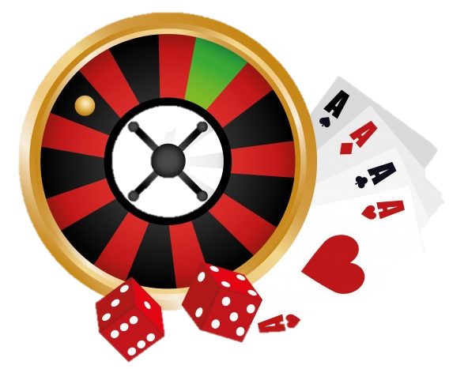
An Overview of GlassCasino
Building a Fair Online Casino on the Blockchain
Adam Hodson, 3rd Year BSc Computer Science
Notes:
Hi, I’m Adam and this is my project GlassCasino.

Slide 2
The Problem to be Solved
Lack of transparency and reliance on blind trust
Traditionally, a casino (online or otherwise) is backed by its reputation and nothing else. You trust them not to cheat you.
This model does not hold up so well in an increasingly rapid and trust-less world like the internet.
71% of the UK population did not trust casinos overall in 2021 (and it’s increasing). (1)
45.5% of online casino users have, at one point, felt cheated by ‘unfair software’ and 59.1+% complain of ‘not being paid properly or at all’. (2)
Notes:
Traditionally, the only thing stopping a casino (online or physical) from cheating the player is its own reputation, as casinos that cheat will lose business. Online casinos can conceal this cheating as their games run on centralized servers where the user will only ever see the outcome of the game.
However this model is susceptible to confidence scams, rug-pulls and of course, can cause distrust amongst players when they lose as shown by the stats here.

Slide 3
The Project
A blockchain-based implementation
The blockchain removes the factor of trust with concrete cryptographic proof of transactions.
Modern developments in blockchain technology have built on the concept of ‘smart contracts’.
These properties lead to innate fairness and an inability of any interested 3rd party (i.e., a casino) to interfere with outcomes of these contracts.
These characteristics of blockchains beg the question: “How technically viable is it to implement an online casino on the blockchain?”.
Notes:
This project aims to solve these problems of distrust, potential scams and withheld winnings by implementing fair casino games entirely on the blockchain. You no longer have to trust a the casino, only the decentralised, shared, blockchain.
This implementation has been made possible with smart contracts popularised by Buterin in the 2014 Ethereum white paper.

Slide 4
Objectives
Building and measuring the technical viability of such an implementation
Implement a small selection of traditional casino games as smart contracts with verifiable, fair randomness.
Build a robust migration chain to reliably deploy our smart contracts to any compatible network.
Create a user-friendly, responsive web-based UI to play and watch games take place with mainstream ‘wallet’ integration.
Achieve accepted levels of scalability, speed and cost of operation when compared against traditional, centralized online casinos.
Notes:
TODO

Slide 5
Achievements
TODO
Two games
Verifiable randomness
Central banking
Notes:
TODO

Slide 6
The Result
Almost there, but not quite.
While the technical possibility exists, the speed and scalability of our work has not surpassed the threshold required to replace traditional (centralized) systems.
However, given a faster platform or more robust technology stack – it may be viable. Further research is required.
Notes:
We conclude that while the implementation of a
TODO

Slide 7
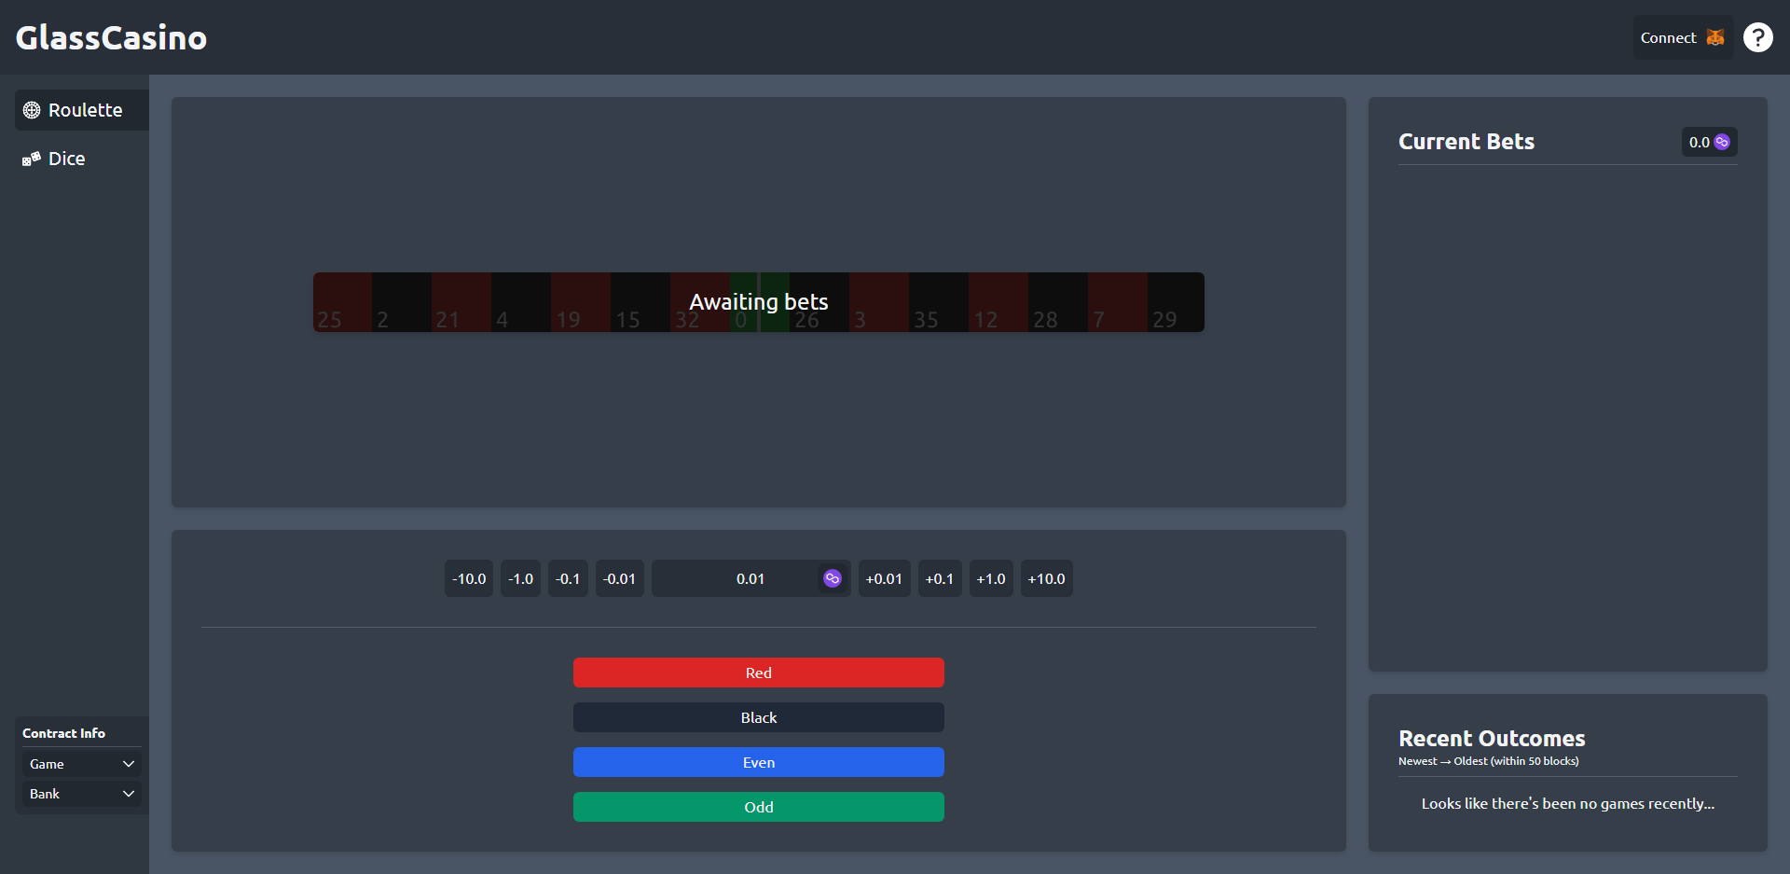
Live Demonstration

Slide 8
References
Overview of the British gambling sector - Gambling Commission. (2021). Retrieved April 16, 2022, from https://www.gamblingcommission.gov.uk/manual/annual-report-and-accounts-2020-to-2021/annual-report-20-21-performance-report-overview-of-the-british-gambling..
Gainsbury, S., Parke, J., & Suhonen, N. (2013). Consumer attitudes towards Internet gambling: Perceptions of responsible gambling policies, consumer protection, and regulation of online gambling sites. Computers in Human Behavior, 29 (1). https://doi.org/10.1016/j.chb.2012.08.010

