Slide 1


An Overview of GlassCasino
Building a Fair Online Casino on the Blockchain
Adam Hodson, 3rd Year BSc Computer Science
Notes:
Hi, I’m Adam and this is my project:
“GlassCasino – Building a Fair Online Casino on the Blockchain”
These slides are going to give a general overview of the project including its motivation, objectives, achievements and lastly, its results.
After this we’ll proceed to the live demonstration of the final work.

Slide 2
Motivation
Lack of transparency and reliance on blind trust in iGaming
Traditionally, a casino (online or otherwise) is backed by its reputation and nothing else. You trust them not to cheat you.
This model does not hold up so well in an increasingly rapid and trust-less world like the internet.
71% of the UK population did not trust casinos overall in 2021 (and it’s increasing). (1)
45.5% of online casino users have, at one point, felt cheated by ‘unfair software’ and 59.1+% complain of ‘not being paid properly or at all’. (2)
Notes:
We begin in establishing the problem to address.
That is, there is a lack of transparency and reliance on blind trust in the online gambling industry.
Online casinos, unlike physical ones, can conceal cheating their players nearly undetectably as their games run on their own centralized servers where the user will only ever see the outcome of the game like a black box.
This centralized model is susceptible to various types of scam and fraud but most importantly it causes distrust amongst players when they lose as shown by the stats here.
People distrust the platforms, and many have personally felt cheated by them when using them.

Slide 3
The Project
How technically viable is it to implement an online casino on the blockchain?
The blockchain removes the factor of trust with concrete cryptographic proof of transactions.
The modern elliptic curve cryptography it’s built on lends innate security.
Decentralization lends innate trustability as 3rd parties (i.e., a casino) cannot interfere with outcomes of these contracts.
Modern developments in blockchain technology have built on the concept of ‘smart contracts’ – arbitrary programs that run on a blockchain’s network of validators.
Notes:
Our work looks at a potential solution to these problem – blockchain. Thus, we pose the question:
[CLICK]
“How technically viable is it to implement an online casino on the blockchain?”
[CLICK]
We ask this because we know blockchain networks to have innate security and trustability, as per their design as listed here. More recently, with the advancement of smart contracts popularized by Buterin in the 2014 Ethereum white paper, building out fully-fledged apps is possible and thus our work begins.

Slide 4
Objectives
Building and measuring the technical viability of such an implementation
Implement a small selection of traditional casino games as smart contracts with verifiable, fair randomness. [Figure 1]
Build a robust migration chain to reliably deploy our smart contracts to any compatible network.
Create a user-friendly, responsive web-based UI to play and watch games take place with mainstream ‘wallet’ integration. [Figure 3]
Achieve accepted levels of scalability, speed and cost of operation when compared against traditional, centralized online casinos.
Notes:
Now that we’ve covered the posed question and why it needs to be asked - we can outline the objectives required to get us to a point where we can answer that question.
To do so we introduce a handful deliverables here:
- The smart contracts themselves. This the code governing either game logic or banking logic – i.e., deposits, withdrawals and prize allocation etc. These are annotated ‘Game’ on Figure 1.
- The migration chain to get the contracts onto the blockchain and this ties in heavily with the banking logic
- An interface allowing easy user interaction with the platform just using their crypto wallet of choice
You’ll also have noticed the ‘house’ on Figure 1. This is some necessary off-chain logic required to manage certain aspects of certain games. In our completed work this is to manage the timing of spinning the roulette wheel.
With all these deliverables built and connected as shown in Figure 1 - we can measure the three tenets of mainstream technical viability: scalability, speed and cost.

Slide 5
Achievements
What was built?
Two games: Chuck-a-Luck (single-player vs. house), Roulette (multi-player vs. house)
Single-contract, low-gas simple banking [Figure 2]
Robust, extensible smart contract migration chain to any EVM-based network (Polygon here) [Figure 3]
High-performance, responsive web 3.0 user interface with MetaMask wallet integration [Figure 3]
Different RNG approaches for comparative evaluation [Figure 5]
Notes:
Now let’s cover what this work consisted of a little bit more in-depth.
---
Firstly, we’ve got two games – roulette and a dice game called Chuck-a-Luck. These are interesting as they’re both of slightly different paradigms in that they are both played against the house but either in a group or alone. This has some interesting ramifications in terms of throughput and cost particularly.
---
Next up we’ve got the banking system as shown by figure 2 on your appendix. This was a solution to a problem that presented itself in development.
Originally, the plan was for each game to be self-contained. In that, you never deposit any money anywhere except your own wallet.
This led to poor usability and high fees.
Thus, we produced the system shown in figure 2.
It uses a role-based permissions system to retain trust-lessness.
Effectively the bank has two roles it can assign to people or contracts: operators (who can add or subtract value to/from users’ bank balances) and admins who can designate new operators.
--
Thirdly, we have the migration chain. This is the code to put the contracts on the blockchain. The flowchart in figure 4 walks through the process of designating and revoking admin and operator roles I spoke about earlier regarding banking.
The result of this chain is that there will be no bank admins and thus the list of operators (which will be a list of all deployed game contracts) is fixed, public and enumerable.
---
Next, we have the web interface. While there’s not too much novel to say here it’s worth noting that the interface is very quick, very light and has been fully integrated with the most common EVM-blockchain wallet MetaMask to prevent the need for any sign-ups.
---
Finally, coming on to the largest pain point for blockchain-backed online gambling: random number generation.
Figure 5 on your appendix show a traditional method for fair random numbers against a blockchain method provided by an organization called ChainLink. The left flowchart has an obvious weakness as it partially seeds itself with hidden data and thus the vendor can manipulate it.
Whereas the right flowchart is an answers the question: How do you create randomness on a network designed to be deterministic?
Basically – you don’t.
The two approaches for blockchain RNG are hashing block headers (which can be manipulated by validators) or verifiable random function, which work partially off-chain.
The basic flow of how it works is shown in the figure but it’s important to note that ChainLink has no control over the number generated, nor do miners or the casino owner as it’s seeded by all those parties individually with block headers, ChainLink private keys and random nonces and transaction data.

Slide 6
Results
Notes:
So, the scores we achieve in speed, cost and scalability are given to you Figures 6 through 8.
Figure 6 shows excellent performance for the web app, but it must be kept in mind that GlassCasino is not nearly as feature rich as bc.game.
However, for the smart contract speed shown in Figure 7, we see poor speeds. Even on the better performing games and the bank it still takes around 10 seconds for transaction confirmation.
Dice, as the VRF-backed game, sees speeds of an order of magnitude slower! This is something innate to ChainLink’s implementation. In fact, while developing this project they came out with a complete re-implementation of their oracle network.
As for scalability shown in Figure 8, we see some poor numbers. In the paper we make some very optimistic estimates of the scalability required to rival mainstream platforms and find we would need at minimum 20% of the Polygon network’s global gas limit to run these games 24/7. However, this could easily spike to 100% or more during peak times, thus flooding the network.
Because of all this we conclude [CLICK].
This.
What we’ve created is a good proof-of-concept for blockchain based online gambling. So, we find that while the technical possibility of decentralized iGaming exists, our platform cannot be deemed technically viable for mainstream adoption. This is due to speed and throughput limitations.
However [CLICK] a key stipulation is that this work is limited by the current smart contract ecosystem which, while growing rapidly, is still relatively immature. Given a better platform that hopefully doesn’t sacrifice decentralization for speed/throughput we believe this threshold could easily be passed.

Slide 7
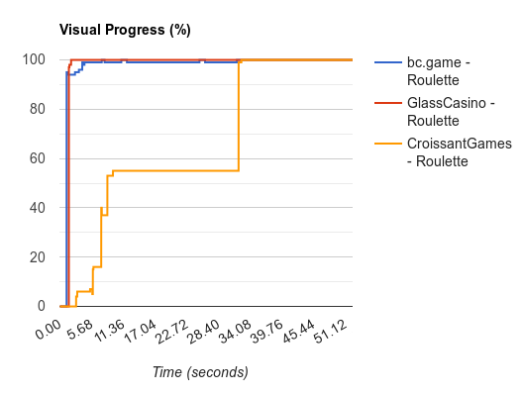
Results
Notes:
So, the scores we achieve in speed, cost and scalability are given to you Figures 6 through 8.
Figure 6 shows excellent performance for the web app, but it must be kept in mind that GlassCasino is not nearly as feature rich as bc.game.
However, for the smart contract speed shown in Figure 7, we see poor speeds. Even on the better performing games and the bank it still takes around 10 seconds for transaction confirmation.
Dice, as the VRF-backed game, sees speeds of an order of magnitude slower! This is something innate to ChainLink’s implementation. In fact, while developing this project they came out with a complete re-implementation of their oracle network.
As for scalability shown in Figure 8, we see some poor numbers. In the paper we make some very optimistic estimates of the scalability required to rival mainstream platforms and find we would need at minimum 20% of the Polygon network’s global gas limit to run these games 24/7. However, this could easily spike to 100% or more during peak times, thus flooding the network.
Because of all this we conclude [CLICK].
This.
What we’ve created is a good proof-of-concept for blockchain based online gambling. So, we find that while the technical possibility of decentralized iGaming exists, our platform cannot be deemed technically viable for mainstream adoption. This is due to speed and throughput limitations.
However [CLICK] a key stipulation is that this work is limited by the current smart contract ecosystem which, while growing rapidly, is still relatively immature. Given a better platform that hopefully doesn’t sacrifice decentralization for speed/throughput we believe this threshold could easily be passed.

Slide 8
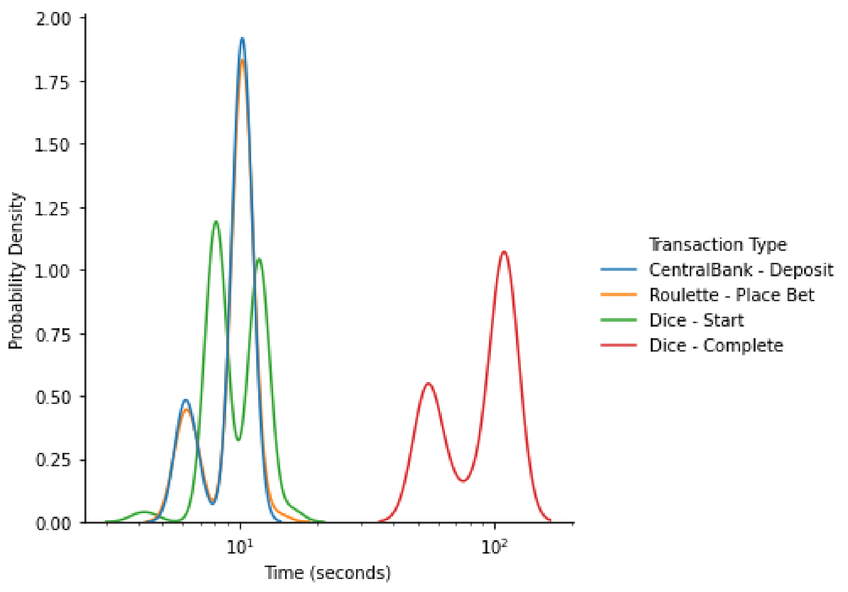
Results
Notes:
So, the scores we achieve in speed, cost and scalability are given to you Figures 6 through 8.
Figure 6 shows excellent performance for the web app, but it must be kept in mind that GlassCasino is not nearly as feature rich as bc.game.
However, for the smart contract speed shown in Figure 7, we see poor speeds. Even on the better performing games and the bank it still takes around 10 seconds for transaction confirmation.
Dice, as the VRF-backed game, sees speeds of an order of magnitude slower! This is something innate to ChainLink’s implementation. In fact, while developing this project they came out with a complete re-implementation of their oracle network.
As for scalability shown in Figure 8, we see some poor numbers. In the paper we make some very optimistic estimates of the scalability required to rival mainstream platforms and find we would need at minimum 20% of the Polygon network’s global gas limit to run these games 24/7. However, this could easily spike to 100% or more during peak times, thus flooding the network.
Because of all this we conclude [CLICK].
This.
What we’ve created is a good proof-of-concept for blockchain based online gambling. So, we find that while the technical possibility of decentralized iGaming exists, our platform cannot be deemed technically viable for mainstream adoption. This is due to speed and throughput limitations.
However [CLICK] a key stipulation is that this work is limited by the current smart contract ecosystem which, while growing rapidly, is still relatively immature. Given a better platform that hopefully doesn’t sacrifice decentralization for speed/throughput we believe this threshold could easily be passed.

Slide 9
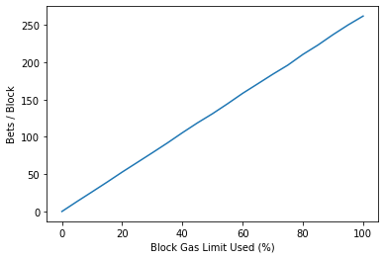
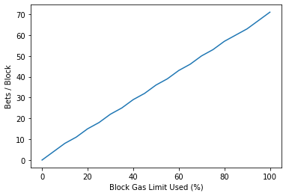
Results
Notes:
So, the scores we achieve in speed, cost and scalability are given to you Figures 6 through 8.
Figure 6 shows excellent performance for the web app, but it must be kept in mind that GlassCasino is not nearly as feature rich as bc.game.
However, for the smart contract speed shown in Figure 7, we see poor speeds. Even on the better performing games and the bank it still takes around 10 seconds for transaction confirmation.
Dice, as the VRF-backed game, sees speeds of an order of magnitude slower! This is something innate to ChainLink’s implementation. In fact, while developing this project they came out with a complete re-implementation of their oracle network.
As for scalability shown in Figure 8, we see some poor numbers. In the paper we make some very optimistic estimates of the scalability required to rival mainstream platforms and find we would need at minimum 20% of the Polygon network’s global gas limit to run these games 24/7. However, this could easily spike to 100% or more during peak times, thus flooding the network.
Because of all this we conclude [CLICK].
This.
What we’ve created is a good proof-of-concept for blockchain based online gambling. So, we find that while the technical possibility of decentralized iGaming exists, our platform cannot be deemed technically viable for mainstream adoption. This is due to speed and throughput limitations.
However [CLICK] a key stipulation is that this work is limited by the current smart contract ecosystem which, while growing rapidly, is still relatively immature. Given a better platform that hopefully doesn’t sacrifice decentralization for speed/throughput we believe this threshold could easily be passed.

Slide 10
Results
Almost there, but not quite.
While the technical possibility exists, the speed and scalability of our work has not surpassed the threshold required to replace traditional (centralized) systems.
However, given a faster platform or more robust technology stack; it may pass that threshold - further research is required.
Notes:
So, the scores we achieve in speed, cost and scalability are given to you Figures 6 through 8.
Figure 6 shows excellent performance for the web app, but it must be kept in mind that GlassCasino is not nearly as feature rich as bc.game.
However, for the smart contract speed shown in Figure 7, we see poor speeds. Even on the better performing games and the bank it still takes around 10 seconds for transaction confirmation.
Dice, as the VRF-backed game, sees speeds of an order of magnitude slower! This is something innate to ChainLink’s implementation. In fact, while developing this project they came out with a complete re-implementation of their oracle network.
As for scalability shown in Figure 8, we see some poor numbers. In the paper we make some very optimistic estimates of the scalability required to rival mainstream platforms and find we would need at minimum 20% of the Polygon network’s global gas limit to run these games 24/7. However, this could easily spike to 100% or more during peak times, thus flooding the network.
Because of all this we conclude [CLICK].
This.
What we’ve created is a good proof-of-concept for blockchain based online gambling. So, we find that while the technical possibility of decentralized iGaming exists, our platform cannot be deemed technically viable for mainstream adoption. This is due to speed and throughput limitations.
However [CLICK] a key stipulation is that this work is limited by the current smart contract ecosystem which, while growing rapidly, is still relatively immature. Given a better platform that hopefully doesn’t sacrifice decentralization for speed/throughput we believe this threshold could easily be passed.

Slide 11
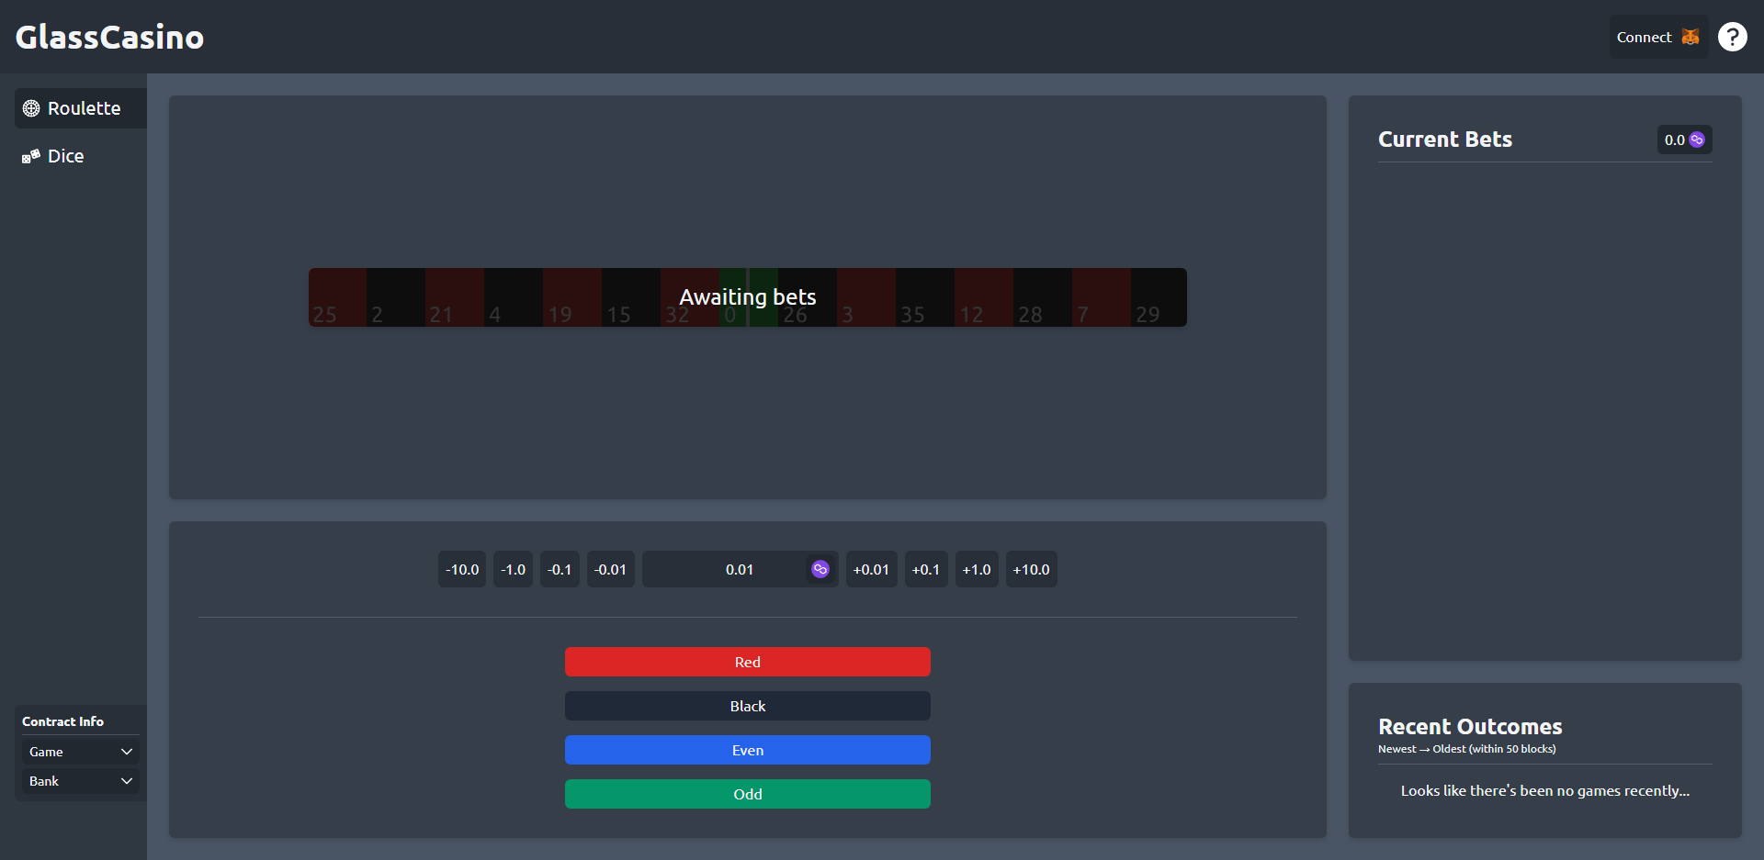
Live Demonstration
Notes:
3And that’s it. Now let’s look at the demo.
[OPEN PAGE]
This is a live version available at glasscasino.io
Should be responsive to phone viewports also so if it’s allowed feel free to pull it up on your phones too
It doesn’t require a wallet or anything to watch others play
Contracts are on Polygon Mumbai test network which is just a 1:1 copy of our blockchain of choice Polygon.
Tokens are worth nothing so it’s all just for fun.
Deploying to the main network is as simple as changing one or two variables when deploying.
So, we’re already on the roulette page here but we need to connect our wallet as shown by this little help menu up here.
[CLICK HELP]
This is just a few small pieces of dialog that will detect a wallet and if it’s signed in to guide a user not familiar with DApps through the process.
Now I’ll connect to my MetaMask wallet – this is a widely used wallet available as a browser extension or mobile app.
However, there’s currently a bug with iOS and certain Android devices where the mobile app can’t connect with web apps.
[CONNECT TO METAMASK]
Now we’re logged in. So, let’s deposit some MATIC. This is the primary token of the Polygon network and the accepted currency of GlassCasino.
We open up this menu [CLICK] which can be used to deposit or withdraw currency you have won whilst playing.
I’ll just deposit __ and wait for confirmation…
Now we start by playing some roulette. We can adjust our stake here and hit our desired bet with these buttons. This will trigger a new round to begin and will start to populate some of the other UI elements on screen.
Is there any preference for red, black odd or even?
Okay, ___.
[BET]
Now we approve the transaction from our wallet. This is a MetaMask interface that is required to sign any transaction and verify its sender. And we wait…
So now the countdown begins until the house server will spin the wheel. We see active bets up on the right with a sum above it.
[WAIT GAME]
Ah so we ___. And the outcome is listed down here by querying the contract logs.
Now, we can dive into the contract here.
[CLICK POLYGONSCAN]
Here’s the transaction logs .
[CLICK OUR BET]
and here’s our bet.
[CLICK SOURCE]
Over here we can see the verified source code.

Slide 12
References
Overview of the British gambling sector - Gambling Commission. (2021). Retrieved April 16, 2022, from https://www.gamblingcommission.gov.uk/manual/annual-report-and-accounts-2020-to-2021/annual-report-20-21-performance-report-overview-of-the-british-gambling..
Gainsbury, S., Parke, J., & Suhonen, N. (2013). Consumer attitudes towards Internet gambling: Perceptions of responsible gambling policies, consumer protection, and regulation of online gambling sites. Computers in Human Behavior, 29 (1). https://doi.org/10.1016/j.chb.2012.08.010

