Slide 1
SAMR: A Self-adaptive MapReduce Scheduling Algorithm In Heterogeneous Environment
Quan Chen Daqiang Zhang Minyi Guo Qianni Deng
Department of Computer Science
Shanghai Jiao Tong University, Shanghai, China
Authors
Song Guo
School of Computer Science and Engineering,
The University of Aizu, Japan
Presented by Xiaoyu Sun

Slide 2
Table of Contents
Overview
Scheduling in Hadoop
Heterogeneity in Hadoop
The LATE Scheduler(Longest Approximate Time to End)
The SAMR(A Self-adaptive MapReduce Scheduling Algorithm) Scheduler
Experiment
Conclusion

Slide 3
Overview
User
Program
fork
fork
fork
Master
assign
map
assign
reduce
Input Data
Worker
write
Output
File 0
local
write
Worker
Split 0
read
Split 1
Worker
Split 2
Output
File 1
Worker
Worker
remote
read,
sort

Slide 4
The Map Step
k
v
map
k
v
k
v
map
k
v
k
v
…
…
k
v
k
v
Input
key-value pairs
Intermediate
key-value pairs

Slide 5
The Reduce Step
reduce
k
v
k
v
v
v
k
v
reduce
k
v
k
v
v
k
v
group
k
v
…
…
…
k
v
k
v
k
v
Intermediate
key-value pairs
Key-value groups
Output
key-value pairs

Slide 6
Overview
Google has noted that speculative execution improves response time by 44%
The paper shows an efficient way to do speculative execution in order to maximize performance
It also shows that Hadoop’s simple speculative algorithm based on comparing each task’s progress to the average progress brakes down in heterogeneous systems

Slide 7
Overview
The proposed scheduling algorithm increases Hadoop’s response time
The paper addresses two important problems in speculative execution:
Choosing the best node to run the speculative task
Distinguishing between nodes slightly slower than the mean and stragglers

Slide 8
Scheduling in Hadoop
Assumptions made by Hadoop Scheduler:
Nodes can perform work at roughly the same rate
Tasks progress at a constant rate throughout time

Slide 9
Scheduling in Hadoop
M1:1
Execute map function
M2:0
Reorder intermediate results
Reduce Task
R1:1/3
Copy data
R2:1/3
Order
R3:1/3
Merge
Map Task

Slide 10
Scheduling in Hadoop

Slide 11

Scheduling in Hadoop
Task1
11/12
Done
Copy
1/3
Done
Sort
1/3
Processing
Merge
1/4
Task2
Done
Copy
1/3
Done
Sort
1/3
Processing
Merge
1/4
11/12
Task3
x
8/15
Done
Copy
1/3
Done
Sort
1/5
Processing
If Average PS is 10/15

Slide 12
Scheduling in Hadoop
Task1
Done
Copy
1/3
Done
Sort
1/3
Processing
Merge
1/4
11/12
20s
Task2
Done
Copy
1/3
Done
Sort
1/3
Processing
Merge
1/4
11/12
60s
Task3
8/15
x
Done
Copy
1/3
Done
Sort
1/5
Processing
Merge
wating
40s

Slide 13
Scheduling in Hadoop
Task1
x
Done
Copy
1/3
Done
Sort
1/4
Processing
Merge
waiting
7/12
20s
Task2
5/12
x
Done
Copy
1/3
Done
Sort
1/12
Processing
Merge
wating
40s

Slide 14
Scheduling in Hadoop
Task1
Done
Copy
1/3
Done
Sort
waiting
Processing
Merge
waiting
1/3
Not Data locality
180s
Task2
5/12
Done
Copy
1/3
Done
Sort
1/12
Processing
Merge
wating
x
Data locality
20s

Slide 15
The LATE Scheduler

Slide 16
The LATE Scheduler
M1:1
Execute map function
M2:0
Reorder intermediate results
Reduce Task
R1:1/3
Copy data
R2:1/3
Order
R3:1/3
Merge
Map Task

Slide 17
The LATE Scheduler
Task1
x
11/12
Done
Copy
1/3
Done
Sort
1/3
Processing
Merge
1/4
40s
Task2
7/12
Done
Copy
1/3
Done
Sort
1/4
Processing
Merge
waiting
30s

Slide 18
The LATE Scheduler
Task1
x
Done
Copy
1/3
Done
Sort
waiting
Processing
Merge
waiting
1/3
Not Data locality
180s
Task2
5/12
Done
Copy
1/3
Done
Sort
1/12
Processing
Merge
wating
Data locality
20s

Slide 19
The LATE Scheduler
In order to get the best chance to beat the original task which was speculated the algorithm launches speculative tasks only on fast nodes
It does this using a SlowNodeThreshold which is a metric of the total work performed
Because speculative tasks cost resources LATE uses two additional heuristics:
A limit on the number of speculative tasks executed (SpeculativeCap)
A SlowTaskThreshold that determines if a task is slow enough in order to get speculated (uses progress rate for comparison)

Slide 20
The SAMR Scheduler
M1:?
Execute map function
M2:?
Reorder intermediate results
Reduce Task
R1: ?
Copy data
R2:?
Order
R3:?
Merge
Map Task

Slide 21
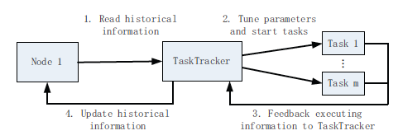
The SAMR Scheduler
The way to use and update historical information

Slide 22
The SAMR Scheduler
SLOW_TASK_CAP (STaC)

Slide 23
The SAMR Scheduler
SLOW_TRACKER_CAP (STrC)

Slide 24
The SAMR Scheduler

Slide 25
The SAMR Scheduler
SLOW_TRACKER_PRO (STrP)
SlowTrackerNum< STrP*TrackerNum (14)

Slide 26
The SAMR Scheduler
Launching backup tasks
BackupNum <BP(Backup Pro) * TaskNum (15)

Slide 27
The SAMR Scheduler

Slide 28
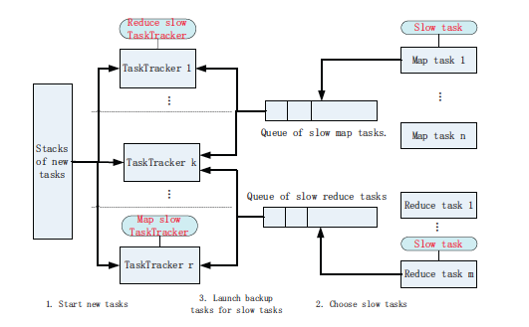
The SAMR Scheduler

Slide 29
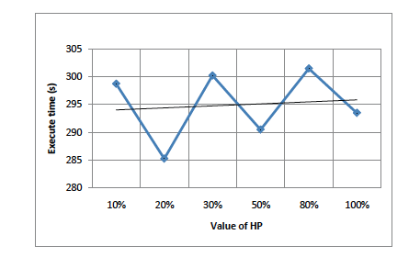
Experiment
Affection of “HP” on the execute time

Slide 30
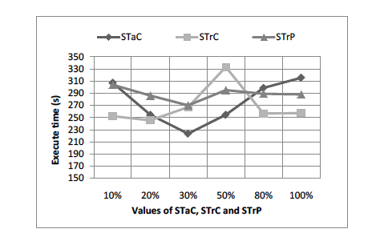
Experiment
Affection of “STac”,”STrC”, and “STrP” on the execute time

Slide 31
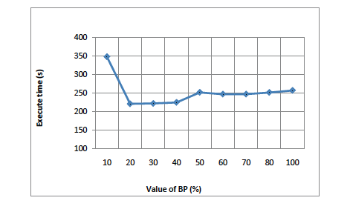
Experiment
Affection of “BP” on the execute time

Slide 32
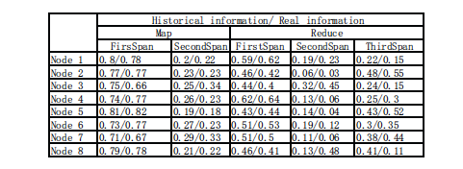
Experiment
Historical information and Real information on all 8 nodes

Slide 33
Experiment
HP=0.2
STaC=0.3
STrC=0.2
STrP=0.3
and BP=0.2

Slide 34
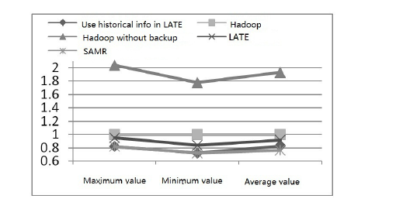
Experiment
The execute results of “Sort” running on the experiment platform.

Slide 35
Experiment
LATE decreases about 7% execute time
LATE using historical information decrease about 15% execute time
SAMR decreases about 24% execute time compared to Hadoop

Slide 36
Conclusion
Identify the problem in Hadoop’s scheduler
Compare two schedulers for improving the performance of MapReduce in heterogeneous environment
How to improve the performance of SAMR

Slide 37
Thanks

