Slide 1
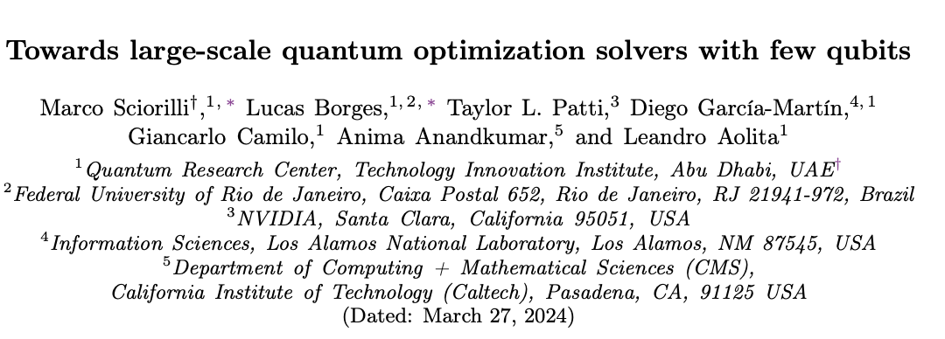
Status update
Marwa Marso

Slide 2



The paper in a nutshell
Problem: Manage large-scale binary optimization where the number of variables $m$ greatly exceeds qubits $n$
Problem: Manage large-scale binary optimization where the number of variables 𝑚 greatly exceeds qubits 𝑛
Efficient Encoding: Regime of classical intractability
Quantum-Classical Hybrid solver
Overcoming Flat Landscapes: Achieve super polynomial suppression of gradient decay
Enhancing Solutions: Employ classical post-processing techniques, such as local bit swaps
Notes:
The paper introduces a hybrid quantum-classical solver for binary optimization problems that can handle a number of binary variables (m) that is polynomially larger than the number of qubits (n) available.
To achieve this, the paper presents a method of encoding these m variables into qubit correlations using m Pauli strings (combinations of the Pauli matrices X, Y, Z, and the identity matrix I), without requiring a qubit for each variable.
The paper focuses on solving the MaxCut problem, a well-known NP-hard problem, using this encoding method
An intriguing aspect of this approach is the super-polynomial suppression of what are known as "barren plateaus" in the landscape of the optimization problem, making the training of quantum circuits more feasible.
Lastly, after the quantum optimization procedure, a classical post-processing step is performed to potentially enhance the solution quality by locally searching for better solutions.
Local bit swap: Search for Adjacent Solutions: The local bit-swap search examines solutions that are close to the current solution (i.e., solutions that can be reached by flipping one or a pair of bits). It's based on the premise that there may be adjacent states in the solution space that have a higher quality (e.g., a higher cut value for the MaxCut problem) than the current state.

Slide 3

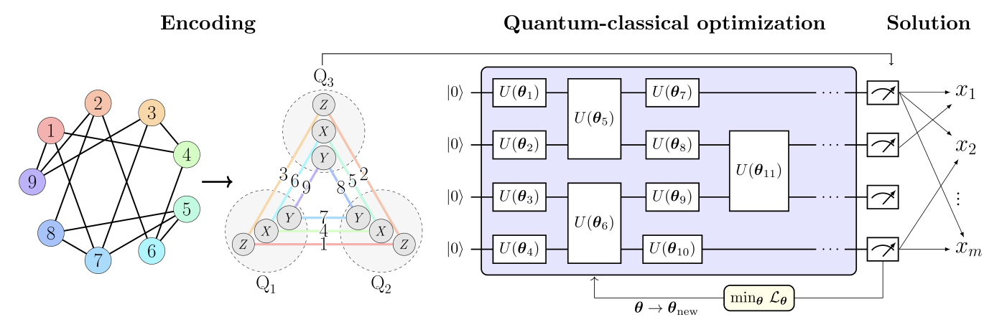
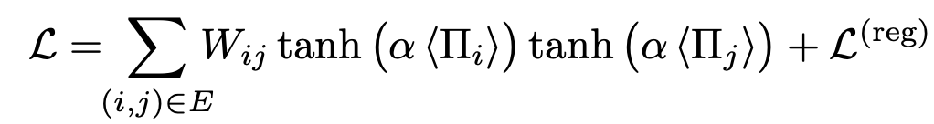
Pauli correlations encoding
Notes:
Goal of Parameter Optimization:
The primary objective of parameter optimization is to minimize the non-linear loss function.
The non-linear loss function is defined as the sum of two terms: the relaxation term and the regularization term.
Relaxation Term:
The relaxation term replaces the binary problem sign functions in the original MaxCut formulation with smooth hyperbolic tangents.
This replacement enables the use of gradient-descent methods for optimization, as these methods work more effectively with smooth functions.
Regularization Term:
The regularization term, denoted as L(reg), improves the solver's performance by imposing constraints on the correlators between qubits.
The regularization term encourages the correlators to approach zero, but excessively small correlators restrict the non-linear response.
To preserve the non-linear response, a rescaling factor α > 1 is introduced to restore the non-linearity of the hyperbolic tangent function.
Choice of α:
The choice of the rescaling factor α is critical for achieving good performance in the solver.
An approximate value of α ≈ n⌊k/2⌋ is observed to yield favorable results, balancing the non-linearity of the response and the overall solver performance.
Impact on Solver Performance:
The non-linear loss function, with its relaxation and regularization terms, plays a crucial role in guiding the training process.
By incorporating smooth hyperbolic tangents and controlling the correlators, the loss function helps the solver achieve better optimization results.

Slide 4

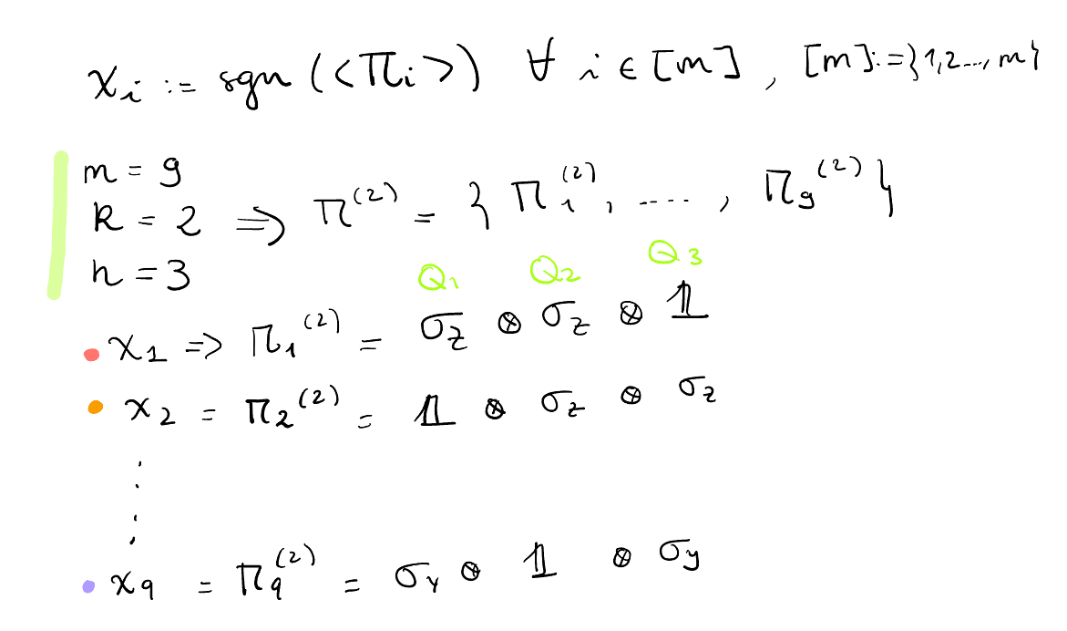



Example: $m=9$,$n=3 k=2$
Vertex 1
$x_{1}$is encoded in the expectation value of
Supported on qubits $Q_{1}$ and $Q_{2}$
Vertex 9
$x_{9}$is encoded in the expectation value of
Supported on qubits $Q_{1}$ and $Q_{3}$
Notes:
Problem Encoding:
Each binary variable xi is represented by the sign of the expectation value of a corresponding Pauli string Πi when measured in a particular quantum state |Ψ⟩. This method allows for a compression of information where the m variables are encoded across multiple qubits.
The encoding uses k qubits to represent each variable and relies on permutations of k-fold tensor products of Pauli matrices and the identity matrix. This provides experimental convenience as only three measurement settings are required due to the mutually-commuting nature of the strings in the encoding sets.
on encodings using strings with k single-qubit traceless Pauli matrices, denoted as Π(k)_1, ..., Π(k)_m. Each Π(k)_i is a permutation of either X⊗k ⊗ 11⊗(n-k), Y⊗k ⊗ 11⊗(n-k), or Z⊗k ⊗ 11⊗(n-k). These encodings offer the advantage of generating three sets of mutually-commuting strings. As a result, only three measurement settings are required throughout the entire experiment
An exemplary MaxCut problem with 9 vertices is encoded into 2-body Pauli-matrix correlations across 3 qubits (Q1, Q2, Q3).
Each Pauli string encodes a specific vertex, and the color code indicates which Pauli string corresponds to each vertex.
For example, the binary variable x1 of vertex 1 is encoded in the expectation value of Z1 ⊗ Z2 ⊗ 113, supported on qubits 1 and 2.
Similarly, x9 is encoded in Y1 ⊗ 112 ⊗ Y3, over qubits 1 and 3.
Space Compression:
The encoding achieves a quadratic space compression, with m variables compressed into n = O(m^(1/2)) qubits.
By using k-body correlations, it is possible to attain polynomial compressions of order k.

Slide 5
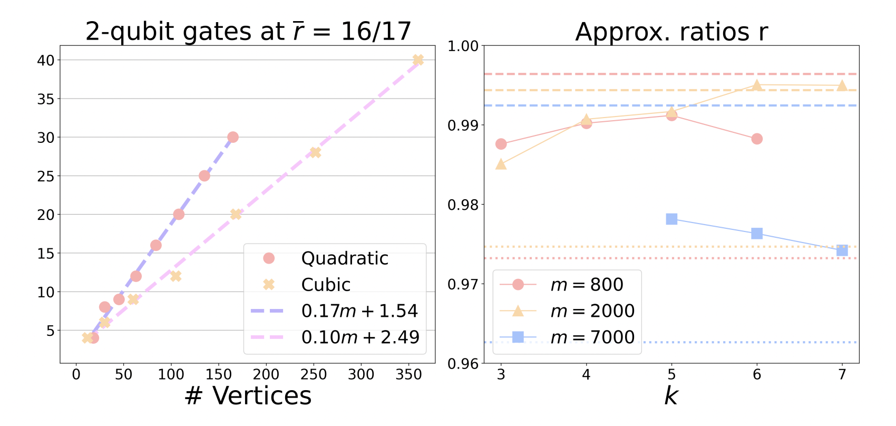

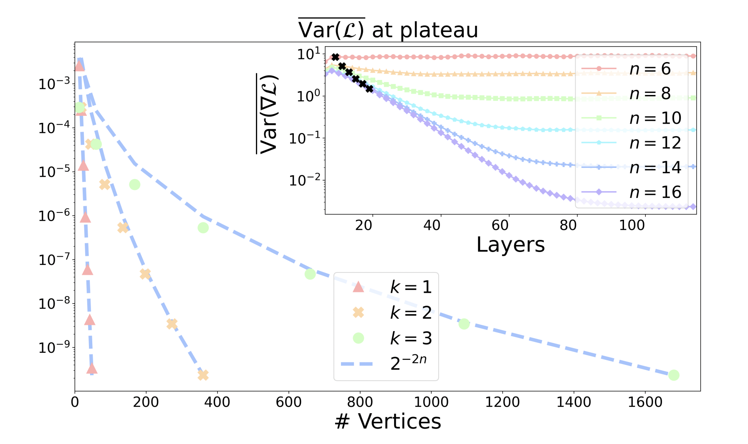
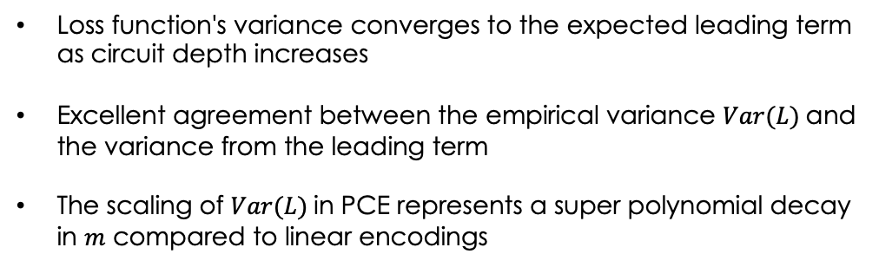

Results
Gate complexity and performance
Gates and variational parameters scale approx. linearly with $m$
Circuit layers scales as
Limit in compression capability before compromising expressivity: r increases with $k$ up to a maximum
Intrinsic mitigation of barren plateaus
Loss function's variance converges to the expected leading term as circuit depth increases
Excellent agreement between the empirical variance $Var(L)$and the variance from the leading term
The scaling of $Var(L)$in PCE represents a super polynomial decay in $m$ compared to linear encodings
Notes:
2QUBIT GATES:
plot of the gate complexity required to reach r = 16/17 ≈ 0.941 without the final local search step
The gate complexity is measured on non-trivial random MaxCut instances of increasing sizes.
The gate complexity scales approximately linearly with the size of the MaxCut problem (m), indicating a mild scaling behavior.
The number of gates scales as O(m), while the number of variational parameters is proportional to the number of gates.
The number of circuit layers scales as O(m/n) with quadratic and cubic compressions corresponding to O(m^(1/2)) and O(m^(2/3)), respectively.
APPROX RATIONS
We plot the solution qualities (approximation ratio) versus k, the number of single-qubit traceless Pauli matrices used in the encoding.
We use three MaxCut instances from the benchmark set Gset to evaluate the performance (see Numerical details).
The total number of variational parameters is fixed by m (or as close to m as allowed by the circuit ansatz) for a fair comparison.
Circuit depths are adjusted accordingly for each k to maintain a consistent number of parameters.
The results show that the approximation ratio (r) generally increases with k up to a maximum, beyond which the performance slightly degrades.
This behavior is in line with the expected limit in compression capability before compromising the model's expressivity
.
Remarkably, our solutions are competitive with state-of-the-art classical solvers, such as gradient-based SDP solvers and the Burer-Monteiro algorithm based on non-linear programming.
Mitigation barren plateau
The plot illustrates the decay of the average variance (Var(L)) of the loss function (L) as a function of m (in log-linear scale).
The variance is normalized by a constant to provide a relative measure of the spread of the loss values.
The encodings Π(1), Π(2), and Π(3) are used, representing different levels of compression (k).
where the variance decreases as 2^(-2n).
As the number of qubits (n) increases, the decay of the variance slows down, indicating that larger problem sizes require more optimization steps to reach convergence.
The inset focuses on the average variances of the entries of the gradient of L as functions of the number of layers for the quadratic compression (Π(2)).
The curves for different values of n demonstrate the decay of the plateau values with increasing n.

Slide 6
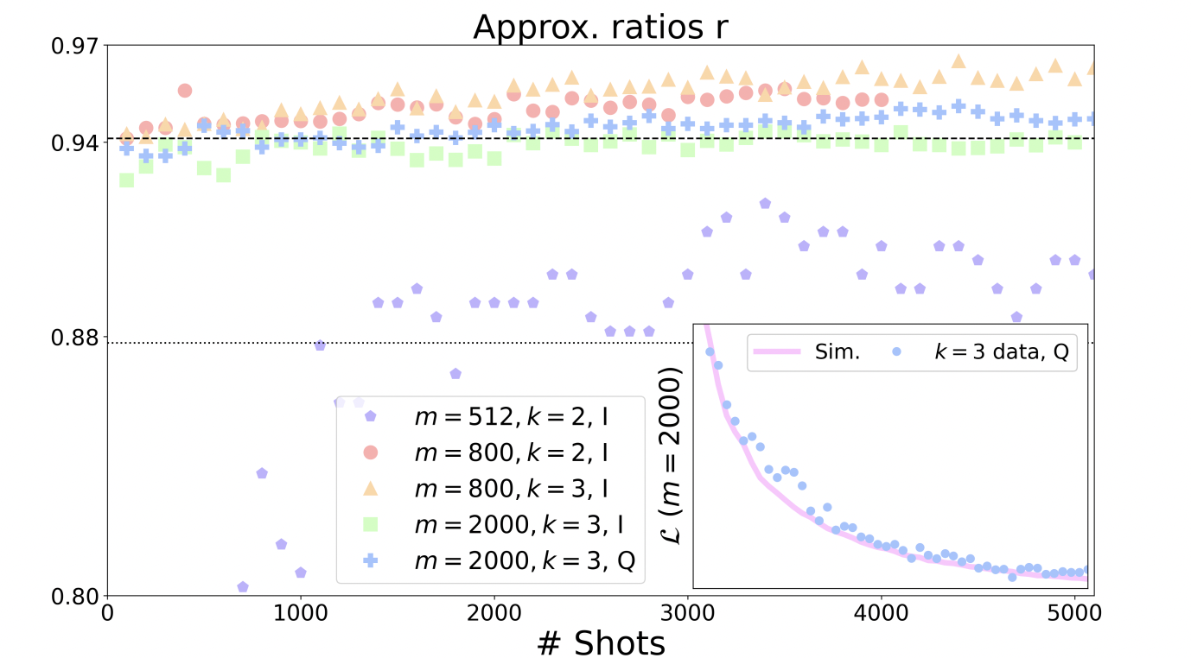
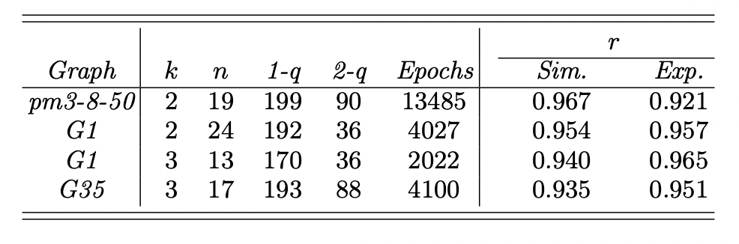
Results
Experimental deployment on quantum hardware
Circuit size limited by gate infidelities
IonQ Aria-1: trade-off between expressivity and gate infidelities at 90 two-qubit gates
Quantinuum H1-1: Higher fidelities but for simplicity same number of gates
Highest-quality solutions attained experimentally in this size regime
Notes:
shows the obtained approximation ratios for each MaxCut instance as a function of the number of measurements
Circuit Size Limitation:
The size of the quantum circuit is limited by gate infidelities.
For IonQ, a good trade-off between expressivity and total infidelity was found, resulting in a circuit with a total of 90 two-qubit gates.
Quantinuum's device, with higher fidelities, allows for larger circuits, but the same number of gates (90) was used for simplicity.
Solver Performance:
The number of gates used in the circuit is below the number required for these instance sizes,especially for k = 2.
However, remarkably, the solver still returns solutions of higher quality than the Göemans-Williamson bound in all cases and even surpasses the worst-case hardness threshold in four out of five experiments.
These results demonstrate the solver's ability to produce high-quality solutions for large MaxCut instances, surpassing previous experiments with QAOA (Quantum Approximate Optimization Algorithm) that solved instances up to size m = 414 with lower approximation ratios.

Slide 7


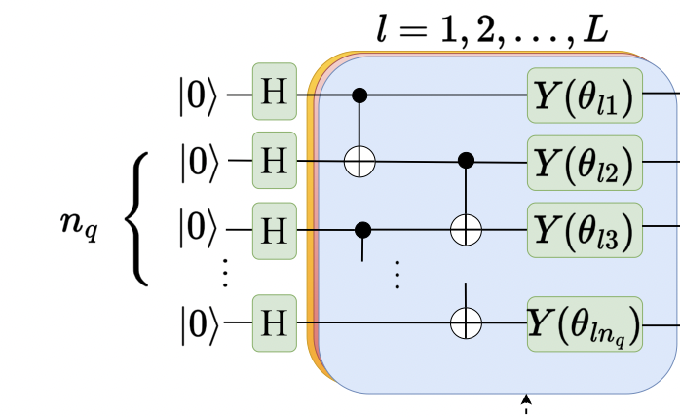
Implementation
Adding new functionality to QUARK to accommodate Max-Cut problems
PCE using hardware-efficient variational ansatz
PCE
Hybrid quantum-classical variational approach
Statevector simulation
MaxCut

Slide 8
Implementing PCE for MaxCut with Hardware-Efficient VQA
Load MaxCut Problem
Generate Adjacency Matrix
Create Pauli Correlation Strings
Create Gate Sequence : Generate gate sequence for hardware-efficient VQA
Translate the gate sequence into an executable Qiskit quantum circuit
Configure the training environment, detailing the loss function and optimization strategy
Implement the nonlinear loss function that evaluates the encoded solution's quality
Visualization with TensorBoardUtilize TensorBoard to monitor and visualize the training process and outcomes for analysis

Slide 9
Execute training
MaxCut dataset
Config File
G9.txt
9 14
1 4 1
1 7 1
1 9 1
2 6 1
2 8 1
2 9 1
3 4 1
3 7 1
3 9 1
4 6 1
5 6 1
5 7 1
5 8 1
7 8 1
application:
config:
n_qubits:
- 3
name: MaxCut
submodules:
- config:
compression_degree:
- 2
name: PauliCorrelationsEncoding
submodules:
- config:
depth:
- 1
name: CircuitHardwareEfficient
submodules:
- config:
backend:
- aer_statevector_simulator_cpu
n_shots:
- 10000
name: LibraryQiskit
submodules:
- config:
loss:
- nonlinear_loss
max_evaluations:
- 100
pretrained:
- 'False'
name: Classical
submodules: []
repetitions: 1

