Slide 1

Notes:
PRESENTATION BLUEPRINT Objective: Communicate the impact and journey of Class Pulse to community stakeholders in a way that earns trust, invites continued investment, and demonstrates TFA's SSP commitments. Audience: Community stakeholders — non-technical, values-driven, care deeply about kids and teachers. Key Message: The 60 seconds between confusion and support is the difference between a student who stays in math and one who doesn't. We built something to close that gap. Story Arc: Hook → Problem → Insight → Solution → Takeaway Total Slides: 22 VISUAL: Dark background. Single centered quote in large white serif font. Sparse. Commanding.

Slide 2
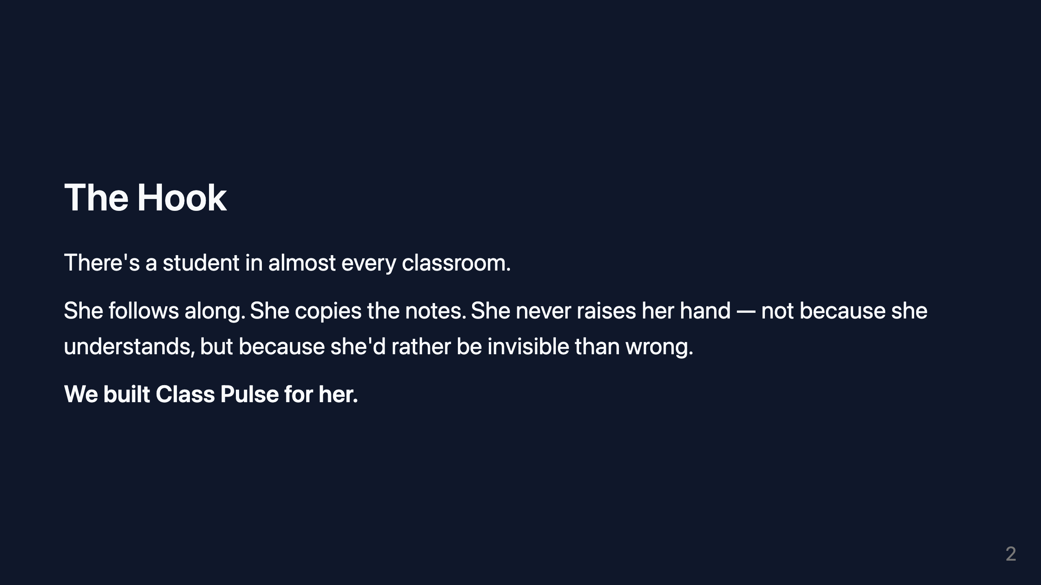
Notes:
VISUAL: One soft image or illustration of an empty classroom desk. Text minimal, left-aligned.

Slide 3
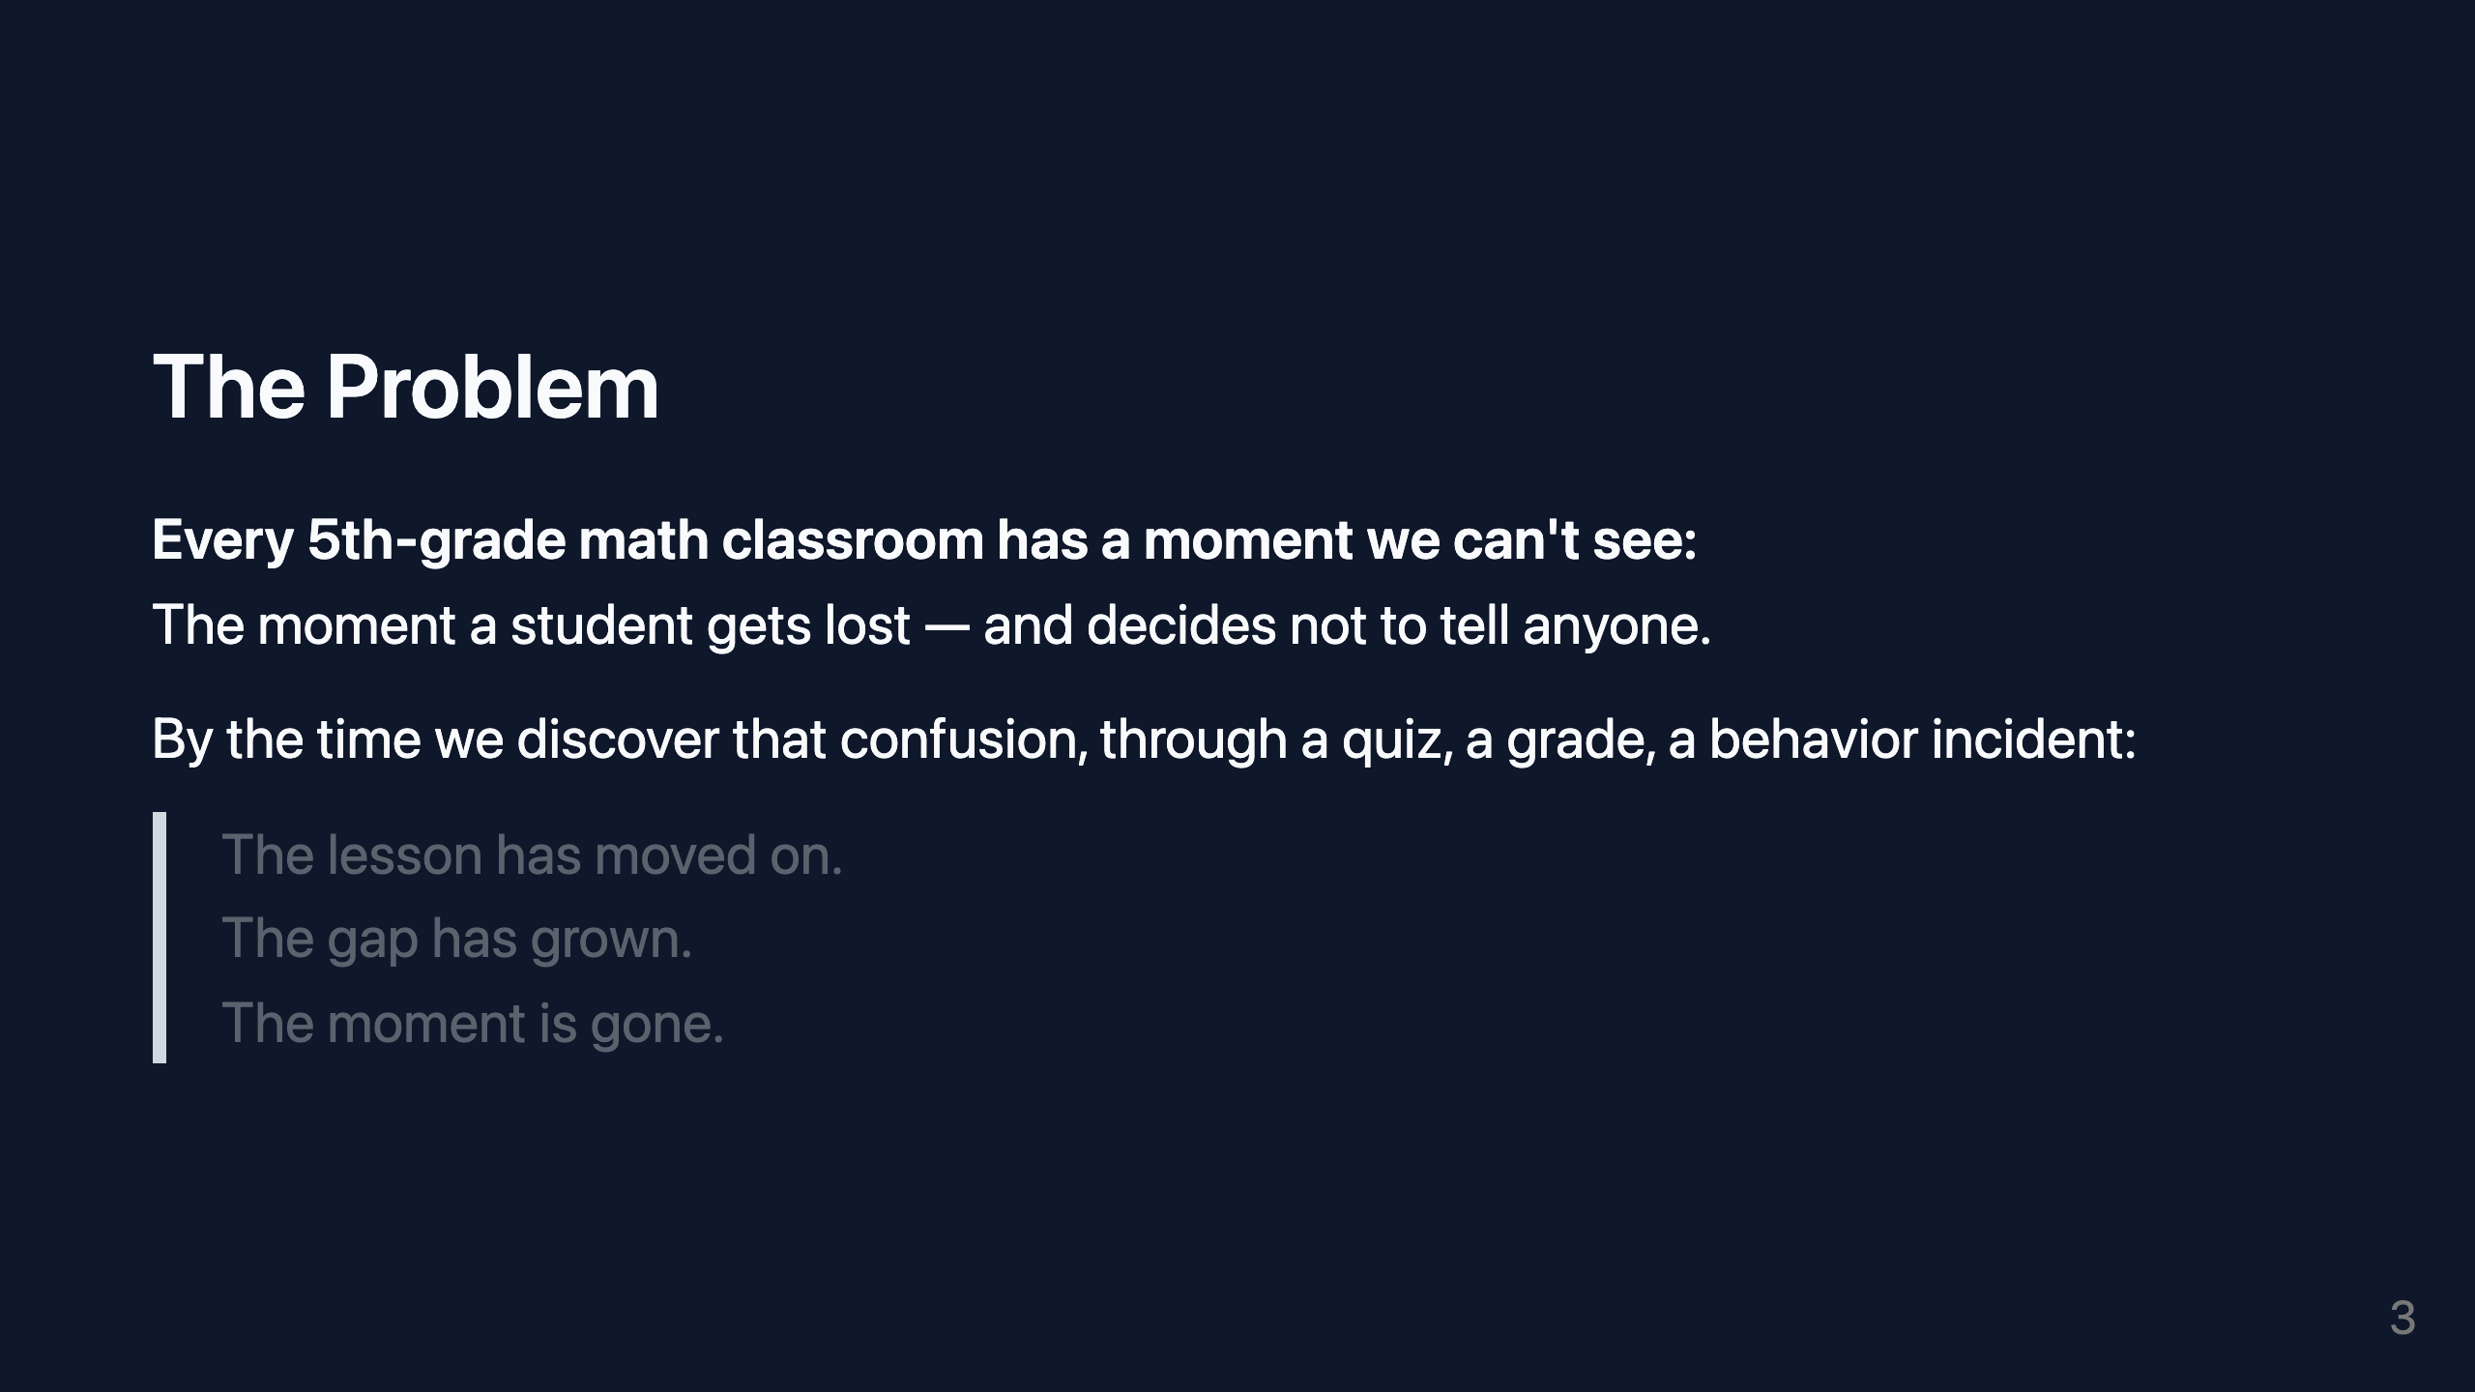
Notes:
SLIDE PURPOSE: Establish the problem clearly. One idea. No jargon. VISUAL: Simple timeline graphic — "Student gets confused" → gap → "Teacher finds out." Emphasize the distance.

Slide 4

Notes:
VISUAL: Two-column layout. Left: photo of a classroom in motion. Right: text only. Clean split.

Slide 5
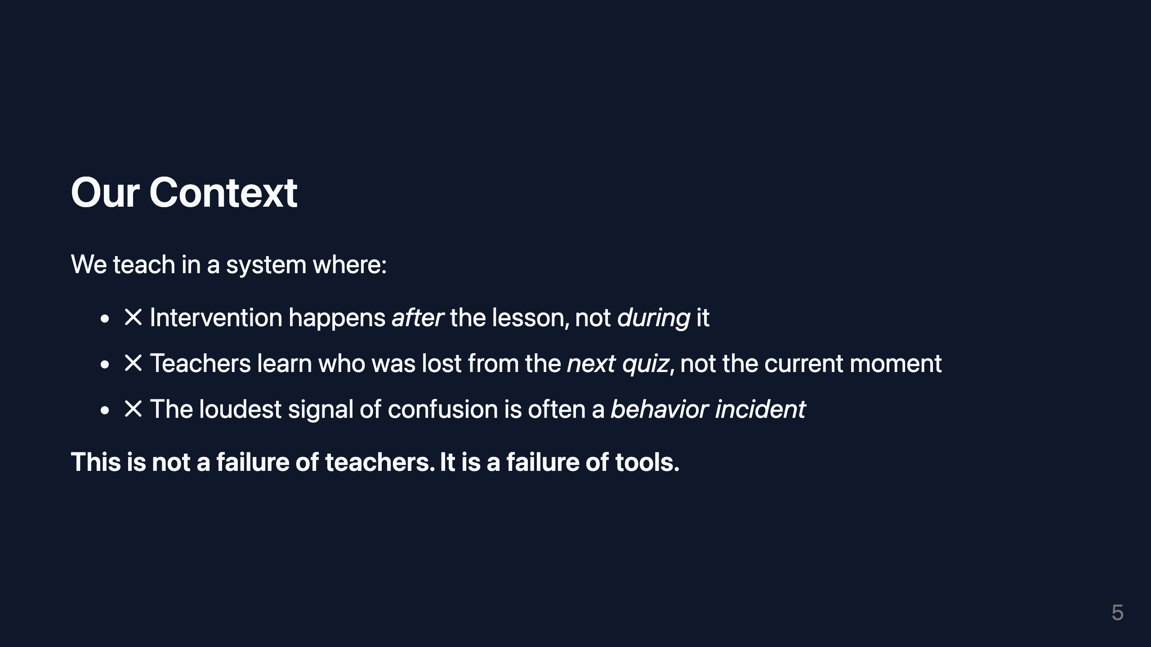
Notes:
VISUAL: Three bullet points with subtle red "x" icons. Clean white text on dark background.

Slide 6
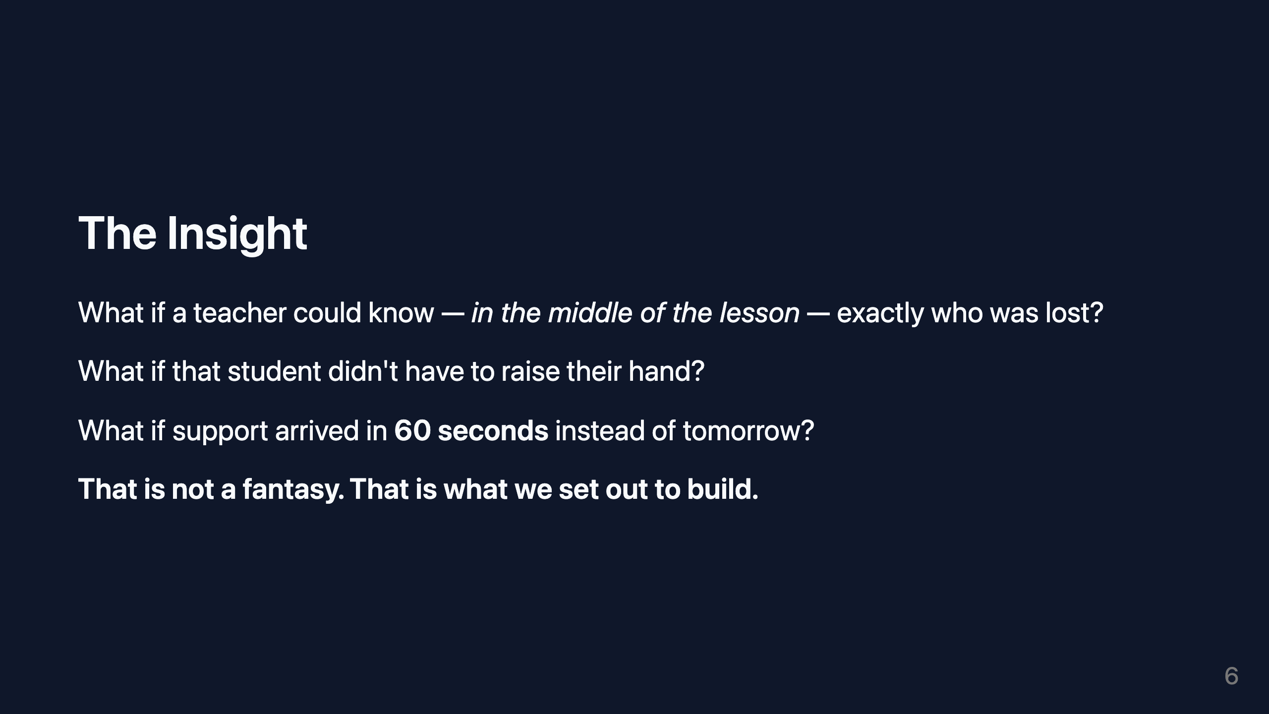
Notes:
SLIDE PURPOSE: The insight — reframe what is possible. Transition from problem to hope. VISUAL: Single bold question in large type, fading into an answer. Minimal. Cinematic.

Slide 7
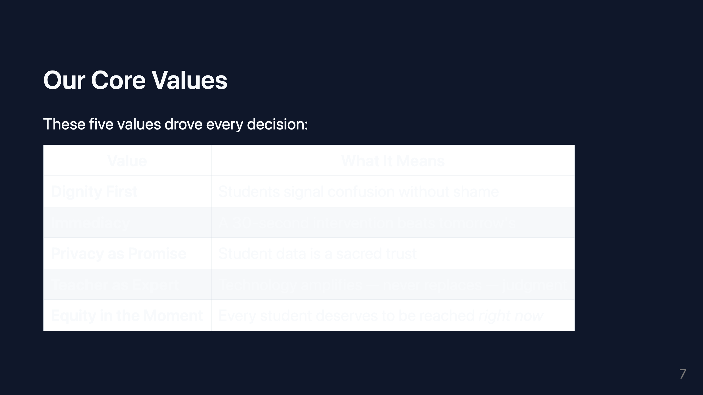
Notes:
VISUAL: Clean table. Light borders. Short text in each cell. No flourishes.

Slide 8
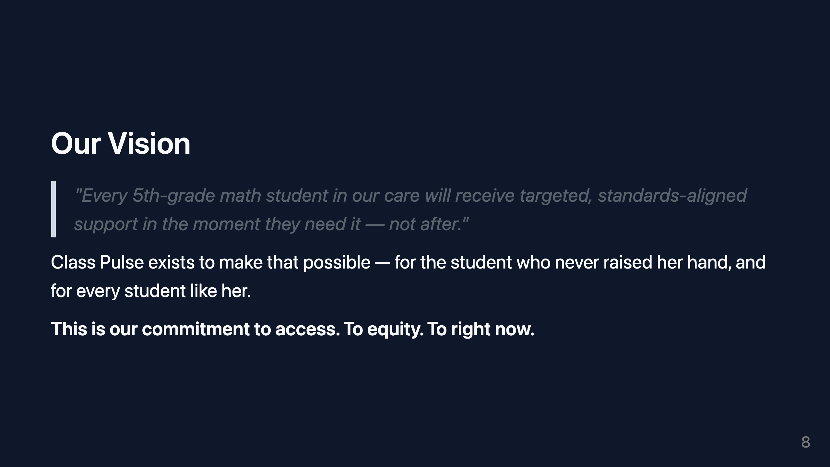
Notes:
SLIDE PURPOSE: Vision statement slide. One clear idea, beautifully expressed. VISUAL: Large pull quote in center. Soft gradient background. Author attribution below.

Slide 9

Notes:
SLIDE PURPOSE: Solution — introduce Class Pulse clearly without tech language.

Slide 10
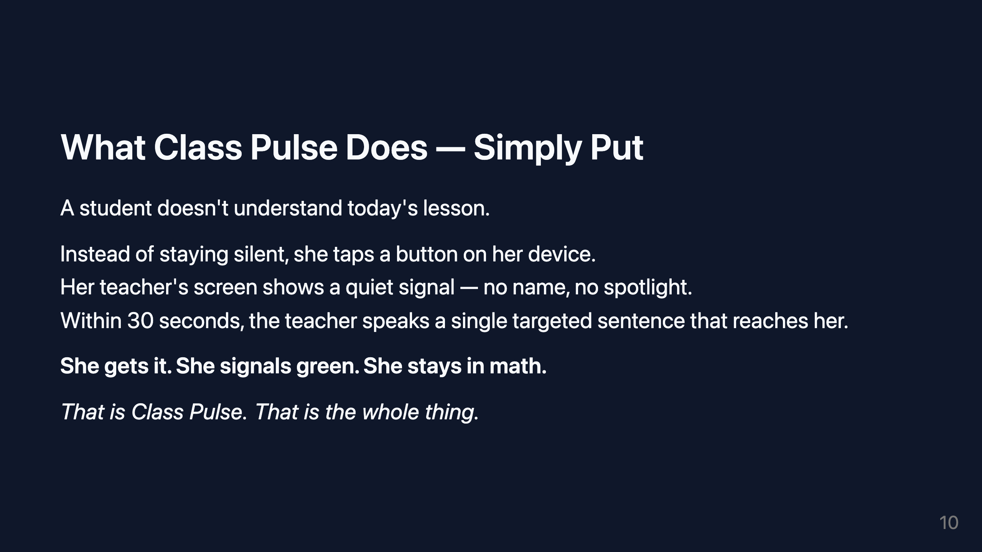
Notes:
VISUAL: Simple illustrated flow: student taps → signal appears → teacher responds → green light. Icon-style, not technical.

Slide 11
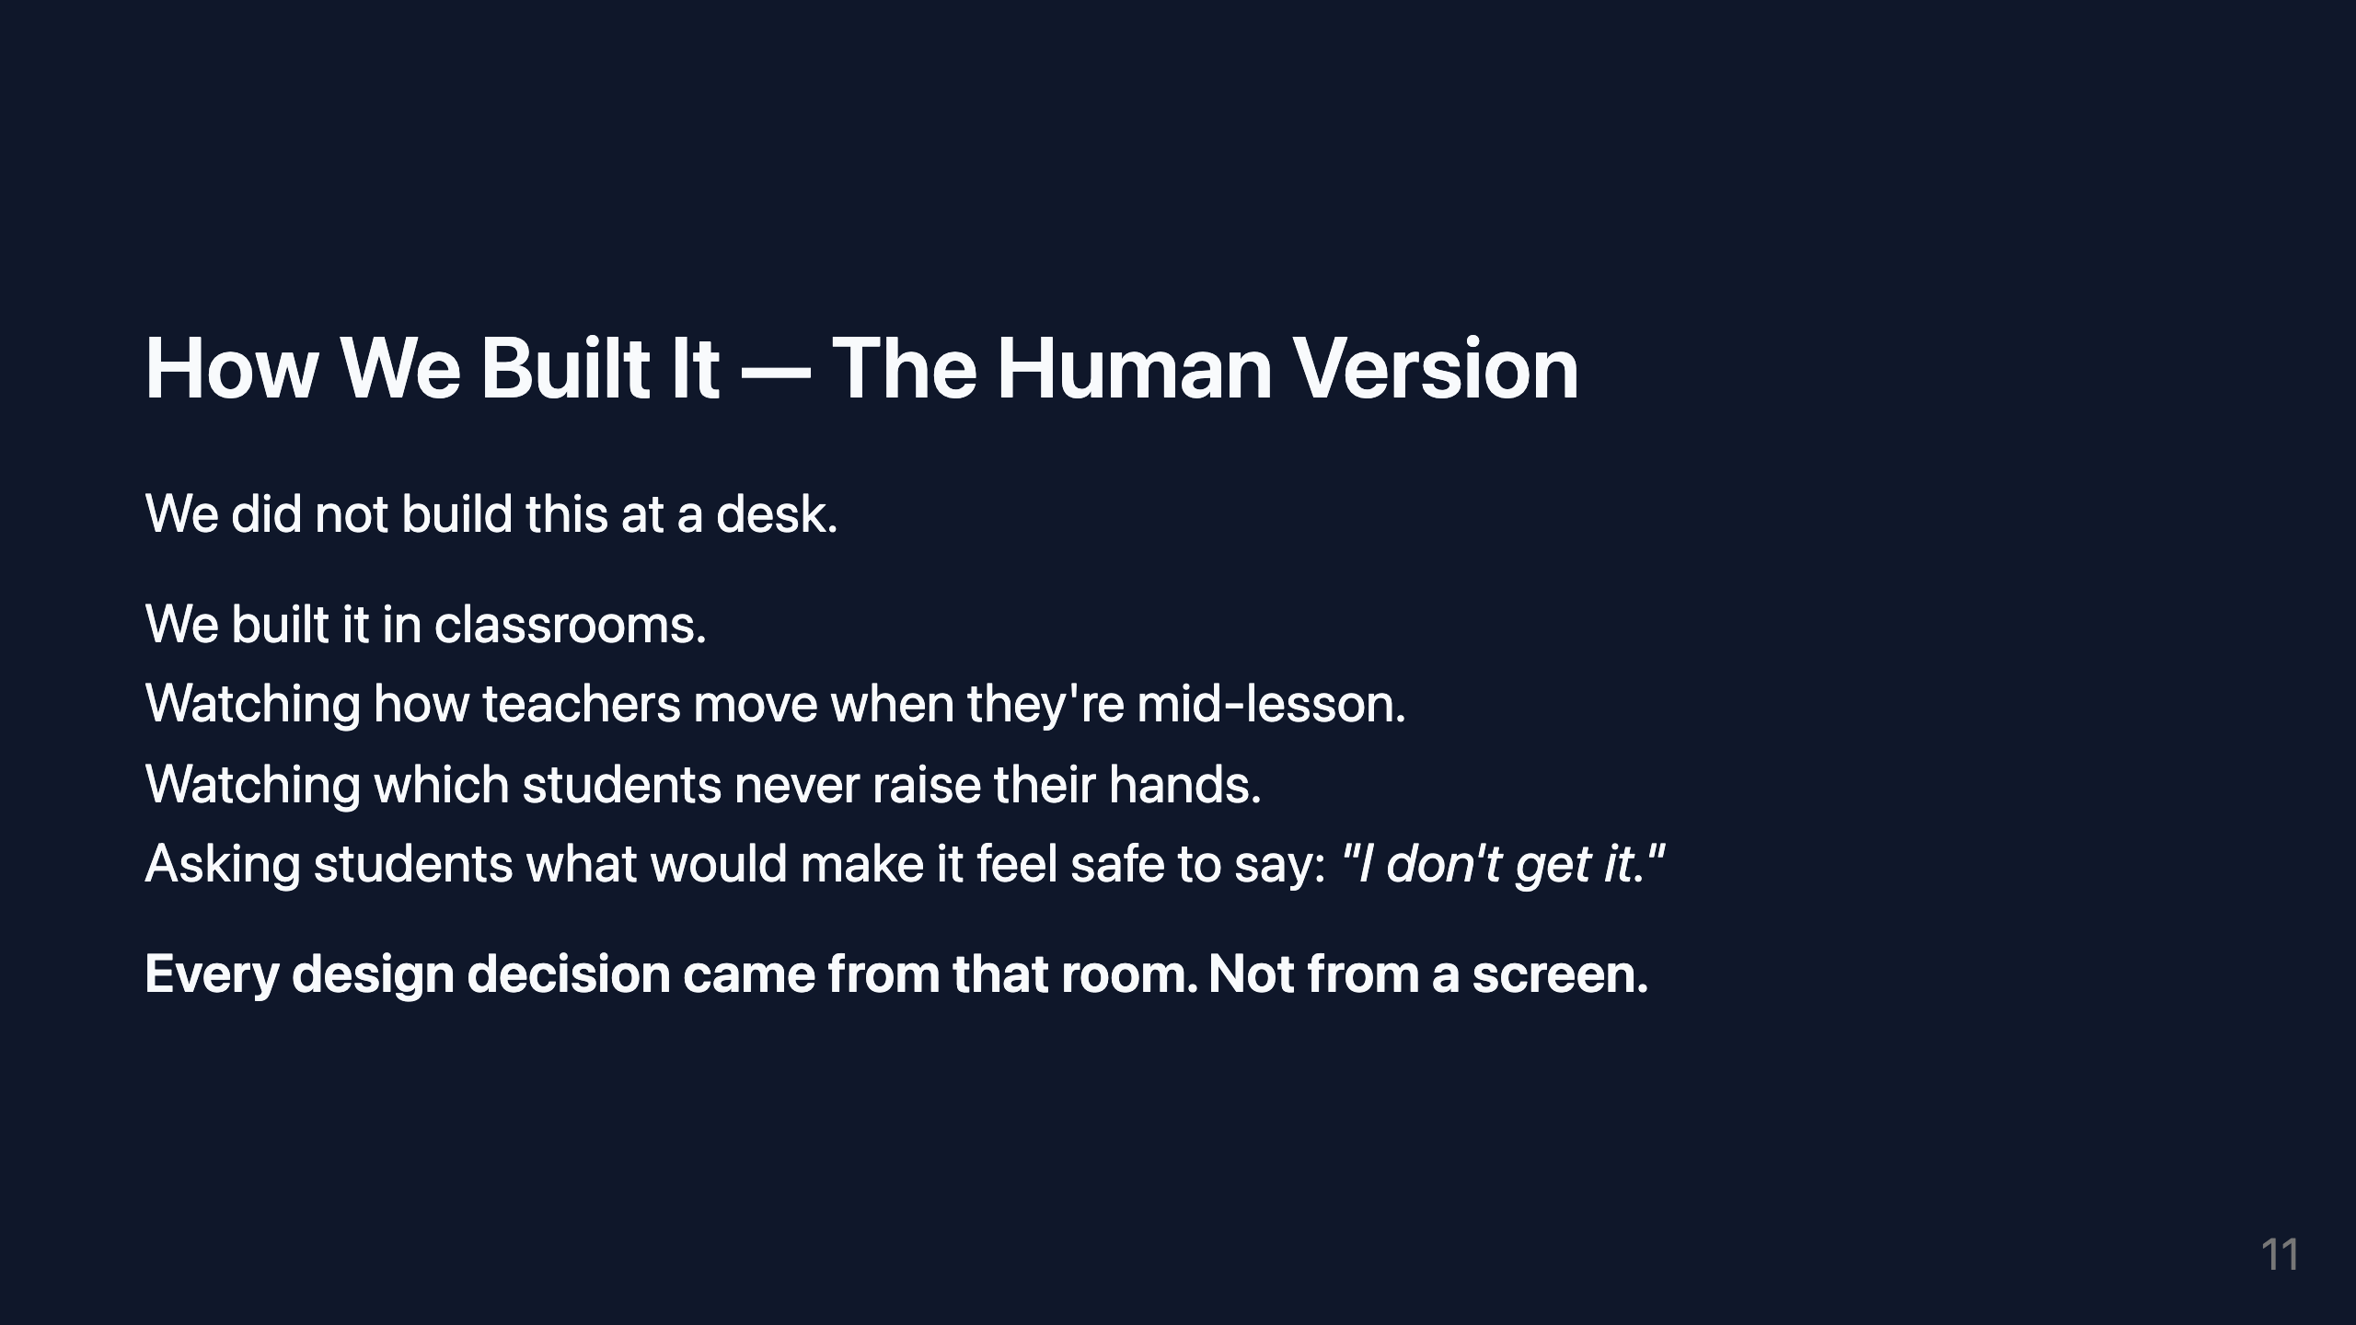
Notes:
VISUAL: Subtle classroom imagery. Left-aligned text. Feels like a personal narrative, not a product launch.

Slide 12

Notes:
VISUAL: Four short quotes or names (initials only) in a 2x2 grid. Warm, understated.

Slide 13
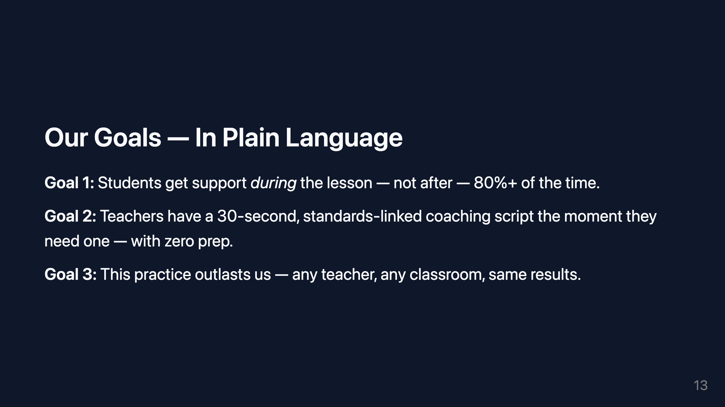
Notes:
VISUAL: Three goals as large numbered statements. Each with a short supporting line. Airy layout.

Slide 14
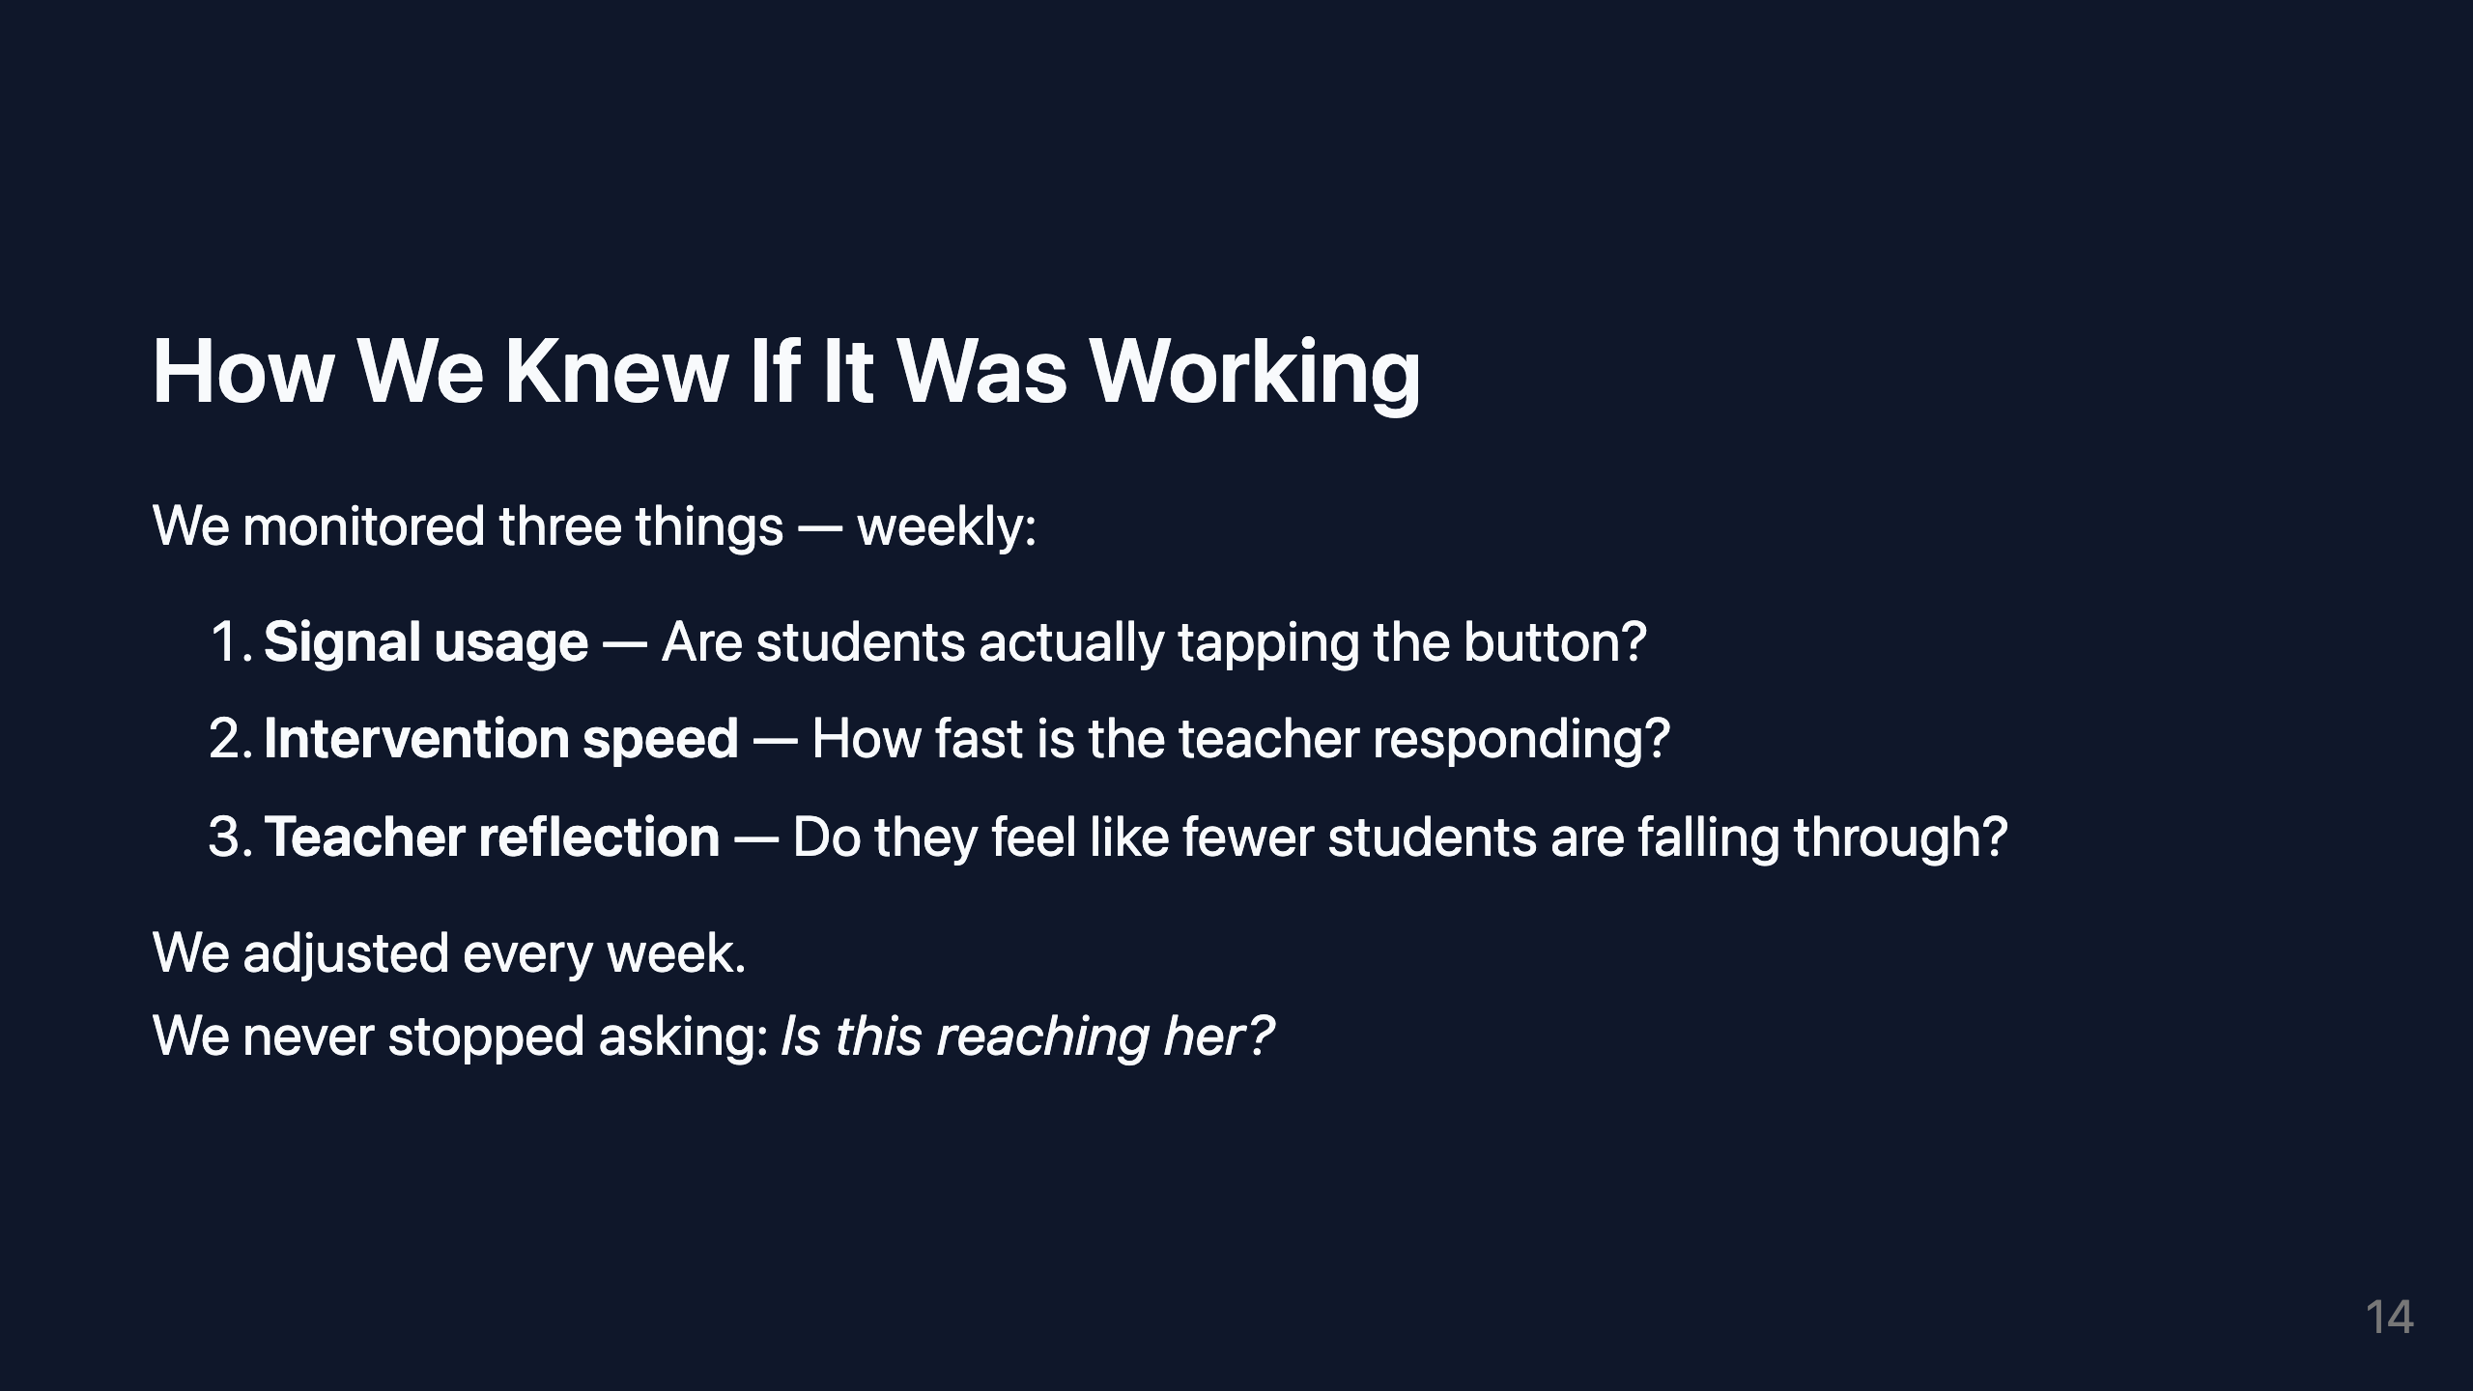
Notes:
VISUAL: Circular progress monitor graphic or simple numbered list with check icons.

Slide 15

Notes:
SLIDE PURPOSE: Climax — data and impact, translated into human terms.

Slide 16
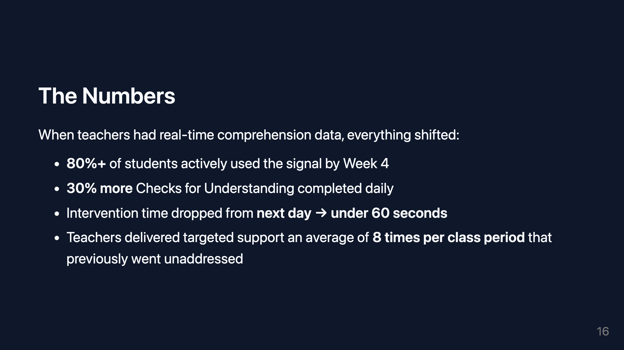
Notes:
VISUAL: Four large stat callouts in a 2x2 grid. Bold numbers, short descriptor below each. Minimal color accents.

Slide 17
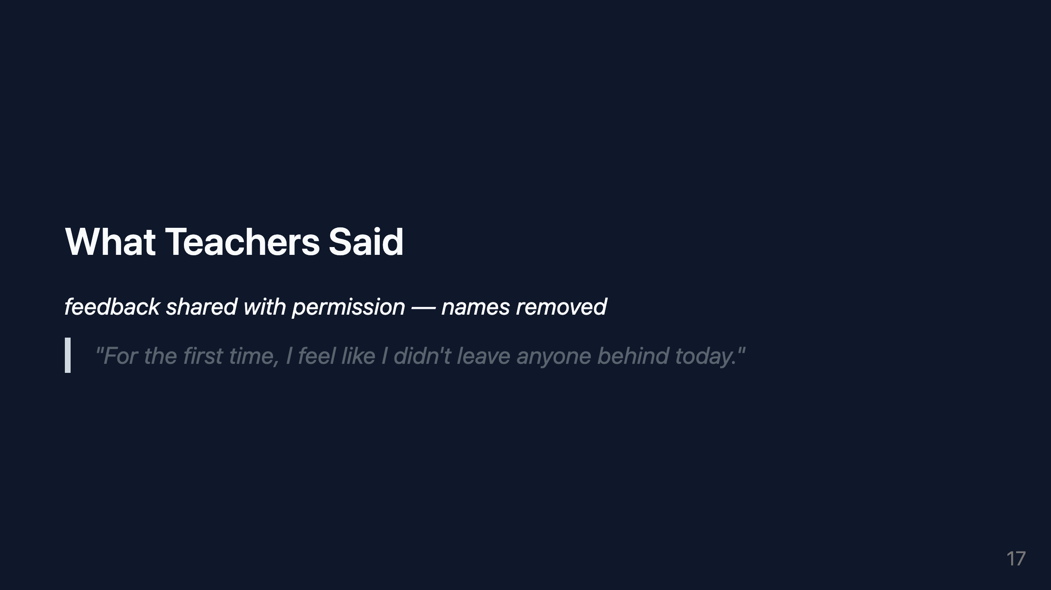

Slide 18
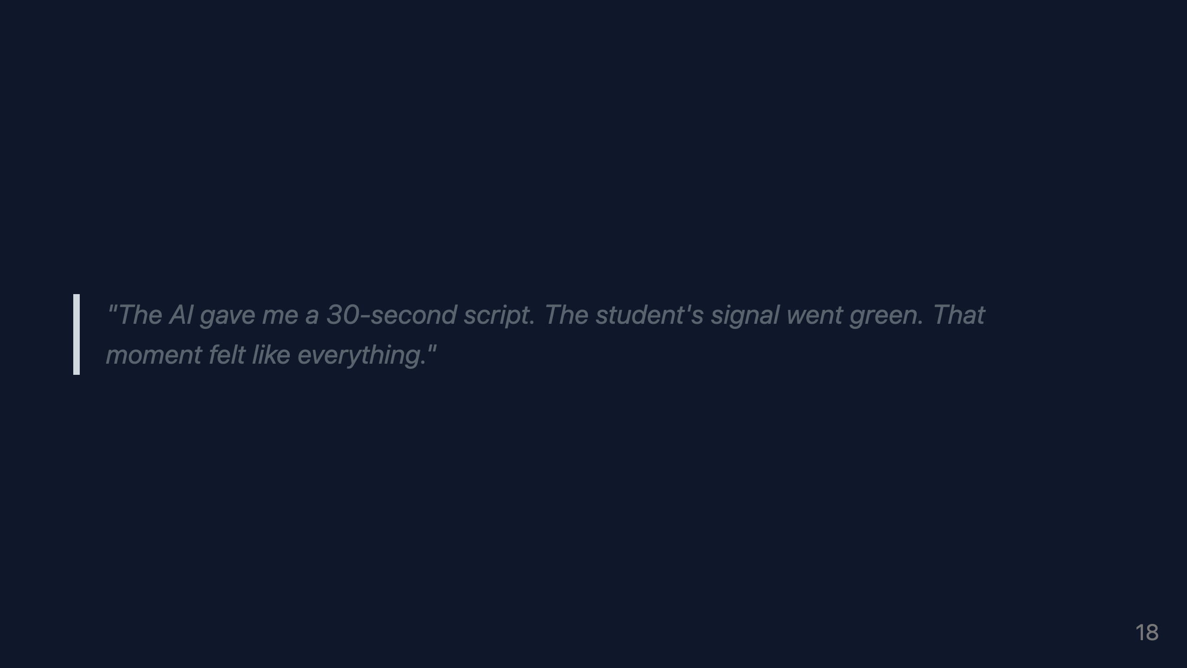

Slide 19
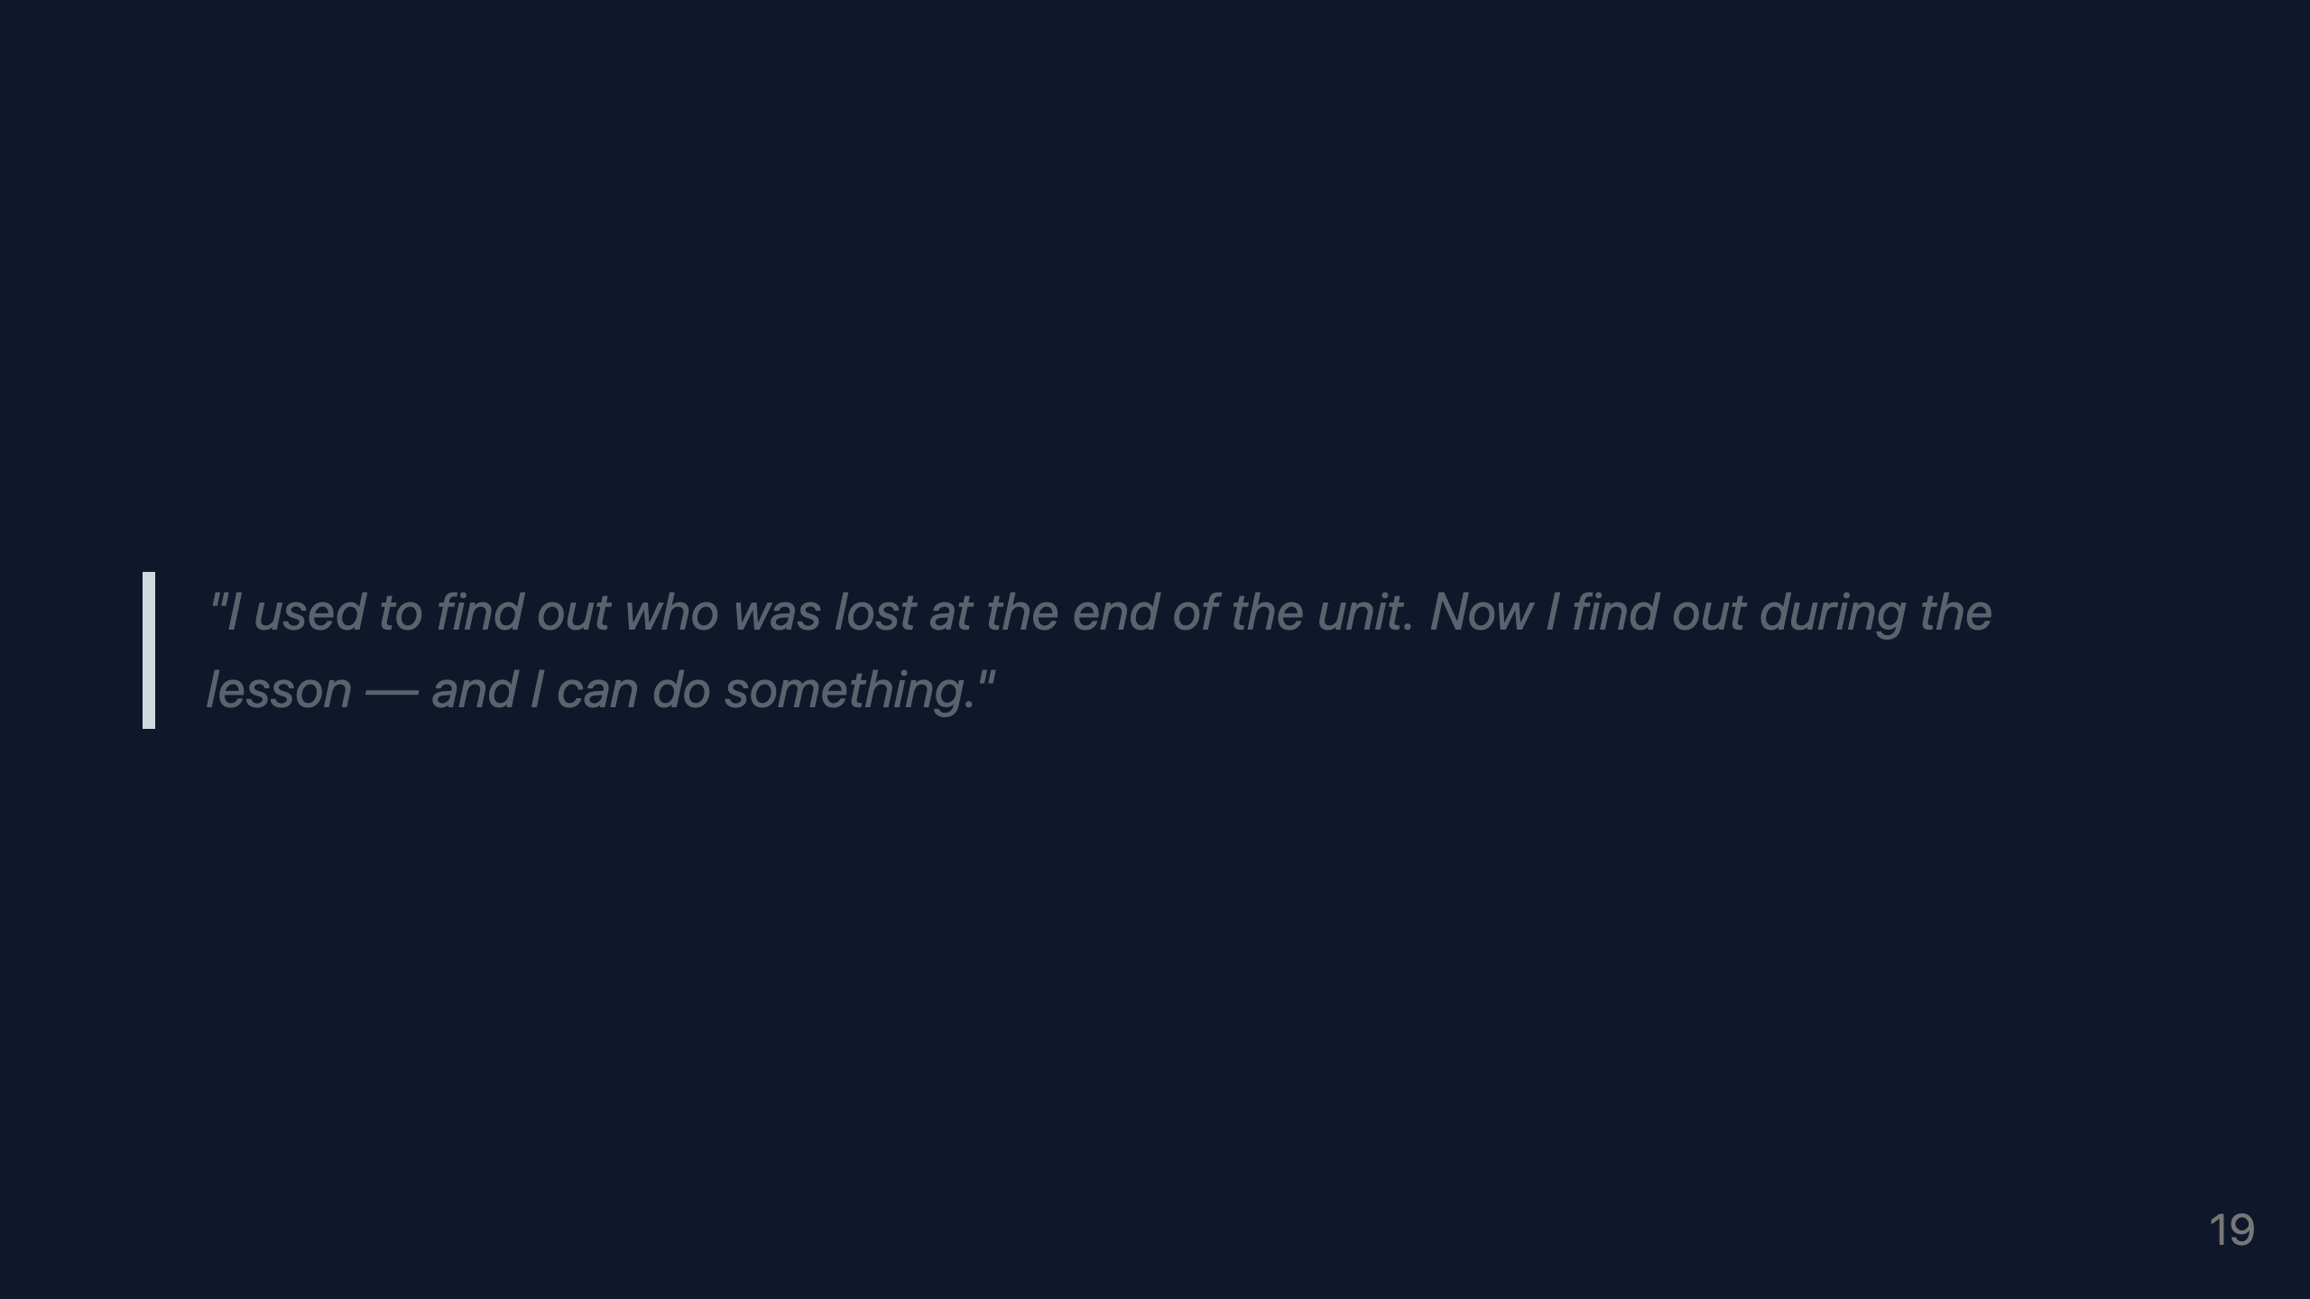
Notes:
VISUAL: One quote per slide section, large italic type, soft horizontal rule between. No attribution. Let the words breathe.

Slide 20
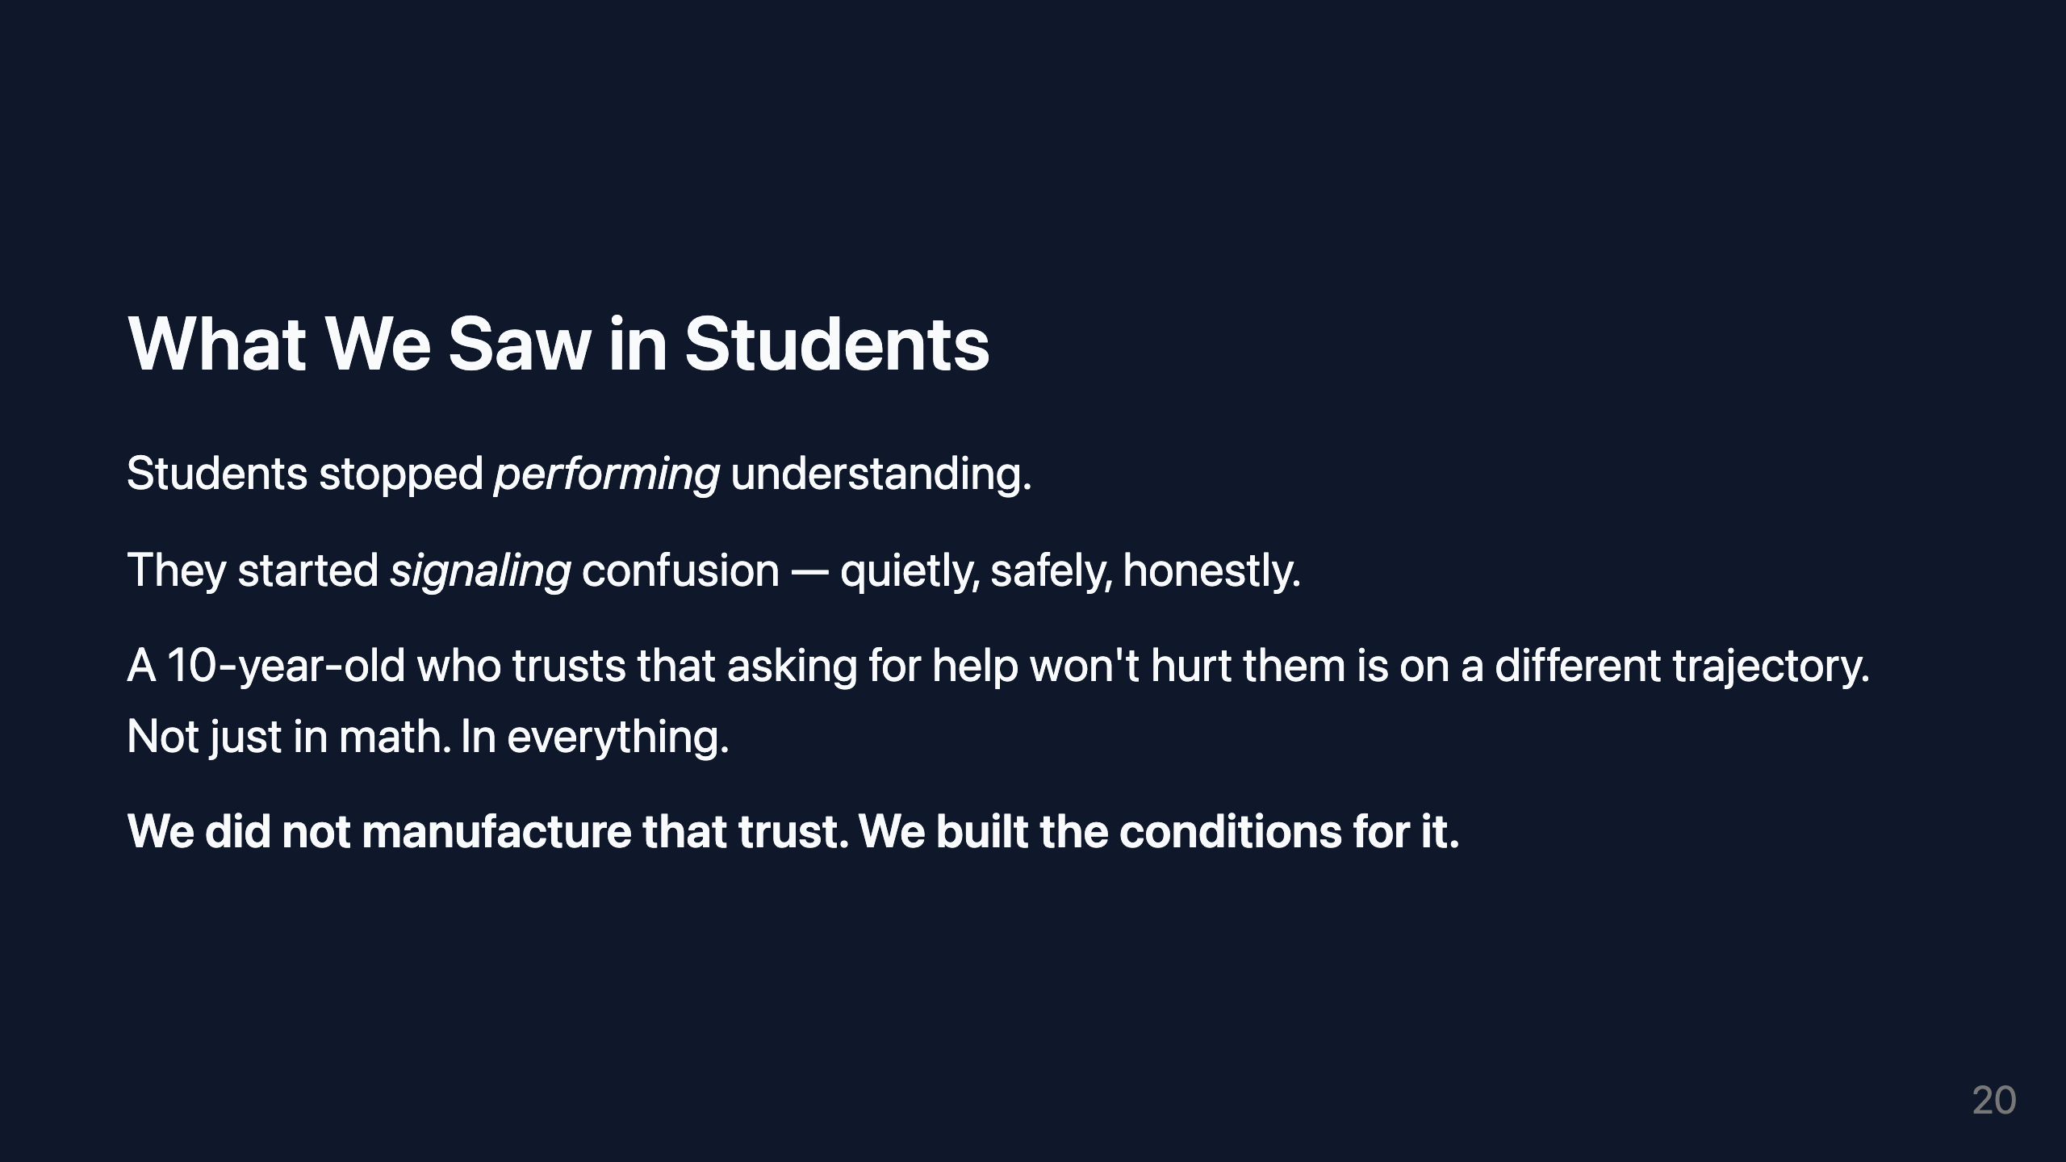
Notes:
VISUAL: Soft, warm-toned slide. One idea. Big white space. Let it land.

Slide 21
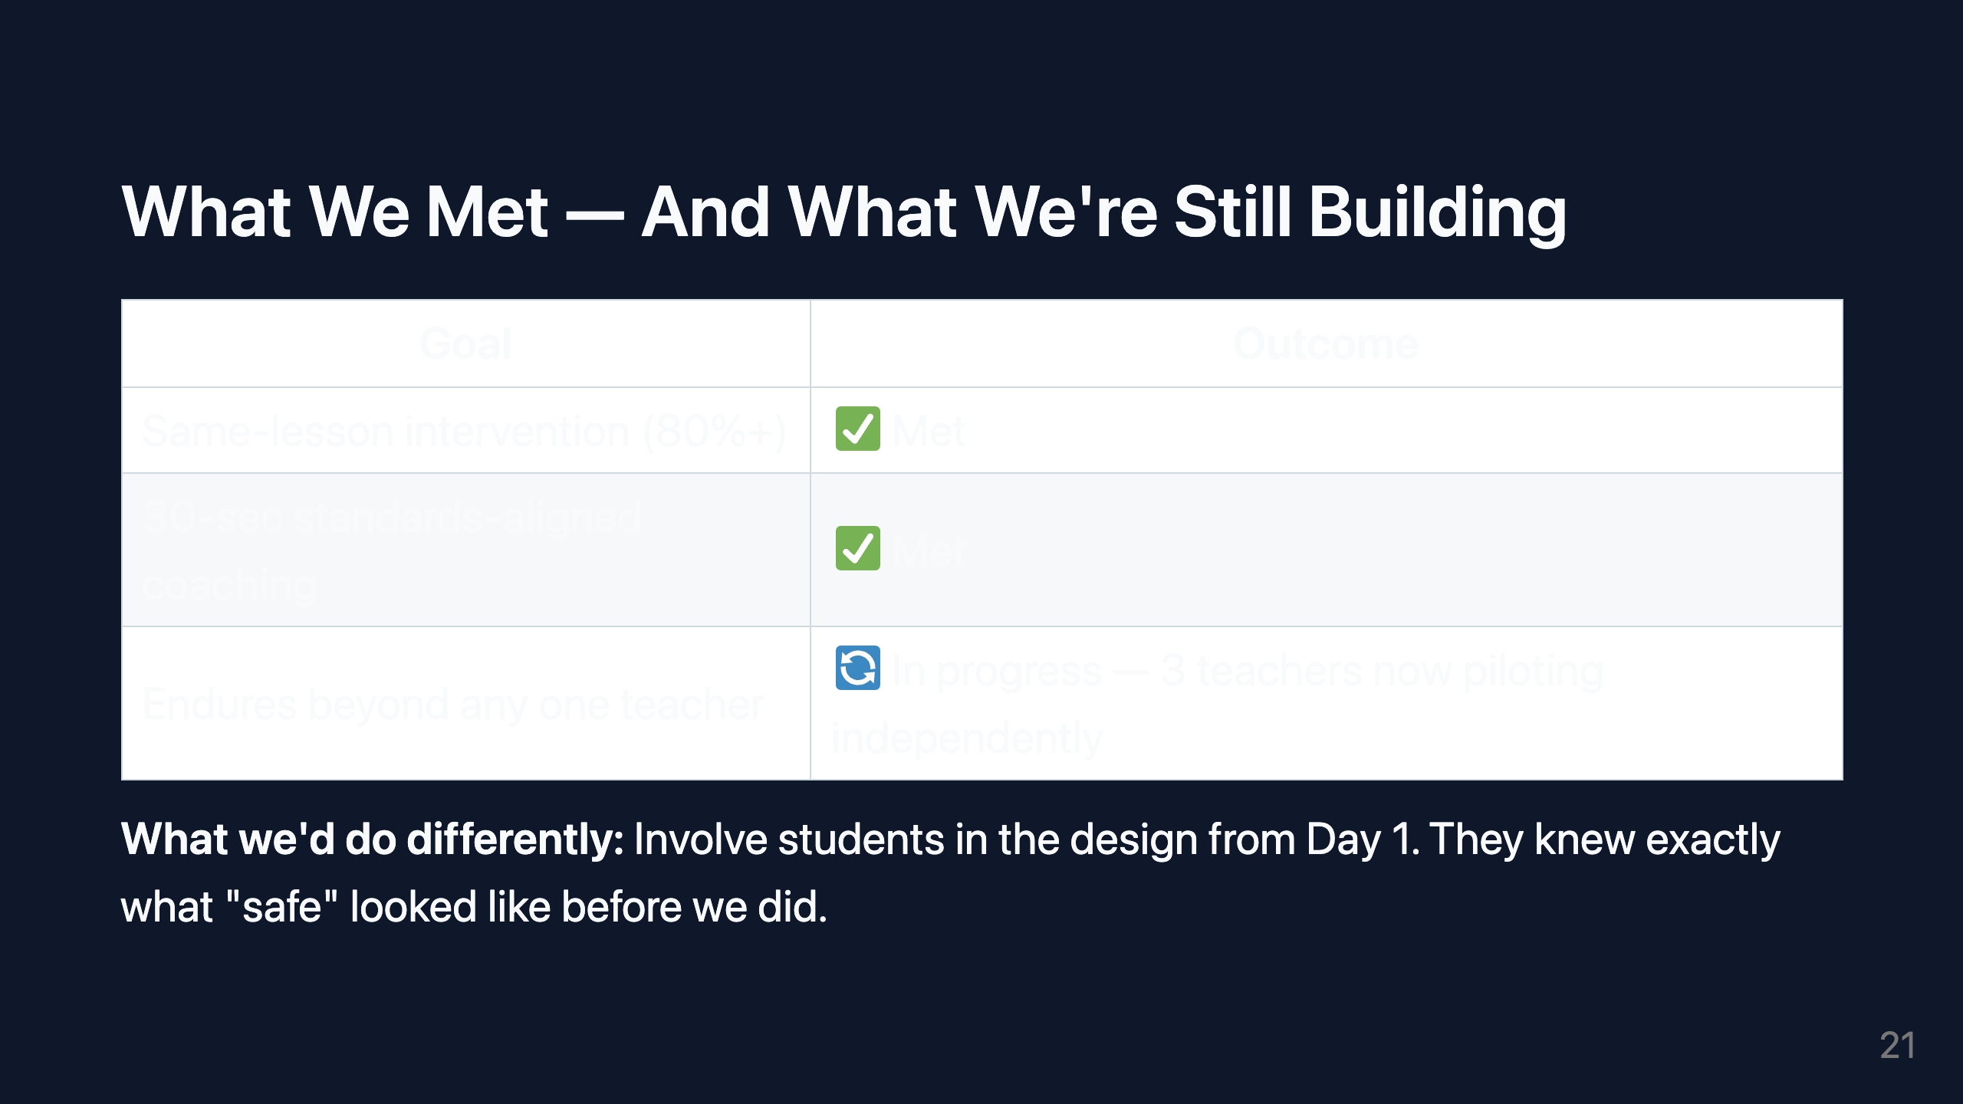
Notes:
VISUAL: Simple table with green check and orange clock icons. Clean, honest.

Slide 22
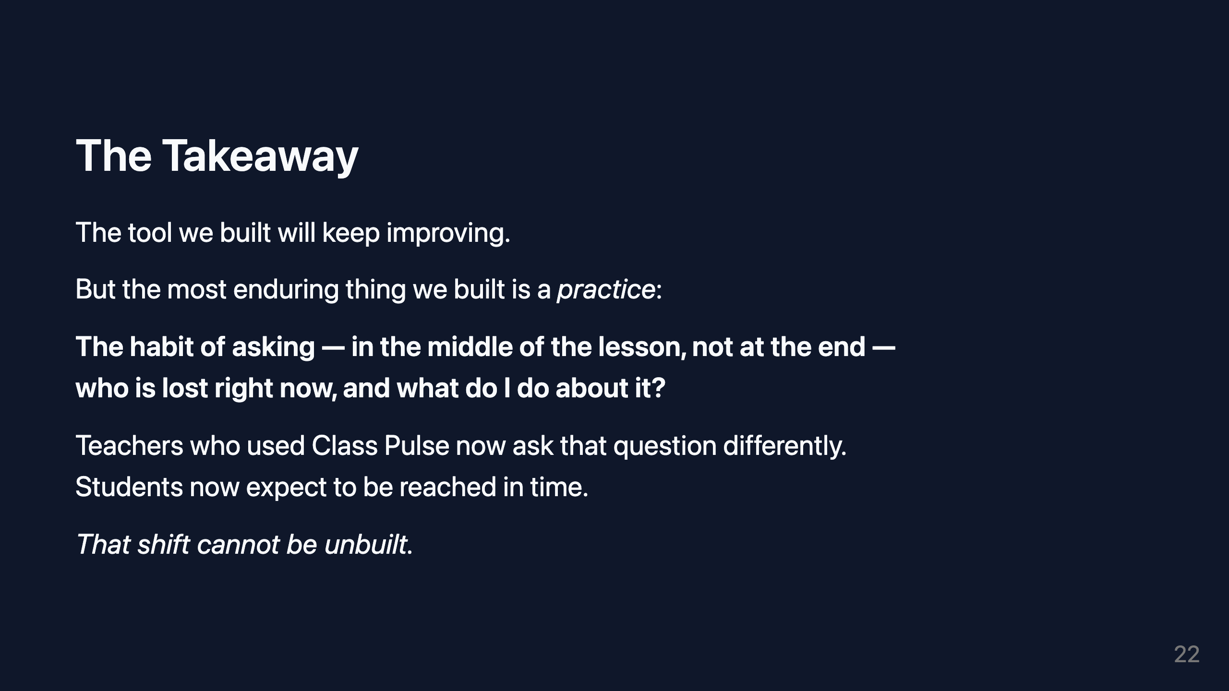
Notes:
SLIDE PURPOSE: Takeaway — what endures, and why it matters. VISUAL: Single powerful sentence. Large type. Dark background. Nothing else.

Slide 23
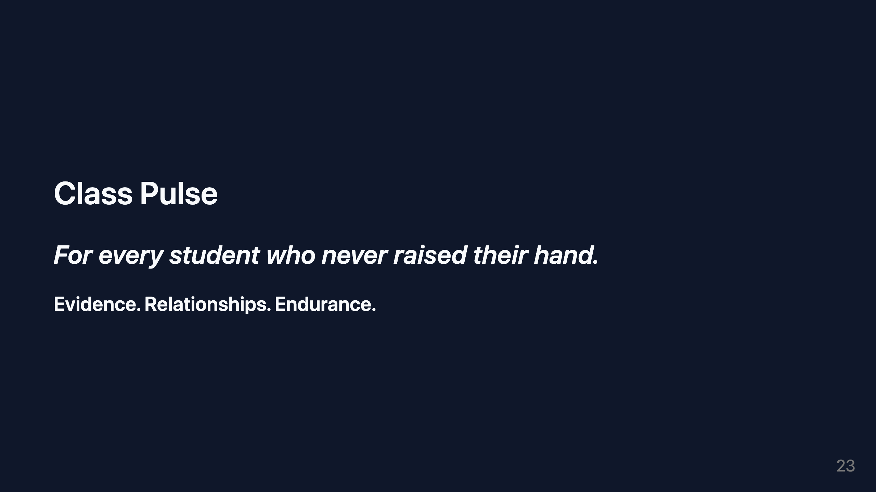

Slide 24
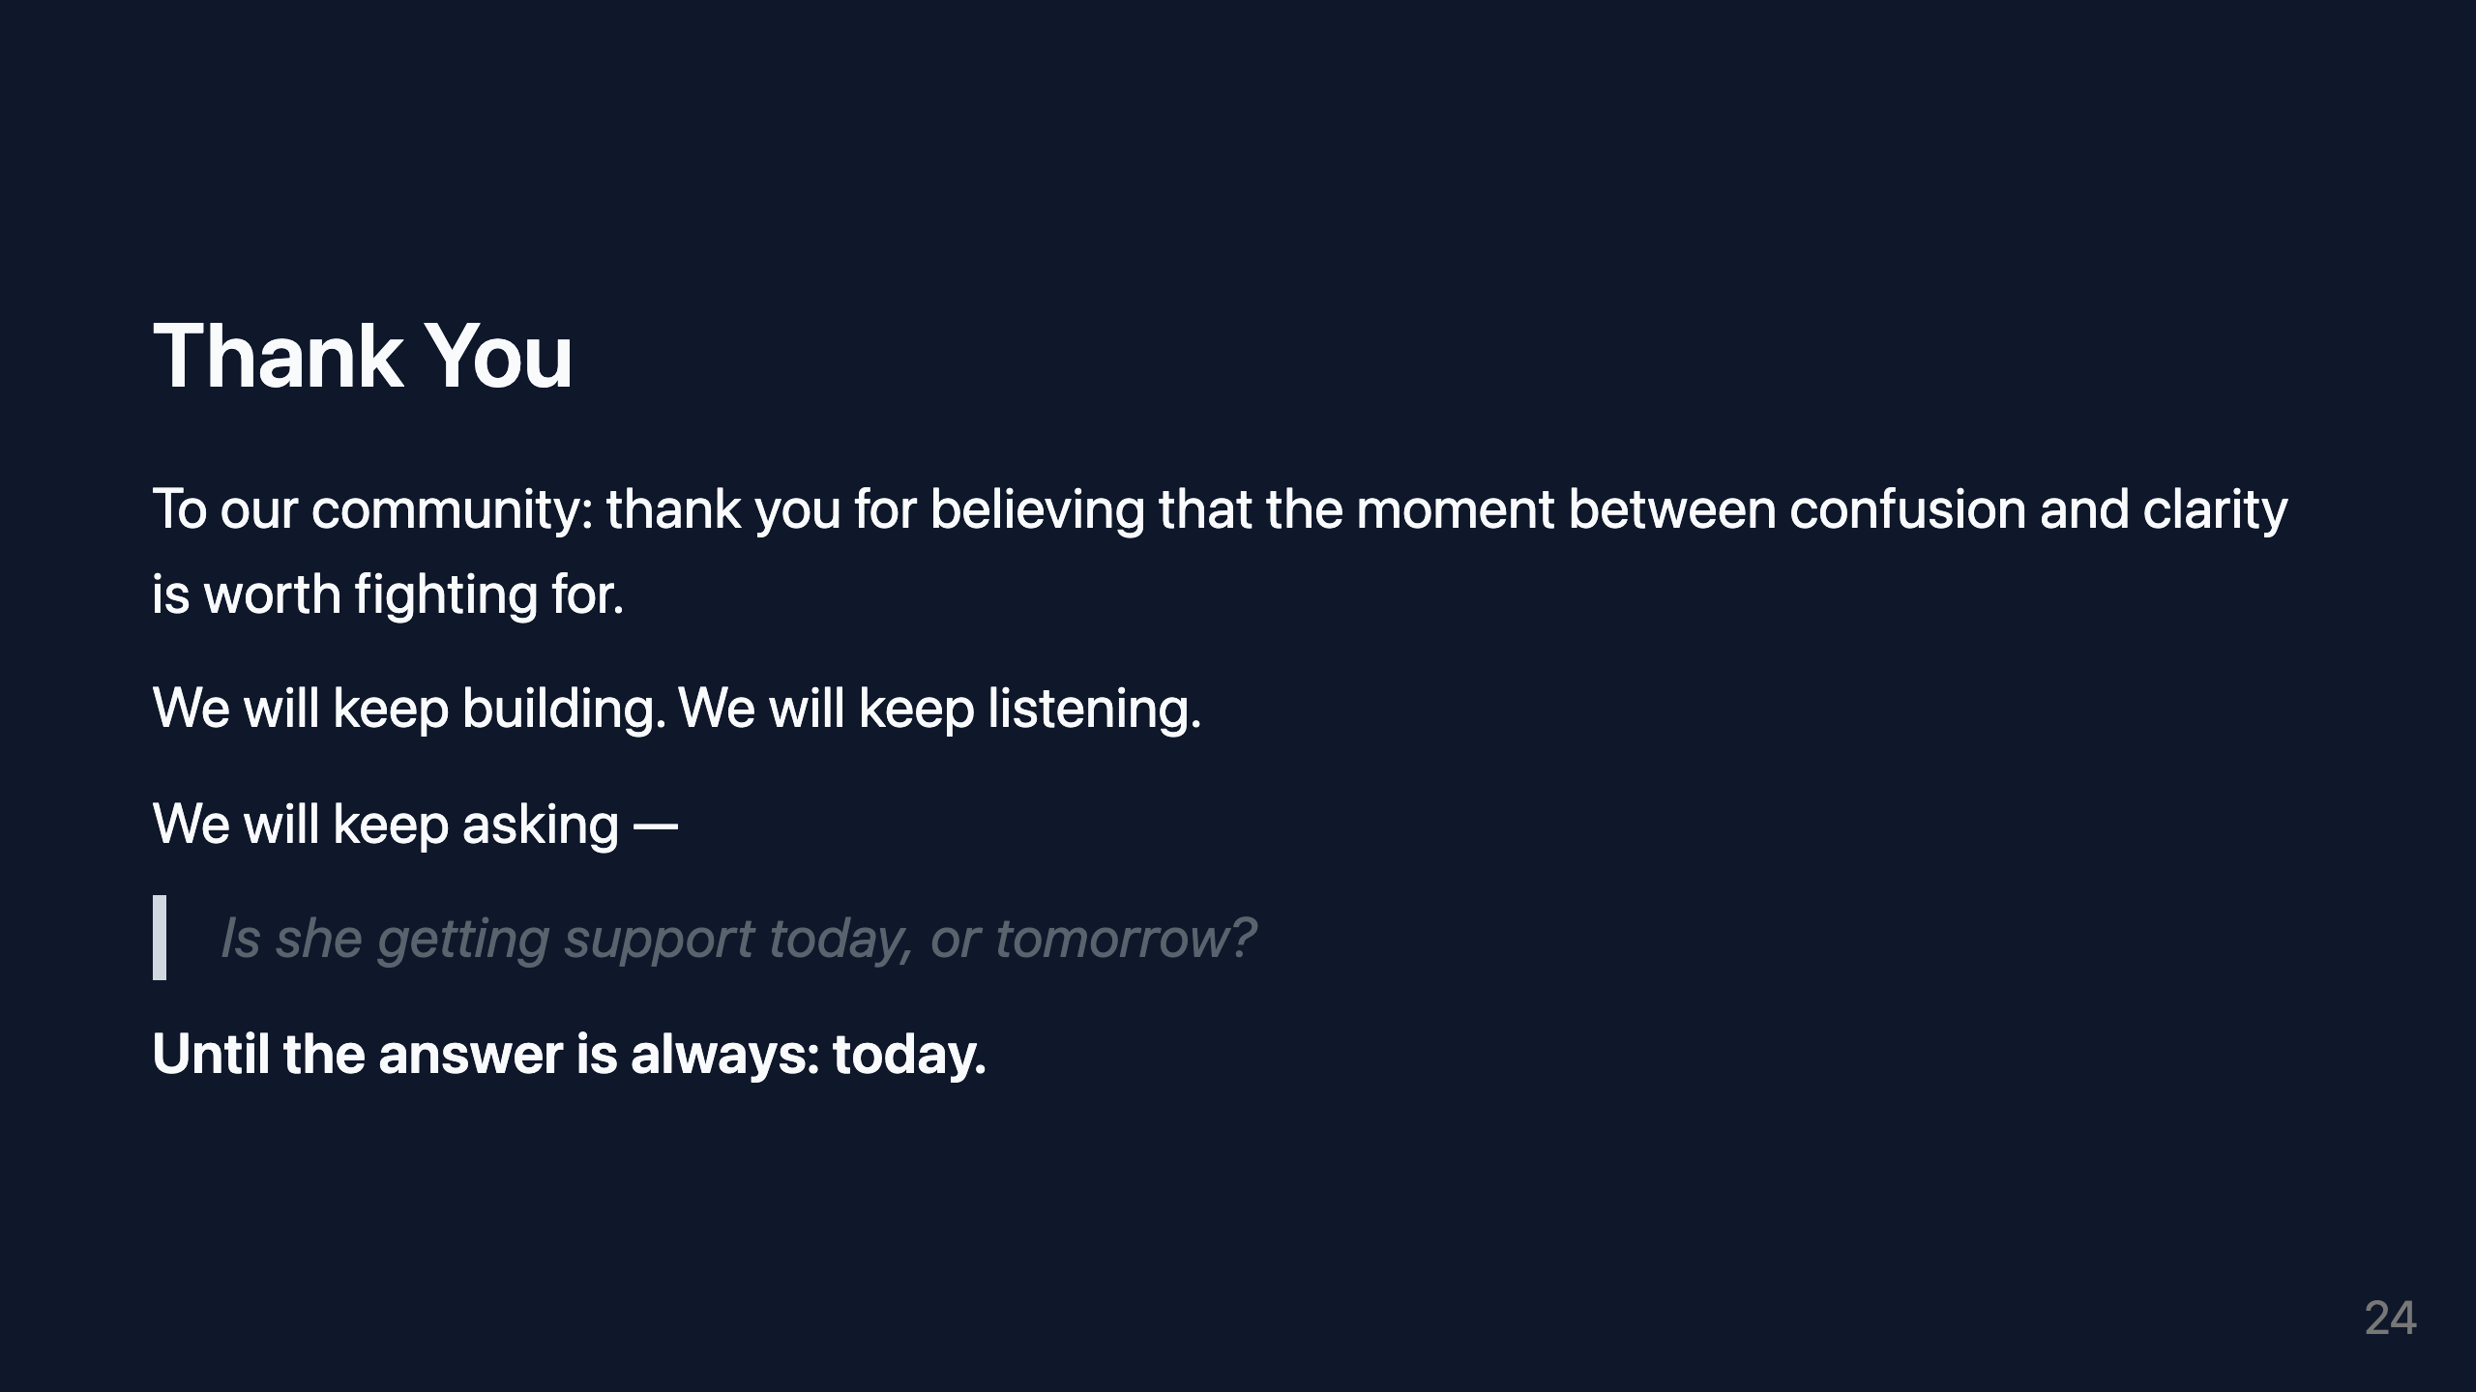
Notes:
VISUAL: Final slide. Soft gradient. Centered text. Sparse and sincere.

