Slide 1

Notes:
BLUEPRINT: V3 Objective: Cover the full Class Pulse platform story in ≤9 min, leaving room for a live demo. Pacing: ~45 seconds per slide → 12 slides = ~9 min. Audience: Community stakeholders — values-driven, non-technical. Arc: Personal Why → The Full Problem → Full Platform → Impact → Demo handoff. ~30 seconds. Pause. Let it land before you speak.

Slide 2
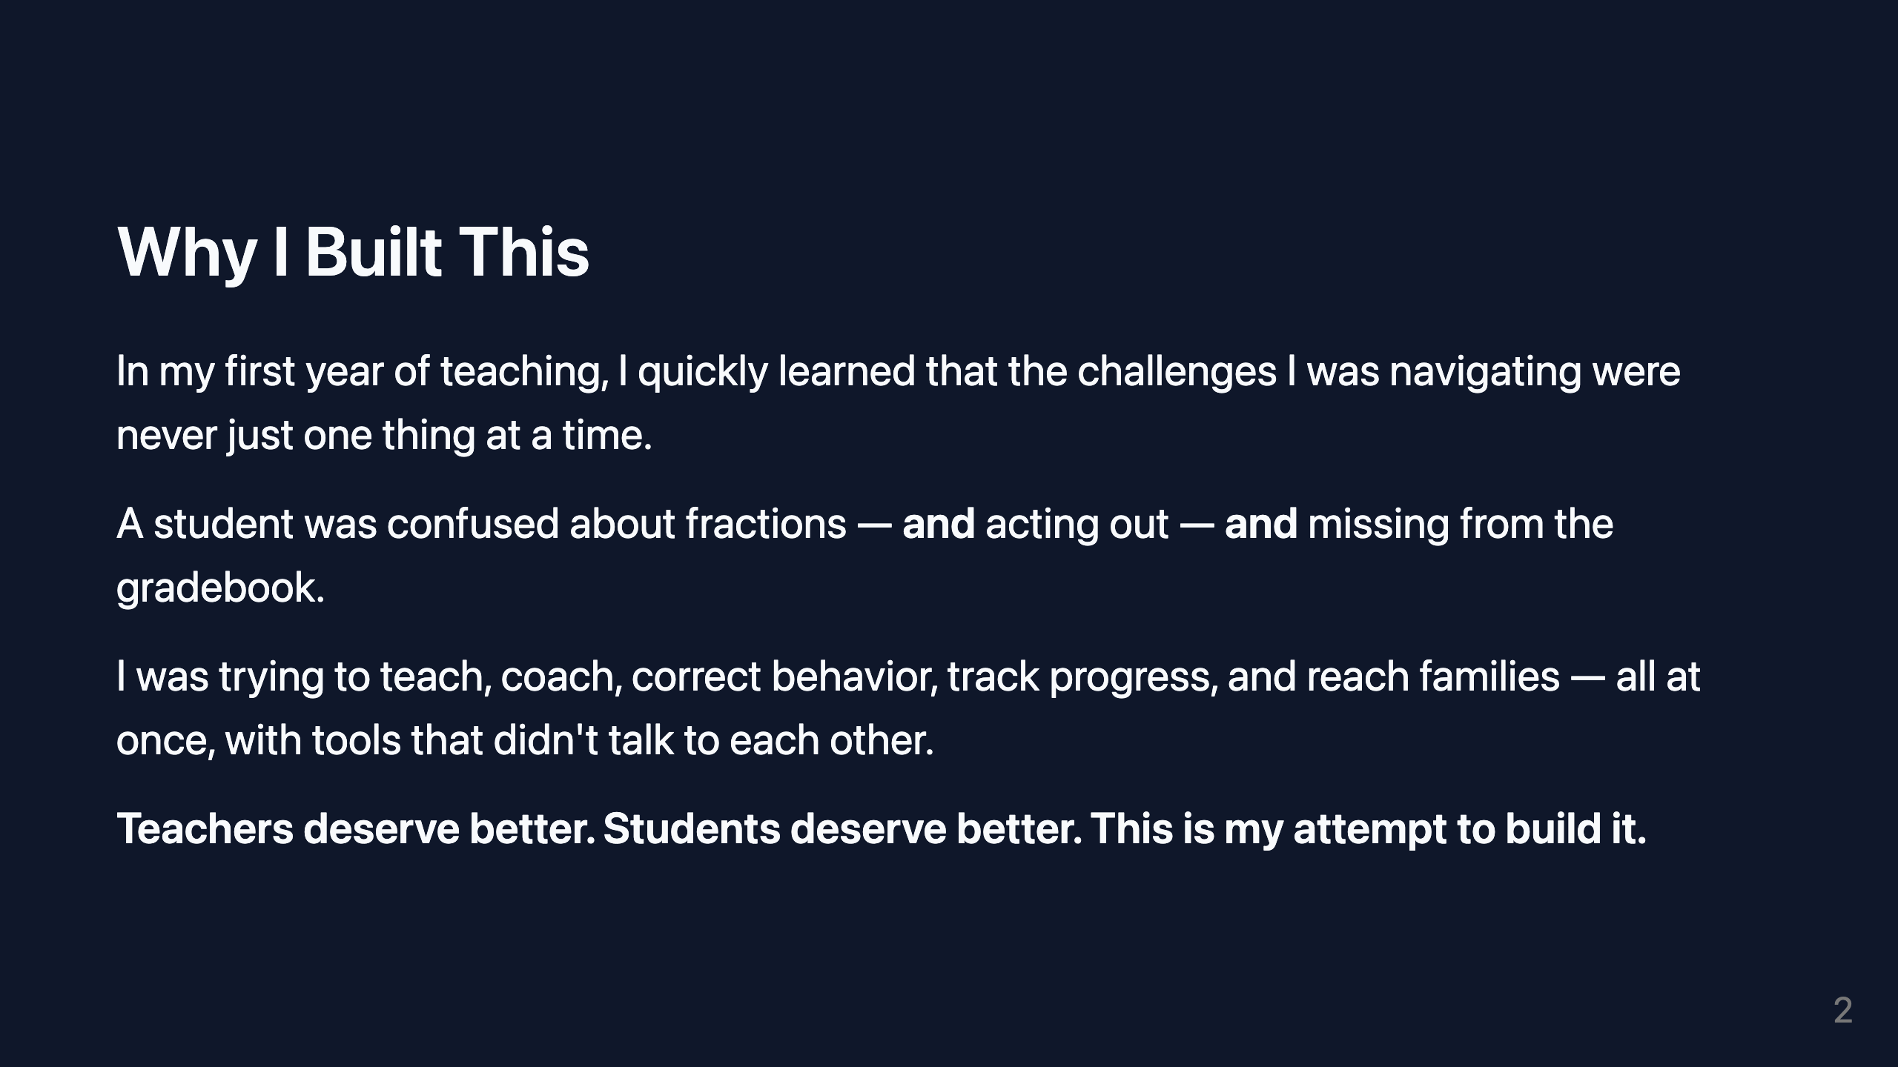
Notes:
~60 seconds. Personal, grounded. Look up from slides.

Slide 3
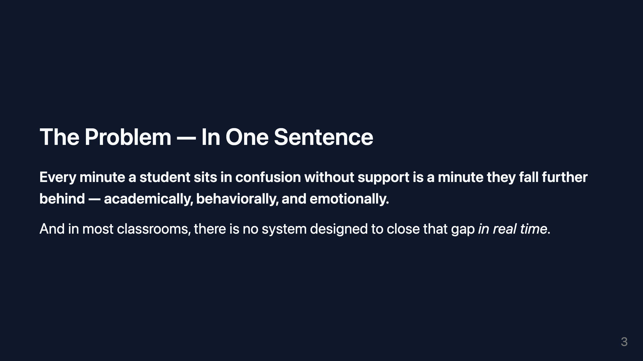
Notes:
~30 seconds. Pause after the first sentence. Let it breathe.

Slide 4
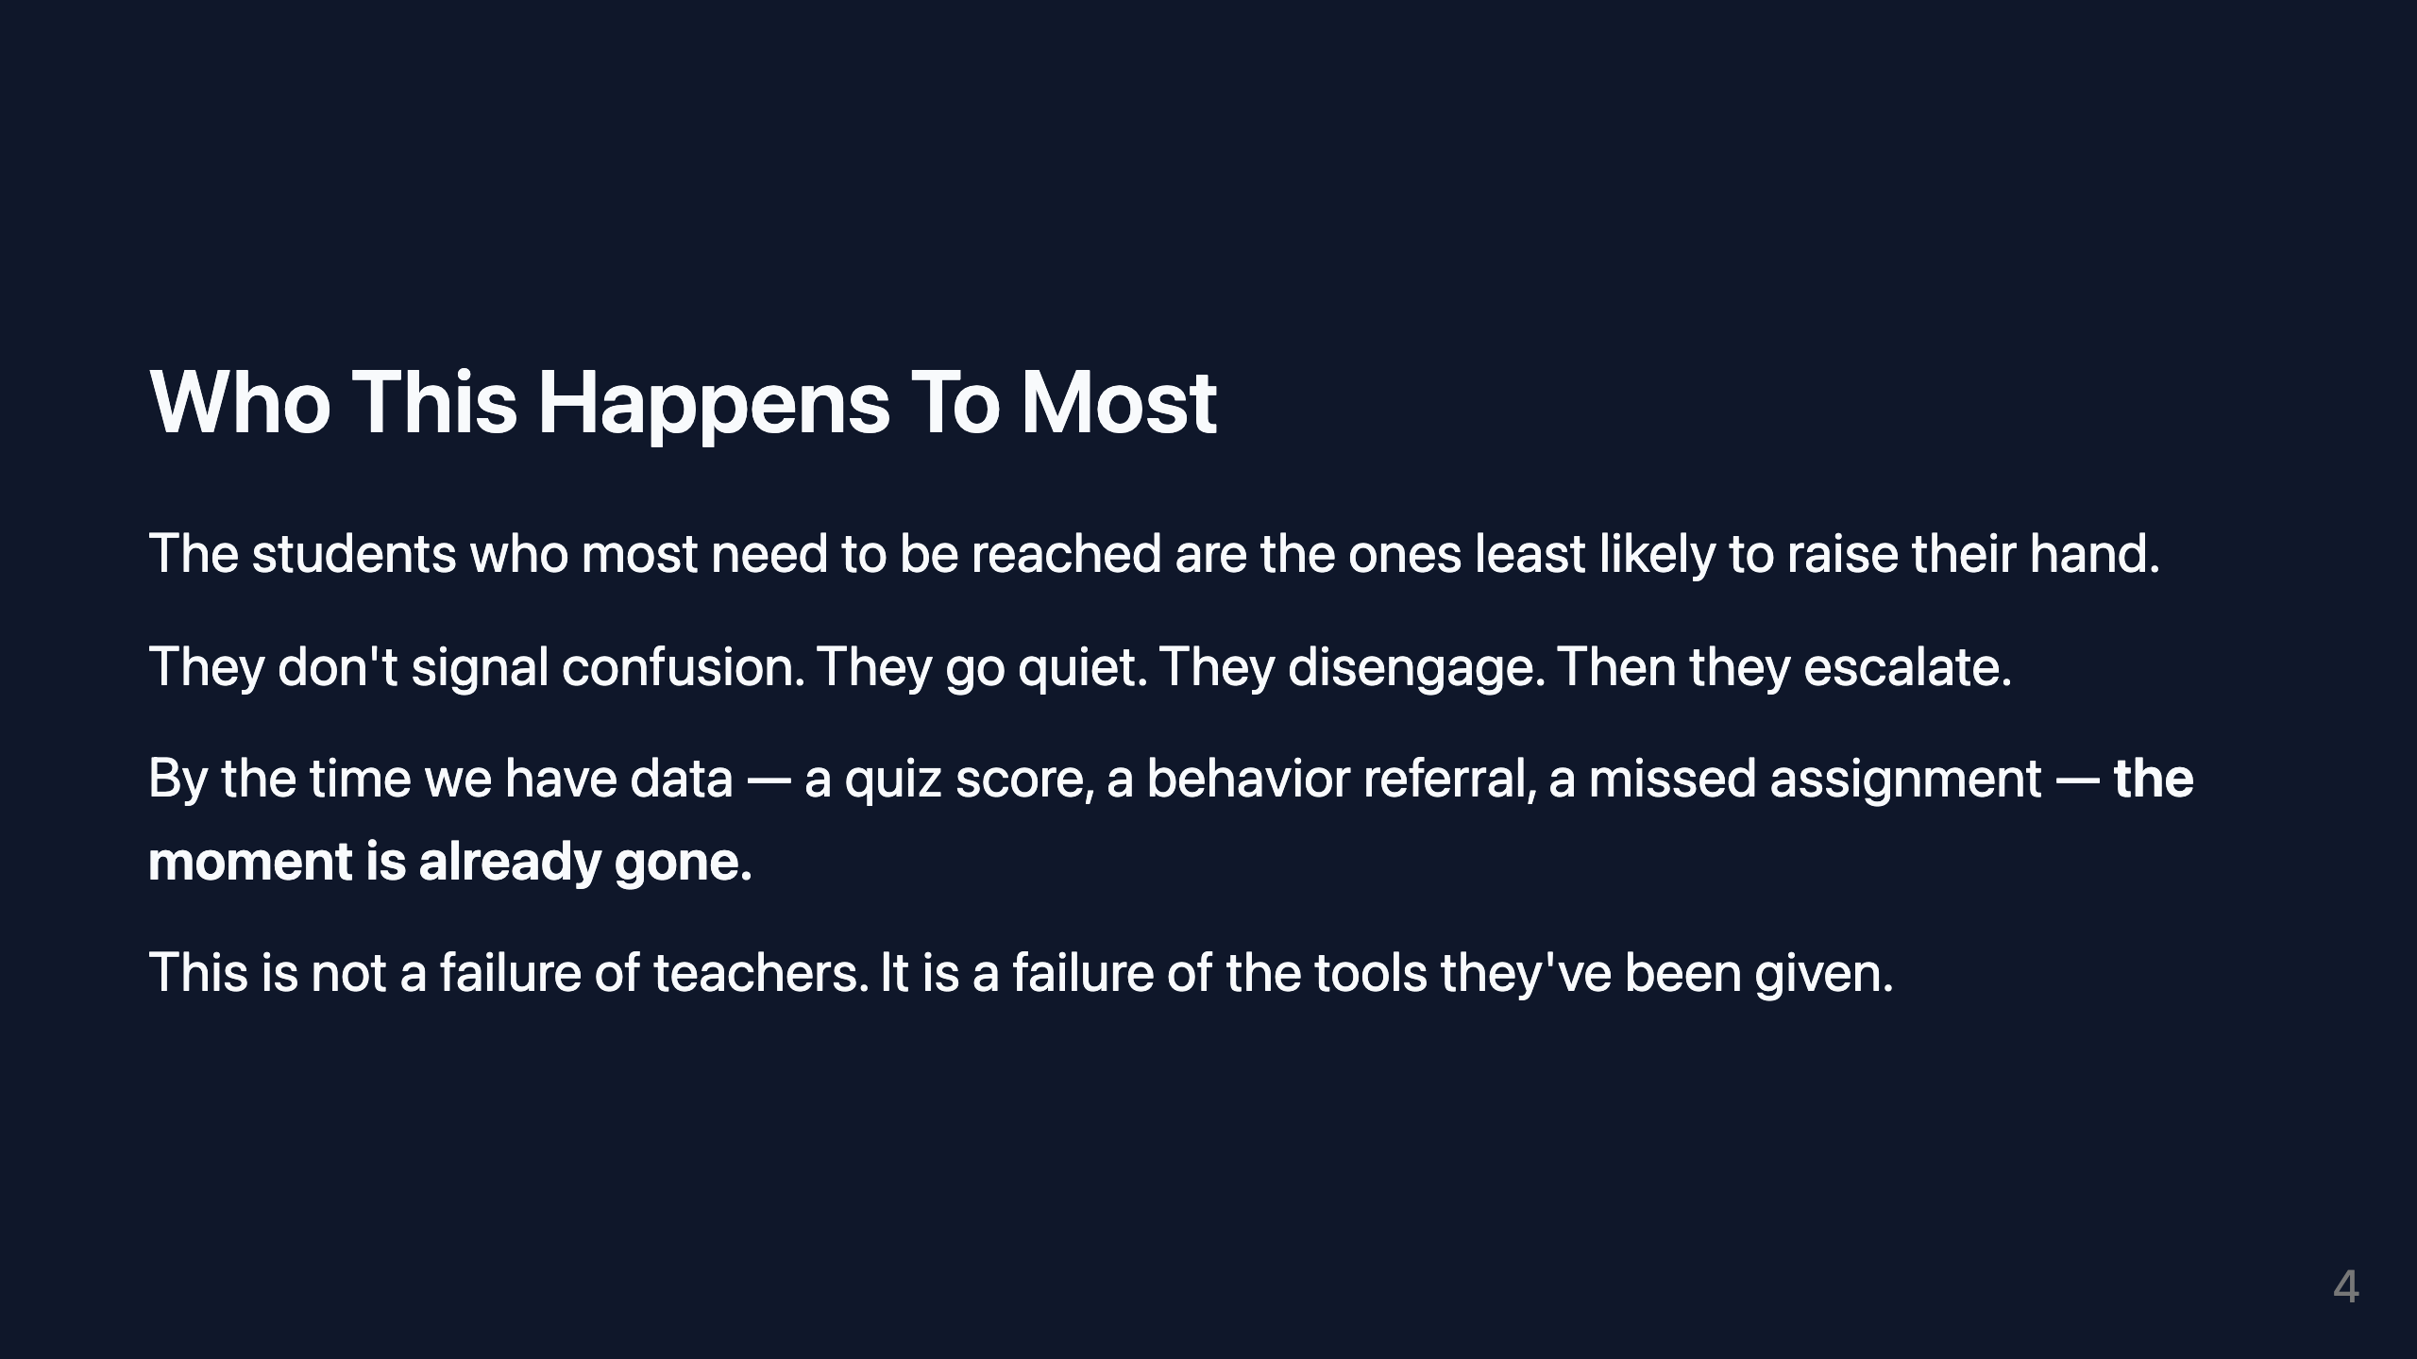
Notes:
~45 seconds.

Slide 5
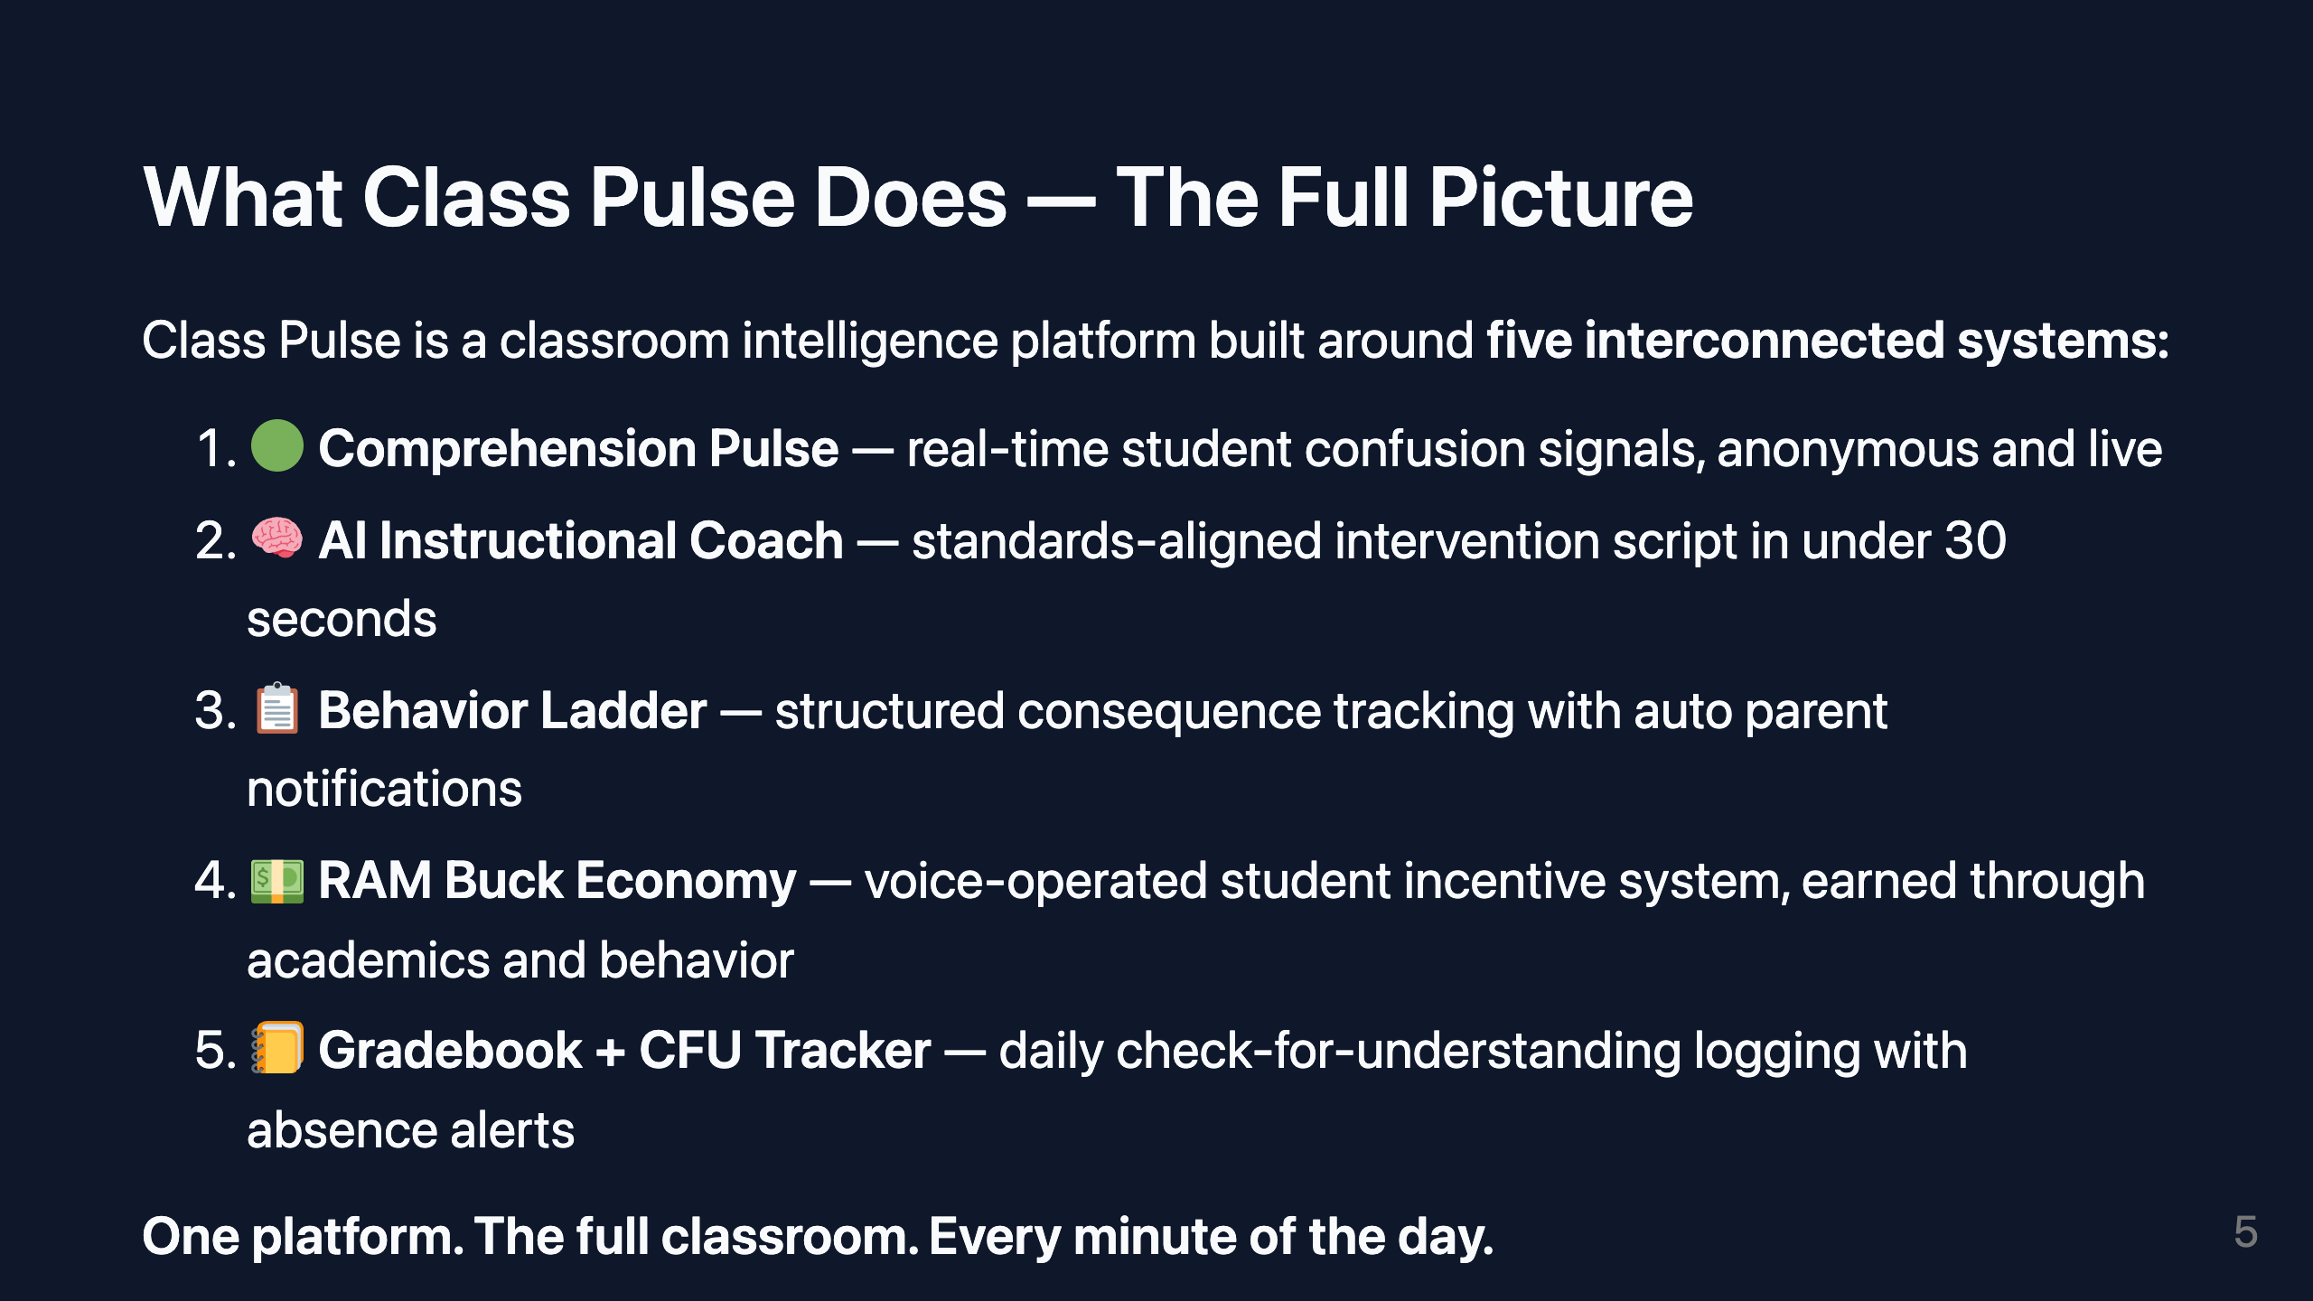
Notes:
~75 seconds. Walk through each point with a brief example. Don't rush.

Slide 6
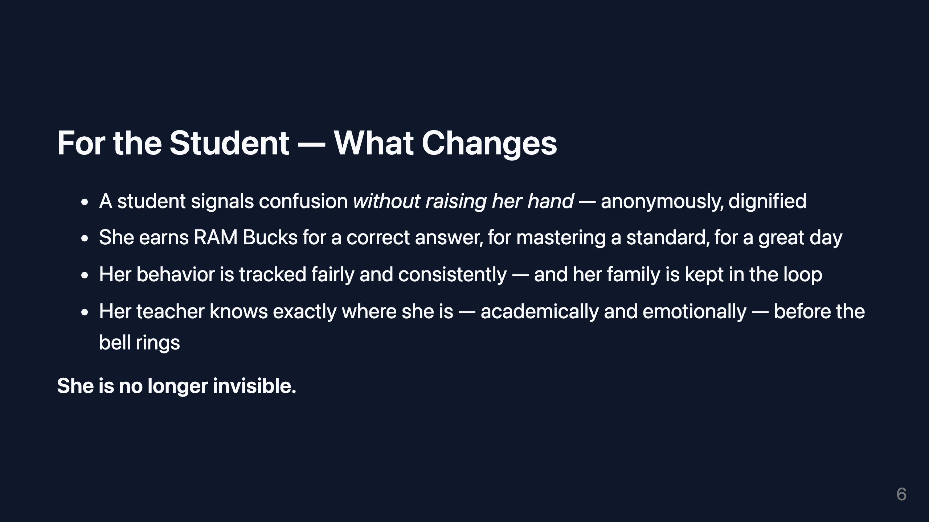
Notes:
~45 seconds. Warm tone. This is about the kid.

Slide 7
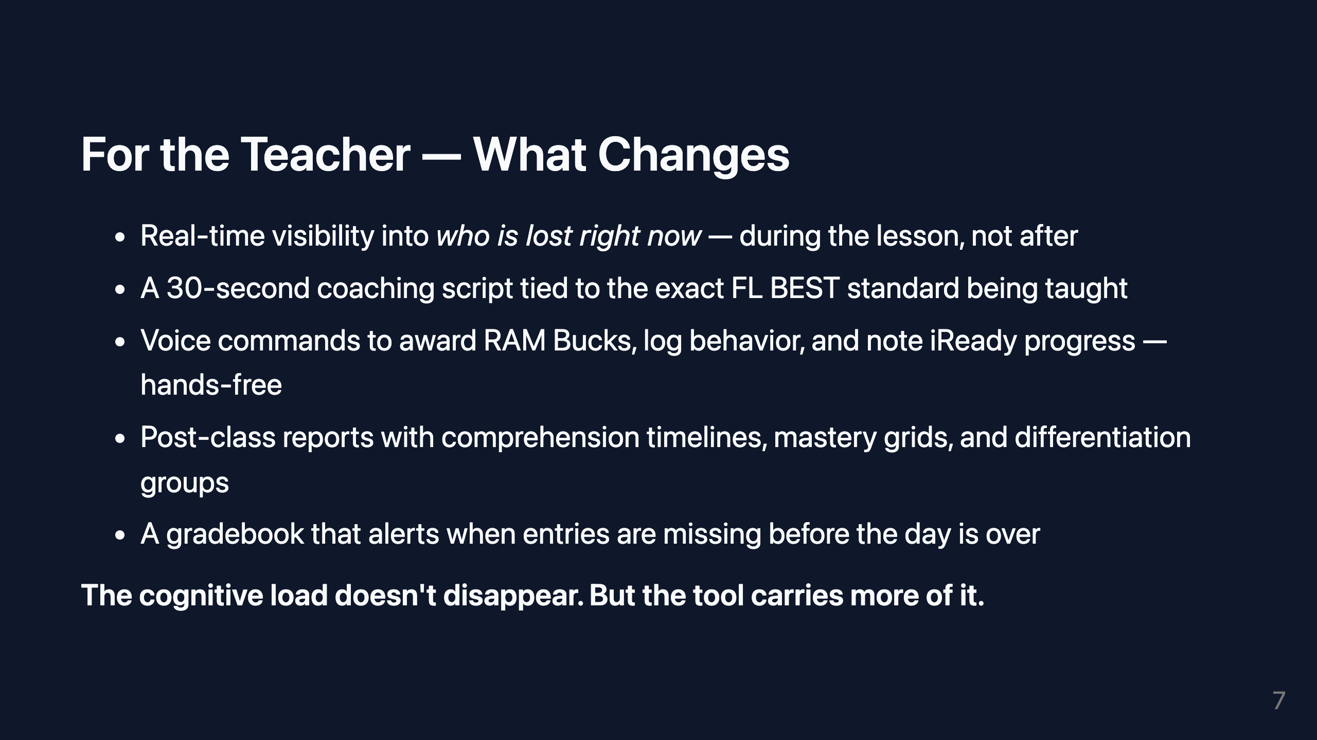
Notes:
~60 seconds.

Slide 8
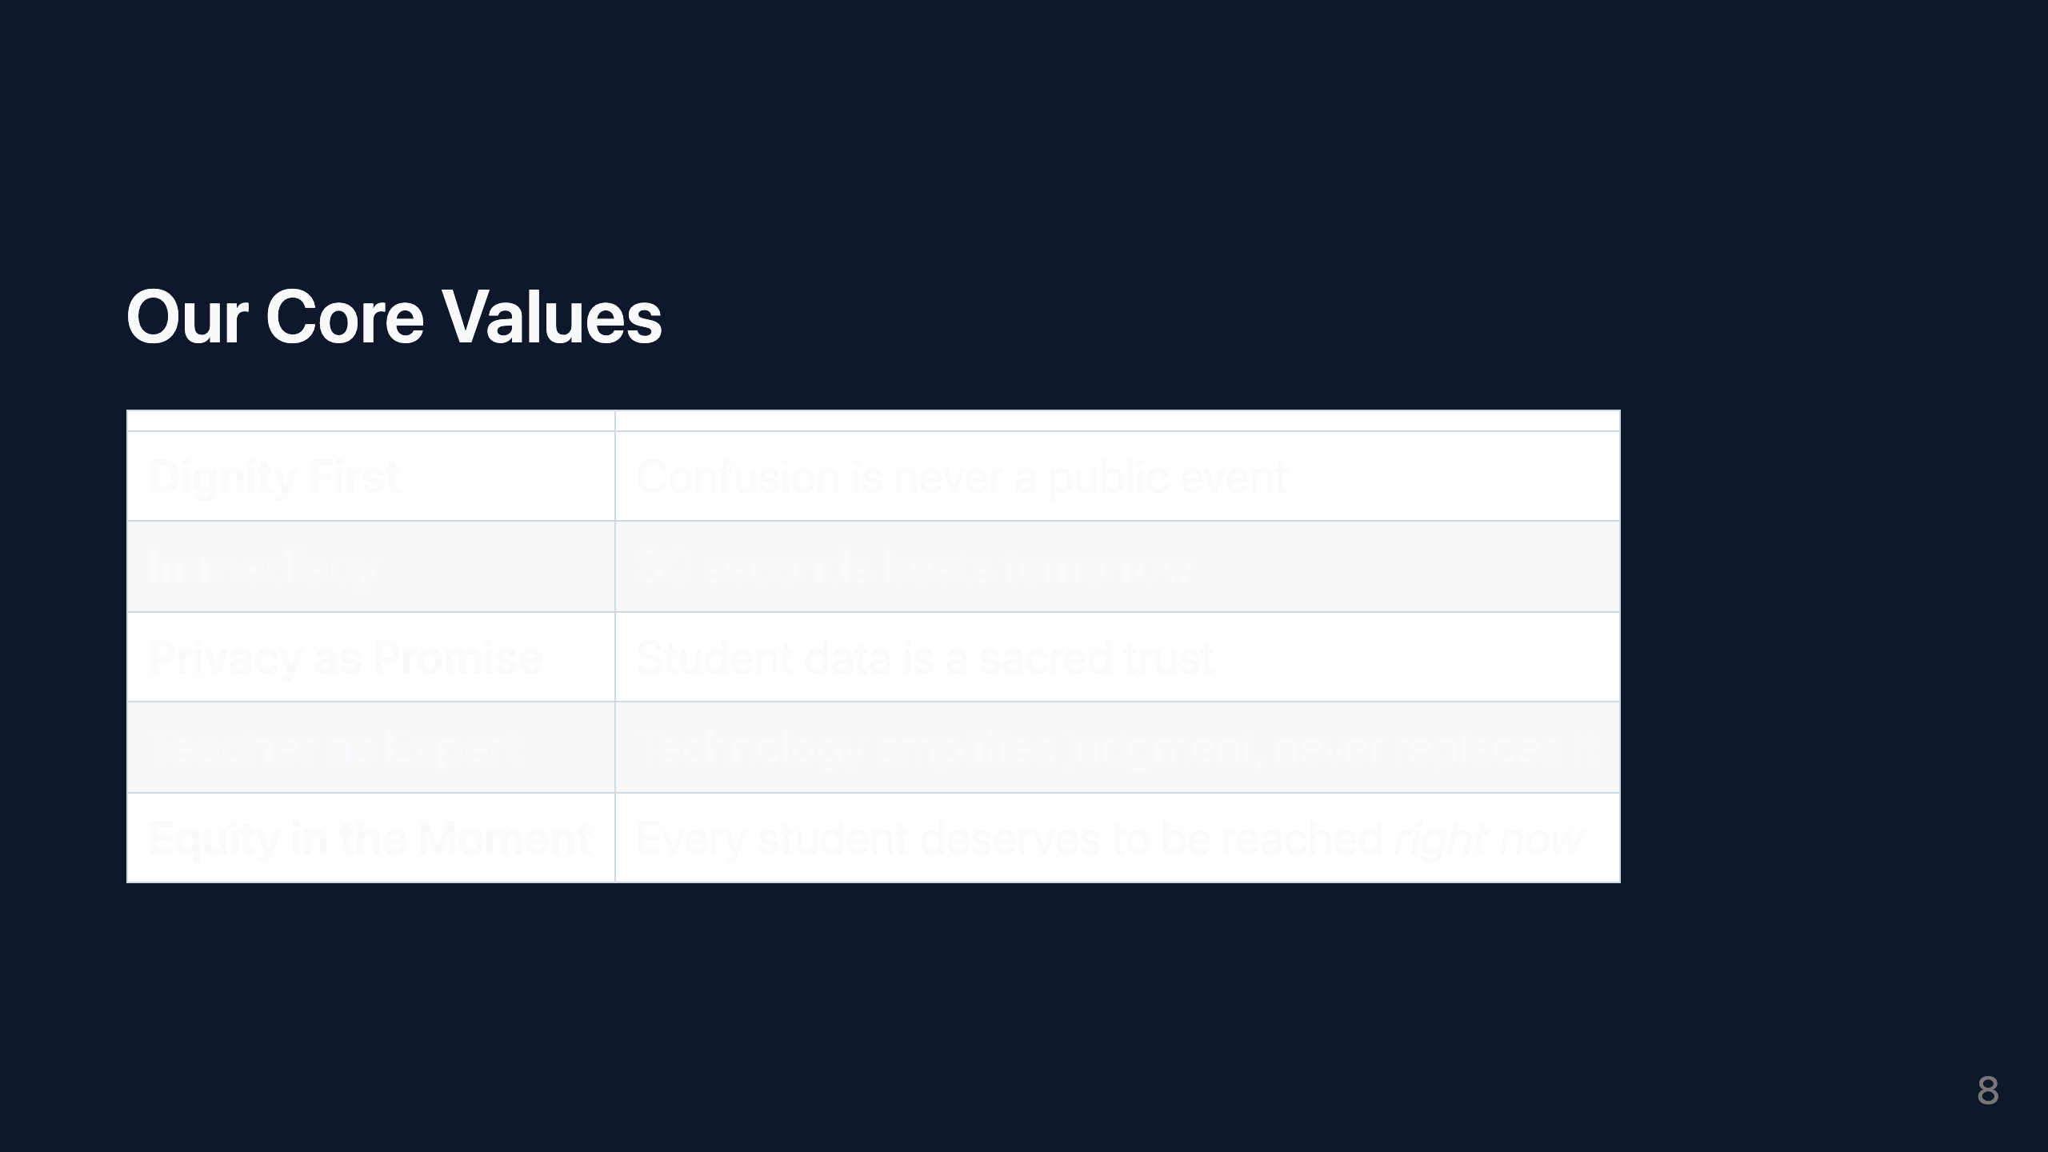
Notes:
~30 seconds. Read through briefly — these are anchors, not explanations.

Slide 9
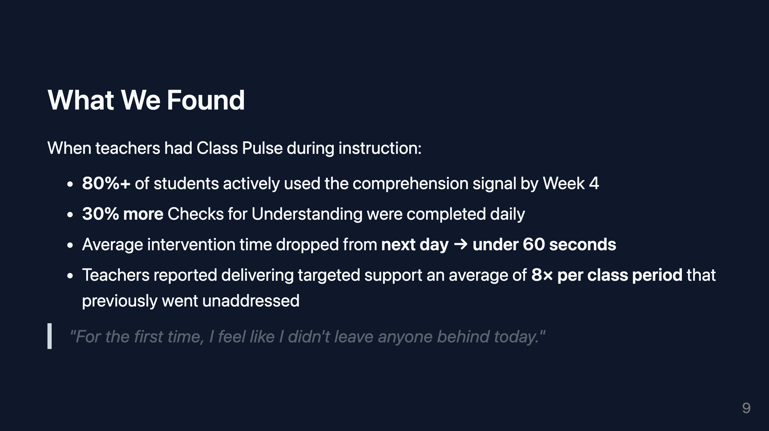
Notes:
~60 seconds. Quote last. Let it finish the slide.

Slide 10
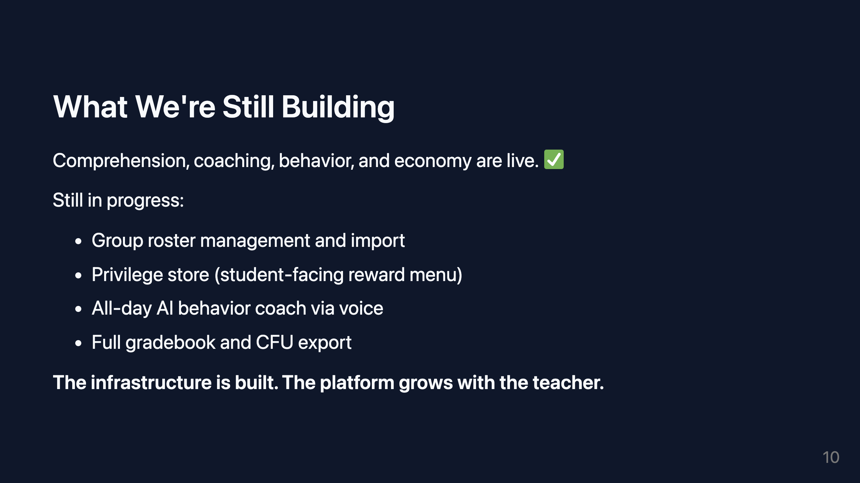
Notes:
~30 seconds.

Slide 11
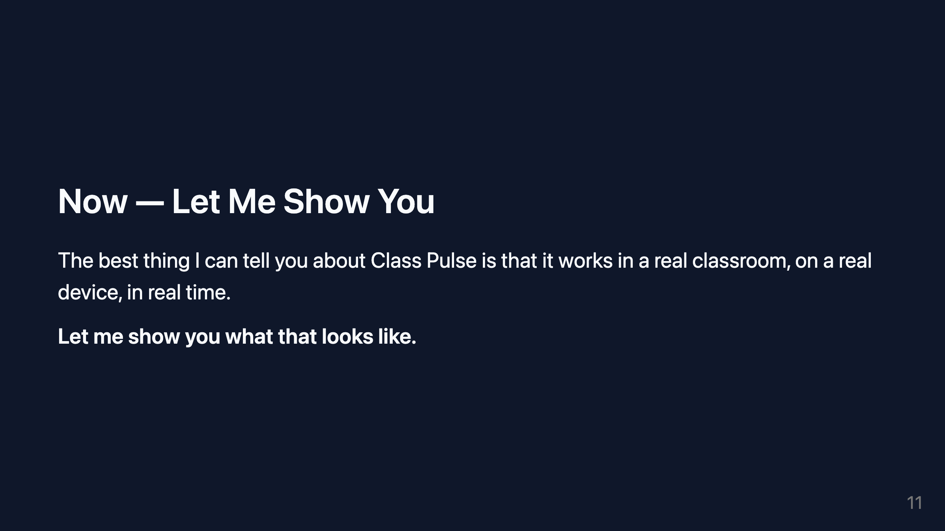
Notes:
~15 seconds. Smooth transition into live demo. Keep this slide up during demo.

Slide 12
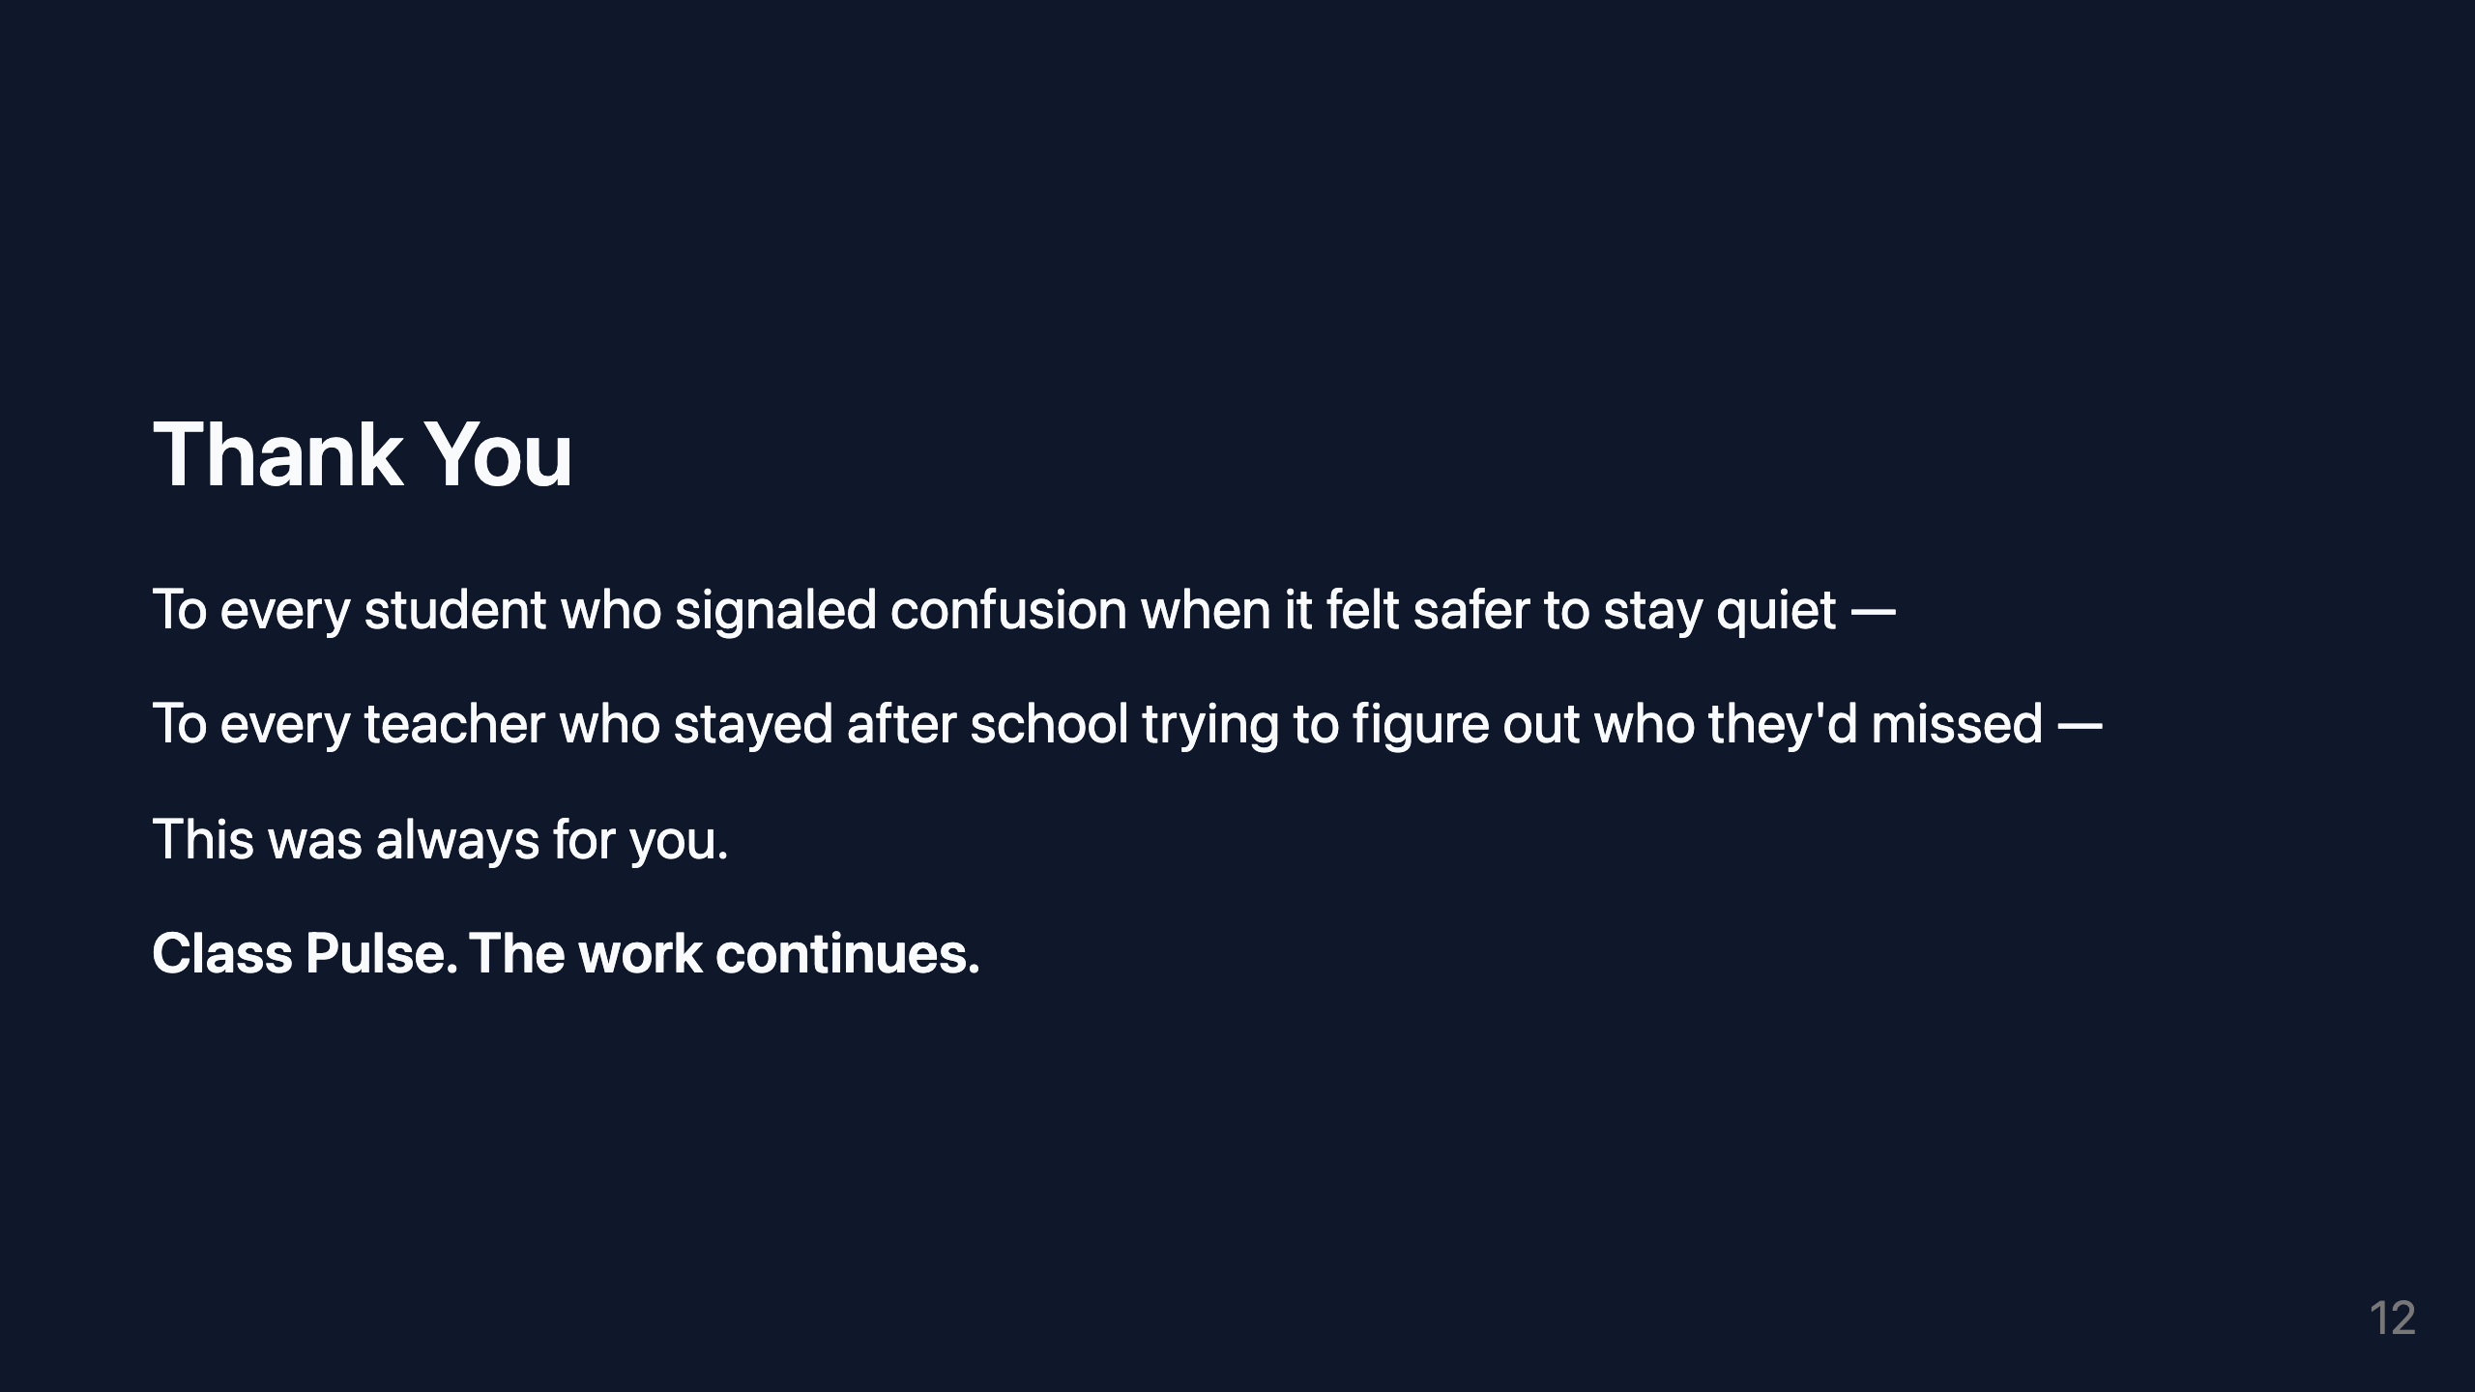
Notes:
~30 seconds. Final slide. Let it sit.

