Slide 1



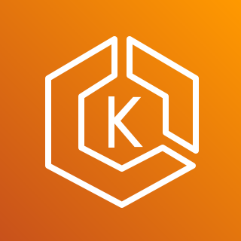








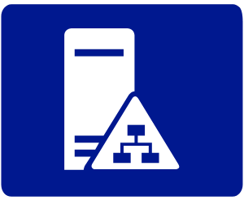


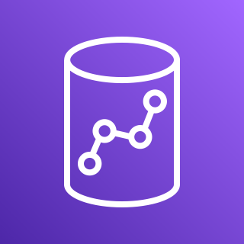

Central Account
Data Fabric solution deploys an Amazon Elastic Kubernetes (EKS) cluster, containing highly-available deployments of Immuta and Radiant Logic.
Immuta becomes the gateway for all access/querying of data sources. It maintains a metadata catalog of linked data sources, tracks updates to source schemas, and controls access to resources via an identity provider (Radiant Logic).
Radiant Logic Federated Identity service aggregates disparate identity stores.
Support for AWS Directory Service (Managed AD) and on-prem AD, as well as cert/PIV card, user/password, and IdP login.
Immuta can control access to physically disparate data sources such as on-premises databases.
Immuta has native support for many query-backed AWS data stores along with support for non-native data stores using custom blob handlers.
Immuta supports object-backed data stores such as S3 along with supporting non-native data stores using custom blob handlers.
Any tool that can connect to a query-based or object-based data source can consume Immuta policy-enforced data.
Data Fabric Security
1
1
Users
Amazon QuickSight
2
Amazon EKS
Users
Amazon SageMaker
2
3
3
Metadata
Catalog
Fingerprint
Query
Engine
Federated
Identity (FID)
4
Users
Client
(SQL/Tableau/Web)
5
Mission Account
Mgmt Account
Corporate
data center
6
4
Amazon RDS
AWS Directory Service
(Managed AD)
Active Directory
LDAP
5
7
6
7
Amazon Athena
8
On-Prem Database
8
Amazon Redshift
Amazon S3

