Slide 1










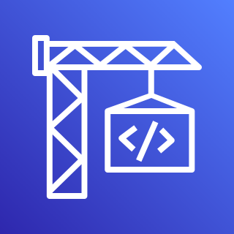


CrowdStrike
Registry
Falcon Sensor Image
Delegated Account
Child Account
Primary Region
Each Region
Lambda Role
EventBridge Rule
Custom
event bus
EventBridge Rule
New EKS Cluster
VPC
CodeBuild Role
Lambda
Deploy
CodeBuild
KPAgent
Operator
Sensor
KAC
CrowdStrike API Secret
optional mirror
EventBridge Role
Execution Role
ECR Repository

