Slide 1










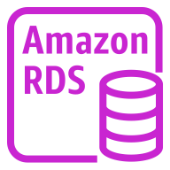


AWS Cloud
Availability Zone 1
Availability Zone 2
VPC
Public subnet
Public subnet
NAT gateway
NAT gateway
CloudWatch
Auto Scaling group
Linux bastion host
Linux bastion host
Private subnet
Private subnet
Amazon SNS
RDS cluster
Write replica
Amazon RDS
Read replica
AWS KMS

