Slide 1








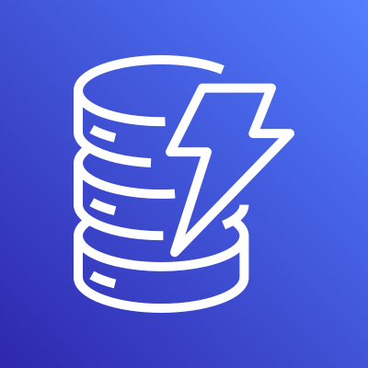







AWS Cloud
AWS Fargate
ECS Cluster
Cloud Storage Security Console Service
Event Service
Scheduled Scans & On-demand Scans
API Agent Endpoint Service
Auto Scaling Group
Run Tasks
Auto Scaling Group
Admins
Apps
Amazon Simple Notification Service
Amazon Simple Queue Service
Amazon DynamoDB
Users & Applications
All Create Events
Notifications
Event Queue
Amazon Cognito
AWS Transfer Family
Amazon CloudWatch

