Slide 1








AWS Cloud
CodePipeline
API Gateway
CodeBuild
SAM Build
CodeBuild
SAM Deploy
CodeCommit
CloudFormation
Lambda Function
S3 Build
Artifacts

Slide 2



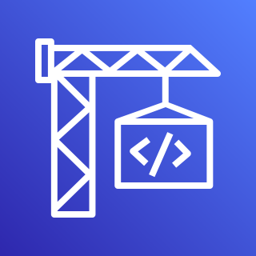









AWS Cloud
AWS CodePipeline
AWS CodeCommit
Bucket
AWS CodeBuild
AWS CodeDeploy
Template
AWS Lambda
Amazon API Gateway
AWS Identity and Access Management (IAM)
Lambda function
AWS CloudFormation
Amazon Simple Storage Service (Amazon S3)

Slide 3



AWS Cloud
AWS CodePipeline
User
GitHub Repository
AWS CodeCommit
Bucket
AWS CodeBuild
Role
AWS CodeDeploy
Template
AWS Lambda
Amazon API Gateway

Slide 4

AWS Cloud
AWS CodePipeline
Developer
GitHub Repository
AWS CodeCommit
Bucket
AWS CodeBuild
Role
AWS CodeDeploy
Template
Lambda function
Amazon API Gateway
Clients

Slide 5
AWS Cloud
AWS CodePipeline
Developer
GitHub Repository
AWS CodeCommit
S3 bucket
AWS CodeBuild
AWS Identity and Access Management (IAM)
AWS CodeDeploy
AWS CloudFormation
Lambda function
Amazon API Gateway
Clients

Slide 6
AWS Cloud
AWS CodePipeline
User
GitHub Repository
AWS CodeCommit
Bucket
AWS CodeBuild
Role
AWS CodeDeploy
AWS Lambda
Amazon API Gateway

