Slide 1

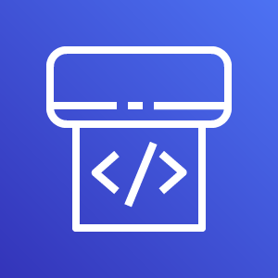
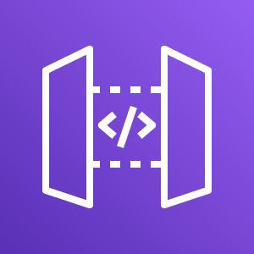
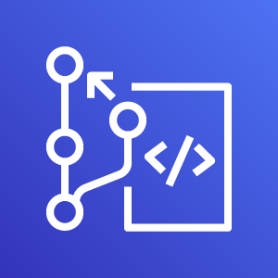
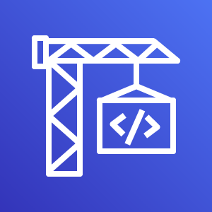

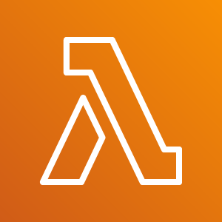

AWS Cloud
CodePipeline
API Gateway
CodeBuild
SAM Build
CodeBuild
SAM Deploy
CodeCommit
CloudFormation
Lambda Function
S3 Build
Artifacts

