Slide 1







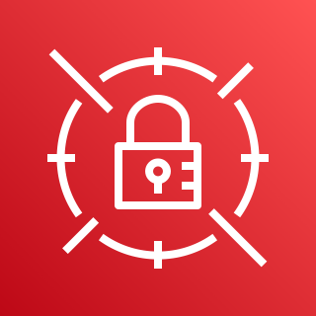


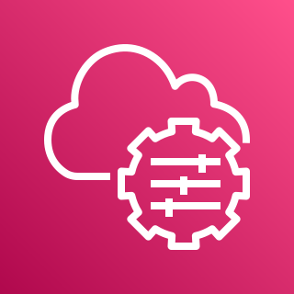
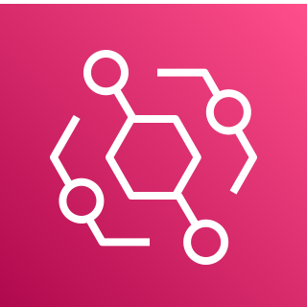
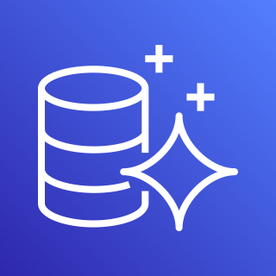
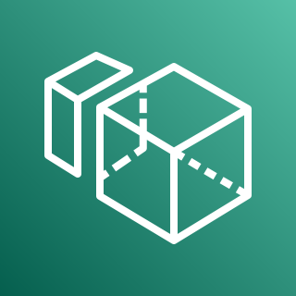
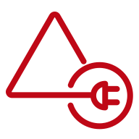
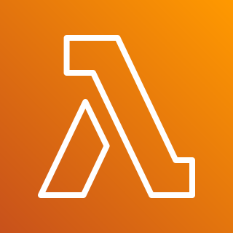
Availability Zone 1
Availability Zone 2
VPC
Public subnet
Public subnet
AWS KMS
Auto Scaling group
NAT gateway
RD Gateway
RD Gateway
NAT gateway
AWS Secrets Manager
Private subnet
Private subnet
Application Load Balancer
Auto Scaling group
Domain controller 1
(forest)
Domain controller 2
(forest)
AWS Systems Manager
RADIUS Server
RADIUS Server
AD Connector
Amazon EventBridge
Amazon Aurora
Amazon WorkSpaces
Amazon WorkSpaces
AWS Lambda

Slide 2

Availability Zone 1
Availability Zone 2
VPC
Public subnet
Public subnet
AWS KMS
Auto Scaling group
NAT gateway
RD Gateway
RD Gateway
NAT gateway
AWS Secrets Manager
Private subnet
Application Load Balancer
Private subnet
Auto Scaling group
Windows EC2
RADIUS Server
RADIUS Server
AWS Systems Manager
AWS Managed Microsoft AD
Amazon EventBridge
Amazon Aurora
Amazon WorkSpaces
Amazon WorkSpaces
AWS Lambda

Slide 3

Availability Zone 1
Availability Zone 2
VPC
Public subnet
Public subnet
AWS KMS
NAT gateway
Application Load Balancer
NAT gateway
AWS Secrets Manager
Private subnet
Private subnet
Auto Scaling group
RADIUS Server
RADIUS Server
AWS Systems Manager
Amazon EventBridge
Amazon Aurora
Amazon WorkSpaces
AWS Directory Service
Amazon WorkSpaces
AWS Lambda

