Slide 1





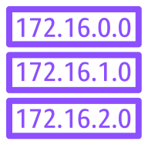



AWS Cloud
Virtual private cloud (VPC)
Security group
Availability Zone 1
Availability Zone 2
Availability Zone 3
Public subnet 1
Public subnet 2
Public subnet 3
Internet
gateway
NAT gateway 1
NAT gateway 2
NAT gateway 3
Auto Scaling
group
Route Tables
Bastion 1
Bastion 2
Private subnet 1
Private subnet 2
Private subnet 3
RHEL HA
cluster
Node 1
Node 2
Node 3

