Slide 1







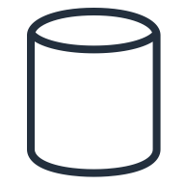

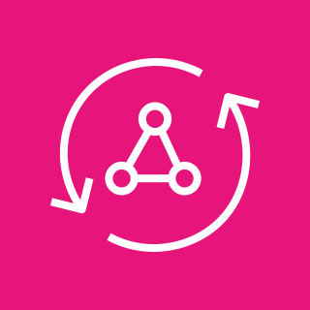

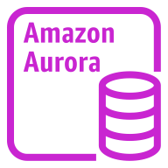

AWS Cloud
Availability Zone 1
Availability Zone 2
VPC
Public subnet
Public subnet
NAT gateway
NAT gateway
AWS Secrets Manager
Salesforce
Private subnet
Private subnet
Parameter Store
External objects
Salesforce Connect adapter for GraphQL
GraphQL resolver
Amazon Aurora instance
Amazon Aurora instance
AWS AppSync
Artifacts

