Slide 1
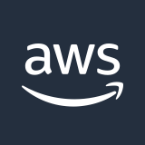




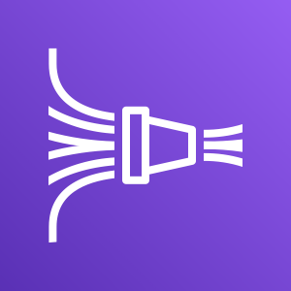





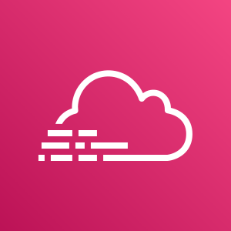
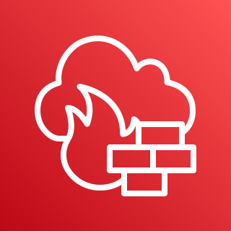

AWS Cloud
Amazon GuardDuty
Amazon CloudWatch
Lambda functions: integration
AWS WAF
Amazon Kinesis
Data Firehose
AWS Security Hub
Amazon CloudWatch
Collector and sources
Amazon VPC flow logs
Apps
AWS Config
Amazon S3
AWS CloudTrail
AWS Network Firewall
Amazon SNS

