Slide 1
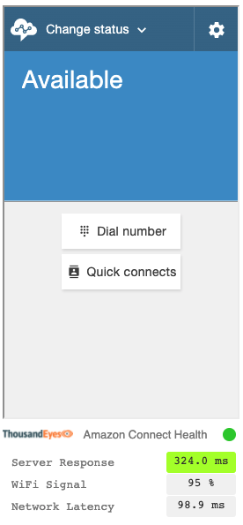








Amazon Connect Contact Control Panel (CCP)
AWS Cloud
Amazon Connect
Streams API
Amazon Connect
Lambda functions
Amazon API Gateway
Amazon S3
Amazon Connect Health widget
IAM role
End-user metrics
Endpoint Agent on end-user laptops or desktops
API

Slide 2


AWS Cloud
Amazon Connect
Streams API
Contact Control Panel
(CCP)
Amazon Connect
IAM Role
(Lambda Execution)
ThousandEyes Metrics Service
AWS Lambda Functions:
http, network, connection, agentinfo, status
Amazon Simple Storage Service (Amazon S3)
Endpoint Agents
ThousandEyes Health Widget
End User Metrics
API

