Slide 1





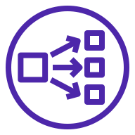


AWS Cloud
Availability Zone 1
Availability Zone 2
Availability Zone 3
VPC
Public subnet
Public subnet
Public subnet
NAT gateway
NAT gateway
NAT gateway
Bastion host
Private subnet
Private subnet
Private subnet
Network Load Balancer
OLAP & visualization service
Workbench host
Graph service
graphd0
graphd1
graphd2
Storage service
storaged0
storaged1
storaged2
EBS volume
EBS volume
EBS volume

