Slide 1
One click SaaS Serverless Integration solution using AWS Quick Starts

Slide 2
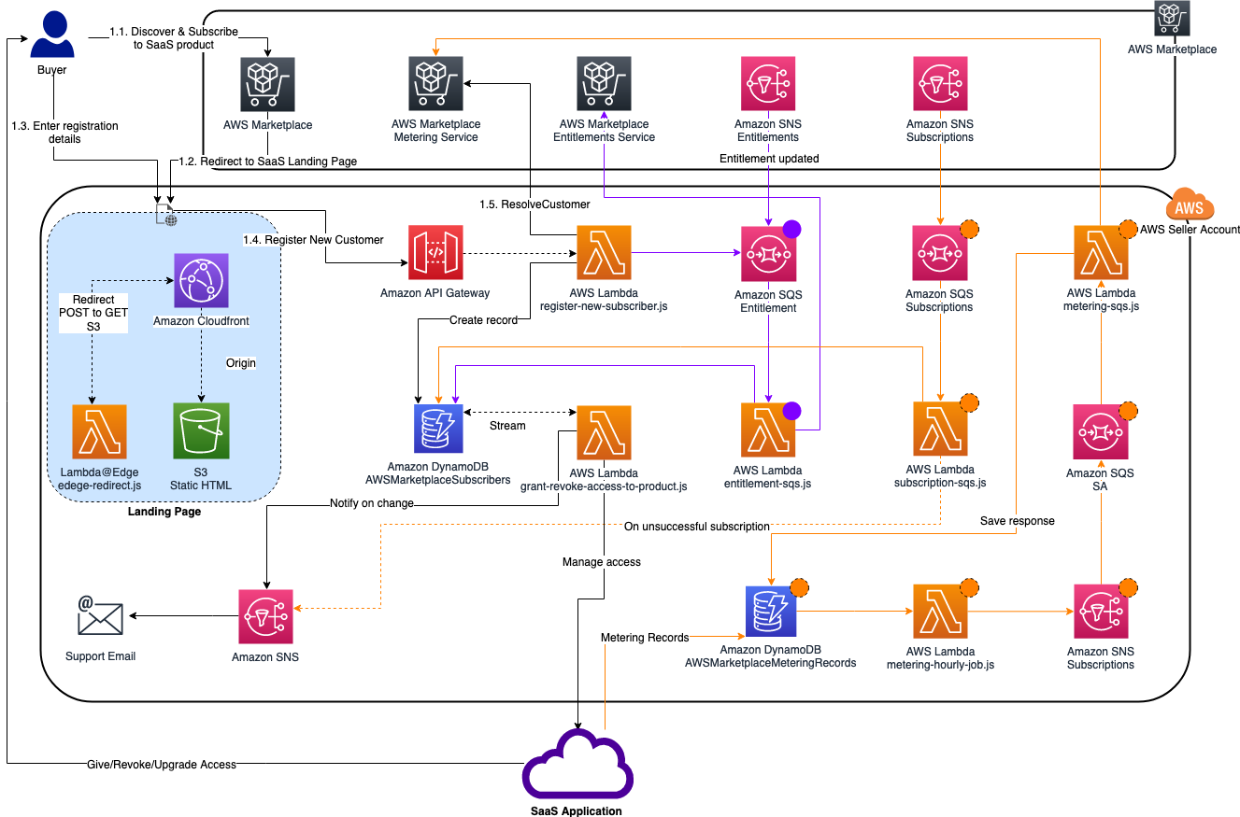
Diagram of created resources

