Slide 1
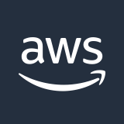
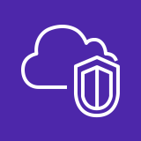



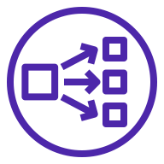






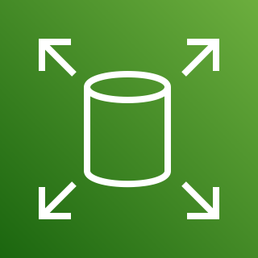
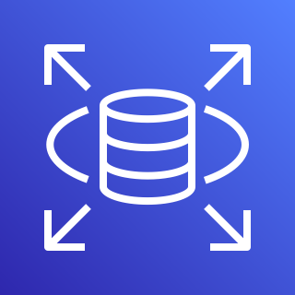
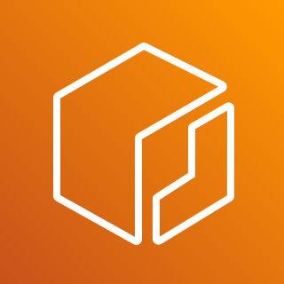
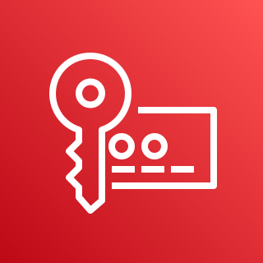
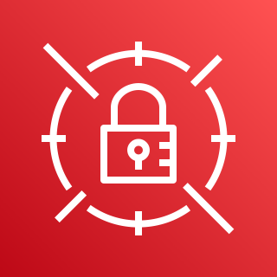
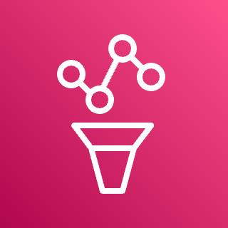

AWS Cloud
Mendix Infrastructure
Availability Zone 1
Availability Zone 2
Availability Zone 3
VPC
Public subnet
Public subnet
Public subnet
NAT gateway
NAT gateway
NAT gateway
Developers
Private Cloud Portal
Network Load Balancer
Users
Route 53 hosted zone
Private subnet
Private subnet
Private subnet
Auto Scaling group
Kubernetes nodes
Kubernetes nodes
Kubernetes nodes
Kubernetes Workload
Secured Bidirectional
Connection
Mendix Apps
Mendix Operator
Mendix Agent
Interactor
Amazon S3
Amazon EBS
Amazon RDS
Amazon ECR
AWS KMS
Secrets Manager
AWS Prometheus
CloudWatch

