Slide 1











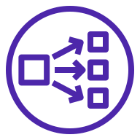










AWS Cloud
Availability Zone 1
Availability Zone 2
Availability Zone 3
AWS VPC
Kubernetes control pane
Kubernetes control pane
Kubernetes control pane
Amazon EKS
User
EKS public endpoint
Availability Zone 1
Availability Zone 2
Availability Zone 3
VPC
Public subnet
Public subnet
Public subnet
NAT gateway
NAT gateway
NAT gateway
AWS KMS
Private subnet
Private subnet
Private subnet
Users
Hosted zone
Network Load Balancer
Auto Scaling group
Kubernetes nodes
Kubernetes nodes
Kubernetes nodes
AWS Secrets Manager
Amazon Route 53
Elastic Load Balancing
Amazon S3
Amazon EBS
Amazon RDS
Amazon ECR

