Slide 1
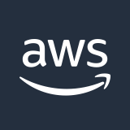





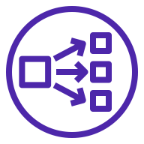




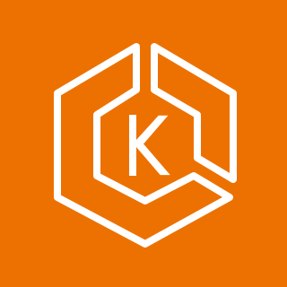


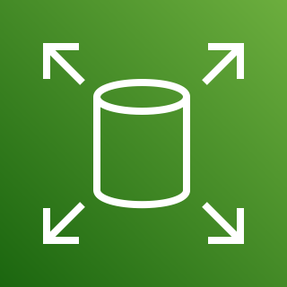
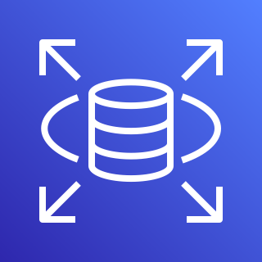
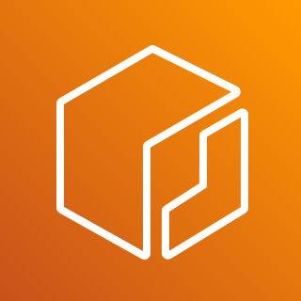
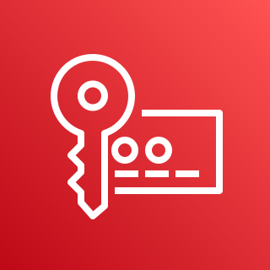
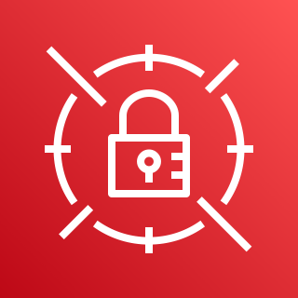


AWS Cloud
Mendix Infrastructure
Availability Zone 1
Availability Zone 2
Availability Zone 3
VPC
Public subnet
Public subnet
Public subnet
Private Cloud
Portal
NAT gateway
NAT gateway
NAT gateway
Developers
Network Load Balancer
Private subnet
Private subnet
Private subnet
Auto Scaling group
Users
Route 53 hosted zone
Kubernetes nodes
Kubernetes nodes
Kubernetes nodes
EKS Workload
Secured Bidirectional
Connection
Interactor
Mendix Apps
Mendix Operator
Mendix Agent
Amazon S3
Amazon EBS
Amazon RDS
Amazon ECR
AWS KMS
Secrets Manager
AWS Prometheus
CloudWatch

