Slide 1





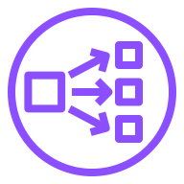




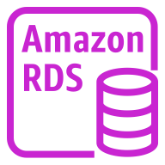
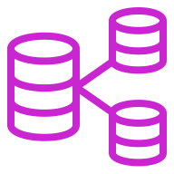
AWS Cloud
Availability Zone 1
Availability Zone 2
Availability Zone 3
VPC
Public subnet
Public subnet
Public subnet
Amazon S3
NAT gateway
Network Load Balancer
NAT gateway
Network Load Balancer
NAT gateway
Private subnet
Private subnet
Private subnet
AWS IAM
NAT gateway
Network Load Balancer
NAT gateway
Network Load Balancer
NAT gateway
Auto Scaling group
Environment, data lake, and data hub cluster nodes
Environment, data lake, and data hub cluster nodes
Environment, data lake, and data hub cluster nodes
Amazon RDS group
Amazon RDS instance
Amazon RDS instance
Multi-AZ DB cluster

