Slide 1





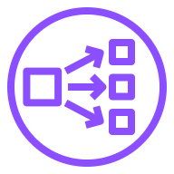




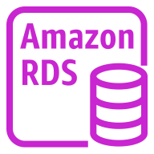
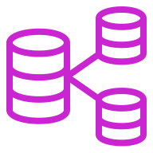
AWS Cloud
Availability Zone 1
Availability Zone 2
Availability Zone 3
VPC
Public subnet
Public subnet
Public subnet
Amazon S3
Public NAT gateway
Public Network Load Balancer
Public NAT gateway
Public Network Load Balancer
Public NAT gateway
AWS Identity and Access Management (IAM)
Private subnet
Private subnet
Private subnet
Private NAT gateway
Private Network Load Balancer
Private NAT gateway
Private Network Load Balancer
Private NAT gateway
Environment and Data Lake cluster nodes
Environment and Data Lake cluster nodes
Auto Scaling group
Environment and Data Lake cluster nodes
Amazon RDS instance
Amazon RDS instance
Multi-AZ DB cluster

