Slide 1
Introduction to Deep Learning on Text and Images
Application of Deep Learning to Text and Image Data
Module 1 – Lesson 0

Slide 2
Today’s activities
Agenda and course overview
Key ML concepts review
Regression
Optimization
Regularization
Text and data representation

Slide 3
Agenda and course overview

Slide 4
Course overview
Modules | Topics
Introduction to Neural Networks | Layers and activation functions, neural network learning, neural network examples that use PyTorch, neural network engineering
Natural Language Processing | Common natural language processing (NLP) domains, text preprocessing and vectorization, word embeddings, recurrent neural networks (RNNs), application examples, introduction to transformers examples
Computer Vision | Common computer vision (CV) domains, convolution concepts, convolutional neural networks (CNNs), modern neural network architectures, fine-tuning and transfer learning

Slide 5
Key ML topics review
This lesson reviews key ML concepts that are important for neural networks:
Linear regression, logistic regression, and the associated evaluation metrics
Optimization and gradient descent
Overfitting and regularization
Text and image representation

Slide 6
Regression review

Slide 7
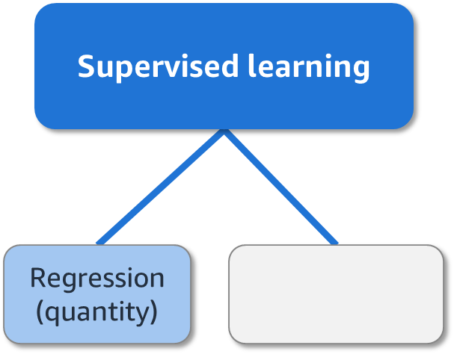
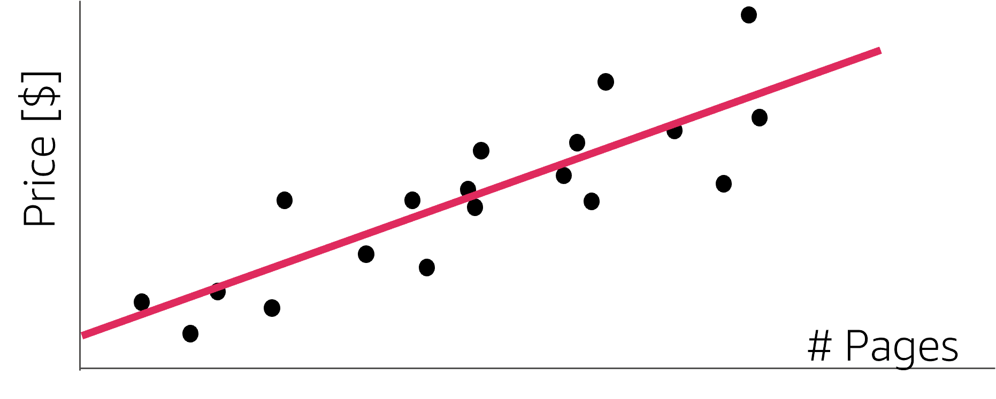
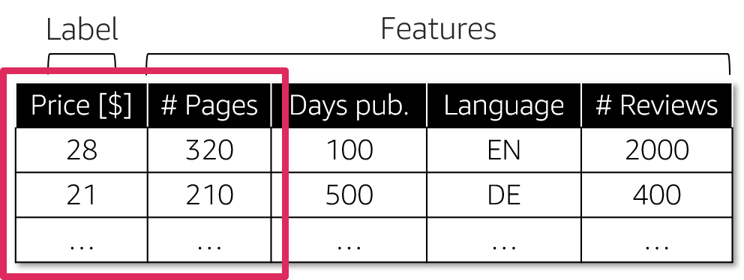
Supervised learning: Regression
Example:
Linear regression
Notes:
~Dev note: Slide is from Machine Learning through Application course, mod 1, lesson 2
~Alt text – scatter plot: Scatterplot of data points with a line of best fit. See details in notes.
~Alt text – table: Table related to the scatterplot. See detail in notes.
~Alt text – supervised learning: Regression (quantity).
~
Image 1 description: Scatterplot of data points with a line of best fit. Price is the y axis, and number of pages is the x axis. The line slopes from lower price and fewer pages in the bottom-left corner toward higher price and more pages in the upper-right corner. End description.
Image 2 description: Table with five columns: price, number of pages, days published, language, and number of reviews. Price is noted as the label. The remaining columns are marked as features. Price and number of pages are circled to indicate that the data points on the scatterplot are based on these columns. End description.
Regression is a popular type of supervised learning problem. Regression aims to learn relationships and correlations between input features and a continuous output variable, with the goal to predict the continuous output variable. For example, the price of a book might depend on a certain combination of the number of pages, days since being published, and language.
The slide shows a simple linear regression model. If you assume that the relationship between the sale price of a book and the number of pages is linear (in other words, as the number of pages increases, the price of the book increases), the line of best fit is a straight line.
Some ML algorithms that you can use to build regression models include linear regression, K-nearest neighbors (KNN), decision trees, and neural networks.

Slide 8
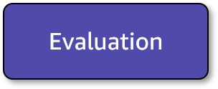
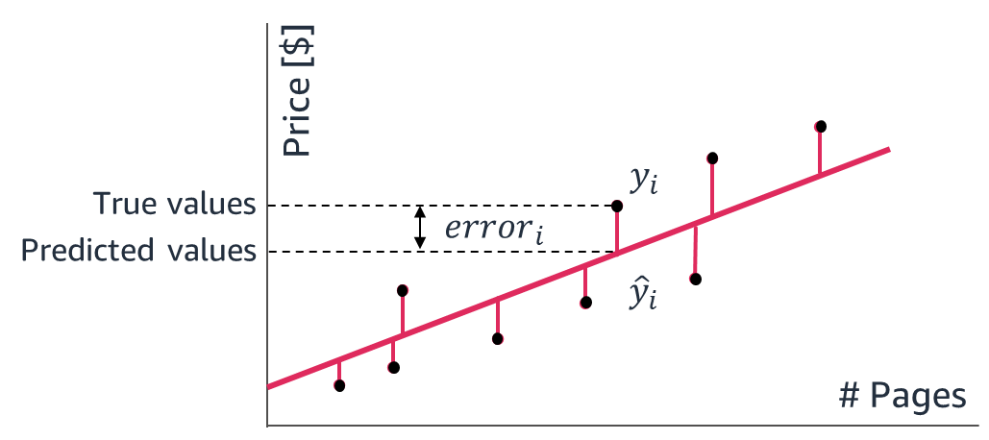
Evaluation: Regression step 1
Find the distance (squared, absolute, others) between your prediction and labels.
Notes:
~Dev note: Slide is from Machine Learning through Application course, mod 1, lesson 4
~Alt text – graph: Graph of price compared to number of pages, with a line of best fit. See details in notes.
~
Image description: Graph of price compared to number of pages with a line of best fit (predicted value). The error for each data point (true value) is shown as a vertical line between the data point and the line of best fit. End description.
In ML, model evaluation is the process of assessing the performance of a trained model on a set of validation data. This involves comparing the model's predictions or decisions to ground truth labels or reference data, and using various metrics to quantify the model's performance.
Errors are the differences between the target values (y_i , which is represented on the graph by black dots) and the values that were predicted with the regression model (y_hat_i, which are the predictions that sit on the regression line).
Four regression metrics look at the overall model errors, and the next slide will describe these metrics. You can look at these errors as absolute values or squared values (so that the negative errors can contribute meaningfully to the overall sum).

Slide 9
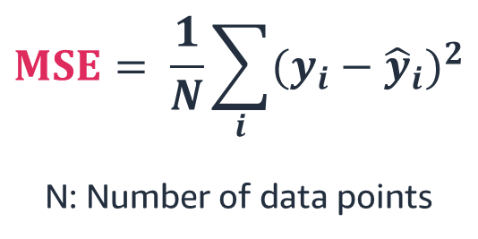
Evaluation: Regression step 2
Aggregate up into 1 value across the whole dataset to give the mean error across squared distances.
$$MSE= \frac{1}{N}\sum_{i}{{(y_{i}−{\hat{y}}_{i})}^{2}}$$
N: Number of data points
Notes:
~Dev note: Slide is from Machine Learning through Application course, mod 1, lesson 4
~Equation
~
The first metric, mean squared error (MSE), is the average of the squared errors. Because MSE squares the error differences, it penalizes even the smallest errors, leading to overestimation of how bad the model is.
Another metric is root mean square error (RMSE), which is the square root of the MSE. This is widely used for regression tasks. While MSE reports errors in units squared, RSME reports errors in the original units, which makes it easier to interpret the error.
You can also look at the mean absolute error (MAE), which is the average of the absolute differences between the target values and the values that the model predicted. Being a linear score, all the individual differences are weighted equally, so MAE is more robust to outliers and does not penalize the errors as extremely as MSE.
Finally, you can use R², which helps compare the regression model with a constant average baseline model (it predicts averages for all data points). This metric tells how much better the regression is compared to the baseline model.
With other metrics, lower scores are desirable; R² is different. Assuming that the ML model will always perform better than the baseline (average) model, R² will take values between 0 and 1. If the model didn’t improve at all over the baseline model and produced the same errors, then R² is 0 (lowest). For the best regression model, which doesn’t have errors between the predicted and actual values (MSE = 0), R² will be 1 (highest).
While MSE is the most preferred metric for regression tasks, as with other areas of ML, there isn’t a clear choice of which metric to use. Best practice is to monitor a few, depending on the business problem and the dataset.

Slide 10
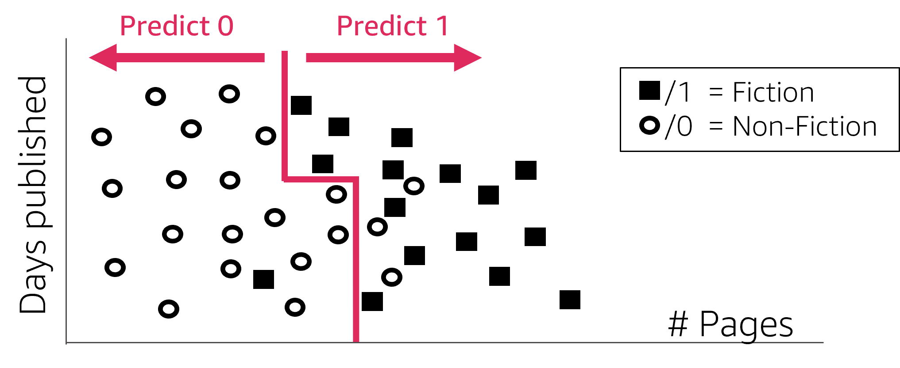
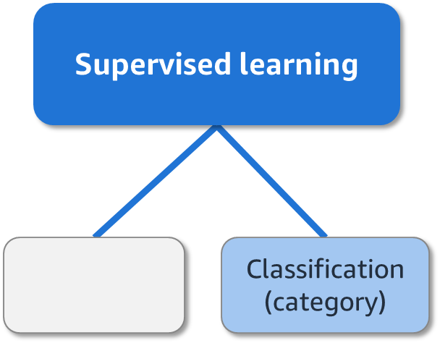
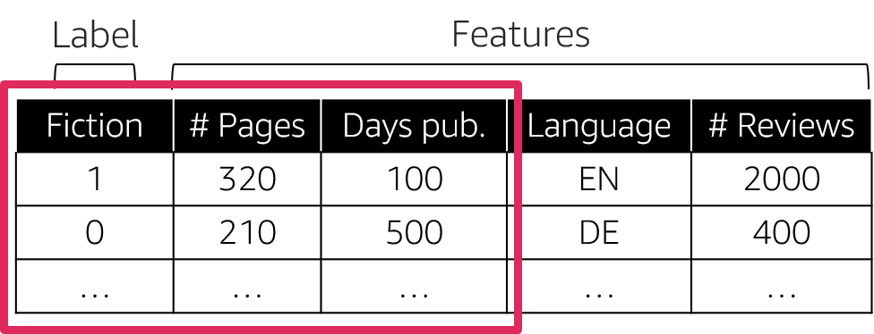
Supervised learning: Classification
Example:
Decision trees
Notes:
~Dev note: Slide is from Machine Learning through Application course, mod 1, lesson 2
~Alt text – chart: Scatterplot with a mix of circles and squares. See details in notes.
~Alt text – supervised learning: Classification (category).
~Alt text – table: Table with five columns related to the scatterplot. See detail in notes.
~
Image 1 description: Scatterplot with a mix of circles and squares. Days published is the y axis, and number of pages is the x axis. The circles represent nonfiction, and the squares represent fiction. The data is divided into multiple rectangular regions that represent each category. The left region is mostly circles, and the right region is mostly squares. The regions represent the way the model classifies data in this dataset. End description.
Image 2 description: A table with five columns: fiction, number of pages, days pub., language, and number of reviews. Fiction is noted as the label, and the values in the fiction column are 0 for nonfiction or 1 for fiction. The remaining columns are marked as features. Fiction, number of pages, and days pub are circled to show that the data on the scatterplot is based on these three columns. End description.
If you’d rather know whether a particular book is fiction or nonfiction, that would be a classification problem. Classification aims to learn the relationships between input features and an output variable, with the scope of separating the data into classes or groups.
The main difference between regression and classification is that the output variable in regression is numerical (or continuous), while the output variable for classification is categorical (or discrete).
The example on the slide shows a binary classification scenario—that is, there are only two classes.
Some ML algorithms that you can use to build classification models are logistic regression, support vector machines, KNN, decision trees, and neural networks.

Slide 11
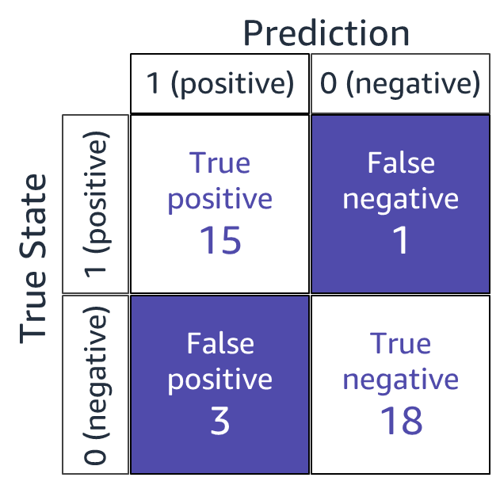
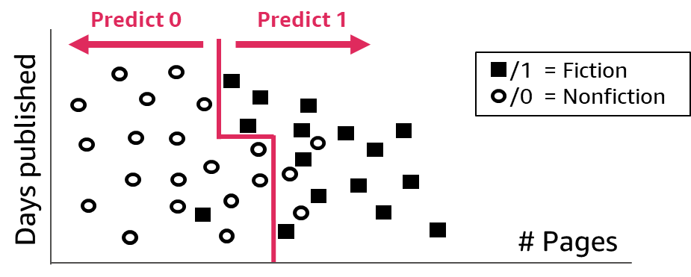
Evaluation: Classification step 1
Compare the true state to the predicted state.
Notes:
~Dev note: Slide is from Machine Learning through Application course, mod 1, lesson 4
~Alt text – matrix: Confusion matrix that shows 15 true positives, 1 false negative, 3 false positives, and 18 true negatives.
~Alt text – scatterplot: Scatterplot. See details in notes.
~
Image description: Scatterplot with a mix of circles and squares. Days published is the y-axis, and number of pages is the x-axis. The circles represent nonfiction books, and the squares represent fiction books. The data is divided into multiple rectangular regions that represent each category. The left region is mostly circles, and the right region is mostly squares. The regions represent the way the model classifies data in this dataset. End description.
How do you evaluate a classification model? You can judge the performance of the model and its associated errors by examining correctly classified cases compared to incorrectly classified cases.
Consider a binary classification task to determine the genre of a book. You can compare the predicted results to the known values. Mark any correct prediction as true and any incorrect prediction as false. Record the results in a confusion matrix (the name reflects that the classifier is sometimes confused and makes mistakes).
In this binary classification example, the matrix has two rows and two columns. The columns represent the predicted class labels, and the rows represent the actual class labels. Each cell contains the number of predictions made by the classifier that fall into that cell.
This matrix makes it easier to observe relationships between the classifier outputs, and examining the confusion matrix usually indicates whether the classifier is bad or good. In this case, the classifier seems to have done a good job of assigning most data points to their correct classes. A perfect classifier would correctly predict all cases, so high numbers would stay on the diagonal that covers true positive and true negative areas and nothing would fall off this diagonal into the false/error tiles.

Slide 12
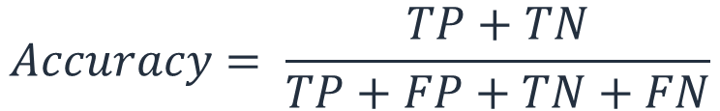
Evaluation: Classification step 2
Aggregate up into 1 value across the whole dataset by creating ratios. One example ratio is accuracy (all correct predictions over the total number of predictions).
$$Accuracy= \frac{TP+TN}{TP+FP+TN+FN}$$
Notes:
~Dev note: Slide is from Machine Learning through Application course, mod 1, lesson 4
~Equation
~
While the confusion matrix contains all information of the outcomes of a classifier, it’s rarely used for reporting results because it’s difficult to compare and discuss. Instead, some overall numerical scores are extracted from the confusion matrix.
To calculate the accuracy of an ML model on a training set or validation set, you can use the following formula:
accuracy = (TP + TN) / (TP + FP + TN + FN)

Slide 13
Optimization review

Slide 14
Optimization in ML
When you build and train an ML model, you hope for the following:
However, the reality is usually as follows:
Difference = error
Goal: Train more until the error gets as small as possible!
Notes:
~Dev note: Slide is from Machine Learning through Application course, mod 2, lesson 4
~Alt text – features-rules-target: Flowchart of the ideal result for an ML model where features are used to create rules that output the target value.
~Alt text – features-rules-prediction: Flowchart of the real result for an ML model where features are used to create rules that output a prediction.
~Alt text – arrow: Arrow indicates a difference, or error, between the target and predicted value.
~
Every ML model aims to take in the model features and match the model target. In reality, almost all ML models take in the model features and make model predictions that rarely match the model target exactly. Some error occurs.
The key focus of ML is learning better models where the overall model error gets smaller—ideally, as small as possible!

Slide 15
Review: The role of the loss function in optimization
The loss function (also called the cost or objective function) plays an important role in the optimization process.
Because it expresses the overall model error, the optimization process try to reach the minimum value
Loss functions are used in neural networks in the same way that they are used for the classical ML linear regression model:
Measure model predictions against actual labels to evaluate how well the model is performing.
Measure the optimization that is applied during the learning process.
Notes:
To understand how the loss function is applied in neural networks, let's briefly review how it works in other areas of ML.

Slide 16
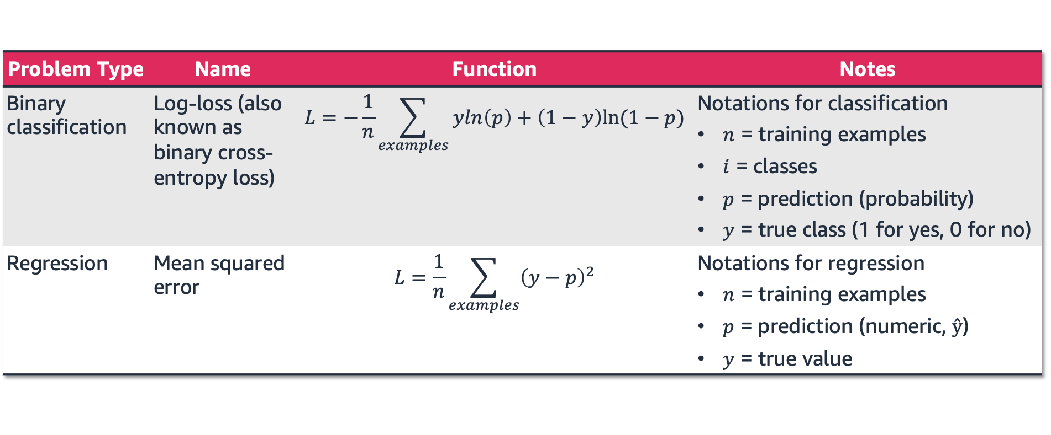
Review: Common loss functions
Recall the loss functions that you have learned so far.
Problem Type | Name | Function | Notes
Binary classification | Log-loss (also known as binary cross-entropy loss) | $$L=−\frac{1}{n}\sum_{examples}{yln\left(p\right)+\left(1−y\right)ln⁡(1−p)}$$ | Notations for classification $n$ = training examples $i$ = classes $p$ = prediction (probability) $y$ = true class (1 for yes, 0 for no)
Regression | Mean squared error | $$L=\frac{1}{n}\sum_{examples}{{\left(y−p\right)}^{2}}$$ | Notations for regression $n$ = training examples $p$ = prediction (numeric, $ŷ$) $y$ = true value
Notes:
For binary classification problems: The logarithmic loss function is a good choice because it outputs values in the range (0,1), which can be interpreted as the probability for each class. For example, an output value of 0.89 suggests an 89 percent chance that the data point is class 1 and an 11 percent chance of being class 0.
For regression: A good choice for an output activation function is the linear function, as seen with linear regression, or the rectified linear unit (ReLU) if negative values are not of interest.

Slide 17
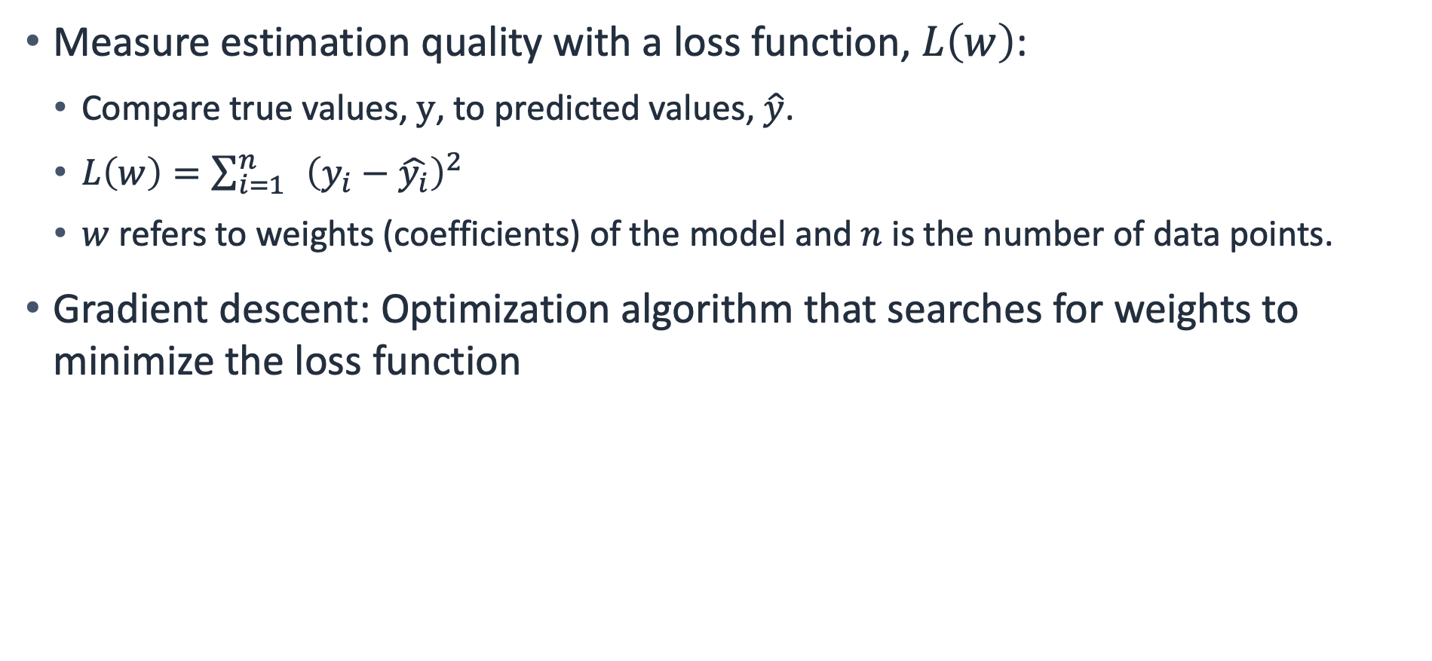
Review: Loss functions and gradient descent
Measure estimation quality with a loss function, $L\left(w\right)$:
Compare true values, $y$, to predicted values, $\hat{y}$.
$L\left(w\right)=\sum_{i=1}^{n}{ }{\left(y_{i}−\hat{y_{i}}\right)}^{2}$
$w$ refers to weights (coefficients) of the model and $n$ is the number of data points.
Gradient descent: Optimization algorithm that searches for weights to minimize the loss function
Notes:
Remember: To measure the estimation quality of a network, you compare the true values, y, to the predicted values, y_hat, by defining a loss function, L(w).

Slide 18
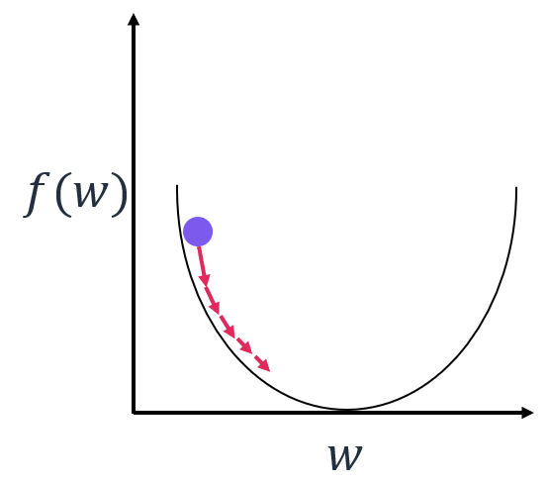
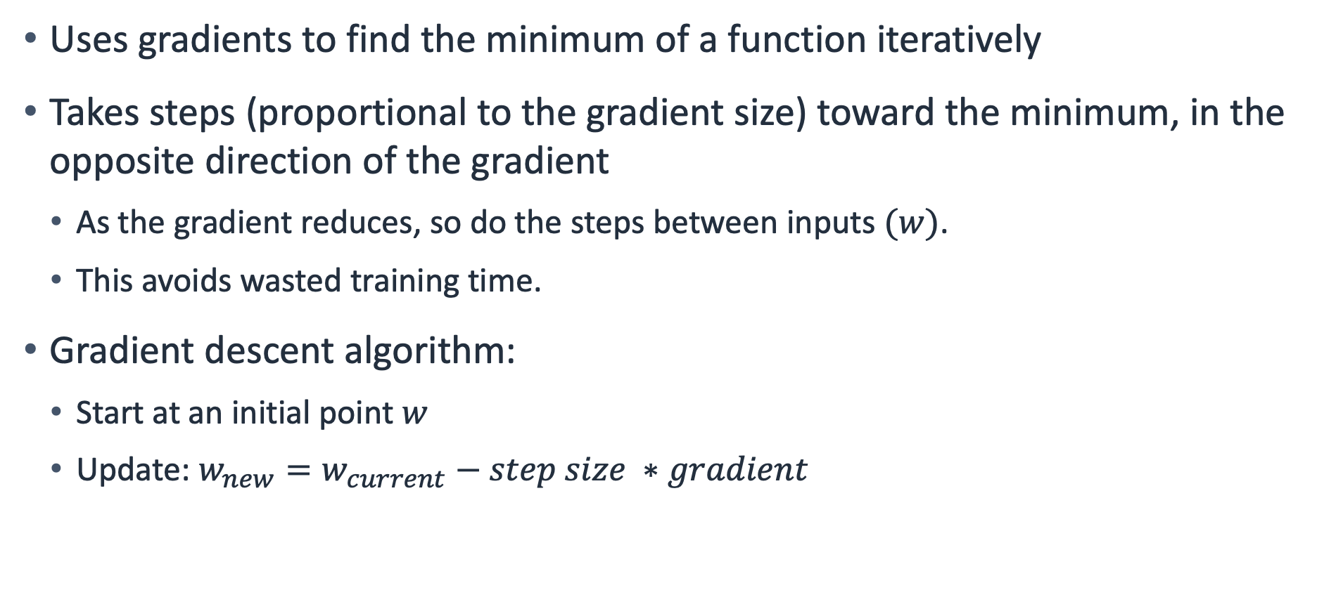
Review: Gradient descent method
Uses gradients to find the minimum of a function iteratively
Takes steps (proportional to the gradient size) toward the minimum, in the opposite direction of the gradient
As the gradient reduces, so do the steps between inputs $(w)$.
This avoids wasted training time.
Gradient descent algorithm:
Start at an initial point $w$
Update: $w_{new}=w_{current}−step size ∗gradient$
Notes:
~Dev note: Slide is from Machine Learning through Application course, mod 2, lesson 4
~Alt text: Graph that shows how the gradient descent algorithm takes small steps toward the function’s local minimum.
~w_{new} = w_{current} - step\_ size * gradient
~
To summarize, this is the gradient descent method. It uses gradients to find the minimum of a function iteratively. Specifically, you take steps that are proportional to the gradient size toward the minimum—in the opposite direction of the gradient.
Gradient descent algorithm: From any initial point w (presumably not at the minimum so the gradient isn’t zero), move toward the minimum. Update the w by small or large steps in the opposite direction of the gradient.
The size of the update is controlled by the step size parameter, also known as the learning rate. If the step size is too small, the algorithm might take a long time to converge or might never reach the global minimum.
More complicated scenarios can also occur. For example, when the step size is too large, the function might jump back and forth over the minimum and never converge.

Slide 19
Regularization review

Slide 20
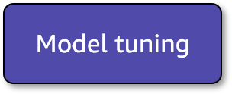
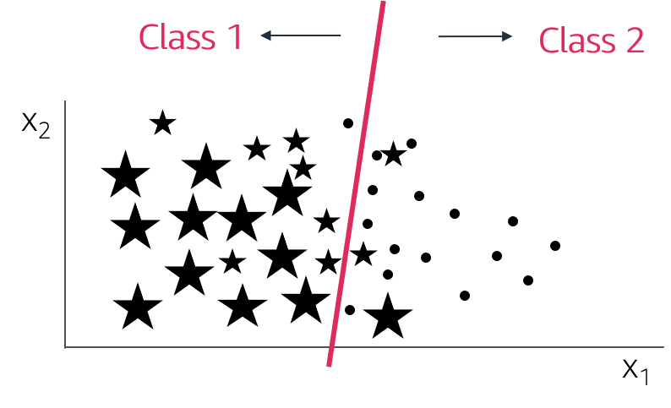
Review: Underfitting
Underfitting: The model isn’t good enough to describe the relationship between the input data (x₁, x₂) and output y: {Class 1, Class 2}.
The model is too simple to capture important patterns of the training data.
The model will perform poorly on training data and validation (or test) data.
Corresponding to high bias, results show a systematic lack of fit in certain regions.
Notes:
~Dev note: Slide is from Machine Learning through Application course, mod 1, lesson 4
~Alt text: Data points from two different classes are plotted, with a linear classifier that separates the two classes.
~
Low scores on the training dataset (high regression errors, R² that is negative or close to zero, or classification metrics close to 0) are indicators that the model didn’t learn much. It is not fit to do the task it is training for. The model is underfitting.
This means that the model did not capture the important patterns in the training dataset. An underfitting model does not perform well during training and is not expected to generalize to new data.
Adjusting model hyperparameters could help to address overfitting. You might also need to return to the data processing or feature engineering steps in the lifecycle. Sometimes, switching to another ML algorithm altogether is a better solution.

Slide 21
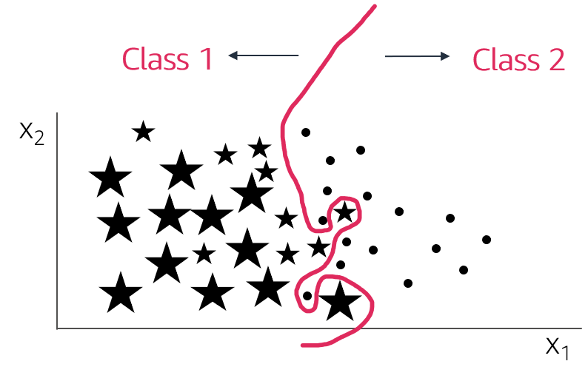
Review: Overfitting
Overfitting: The model memorizes or imitates training data, and fails to generalize well on new “unseen” data (test data).
The model is too complex and picks up noise instead of the patterns of the training data.
The model will perform well on training data but poorly on validation (or test) data.
Corresponding to high variance, small changes in the data lead to big result changes.
Notes:
~Dev note: Slide is from Machine Learning through Application course, mod 1, lesson 4
~Alt text: Data points from two different classes are plotted, with a complex classifier that separates the two classes.
~
At the other extreme, and more common in ML, is when the model works well on the training dataset but doesn’t work with the validation or test dataset.
How can this be? The model learns everything about the training data, including every detail and noise in the training data, but this can negatively impact the performance of the model on future data. All those details and noise that the model picked from the training data as rules might not apply to new data. The model didn’t find generalizable patterns, so the model might not be able to generalize.
This describes the trickiest but most common problem in ML: overfitting.
Several techniques are available to lessen the chance of, or amount of, overfitting. One method is to reduce the generalization gap that is observed between performance scores on training and validation datasets. At the very least, you need to ensure that you train and validate model performance on different datasets.

Slide 22
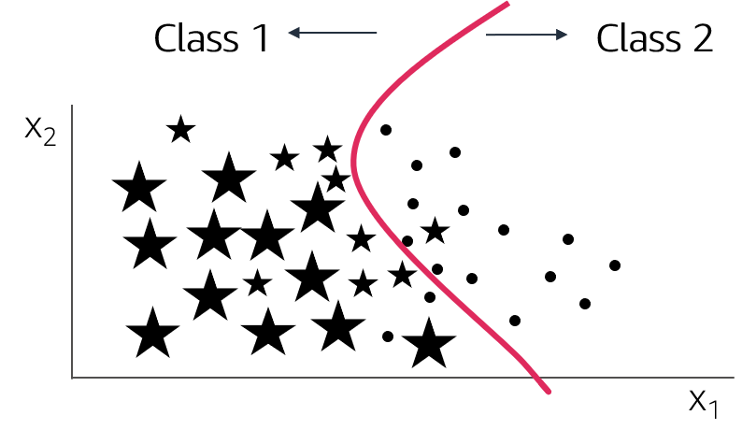
Review: Appropriate fitting
Appropriate fitting: The model captures the general relationship between the input data (x₁, x₂) and output y: {Class 1, Class 2}.
The model isn’t too simple or too complex.
The model picks up the underlying relationship rather than noise in the training data.
The model will perform well enough on training data and validation (or test) data.
Bias-variance trade-off. Too simple model has high bias, too complex has high variance.
Notes:
~Dev note: Slide is from Machine Learning through Application course, mod 1, lesson 4
~Alt text: Data points plotted. See details in notes.
~
Image description: Data points from two different classes are plotted. A curve separates them well (most classes are on the correct side of the line). End description.
Ideally, you want to build ML models that perform somewhere in between the two extremes of underfitting and overfitting. This ideal state is what a good (appropriate) fit would be.
To get an appropriate fit, you need to compromise on model performance on the training set so that the model pays less attention to the noise in the dataset and concentrates more on the patterns that can be generalized. This will help the model to successfully make predictions on future unseen data samples.
The validation set is helpful for the following reasons:
Building models on the training set and validating on the validation set
Monitoring performance metrics for validation in particular
Aiming for the model that performs “good enough” on both
Capturing the model that gives the best validation performance
Other than cross-validation, you can use many other ML techniques and ML algorithms to find appropriate-fit models. These techniques and algorithms include the following:
Early stopping: When you train an ML model iteratively, you can measure how well each iteration of the model performs. Until a certain number of iterations, new iterations improve the model. However, after that point, the model’s ability to generalize can weaken as it begins to overfit the training data.
Regularization: Regularization refers to a broad range of techniques for artificially forcing your model to be simpler.
Ensembling: Ensembles are ML methods to combine predictions from multiple separate models.

Slide 23
Regularization
Regularization helps you train ML models that generalize better beyond their training datasets.
It’s used to reduce overfitting.
The appropriate fitting is where the model can learn the patterns that are present in the training data without memorizing noise that is always present in datasets.
Notes:
Neural networks are prone to overfitting. Adding more layers and increasing the number of neurons in the layers can lead to overfitting faster.
Three methods to prevent overfitting:
Early stopping
Weight decay
Dropout

Slide 24
Recall text and data representation

Slide 25
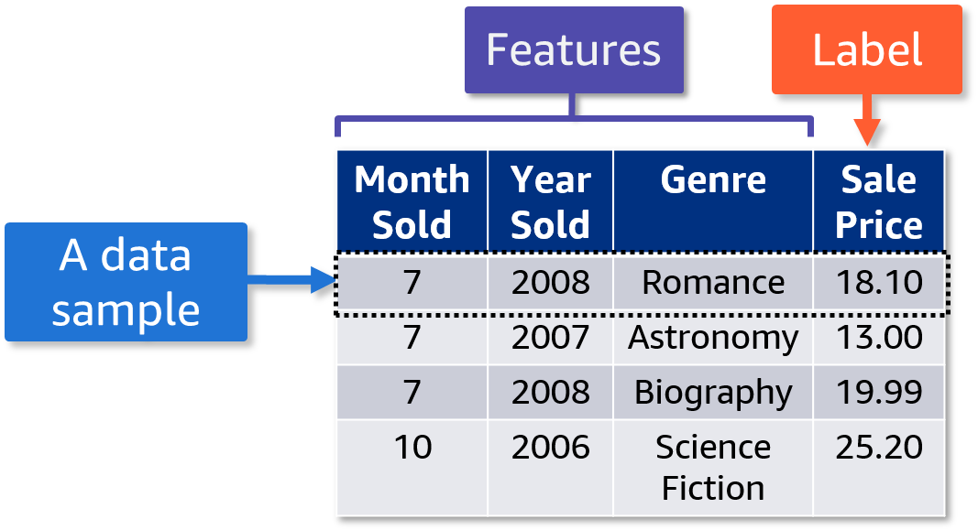
Review: Tabular data
Rows represent each data sample.
Columns represent each feature and the label.
Notes:
~Dev note: Slide is from Machine Learning through Application course, mod 1, lesson 0
~Dev note: Graphic marked as decorative because it is described in the slide notes.
~
When tabular data is used in ML, the rows of the table represent each data sample. The columns represent each feature and the label.
In this table, the features include Month Sold, Year Sold, and Genre, while the label is the Sale Price. Each row is a data sample.

Slide 26
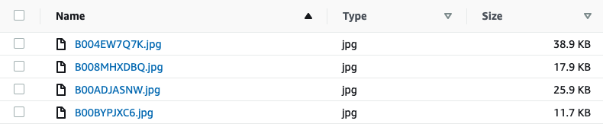
Review: Image data
Each data sample is an image that is stored as a file.
Features are determined by pixels and their relationships to each other.
Example label: What kind of animal is in the image?
Example of an image dataset
Notes:
~Dev note: Slide is from Machine Learning through Application course, mod 1, lesson 2
~Alt text: List of JPG files with their size included.
~
Another of the most commonly used types of data in ML is image data.

Slide 27
Review: Text data
Each data sample is a piece of text that is stored as a file. For example, a data sample might be a sentence, chapter, or document.
Features are text characters or words.
Example label: Does the text express a positive sentiment or a negative sentiment?
Example of a text dataset
“This book is pretty good! I would recommend it to my friends.”
Notes:
~Dev note: Slide is from Machine Learning through Application course, mod 1, lesson 2
~
The last type of data that is commonly used in ML is text data.

Slide 28

Next lesson
Learn the basic components of a neural network and how it implements ML.
Explore a single-layer network (also called a perceptron), which is represented by a single neuron.
Learn how to use a perceptron to solve a regression model.

Slide 30
Image source slide (for curriculum development use only)

Slide 31
Source graphic: Supervised learning: Regression
Supervised learning
Regression (quantity)
Label
Features
Price [$] | # Pages | Days pub. | Language | # Reviews
28 | 320 | 100 | EN | 2000
21 | 210 | 500 | DE | 400
… | … | … | … | …
Notes:
~Source for slide 7

Slide 32
Source graphic: ML lifecycle
Real-life problem
Problem formulation
Data processing
Model training/ tuning/testing
Evaluation
Deployment
Real-life problem
Problem formulation
Data processing
Model training/ tuning/testing
Evaluation
Deployment
Notes:
~Source graphic for ML lifecycle on slides 8-9, 11-12, and 20-22

Slide 33



Source graphic: Evaluation: Regression step 1
Price [$]
$$y_{i}$$
True values
$${error}_{ i}$$
Predicted values
$${\hat{y}}_{i}$$
# Pages
Notes:
~Source for slide 8

Slide 34
Source graphic: Supervised learning: Classification
Supervised learning
Classification (category)
Label
Features
Fiction | # Pages | Days pub. | Language | # Reviews
1 | 320 | 100 | EN | 2000
0 | 210 | 500 | DE | 400
… | … | … | … | …
Notes:
~Source for slide 10

Slide 35
Source graphic: Evaluation: Classification step 1
Prediction
1 (positive)
0 (negative)
Predict 0
Predict 1
True positive
15
False negative
1
/1 = Fiction
/0 = Nonfiction
1 (positive)
True State
Days published
False positive
3
True negative
18
# Pages
0 (negative)
Notes:
~Source for slides 11 and 12

Slide 36
Source graphic: Optimization in ML
Features
Rules
Target
Difference = error
Features
Rules
Prediction
Notes:
~Source for slide 14

Slide 37


Source graphic: Gradient descent method
$$f(w)$$
$$w$$
Notes:
~Source for slide 18

Slide 38
Source graphic: Review: Underfitting
Class 1
Class 2
x₂
x₁
Notes:
~Source for slide 20

Slide 39
Source graphic: Review: Overfitting
Class 1
Class 2
x₂
x₁
Notes:
~Source for slide 21

Slide 40
Source graphic: Review: Appropriate fitting
Model tuning
Class 1
Class 2
x₂
x₁
Notes:
~Source for slide 22

Slide 41
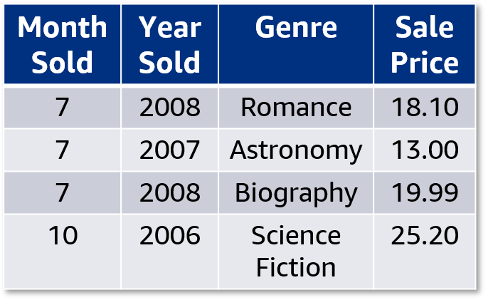
Source graphic: Review: Tabular data
Features
Label
A data sample
Notes:
~Source for slide 25

