Slide 1
Neural Network Engineering
Application of Deep Learning to Text and Image Data
Module 1 – Lesson 4

Slide 2
Today’s activities
The role of neural network architecture
Data structure for computer vision (CV) and natural language processing (NLP) domains
New architectures with weight sharing
Convolutional neural networks (CNNs)
Recurrent neural networks (RNNs)

Slide 3
The role of neural network architecture

Slide 4
Considerations for neural network architecture
Deep learning, specifically neural networks, is a hot area of research.
Countless new neural network architectures are proposed and updated every day.
Neural network architectures affect the following:
Complexity of the network
Evaluation performance
Compute resources for training and inference
Training and inference times
Inclusion of domain information (for example, CNNs, RNNs)
Notes:
Over the past few years, the field of deep learning has attracted a lot of interest. Neural networks make up an integral part of the deep learning process. The primary goal of neural networks is to transform input into a richer, more meaningful representation.
As discussed previously, a neural network consists of an input layer, an output layer, and one or more hidden layer. The design and architecture of a feed-forward neural network primarily depends on the number of neurons in each layer and the number of hidden layers.
As the field evolved, neural networks were designed to meet the needs of specialized domains, such as convolutional neural networks (CNNs) for image data and recurrent neural networks (RNNs) for sequential data.
The architecture of a neural network often plays a crucial role in the overall performance of the network. The architecture also affects the resources—both compute and time—that are required to train and predict the network.

Slide 5
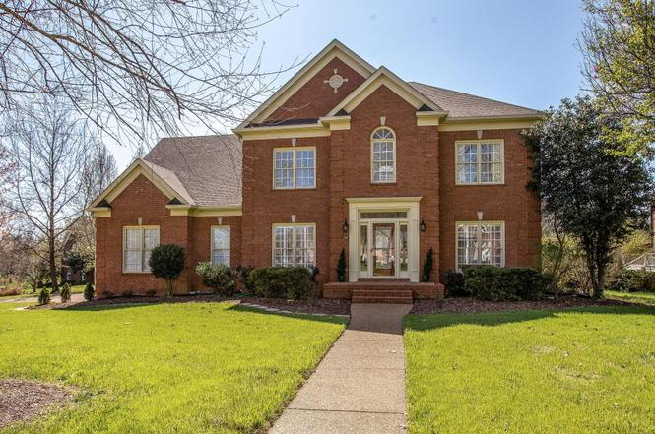
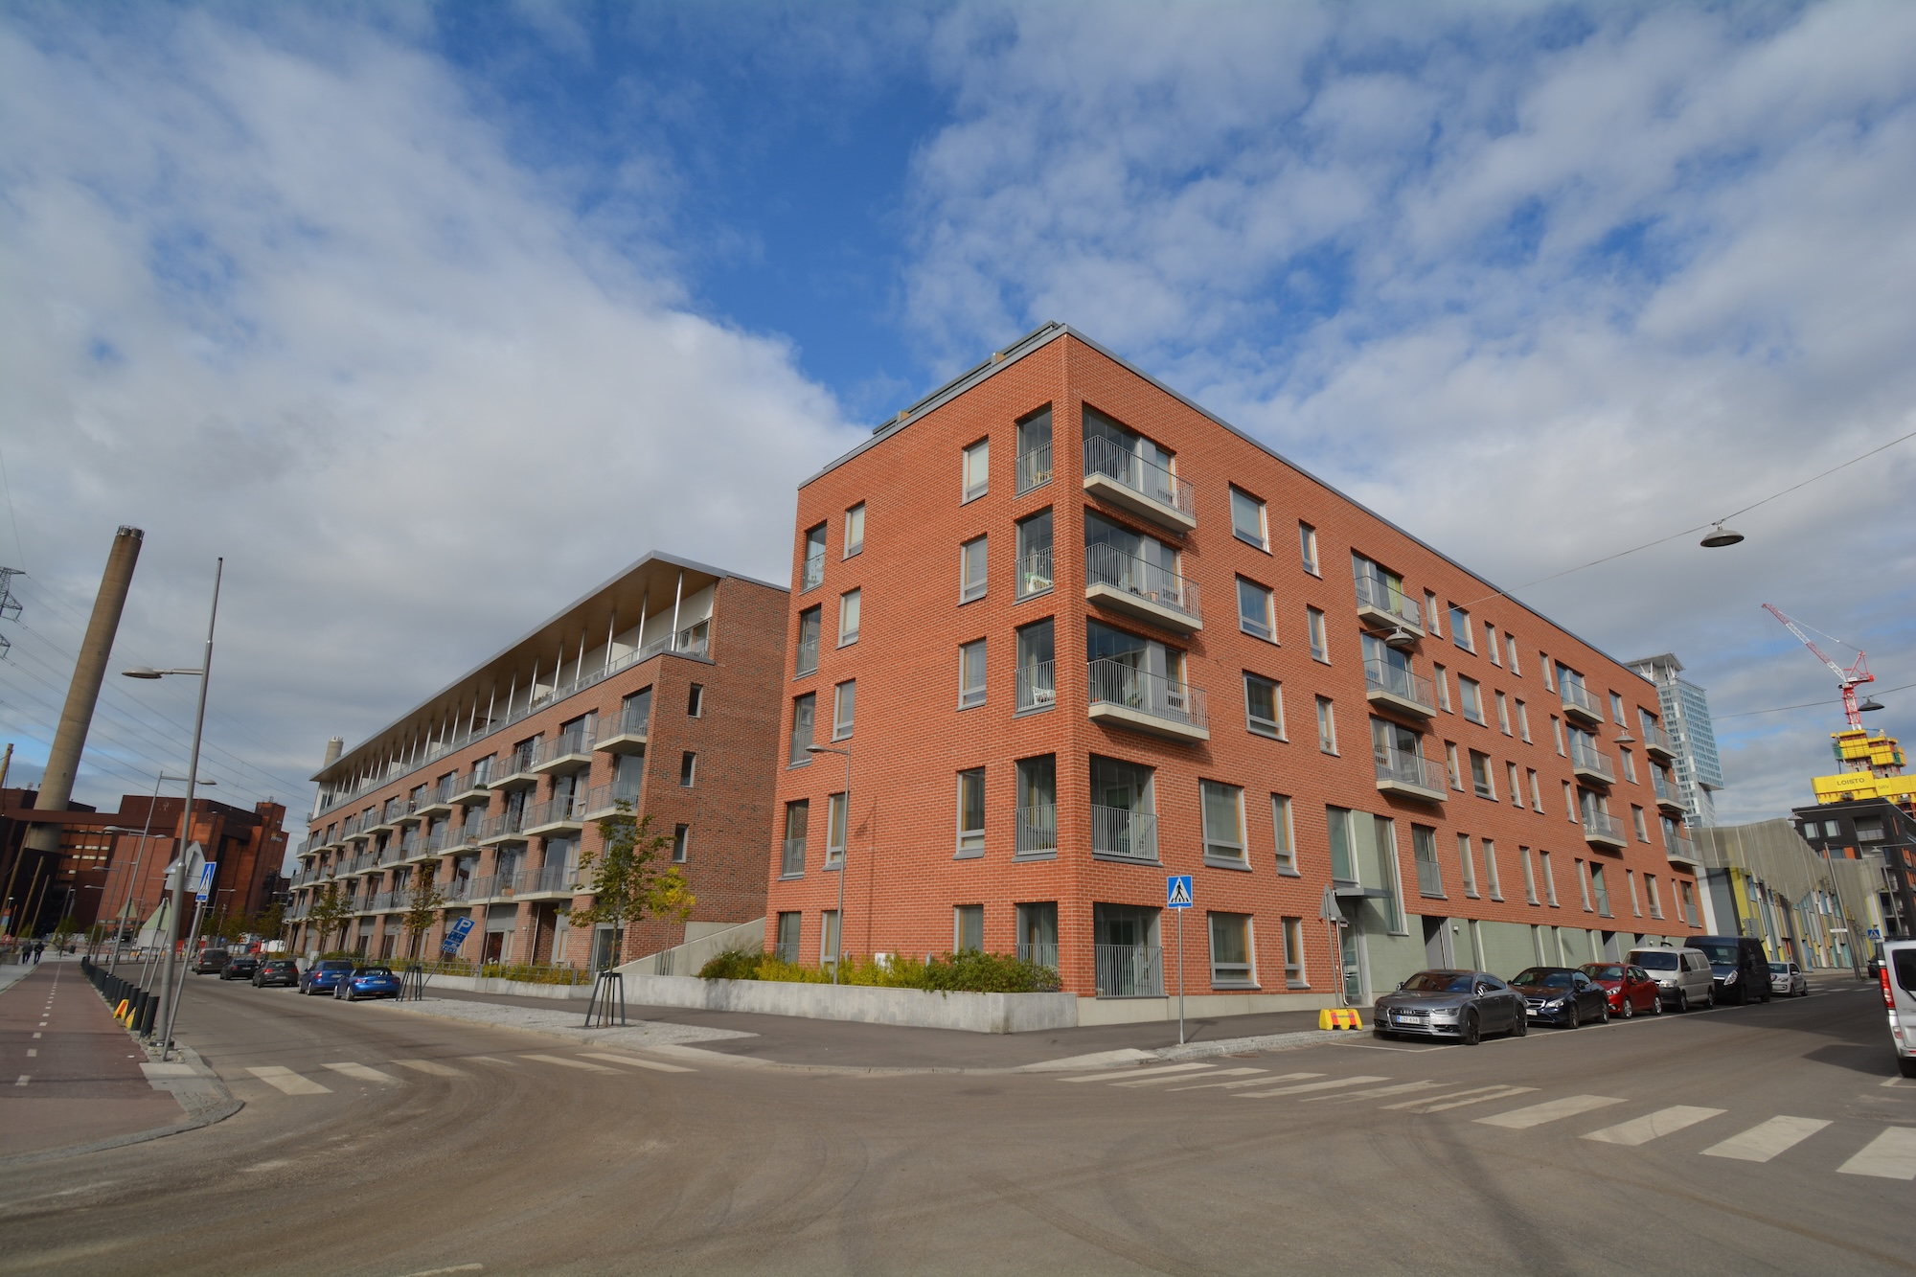
Analogy for neural network architecture
Traditional architecture: While the building blocks might be the same, you have different architectures depending on the problem that you want to solve.
I want to live in a house.
I want to live in an apartment.
Notes:
~Alt text – house on left: Picture of a single-family house.
~Alt text – house on right: Picture of an apartment building.
Image attribution Jacksonpuckett1/CC BY-SA 4.0 (https://creativecommons.org/licenses/by-sa/4.0/): https://commons.wikimedia.org/wiki/File:A_house_in_Chestnut_Bend.jpg
Image attribution Nucatum amygdalarum/CC BY-SA 4.0 (https://creativecommons.org/licenses/by-sa/4.0/): https://commons.wikimedia.org/wiki/File:2019_09_24_Kalasatama_0072.jpg

Slide 6
Match the neural network architecture to the problem
All neural networks have the same building blocks: neurons, layers, activation functions, loss functions, and weights.
Different architectures have been researched and implemented. They use the same building blocks to solve ML problems for different domains.
This lesson explores two important architectures that were developed to handle computer vision (CV) and natural language processing (NLP) problems.

Slide 7
Data structure for CV and NLP domains

Slide 8

Data structure for CV
The 2D structure of image data has important spatial information.
A particular pixel has a close relationship with the surrounding pixels.
You would expect the highlighted pixel in the following image to be surrounded by pixels with similar characteristics (for example, color and contrast).
Notes:
~Alt text – pixelated image: Low-resolution image with visible pixels in shades of blue. A single pixel is highlighted.
~
The assumption that the surrounding pixels would have similar characteristics holds true for most images because a significantly different pixel color, such as bright yellow, would seem like an error. A similar concept is used to extract information from images.

Slide 9
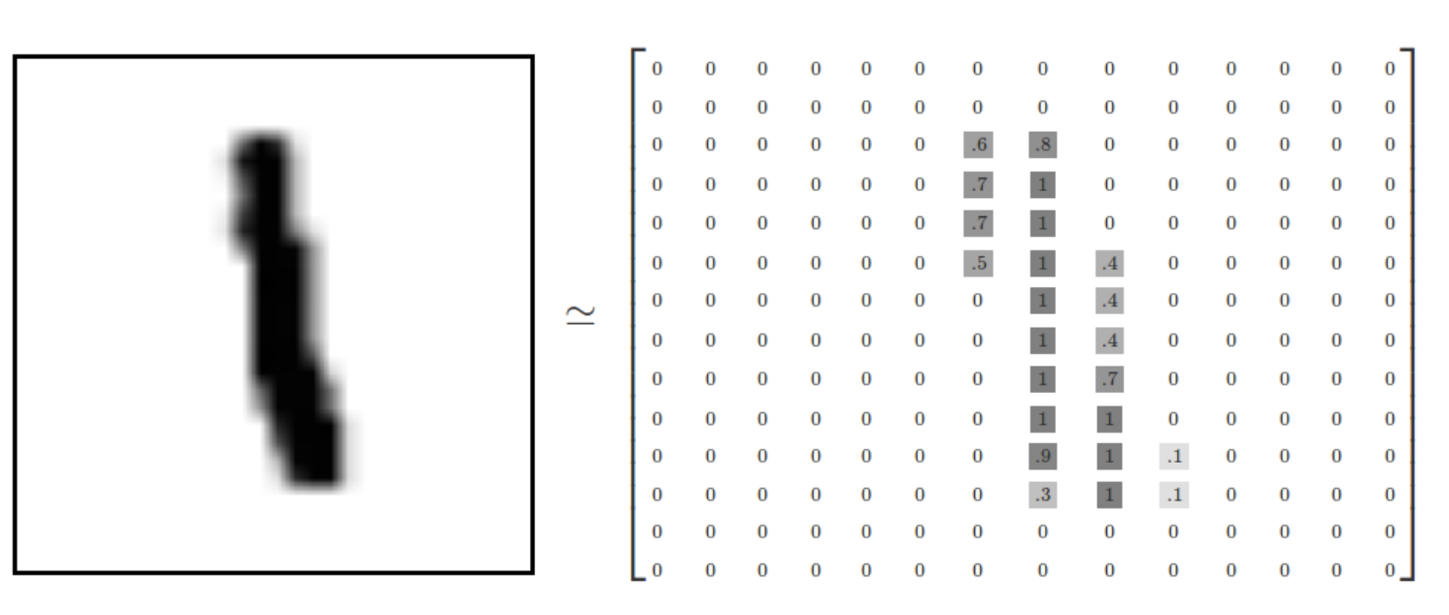
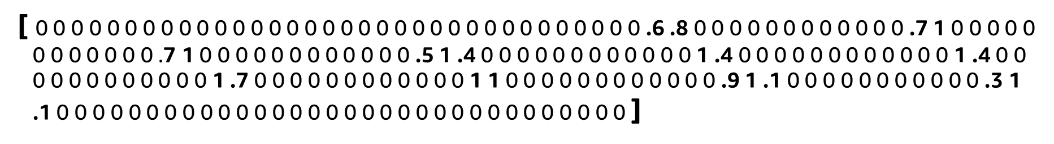
The structure problem: CV
A tabular data approach cannot explore the 2D structure that is present in image data.
Take a 2D grid of pixels.
Flatten into a 1D vector of pixel values.
Feed through a fully connected neural network.
By flattening the data into a vector, the spatial information is lost!
Notes:
~Alt text – handwritten numeral and 2D grid: Handwritten number 1 and an associated matrix representation of the image.
~Alt text – vector: The same pixel representation flattened into a single-dimension vector.
~
This slide demonstrates how a tabular data approach cannot capture the 2D structure of an image.
With image data, the pixel values become the features. Each cell in the matrix represents a grayscale number that is related to each pixel (0 represents white, 1 represents black, and intermediate numbers represent shades of gray).
To use these values as input for a model, you need to flatten this matrix into a single-dimension vector. This is because fully connected neural networks models, which are also called multilayer perceptrons (MLPs), can only receive vectors as input. In the vector image, the pixels are now distributed sparsely and have lost most of the information that is related to their 2D position. Even worse, fully connected neural network models don’t capture the spatial arrangement of pixels in an image.

Slide 10

Data structure for NLP
Humans read text sequentially, one word or character at a time.
Therefore, the sequential structure of text data has important temporal information.
If you change the order of the words, the result is meaningless.
Notes:
~Alt text: Example of why word order matters. See detail in notes.
~
Image description: The sentence "The quick brown fox jumps over the lazy dog" is transformed into a random order of "Quick lazy over jumps dog the fox brown the." This example highlights how the sequence of text matters. End description.

Slide 11
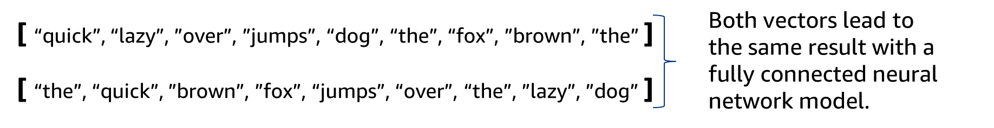
The structure problem: NLP
A tabular data approach cannot consider the sequential structure that is present in text data.
Take a sequence of words.
Flatten into a 1D vector of words.
Feed through a fully connected neural network .
The quick brown fox jumps over the lazy dog
By flattening the data into a unordered vector, the sequential information is lost.
Notes:
~Alt text: Illustration of 1D vectors that could be created from the sentence. See detail in notes.
~
Image description: Two vectors contain the words from the sentence “The quick brown fox jumps over the lazy dog,” but in different order. Both vectors would lead to the same result with a fully connected neural network model because order is not considered. End description.

Slide 12
New architectures with weight sharing

Slide 13
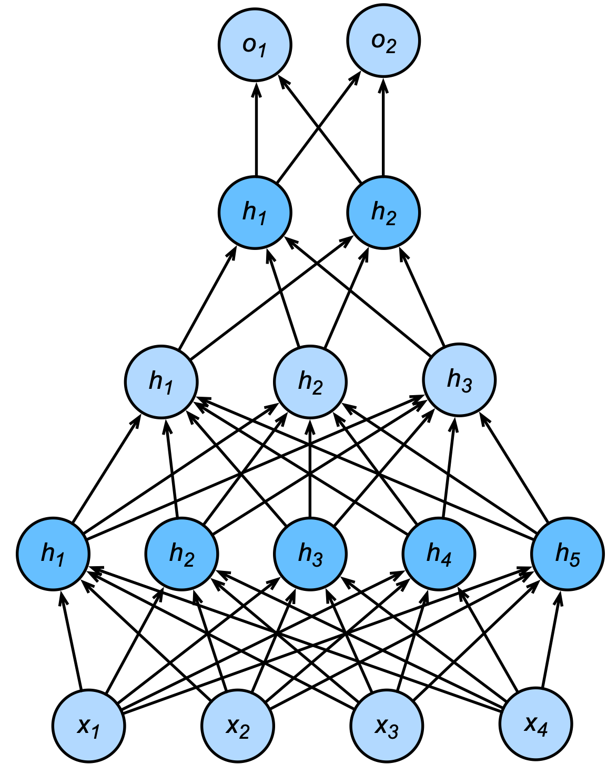
Issue: Too many weights
Deep learning models can have billions of weights.
The computational cost would be prohibitive to train the fully connected neural network architectures that you have learned so far.
An alternative architecture is needed to handle this issue.
Notes:
~Alt text: Fully connected neural network with two output neurons.

Slide 14
Solution: Weight sharing
You need to change the way that the weights participate in the training of a deep learning model.
You can accomplish this by selecting only a small part of the weights.
Weight sharing was first used in 1998 by LeCun et al. The method reduces the number of weights in a network that must be trained.
The method explores additional structures that is present in the data to reuse weights on nodes that are closely related.
Notes:
Reference: “LeNet.” Wikipedia, June 16, 2023. https://en.wikipedia.org/wiki/LeNet.

Slide 15
Explore additional data structures with invariance
As you have seen, in domains such as CV and NLP, the data is not a simple table of numbers.
You can use invariance to explore additional structures that are present in that data:
Invariance in position for CV models
Invariance in time for NLP models

Slide 16
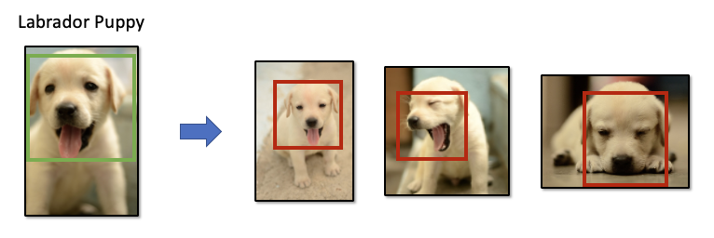
Weight sharing for CV: Invariance
Invariance in position: A model can recognize an object as it is, even when its appearance varies in position in the image.
Notes:
~Alt text: Example using puppy faces. See detail in notes.
~
Image description: The first image shows a Labrador puppy with a rectangle drawn around its head. The second image shows three Labrador puppies in different positions, each with a rectangle drawn around its head. End description.
Invariance in position is a way that a model can recognize an object as an object, even when its appearance varies in position in the image. The example highlights that, no matter where the Labrador puppy appears in the image, the model can detect the main characteristics of the puppy and detect it in the image.
Analogy with your brain: After you looked at the puppy in the left image and then moved to examine the image on the right, the three puppies popped out immediately. That is because your brain explores this invariance in position, transporting the same general characteristics of the Labrador puppy that you saw in the first image to the second image, so you were able to detect this pattern easily.
In other words, a model, like your brain, can look for these patterns and doesn’t need to fully inspect the image before detecting the patterns that are related to the first image.
Image attribution Manokaran M/CC BY-SA 4.0 (https://creativecommons.org/licenses/by-sa/4.0/): https://commons.wikimedia.org/wiki/File:Labrador_retriever_puppy_MZ7_0092.jpg
Image attribution Manokaran M/CC BY-SA 4.0 (https://creativecommons.org/licenses/by-sa/4.0/): https://commons.wikimedia.org/wiki/File:Labrador_retriever_puppy_MZ7_0065.jpg
Image attribution Manokaran M/CC BY-SA 4.0 (https://creativecommons.org/licenses/by-sa/4.0/): https://commons.wikimedia.org/wiki/File:Labrador_retriever_puppy_MZ7_0042.jpg
Image attribution Manokaran M/CC BY-SA 4.0 (https://creativecommons.org/licenses/by-sa/4.0/): https://commons.wikimedia.org/wiki/File:Labrador_retriever_puppy_MZ7_0052.jpg

Slide 17
CNN architecture
Preserves the two dimensions of image data by using a 2D matrix as input to the neural network
Implements weight sharing by keeping the weights in a small window that slide through the image, instead of having one weight per image pixel
Notes:
In the module about CV, you will learn how the CNN architecture works.

Slide 18
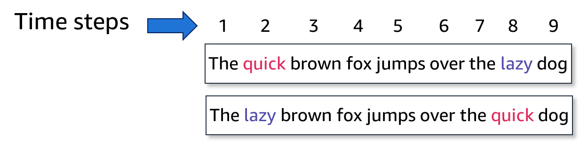
Weight sharing for NLP: Invariance
Invariance in time: The model can recognize that some word have the same meaning regardless of which time step the words are in.
Notes:
~Alt text: Comparison of two similar sentences with some words in a different order. See details in notes.
~
Image description: Two versions of the same sentence, where the words “quick” and “lazy” are swapped between them. Sentence 1: The quick brown fox jumps over the lazy dog. Sentence 2: The lazy brown fox jumps over the quick dog. Above the sentences is a row of numbers from 1 to 9, with one number above each word. The numbers indicate the time step that each word is in. End description.

Slide 19
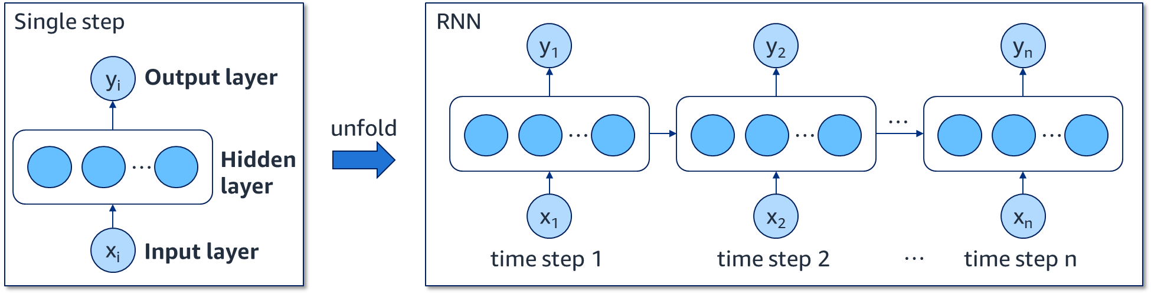
RNN architecture
Preserves the sequential structure of text data by using time steps in the input to the neural network
Implements weight sharing by keeping the weights the same for all time steps while processing the text
Notes:
~Alt text: Illustration of an RNN architecture. See detail in notes.
~
Image description: One side of the illustration shows the key components of a single step in an RNN. The components are input layer, hidden layer, and output layer. The word “unfold” connects to the other side of the illustration. This side shows how a single time step unfolds into many time steps when data passes through an RNN architecture. End description.
You will learn how it works in the module about NLP.

Slide 20

Next module
You will explore NLP.

Slide 22
Image source slide (for curriculum development use only)

Slide 23
Source graphic: The structure problem: CV
[ 0 0 0 0 0 0 0 0 0 0 0 0 0 0 0 0 0 0 0 0 0 0 0 0 0 0 0 0 0 0 0 0 0 0 .6 .8 0 0 0 0 0 0 0 0 0 0 0 0 .7 1 0 0 0 0 0 0 0 0 0 0 0 0 .7 1 0 0 0 0 0 0 0 0 0 0 0 0 .5 1 .4 0 0 0 0 0 0 0 0 0 0 0 0 1 .4 0 0 0 0 0 0 0 0 0 0 0 0 1 .4 0 0 0 0 0 0 0 0 0 0 0 0 1 .7 0 0 0 0 0 0 0 0 0 0 0 0 1 1 0 0 0 0 0 0 0 0 0 0 0 0 .9 1 .1 0 0 0 0 0 0 0 0 0 0 0 .3 1 .1 0 0 0 0 0 0 0 0 0 0 0 0 0 0 0 0 0 0 0 0 0 0 0 0 0 0 0 0 0 0 0 0 ]
Notes:
~Source for slide 9

Slide 24
Source graphic: Data structure for NLP
???
The quick brown fox jumps over the lazy dog
Quick lazy over jumps dog the fox brown the
Notes:
~Source for slide 10

Slide 25
Source graphic: The structure problem: NLP
Both vectors lead to
the same result with a fully connected neural network model.
[ “quick”, “lazy”, ”over”, ”jumps”, “dog”, “the”, “fox”, ”brown”, ”the” ]
[ “the”, “quick”, ”brown”, ”fox”, “jumps”, “over”, “the”, ”lazy”, ”dog” ]
Notes:
~Source for slide 11

Slide 26
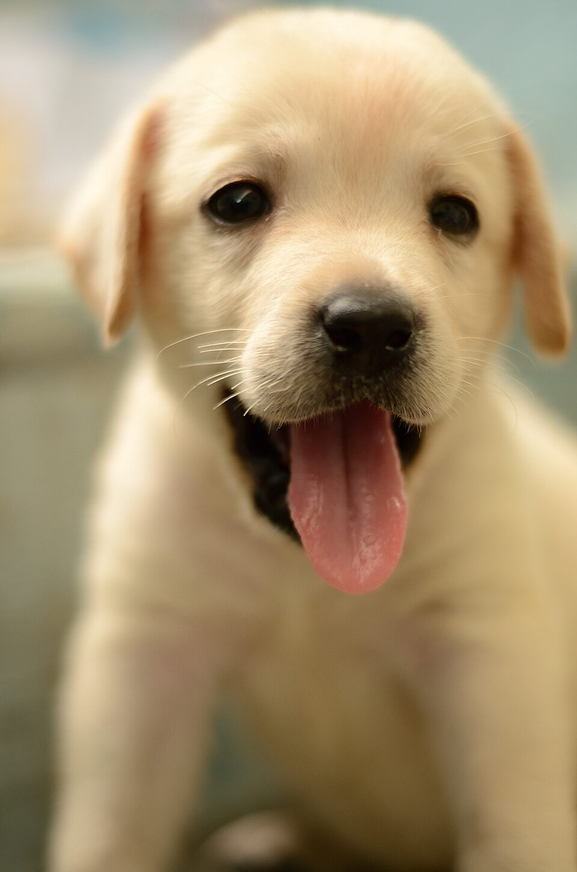
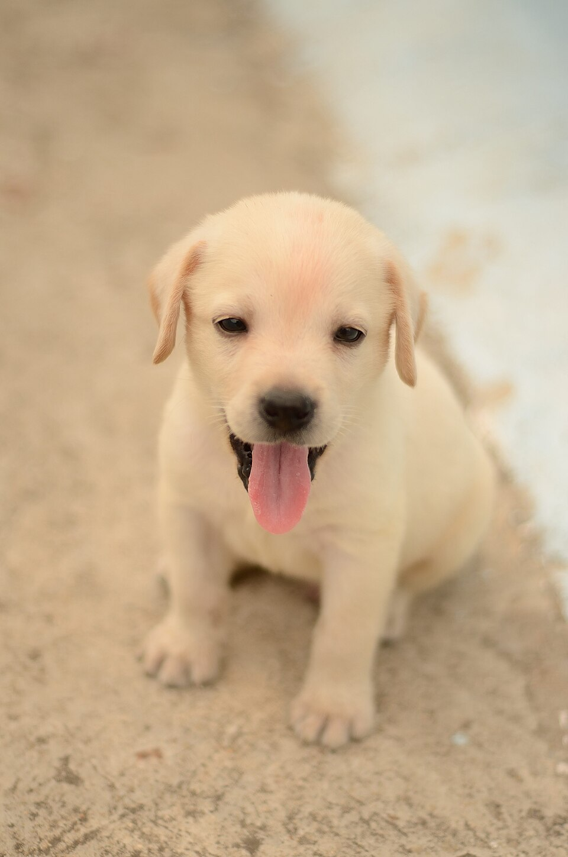
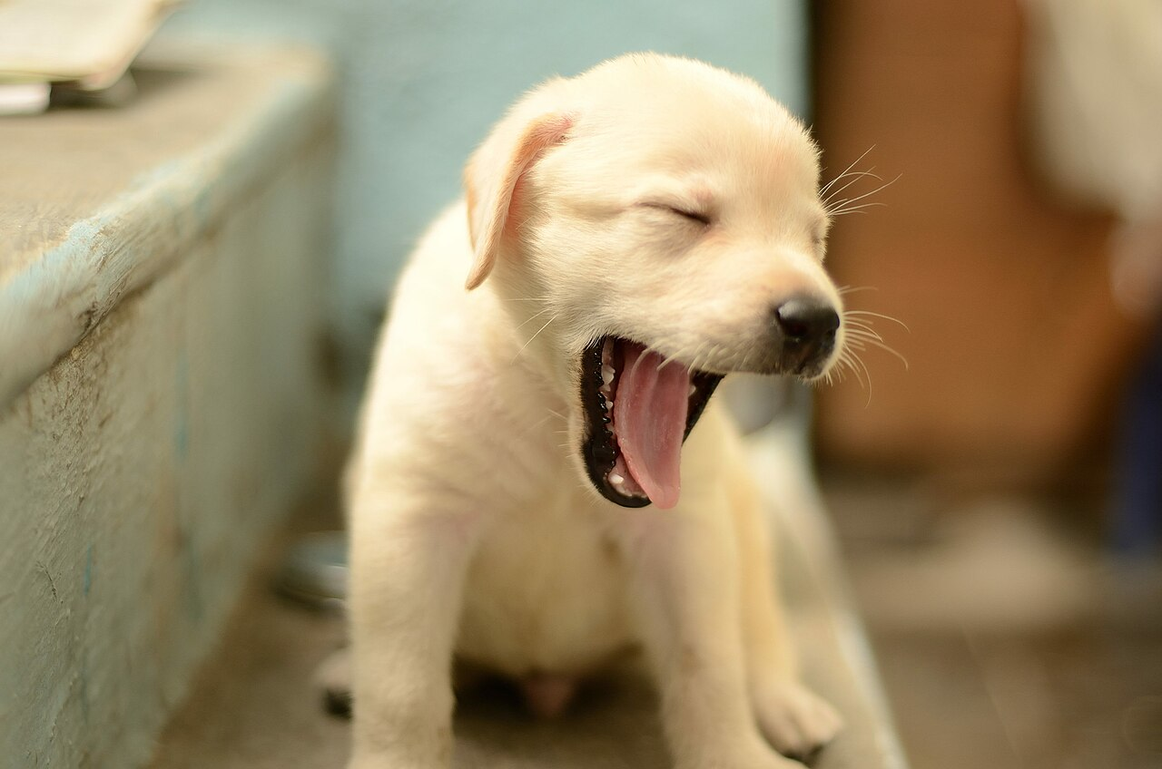
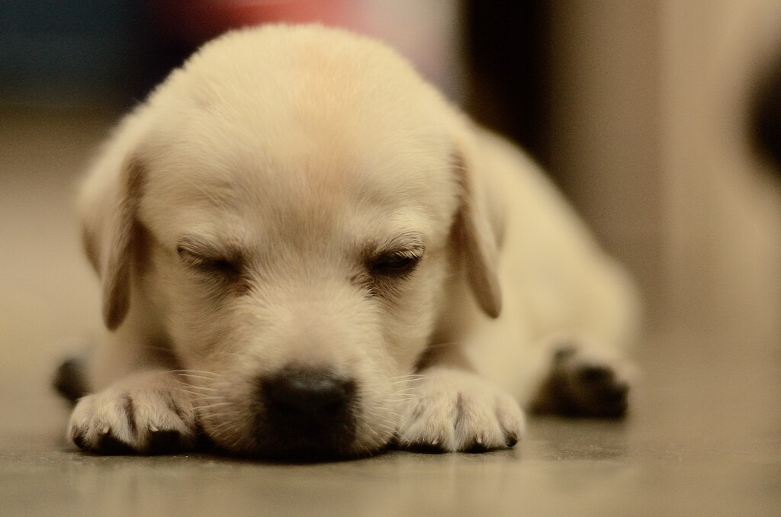
Source graphic: Weight sharing for CV: Invariance
Labrador Puppy
Notes:
~Source for slide 16
Image attribution Manokaran M/CC BY-SA 4.0 (https://creativecommons.org/licenses/by-sa/4.0/): https://commons.wikimedia.org/wiki/File:Labrador_retriever_puppy_MZ7_0092.jpg
Image attribution Manokaran M/CC BY-SA 4.0 (https://creativecommons.org/licenses/by-sa/4.0/): https://commons.wikimedia.org/wiki/File:Labrador_retriever_puppy_MZ7_0065.jpg
Image attribution Manokaran M/CC BY-SA 4.0 (https://creativecommons.org/licenses/by-sa/4.0/): https://commons.wikimedia.org/wiki/File:Labrador_retriever_puppy_MZ7_0042.jpg
Image attribution Manokaran M/CC BY-SA 4.0 (https://creativecommons.org/licenses/by-sa/4.0/): https://commons.wikimedia.org/wiki/File:Labrador_retriever_puppy_MZ7_0052.jpg

Slide 27
Source graphic: Weight sharing for NLP: Invariance
Time steps
1
2
3
4
5
6
7
8
9
The quick brown fox jumps over the lazy dog
The lazy brown fox jumps over the quick dog
Notes:
~Source for slide 18

Slide 28
Source graphic: RNN architecture
Single step
RNN
y₁
y₂
y_{n}
y_{i}
Output layer
unfold
…
…
…
…
…
Hidden layer
x₁
x₂
x_{n}
x_{i}
Input layer
…
time step 1
time step 2
time step n
Notes:
~Source for slide 19

