Slide 1
Challenges of Textual Data and Domains of NLP
Application of Deep Learning to Text and Image Data
Module 2 – Lesson 1

Slide 2
Today’s activities
Challenges of textual data
Domains of natural language processing (NLP)
NLP approaches and tools

Slide 3
Challenges of textual data

Slide 4
What is textual data?
Any data in the form of written or spoken language
Text data:
Is unstructured (not organized in a predefined format)
Can contain a wide variety of information, such as dates, names, locations, and opinions
Is a critical component of NLP
Notes:
Textual data refers to any data in the form of written or spoken language. It can include emails, social media posts, news articles, product reviews, and more. Textual data is often unstructured, meaning that it isn’t organized in a predefined format. It can contain a variety of information, such as dates, names, locations, and opinions.
Textual data is a critical component of natural language processing (NLP), but it poses several challenges that you must address to achieve accurate and useful results. Challenges include its unstructured nature, linguistic complexity, and data volume. However, with the correct tools and techniques, you can extract valuable insights and make informed decisions from this rich source of information.

Slide 5
Linguistic complexity of textual data
Human language is incredibly complex and nuanced. Its many variations make it difficult for machines to fully understand and interpret.
The following are examples of linguistic complexity in textual data:
Homophones
Polysemy
Named entities
Colloquialisms
Notes:
The following are examples of linguistic complexity in textual data:
Homophones: Words that are pronounced the same but have different meanings, such as there, their, and they're. Machines might struggle to differentiate between these words in text.
Polysemy: Words with multiple meanings, such as mouse (which can refer to a computer input device or a small rodent). Machines might struggle to determine which meaning is intended in a particular context.
Named entities: Proper nouns and other named entities (such as places, organizations, and people) can be difficult for machines to identify and disambiguate. For example, the name Washington could refer to a person, a place, or a number of other entities.
Colloquialisms: Informal language and slang can be difficult for machines to understand. For example, the phrase "I'm gonna bounce" means "I'm going to leave," but this is not immediately obvious from the individual words.

Slide 6
Key challenges in textual data
Key challenges include the following:
Ambiguity
Idiomatic expressions
Sarcasm and irony
Regional and cultural variations
Understanding natural language is a complex and ongoing challenge for machines. It requires sophisticated algorithms and a deep understanding of human language and culture.
Notes:
Key challenges in NLP include the following:
Ambiguity: Many words and phrases can have multiple meanings, depending on context. For example, the word bank can refer to a financial institution, a riverbank, or even a verb meaning to tilt to one side.
Idiomatic expressions: Many expressions in human language are idiomatic, which happens when their meaning cannot be inferred from the individual words. For example, the phrase "kick the bucket" means to die, but this isn’t immediately obvious from the literal meanings of the words.
Sarcasm and irony: Sarcasm and irony involve saying one thing while meaning the opposite. They are often conveyed through tone of voice and other nonverbal cues. These can be difficult for machines to interpret.
Regional and cultural variations: Language can vary significantly depending on where it’s spoken and who is speaking it. Slang, dialects, and regional idioms can all present challenges for machines that are trying to understand natural language.

Slide 7




Example of ambiguity
Draw a match
Each string can have many interpretations at every level.
The correct resolution of the ambiguity depends on the intended meaning, which can often be inferred from context.
Notes:
The verb draw could mean to produce a picture of something or to pull something out of a receptacle. The noun match could refer to a short, thin piece of wood that’s used to light a fire or to two things that closely resemble one another.
Upper left image attribution: "Hand drawing on a graphic tablet" by Piknuz is licensed under CC BY-SA 4.0 (https://creativecommons.org/licenses/by-sa/4.0/): https://commons.wikimedia.org/wiki/File:Hand_drawing_on_a_graphic_tablet.jpg
Lower left image attribution: “Card Game 10“ by Benebiankie is licensed under CC BY-SA 4.0 (https://creativecommons.org/licenses/by-sa/4.0/): https://commons.wikimedia.org/wiki/File:Card_Game_10.jpg
Upper right image attribution: “Closeup of match stick heads” by Subhrajyoti07 is licensed under CC BY-SA 4.0 (https://creativecommons.org/licenses/by-sa/4.0/): https://commons.wikimedia.org/wiki/File:Closeup_of_match_stick_heads.jpg
Lower right image attribution: “Four Aces in a poker hand by blickpixel” is licensed under CC0 1.0 (https://creativecommons.org/publicdomain/zero/1.0/deed.en): https://commons.wikimedia.org/wiki/File:Four_Aces_in_a_poker_hand_by_blickpixel.jpg

Slide 8
Example of an idiomatic expression
"It's like trying to nail Jell-O to a wall."
Textual data is incredibly nuanced and complex. It has a variety of nuances, idioms, and cultural references, which make it challenging to understand and analyze.
Notes:
This expression is often used to describe a task that is almost impossible to accomplish, much like managing the complexities of NLP. Similar to how Jell-O is slippery and difficult to handle, natural language is incredibly nuanced and complex. Its variety of nuances, idioms, and cultural references make it challenging to understand and analyze. Despite the many advances in NLP technology in recent years, it remains a difficult task that requires a great amount of expertise and resources to achieve accurate results.

Slide 9
Other challenges of textual data
Acronyms
Tricky entity names
Neologisms
Nonstandard English
HTML and XML
Phone numbers and dates
Emojis
Clitics
Notes:
The same meaning can be expressed in many ways, and there are immeasurable meanings to express. In addition to the challenges on the previous slide, think of other ways in which you use language that might be difficult for a machine to understand.
Consider the following examples:
Acronyms: Acronyms require context and aren't universally known. For example, IP could mean “intellectual property” or “internet protocol.”
Tricky entity names: For example, to interpret the phrase "Where is A Bug’s Life playing?", you need to understand that A Bug's Life is a movie title, and playing refers to being shown in a theatre.
Neologisms: This includes newly invented terms, such as unfriend.
Nonstandard English: For example, someone might write "sooooo loooong" for “so long.”
HTML and XML: To interpret HTML or XML, you need to understand which parts are HTML or XML tags, recognize special characters, and handle URL formatting.
Phone numbers and dates: These can be presented in different formats, and standards are different across the world.
Emojis: Emojis can have different meanings based on context.
Clitics: A clitic is an unstressed word that usually only appears with another word; for example, I'm or we're.

Slide 10
Data volume
Large datasets are required for training.
Manually annotating data is time-consuming and costly.
Billions of internet users worldwide generate vast amounts of textual data, including the following:
Social media posts
Email
Chats
Other forms of communication
The challenge of storing, processing, and analyzing this vast amount of textual data is significant.

Slide 11
Domain-specific vocabulary
Examples in different domains include the following:
Medical: Terms such as myocardial infarction and angioplasty are specific to the field of cardiology.
Legal: Legal terms such as affidavit and amicus curiae are not commonly used in everyday language.
Financial: Terms such as earnings per share and price-to-earnings ratio might not be familiar to people who are outside of the financial industry.
Scientific: Terms such as deoxyribonucleic acid (DNA) and photosynthesis are specific to the fields of genetics and biology.
These terms require domain-specific knowledge to understand and interpret the data accurately.
Notes:
Domain-specific vocabulary refers to the specialized language that is used in a particular field or industry. This language might not be familiar to people who are outside of that field.
Examples of domain-specific vocabulary in different domains include the following:
Medical: A large number of technical terms, acronyms, and abbreviations are specific to the field of medicine.
Legal: The legal domain has a unique vocabulary.
Financial: A large number of technical terms and acronyms are specific to the financial industry.
Scientific: A large number of technical terms and acronyms are specific to fields such as chemistry, biology, and physics.
NLP techniques such as entity recognition, named entity recognition, and topic modeling can be used to identify and analyze domain-specific vocabulary in textual data.

Slide 12
Data quality
Cleaning and preparing textual data for analysis can be a challenging task. Textual data is often noisy, incomplete, and inconsistent, which can make it difficult to analyze and draw meaningful insights from.
Some common challenges include the following:
Noisy data: The data contains misspellings, typos, nonstandard abbreviations, punctuation errors, emojis, and hashtags.
Incomplete data: The data source isn’t exhaustive or well structured.
Inconsistent data: The data is collected from multiple sources or isn’t well organized.
Examples of noisy, incomplete, and inconsistent textual data include Twitter data, customer feedback, medical records, and legal documents.
Notes:
Some of the common challenges in cleaning and preparing textual data for analysis include the following:
Noisy data: Noisy data is contains irrelevant or unwanted information that can obscure or mislead the analysis. Noisy data can include misspellings, typos, nonstandard abbreviations, and punctuation errors. For example, social media data might include emojis, hashtags, and misspellings that can make it difficult to accurately interpret the intended meaning.
Incomplete data: Incomplete data is missing information that is needed for analysis. Incomplete data can occur when the data source isn’t exhaustive or well structured. For example, in medical records, some of the patient's medical history might not be recorded, which makes it difficult to accurately analyze.
Inconsistent data: Inconsistent data contains conflicting or contradictory information. Inconsistent data can occur when data is collected from multiple sources or when data isn’t well organized. For example, in customer feedback surveys, some customers might provide feedback that contradicts the feedback of other customers, which makes it difficult to accurately identify patterns.

Slide 13
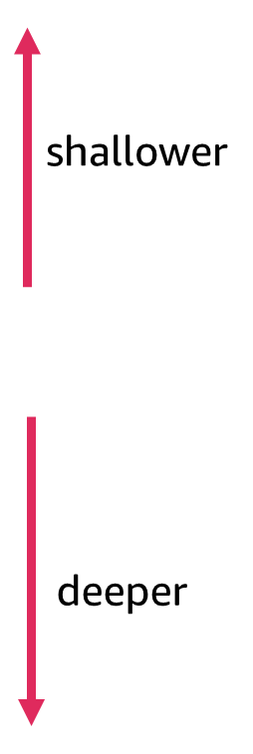
Levels of linguistic knowledge
Level | Description
Phonetics | Study of the sounds of human language
Phonology | Study of sound systems in human language
Morphology | Study of the formation and internal structure of words
Syntax | Study of the formation and internal structure of sentences
Semantics | Study of the meaning of sentences
Pragmatics | Study of the way that sentences, with their semantic meanings, are used for particular communicative goals
Notes:
~Alt text: Arrows indicate that levels at the top of the table are shallower, and levels toward the bottom of the table are deeper.
~
The following are the levels of linguistic knowledge:
Phonetics and phonology are the levels of linguistic knowledge that involve the study of the sounds of language. Phonetics is concerned with the physical properties of speech sounds, while phonology is concerned with the systematic organization of speech sounds in a particular language.
Morphology is concerned with the rules that govern the formation of words and the way in which words are formed from smaller units that are called morphemes.
Syntax is concerned with the rules that govern how words are combined to form phrases and sentences.
Semantics is concerned with the way that words and sentences are used to convey meaning.
Pragmatics is concerned with the way that speakers use language to achieve their goals in communication. This field is also concerned with how meaning is affected by context and social factors.

Slide 14
Domains of NLP

Slide 15
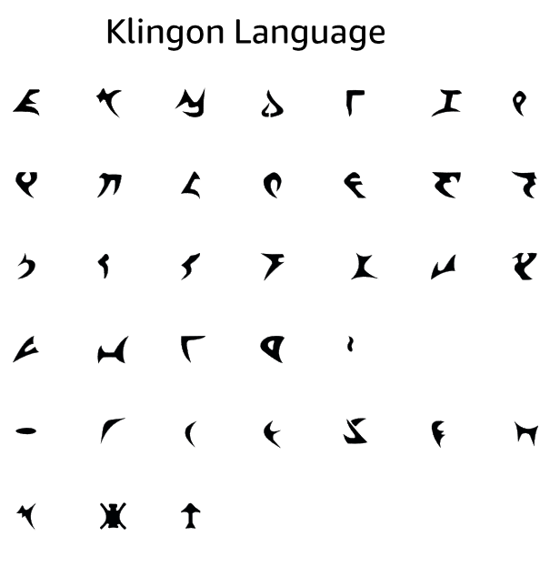
What is natural language?
What is a natural language?
A human language that evolved naturally through human use over time
Examples include English, Arabic, Mandarin, Spanish, and Hindi
What isn’t a natural language?
Controlled or artificial languages, such as Klingon, Esperanto, and Interlingua
An animal language
Programming languages
Notes:
~Alt text: Array of glyphs in the Klingon language.

Slide 16
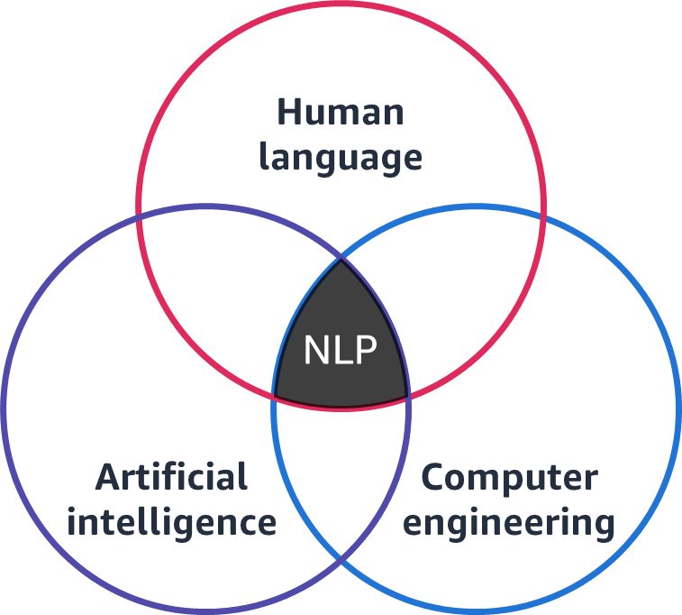
What is NLP?
Natural language processing (NLP) is a branch of AI that focuses on enabling machines to understand, interpret, and generate human language.
NLP involves the use of various algorithms, statistical models, and linguistic rules to process and analyze large amounts of natural language data.
Notes:
~definition from AWS

Slide 17
Common applications of NLP
Sentiment analysis
Machine translation
Chatbots and virtual assistants
Text summarization
Named entity recognition
Notes:
Common applications of NLP include the following:
Sentiment analysis: NLP can be used to analyze large volumes of customer reviews, social media posts, and other text data to determine the overall sentiment or emotional tone of the content. This can help businesses understand customer feedback and improve their products or services accordingly.
Machine translation: NLP can be used to automatically translate text from one language to another. Machine translation is used in a variety of applications, including online language learning platforms, international business communication, and multilingual customer support.
Chatbots and virtual assistants: NLP can be used to build chatbots and virtual assistants that can understand and respond to user queries in natural language. These applications are used in a variety of domains, including customer service, healthcare, and ecommerce.
Text summarization: NLP can be used to automatically generate summaries of long text documents, such as news articles or academic papers. This can help users quickly understand the main points of a document without having to read the entire text.
Named entity recognition: NLP can be used to identify and extract named entities, such as people, organizations, and locations, from large volumes of text data. This can be useful in a variety of applications, including information retrieval and text mining.

Slide 18
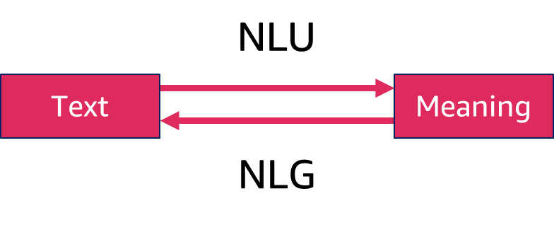
NLP, NLU, and NLG
Natural language understanding (NLU) is a subfield of NLP that focuses on the ability of a machine to understand the meaning of human language.
Natural language generation (NLG) is a subfield of NLP that focuses on the ability of a machine to generate human-like language.
Notes:
~Alt text: Relationship between NLU and NLG. See detail in notes.
~
Image description: NLU takes human-readable text and provides the meaning to an ML model. NLG uses that derived meaning to provide a human-readable response. End description.
The key difference between NLP, natural language understanding (NLU), and natural language generation (NLG) is the specific focus of each field on different aspects of processing natural language:
Natural language processing (NLP) is a broad field that includes all aspects of processing human language by computers. NLP techniques can be used for a wide range of applications, such as sentiment analysis, speech recognition, and machine translation.
Natural language understanding (NLU) is a subfield of NLP that focuses on the ability of a machine to understand the meaning of human language. NLU techniques extract information from text or speech, understand the intent of a statement, and identify relevant entities or concepts.
Natural language generation (NLG) is another subfield of NLP and focuses on the ability of a machine to generate human-like language. NLG techniques create text or speech that is coherent, understandable, and fluent, often based on structured data or other forms of input.
In short, NLP is a general term that encompasses all aspects of processing natural language, while NLU and NLG are more specific subfields that focus on understanding and generating language, respectively.

Slide 19






Examples of NLP applications in different domains
Healthcare: Analyze medical records and patient data, automate clinical documentation, and support medical decision-making.
Finance: Analyze market trends, perform sentiment analysis, and support automated trading.
Education: Support language learning, automated grading, and educational chatbots.
Law: Automate analysis of legal documents, support electronic discovery, and analyze contracts.
Customer service: Provide personalized recommendations, implement chatbots, and perform sentiment analysis of customer feedback.
Marketing: Analyze customer feedback and social media data, and provide personalized recommendations.
Notes:
Overall, NLP has a range of applications in various domains. It has the potential to significantly improve efficiency, accuracy, and customer satisfaction in many industries.

Slide 20


Sentiment analysis in NLP
Identify and extract subjective information from text data, such as opinions, emotions, attitudes, and feelings.
Used in a variety of domains:
Social media: Track public sentiment toward a brand or event.
Customer service: Understand customer sentiment toward a product or service.
Finance: Understand the sentiment of investors toward a company, stock, or industry.
Healthcare: Understand the sentiment of patients toward a healthcare provider or medication.
Politics: Analyze public sentiment toward political candidates or issues.
Marketing: Analyze feedback and reviews to improve marketing strategies, such as product design or advertising.
Notes:
NLP is used for sentiment analysis by automatically identifying and extracting subjective information from text data, such as opinions, emotions, attitudes, and feelings.
Sentiment analysis applications are used in a variety of domains:
Social media: Monitor social media posts, such as tweets or Facebook updates, to track public sentiment toward a brand or event.
Customer service: Analyze customer feedback and reviews to understand the customer sentiment toward a product or service.
Finance: Analyze financial news articles or reports to understand the sentiment of investors toward a company, stock, or industry.
Healthcare: Analyze patient feedback and reviews to understand the sentiment of patients toward a healthcare provider or a medication.
Politics: Analyze public sentiment toward political candidates or issues.
Marketing: Analyze customer feedback and reviews to improve marketing strategies, such as product design or advertising.

Slide 21


Named entity recognition in NLP
Identify and classify named entities, such as people, organizations, and locations.
Used in a variety of domains:
News: Extract the names of people, organizations, or locations that are involved in an event.
Social media: Extract the names of people, organizations, or locations from a post.
Ecommerce: Extract product names or brands that are mentioned in customer reviews or product descriptions.
Healthcare: Extract medical entities, such as drug names, dosages, and diseases, that are mentioned in clinical notes or medical reports.
Legal: Extract laws, cases, and organizations from legal documents or case law.
Finance: Extract companies, stocks, and currencies that are mentioned in financial news articles or reports.

Slide 22



Machine translation in NLP
Translate text from one language to another, typically with the goal of preserving the meaning and intent of the original text.
Used in a variety of domains:
Business: Translate emails or reports between international teams.
Travel: Translate hotel or transportation information for travelers.
Education: Translate textbooks or lectures for students.
Healthcare: Translate patient records or research papers to enable international collaboration and research.
Legal: Translate contracts or court cases for international legal cases or collaborations.
Government: Translate treaties or policies for international cooperation or communication.
Notes:
NLP is used for machine translation by automatically translating text from one language to another, typically with the goal of preserving the meaning and intent of the original text.

Slide 23
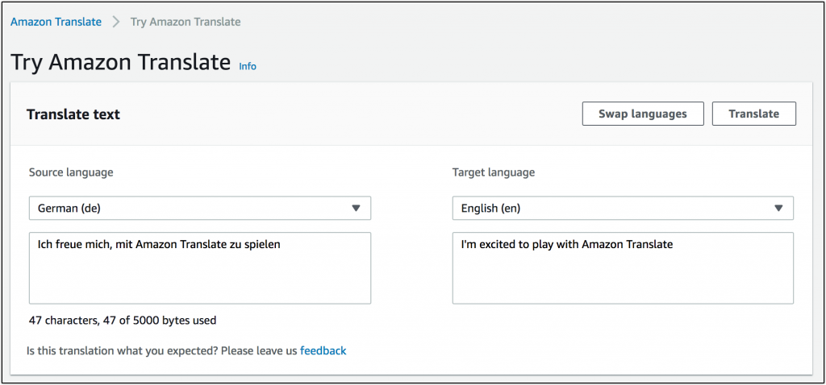
Example of machine translation in NLP
Notes:
~Alt text: Screenshot from the Amazon Translate console. A sentence is translated from German to English.

Slide 24

Text classification in NLP
Categorize text documents into predefined classes or categories, typically based on their content or topic.
Used in a variety of domains:
News: Categorize news articles into topics, such as sports, politics, or entertainment.
Social media: Categorize posts by sentiment (positive, negative, or neutral).
Ecommerce: Categorize product reviews into topics, such as quality, price, or customer service.
Customer service: Categorize customer feedback into topics, such as product issues or service quality.
Fraud detection: Categorize financial documents, such as loan applications or insurance claims, to identify potential fraud or risk.
Legal: Categorize legal documents, such as contracts or court cases, to identify relevant information and improve legal research and analysis.
Notes:
NLP is used for text classification by automatically categorizing text documents into predefined classes or categories, typically based on their content or topic

Slide 25
Text summarization in NLP
Generate a summary of a larger document or set of documents, typically with the goal of capturing the most important information in a condensed form.
Used in a variety of domains:
Business: Summarize business reports, such as market research or sales data.
News: Generate summaries of news articles.
Social media: Summarize social media posts.
Healthcare: Summarize medical documents, such as patient records.
Legal: Summarize legal documents.
Finance: Summarize financial reports and news articles.
Notes:
Text summarization applications are used in a variety of domains:
Business: Summarize business reports, such as market research or sales data, to enable improved decision-making and planning.
News: Summarize news articles to enable users to quickly understand the main points of a story.
Social media: Summarize social media posts to enable users to quickly understand the most important content.
Healthcare: Summarize medical documents, such as patient records or research papers, to enable improved clinical decision-making and research.
Legal: Summarize legal documents to enable improved legal research and analysis.
Finance: Summarize financial reports and news articles to enable users to quickly understand the most important information and trends.

Slide 26

Question answering in NLP
Answer questions from users, typically by extracting the relevant information from structured or unstructured data sources.
Used in a variety of domains:
Customer service: Answer frequently asked questions (FAQs) from customers to improve customer satisfaction.
Search engines: Answer queries from users to improve search results and user satisfaction.
Education: Answer questions from students.
Healthcare: Answer questions about medical conditions, treatments, and medications.
Legal: Answer legal questions about contracts, regulations, and court cases.
Financial services: Answer questions about financial products, such as loans or credit cards.

Slide 27

Generating natural language in NLP
Generate natural language text that conveys information from structured data or other sources.
Used in a variety of domains:
Ecommerce: Generate product descriptions, reviews, and recommendations.
Journalism: Generate news articles and summaries based on data sources.
Chatbots: Generate responses for chatbots.
Customer service: Generate personalized messages and responses in customer service interactions.
Healthcare: Generate patient reports, summaries, and recommendations based on medical data.
Finance: Generate financial reports and summaries based on financial data.
Notes:
Natural language generation applications are used in a variety of domains:
Ecommerce: Generate product descriptions, reviews, and recommendations based on user data to provide personalized product recommendations and improve the customer experience.
Journalism: Generate news articles and summaries based on data sources to provide personalized news content and improved journalism.
Chatbots: Generate responses for chatbots to provide better human-like interactions and improve customer service.
Customer service: Generate personalized messages and responses to improve customer satisfaction and retention.
Healthcare: Generate patient reports, summaries, and recommendations based on medical data to improve clinical decision-making and patient outcomes.
Finance: Generate financial reports and summaries based on financial data to automate financial analysis and reporting.

Slide 28


Information extraction in NLP
Identify and extract specific types of information from unstructured or semistructured textual data.
Used in a variety of domains:
Business intelligence: Extract data from financial reports and news articles.
Media monitoring: Monitor news articles and social media posts to identify key topics, sentiment, and other relevant information.
Customer service: Extract customer feedback and sentiment from customer service calls.
Academic research: Identify key topics and entities in academic literature.
Healthcare: Extract patient data from electronic health records (EHRs).
Legal: Extract key information from legal documents, such as contracts and patents.
Notes:
Information extraction applications are used in a variety of domains:
Business intelligence: Extract data from financial reports, news articles, and other business documents to automate data analysis and trend analysis.
Media monitoring: Monitor news articles and social media posts to identify key topics, sentiment, and other relevant information.
Customer service: Extract customer feedback and sentiment from customer service calls to improve customer service and product development.
Academic research: Automatically identify key topics and entities in academic literature to help researchers quickly identify relevant articles and research findings.
Healthcare: Automatically extract patient data from electronic health records (EHRs) to improve clinical decision-making, population health management, and medical research.
Legal: Automatically extract key information from legal documents, such as contracts or patents, to improve contract management and legal research.

Slide 29
NLP approaches and tools

Slide 30
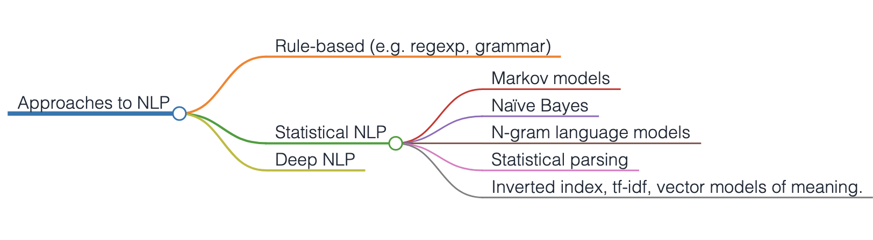
Approaches to NLP
Notes:
~Alt text: Mind map of the hierarchical relationship between the approaches of NLP and the associated subfields.
~
Rule-based NLP
Rule-based NLP involves creating a set of handcrafted rules that are applied to text to extract information or perform other tasks. For example, a rule-based NLP system might include rules to identify named entities, such as person names, company names, and locations, by searching for specific patterns of words and symbols in the text.
Statistical NLP
Statistical NLP involves using statistical models and ML algorithms to automatically learn patterns in text data. For example, a statistical NLP system might use an ML algorithm, such as a naive Bayes classifier, to classify text as positive or negative sentiment based on the frequency of certain words in the text.
Deep NLP
Deep NLP involves using deep neural networks, which are ML models that are composed of multiple layers of interconnected nodes, to analyze text data. Deep NLP models can be highly accurate for a range of tasks and can often learn to generalize to new language variations without requiring as much labeled training data as statistical models. However, deep NLP models can be complex to develop and train, and might require significant computing resources to run efficiently.
Each approach to NLP has advantages and disadvantages, and the choice of approach will depend on the specific task and the resources that are available.

Slide 31
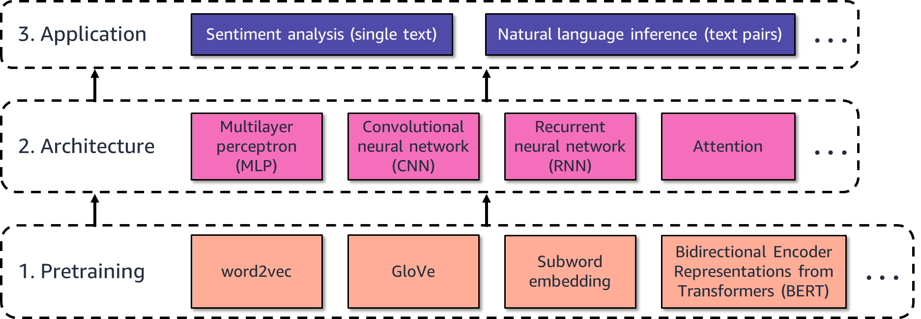
Deep NLP overview
Three main components:
Notes:
~Alt text: Components of NLP in a deep learning context. See detail in notes.
~ Image description: NLP in the context of deep learning has three main components. The first component is pretraining. Examples of pretraining include word2vec, GloVe, subword embedding, and Bidirectional Encoder Representations from Transformers (BERT). The second component is architecture. Types of architectures include multilayer perceptron (MLP), convolutional neural network (CNN), recurrent neural network (RNN), and attention. The third component is application. Examples of application include sentiment analysis (single text) and natural language inference (text pairs). End description.
Most of these concepts will be covered in this class.

Slide 32
NLP tools and technologies
Natural Language Toolkit (NLTK): Tokenization, stemming, tagging, parsing, and classification.
spaCy: Pretrained models for various languages. Offers features such as part-of-speech tagging, named entity recognition, and dependency parsing.
TensorFlow: Prebuilt models for text analysis, such as sentiment analysis and text classification, as well as tools to build custom models.
Gensim: Topic modeling and semantic analysis of large-scale text collections.
word2vec: A neural network-based approach to generate word embeddings, which are often used in tasks such as text classification and sentiment analysis.
Notes:
Natural Language Toolkit (NLTK) is a popular Python library to work with human language data. The toolkit provides various modules and algorithms for tasks such as tokenization, stemming, tagging, parsing, and classification.
spaCy is another popular NLP library for Python, and the library provides fast and efficient processing for natural language. spaCy includes pretrained models for various languages and offers features such as part-of-speech tagging, named entity recognition, and dependency parsing.
TensorFlow is an open source ML platform that Google developed. The platform can be used for a variety of tasks, including NLP. It provides a number of prebuilt models for text analysis, such as sentiment analysis and text classification, as well as tools to build custom models.
Gensim is a Python library for topic modeling and semantic analysis of large-scale text collections. It includes algorithms for document similarity, topic modeling, and word embedding, among others.
word2vec is a neural network-based approach to generate word embeddings, which are numerical representations of words that capture their meaning and context. It is often used in tasks such as text classification and sentiment analysis.

Slide 33
Other NLP tools and technologies
TextBlob
LexNLP
Holmes
Elasticsearch
Stanford NLP
GluonNLP
Hugging Face
PyTorch-Transformers
Amazon Comprehend
Notes:
Other NLP tools and technologies include the following:
Stanford NLP: The Stanford NLP Group developed this suite of NLP tools.
GluonNLP: This toolkit for NLP was built on top of the Gluon deep learning framework.
Hugging Face: This company provides a range of NLP tools and services, including pretrained models for various tasks, such as text classification.
PyTorch-Transformers: This is a Python library to work with pretrained transformer models, such as BERT and GPT-2.
Amazon Comprehend: Amazon Web Services (AWS) provides this cloud-based NLP service.
TextBlob: This Python library provides tools for tasks such as part-of-speech tagging, sentiment analysis, and noun phrase extraction. It also provides utilities to work with text data in various formats.
LexNLP: This is a Python library to work with legal text data. It includes tools for tasks such as entity recognition, citation extraction, and document classification.
Holmes: Holmes is an open source framework to build custom NLP pipelines. It provides tools for tasks such as tokenization and part-of-speech tagging.
Elasticsearch: This open source search and analytics engine includes support for NLP tasks such as entity recognition and document classification.

Slide 34

Next lesson
You will explore preprocessing text and vectorization.

Slide 36
Image source slide (for curriculum development use only)

Slide 37
Source graphic: Levels of linguistic knowledge
shallower
deeper
Notes:
~Source for slide 13

Slide 38
Source graphic: What is NLP?
Human language
Artificial intelligence
Computer engineering
NLP
Notes:
~Source for slide 16

Slide 39
Source graphic: NLP, NLU, and NLG
NLU
Text
Meaning
NLG
Notes:
~Source for slide 18

Slide 40
Source graphic: Deep NLP overview
3. Application
Sentiment analysis (single text)
Natural language inference (text pairs)
. . .
Multilayer perceptron (MLP)
Convolutional neural network (CNN)
Recurrent neural network (RNN)
Attention
2. Architecture
. . .
word2vec
GloVe
Subword embedding
Bidirectional Encoder Representations from Transformers (BERT)
1. Pretraining
. . .
Notes:
~Source for slide 31

