Slide 1
Recurrent Neural Networks
Application of Deep Learning to Text and Image Data
Module 2 – Lesson 4

Slide 2
Today’s activities
Regular neural networks compared to recurrent neural networks (RNNs)
RNN architecture
Advantages and disadvantages of RNNs

Slide 3
Reminder: Neural networks
Neural networks: Information travels from one layer to the next, following the pathways in the network.
Information goes from the input layer to the hidden layer and then to the output layer. (Examples are available on the next slide.)
Notes:
With neural networks, information goes from one layer to the next in the following order: input to hidden to output. The connections help to pass the information.

Slide 4
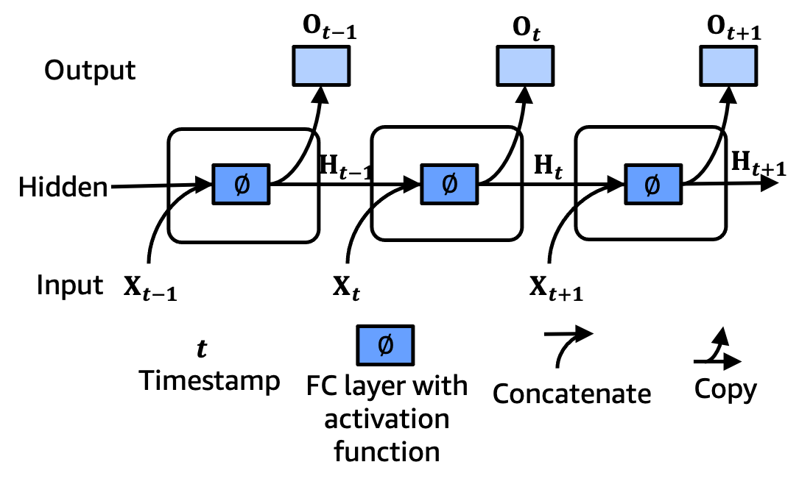
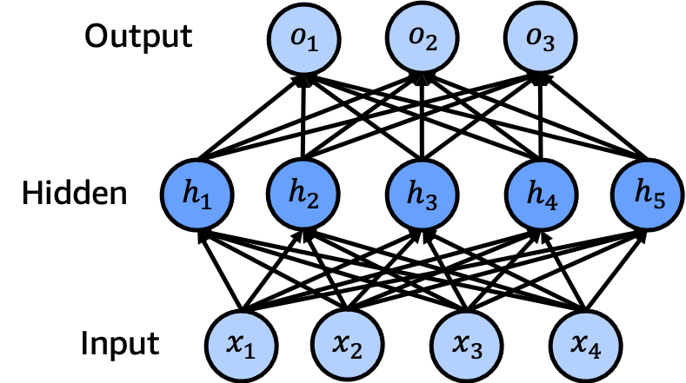
Recurrent networks: Modification
Feed-forward: Information travels from one layer to the next.
Recurrent: Information can travel from one unit to another within the same layer.
Notes:
~Alt text – feed-forward network: Figure of a multilayer neural network. See detail in notes.
~Alt text – recurrent network: Recurrent network with three sequential units. Each unit corresponds to one input.
~
Image description – feed-forward network: Figure of a multilayer neural network with three layers: input, hidden, and output. The input layer has four inputs, the hidden layer has five units, and the output layer has three units. End description.
In the feed-forward architecture, neurons (which are named h₁, h₂, h₃, h₄, and h₅ in the diagram) in the hidden layer don’t directly communicate with each other. If you pass some sequential information, the relationship between the inputs might get lost. Can this architecture be improved and those relationships preserved?
You can design a better system by allowing these neurons to communicate with each other:
In the recurrent architecture, you assign time step information with subscript t.
X_{t} is the current input, X_{t+1} is the next one, and so on.
Similarly, as you allow communication between the neurons, you use a concept called hidden state, which is shown as H_{t-1}, H_{t}, and H_{t+1} in the diagram on the slide. Hidden states go from one unit to the next and help build and preserve the relationship information between the units.
Therefore, a unit at time t uses X_{t} and H_{t-1} as inputs and produces the output O_{t} and the current hidden state H_{t}.
Time step t extends until the end of the time horizon that you use (in other words, the number of inputs).

Slide 5
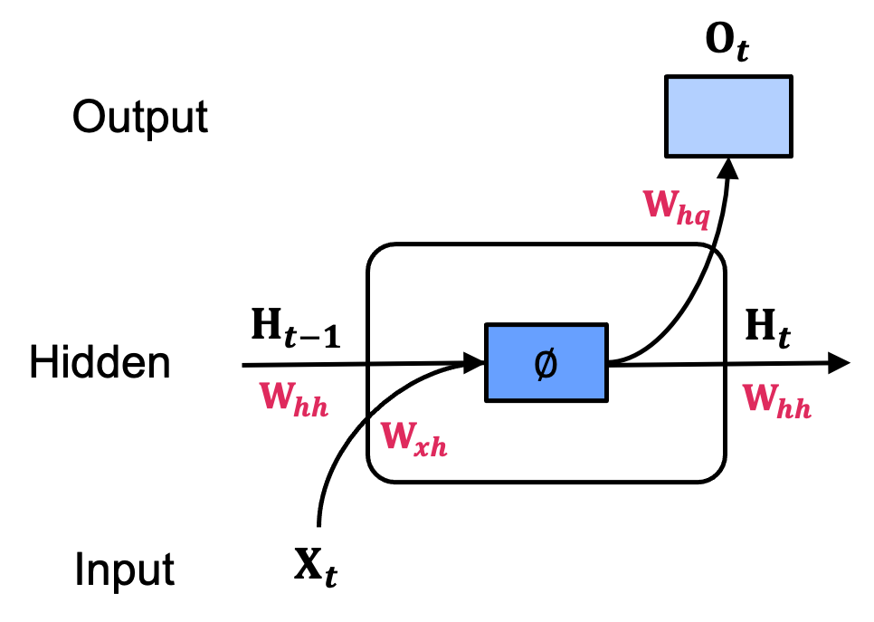


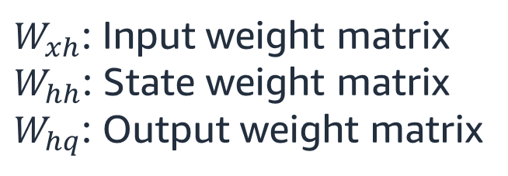
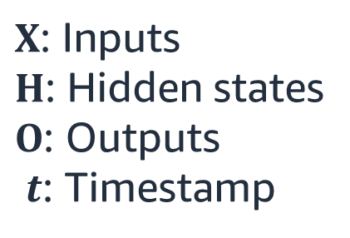
A simple recurrent unit
$W_{xh}$: Input weight matrix
$W_{hh}$: State weight matrix
$W_{hq}$: Output weight matrix
Hidden state update:
$$H_{t}=∅({H_{t−1}W}_{hh}+{X_{t}W}_{xh}+b_{h})$$
$X$: Inputs
$H$: Hidden states
$O$: Outputs
$t$: Timestamp
Observation update (output):
$$o_{t}=H_{t}W_{hq}+b_{q}$$
Notes:
~Equations
~alt text: Single RNN unit. See details in notes.
~
Image description: Single RNN unit with input, hidden, and output layers. Multiple weights are associated with the input (𝑾_{𝒙𝒉}), hidden state (𝑾_{𝒉𝒉}), and output (𝑾_{𝒉𝒒}). End description.
This slide looks at an individual unit and its details. Multiple weights are associated with the input, hidden state, and output:
$W_{xh}$: Input weight matrix
$W_{hh}$: State weight matrix
$W_{hq}$: Output weight matrix
The hidden state is updated by multiplying the previous hidden state $H_{t−1}$ with the corresponding weight matrix $W_{hh}$, and then adding the multiplication between the current input $X_{t}$ and the corresponding weight matrix $W_{xh}$ and bias weight $b_{h}$. This summation goes through the activation function $∅$.
Output (observation update) is calculated by multiplying the current hidden state $H_{t}$ and output weight matrix $W_{hq}$ and adding the bias $b_{q}$.

Slide 6
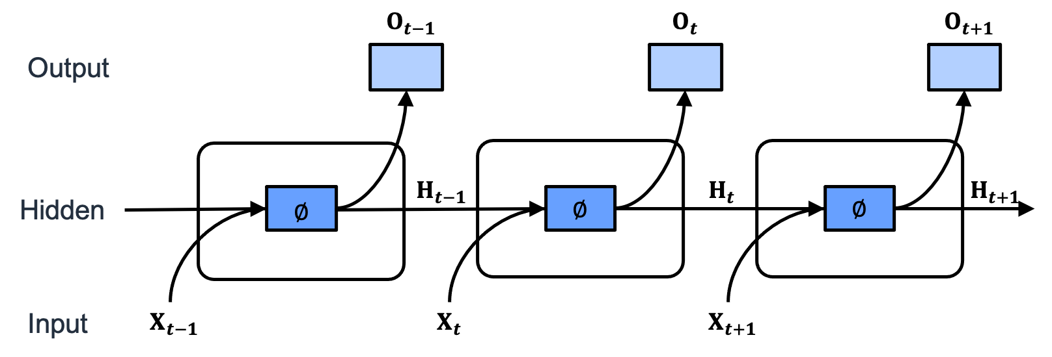
Hidden states
RNNs can use internal (hidden) state to preserve the sequential information between elements in the same sequences.
Notes:
~Alt text: Multiple RNN units. Each unit is connected to the next unit.
~
In the diagram on the slide, the hidden states (shown with H_{t-1}, H_{t}, and H_{t+1}) are emphasized. Hidden states are tools to model, update, and preserve the sequence information as you move from one unit (current time step) to another (the next time step).

Slide 7
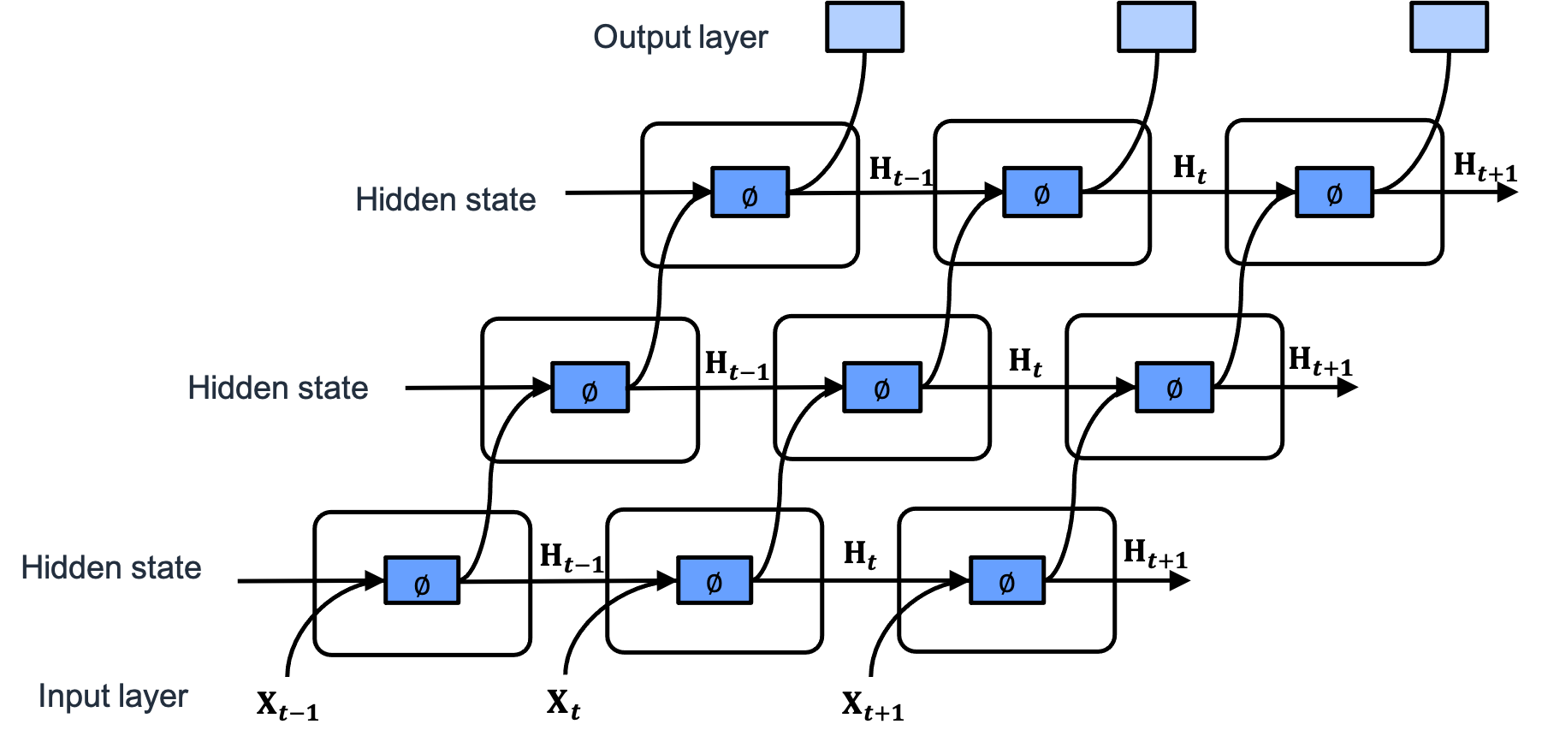
Stacking RNNs
The depth can be increased by stacking RNNs.
Notes:
~Alt text: Stack of thee RNNs. See detail in notes.
~
Image description: Stack of three RNNs. Outputs from one layer are the inputs of the next layer. At the end, the output of the whole system comes from the output of the last layer. End description.
You can build multilayer neural networks by stacking multiple layers. You can also do this with RNNs. You simply connect the outputs from one layer to the inputs of the next layer. At the end, the output of the system comes from the output of the last layer.

Slide 8
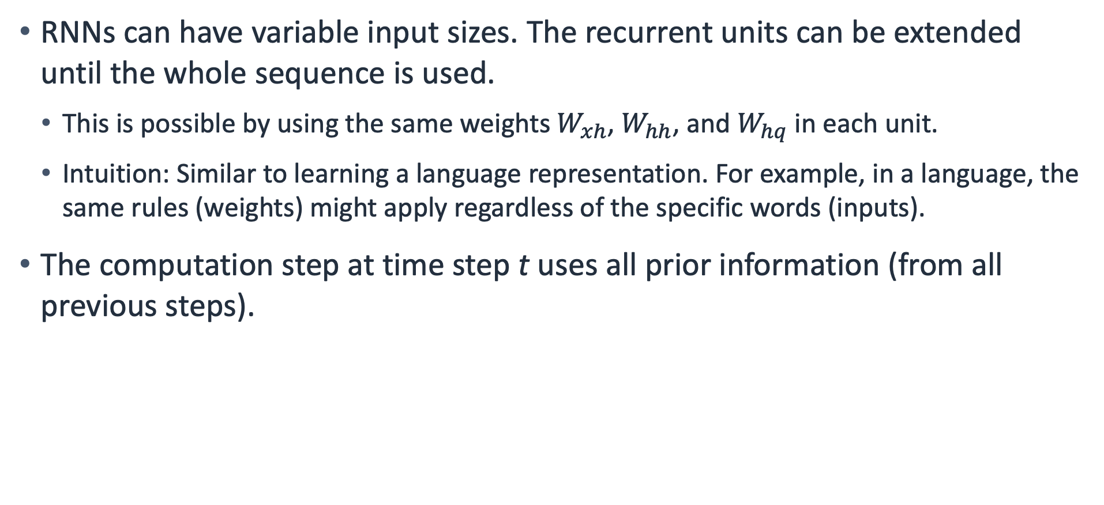
Advantages of RNNs
RNNs can have variable input sizes. The recurrent units can be extended until the whole sequence is used.
This is possible by using the same weights $W_{xh}$, $W_{hh}$, and $W_{hq}$ in each unit.
Intuition: Similar to learning a language representation. For example, in a language, the same rules (weights) might apply regardless of the specific words (inputs).
The computation step at time step t uses all prior information (from all previous steps).
Notes:
~Equations

Slide 9
Problems with RNNs
Slow when training and making predictions
Data needs to be processed in sequence (not parallel)
Backpropagation through time (BPTT)
Vanishing (or exploding) gradients
Long-term dependency problem: Hidden states get corrupted with long sequences. RNNs can forget the initial parts of the sequence.
Notes:
RNNs are inherently slow. All time steps in the data need to be processed. During the training and backpropagation, similarly, you would need to consider all time steps. During the training, the backpropagation process is applied as backpropagation through time (BPTT), which uses all time steps of the input. This is an additional burden in terms of the time commitment for training.
Vanishing (or exploding) gradients: During the backpropagation process, the math formula that gives the gradients involves many multiplicative terms because it has multiple steps. Due to the nature of the multiplication, if the multiplication operation has many small values, the whole value gets very small, which leads to vanishing gradients. Additionally, large values get even larger when multiplied, which leads to exploding gradients.
Long-term dependency problem: As the sequence length increases, it becomes more difficult to keep track of the overall relationship between the time steps and the early information. The information that passed using the hidden state can get corrupted. This is called the long-term dependency problem. RNNs work better with short sequences.

Slide 10
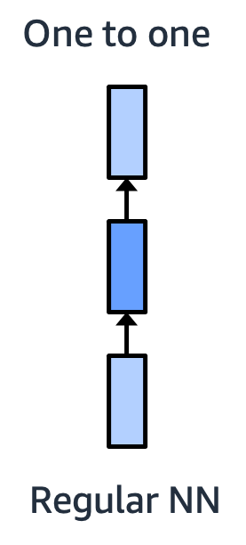
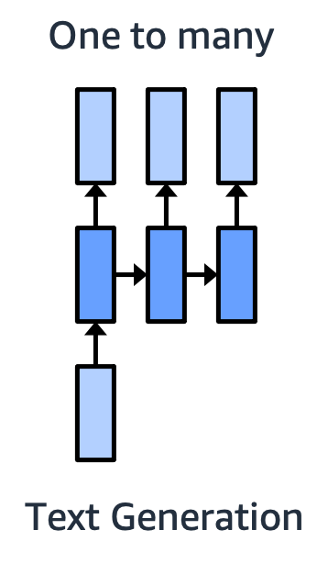
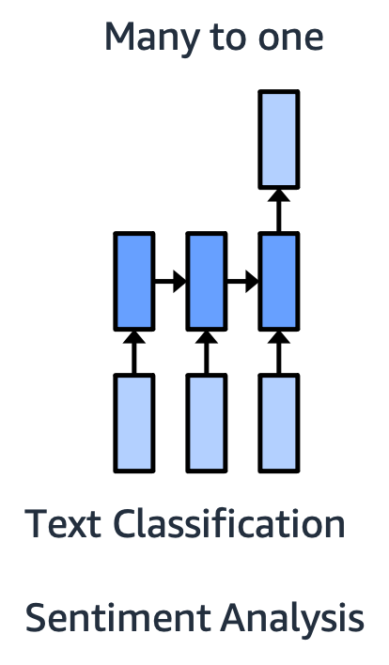
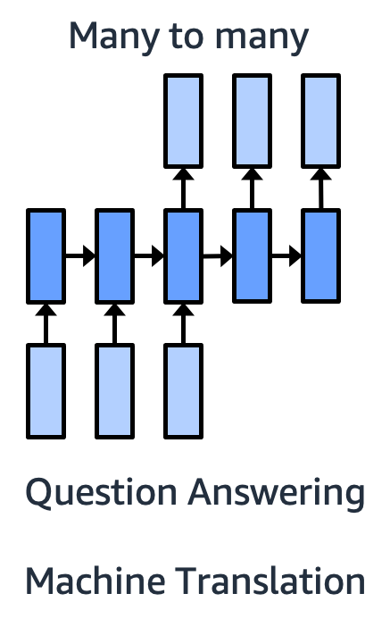
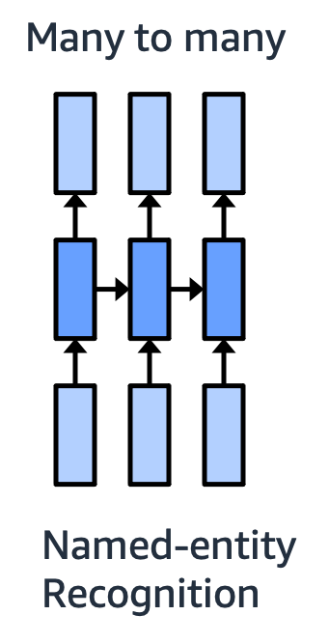
RNNs with different applications
Notes:
~Alt text – one to one: One to one architecture. A single input produces a single output.
~Alt text – one to many: One to many architecture. A single input produces more than one output.
~Alt text – many to one: Many to one architecture. See detail in notes.
~Alt text – many to many, question answering example: Many to many architecture for question answering. See detail in notes.
~Alt text – many to many, named entity recognition example: Many to many architecture for named entity recognition. Multiple inputs produce multiple outputs.
~
You can put the components of an RNN together in different ways to build different applications:
One to one: Simple one input to one output prediction. This is the same as a regular neural network.
One to many: Multiple outputs are produced from a single input. An example is generating a text description of an image.
Many to one: This configuration can be used for simple text classification. Multiple inputs are the words or tokens in the input sentence. The single output is the class of the sentence—for example, whether the sentence is positive or negative.
Many to many: Consider two use cases: question answering and named entity recognition.
In the question answering example, a hidden state is built and then used to start producing the outputs. This is also called the encoder-decoder architecture, where the encoder part finishes processing the inputs and then produces the outputs with the decoder part. Example: language translation where there is an input sentence (sequence of words) in one language and an output sentence (sequence of words) produced in another language.
The second example is for named-entity recognition. In this task, you identify information or entities in text. For example, the model determines what part of speech a word is, such as a noun or verb, or identifies known entities, such as company names.

Slide 11
Variations of RNNs
Variations of RNNs propose additional mechanisms to handle the long-term dependency problem.
Gated recurrent units (GRUs): These models propose two gates, update and reset, to learn to write to and clear the hidden states.
Long short-term memory (LSTM) networks: In addition to the hidden states, and update and reset gates, a separate memory mechanism acts like a memory for the whole sequence.
Notes:
Variations of RNNs include gated recurrent units (GRUs) and long short-term memory (LSTM) networks:
GRU: The model uses two gates, update and reset, to manage the hidden states. For more information, see Gated Recurrent Units (GRU) in Dive into Deep Learning at https://d2l.ai/chapter_recurrent-modern/gru.html.
LSTM network: This is a more advanced GRU model. Additionally, a memory concept acts like a memory of the sequence. For more information, see Long Short-Term Memory (LSTM) in Dive into Deep Learning at https://d2l.ai/chapter_recurrent-modern/lstm.html.

Slide 12
Summary
This lesson covered a new type of neural network that is effective for sequences.
By using hidden states, you can build and preserve the sequence information.
Although RNNs have hidden states, they tend to have trouble with long sequences. The early information can get lost or modified.
Variations of RNNs, such as GRUs and LSTM networks, try to preserve the long-term information through special gating mechanisms.

Slide 13

Next lesson
You will explore examples of neural networks.

