Slide 1
RNN Example with a Practical Dataset
Application of Deep Learning to Text and Image Data
Module 2 – Lesson 5

Slide 2
Today’s activities
Using PyTorch to implement an RNN

Slide 3
The ML problem
Real-world problem
It’s important for an online store to offer only the best products to its customers.
To do that, the company needs to identify whether customers are happy with the products that they offer.
ML solution: Create a model that implements sentiment analysis based on customer reviews.

Slide 4
The model
This lesson will examine one possible solution, step by step:
Implement a recurrent neural network (RNN)
Use the PyTorch deep learning framework
Use a practical dataset
Notes:
PyTorch is a popular deep learning framework that simplifies the processes of building, training, and evaluating deep neural networks. It uses automatic differentiation to compute gradients efficiently during backpropagation. PyTorch uses tensors (multidimensional arrays) for all data operations.

Slide 5
Importing PyTorch libraries
# Import the main PyTorch package
import torch
# Import submodules: nn: neural network, optim: optimization algorithms
from torch import nn, optim
# Import classes to manipulate datasets and tensors
from torch.nn import BCEWithLogitsLoss
from torch.utils.data import TensorDataset, DataLoader
Notes:
The example code includes the following:
torch: The main PyTorch package. It provides a range of functions to build and train neural networks. For more information, see torch in the PyTorch documentation at https://pytorch.org/docs/stable/torch.html.
nn: A submodule of PyTorch that contains various classes—such as Linear, Conv2d, and long short-term memory (LSTM)—to define neural network layers.
optim: A submodule of PyTorch that contains optimization algorithms—such as stochastic gradient descent (SGD), Adam, and AdaGrad—to train neural networks.
BCEWithLogitsLoss: A class from nn that computes the binary cross-entropy loss between a set of logits (that is, unnormalized predictions) and a set of binary labels.
TensorDataset: A class from torch.utils.data that represents a dataset of input/output pairs, where each input and output is a PyTorch tensor.
DataLoader: A class from torch.utils.data that wraps a TensorDataset and provides an iterator interface to efficiently load batches of data during training.

Slide 6
Importing text-related PyTorch libraries
The torchtext package contains data processing utilities and popular datasets for NLP.
import torchtext
from torchtext.vocab import Vocab
from torchtext.data.utils import get_tokenizer
from torchtext.vocab import Glove
The vocab class defines a vocabulary object.
The get-tokenizer function generates tokenizers for a string sentence.
GloVe provides vector representations from pretrained word embeddings.
Notes:
For information about the torchtext package, see the TorchText documentation at https://pytorch.org/text/stable/#torchtext.

Slide 7
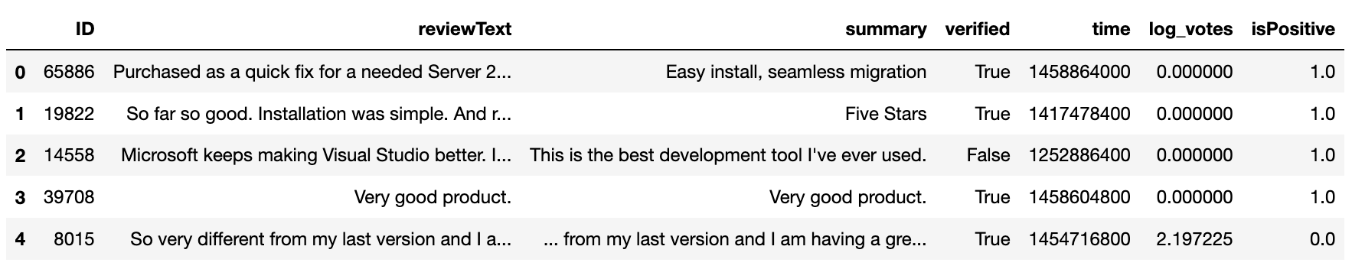
Reading the dataset
# Read the review dataset and output the first five rows
df = pd.read_csv( “NLP-REVIEW-DATA-CLASSIFICATION-TRAINING.csv” )
df.head()
Notes:
~Alt text: Screenshot of the first five rows of the DataFrame. See details in notes.
~
Image description: Screenshot of the first five rows of the DataFrame and their column names: ID, reviewText, summary, verified, time, log_votes, and isPositive. End description.
The code snippet on this slide reads in a .csv file named NLP-REVIEW-DATA-CLASSIFICATION-TRAINING.csv and assigns it to a Pandas DataFrame object that is nameddf. The .head() method is then called on this DataFrame object to display the first five rows of the DataFrame and the column names.

Slide 8
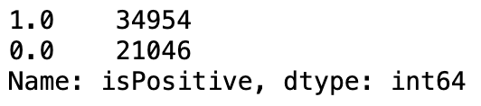
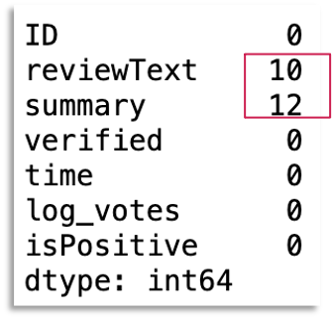
Performing basic EDA
# Check for imbalanced labels
df[“isPositive”].value_counts()
# Identify missing values
print(df.isna().sum())
# Fill in missing values
df[“reviewText”] = df[“reviewText”].fillna(“missing”)
Notes:
~Alt text – image 1: First line: 1.0, 34954. Second line: 0.0, 21046.
~Alt text – image 2: Screenshot of output, which includes column names and the number of missing values for each column. Missing values for reviewText and summary columns are 10 and 12 respectively. Missing values are zero for the rest of the columns: ID, verified, time, log_votes, isPositive.
~
The Pandas DataFrame offers several useful functions and modules to perform exploratory data analysis (EDA), including the following:
value_counts(): Returns the number of occurrences of each category. In the example on the slide, the function is used to count the number of occurrences of categories of the isPositive column.
isna(): Returns the missing values in each column of a given DataFrame.
sum(): Adds all the elements in a list (or a supporting data structure).
fillna(): Replaces the missing values of a given data structure by using a defined strategy. In the example on the slide, the missing values are replaced with the string “missing.”

Slide 9
Splitting the training and validation datasets
# Separate 10% for the validation dataset
train_text, val_text, train_label, val_label = train_test_split(
df[“reviewText”].tolist(),
df[“isPositive”].tolist(),
test_size = 0.10,
shuffle = True,
random_state = 324
)
Remember: Always shuffle before splitting!
Notes:
Sklearn’s train_test_split function uses array-like structures. The allowed inputs are lists, NumPy arrays, SciPy-sparse matrices, and Pandas DataFrames. Tensors, which are the preferred data structures in PyTorch, aren’t compatible with sklearn’s modules.
The test_size parameter can either be a float that represents the portion of the dataset to include in the test split, or it can be an integer that represents the absolute number of test samples.
The random state controls the shuffling that is applied to the data before the split. The random state is often used to generate reproducible outputs across multiple function calls.

Slide 10
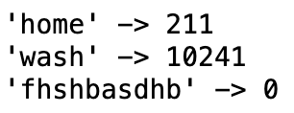
Transforming the text
# Use get_tokenizer to extract tokens from the text
# Use Vocab to create a vocabulary with the tokens
tokenizer = get_tokenizer(“basic_english”)
counter = Counter()
for line in train_text:
counter.update(tokenizer(line))
vocab = Vocab(counter, min_freq = 2) # min_freq>1 for skipping misspelled words
# Print examples
print(f“‘home’ -> {vocab[‘home’]}”)
print(f“‘wash’ -> {vocab[‘wash’]}”)
# unknown word (assume from test set)
print(f“‘fhshbasdhb’ -> {vocab[‘fhshbasdhb’]}”)
Notes:
~Alt text: Screenshot of output from the example print commands: "home" outputs 211, "wash" outputs 10241, and "fhshbasdhb" outputs 0.
~
get_tokenizer requires a tokenizer function to generate tokens or requires the language to select a preselected tokenizer for the specified language.
vocab is used to generate a vocabulary based on the training data. The min_freq parameter is set to 2 to avoid any misspelled words to be added in the vocabulary. This parameter can also be used to control the size of the vocabulary and prevent rare words, such as proper nouns, which often don’t contribute as much to the meaning of the text.

Slide 11
Transforming the text: Mapping tokens
Use the vocabulary to map tokens in the text and see what happens for one row of the training dataset.
# Create a mapper to transform the text data
text_transform_pipeline = lambda x: [vocab[token] for token in tokenizer(x)]
# Display results
print(f“Before transform:\t{train_text[37]}”)
print(f“After transform:\t{text_transform_pipeline(train_text[37])}”)
Before transform: Happy to own it.
After transform: [321, 6, 237, 8, 2]

Slide 12
Transforming the text: Creating a function
Create a function to work on the full training dataset.
# Use the dictionary to tokenize each review in reviews_split
# Store the tokenized reviews in reviews_ints
def pad_features(reviews_split, seq_length):
reviews_ints = []
for review in reviews_split:
reviews_ints.append(text_transform_pipeline(review))
# Get the correct rows x columns shape
features = np.ones((len(reviews_ints), seq_length), dtype=int)
# For each review, grab that review
for i, row in enumerate(reviews_ints):
features[i, -len(row):] = np.array(row)[:seq_length]
return torch.tensor(features, dtype=torch.int64)
Notes:
The pad_features function allows all transformed text to have the same sequence length of 50. An example is shown on the next slide. The 1s represent the padding that is applied to maintain the sequence length.

Slide 13
Transforming the text: Example
An example for one row of the training dataset:
for text in train_text[9:10]:
print(f“Text: {text}\n”)
print(f“Original length of the text: {len(text)}\n”)
tt = pad_features([text], seq_length = 50)
print(f“Transformed text: \n{tt}\n”)
print(f“Shape of transformed text: {tt.shape}\n”)
Text: Didnt give a 5 because I don’t know what I need. I like it great
Original length of the text: 64
Transformed text:
Tensor([[ 1, 1, 1, 1, 1, 1, 1, 1, 1, 1, 1, 1,
1, 1, 1, 1, 1, 1, 1, 1, 1, 1, 1, 1,
1, 1, 1, 1, 1, 1, 1, 1, 4934, 240, 9, 189,
100, 4, 85, 10, 25, 155, 67, 4, 109, 2, 4, 60,
8, 68]])
Shape of transformed text: torch.Size([1,50])

Slide 14
Generating the data batch and iterator
Generate the batch and iterator to offer the data to the model.
max_len = 50 # Consider only the first 50 words
batch_size = 64 # Define the batch size
# Dataset wrapping tensor, preparing the training data to feed the model
train_dataset = TensorDataset(
pad_features(train_text, max_len),
torch.tensor(train_label, dtype=torch.float32))
# Combine a dataset and a sampler, and provide an iteration over the training dataset
train_loader = DataLoader(train_dataset, batch_size=batch_size)
# Repeat for the validation dataset
val_dataset = TensorDataset(
pad_features(val_text, max_len),
torch.tensor(val_label, dtype=torch.float32))
val_loader = DataLoader(val_dataset, batch_size=batch_size)

Slide 15
Using pretrained GloVe word embeddings
In this example, use GloVe word vectors:
name='6B' dim=300 gives 6 billion word/phrase vectors
Each word vector has 300 numbers in it
glove = Glove(name=“6B”, dim = 300)
embedding_matrix = glove.get_vecs_by_tokens(vocab.itos)
Notes:
You can use the GloVe algorithm to obtain word embeddings by using unsupervised learning. In this example, a pretrained model is used to generate the word embeddings. The GloVe 6B model was trained on Wikipedia 2014 and Gigaword5, and it contains six billion unique tokens in its vocabulary. The dim parameter determines the dimension of the word embedding.
For more information about GloVe, see the GloVe: Global Vectors for Word Representation page at https://nlp.stanford.edu/projects/glove.
For more information about Gigaword5, see English Gigaword Fifth Edition on the Linguistic Data Consortium page at https://catalog.ldc.upenn.edu/LDC2011T07.

Slide 16
Setting hyperparameters and building the network
# Define RNN hyperparameters, size of the hidden state vectors
hidden_size = 128
# Define general neural network training hyperparameters
learning_rate = 0.0001
epochs = 15
# Define embedding vector and vocabulary size hyperparameters
embed_size = 300 # glove.6B.300d.txt
vocab_size = len(vocab.itos)

Slide 17
Defining a neural network: init constructor
This is the Net class from PyTorch:
Class Net(nn.Module):
def __init__(self, vocab_size, embed_size, hidden_size, num_layers=1):
def forward(self, inputs):
The init constructor receives the hyperparameters and does the following:
# Initiate embedding
def __init__(self, vocab_size, embed_size, hidden_size, num_layers=1):
super().__init__()
self.embedding == nn.Embedding(vocab_size, embed_size, padding_idx = 1)
# Instantiate the RNN layer
self.rnn = nn.RNN(
embed_size, hidden_size, num_layers=num_layers, batch_first=True
)
self.linear = nn.Linear(hidden-size, 1) # Instantiate the linear output layer
self.act = nn.Sigmoid() # Instantiate the sigmoid activation function

Slide 18
Defining a neural network: forward function
Class Net(nn.Module):
def __init__(self, vocab_size, embed_size, hidden_size, num_layers=1):
def forward(self, inputs):
The forward function performs the forward propagation:
# Receive input data and call the embedding layer
def forward(self, inputs):
embeddings = self.embedding(inputs)
# Receive the embedding layer output and call the RNN layer
outputs, _ = self.rnn(embeddings)
# Receive the RNN layer output and call the linear layer
# Output shape after RNN
outs = self.linear(outputs[:, -1, :])
return self.act(outs)
Notes:
The forward function is used for prediction or a forward pass. It starts by generating embeddings from the text input, followed by the RNN module to model this sequential data. Finally, a linear output layer processes the output of the RNN module and transforms it using the sigmoid activation for the binary classification task.

Slide 19
Defining a function to initialize the weights
Before initializing the neural network model, define the function that initializes the weights.
# Initialize the weights
def init_weights(m):
# Receive the model as input
if type(m) == nn.Linear:
# Use Xavier initialization for the weights in the linear layer
nn.init.xavier_uniform_(m.weight)
if type(m) == nn.RNN:
for param in m._flat_weights_names:
if “weight” in param:
# Use Xavier initialization for the weights in the RNN layer
nn.init.xavier_uniform_(m._parameters[param])

Slide 20
Initializing the neural network (1 of 3)
Now, initialize the neural network.
# Architecture with two RNN layers
# Instantiate the model
model = Net(vocab_size, embed_size, hidden_size, num_layers=2)
# Set the embedding layer’s parameters from GloVe by using the embedding matrix loaded before your code
model.embedding.weight.data.copy_(embedding_matrix)
# Don’t change or train the embedding layer. You are using pretrained weights,
# so you don't want to change them with gradient descent.
model.embedding.weight.requires_grad = False
# Initialize the weights by using the function that you defined previously
model.apply(init_weights)

Slide 21
Initializing the neural network (2 of 3)
After initialization, the output describes your neural network architecture.
The embedding layer has:
Dictionary of size 26300
Embedding vectors of size 300 (the embedding dimension)
Net(
(embedding): Embedding(26300, 300, padding_idx=1)
(rnn): RNN(300, 128, num_layers=2, batch_first=True)
(linear): Linear(in_features=128, out_features=1, bias=True)
(act): Sigmoid()
)
Each RNN layer has:
Input size 300 (same as the embedding dimension)
Hidden state vector of size 128
Two layers
Notes:
~Alt text: It highlights the input and output dimensions of each RNN layer and number of layers 2.
~

Slide 22
Initializing the neural network (3 of 3)
After initialization, the output describes your neural network architecture.
Net(
(embedding): Embedding(26300, 300, padding_idx=1)
(rnn): RNN(300, 128, num_layers=2, batch_first=True)
(linear): Linear(in_features=128, out_features=1, bias=True)
(act): Sigmoid()
)
The linear (output) layer has:
Input vector of size 128
Output of size 1 (the prediction output)
The output activation function is a sigmoid function.
The linear output size of one associated with the sigmoid function gives the prediction for your classification problem (sentiment analysis).
Notes:
~Alt text: It highlights the input and output dimensions of each RNN layer and number of layers 2.
~

Slide 23
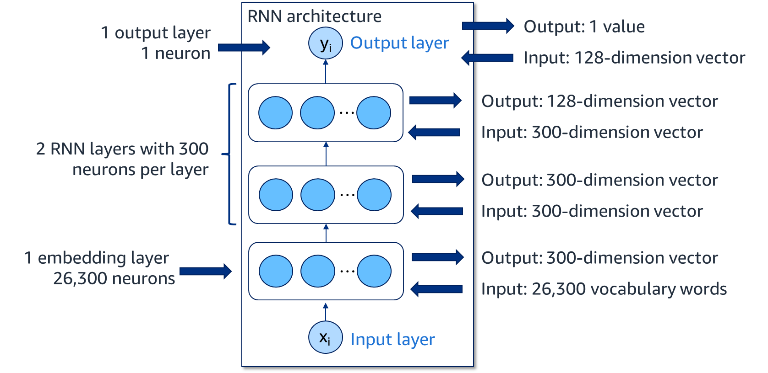
The RNN architecture initialized
Notes:
~Alt text: RNN architecture. See detail in notes.
~
Image description: Typical RNN architecture with input layer x_i, output layer y_i, and one embedding layer of 26,300 neurons. The architecture also has two RNN layers with 300 neurons in each layer. End description.

Slide 24
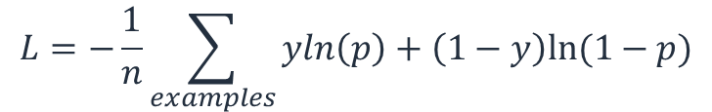
Training the neural network (1 of 3)
First, define the loss function: binary cross-entropy for sentiment analysis problem.
$$L=−\frac{1}{n}\sum_{examples}{yln\left(p\right)+\left(1−y\right)ln⁡(1−p)}$$
Set up the trainer object that will handle the optimization process by using stochastic gradient descent (SGD).
# Set the trainer
trainer = torch.optim.SGD(model.parameters(), lr = learning_rate)
# Use binary cross-entropy loss
# Reduction = “sum” sums the losses for the given output and target
cross_ent_loss = nn.BCELoss(reduction = “sum”)
Notes:
~Equations

Slide 25
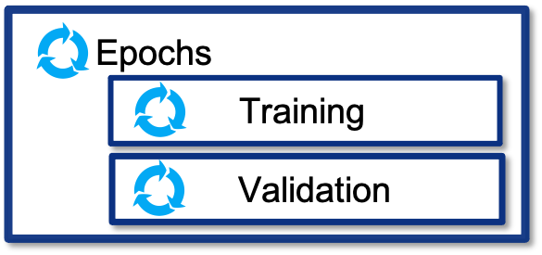
Training the neural network (2 of 3)
This is a classical approach to train a model.
# Get the compute device
model.to(device)
# Epoch loop
# For each epoch, run the training and validation iterations on the full datasets:
# Training and validation
for epoch in range(epochs):
# Training loop, train the network
# Training iteration runs on full training dataset, optimizing the model
for data, target in train_loader:
# Here comes the code to run for each training batch
for data, target in val_loader:
# Here is the code to run for each validation batch

Slide 26
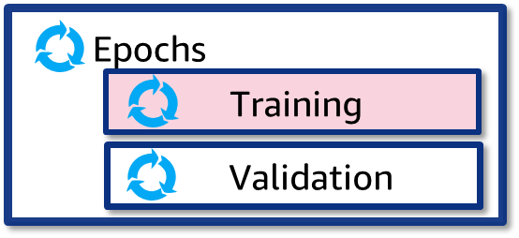
Training the neural network (3 of 3)
Details of the training iteration are described in the following code.
Optimization steps include the forward pass, loss function calculation, and backpropagation.
# Training loop, train the network
for data, target in train_loader:
trainer.zero_grad() # 1. Set the gradients of all optimized tensors to zero
data = data.to(device) # 2. Instantiate GPU device for training
target = target.to(device)
# 3. Input the training data; output the predictions and perform forward pass
output = model(data)
# 4. Apply the loss function, comparing prediction and label
L = cross_ent_loss(output, target.unsqueeze(1))
training_loss += L.item() # 5. Summarize the loss per epoch for further plotting
L.backward() # 6. Apply backpropagation, calculating gradient descent
trainer.step() # 7. Get the next data sample for next iteration

Slide 27
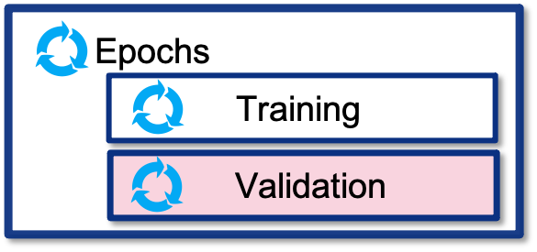
Training the neural network: Validation iteration
Details of the validation iteration are described in the following code.
Notice that no training occurs, so optimization steps aren’t included.
# Validate the network, no training (no weight update)
for data, target in val_loader:
# Input the validation data into the trained model
val_predictions = model(data.to(device))
# Apply the loss function, comparing prediction and label
L = cross_ent_loss(val_predictions, target.to(device).unsqueeze(1))
# Summarize the validation loss per epoch for further plotting
val_loss += L.item()

Slide 28
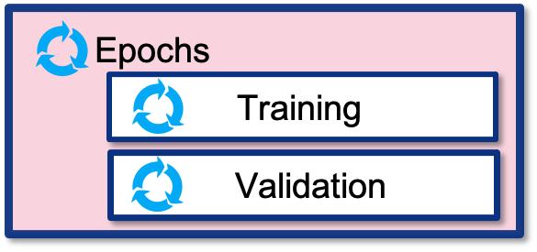
Training the neural network: Epoch iteration
# Initialize loss function summary variable per epoch
for epoch in range(epochs):
start = time.time()
training_loss = 0
val_loss = 0
# Training loop, train the network
for data, target in train_loader:
# code to run for each training batch
# Validate the network
for data, target in val_loader:
# code to run for each validation batch
# Take the average losses per epoch and print the results
training_loss = training_loss / len(train_label)
val_loss = val_loss / len(val_label)
end = time.time()
print(
f“Epoch {epoch}. Train_loss {training_loss}. Val_loss {val_loss}. Seconds {end-start}”
)
This code
shows
the epoch iteration.

Slide 29
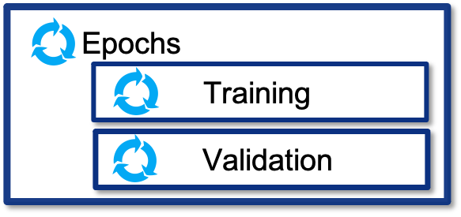
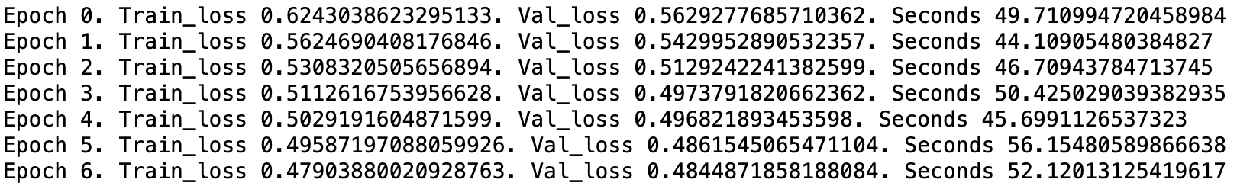
Training the neural network: Epoch iteration output
This slide displays the output per epoch for seven epochs.
Notes:
~Alt text: Example of output per epoch for seven epochs. Results include Train_loss, Val_loss, and how many seconds were spent. It starts from epoch 0.

Slide 30
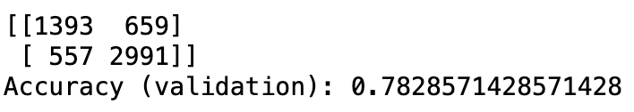
Metrics for classification
Print the confusion matrix and accuracy score.
print(confusion_matrix(val_label, val_predictions))
print(classification_report(val_label, val_predictions))
print(“Accuracy (validation):”, accuracy_score(val_label, val_predictions))
Remember that a good qualitative shape for a confusion matrix has higher numbers for both values in this diagonal (true positives and true negatives).
Notes:
~Alt text – output screenshot: Screenshot of output. See details in notes.
~Alt text – true positives value: Number of true positives is 1393.
~Alt text – true negatives value: Number of true negatives is 2991.
~
Image description: Screenshot of the output of the code. Includes the accuracy based on the confusion matrix values, including true positives, true negatives, and the accuracy (total of true positives and true negatives divided by the total number). End description.

Slide 31
Test the classifier on the unseen test data (1 of 2)
Next, read and process unseen data to make predictions.
# Read test data
df_test = pd.read_csv(“data/examples/NLP-REVIEW-DATA-CLASSIFICATION-TEST.csv”)
# Fill in missing values
test_text = df_test[“reviewText”].fillna(value=“missing”).tolist()
# Prepare data for PyTorch
test_dataset = TensorDataset(pad_features(test_text, max_len))
test_loader = DataLoader(test_dataset, batch_size=batch_size)

Slide 32
Test the classifier on the unseen test data (2 of 2)
Get the predictions for the 10 first data samples.
val_predictions = []
for data, target in val_loader:
val_preds = model(data.to(device))
val_predictions.extend(
[np.rint(val_pred)[0] for val_pred in val_preds.detach().cpu().numpy()]
)
print(val_predictions[:10])
Remember your business problem: sentiment analysis on customer reviews:
1 means positive sentiment
0 means negative sentiment
Notes:
~Alt text: List of values: 1.0, 1.0, 1.0, 0.0, 1.0, 1.0, 1.0, 0.0, 1.0, 1.0.

Slide 33
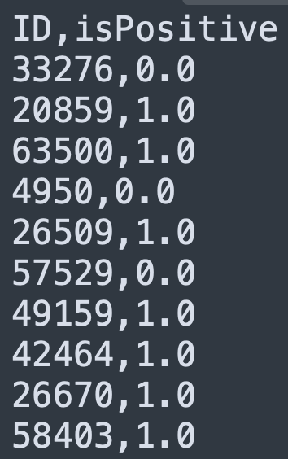
Saving the predictions
Save the predictions in a simple .csv format file.
These files usually contain only the prediction value and the associated ID for each row.
import pandas as pd
result_df = pd.DataFrame()
result_df[“ID”] = df_test[“ID”]
result_df[“isPositive”] = test_predictions
result_df.to_csv(“result_rnn.csv”, encoding=“utf-8”, index=False)
This file can be offered, for example, to the client application that will handle the predictions.
Notes:
~Alt text: Example .csv output. See details in notes. ~
Image description: Example .csv output. The output contains two columns: ID and isPositive. The values for ID are four or five digits long, and the values for isPositive are 0 or 1. End description.

Slide 34

Next lesson
The next lesson will explore computer vision (CV).

Slide 36
Image source slide (for curriculum development use only)

Slide 37
Source graphic: The RNN architecture initialized
RNN architecture
1 output layer
1 neuron
Output: 1 value
y_{i}
Output layer
Input: 128-dimension vector
…
Output: 128-dimension vector
Input: 300-dimension vector
2 RNN layers with 300 neurons per layer
…
Output: 300-dimension vector
Input: 300-dimension vector
1 embedding layer
26,300 neurons
…
Output: 300-dimension vector
Input: 26,300 vocabulary words
x_{i}
Input layer
Notes:
~Source for slide 24

Slide 38

Source graphic
Epochs
Epochs
Training
Training
Validation
Validation
Epochs
Epochs
Training
Training
Validation
Validation
Notes:
~Source for the Epochs graphic that appears on slides 26–30

