Slide 1
How Are Images Stored in a Computer?
Application of Deep Learning to Text and Image Data
Module 3 – Lesson 1

Slide 2
Today’s activities
Computer vision (CV) problems
Image representation

Slide 3
CV problems
Notes:
Before talking about how images are stored on computers, let’s look at typical computer vision (CV) problems. We will explore what kind of tasks you can solve by using image data.

Slide 4
Three types of CV problems in this lesson
Image classification
Object detection
Semantic segmentation

Slide 5
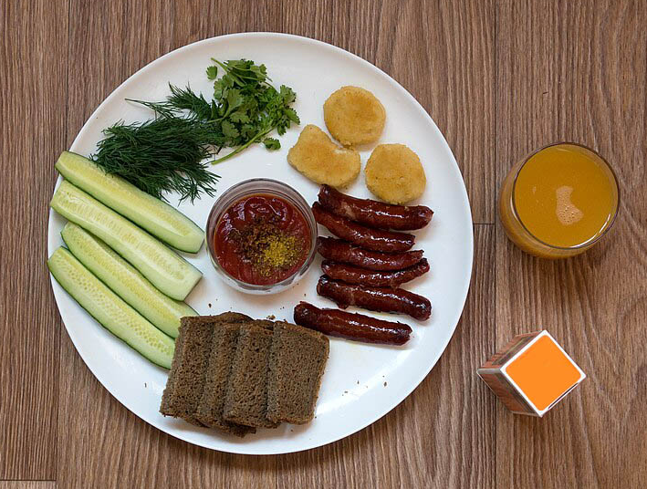
CV problem: Image classification
What category or categories does this image belong to?
Breakfast?
Lunch?
Dinner?
Notes:
~Alt text: Breakfast plate with assorted foods. See details in notes.
~
Image description: Breakfast plate with different foods, including bread, fried bananas, spices, sausage, cucumbers, and a glass of orange juice. End description.
This lesson describes three main types of CV problems. The first and most common type of CV problem is called image classification. This means providing an image as input and letting the model predict which category the image belongs to, based on a set of predefined categories. For example, you could classify which meal is shown in the image on this slide. Another classification problem would be to use CV to identify when a defect occurs in products on an assembly line.
Image attribution: “Zakuski, Plate with food, Rostov-on-Don, Russia” Vyacheslav Argenberg/CC BY-SA 4.0 (https://creativecommons.org/licenses/by-sa/4.0/): https://commons.wikimedia.org/wiki/File:Zakuski,_Plate_with_food,_Rostov-on-Don,_Russia.jpg

Slide 6
CV problem: Object detection
What are the locations of the objects that are detected in the image?
Orange juice
Fried bananas
Sausage
Spices
Bread
Cucumbers
Notes:
~Alt text: Same plate of food from the prior slide, with a rectangle drawn around each individual food item.
~
Usually, images contain many objects. Therefore, the second kind of CV problem is object detection. During object detection, bounding boxes are created around objects to define where they are in an image and how big they are. Object positioning can be important, such as specifying the location of a defect on a product. Object detection is often a necessary step before image classification.
Image attribution: “Zakuski, Plate with food, Rostov-on-Don, Russia” Vyacheslav Argenberg/CC BY-SA 4.0 (https://creativecommons.org/licenses/by-sa/4.0/): https://commons.wikimedia.org/wiki/File:Zakuski,_Plate_with_food,_Rostov-on-Don,_Russia.jpg

Slide 7
CV problem: Semantic segmentation
What are the boundaries and locations of detected objects?
Food
Plate
Notes:
~Alt text: Same plate of food with segmentation outlines around the different food items.
~
Finally, an image could contain different scenes. Some objects might be in the foreground, and some might be in the background. Semantic segmentation separates those scenes and can be done using unsupervised techniques. As an example, this kind of task is important for self-driving cars, which need to distinguish between scenes, such as the sidewalk, the road, and a building.
Image attribution: “Zakuski, Plate with food, Rostov-on-Don, Russia” Vyacheslav Argenberg/CC BY-SA 4.0 (https://creativecommons.org/licenses/by-sa/4.0/): https://commons.wikimedia.org/wiki/File:Zakuski,_Plate_with_food,_Rostov-on-Don,_Russia.jpg

Slide 8
Image representation
Notes:
Next, let’s look at how to store images on computers to learn from them.

Slide 9
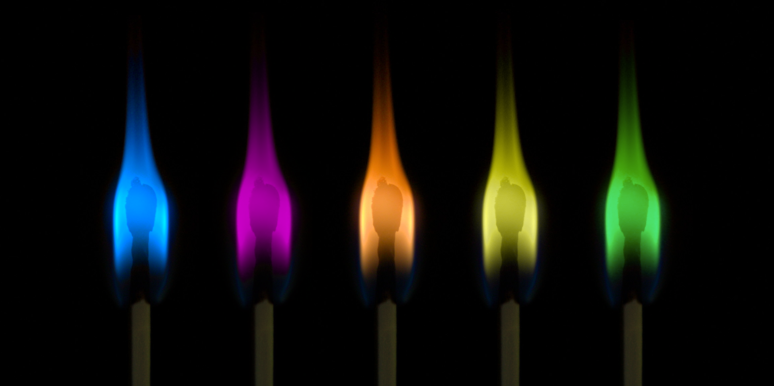
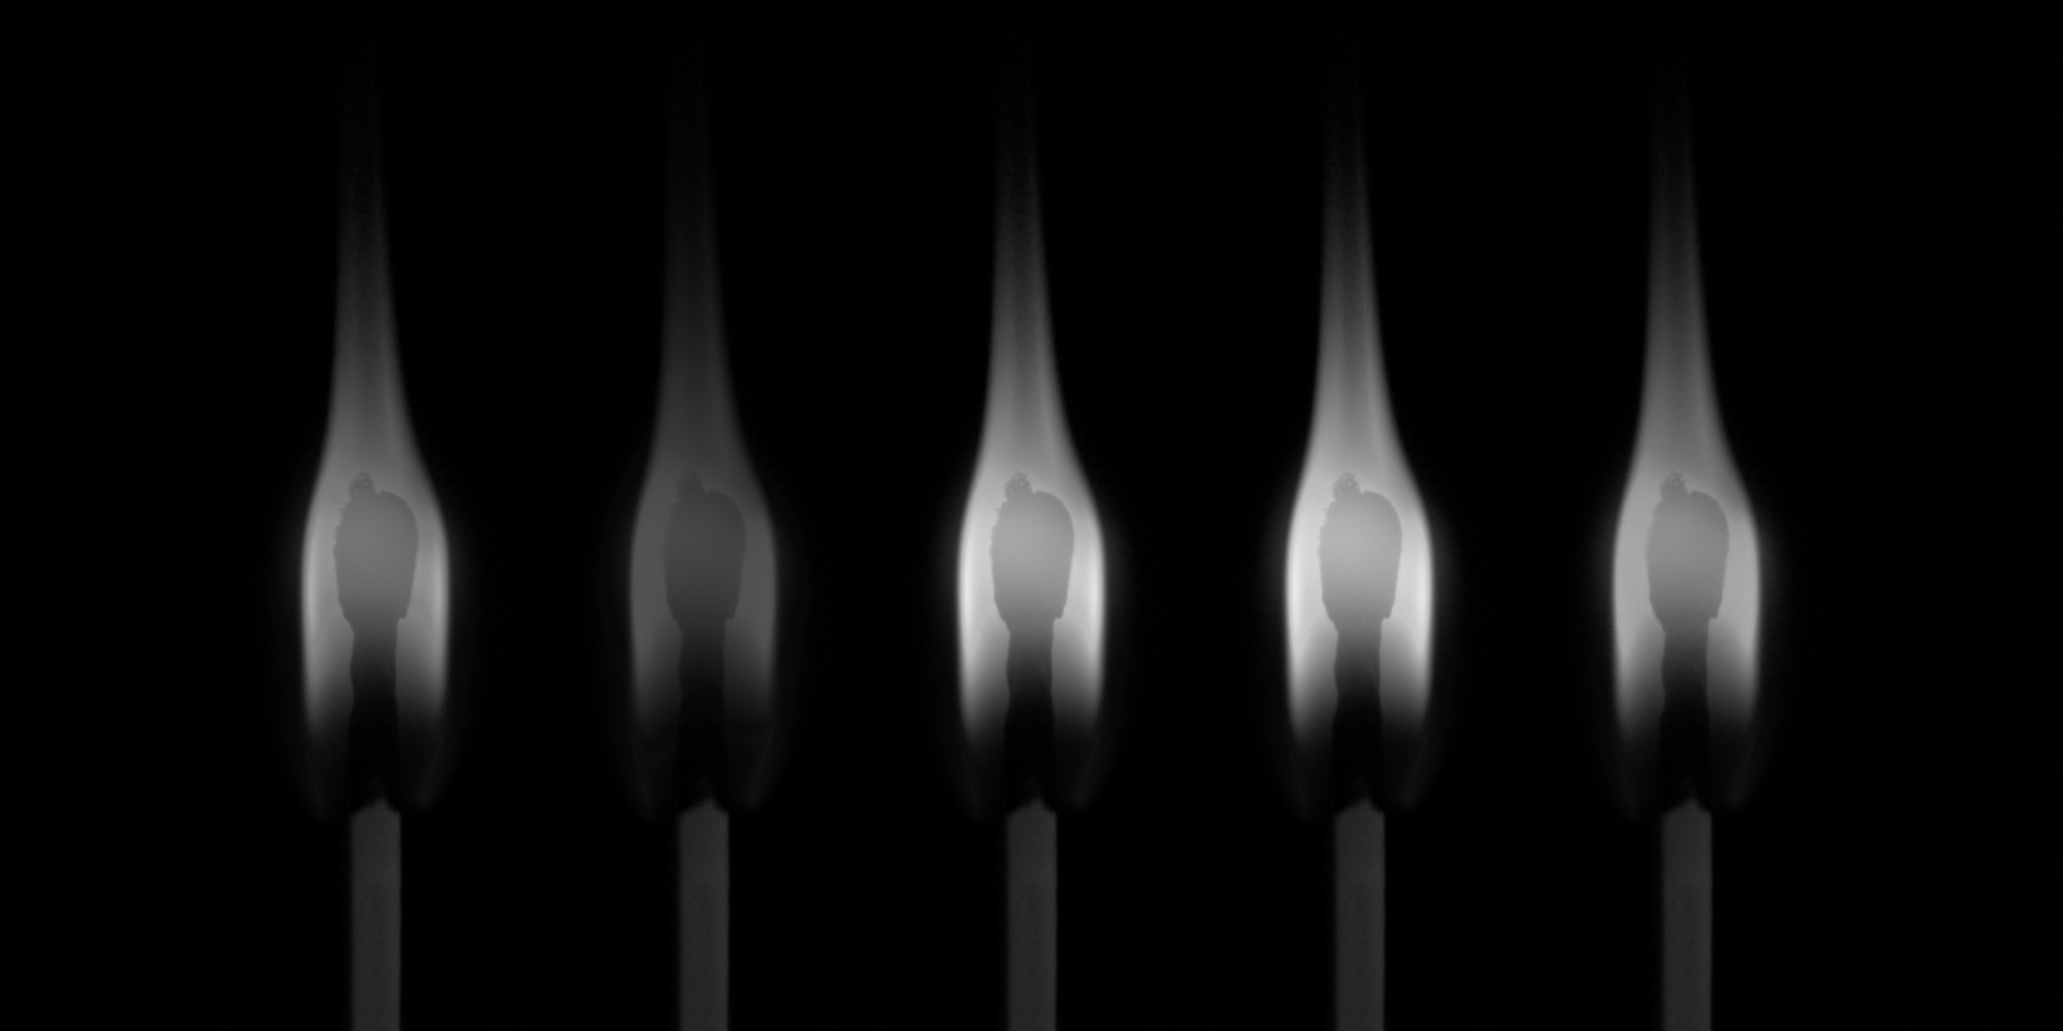
Grayscale and color images
Images are made of pixels. Pixels have values from 0–255, where the closer a value is to 0, the darker the shade is.
It’s important to distinguish between color and grayscale images.
Color images:
3 channels (Red, green, and blue are a common representation.)
Pixels in each channel have values from 0–255.
Grayscale images:
Single channel
Pixels have values from 0–255.
Notes:
Image attribution: "Colorful matches" by szabolor is licensed under CC BY-SA 2.0.
~Alt text – color image: Color image of matches with colored flames
~Alt text – grayscale image: grayscale image of matches with colored flames
~
Images are made of pixels with a certain value range. Cameras can detect incoming light in different wavelengths. To create a color image, a sensor records incoming (reflected) light in different wavelengths. The most common choice of colors is red, green, and blue. By recording light intensity ranging from 0–255 in those three channels, it’s possible to create a color composite image. With the RGB range, 16,777,216 possible colors can be created.

Slide 10
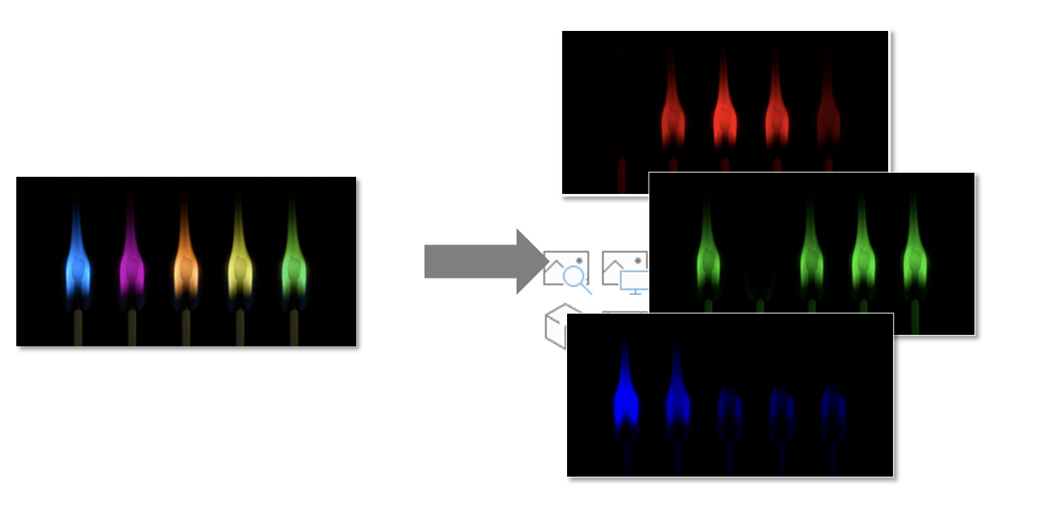
Color channels
Red channel intensity
Green channel intensity
Blue channel intensity
Notes:
Image attribution: "Colorful matches" by szabolor is licensed under CC BY-SA 2.0.
~Alt text: An image of matches with colored flames and three associated images for the red, green and blue color channels
~
This slide provides an example of what the individual color channels look like, shaded according to that color’s intensity. You can simply open color images on your computer, but ML libraries actually need to ingest each channel of the image separately.
When an image is split into different color channels, the results look like grayscale images, but the intensity corresponds to the amounts of red, green, and blue, respectively. A red color channel image that shows high intensity (which is represented visually as being almost white) means that the image has a high intensity of red.

Slide 11
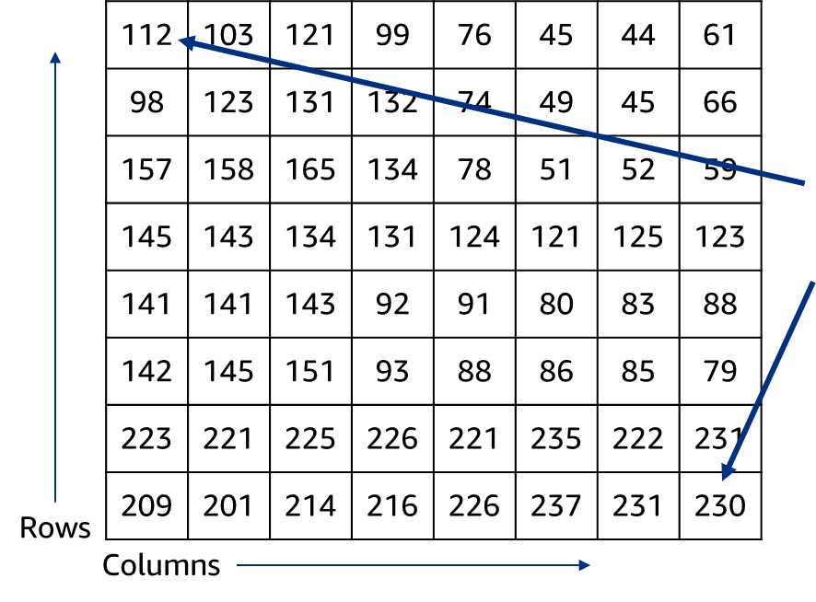
Representing an image as a matrix
On an N x M grayscale image, where N is the number of rows and M is the number of columns:
image[0, 0] => Top-left corner of the image
image[y, x] => y pixels down, x pixels right
image[N-1, M-1] => Bottom-right corner
Notes:
~Alt text: Example 8x8 matrix of values between 0 and 255, representing pixels in an image.
~
How does an image translate to something that a computer can understand? You can read out the light intensity values as they were recorded on the sensor of the camera and store them in a matrix. The position of the pixel refers to the same position in the image. For example, the top-left pixel in the matrix corresponds to the top-left corner of the image.

Slide 12
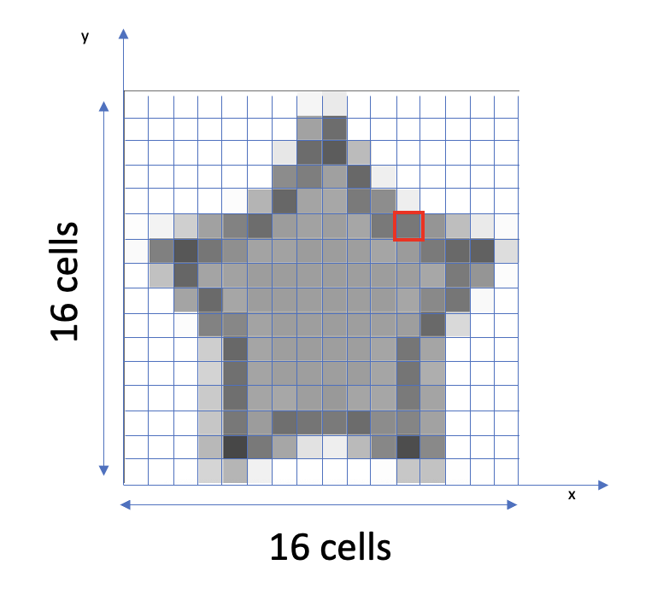
Image representation: Grayscale
On a 16x16 grayscale image:
16x16 grayscale image:
x indexes => [0,.., 15]
y indexes => [0,.., 15]
I(y=11, x=11) = 198
Notes:
~Alt text – pixelated image: Grayscale letter from Amazon logo represented as 16x16 pixel grid.
~Alt text – arrow: Arrow pointing to pixel in row 5 and column 11 that has a grayscale value of 198.
~
This slide provides an example of a grayscale image with a size of 16x16 pixels. Given a certain row and column, you can access pixels individually to inspect what value (0-255) any given pixel has.
In this example, row 5, column 11 is a gray pixel with a value of 198 (which is dark but not quite black, which has the value 255). By looking at an image pixel by pixel, you can see that areas of the same color form when neighboring pixels have similar values. Contrast occurs when neighboring pixels have different values.

Slide 13
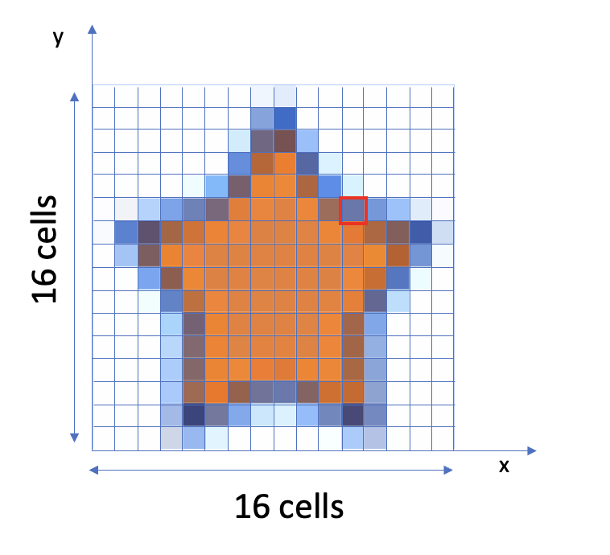
Image representation: Color
On a 16x16 RGB image:
Red
Blue
I(y=11, x=11) = [139, 136, 128]
Green
Notes:
~Alt text – pixelated image: Color letter from Amazon logo represented as 16x16 pixel grid.
~Alt text – arrow to pixel: Arrow pointing to pixel in row 5 and column 11 that has a grayscale value of [139 Red, 136 Green, and 128 Blue].
~Alt text – arrow to red value: Arrow pointing to red channel value: 139.
~Alt text – arrow to green value: Arrow pointing to green channel value: 136.
~Alt text – arrow to blue value: Arrow pointing to blue channel value: 128.
~
A color image needs to be separated into its different color channels.

Slide 14
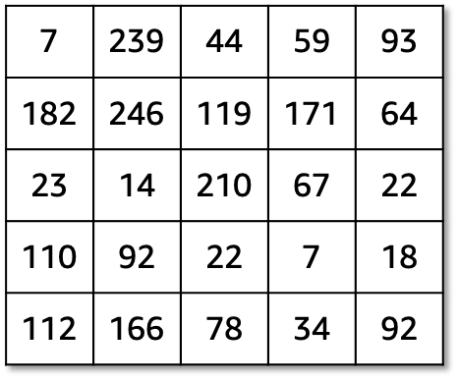
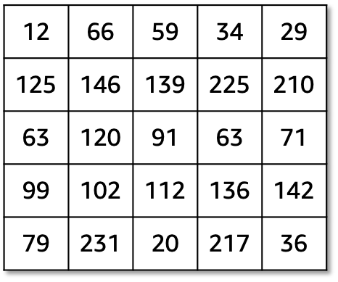
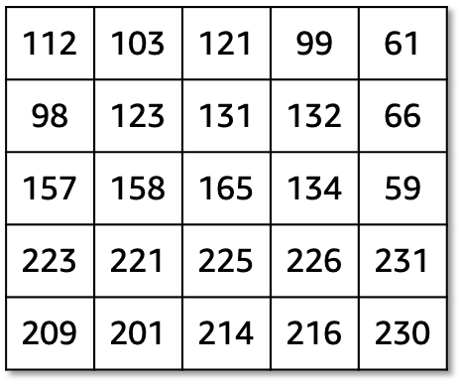
Color image as a matrix (1 of 4)
On an N x M x 3 color image, where N is the number of rows and M is the number of columns:
im[0, 0, 0] => Top-left corner of R image (112)
im[0, 0, 1] => Top-left corner of G image (12)
im[0, 0, 2] => Top-left corner of B image (7)
im[N-1, M-1, 0] => Bottom-right corner of R (230)
im[N-1, M-1, 1] => Bottom-right corner of G (36)
im[N-1, M-1, 2] => Bottom-right corner of B (92)
Blue
Green
Red
Notes:
~Alt text – red matrix: 5x5 matrix labeled "Red".
~Alt text – green matrix: 5x5 matrix labeled "Green".
~Alt text – blue matrix: 5x5 matrix labeled "Blue".
~
In its decomposed form, a color image looks like an N x M x 3 matrix, where N is the number of rows and M is the number of columns. The 3 represents the 3 color channels, red, green, and blue.

Slide 15
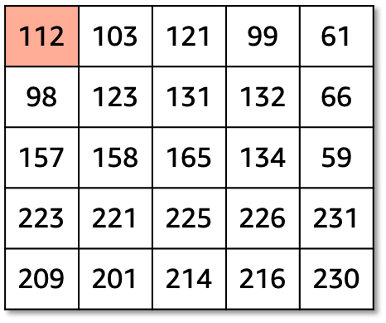
Color image as a matrix (2 of 4)
On an N x M x 3 color image:
im[0, 0, 0] => Top-left corner of R image (112)
im[0, 0, 1] => Top-left corner of G image (12)
im[0, 0, 2] => Top-left corner of B image (7)
im[N-1, M-1, 0] => Bottom-right corner of R (230)
im[N-1, M-1, 1] => Bottom-right corner of G (36)
im[N-1, M-1, 2] => Bottom-right corner of B (92)
Blue
Green
Red
Notes:
~Alt text – red matrix: Red channel matrix from previous slide with top-left corner value, 112, highlighted.
~Alt text – green matrix: Green channel matrix from previous slide.
~Alt text – blue matrix: Blue channel matrix from previous slide.
~
On this slide, a pixel in the red channel is highlighted.

Slide 16
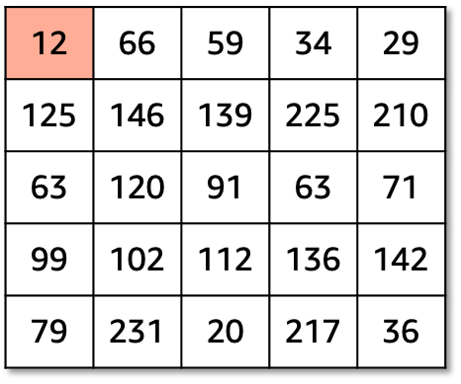
Color image as a matrix (3 of 4)
On an N x M x 3 color image:
im[0, 0, 0] => Top-left corner of R image (112)
im[0, 0, 1] => Top-left corner of G image (12)
im[0, 0, 2] => Top-left corner of B image (7)
im[N-1, M-1, 0] => Bottom-right corner of R (230)
im[N-1, M-1, 1] => Bottom-right corner of G (36)
im[N-1, M-1, 2] => Bottom-right corner of B (92)
Blue
Green
Red
Notes:
~Alt text – red matrix: Red channel matrix from previous slide, no values highlighted.
~Alt text – green matrix: Green channel matrix from previous slide with top-left corner value, 12, highlighted.
~Alt text – blue matrix: Blue channel matrix from previous slide.
~
Next, a pixel in the green channel is highlighted.

Slide 17
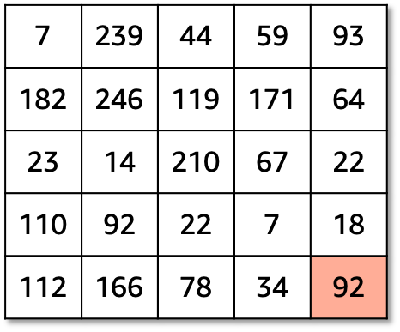
Color image as a matrix (4 of 4)
On an N x M x 3 color image:
im[0, 0, 0] => Top-left corner of R image (112)
im[0, 0, 1] => Top-left corner of G image (12)
im[0, 0, 2] => Top-left corner of B image (7)
im[N-1, M-1, 0] => Bottom-right corner of R (230)
im[N-1, M-1, 1] => Bottom-right corner of G (36)
im[N-1, M-1, 2] => Bottom-right corner of B (92)
Blue
Green
Red
Notes:
~Alt text – red matrix: Red channel matrix from previous slide, no values highlighted.
~Alt text – green matrix: Green channel matrix from previous slide with top-left corner value, 12, highlighted.
~Alt text – blue matrix: Blue channel matrix from previous slide.
~
And finally, a pixel in the blue channel is highlighted.

Slide 18

Next lesson
Concept of convolution
Additional techniques related to convolution: padding and stride

Slide 20
Image source slide (for curriculum development use only)

Slide 21
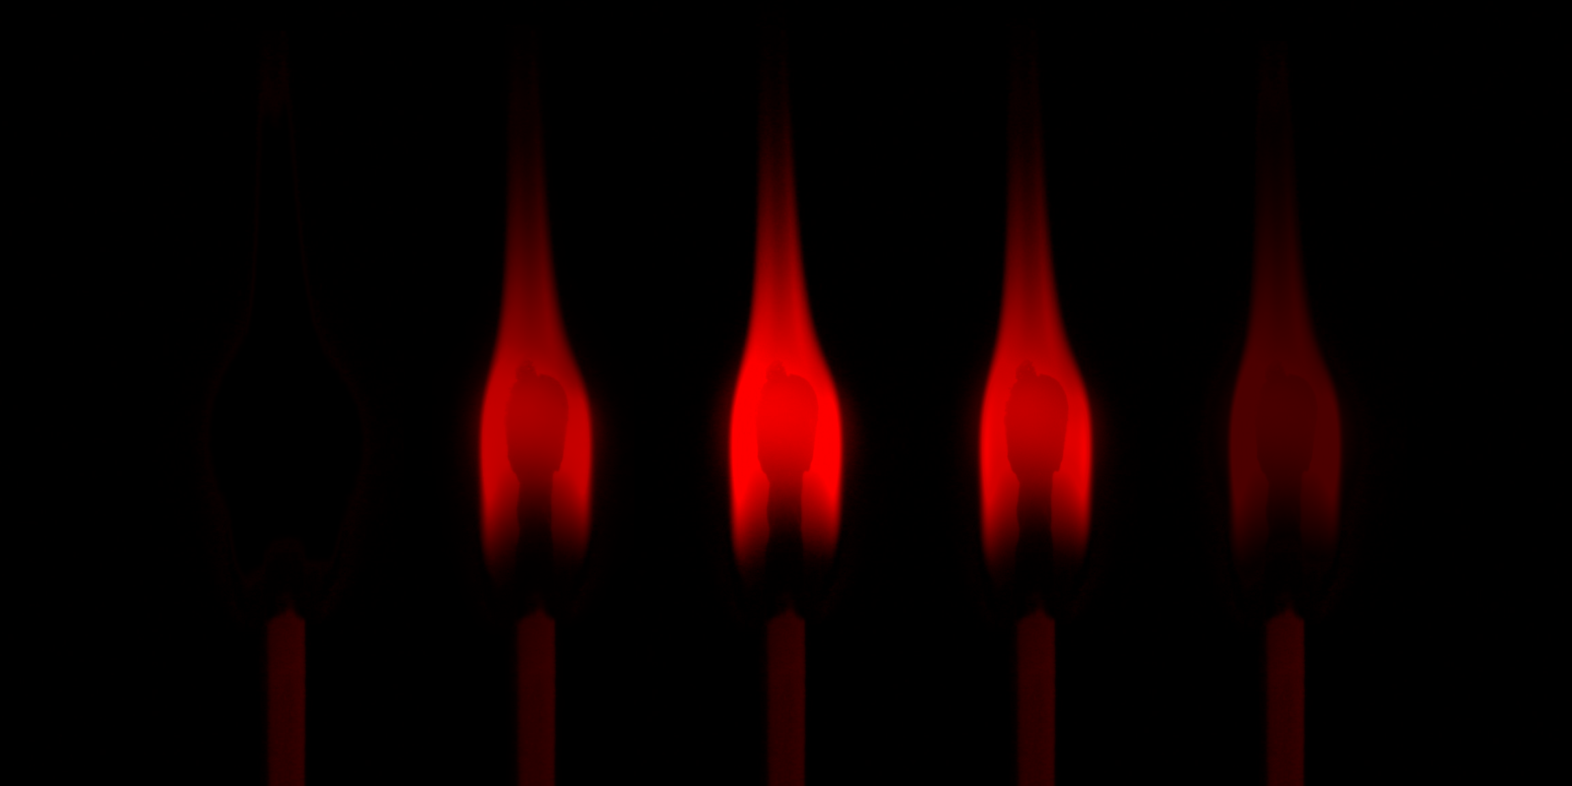
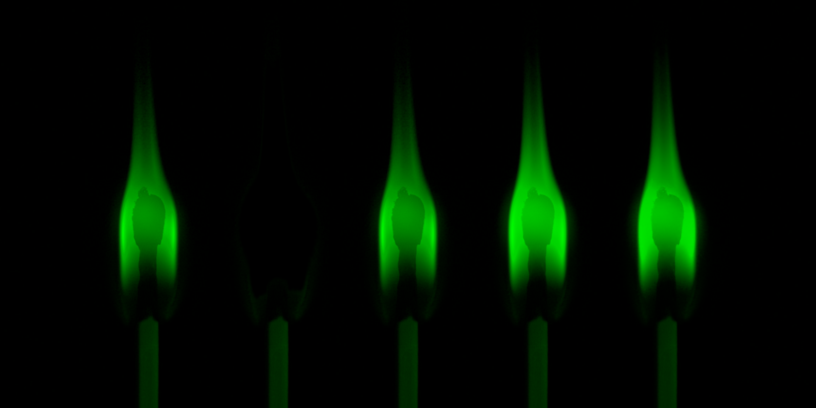
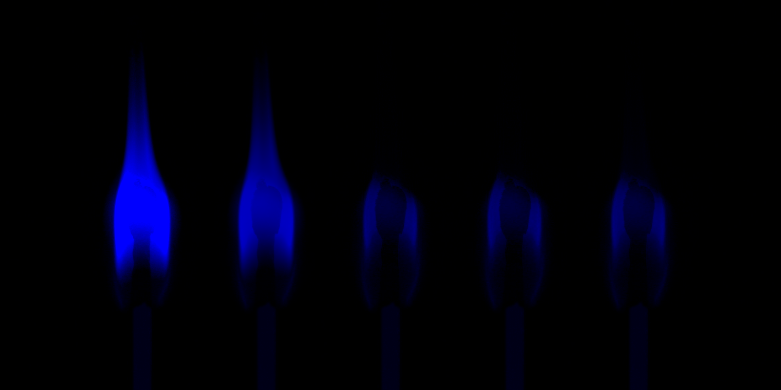
Source graphic: Grayscale vs color images
Notes:
~Source for slide 10

Slide 22
Source graphic: Representing an image as a matrix
112 | 103 | 121 | 99 | 76 | 45 | 44 | 61
98 | 123 | 131 | 132 | 74 | 49 | 45 | 66
157 | 158 | 165 | 134 | 78 | 51 | 52 | 59
145 | 143 | 134 | 131 | 124 | 121 | 125 | 123
141 | 141 | 143 | 92 | 91 | 80 | 83 | 88
142 | 145 | 151 | 93 | 88 | 86 | 85 | 79
223 | 221 | 225 | 226 | 221 | 235 | 222 | 231
209 | 201 | 214 | 216 | 226 | 237 | 231 | 230
Rows
Columns
Notes:
~Source for slide 11

Slide 23
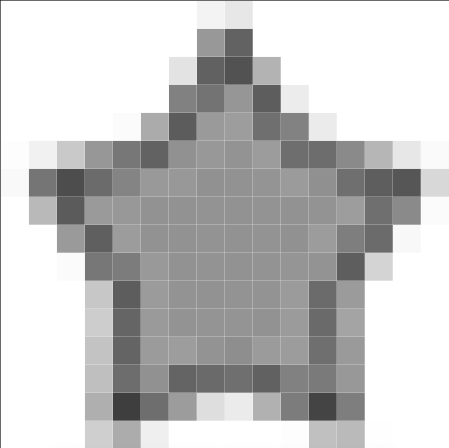
Source graphic: Image representation: Grayscale
y
16 cells
16 cells
x
16 cells
16 cells
Notes:
~Source for slide 12

Slide 24
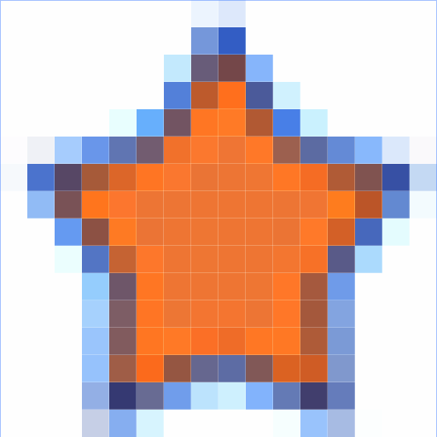
Source graphic: Image representation: Color
y
16 cells
x
16 cells
Notes:
~Source for slide 13

Slide 25
Source graphic
112 | 103 | 121 | 99 | 61
98 | 123 | 131 | 132 | 66
157 | 158 | 165 | 134 | 59
223 | 221 | 225 | 226 | 231
209 | 201 | 214 | 216 | 230
12 | 66 | 59 | 34 | 29
125 | 146 | 139 | 225 | 210
63 | 120 | 91 | 63 | 71
99 | 102 | 112 | 136 | 142
79 | 231 | 20 | 217 | 36
7 | 239 | 44 | 59 | 93
182 | 246 | 119 | 171 | 64
23 | 14 | 210 | 67 | 22
110 | 92 | 22 | 7 | 18
112 | 166 | 78 | 34 | 92
Notes:
~Source for graphics on slides 14–17

