Slide 1
The Concept of Convolution
Application of Deep Learning to Text and Image Data
Module 3 – Lesson 2

Slide 2
Today’s activities
How convolution works
Stride and padding
Convolution examples

Slide 3
Convolution
Convolution is a mathematical operation that involves sliding a small matrix, called a kernel or filter, over a larger input matrix and computing a dot product at each position.
Convolution is used in image and signal processing for operations such as feature detection, edge detection, and blurring. It’s great to detect structures.
The size and shape of the kernel or filter matters:
Different filters can emphasize different aspects of the input data.
Larger kernels generally provide more global information while smaller kernels focus on local details.
Notes:
The resulting output matrix, which is also 2D, represents the spatial relationship between the input elements and the filter weights. The output value at each position is a function of the values in the input matrix and the filter weights.
One important consideration when using 2D convolution is the choice of kernel or filter. Different filters can emphasize different aspects of the input data, such as high-frequency features, edges, or smooth areas. The size and shape of the kernel also affect the output, with larger kernels generally providing more global information and smaller kernels focusing on local details.

Slide 4
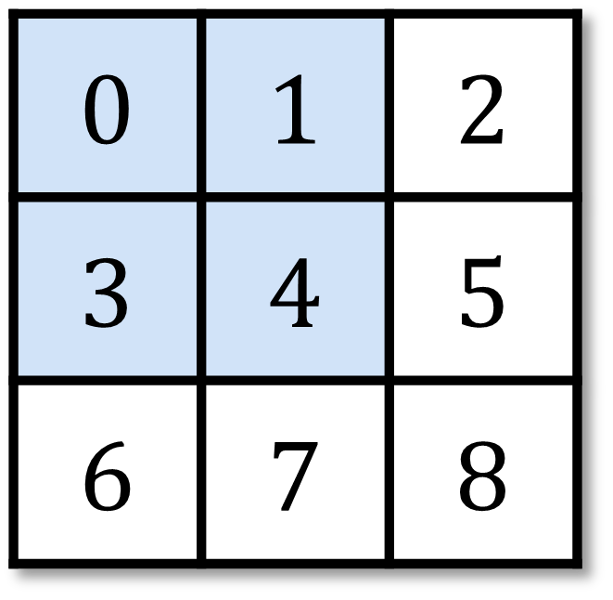
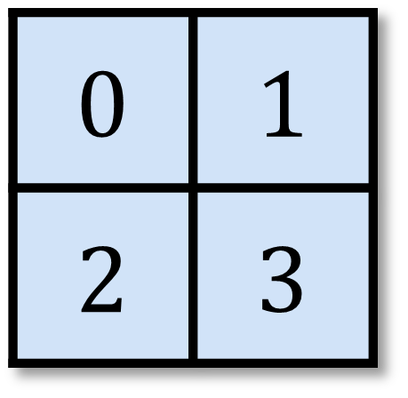
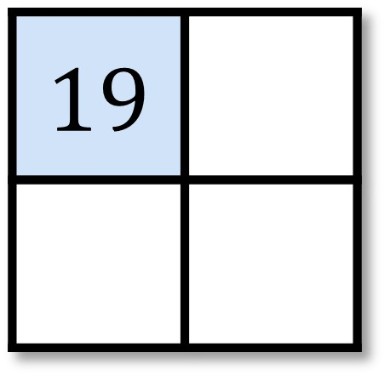
2D convolution example: Dot product operation
Input
Kernel
Output
=
*
$$0×0+1×1+3×2+4×3=19$$
Notes:
~Equation
~Alt text – input matrix: 3x3 matrix with the 2x2 area in the top left highlighted. Those values are 0, 1, 3, and 4.
~Alt text – kernel matrix: 2x2 matrix with all four values highlighted. Those values are 0, 1, 2, and 3.
~Alt text – output matrix: 2x2 matrix with the top-left value highlighted. The value is 19.
~
To calculate the 2D convolution, use the kernel and slide it over the input image. Multiply each element in the input with the corresponding position in the kernel. This is called a dot product operation.

Slide 5
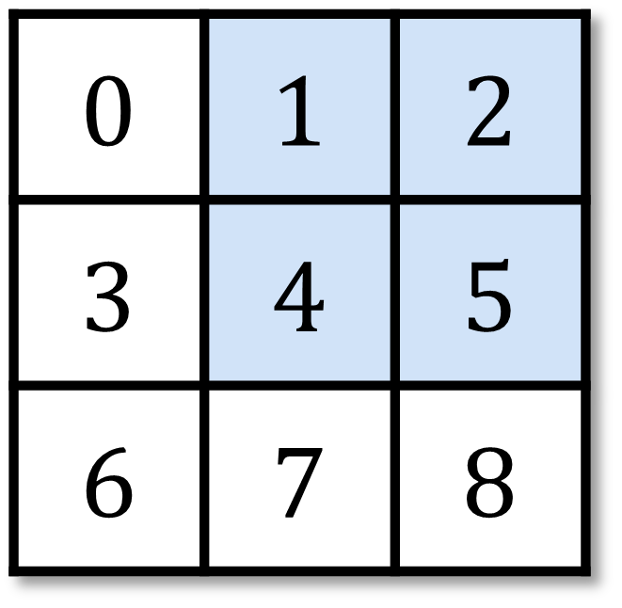
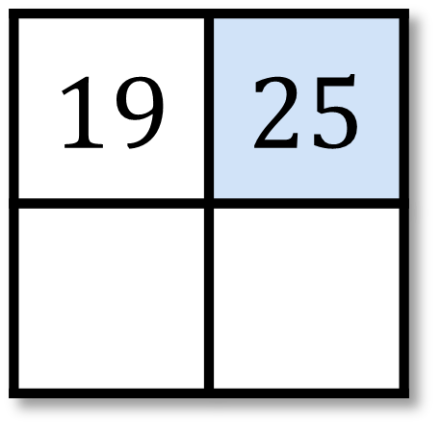
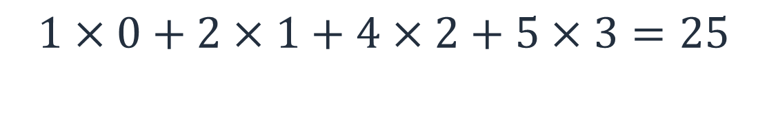
2D convolution example: Second position
Input
Kernel
Output
=
*
$$1×0+2×1+4×2+5×3=25$$
Notes:
~Equation
~Alt text – input matrix: 3x3 matrix with the 2x2 area in the top right highlighted. Those values are 1, 2, 4, and 5.
~Alt text – kernel matrix: Same kernel matrix as in previous slide, with the values 0, 1, 2, and 3.
~Alt text – output matrix: Same 2x2 matrix from previous slide with a highlighted value added at the top right. The value is 25.
~
The kernel moves to the second position. Now multiply the inputs with the corresponding position in the kernel to create the second output value.

Slide 6
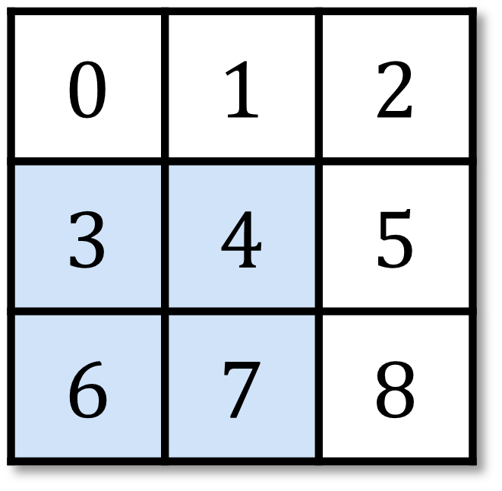
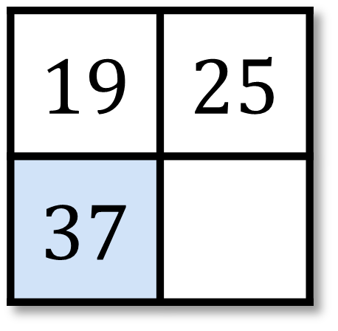
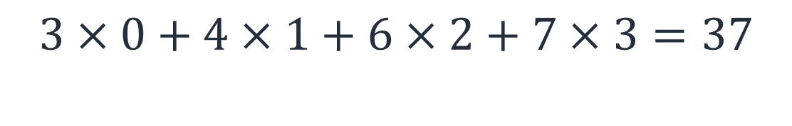
2D convolution example: Third position
Input
Kernel
Output
=
*
$$3×0+4×1+6×2+7×3=37$$
Notes:
~Equation
~Alt text – input matrix: 3x3 matrix with the 2x2 area in the bottom left highlighted. Those values are 3, 4, 6, and 7.
~Alt text – kernel matrix: Same kernel matrix from previous two slides.
~Alt text – output matrix: Same 2x2 matrix from previous slide with a highlighted value added at the bottom left. The value is 37.
~
The kernel moves down to calculate the third output value.

Slide 7
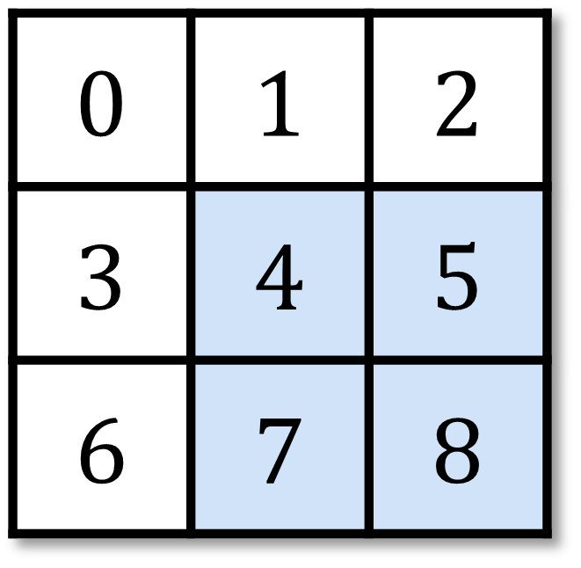
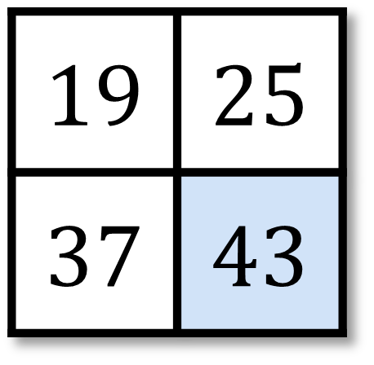
2D convolution example: Fourth position
Input
Kernel
Output
=
*
$$4×0+5×1+7×2+8×3=43$$
Notes:
~Equation
~Alt text – input matrix: 3x3 matrix with the 2x2 area in the bottom right highlighted. Those values are 4, 5, 7, and 8.
~Alt text – kernel matrix: Same kernel matrix from previous three slides.
~Alt text – output matrix: Same 2x2 matrix from previous slides with a highlighted value added at the bottom right. The value is 43.
~
Finally, the last element is computed from the final position of the kernel.

Slide 8
Stride: Motivation
Convolutions reduce shapes linearly with the number of layers:
224x224 inputs needs 44 successive 5x5 convolutions to get to 4x4.
This might make the network too deep.
The stride of a convolution is the number of row and column steps that are taken when you shift the kernel.
Notes:
In image processing, stride refers to the step size that is used when applying a convolutional filter to an input image. Specifically, stride is the number of pixels that the filter is moved horizontally and vertically across the image when performing the convolution.
A larger stride value means that the filter skips more pixels when moving across the image, which results in a smaller output size. Conversely, a smaller stride value means that the filter moves more slowly across the image, which results in a larger output size.
Stride is an important parameter to consider when building deep learning models for image processing. Increasing the stride can reduce the computational complexity of the network and speed up the training process, but it can lead to a loss of information if important features are skipped. Decreasing the stride can improve the accuracy of the model by allowing it to capture more fine-grained details, but it also increases the computational cost and might lead to overfitting.
Overall, choose the stride value based on the specific requirements of the problem and the available computational resources. In general, a smaller stride value is better for tasks that require high accuracy and fine-grained feature detection, while a larger stride value is better for tasks that require fast computation and coarse feature detection.
An animation of stride is available at https://github.com/vdumoulin/conv_arithmetic/blob/master/gif/padding_strides.gif.

Slide 9
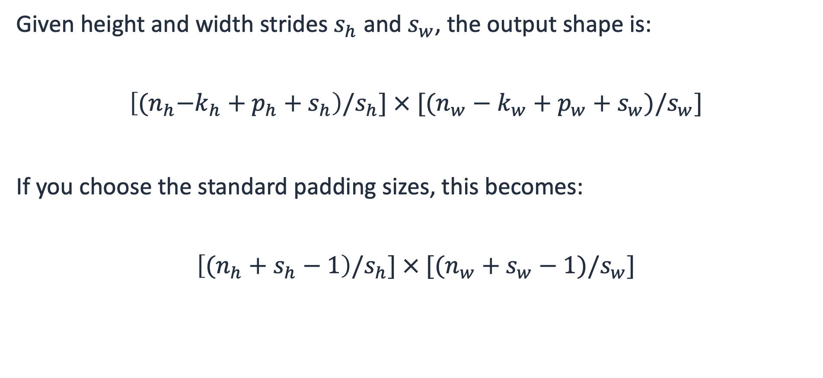
Stride output shape
Given height and width strides $s_{h}$ and $s_{w}$, the output shape is:
$$\left[{(n}_{h}−k_{h}+p_{h}+s_{h}\right)/s_{h}] × [(n_{w}−k_{w}+p_{w}+s_{w})/s_{w}]$$
If you choose the standard padding sizes, this becomes:
$$\left[{(n}_{h} + s_{h}−1\right)/s_{h}] × [(n_{w}+s_{w}−1)/s_{w}]$$
Notes:
~Equations

Slide 10
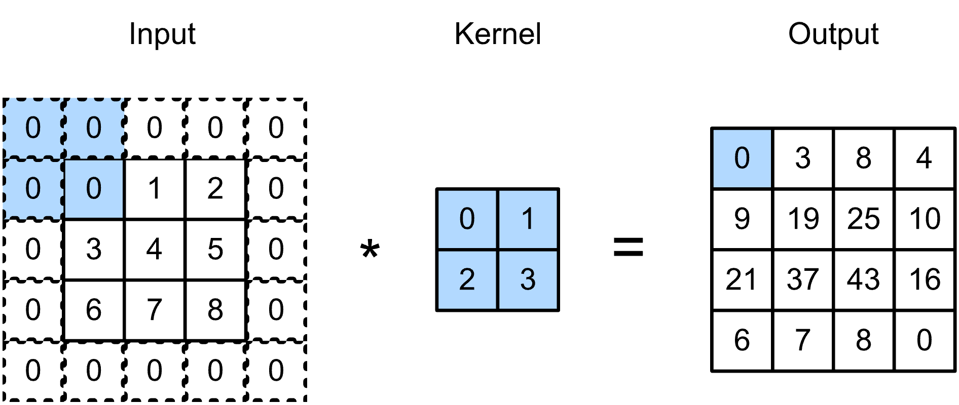
Padding: Motivation
To avoid reducing the size of image, add extra pixels to the edge.
Pad input with zeroes, the same value, or the average.
Notes:
~Alt text: Example of padding. See details in notes.
~
Image description: Graphic of a grayscale input image with certain pixel values highlighted and an additional border of pixels with value 0. The input is multiplied with a kernel. The result of the multiplication shows an output that has preserved the size of the original input. End description.
In image processing, padding refers to the process of adding extra pixels to the edges of an image before applying a convolutional operation to it. Padding is used to preserve the spatial dimensions of the input image after the convolutional operation, and it’s an important technique in deep learning and AI.
When a convolutional filter is applied to an image, the edges of the image are not processed in the same way as the central pixels. This can lead to a reduction in the size of the output image after the convolution, which can be problematic when trying to build deep networks with multiple layers of convolutions. Padding addresses this issue by adding extra pixels to the edges of the image, which ensures that the edge pixels are processed in the same way as the central pixels.
Padding can be done in different ways, such as adding zeros or replicating the edge pixels, and the amount of padding can vary depending on the size of the filter and the desired output dimensions.
By using padding, it’s possible to preserve the spatial dimensions of the input image, which can lead to better performance in image classification, object detection, and other computer vision (CV) tasks.

Slide 11
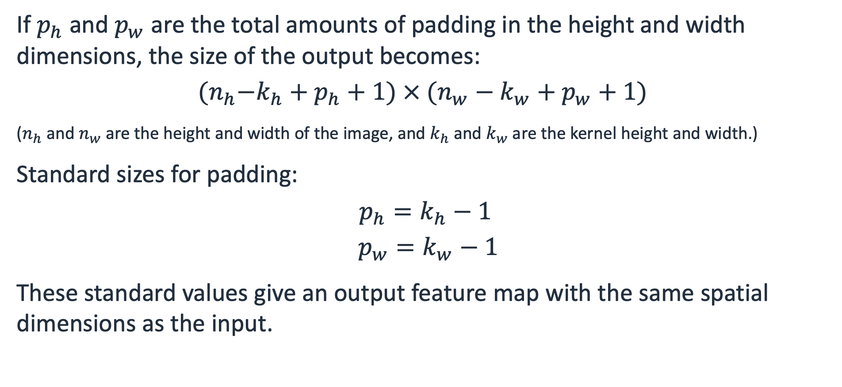
Padding output shape
If $p_{h}$ and $p_{w}$ are the total amounts of padding in the height and width dimensions, the size of the output becomes:
$${(n}_{h}−k_{h}+p_{h}+1) × (n_{w}−k_{w}+p_{w}+1)$$
($n_{h}$ and $n_{w}$ are the height and width of the image, and $k_{h}$ and $k_{w}$ are the kernel height and width.)
Standard sizes for padding:
$$p_{h}=k_{h}−1$$
$$p_{w}=k_{w}−1$$
These standard values give an output feature map with the same spatial dimensions as the input.
Notes:
~Equations
~
Note that the padding specified here is the total padding per dimension. However, PyTorch requires padding to be specified as the amount added to a single side for each dimension.

Slide 12
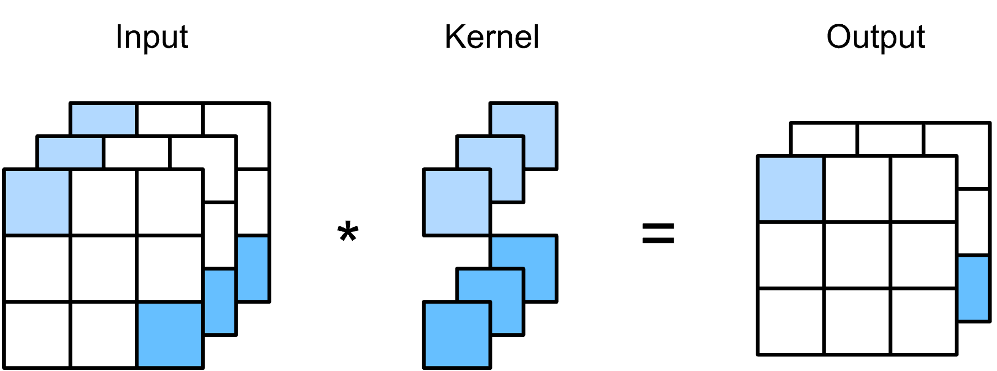
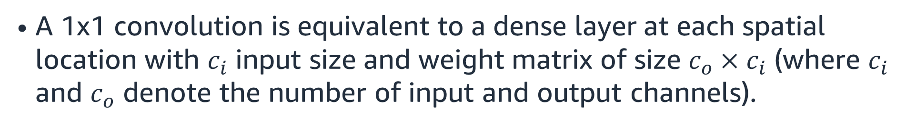
1x1 convolutional layers
Convolutions with kernel size 1x1 don’t recognize patterns but fuse channels.
A 1x1 convolution is equivalent to a dense layer at each spatial location with $c_{i}$ input size and weight matrix of size $c_{o}×c_{i}$ (where $c_{i}$ and $c_{o}$ denote the number of input and output channels).
Notes:
~Equations
~Alt text: Graphic showing a three-layer input image being multiplied by a special 1x1 kernel. The result is a two-layer output.
~
A 1x1 convolutional layer, also known as a pointwise convolution, is a type of convolutional layer that is used in deep learning models for image processing and other applications.
Unlike traditional convolutional layers, which use square or rectangular filters to scan the input image, a 1x1 convolutional layer uses a 1x1 filter, which only considers individual pixels in the image. Specifically, the filter is applied to each pixel in the input tensor independently. This results in a new tensor with the same spatial dimensions as the input but a different number of channels. The reduction in number of channels is a consequence of the dot product between the image matrices and the kernel over multiple channels.
One common application of 1x1 convolutional layers is in the design of network architectures, where they are used to reduce the number of channels and reduce computational complexity. For example, a 1x1 convolutional layer can be inserted between two larger convolutional layers to reduce the number of channels before the next convolution, without changing the spatial dimensions of the data.

Slide 13
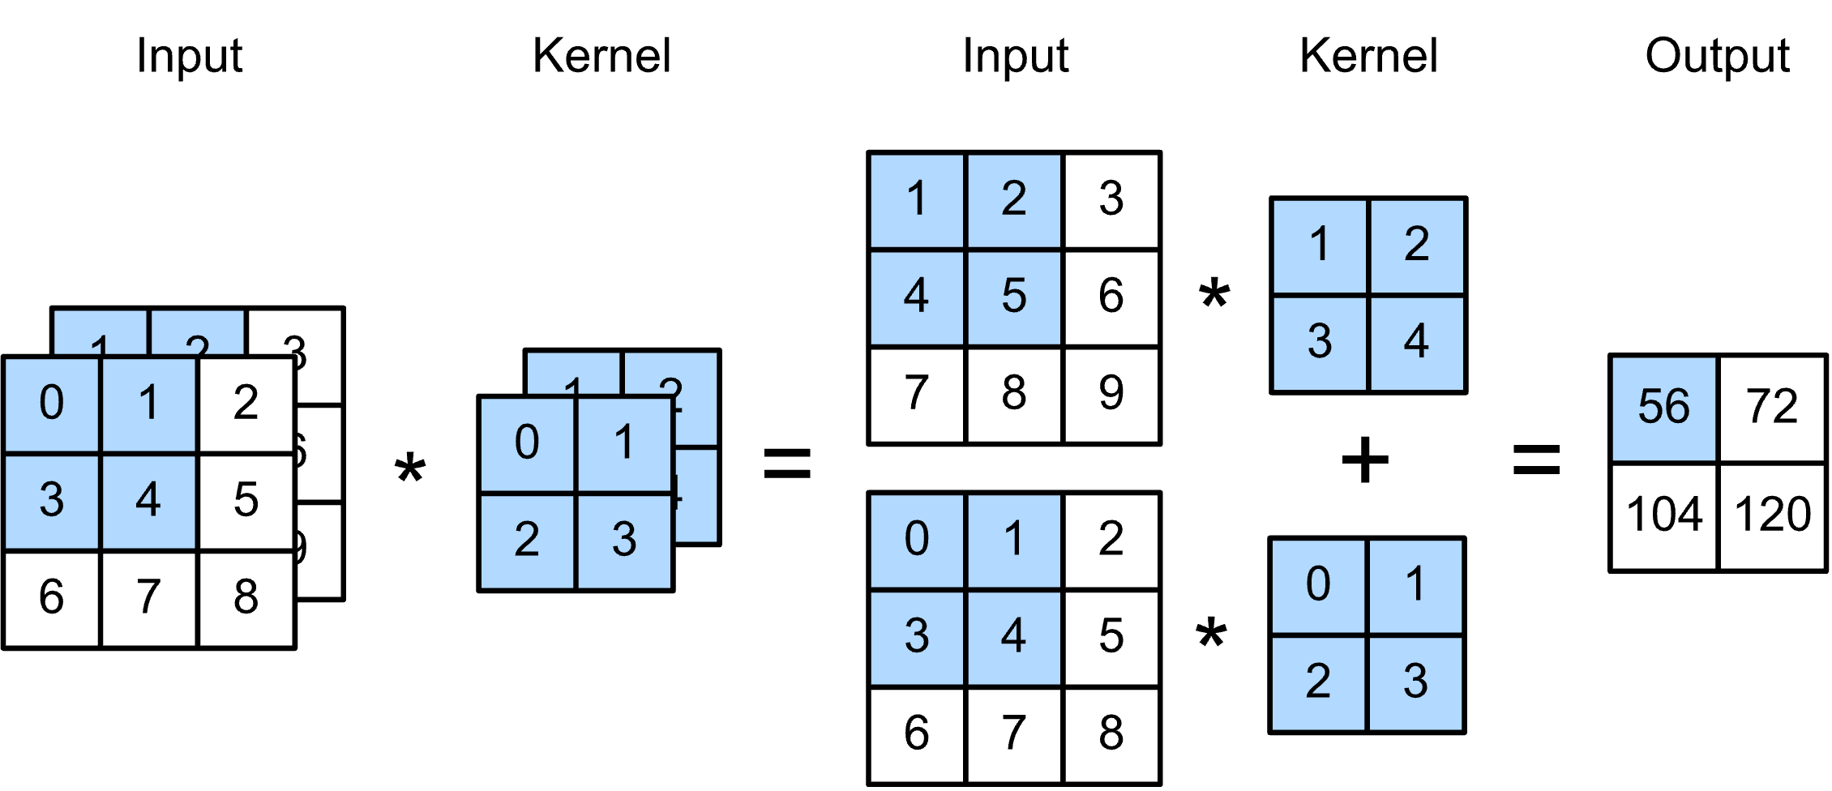
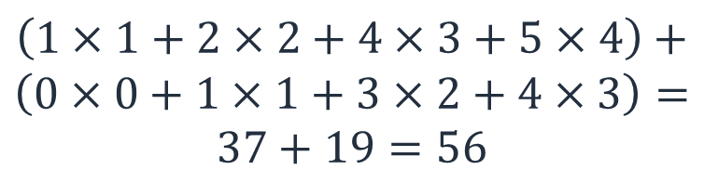
Convolution on multiple input channels (1 of 2)
Most images will be RGB and not grayscale.
Think of the kernel having the same number of channels as the input but still outputting one value.
$$\left(1×1+2×2+4×3+5×4\right)+$$
$$\left(0×0+1×1+3×2+4×3\right)=$$
$$37+19=56$$
Notes:
~Alt text: Example of calculating convolution on a two-layer input. See details in notes.
~Equations
~
Image description: Graphic of a two-layer input image where each layer is multiplied by a kernel. The result is a one-layer output (the additive result of the layer-wise kernel multiplication). End description.
You can also apply convolution to color images. In that case, you can use different kernels for each color channel of the image.

Slide 14
Convolution on multiple input channels (2 of 2)
Each kernel produces a single 2D output channel regardless of the number of input channels.
Apply multiple kernels in a single layer to create an output with multiple channels.
Apply convolutions to layers with multiple channels and output multiple channels to create a network.
Notes:
A convolutional neural network (CNN) is a combination of the convolution technique and some additional methods that help identify patterns. More details will be covered in the next lesson.

Slide 15

Next lesson
Convolutional neural networks (CNNs)
Using PyTorch to build a CNN

Slide 17
Image source slide (for curriculum development use only)

Slide 18
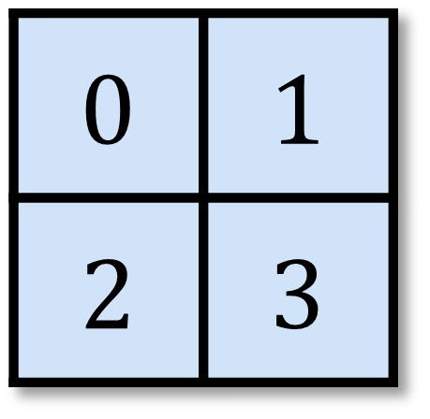
Source graphic
Input
Kernel
Output
0 | 1 | 2
3 | 4 | 5
6 | 7 | 8
19
x
=
$$0×0+1×1+3×2+4×3=19$$
Notes:
~Source graphic for slides 4–7

