Slide 1
Convolutional Neural Networks
Application of Deep Learning to Text and Image Data
Module 3 – Lesson 3

Slide 2
Today’s activities
Architecture of convolutional neural networks (CNNs)
LeNet as an example of a well-known CNN architecture

Slide 3
CNNs
Are a type of artificial neural network that is commonly used for image and video processing tasks
Use convolutional layers, which apply filters to input data to detect and extract features
Typically, also include the following:
Pooling layers to downsample the feature maps that the convolutional layers produce
Connected layer (with the number of neurons corresponding to output classes in classification)

Slide 4
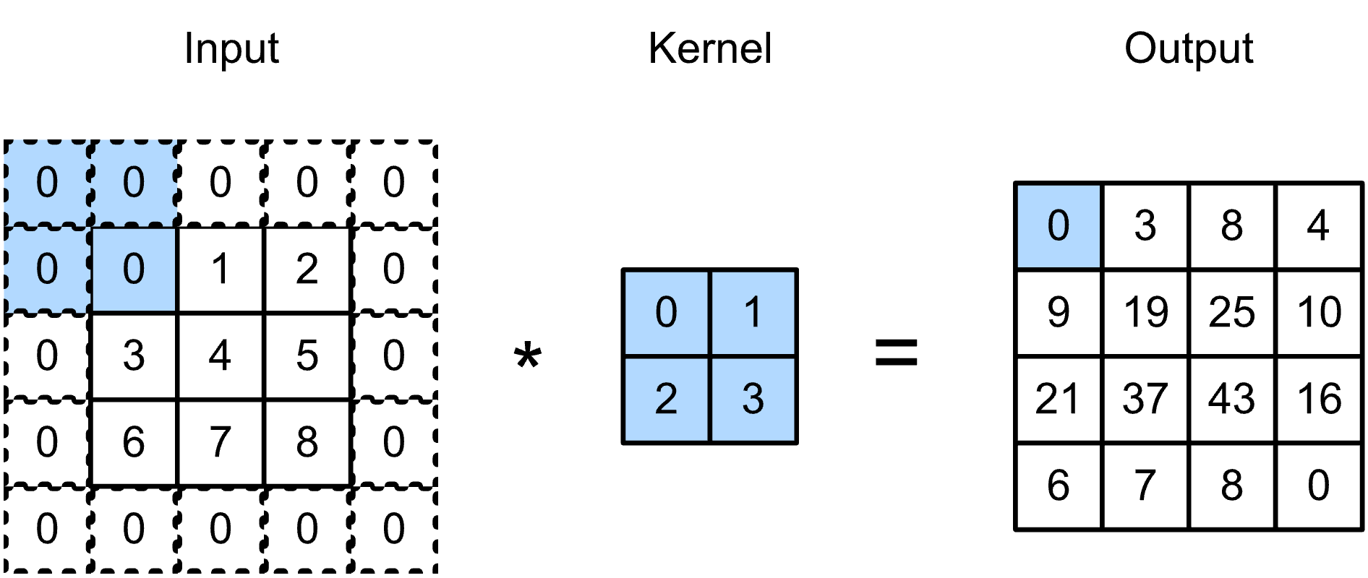
Review: Padding
To avoid reducing the size of image, add extra pixels to the edge.
Pad input with zeroes, the same value, or the average.
Notes:
~Dev note: This slide is from lesson 2 of this module.
~Alt text: Example of padding. See details in notes.
~
Image description: Graphic of a grayscale input image with certain pixel values highlighted and an additional border of pixels with value 0. The input is multiplied with a kernel. The result of the multiplication shows an output that has preserved the size of the original input. End description.
In image processing, padding refers to the process of adding extra pixels to the edges of an image before applying a convolutional operation to it. Padding is used to preserve the spatial dimensions of the input image after the convolutional operation, and it’s an important technique in deep learning and AI.
When a convolutional filter is applied to an image, the edges of the image are not processed in the same way as the central pixels. This can lead to a reduction in the size of the output image after the convolution, which can be problematic when trying to build deep networks with multiple layers of convolutions. Padding addresses this issue by adding extra pixels to the edges of the image, which ensures that the central pixels are processed in the same way as the edge pixels.
Padding can be done in different ways, such as adding zeros or replicating the edge pixels, and the amount of padding can vary depending on the size of the filter and the desired output dimensions.
By using padding, it’s possible to preserve the spatial dimensions of the input image, which can lead to better performance in image classification, object detection, and other computer vision (CV) tasks.

Slide 5
Review: Stride
Convolutions reduce shapes linearly with the number of layers:
224x224 inputs needs 44 successive 5x5 convolutions to get to 4x4.
This might make the network too deep.
The stride of a convolution is the number of row and column steps that are taken when you shift the kernel.
Notes:
~Dev note: This slide is from lesson 2 of this module.
~
In image processing, stride refers to the step size that is used when applying a convolutional filter to an input image. Specifically, stride is the number of pixels that the filter is moved horizontally and vertically across the image when performing the convolution.
A larger stride value means that the filter skips more pixels when moving across the image, which results in a smaller output size. Conversely, a smaller stride value means that the filter moves more slowly across the image, which results in a larger output size.
Stride is an important parameter to consider when building deep learning models for image processing. Increasing the stride can reduce the computational complexity of the network and speed up the training process, but it can lead to a loss of information if important features are skipped. Decreasing the stride can improve the accuracy of the model by allowing it to capture more fine-grained details, but it also increases the computational cost and might lead to overfitting.
Overall, choose the stride value based on the specific requirements of the problem and the available computational resources. In general, a smaller stride value is better for tasks that require high accuracy and fine-grained feature detection, while a larger stride value is better for tasks that require fast computation and coarse feature detection.

Slide 6
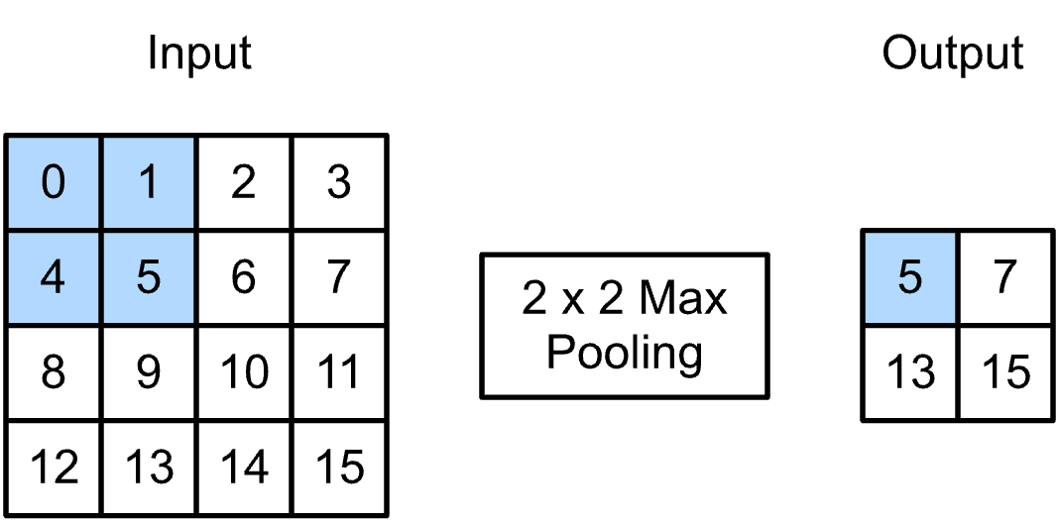
2D max pooling
Returns the maximal value in a sliding window
Notes:
~Alt text: Matrix representation of the 2D max pooling calculation.
~
The main purpose of pooling is to reduce the size of feature maps or inputs without losing a lot of information. This makes computation faster because the number of training parameters is reduced. Pooling reduces the spatial dimensionality of the feature maps while preserving the most important information. This is achieved by applying a fixed function, such as max pooling or average pooling, to small local regions of the input feature maps.

Slide 7
Pooling parameters
Pooling layers have the same stride and padding options as convolutions.
Pooling doesn’t have learnable parameters. It’s a fixed, deterministic operation.
Pooling is applied to each input channel independently. This results in a layer with the same number of channels but possibly different spatial dimensions.
Notes:
Pooling doesn’t have learnable parameters because it’s a fixed and deterministic operation that is applied to the input data.
Pooling is applied to each input channel independently in a convolutional neural network (CNN) because different channels can contain different features or patterns that are important for the overall classification task.
In a CNN, each input channel corresponds to a different feature map or channel from the previous convolutional layer. The purpose of pooling is to reduce the dimensionality of the feature maps while preserving the most important information. Applying pooling to each input channel independently ensures that each channel is reduced in dimensionality by the same factor, which helps to maintain the relative importance of each channel's information.
For example, if the pooling operation was applied to all input channels at once, the information in one channel might be overemphasized, while the information in another channel might be lost or downplayed. By applying pooling independently to each channel, the relative importance of the information in each channel is preserved, which can improve the overall performance of the CNN.

Slide 8
Some important CNNs
CNNs for image classification tasks:
LeNet (1998)
AlexNet (2012)
VGGNet (2014)
ResNet (2015)
This lesson will examine the LeNet architecture to understand the key components of a CNN.
Other CNNs are evolutions and modifications of the main ideas from LeNet.
Notes:
Over the years, several important CNN architectures were widely adopted by the research community. The first famous CNN was an architecture called LeNet.

Slide 9
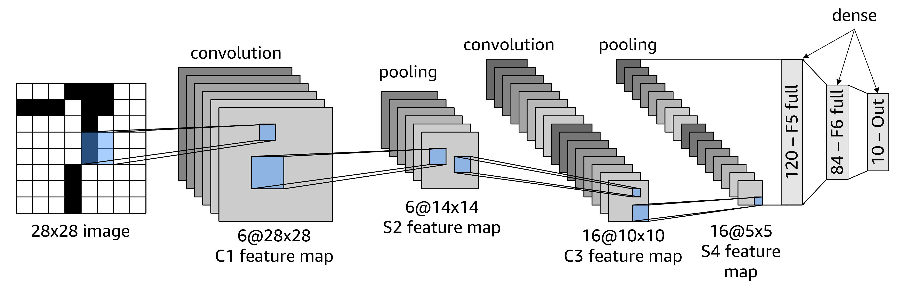
LeNet (1998)
LeNet is a five-layer CNN. Even though LeNet is an older CNN architecture, it’s still important because it contains all the important elements.
Notes:
~Alt text: Diagram of LeNet's five-layer CNN. See detail in notes.
~
Image description: Diagram of LeNet’s five-layer CNN. Shows the input image, a convolutional layer, a pooling layer, another convolutional layer, another pooling layer, and a final sequence of three dense layers. End description.
LeNet is a five-layer CNN. Convolution layers are followed by pooling layers. At the end, dense layers take in the pooling layer’s results. Feature maps get smaller in height and width, and the number of channels increases as you go deeper in the network.

Slide 10
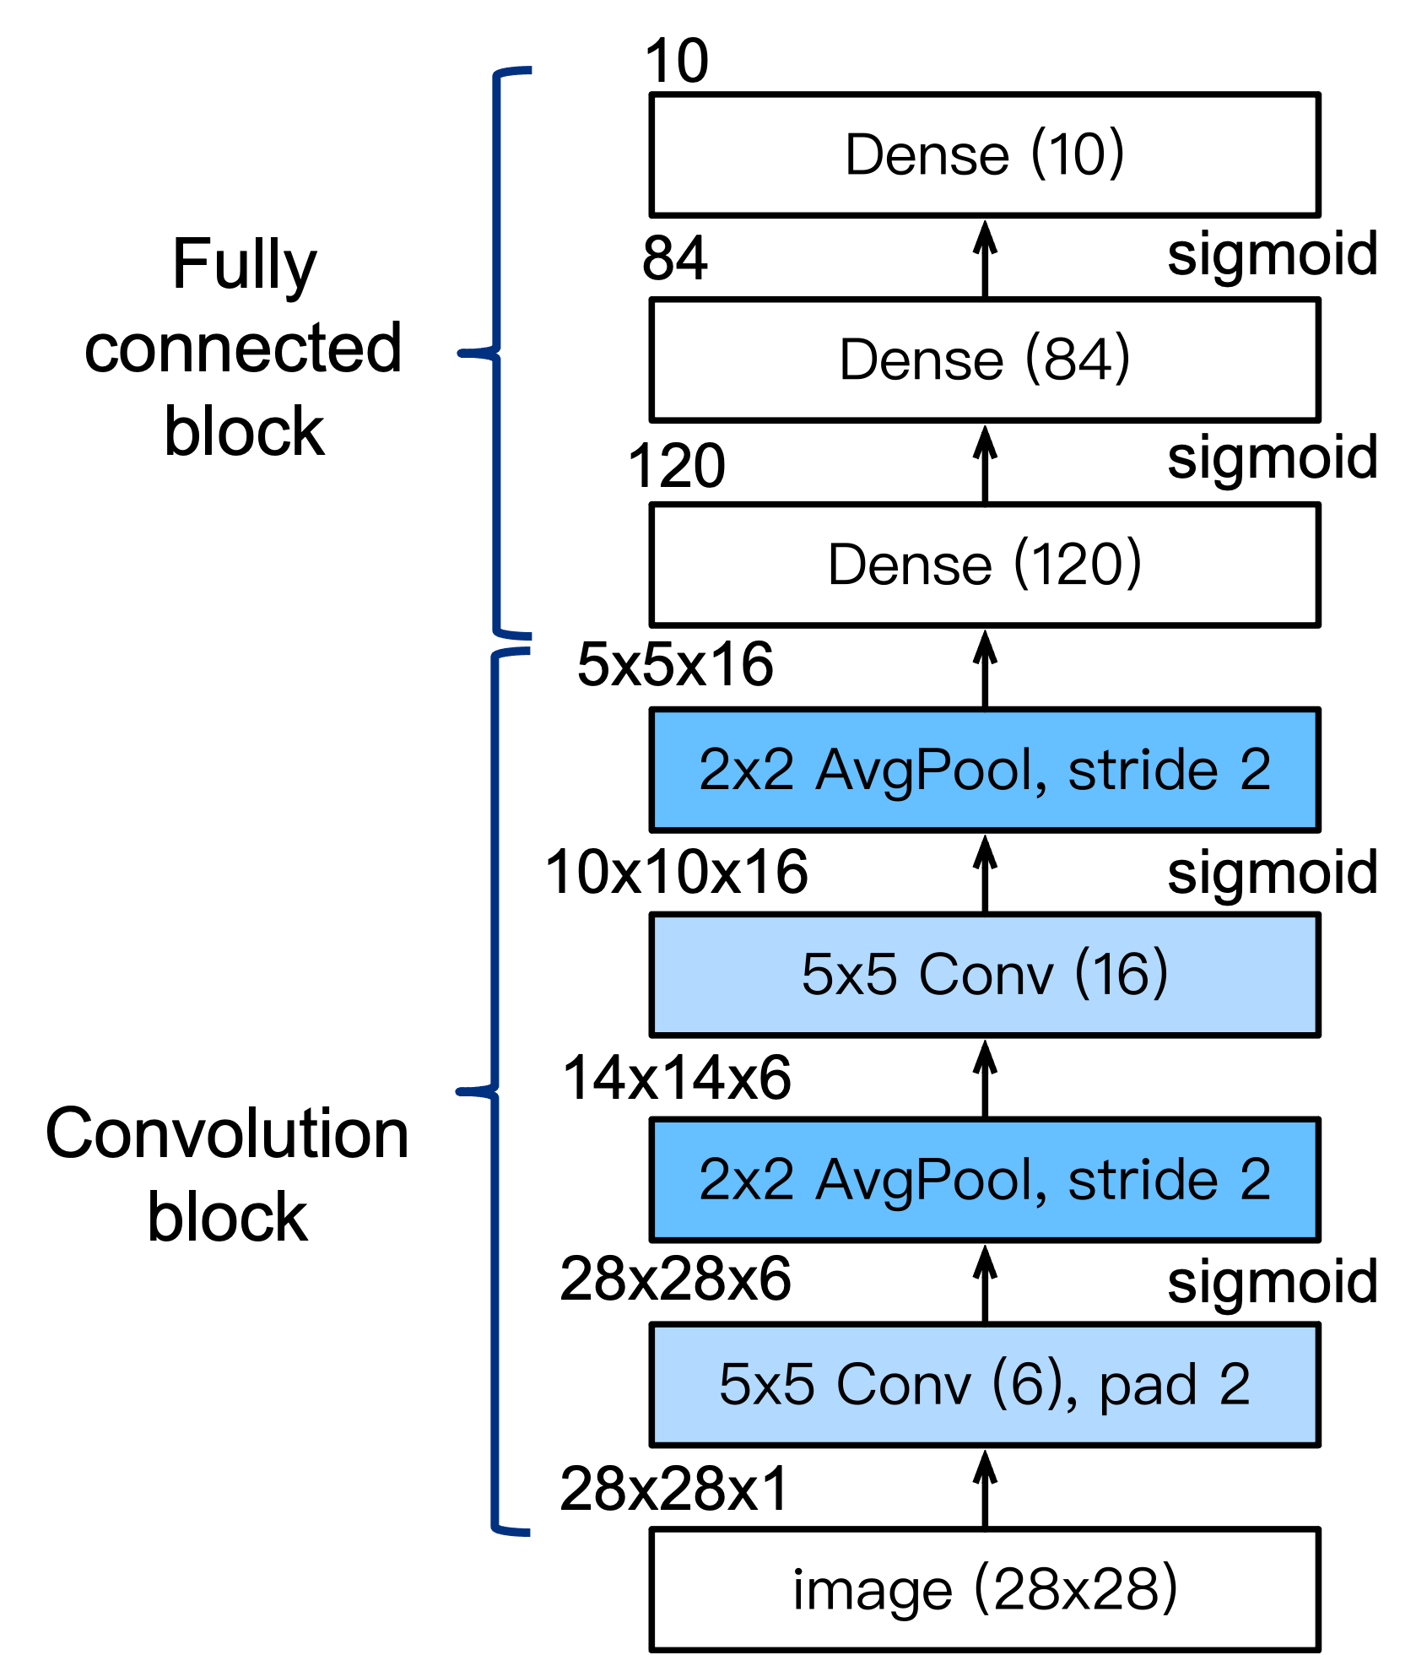
LeNet simplified view
Part 1: Convolution block
Convolution layer to recognize the spatial patterns
5×5 kernel with the sigmoid activation function
Average pooling layer to reduce the dimensionality
Part 2: Fully connected layers block
3 fully connected layers with 120, 84, and 10 outputs, respectively
Notes:
~Alt text: Simplified diagram of LeNet's 5 layer CNN. See detail in notes.
~
Image description: Simplified diagram of LeNet's 5 layer CNN that shows input image, the convolutional layer, a pooling layer, followed by another convolutional & polling layer and a final sequence of 3 dense layers. End description.
It can be helpful to look at a simplified view of a CNN that only indicates the network’s main characteristics, rather than actually visualizing the number of layers. For LeNet, you can also distinguish between a set of layers that performs convolution and the fully connected block of dense layers.

Slide 11
Constructing datasets in PyTorch
Use PyTorch’s Dataset and DataLoader:
Provide mini-batches of data for training and testing
Preferred method: torch.utils.data.Dataset
Provides an object wrapper around data
Allows it to be queried by a DataLoader object: torch.utils.data.DataLoader
DataLoader is usually the most efficient way to load in images.
Notes:
This slide provides a quick introduction to DataLoader in PyTorch. This construct is commonly found when building CNNs to load in image data.

Slide 12
CNN (LeNet) PyTorch code example
import torch
import torch.nn as nn
class Reshape(torch.nn.Module):
def forward(self, x):
return x.view(-1, 1, 28, 28)
net = torch.nn.Sequential(Reshape(),
nn.Conv2d(1, 6, kernel_size=5,padding=2),
nn.Sigmoid(),
nn.AvgPool2d(kernel_size=2, stride=2),
nn.Conv2d(6, 16, kernel_size=5),
nn.Sigmoid(),
nn.AvgPool2d(kernel_size=2, stride=2),
nn.Flatten(),
nn.Linear(16 * 5 * 5, 120),
nn.Sigmoid(),
nn.Linear(120, 84),
nn.Sigmoid(),
nn.Linear(84, output_dim)
)
Notes:
First, you need to reshape input images to 28x28 pixels. Then, you construct the network exactly as discussed in the previous section with convolutional layers, pooling layers, and dense (linear) layers. Between the layers, you can see sigmoid activation functions.

Slide 13
Summary of CNNs
CNNs perform feature extraction and outperform most manual efforts.
However, CNNs:
Don’t encode position, scale, and orientation of objects.
Are slow to train and need large amounts of data.
Don’t remember composition of images.
Are possible to fool with adversarial examples.
Notes:
CNNs will struggle to classify images correctly if the orientation of the object or position is different.
CNNs are also slow to train and don’t preserve the composition of different elements that make up an object. This is part of why CNNs can be fooled.
Adversarial examples: If a CNN takes an image along with some noise, the CNN will recognize the image as a completely different image. The human visual system would identify the image as the same image with the noise. This also proves that CNNs are using different information to recognize images than a regular visual system.

Slide 14

Next lesson
You will learn about the trade-offs of depth and model performance.

Slide 16
Image source slide (for curriculum development use only)

Slide 17
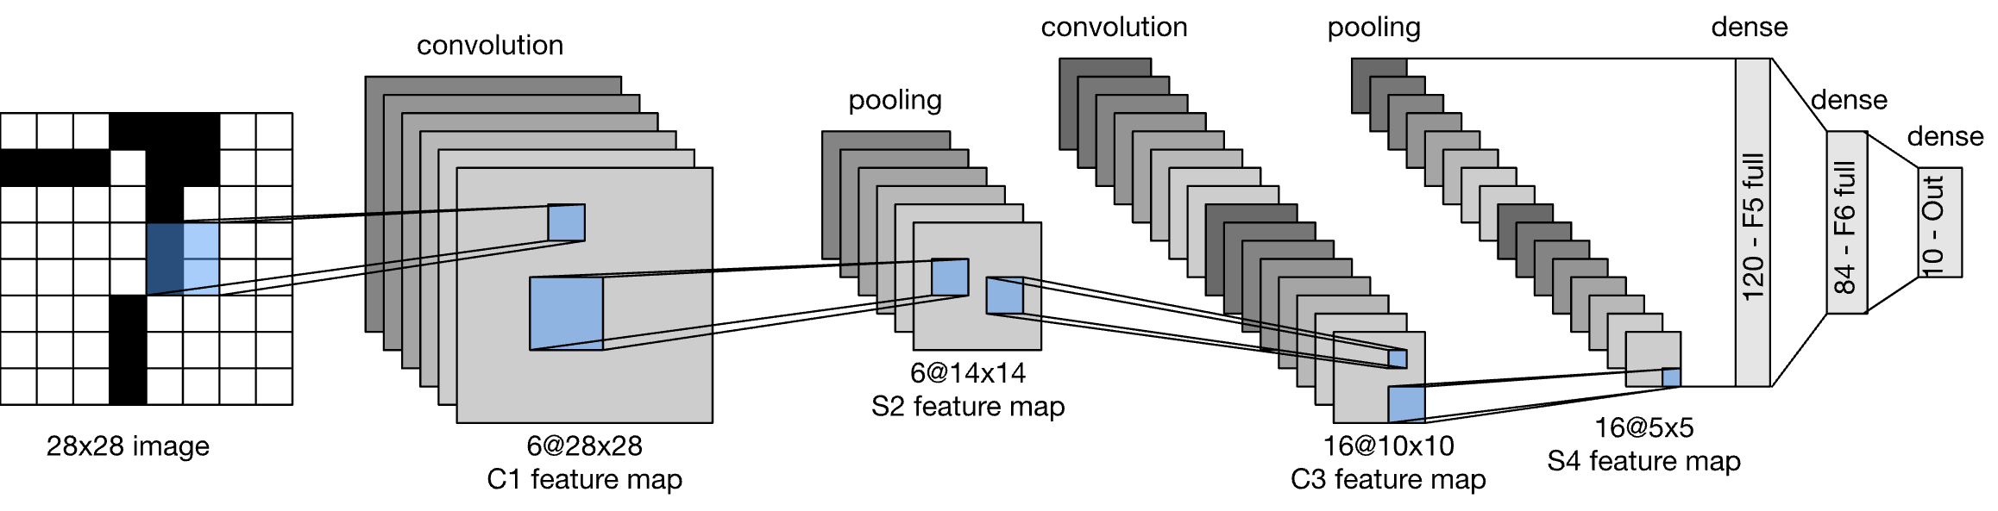
Source graphic: LeNet (1998)
dense
convolution
convolution
pooling
pooling
120 – F5 full
84 – F6 full
10 – Out
6@14x14 S2 feature map
28x28 image
6@28x28 C1 feature map
16@10x10 C3 feature map
16@5x5 S4 feature map
Notes:
~Source for slide 9

Slide 18
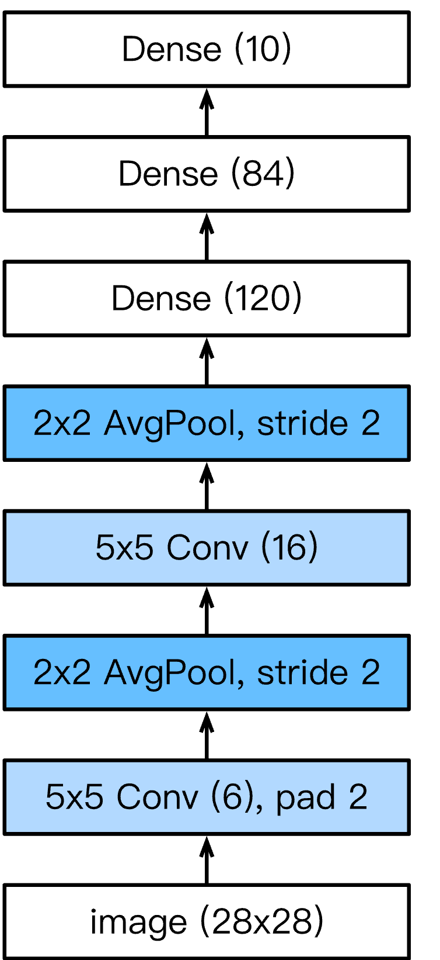
Source graphic: LeNet simplified view
10
Fully connected block
84
sigmoid
120
sigmoid
5x5x16
10x10x16
sigmoid
14x14x6
Convolution block
28x28x6
sigmoid
28x28x1
Notes:
~Source for slide 10

