Slide 1
Tree-Based Models
Machine Learning through Application
Module 2 – Lesson 3

Slide 2
Today’s activities
Introduction to decision trees
Iterative Dichotomiser 3 (ID3) tree-building algorithm
Impurity functions

Slide 3
Introduction to decision trees

Slide 4
What is a decision tree?
Decision trees are the first type of ML model that this module covers. You can use a decision tree for regression and classification tasks.
How do you build a decision tree?
Build or learn a decision tree by using your features to ask multiple questions.
Choose questions that will create a good amount of separation among the data points, considering their target (label) values.
Notes:
Decision tree-based ML models are widely used. Decision trees are flowchart-like structures that you build by using your features to ask multiple questions.
The best way to understand what a decision tree is to build one by using a dataset.

Slide 5
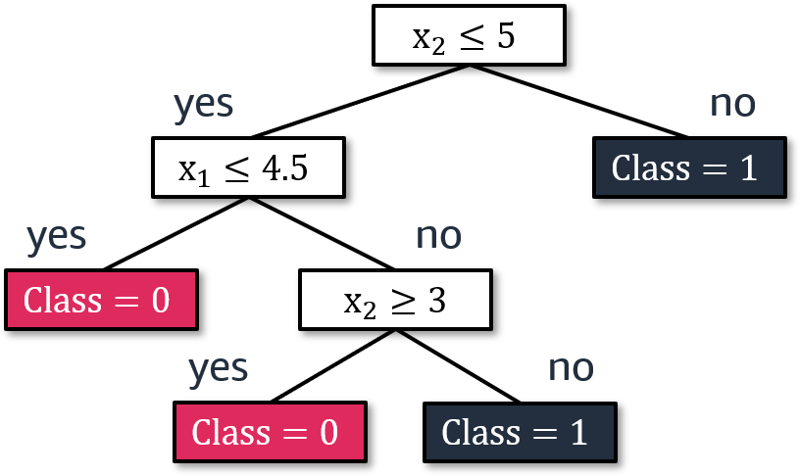
Decision tree example
Tree
Pet adoption dataset
x₁:pet_age (years) | x₂:time_until_outcome (month) | adoption outcome
3.5 | 2 | 0
5 | 2.5 | 1
1 | 3 | 0
2 | 4 | 0
4 | 2 | 0
6 | 6 | 1
2 | 9 | 1
4 | 9 | 1
5 | 4 | 0
3 | 8 | 1
Notes:
~Alt text – tree: Example decision tree that sorts data samples into class 0 or 1 based on a series of evaluations of the x1 and x2 values.
~
This example decision tree has multiple yes or no paths. The questions in this tree are x₂ is less than or equal to 5, x₁ is less than or equal to 4.5, and x₂ is greater than or equal to 3, and the answer to those questions is yes or no. (Later in this lesson, you will learn about how to decide which questions to use in the tree.)
With each question, data points are split into two sets: the yes set and the no set. You start with the whole dataset at the top of the tree and split the data points into branches as you go to the lower levels.

Slide 6
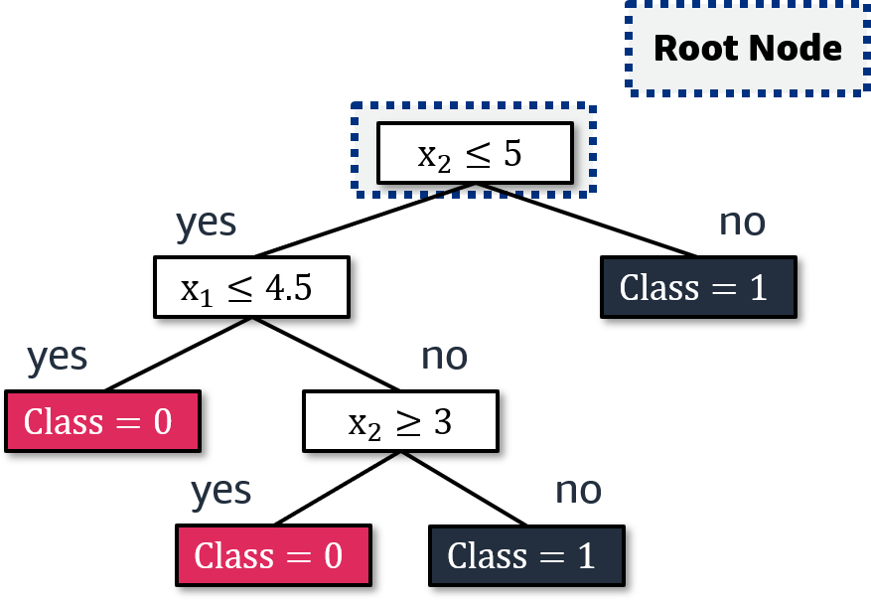
Root node in a decision tree
Tree
Pet adoption dataset
x₁:pet_age (years) | x₂:time_until_outcome (month) | adoption outcome
3.5 | 2 | 0
5 | 2.5 | 1
1 | 3 | 0
2 | 4 | 0
4 | 2 | 0
6 | 6 | 1
2 | 9 | 1
4 | 9 | 1
5 | 4 | 0
3 | 8 | 1
Notes:
~Alt text – tree: Same decision tree from the previous slide. The starting point at the top of the tree is labeled as the root node.
~
The root node is at the top of the tree and is the starting point of the tree.

Slide 7
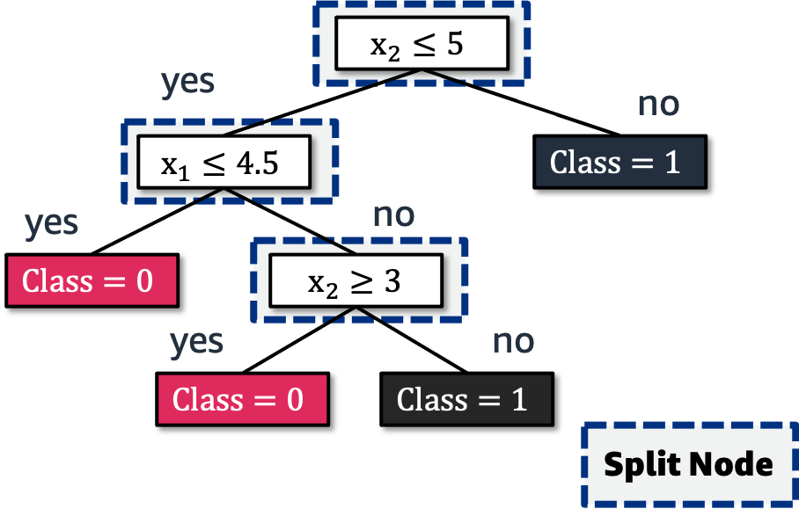
Split nodes in a decision tree
Tree
Pet adoption dataset
x₁:pet_age (years) | x₂:time_until_outcome (month) | adoption outcome
3.5 | 2 | 0
5 | 2.5 | 1
1 | 3 | 0
2 | 4 | 0
4 | 2 | 0
6 | 6 | 1
2 | 9 | 1
4 | 9 | 1
5 | 4 | 0
3 | 8 | 1
Notes:
~Alt text – tree: Same decision tree from previous slides. See details in notes.
~
Image description: Same decision tree from the previous slides. The nodes between the root node and the last nodes (where class is determined) are labeled as split nodes. End description.
The split nodes are where you split the data points into two or more branches. The root node is also a split node. In ML literature, split nodes are also called decision nodes, internal nodes, or parent nodes.

Slide 8
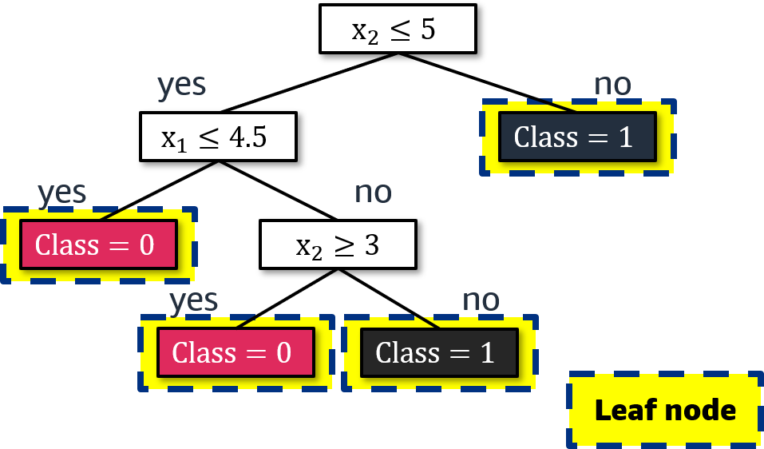
Leaf nodes in a decision tree
Tree
Pet adoption dataset
x₁:pet_age (years) | x₂:time_until_outcome (month) | adoption outcome
3.5 | 2 | 0
5 | 2.5 | 1
1 | 3 | 0
2 | 4 | 0
4 | 2 | 0
6 | 6 | 1
2 | 9 | 1
4 | 9 | 1
5 | 4 | 0
3 | 8 | 1
Notes:
~Alt text – tree: Same decision tree from the previous slides. The last node in each branch is labeled as a leaf node.
~
Leaf nodes are the final locations in the tree. When you reach a leaf node, you don’t split the data points anymore; instead, you make predictions.
Each leaf node has a dedicated value to return. In the example tree on the slide, two leaf nodes are for class 0 and two leaf nodes are for class 1.

Slide 9
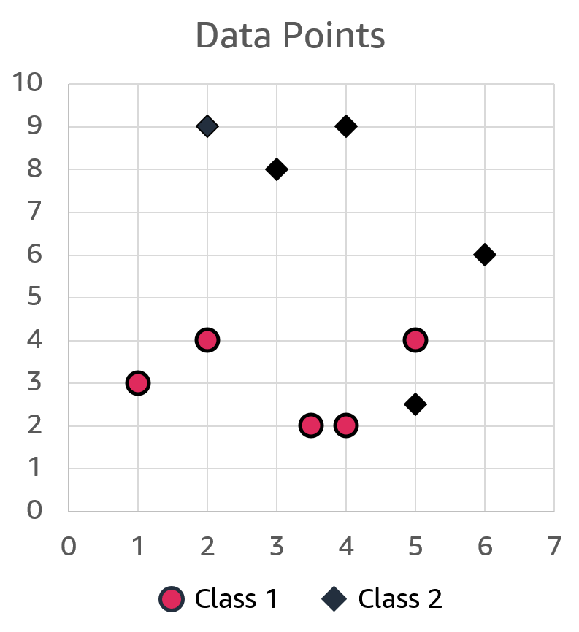
Plotting the data
Pet adoption dataset
x₁:pet_age (years) | x₂:time_until_outcome (month) | adoption outcome
3.5 | 2 | 0
5 | 2.5 | 1
1 | 3 | 0
2 | 4 | 0
4 | 2 | 0
6 | 6 | 1
2 | 9 | 1
4 | 9 | 1
5 | 4 | 0
3 | 8 | 1
Notes:
One good way to understand trees is to visualize a dataset and to see how a tree makes its decisions.
The plot on this slide shows the data points from the dataset table on the slide. The x₁ feature is plotted along the x-axis, and the x₂ feature is plotted on the y-axis. A red circle or black diamond appears in each point where the data meets. A red circle represents a label value of 0, and a black diamond represents a label value of 1.

Slide 10
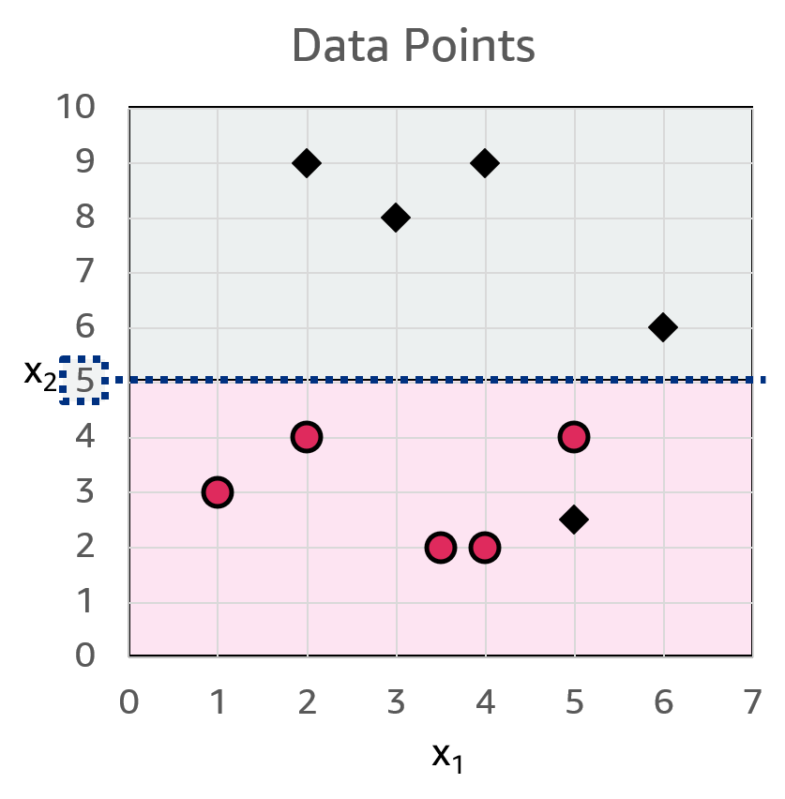
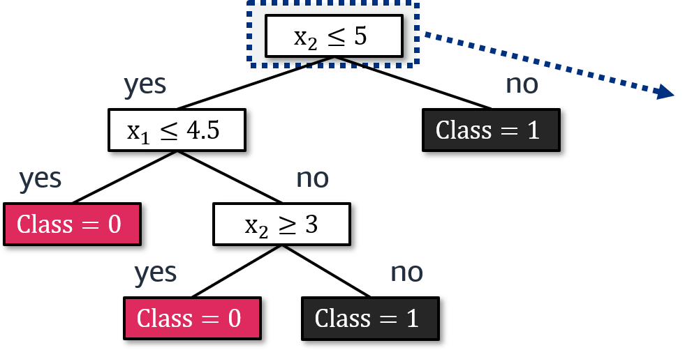
Graphing the decision tree: Root node
Which feature (x₁ or x₂) to split first to best separate class 1 from class 2?
Notes:
~Alt text – tree: Updated decision tree from previous slides. See details in notes.
~Alt text – plot: Updated plot from previous slides. See details in notes.
~
Image 1 description: Same decision tree from the previous slides. An arrow points from the root node, where the decision is x₂ is less than or equal to 5, to the associated value (5) on the y-axis (x₂) on a plot of the data points. The space on the plot above 5 on the y-axis is grayed out. End description.
Image 2 description: Plot from the previous slide with a horizontal line at x₂ equals 5 to match the decision tree. All points above the line are class 1. Most points below the line are class 0, but one point below the line is class 1. End description.
To create a root node, you need to select a feature and determine the condition for a split. To find a good split condition, pick a feature and value that best separates data points into their respective classes.
In the plot on the slide, choosing the x₂ feature at a value of 5 splits the data points almost evenly into two groups. The group above the dashed line is completely pure, with all samples belonging to class 1. The other group has only a single data point that is not correctly classified.
You will continue to split the data points with more questions until you correctly classify all data points.

Slide 11
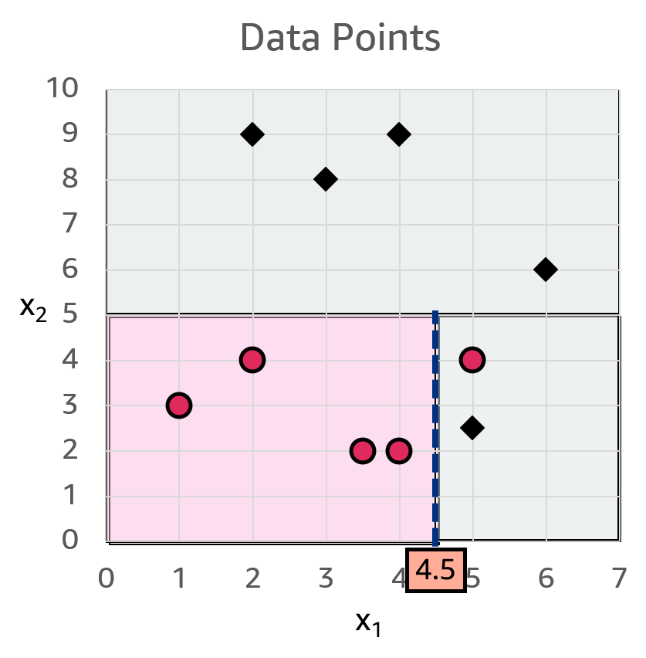
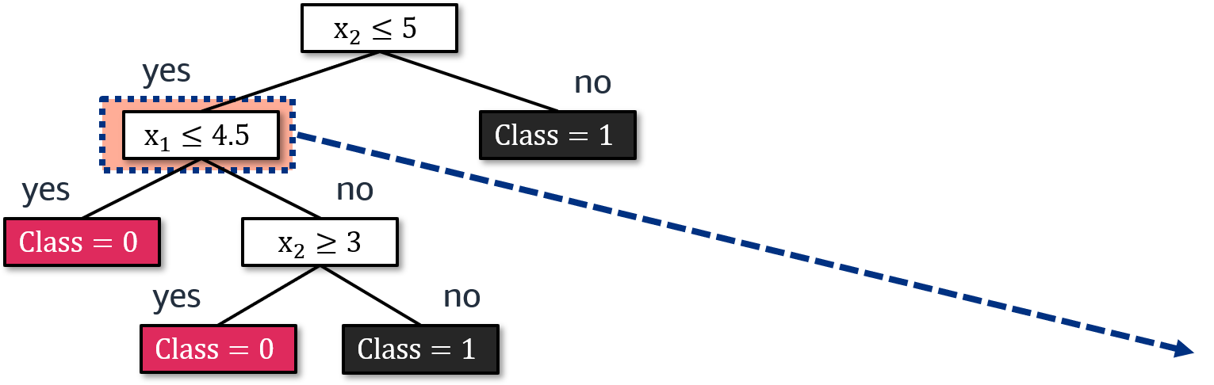
Graphing the decision tree: Split node 1
Which feature (x₁ or x₂) to split first to best separate class 1 from class 2?
Notes:
~Alt text – tree: Updated decision tree from previous slides. See details in notes.
~Alt text – plot: Updated plot from previous slides. See details in notes.
~
Image 1 description: Same decision tree from previous slides. An arrow from the split node for x₁ is less than or equal to 4.5 points to the value 4.5 on the x-axis (x₁ feature). Now all values on the y-axis that are equal to or greater than 5 are grayed out, and all the values on the x-axis that are equal to or greater than 4.5 are grayed out. End description.
Image 2 description: Plot from previous slides with a vertical line added at x₁ equals 4.5 that goes from x₂ equals 0 to x₂ equals 5 to match the decision tree. All data points to the left of the line are class 0. To the right of the line are one class 0 point and one class 1 point. End description.
The second question is asked on the x₁ feature. Now, focus only on the area under x2 = 5. A good separating condition is a value between 4 and 5. This example uses 4.5.
Again, the group on the left side of the line is completely pure, and the other group needs some work to correctly classify each data point.

Slide 12
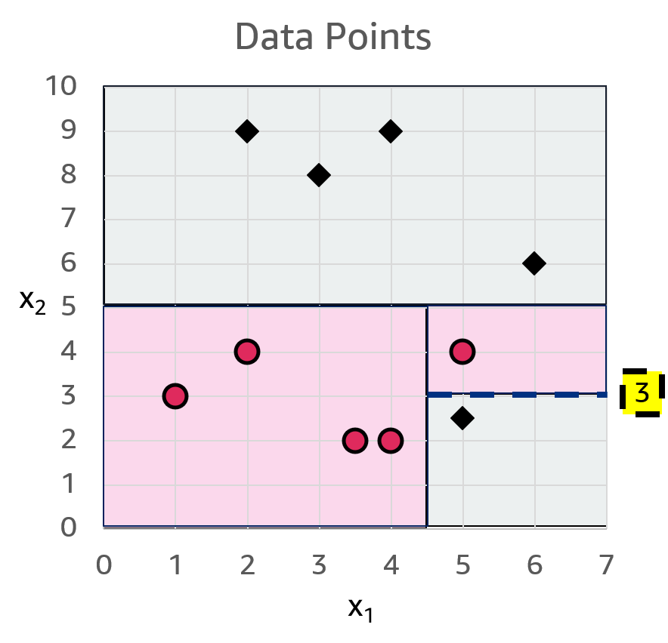
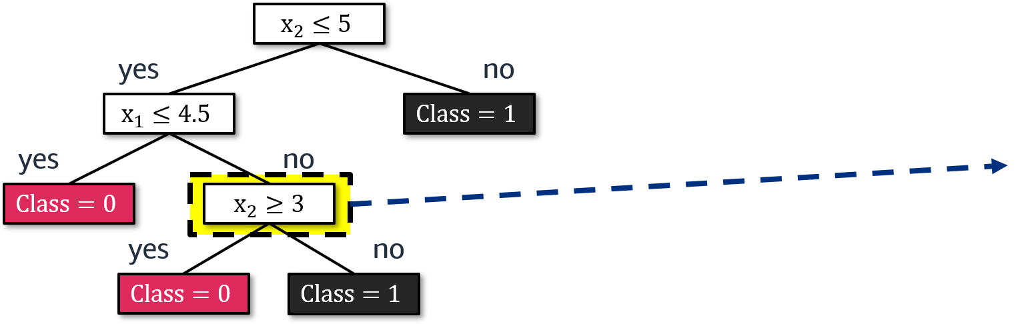
Graphing the decision tree: Split node 2
Which feature (x₁ or x₂) to split first to best separate class 1 from class 2?
Notes:
~Alt text – tree: Updated decision tree from previous slides. See details in notes.
~Alt text – plot: Updated plot from previous slides. See details in notes.
~
Image 1 description: Same decision tree from previous slides. A second-order split node, x₂ is greater than or equal to 3, points to the value x₁ equals 4.5, x₂ equals 3 on the data plot. Now less of the plot graph is grayed out, such that all the class 0 data points are in a red-shaded area, and all the class 1 data points are in a gray-shaded area. End description.
Image 2 description: Updated plot from previous slides. A horizontal line appears at x₂ equals 3 that goes from x₁ equals 4.5 to x₁ equals 7 to match the decision tree. This divides all points into the correct classes. End description.
The last question is asked on the x₂ feature. Choose a value that separates the remaining two data points into their classes. The feature x₂ on value 3 works well.
All data points are now correctly classified, so you can stop and not extend the tree any further.

Slide 13
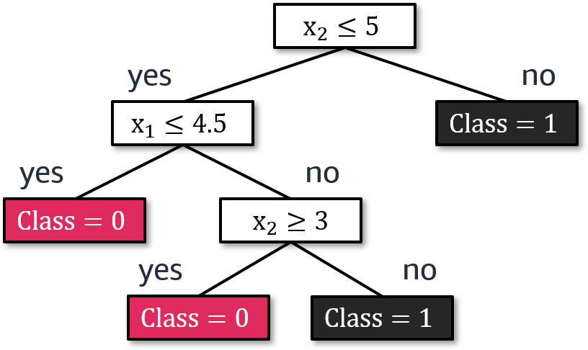
How do you use a decision tree to make predictions?
Predict y from x₁ and x₂.
Pet adoption dataset
x₁:pet_age (years) | x₂:time_until_outcome (month) | adoption outcome
3.5 | 2 | 0
5 | 2.5 | 1
1 | 3 | 0
2 | 4 | 0
4 | 2 | 0
6 | 6 | 1
2 | 9 | 1
4 | 9 | 1
5 | 4 | 0
3 | 8 | 1
Notes:
Now, you have a tree, but how do you use it to make predictions?

Slide 14
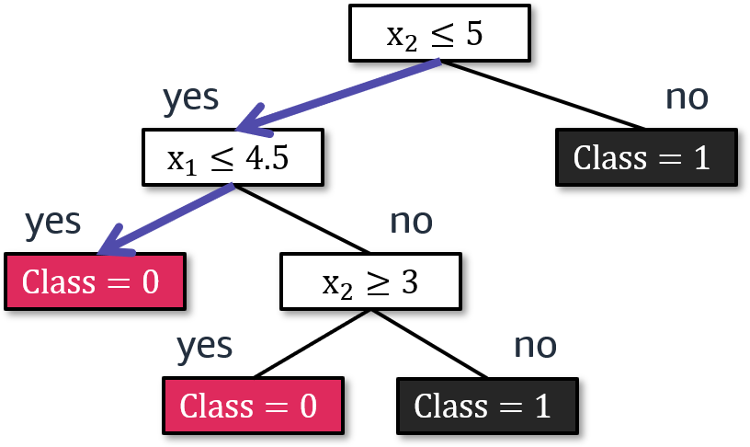

Making a prediction
Pet adoption dataset
x₁:pet_age (years) | x₂:time_until_outcome (month) | adoption outcome
3.5 | 2 | 0
5 | 2.5 | 1
1 | 3 | 0
2 | 4 | 0
4 | 2 | 0
6 | 6 | 1
2 | 9 | 1
4 | 9 | 1
5 | 4 | 0
3 | 8 | 1
$$f\left(x_{1}=2, x_{2}=4\right)= ?$$
Notes:
~Equation
~Alt text – tree: Decision tree from previous slides with arrows showing the evaluation path for the x1 and x2 values that are provided.
~Alt text – table highlight: Box on table to indicate that the tree selects x1 equals 2, x2 equals 4, and y equals 1.
~
To make a prediction, use the conditions in the tree and follow the paths until you reach a leaf node. The leaf node value at the end becomes the prediction.
In this example, x₁ = 2 and x₂ = 4 gives a class 0 prediction. This is an existing data point in the dataset.

Slide 15
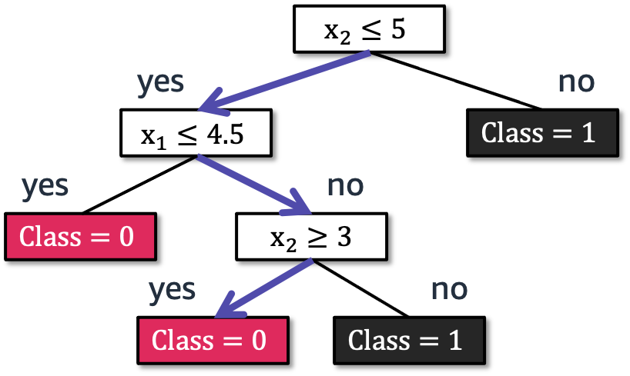

Making another prediction
Pet adoption dataset
x₁:pet_age (years) | x₂:time_until_outcome (month) | adoption outcome
3.5 | 2 | 0
5 | 2.5 | 1
1 | 3 | 0
2 | 4 | 0
4 | 2 | 0
6 | 6 | 1
2 | 9 | 1
4 | 9 | 1
5 | 4 | 0
3 | 8 | 1
$$f\left(x_{1}=7.5, x_{2}=5\right)= ?$$
Notes:
~Equation
~Alt text – tree: Decision tree from previous slides with arrows showing the evaluation path for the x1 and x2 values that are provided.
~
Now, consider a data point that isn’t in the dataset.
In this example, x₁ = 7.5 and x₂ = 5 gives a class 0 prediction.

Slide 16
ID3 tree-building algorithm

Slide 17
Learning a decision tree
The Iterative Dichotomiser 3 (ID3) algorithm:
Select the best feature and the condition to split.
Separate the training samples according to the selected feature.
If you have samples from a single class or you have used all features, stop. This becomes a leaf node.
Top-down approach: Grow the tree from the root node to the leaf nodes.
Notes:
The Iterative Dichotomiser 3 (ID3) algorithm is an algorithm that you can use to build decision trees. The algorithm has three main steps:
Select the best feature and the condition to split.
Separate the training samples according to the selected feature.
If you have samples from a single class or you have used all features, stop. This becomes a leaf node.

Slide 18
Impurity functions

Slide 19
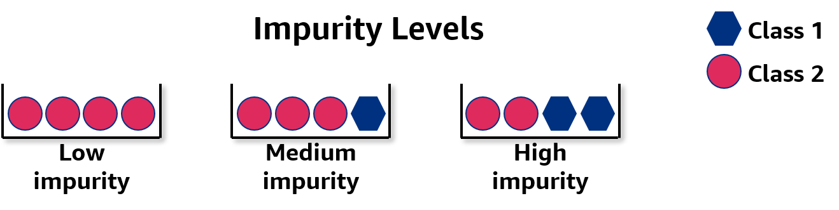
What does “impurity” mean here?
Assume that the following bucket is a node in a decision tree:
Decision trees use this iteratively to guide the node question (split criteria).
Notes:
~Alt text: Diagram to explain impurity. See details in notes.
~
Image description: Diagram with three buckets that each have a different amount of impurity. The buckets can be thought of as nodes in a decision tree. Each bucket contains four items, and the items are from two classes. The items in the first bucket are from the same class, which indicates low impurity. The second bucket has three items from the first classes and one item from the second class, which indicates medium impurity. The third bucket has two items from each of the two classes, which indicates high impurity. End description.
The main idea is to pick a feature and value that separates the data points into their corresponding target groups.
Impurity is a measure that tells how well those data points are separated, considering their targets.
For example, put one group from the same target class to one side and the other group to the other side. Separate these data points by asking questions, as in the previous examples. The goal is to get low impurity or high purity after splitting the data points. In this example, three impurity levels are defined: low, medium, and high.

Slide 20
Example: Package delivery problem
Requirement: A decision tree that predicts on-time delivery
Weather | Demand | Address | ontime
Sunny | High | Correct | No
Sunny | High | Misspelled | No
Overcast | High | Correct | Yes
Rainy | High | Correct | Yes
Rainy | Normal | Correct | Yes
Rainy | Normal | Misspelled | No
Overcast | Normal | Correct | Yes
Sunny | High | Correct | No
Sunny | Normal | Correct | Yes
Rainy | Normal | Misspelled | Yes
Sunny | Normal | Misspelled | Yes
Overcast | High | Misspelled | Yes
Overcast | Normal | Correct | Yes
Rainy | High | Misspelled | No
Notes:
Consider the example dataset on the slide.

Slide 21

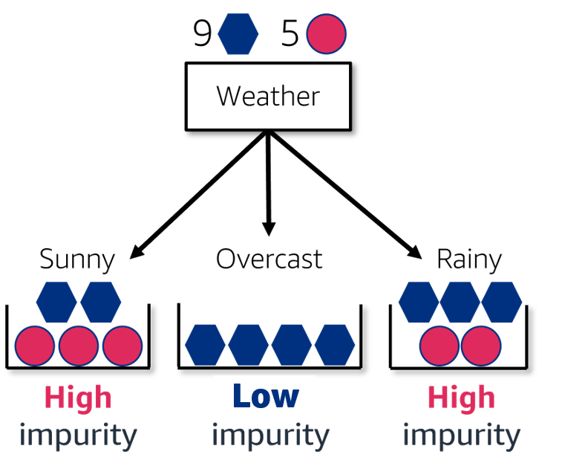
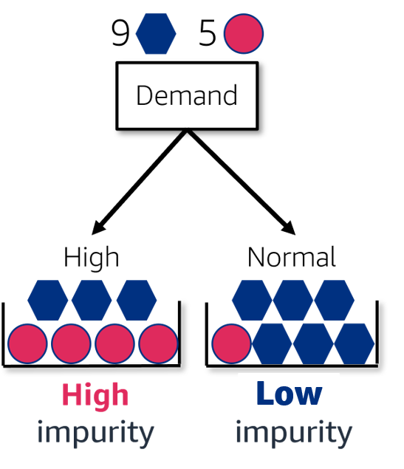
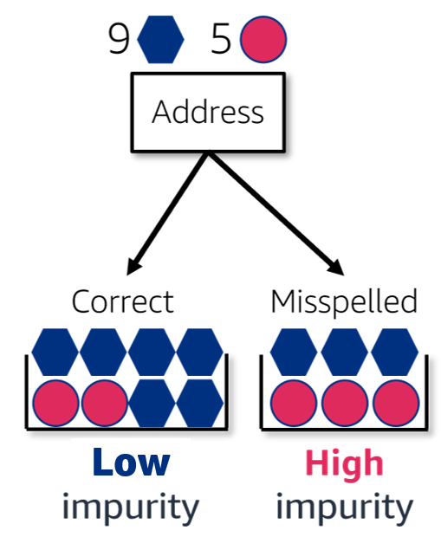
Impurity function uncertainty
Which split results in the least impurity (uncertainty) overall?
Notes:
~Alt text – diagram key: Diagram key. Blue hexagon is yes, and pink circle is no.
~Alt text – weather split: Diagram of impurity for the weather feature. See details in notes.
~Alt text – demand split: Diagram of impurity for the demand feature. See details in notes.
~Alt text – address split: Diagram of impurity for the address feature. See details in notes.
~
Image 1 description: Diagram of impurity for the weather feature, which has 9 yes and 5 no decisions. There are 3 predictions: sunny (high impurity: 2 yes, 3 no), overcast (low impurity: 4 yes), and rainy (high impurity: 3 yes, 2 no). End description.
Image 2 description: Diagram of impurity for the demand feature, which has 9 yes and 5 no decisions. There are 2 predictions: high (high impurity: 3 yes, 4 no), and normal (low impurity: 6 yes, 1 no). End description.
Image 3 description: Diagram of impurity for the address feature, which has 9 yes and 5 no decisions. There are 2 predictions: correct (low impurity: 6 yes, 2 no), and misspelled (high impurity: 3 yes, 3 no). End description.
Which split will result in the least impurity overall? To do this, these impurities need to be quantified and compared.
You need more granularity because not every medium or high impurity is equal.

Slide 22
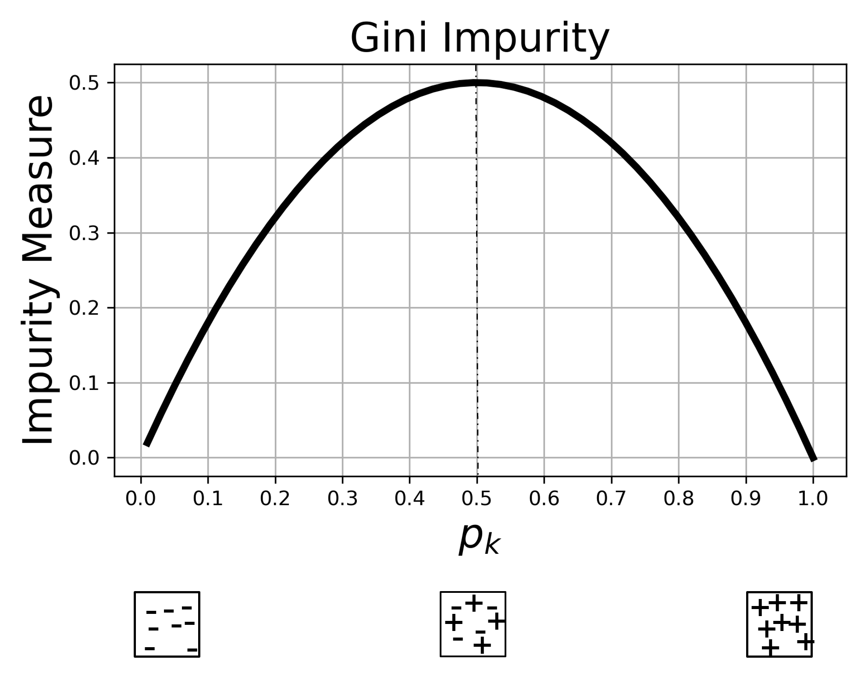
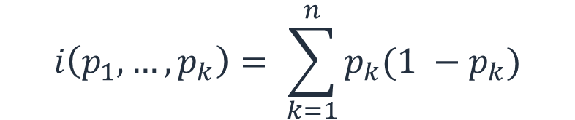
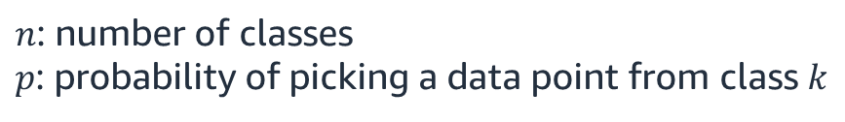
Gini impurity
How can you accurately evaluate this?
Use Gini impurity:
$$i\left(p_{1}, …, p_{k}\right)= \sum_{k=1}^{n}{p_{k}(1 −p_{k})}$$
$n$: number of classes $p$: probability of picking a data point from class $k$
Notes:
~Equation
~Alt text – graph: Graph of an upward curve labeled "Gini Impurity". The x axis is pk, and the y axis is "Impurity measure".
~
Gini impurity is a measure to quantify impurity levels. It’s an equation that accepts the probabilities of each class occurring.
The figure on the slide shows its nature. It peaks in the middle and dies out on both ends. At the peak is maximum impurity. Think about having a 50/50 distribution of two classes, + and -. At both ends, you have only a single class—either + or -. Therefore, you have zero impurity at each end. Anything in between will be a value on the curve with some amount of impurity.

Slide 23
Impurity for classification
If you have mix of + and - samples:
High uncertainty
If you have only + or - samples:
Low uncertainty
Notes:
~Alt text – graph: Labeled Gini Impurity graph. See details in notes.
~
Image description: Same Gini Impurity graph as in the last slide, with "High uncertainty" pointing at the apex of the curve, and "Low uncertainty" pointing at the start and end points of the curve. End description.
The two extremes are the peak and the endpoints.

Slide 24
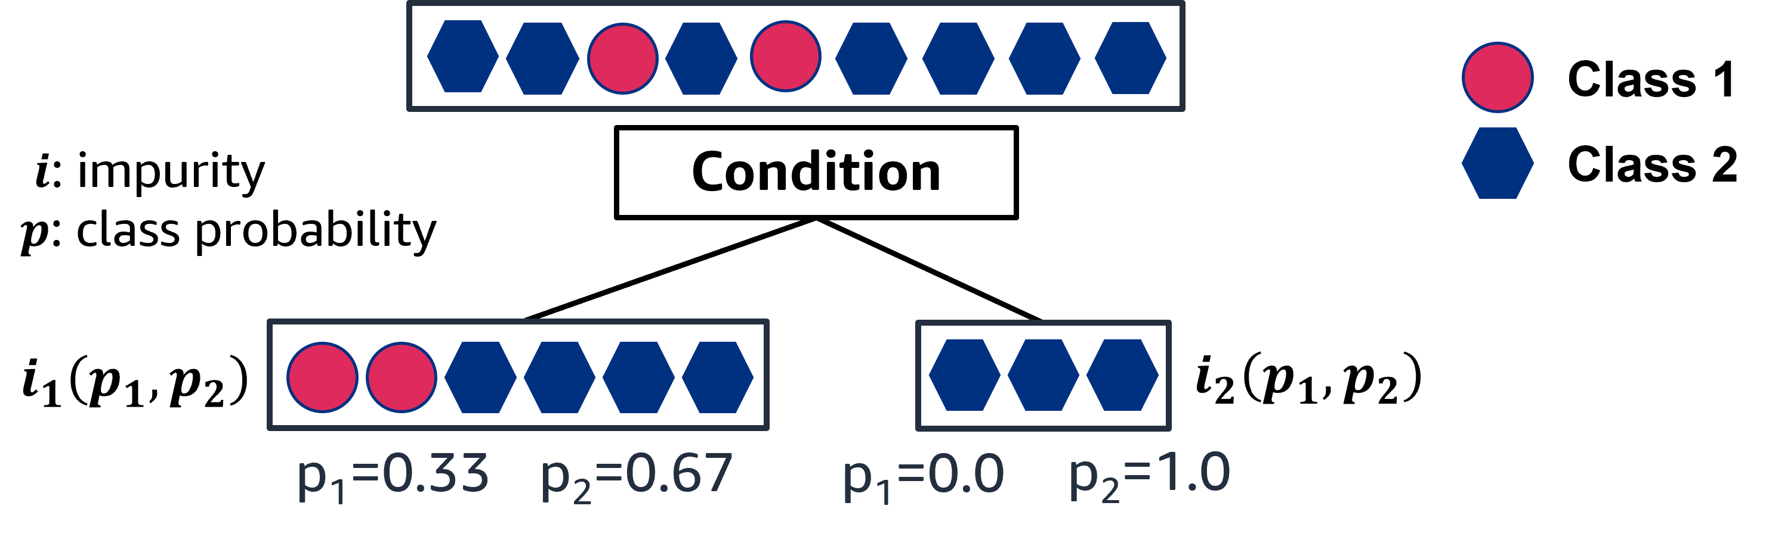
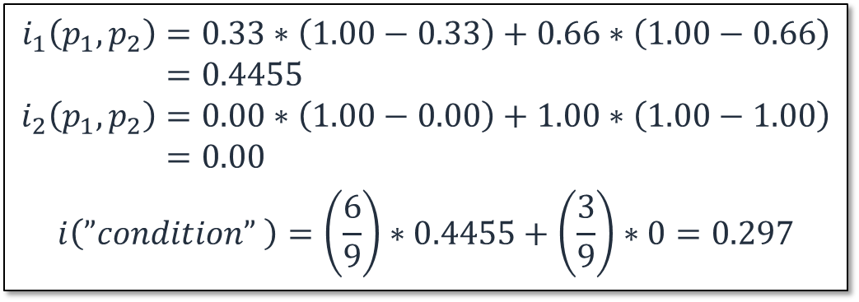
Impurity for classification: Example
Calculate the Gini impurity that results from this split:
$$i_{1}\left(p_{1},p_{2}\right)=0.33∗\left(1.00−0.33\right)+0.66∗\left(1.00−0.66\right) \\ =0.4455 \\ i_{2}\left(p_{1},p_{2}\right)=0.00∗\left(1.00−0.00\right)+1.00∗\left(1.00−1.00\right) \\ =0.00$$
$$i\left(”condition” \right)=\left(\frac{6}{9}\right)∗0.4455+\left(\frac{3}{9}\right)∗0=0.297$$
Notes:
~Equation
~Alt text: Diagram of calculating Gini impurity for a split. See details in notes.
~
Image description: Diagram of 9 data points. Two of the data points belong to class 2, and 7 of the data points belong to class 2. A split condition is applied, and the data points are split in two subsets. The first subset contains 2 data points from class 1 and 4 data points from class 2. The second subset contains 3 data points from class 2. The class probabilities have been calculated for each subset. End description.
This slide shows a numerical example to understand this concept. A split causes two subsets, and the impurity is calculated after this split. The subset on the right is pure—it has an impurity of 0.
The final Gini impurity is the weighted sum of $i_{1}\left(p_{1}, p_{2}\right)$ and $i_{2}\left(p_{1}, p_{2}\right)$.

Slide 25
Information gain and feature selection
Information gain is the expected reduction in impurity (uncertainty) with the selected feature.
$$Information gain=i{\left(p_{1}, …, p_{k}\right)}_{before} −i{\left(p_{1}, …, p_{k}\right)}_{after}$$
Impurity before split
Impurity after split
Notes:
~Equation
~
A related concept is information gain, which is another way to decide which feature and condition to use. Information gain measures the decrease in impurity after the split. It is the difference between the impurities before and after the split. You want this value to be as high as possible when you choose a condition.

Slide 26
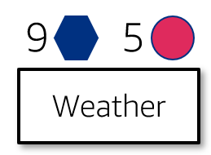

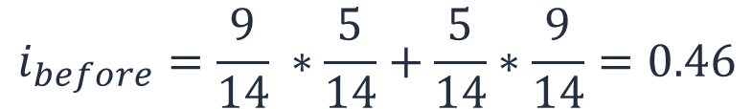
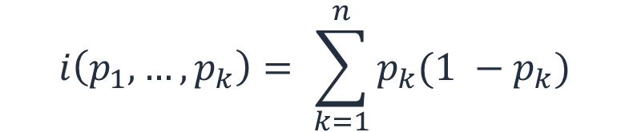
Information gain: Impurity before the split
Gini impurity:
$$i\left(p_{1}, …, p_{k}\right)= \sum_{k=1}^{n}{p_{k}(1 −p_{k})}$$
$$i_{before}=\frac{9}{14} ∗\frac{5}{14}+\frac{5}{14}∗\frac{9}{14}=0.46$$
$$i_{before}=0.46$$
Notes:
~Equation
~Alt text: Diagram of source data for a tree. Source is the weather feature, and there are 9 yes data points and 5 no data points.
~
First, the impurity before the split is calculated.

Slide 27
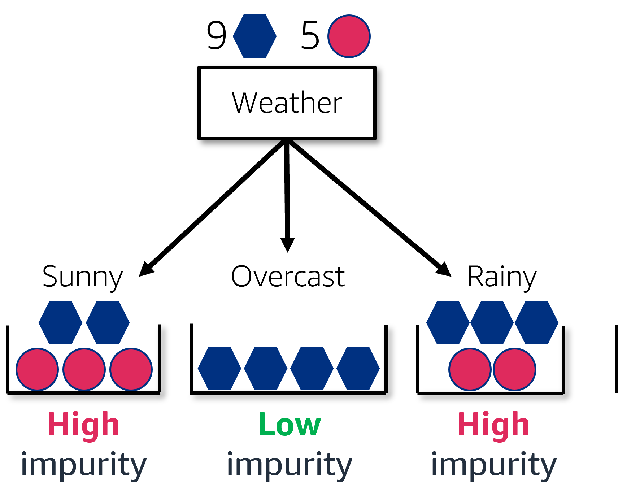





Calculating impurity for each weather class
Gini impurity:
$$i\left(p_{1}, …, p_{k}\right)= \sum_{k=1}^{n}{p_{k}(1 −p_{k})}$$
$$i_{before}=0.46$$
$$i_{sunny}=\frac{2}{5} ∗\frac{3}{5}+\frac{3}{5}∗\frac{2}{5}=0.48$$
$$i_{overcast}=\frac{4}{4} ∗\frac{0}{4}+\frac{0}{4}∗\frac{4}{4}=0$$
$$i_{rainy}=\frac{2}{5} ∗\frac{3}{5}+\frac{3}{5}∗\frac{2}{5}=0.48$$
$$i_{weather}=\frac{5}{14} ∗i_{sunny}+\frac{4}{14}∗i_{overcast}+\frac{5}{14}∗i_{rainy}$$
Notes:
~Equation
~Alt text: Diagram of impurity for the weather feature. See details in notes.
~
Image description: Diagram of impurity for the weather feature, which has 9 yes and 5 no decisions. There are 3 predictions: sunny (high impurity: 2 yes, 3 no), overcast (low impurity: 4 yes), and rainy (high impurity: 3 yes, 2 no). End description.
The impurity for the weather feature is calculated. See the weighted sum at the end.

Slide 28



Impurity of weather category after the split
Gini impurity:
$$i\left(p_{1}, …, p_{k}\right)= \sum_{k=1}^{n}{p_{k}(1 −p_{k})}$$
$$i_{before}=0.46$$
$$i_{sunny}=\frac{2}{5} ∗\frac{3}{5}+\frac{3}{5}∗\frac{2}{5}=0.48$$
$$i_{overcast}=\frac{4}{4} ∗\frac{0}{4}+\frac{0}{4}∗\frac{4}{4}=0$$
$$i_{rainy}=\frac{2}{5} ∗\frac{3}{5}+\frac{3}{5}∗\frac{2}{5}=0.48$$
$$i_{weather}=\frac{5}{14} ∗0.48+\frac{4}{14}∗0+\frac{5}{14}∗0.48=0.34$$
(Weighted sum of impurities)

Slide 29


Difference between impurity before and after split
$$Gain=i{\left(p_{1}, …, p_{k}\right)}_{before} −i{\left(p_{1}, …, p_{k}\right)}_{after}$$
$$i_{before}=0.46$$
$$i_{before}=0.46$$
$$i_{weather}=0.34$$
$$Gain\left(\text{Weather}\right)=0.46−0.34=0.12$$
$$i_{weather}=\frac{5}{14} ∗0.48+\frac{4}{14}∗0+\frac{5}{14}∗0.48=0.34$$
Notes:
~Equation
~Alt text – i_before arrow: Arrow indicating that i_before = 0.46 is substituted into the Gain(Weather) equation.
~Alt text – i_weather arrow: Arrow indicating that i_weather = 0.334 is substituted into the Gain(Weather) equation.
~
Information gain is the difference between impurities before and after the split.

Slide 30
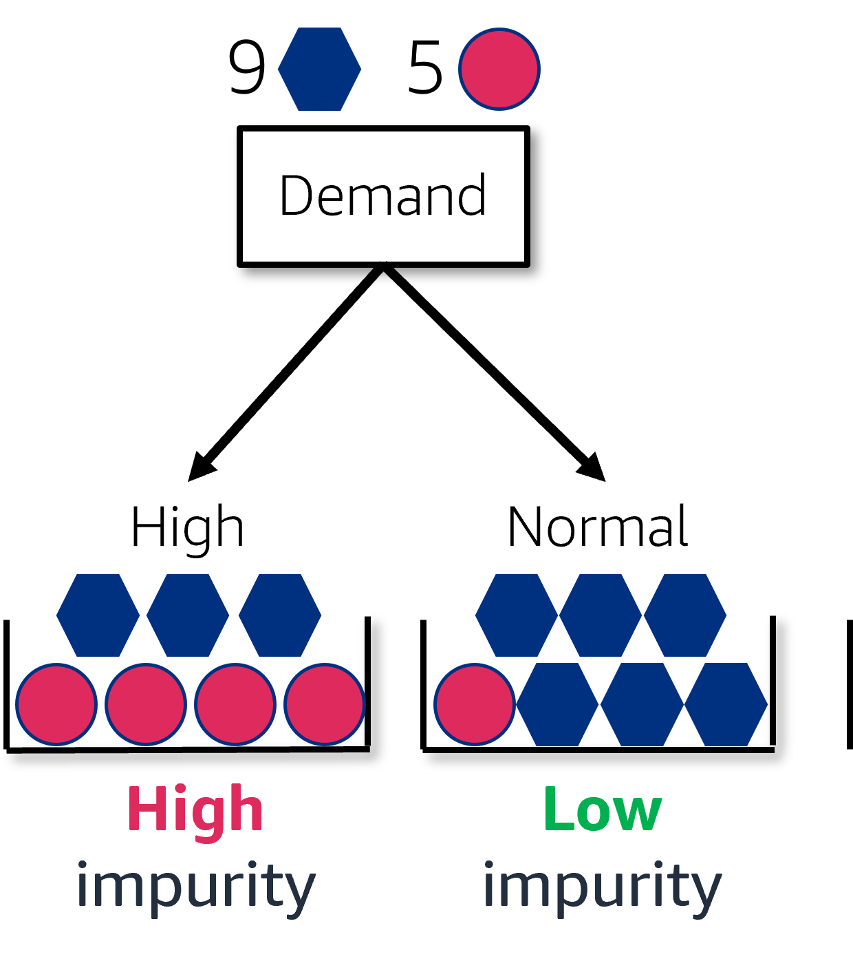
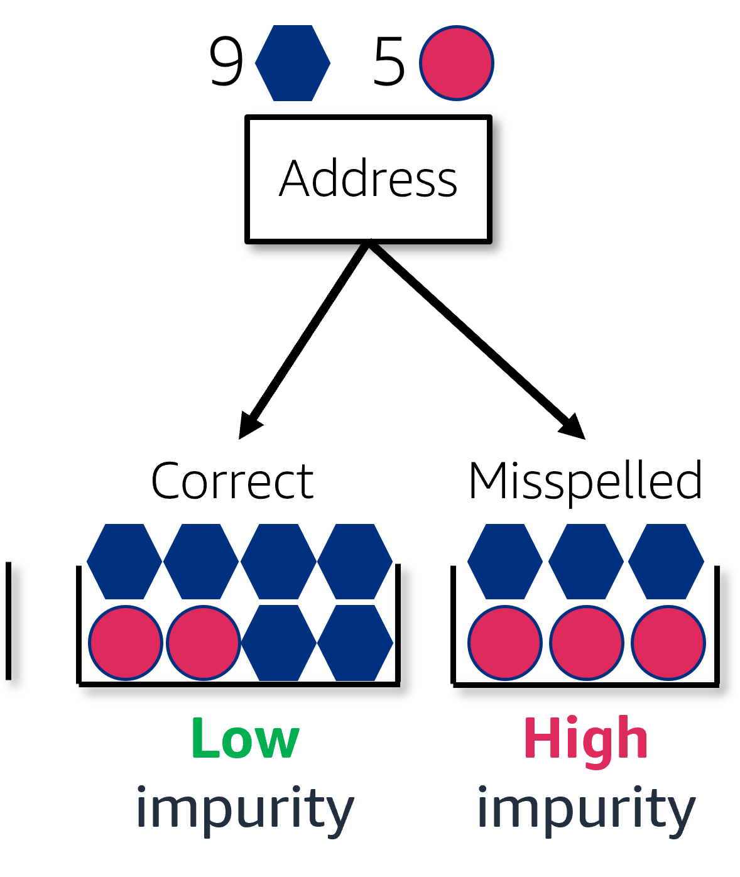








Repeat for the other categories
Comparing gains for each feature:
Gain(Weather) = 0.46 - 0.34 = 0.12
Gain(Demand) = 0.46 - 0.37 = 0.09
Gain(Address) = 0.46 - 0.43 = 0.03
“Weather” has the highest gain of all, so start the tree with that feature as the root node.
$$i_{high}=0.49$$
$$i_{normal}=0.245$$
$$i_{correct}=0.38$$
$$i_{misspelled}=0. 5$$
$$i_{demand}=\frac{7}{14}∗0.49+ \frac{7}{14}∗ 0.245$$
$$i_{address}=\frac{8}{14}∗0.38+ \frac{6}{14}∗ 0. 5$$
$$i_{demand}=0.37$$
$$i_{address}=0.43$$
Notes:
~Equation
~Alt text – highlight box: Box highlighting the Gain(Weather) results from the previous slide.
~Alt text – demand diagram: Diagram of impurity for the demand feature. See details in notes.
~Alt text – address diagram: Diagram of impurity for the address feature. See details in notes.
~
Image 1 description: Diagram of impurity for the demand feature that has 9 yes and 5 no decisions. There are 2 predictions: high (high impurity: 3 yes, 4 no), and normal (low impurity: 6 yes, 1 no). End description.
Image 2 description: Diagram of impurity for the address feature that has 9 yes and 5 no decisions. There are 2 predictions: correct (low impurity: 6 yes, 2 no), and misspelled (high impurity: 3 yes, 3 no). End description.
Repeating the process for the demand and address features yields the information gains as 0.09 and 0.03. Choose the feature with the largest information gain, which is the weather feature in this example.
The process continues in a similar way. Use the weather feature, which results in three subsets. Try different features to further split those subsets, and the tree grows.

Slide 31
Next lesson
This lesson covered how to build decision trees by using the impurity concept.
The next lesson will explain how to optimize the weights of the model to reduce the error.
The next lesson will also describe how to mitigate overfitting by using regularization.

Slide 33
Image source slide (for curriculum development use only)

Slide 34







Source graphic: Decision tree example
x₁:pet_age (years) | x₂:time_until_outcome (month) | adoption outcome
3.5 | 2 | 0
5 | 2.5 | 1
1 | 3 | 0
2 | 4 | 0
4 | 2 | 0
6 | 6 | 1
2 | 9 | 1
4 | 9 | 1
5 | 4 | 0
3 | 8 | 1
$$x_{2}≤5$$
yes
no
$$x_{1}≤4.5$$
$$Class=1$$
yes
no
$$Class=0$$
$$x_{2}≥3$$
yes
no
$$Class=0$$
$$Class=1$$

Slide 35



Source graphic: Root node in a decision tree
Root Node
x₁:pet_age (years) | x₂:time_until_outcome (month) | adoption outcome
3.5 | 2 | 0
5 | 2.5 | 1
1 | 3 | 0
2 | 4 | 0
4 | 2 | 0
6 | 6 | 1
2 | 9 | 1
4 | 9 | 1
5 | 4 | 0
3 | 8 | 1
$$x_{2}≤5$$
yes
$$x_{1}≤4.5$$
$$Class=1$$
yes
$$Class=0$$
$$x_{2}≥3$$
yes
$$Class=0$$
$$Class=1$$

Slide 36




Source graphic: Split nodes in decision trees
x₁:pet_age (years) | x₂:time_until_outcome (month) | adoption outcome
3.5 | 2 | 0
5 | 2.5 | 1
1 | 3 | 0
2 | 4 | 0
4 | 2 | 0
6 | 6 | 1
2 | 9 | 1
4 | 9 | 1
5 | 4 | 0
3 | 8 | 1
$$x_{2}≤5$$
yes
no
$$x_{1}≤4.5$$
$$Class=1$$
yes
no
$$Class=0$$
$$x_{2}≥3$$
yes
no
$$Class=0$$
$$Class=1$$
Split Node

Slide 37
Source graphic: Leaf nodes in a decision tree
x₁:pet_age (years) | x₂:time_until_outcome (month) | adoption outcome
3.5 | 2 | 0
5 | 2.5 | 1
1 | 3 | 0
2 | 4 | 0
4 | 2 | 0
6 | 6 | 1
2 | 9 | 1
4 | 9 | 1
5 | 4 | 0
3 | 8 | 1
$$x_{2}≤5$$
yes
no
$$x_{1}≤4.5$$
$$Class=1$$
yes
no
$$Class=0$$
$$x_{2}≥3$$
yes
no
$$Class=0$$
$$Class=1$$
Leaf node
Leaf node

Slide 38
Source graphic: Plotting the data
x₁:pet_age (years) | x₂:time_until_outcome (month) | adoption outcome
3.5 | 2 | 0
5 | 2.5 | 1
1 | 3 | 0
2 | 4 | 0
4 | 2 | 0
6 | 6 | 1
2 | 9 | 1
4 | 9 | 1
5 | 4 | 0
3 | 8 | 1
Class 1
Class 2

Slide 39







Source graphic: Graphing the decision tree: Root node
$$x_{2}≤5$$
yes
no
x₂
$$x_{1}≤4.5$$
$$Class=1$$
yes
no
$$Class=0$$
$$x_{2}≥3$$
yes
no
$$Class=0$$
$$Class=1$$
x₁

Slide 40
Source graphic: Graphing the decision tree: Split node
$$x_{2}≤5$$
yes
no
x₂
$$x_{1}≤4.5$$
$$Class=1$$
yes
no
$$Class=0$$
$$x_{2}≥3$$
yes
no
$$Class=0$$
$$Class=1$$
4.5
x₁

Slide 41
Source graphic: Graphing the decision tree: Split node 2
$$x_{2}≤5$$
yes
no
x₂
$$x_{1}≤4.5$$
$$Class=1$$
yes
no
3
$$Class=0$$
$$x_{2}≥3$$
yes
no
$$Class=0$$
$$Class=1$$
x₁

Slide 42


Source graphic: How do we use this to make predictions?
x₁:pet_age (years) | x₂:time_until_outcome (month) | adoption outcome
3.5 | 2 | 0
5 | 2.5 | 1
1 | 3 | 0
2 | 4 | 0
4 | 2 | 0
6 | 6 | 1
2 | 9 | 1
4 | 9 | 1
5 | 4 | 0
3 | 8 | 1
$$x_{2}≤5$$
yes
no
$$x_{1}≤4.5$$
$$Class=1$$
yes
no
$$Class=0$$
$$x_{2}≥3$$
yes
no
$$Class=0$$
$$Class=1$$

Slide 43

Source graphic: Making a prediction
x₁:pet_age (years) | x₂:time_until_outcome (month) | adoption outcome
3.5 | 2 | 0
5 | 2.5 | 1
1 | 3 | 0
2 | 4 | 0
4 | 2 | 0
6 | 6 | 1
2 | 9 | 1
4 | 9 | 1
5 | 4 | 0
3 | 8 | 1
$$x_{2}≤5$$
yes
no
$$x_{1}≤4.5$$
$$Class=1$$
yes
no
$$Class=0$$
$$x_{2}≥3$$
yes
no
$$Class=0$$
$$Class=1$$

Slide 44
Source graphic: Making another prediction
x₁:pet_age (years) | x₂:time_until_outcome (month) | adoption outcome
3.5 | 2 | 0
5 | 2.5 | 1
1 | 3 | 0
2 | 4 | 0
4 | 2 | 0
6 | 6 | 1
2 | 9 | 1
4 | 9 | 1
5 | 4 | 0
3 | 8 | 1
$$x_{2}≤5$$
yes
no
$$x_{1}≤4.5$$
$$Class=1$$
yes
no
$$Class=0$$
$$x_{2}≥3$$
yes
no
$$Class=0$$
$$Class=1$$

Slide 45
Source graphic: What does “impurity” mean here?
Impurity Levels
Class 1
Class 2
Low impurity
Medium impurity
High impurity

Slide 46
Source graphic: Impurity functions
= Yes = No
Low
Low
Low

Slide 47

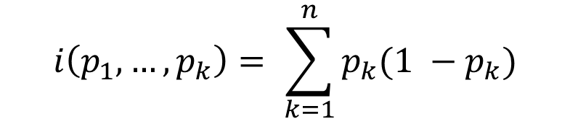
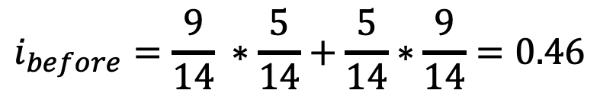
Source graphic: Information gain: Impurity before the split
9
5
$$i\left(p_{1}, …, p_{k}\right)= \sum_{k=1}^{n}{p_{k}(1 −p_{k})}$$
Weather
$$i_{before}=\frac{9}{14} ∗\frac{5}{14}+\frac{5}{14}∗\frac{9}{14}=0.46$$
$$i_{before}=0.46$$

