Slide 1
Hyperparameter Tuning
Machine Learning through Application
Module 2 – Lesson 5

Slide 2
Today’s activities
Hyperparameters in ML algorithms
Setting your hyperparameters
Validation methods

Slide 3
Hyperparameters in ML algorithms

Slide 4
Hyperparameters
Hyperparameters are adjustable parameters in an algorithm, and they influence the training process.
Think of them as options or settings for model training jobs.
Examples:
K-nearest neighbors (KNN): n_neighbors, metric
Decision trees: max_depth, min_samples_leaf, class_weight, criterion
Random forest: n_estimators, max_samples
Ensemble bagging: base_estimator, n_estimators
Gradient descent: Learning rate
Notes:
Hyperparameters are parameters that affect the performance and structure of an ML algorithm. You specify hyperparameters when you configure the code before training.
Hyperparameters are not the same as the ML model’s parameters (for example, weights that are attached to each model’s features), which are learned from the data.
Different choices of hyperparameters could lead to different model performance metrics. However, knowing exactly which values would maximize learning—and therefore model performance—is challenging. Typically, you start at a random value and iterate through adjustments as you see what effect the parameters have. This process can be long depending on how many hyperparameters your model has and how long it takes to train.

Slide 5
Comparing hyperparameters and parameters
Hyperparameters | Parameters
Configurations or settings for an ML algorithm or model | Values that are learned during optimization or training
Typically set manually using heuristics | Not set manually by the scientist or designer
Usually set prior to training | Updated during training
Example: Learning rate for linear regression | Example: Weight and bias values for linear regression
Notes:
Hyperparameters and parameters are two different concepts in ML, although they are often mistaken to be the same. You can consider hyperparameters as the configurations or settings for the ML algorithm or model. However, parameters are values that loosely embody the rules that the ML algorithm seeks to learn from the data.
You set hyperparameter values based on heuristics prior to training. Parameters, such as weights, are learned during model training.
Some common hyperparameters for linear regression are learning rate for gradient descent and coefficient for regularizing penalty term. Parameters for a linear regression model are weights and bias values.

Slide 6
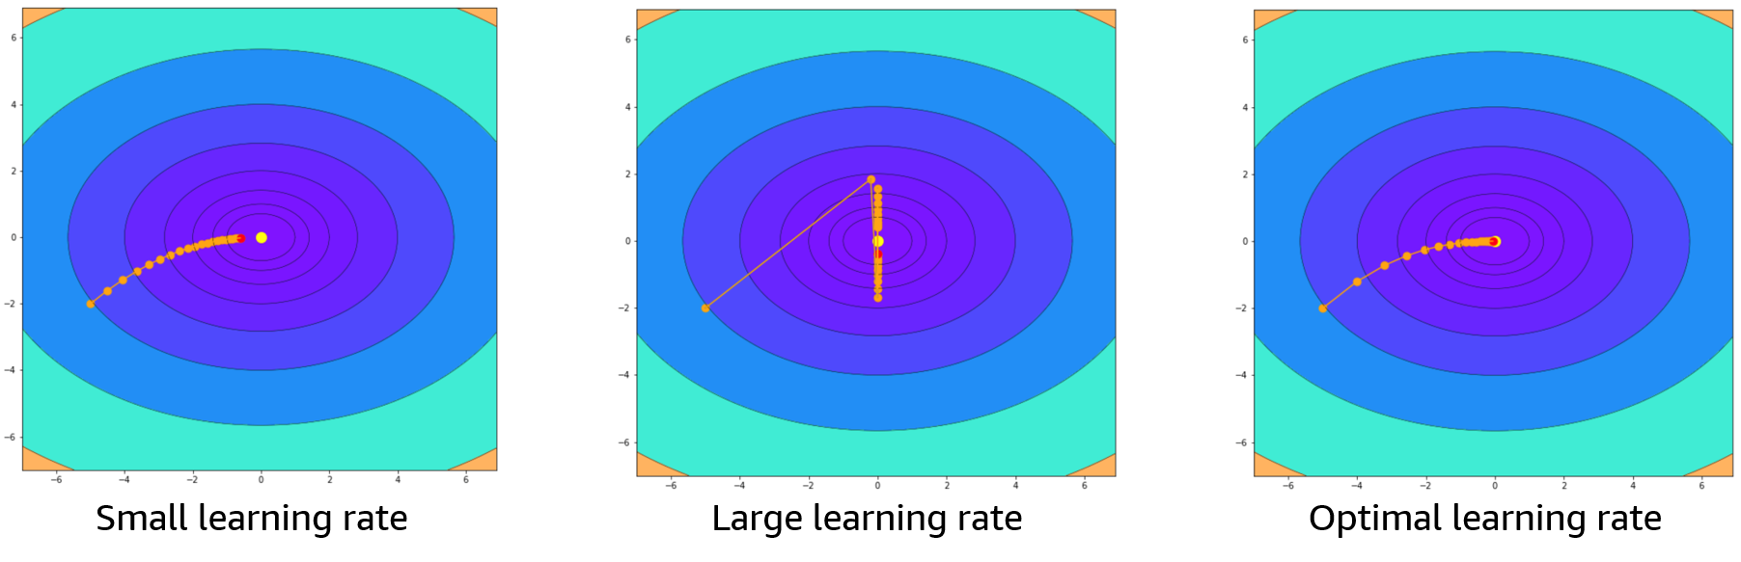
Hyperparameters
Hyperparameters affect:
Model performance
Training and inference time
Compute cost
Notes:
~Alt text: Graphs showing different learning rates. See details in notes.
~
Image description: Graphs showing different learning rates. First graph shows a small learning rate that never reaches the target. Second graph shows a large learning rate that continually jumps back and forth over the target, never reaching it. Third graph shows a good learning rate that quickly reaches the target. End description.
The learning rate hyperparameter has an impact on how long it takes the model to converge. When this hyperparameter is too small or too large, the model might never converge. By finding the optimal learning rate, you can reduce the time to train a model, which also reduces the compute cost for training.

Slide 7
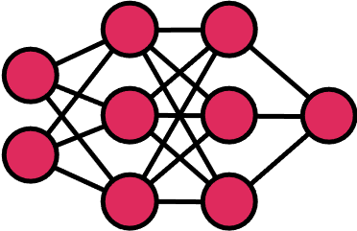
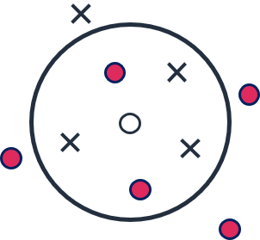
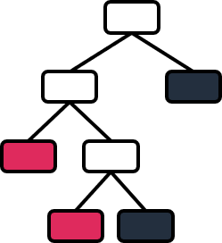
Different solutions have different hyperparameters
Neural networks
Examples
Learning rate
Hidden layers
Activations
K-nearest neighbors (KNN)
Examples
K value
Distance metric
Decision trees
Examples
Max depth
Min samples leaf
Class weight
Logistic regression
Examples
Learning rate
Penalty coefficient
Notes:
You have seen several models, such as neural networks, K-nearest neighbors (KNN), decision trees, and logistic regression. As the designer, it’s confusing to know exactly which model would be most appropriate for a dataset. In addition, each model has a set of hyperparameters as some examples are given in the slide.
With all these choices of models and their corresponding hyperparameters, how should you select a model that yields the best performance?

Slide 8
Setting your hyperparameters
Notes:
As ML models get more sophisticated, you need to make more architectural decisions. Several methods are available to tune ML architectural choices—the hyperparameters—to improve model performance.

Slide 9
Choosing optimal hyperparameters
No concrete strategy exists to determine the optimal hyperparameters through theoretical calculations.
Hyperparameters can be automatically selected by experimentation and iteration.
Selection can be based on maximizing some evaluation metric, such as accuracy, precision, or mean squared error (MSE).
Notes:
The search for the best combination of hyperparameters is called hyperparameter tuning. This process involves adjusting one or more hyperparameters to improve a desired performance metric.
Any good ML project relies on knowing what the best values are to use for the hyperparameters of a given algorithm on a given dataset. All ML libraries and ML platforms have a few choices or implementations of hyperparameter tuning (also called hyperparameter optimization).

Slide 10
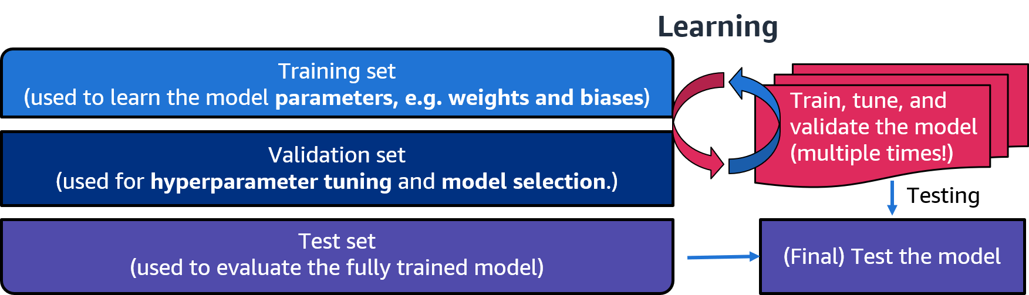
Training, validation, and test sets
Shuffle the dataset before the split!
Notes:
~Alt text: Graphic of a dataset that is split into three parts. See details in notes.
~
Image description: Graphic of a dataset that is split into three parts. The top part is labeled "Training set (used to learn the model parameters, e.g. weights and biases)." The second part is labeled "Validation set (used for hyperparameter tuning and model selection)." The third part is labeled "Test set (used to evaluate the fully trained model)." The graphic also includes the other parts of the train, test, and validate cycle as shown before. End description.
If you don’t have separate training and test datasets, make sure that you split your data into training and test datasets. Create a set of data that is not used during the training and validation phases. You will use this dataset at the end of the process to test model performance. You can then estimate the model error by using the test dataset. Even then, model building involves some experimentation or tuning (for example, which ML hyperparameters and algorithm parameters to choose).
With the test set separated, you need a way to validate the model during training. One option is to further divide the training dataset into a training set and a validation set. You proceed as before, but you use the validation set to validate the performance and adjust the algorithm’s hyperparameters, selecting the model that performs best on this validation set.
You can train this best model on the full training set (including the validation set), for the last time. This gives you the final model, which you can evaluate on the test set to get a final good estimate of the generalization error.
How should you split your dataset into training, validation, and test sets? You could simply slice your dataset or use library functions to split the data. One library is train_test_split from sklearn.
It’s a good practice to shuffle the dataset before splitting to avoid bias in the resulting sets.
How much of the original dataset to keep for the training and test sets mainly depends on the total number of samples (rows) in your data. Like many other things in ML, the train-test-validation split ratio is quite specific to your case, dataset, or algorithm of choice. Consider the following questions to help you choose the split ratio:
Does your choice of algorithm need more training data to learn?
Does your choice of algorithm have many hyperparameters to tune?
Do you have a lot of data?
You can experiment with different split ratios to find the best data split. After a while, you might get a sense for what works best for your particular case.

Slide 11
Why separate the validation and test sets?
Evaluation on the validation set will be biased (different than the true error) because the validation set is used to select the model.
The test set is not used for model selection or training. Therefore, the test set provides an unbiased evaluation of the model’s generalization.
Notes:
If both the validation and test sets are used to evaluate the model’s generalization performance, why do you need two different subsets?
Even though the validation set samples are not used to train the model, the evaluation is used to compare multiple models or hyperparameters. Therefore, the validation score plays a role in selecting the model and tuning the hyperparameters, which makes the evaluation biased. For a truly unbiased evaluation, you would need a dataset that hasn’t been observed during training, or model or hyperparameter selection. That is why a separate test set is used. The samples of the test set are strictly used to evaluate the trained model with hyperparameters that were selected by the validation set. It is the final evaluation of the trained model.

Slide 12
Validation methods

Slide 13
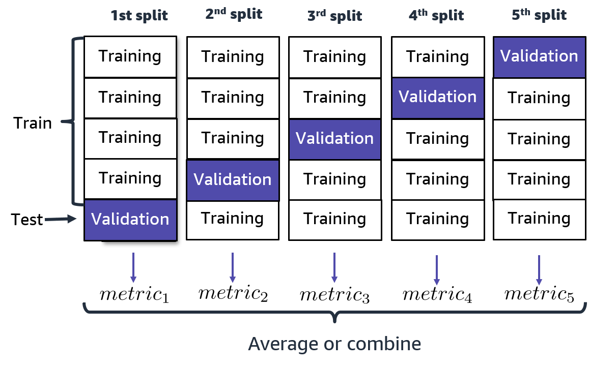
K-fold cross-validation (example with K = 5)
Split the training dataset into K independent folds.
Set aside K^{th} fold of the data for validation.
Train the model on the other folds in the training set.
Test the model on the validation set.
Repeat steps 2–4 K times on the same dataset, using a different fold for validation each time.
Average or combine the model performance metrics.
Notes:
~Alt text: Chart showing k-fold cross validation. See details in notes.
~
Image description: Chart showing k-fold cross validation. The dataset is split into five pieces. One piece is held for validation, while the other four are used for training. The training is run five times with a different validation set each time. End description.
K-fold cross-validation is a popular validation technique to systematically give you the opportunity to train and validate your choice of model multiple times (K times) using the same dataset.
Because K-fold cross-validation is a popular technique to assist with model learning and model tuning, many ML library functions do this by default.

Slide 14
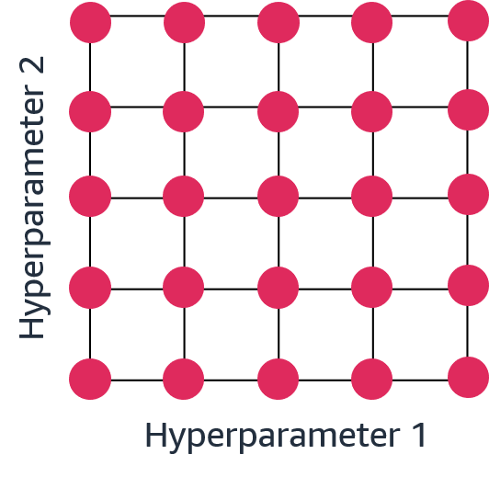
Grid search
Search over all the combinations of hyperparameter values. This is a brute-force approach.
Example: Hyperparameters for a decision tree:
# Example of hyperparameters for a decision tree
param_grid = {max_depth: [5, 10, 50, 100, 250], min_samples_leaf: [15, 20, 25, 30, 35]}
Total hyperparameter combinations
5 x 5 = 25
[5, 15], [5, 20], [5, 25], [10, 15], …
Notes:
~Code
~Alt text: Graphic of a grid search. See details in notes.
~
Image description: Five by five grid with hyperparameter 1 on the x axis and hyperparameter 2 on the y axis. Every point on the grid has a dot to indicate that all combinations are used. End description.
GridSearchCV is a basic hyperparameter tuning method in sklearn to find the optimum combination of hyperparameters by exhaustive search over specified parameter values.
Example hyperparameters for a decision tree:
estimator = tree
scoring = your choice of model performance metric
param_grid = { max_depth: [5, 10, 50, 100, 250], min_samples_leaf: [15, 20, 25, 30, 35]}
In this example, you would build a decision tree with a specific scoring metric that has five choices for the max_depth and five choices for min_samples_leaf. This indicates that you want the model to build 25 different scenarios (5 depths * 5 leaf sizes) to find the best hyperparameter combination.
For each fit call on the training set, the GridSearchCV estimator will build, train, and validate as many models as mentioned by the cross-validation hyperparameter. For the case with 25 combinations and hyperparameters, and the default cross-validation of 5, 25 x 5 models would be trained and validated—125 models. Beware that this might take a long time to complete.
After all the combinations are evaluated, the model with the set of parameters that gives the top metric is considered to be the best. GridSearchCV returns the best combination of the hyperparameters, the best estimator equipped with these best hyperparameters, and will report the performance metric of this best estimator.
GridSearchCV can take a long time to complete, so it does not scale well. If you want to add more hyperparameters to the grid, which is important for many ML projects, the grid will have a huge number of combinations (nodes). The exhaustive search will move sequentially from one combination to another. This can cause it to spend a lot of time in hyperspace regions with no benefits or low metrics until moving into more promising regions.

Slide 15
Grid search pros and cons
Pros:
Easy to implement
Exhaustive search considers all possibilities in the given range
Can be run in parallel
Cons:
Discretizes continuous variables
Compute cost grows exponentially with the number of hyperparameters
Not smart (previous evaluations aren’t used to select the next values)

Slide 16
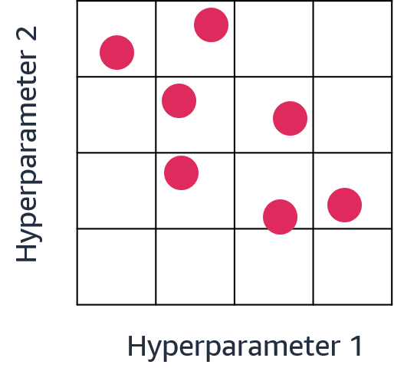
Randomized search
Chooses a fixed number of random combinations of hyperparameter values and only tries those
Can sample from distributions (uses sampling with replacement), if at least one parameter is given as a distribution
# Example of hyperparameters for a decision tree
param_grid ={max_depth: [5, 10, 50, 100, 250], min_samples_leaf: uniform(15,35,5)}
Notes:
~Code
~Alt text: Graphic of a randomized search. See details in notes.
~
Image description: Five by five grid with hyperparameter 1 on the x axis and hyperparameter 2 on the y axis. Points fall on the grid in random locations to indicate the combinations used. End description.
A more efficient implementation of hyperparameter tuning in sklearn is RandomizedSearchCV. In contrast to GridSearchCV, not all parameter values are tested. A fixed number of parameter settings are sampled from the specified distributions. The number of parameter settings that are tried is given by n_iter.
If all parameters are presented as a list, sampling without replacement is performed. If at least one parameter is given as a distribution, sampling with replacement is used. It is highly recommended to use continuous distributions for continuous parameters.
Example hyperparameters for a decision tree:
estimator = tree
scoring = your choice of model performance metric
param_grid:
max_depth: [5, 10, 50, 100, 250]
min_samples_leaf: uniform(15,35,5); 5 values form the unified distribution between 15 and 35
And n_iter (default 10) = Number of random parameter settings that are sampled
n_iter trades off runtime compared to the quality of the solution
You are not guaranteed to identify the best combination because not all combinations are tested. However, RandomizedSearchCV will randomly try various hyperparameter regions or combinations, which increases the chances to find models that are as good within a small fraction of the computation time.

Slide 17
Randomized search pros and cons
Pros:
Scalable with respect to the number of hyperparameters
Compatible with continuous variables
Can easily try more combinations
Can be computed in parallel
Cons:
Choice of the best sampling distribution might be not be trivial
Not smart (previous evaluations aren’t used to select the next values)

Slide 18
Bayesian search
Keeps track of previous hyperparameter evaluations and builds a probabilistic model
Balances exploration (exploring the whole sample space) and exploitation (exploiting promising areas)
Amazon SageMaker uses Bayesian search for hyperparameter optimization.
Notes:
While RandomizedSearchCV tests different hyperparameter combinations and computing model metrics, what if you stopped or searched more in the regions that look more promising?
This type of search is called a Bayesian search. This method keeps track of previous hyperparameter evaluations and builds a probabilistic model around it. This type of search tries to balance exploration (uncertain hyperparameter set) and exploitation (hyperparameters with a good chance of being optimum). Bayesian search prefers points near ones that worked well.

Slide 19
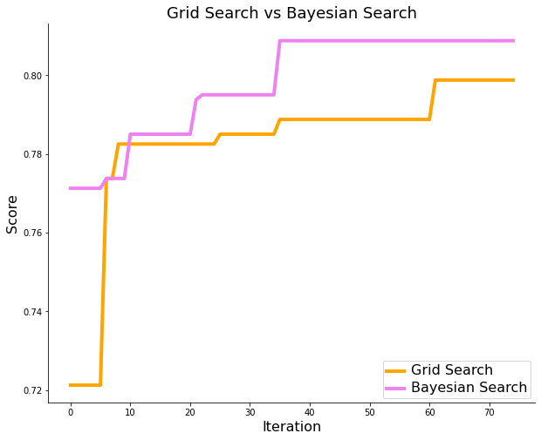
Comparing Bayesian search and grid search
Optimizing the choice of the next hyperparameters
Instead of randomly choosing the next set of hyperparameters
Likely to reach optimal hyperparameters faster than with grid search or random search
Partially parallelizable
Notes:
~Alt text: Graph of number of iterations against score. See details in notes.
~
Image description: Graph of number of iterations against score. Data is plotted for a grid search and a Bayesian search. Scores for both methods increase with more iterations. The Bayesian search performs better overall and ends with a higher score. End description.
Bayesian search is a more efficient hyperparameter optimization strategy than grid search. Instead of discarding the previous training results, this search type uses that information strategically to select the next hyperparameters. This means that the algorithm is likely to find the optimal hyperparameters faster than GridSearch (as shown in the plot on the slide).
Bayesian search typically performs better than GridSearch, but GridSearch performs a more exhaustive search over the search space. This might allow the algorithm to find a better suite of hyperparameters than Bayesian search (provided a good search space). GridSearch is also parallelizable (can run multiple searches at the same time), but Bayesian search relies on the previous run’s value to select the next set of hyperparameters and can only search one set of parameters at a time.

Slide 20
Bayesian search pros and cons
Pros
Scalable with respect to the number of hyperparameters
Compatible with continuous valued hyperparameters
Smarter and faster than grid search (previous evaluations are used to select the next hyperparameter values)
Cons
Partially parallelizable
Still have some settings that the designer needs to choose (hyper-hyperparameters?)

Slide 21
Using sklearn for hyperparameter tuning
The hyperparameter tuning methods can be used with .fit() and .predict().
Method | Example Code
Grid search | GridSearchCV(estimator, param_grid, scoring=None)
Random search | RandomizedSearchCV(estimator, param_distributions, n_iter=10, scoring=None)
Bayesian search | BayesSearchCV(estimator, search_spaces, n_iter=50, scoring=None)
Notes:
~Code
~
Recap:
GridSearchCV and RandomizedSearchCV can be applied using sklearn’s modules. Bayesian search is provided by scikit-optimize, which is also known as skopt. For more information, see the scikit-optimize website at https://scikit-optimize.github.io/stable.
GridSearchCV can be used as an estimator, with the fit and predict methods, and by default also performs a 5-fold cross-validation (CV) for each combination of hyperparameters. The number of CVs performed is also a hyperparameter, which you can tweak to get the best results. This means that the parameters of the estimator used are optimized by a cross-validated search over parameter settings.
For each fit call on the training set, the GridSearchCV estimator will build, train, and validate as many models as mentioned by the cross-validation hyperparameter. For the case with 25 combinations and hyperparameters, and the default cross-validation of 5, 25 x 5 models would be trained and validated—125 models. Beware that this might take a long time to complete. After all the combinations are evaluated, the model with the set of parameters that gives the top metric is considered to be the best.
RandomizedSearchCV also performs 5-fold CV by default for each combination of hyperparameters. If n_iter is 7, you will wait for 7x5 = 35 models to be trained and validated before RandomizedSearchCV is completed.
By trying only 7 combinations out of the 25 that GridSearchCV did, over a similar range of parameters, RandomizedSearchCV is faster. However, it isn’t always as good as GridSearchCV.
BayesSearchCV is quite similar to GridSearchCV and RandomizedSearchCV, with the addition of search_spaces instead of param_grid. BayesSearchCV uses the same cross-validation method that the other two techniques use. However, it uses the results of the previous run to find the optimal hyperparameters faster. It can only run one search at a time.

Slide 22

Next lesson
This lesson covered how to select hyperparameters to improve a model’s performance.
In the next lesson, you will learn how to combine individual ML models to build stronger predictors.

Slide 24
Image source slide (for curriculum development use only)

Slide 25
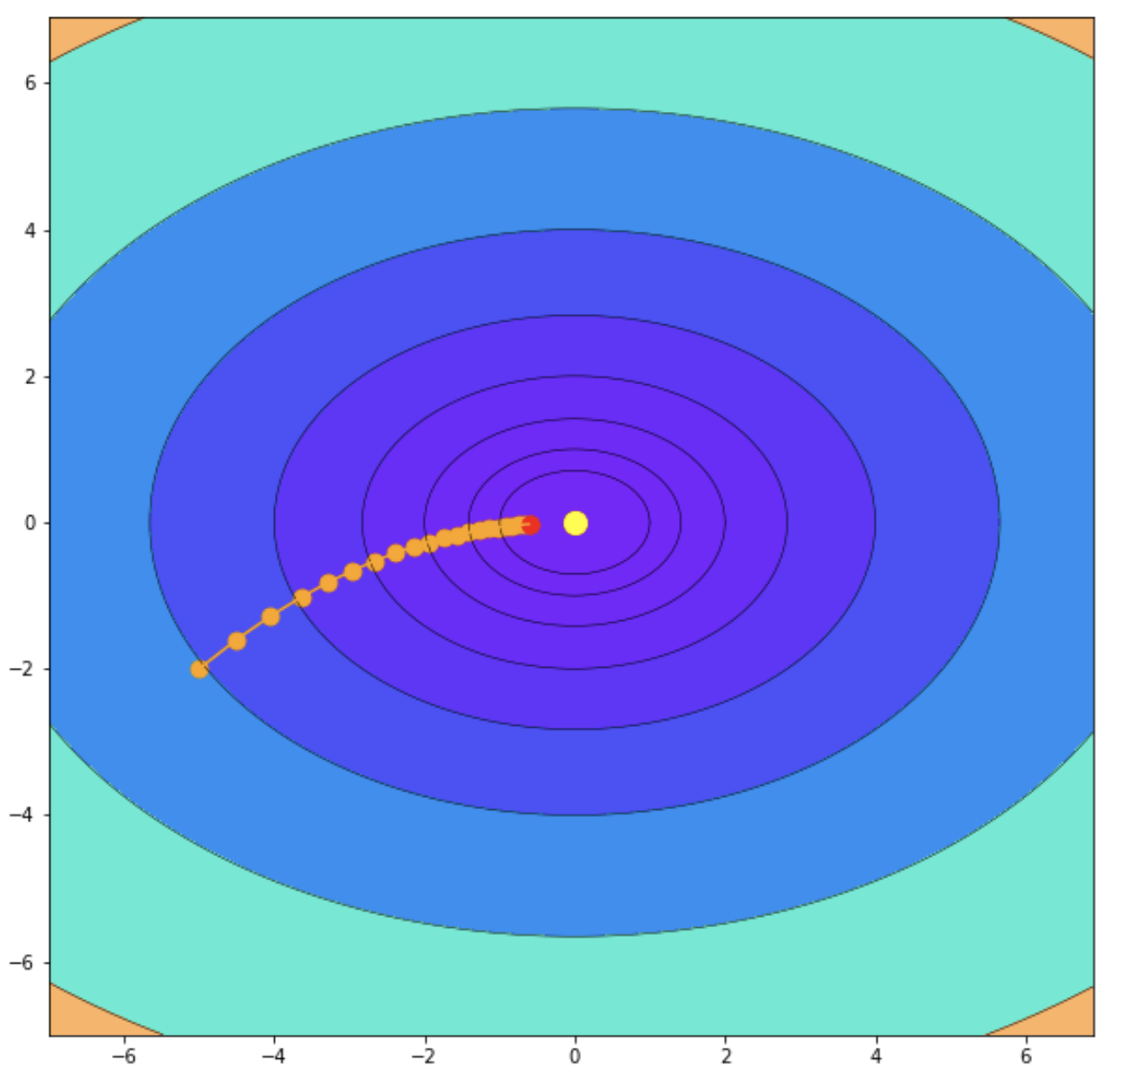
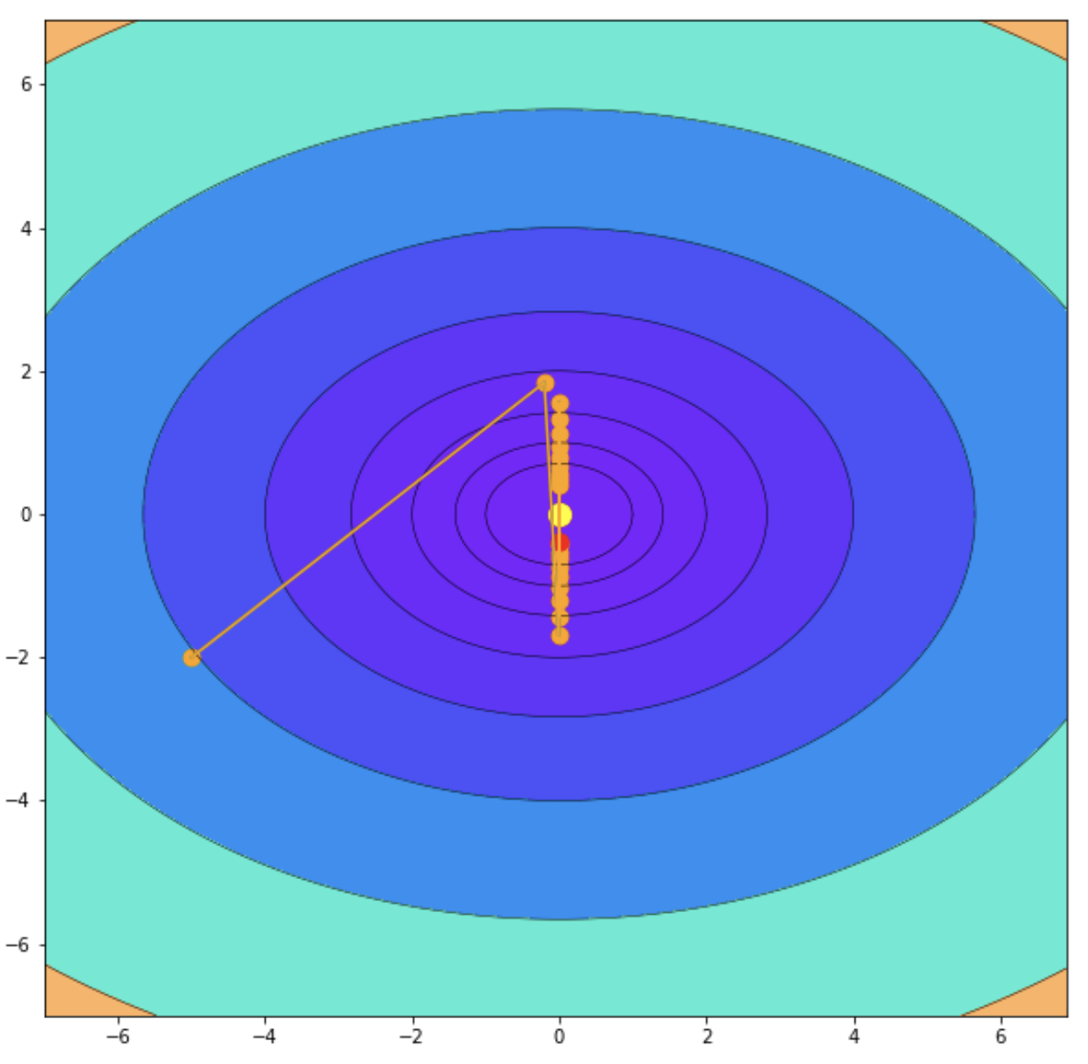
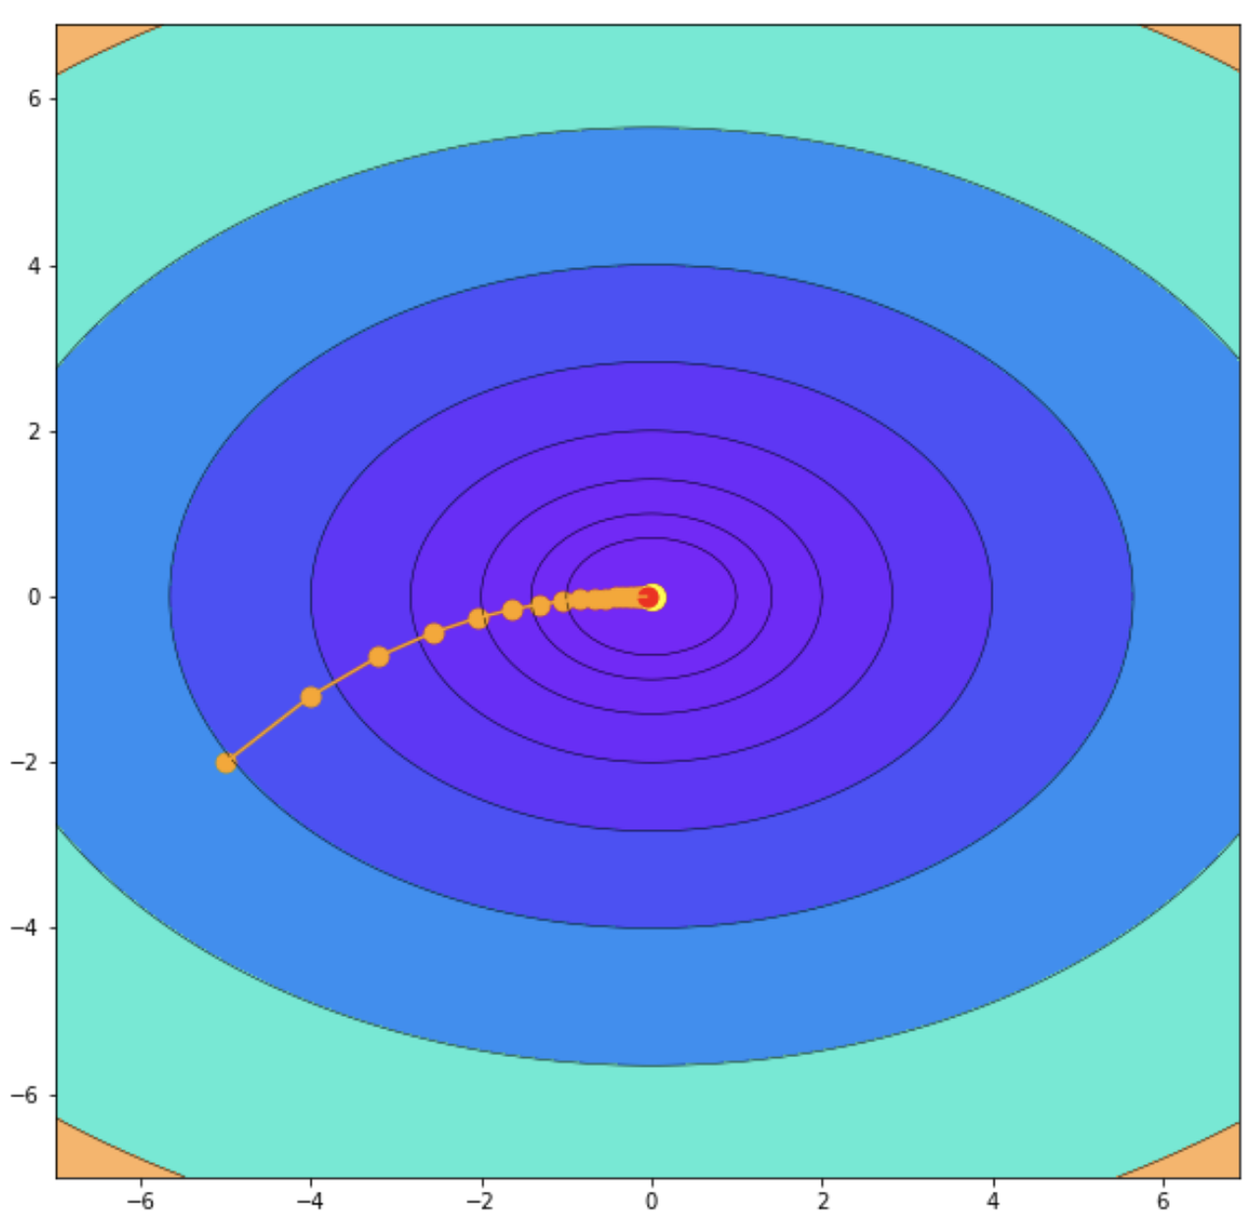
Source: Hyperparameters
Small learning rate
Large learning rate
Optimal learning rate

Slide 26

Source: Different solutions have different hyperparameters

Slide 27
Source: Training, validation, and test sets
Learning
Training set
(used to learn the model parameters, e.g. weights and biases)
Train, tune, and validate the model (multiple times!)
Validation set
(used for hyperparameter tuning and model selection.)
Testing
Test set
(used to evaluate the fully trained model)
(Final) Test the model

Slide 28
Source: K-fold cross-validation (example with K = 5)
1st split
2nd split
3rd split
4th split
5th split
Training
Training
Validation
Training
Training
Training
Training
Training
Training
Validation
Training
Train
Training
Training
Validation
Training
Training
Training
Validation
Training
Training
Training
Test
Validation
Training
Training
Training
Training
Average or combine

Slide 29
Source: Grid search
Hyperparameter 2
Hyperparameter 1

Slide 30
Source: Randomized search
Hyperparameter 2
Hyperparameter 1

