Slide 1
Introduction to Fairness and Bias Mitigation in ML
Machine Learning through Application
Module 3 – Lesson 1

Slide 2
Today’s activities
Introduction to fairness and responsible AI
Defining responsible AI
Dimensions of responsible AI
Group fairness compared to individual fairness
Fairness throughout the ML lifecycle
ML problem formulation
Data collection and processing
Model training and tuning
Model testing and evaluation
Deployment and maintenance
Notes:
This lesson will cover the topics that are listed.

Slide 3
Introduction to fairness and responsible AI

Slide 4
What is responsible AI?
[…] "AI that is innovative and trustworthy and that respects human rights and democratic values."
- Organization for Economic Co-operation and Development (OECD), OECD AI principles overview, May 2019
Notes:
~dev note – based on a read of the website's terms, and a post on editors slack about legal requirements for citations, we removed the link.
~
Responsible AI leverages and builds tools that respect fairness, security measures, and privacy measures. Responsible AI also considers explainability, robustness, and transparency of AI systems.
Source: Organization for Economic Co-operation and Development website

Slide 5
Why responsible AI?
Here are a few of the reasons why responsible AI is important:
Is the right thing to do
Helps prevent unintended impacts
Allows auditing of AI systems to gain trust from users
Can help meet regulatory and policy requirements
Notes:
This is not an exhaustive list. Additional considerations could play a role depending on stakeholders and as the field of responsible AI continues to grow.

Slide 6
Six dimensions of responsible AI
Fairness and bias: How does the system impact different subpopulations (groups with shared demographic values)?
Additional dimensions to consider:
Privacy and security
Robustness
Explainability
Governance
Transparency
Different organizations consider different dimensions.
Notes:
Which dimensions (or pillars, principles, virtues) should be part of “responsible AI” is debated globally.
However, AI designers, developers, and operators should aspire to certain core virtues (see the slide). The importance of a virtue varies depending on the use case.
Other key attributes of a service include overall accuracy, cost, feature set, and latency. But these attributes are already considered in the normal process of building a service.
Keep in mind that different organizations might capture these dimensions differently. For example, the Organization for Economic Co-operation and Development (OECD) lists five AI principles: https://www.oecd.org/going-digital/ai/principles.
Questions to ask about each dimension:
Fairness and bias: How does the system impact different subpopulations of users?
Privacy and security: Is data protected from theft and exposure?
Robustness: What is the mechanism to ensure that the AI system operates reliably?
Explainability: What are the mechanisms to understand and evaluate the outputs of the AI system?
Governance: Is there a process to define, implement, and enforce responsible AI practices within the organization?
Transparency: How is information about the AI system communicated so that stakeholders can make informed choices about use of the system?
The dimensions might also be known as pillars, principles, virtues.

Slide 7
A closer look at the fairness dimension
Fairness considers how a system impacts different subpopulations of users.
Fairness can generally be described as the absence of bias.
Bias (in the responsible AI space) means disparity in performance.
Notes:
The focus of this lesson is fairness as one of the six dimensions of responsible AI.
With fairness, you need to consider how a system impacts different subpopulations of users. Subpopulations might be defined by characteristics such as ethnicity, sex, primary language, physical capability, or religion. Make sure that the system itself does not perform too differently on different subpopulations.
To be responsible ML practitioners, you need an agreed-upon technical definition for fairness. Most generally, this would be fairness as the absence of bias, where bias (in the responsible ML space) means some sort of disparity in performance. Generally, we strive for equity (everyone gets what they deserve—regardless of group membership) or equality (everyone gets the same). Equality can be impossible to achieve in practice with limited resources—for example, a bank cannot give out infinite loans.

Slide 8
The meaning of bias depends on the domain
Domain | Meaning of Bias
Model evaluation | Unexplained error that stems from model selection and assumptions
Neural networks | Value that helps control the quality of fit during training of a neural network (NN)
Social context | Systematic differences; disproportionate favor for or against different subpopulations.
Responsible AI | Harmful disparities in system behavior on subpopulations; also “unwanted bias”
Notes:
Bias is an overloaded term in the ML community. Depending on the domain, different practitioners have different meanings for bias. For example, sometimes bias refers to a specific component in an equation. Sometimes, bias is used to talk about disparity in system behavior.

Slide 9
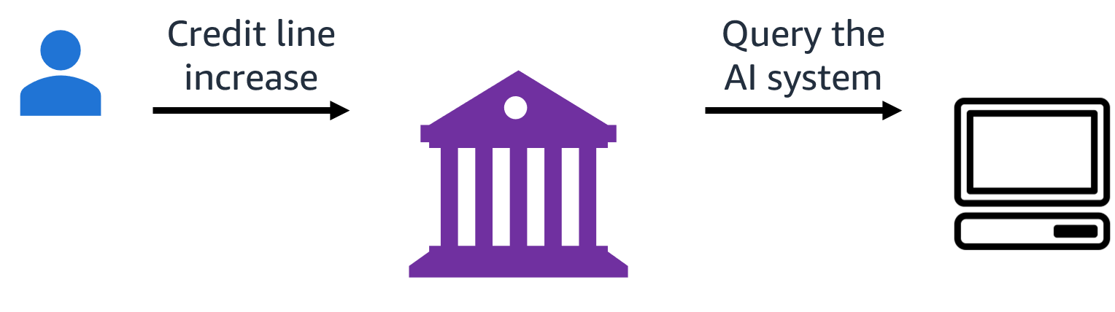
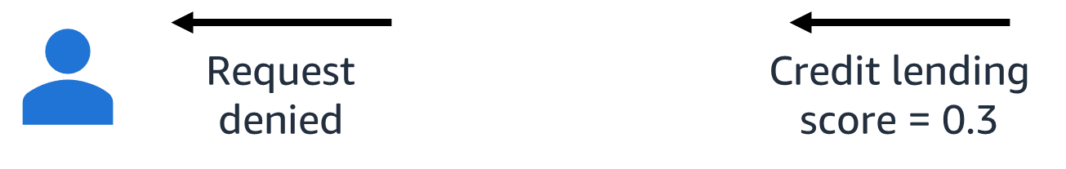
Example of a credit line increase
Fair lending laws (ECOA, FCRA) require credit decisions to be explainable.
Notes:
~Alt text – credit line increase: Customer requests a credit line increase from a bank. The bank queries an AI system.
~Alt text – request denied: The AI system generates a lending score of 0.3, and the request is denied.
~Dev note: This is an AWS employee's presentation. But we should consider whether there is a more durable source. Do we need to cite it since it's an AWS employee presentation. https://www.slideshare.net/KrishnaramKenthapadi?utm_campaign=profiletracking&utm_medium=sssite&utm_source=ssslideview
~Source: Responsible AI in Industry: Practical Challenges and Lessons Learned by Krishnaram Kenthapadi on slideshare.net, August 15, 2021.
~
Let’s look at a hypothetical credit-lending scenario. A user requests a credit line increase. Because of a large request volume, the bank uses an AI system to initiate a credit-lending model. The system indicates a low credit score as output for the requestor. A score of 0.3 results in a denied outcome. Therefore, the user request is denied.
In addition to scaling requirements, an argument can also be made that an AI system could potentially be less biased than a human evaluator.
Keep this workflow in mind as an example of how a user experiences an ML model outcome. This is also a classification example because the outcomes are yes or no—approved or denied.
ECOA is the Equal Credit Opportunity Act. FCRA is the Fair Credit Reporting Act.

Slide 10
Group fairness compared to individual fairness
Group fairness
Strives to equalize impact or treatment across groups
Has strong theory and algorithms as well as practical implementations; for example, the same rate of error across different groups
Provides no guarantees at the individual level
Individual fairness
Ensures that similar individuals are impacted/treated similarly
Has strong (nonstatistical) assumptions that prevent practical implementations
Binds at the individual level
Notes:
~Dev note: need to pass note edits back through Mia and double check any potential legal review. Leave as is for now.
~
When building an AI system, it is important to consider whether the system should be fair with respect to individuals or with respect to groups.
Making a model fair for groups means that the outputs will be similar when aggregated on the group level. However, group fairness does not consider individual merits and might result in choosing the less-qualified members of a group.
Individual fairness requires that two similar individuals (regardless of which group they belong to) are treated/impacted similarly. This is difficult to achieve in practice, which is why group fairness is more commonly used.

Slide 11
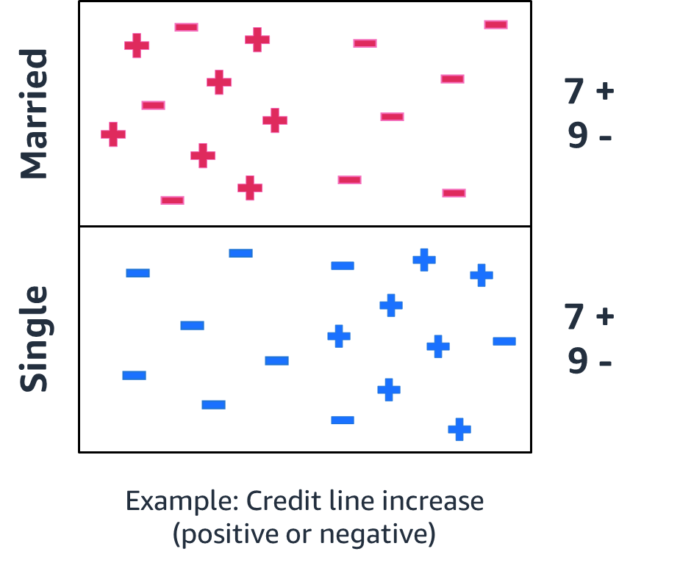
How do you define groups?
Individuals can exhibit multiple demographic attributes.
If multiple attributes intersect, new subgroups emerge.
Notes:
~Alt text: Chart of outcomes for credit line increases across two groups. See description in notes.
~Dev note: need to pass note edits back through Mia and double check any potential legal review. Leave as is for now.
~
Image description: The chart illustrates the distribution of positive and negative outcomes for requests to increase credit lines. The outcomes are grouped into single or married requestors. The married group indicates seven positive outcomes and nine negative outcomes. The single group also indicates seven positive and nine negative outcomes. End of description.
A model that produces the distribution that is shown in this chart would be considered fair for the two respective groups (married and single). However, individuals can exhibit multiple demographic attributes at the same time. If these multiple attributes intersect, new (more granular) subgroups emerge. It’s important to understand if the newly defined subgroups still receive fair outcomes.

Slide 12
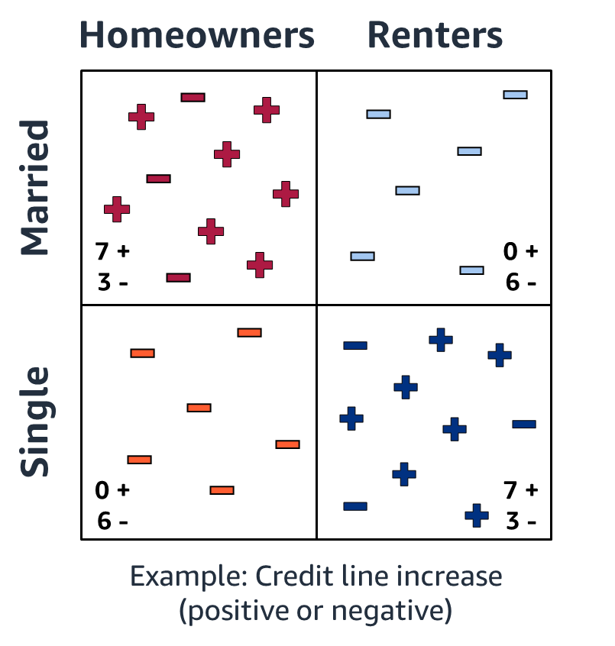
Intersectional fairness
Subgroups might experience additional disparity (see positive or negative outcomes per subgroup).
In certain domains in the US, it is against regulations to build different models for separate subpopulations as this would constitute disparate treatment (treating people differently because of their demographics).
Notes:
~Alt text: Chart of outcomes for credit line increases across two groups and two subgroups. See description in notes. ~
Image description: The chart illustrates the distribution of positive and negative outcomes for requests to increase credit lines. The outcomes are grouped into single or married requestors, as in the previous chart, but are now split into two additional groups. This creates four quadrants: married homeowners, married renters, single homeowners, and single renters. Married homeowners has seven positive outcomes and three negative outcomes. Married renters has zero positive outcomes and six negative outcomes. Single homeowners has zero positive outcomes and six negative outcomes. Single renters has seven positive outcomes and three negative outcomes. End of description.
A possible intersection of attributes is given by marital status and an additional group status. In the chart, columns refer to group status and rows refer to marital status. Certain subsets have favorable numbers of outcomes. Overall, both marital status groups have the same number of positive outcomes (seven), but they are concentrated for a certain group attribute.
If you now overlay a second demographic variable—in this case, homeowner or renter—observe that the positive outcomes are disproportionately concentrated in different subpopulations.
This example shows that different subgroups might experience additional disparity. As indicated in the chart, the married renters group has zero positive outcomes and six negative outcomes.
This is a hypothetical example, and you could think about many more attributes. In fact, those attributes don’t need to be binary. The reason that they are binary in this example is that most of the literature and research actually distinguishes on binary attributes.
One idea at this point would be to build separate models for each subgroup. However, in the United States, building separate models for different groups or different attribute groups would be against the law.

Slide 13
Fairness throughout the ML lifecycle

Slide 14
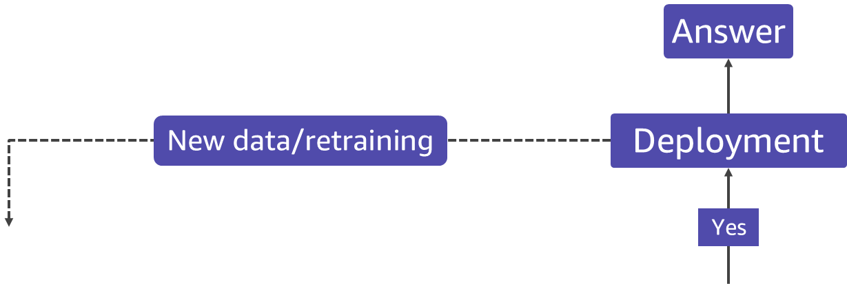
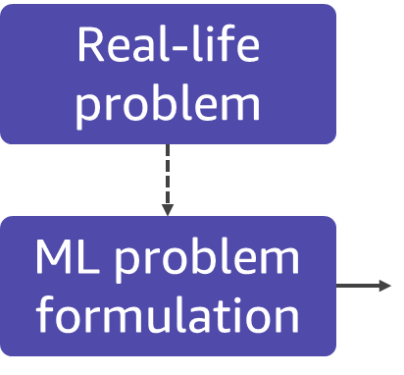
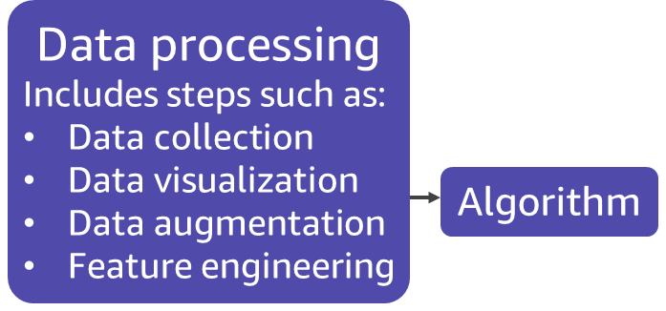
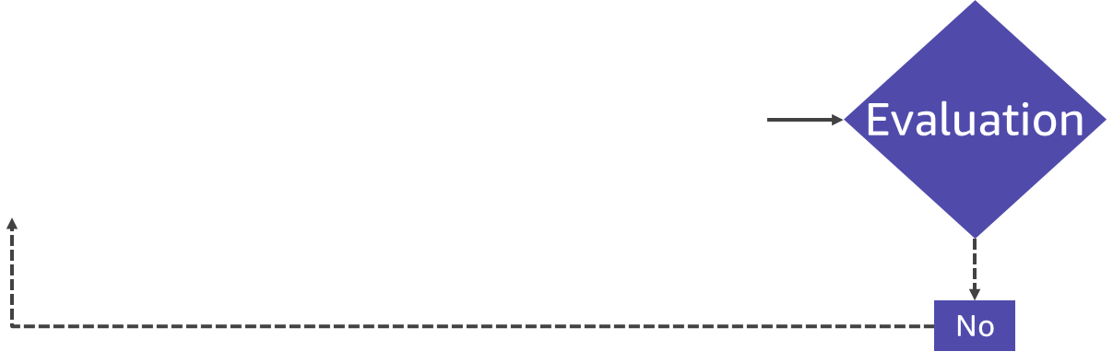
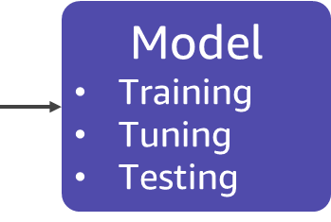
Where should you consider fairness?
Notes:
~Alt text – problem: The ML lifecycle starts with formulating the ML problem from a real-life problem.
~Alt text – processing: After ML problem formulation, data is collected and prepared for ML, and an algorithm is selected for the ML model.
~Alt text – modeling: The prepared data and selected algorithm are used to build, train, tune, and test an ML model.
~Alt text – evaluate: The model is evaluated, and more iterations of data processing and modeling occur if it is not ready to deploy.
~Alt text – deploy: When ready, the model is deployed to deliver answers in production. Production data is used to continually retrain the model.
~
Consider a typical ML lifecycle from ideation to creating predictions (answers). Where in this lifecycle should you consider fairness?

Slide 15
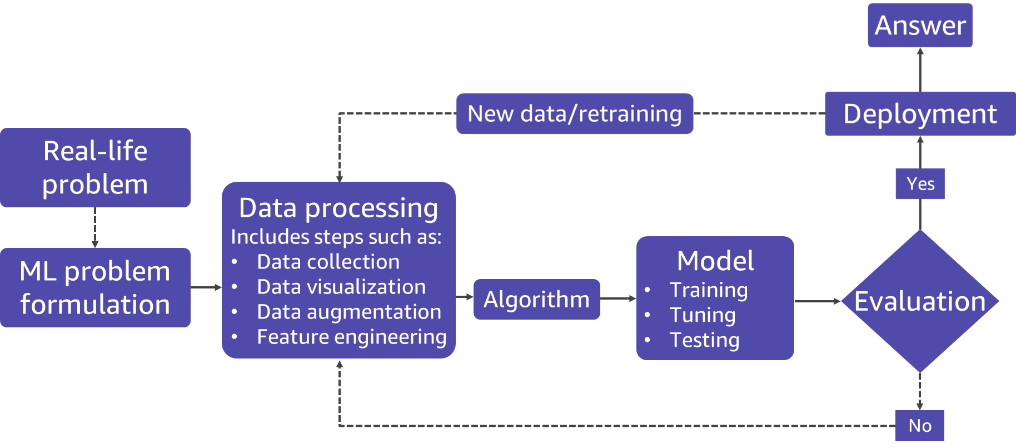
Everywhere!
Always consider fairness principles across all parts of the ML pipeline.
Notes:
Fairness should encompass all stages of the ML lifecycle. In the next slides, you will learn about a few practical examples of how to consider fairness by using techniques to mitigate bias.

Slide 16
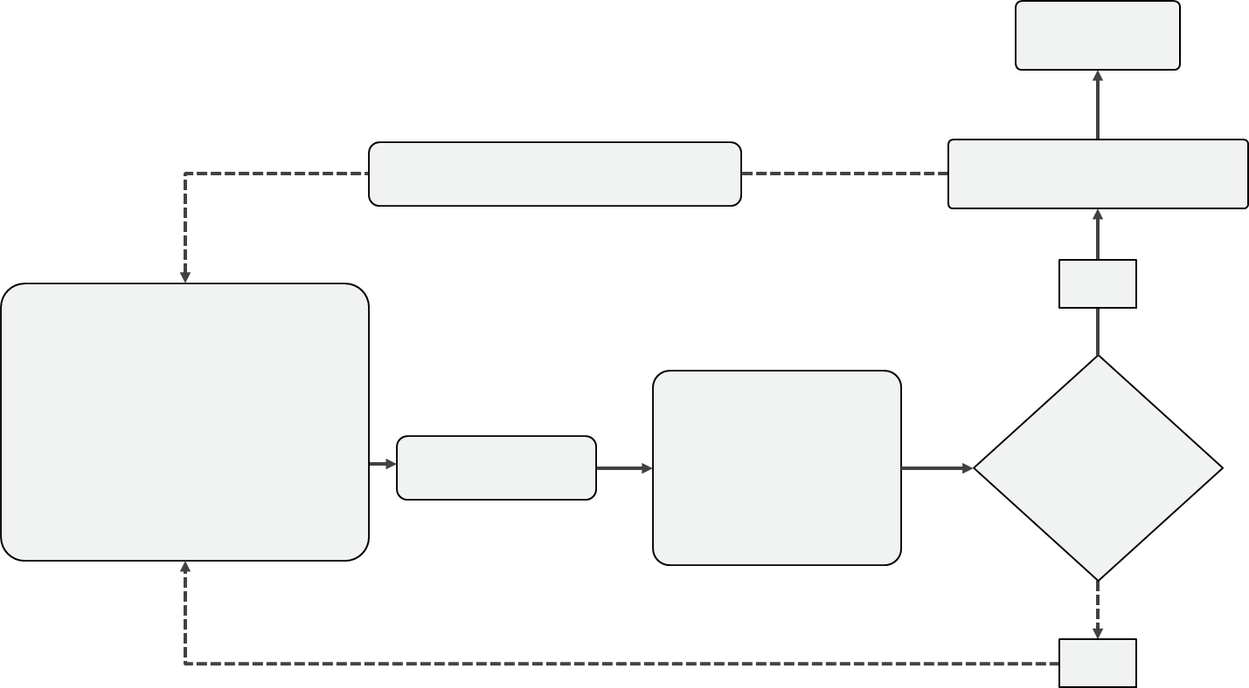
ML lifecycle: ML problem formulation
The ML problem needs to be clear.
Every person who is engaged in developing the product must be responsible for understanding the use case and limitations.
Notes:
Everyone needs to understand the business problem. By understanding the use case and problem, you can prevent harm.
Try to classify the risk that is associated with a particular use case, and take efforts to scrutinize potential misuse or harm that could be caused by building this ML solution. Ask questions such as, What is the use case? What are possible risks?

Slide 17
ML lifecycle: Key questions for ML problem formulation
How do you ensure that the ML problem considers different perspectives?
Discuss your modeling approach with different stakeholders and diverse groups.
Is an algorithm an ethical solution to the problem?
Notes:
To ensure that you consider different perspectives, discuss your modeling approach with different stakeholders and diverse groups.
Examples of diverse groups include the following:
Fairness experts
Privacy experts
Legal
Examples of diverse identities include the following:
Gender
Sexual orientation
Race
Nationality
Religion

Slide 18
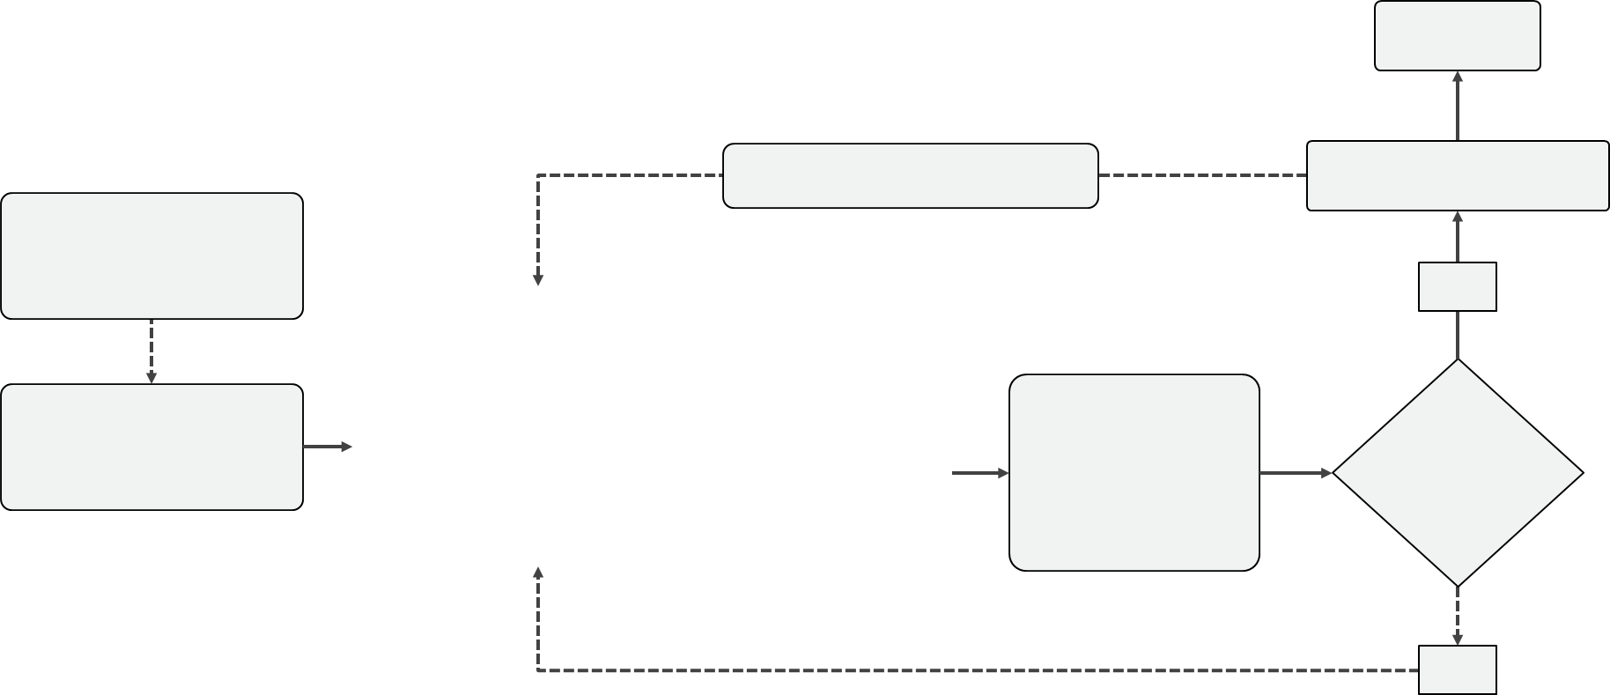
ML lifecycle: Data collection
Collect relevant and high-quality data.
Check for sampling issues, biased outcomes, and hidden proxy variables
Check for legal considerations, such as licensing, privacy, and consent issues where applicable.
Notes:
If bias is present in the data that goes into the model, then the model will produce predictions that are biased. This is similar to the infamous “garbage in, garbage out” principle. You should assume that models are inherently biased and try to find the bias rather than assuming that there won’t be any issues.
A proxy is a variable that “secretly” encodes a sensitive attribute. For example, ZIP code could be a proxy for ethnicity; same with income which could be a proxy for ethnicity too.

Slide 19
ML lifecycle: Key questions for data collection
Is the training data representative of different groups?
Are there biases in labels or features?
Does the data need to be modified to mitigate bias?

Slide 20
ML lifecycle: Data processing
Identify sensitive features and process accordingly.
Transform targets, features, or both if necessary.
Notes:
If you identify bias in the data, you can take certain steps to remove the bias. For example, you could try to remove the problematic features or transform the dataset.
However, removing the bias isn’t as easy as you might think. As an example, assume that you were to remove ethnicity features but keep ZIP code. ZIP code tends to be a proxy for ethnicity, so the information remains encoded in the dataset. Keep in mind that, in some domains, there is a legal obligation to delete sensitive attributes. In such cases, there’s no choice.
One way to transform the dataset is re-labelling. Find a data point in the favored group that is similar to a given data point in the unfavored group, and assign the outcome of the favored group to the disfavored individual.
These are not the only techniques. There is also re-weighting, learning fair representations, and other types of data transformations.
BEWARE: Sensitive attributes are often correlated to other attributes, so check for correlations before deleting attributes.
BEWARE: In some domains, sensitive attributes are useful (health), so you should not delete those.

Slide 21
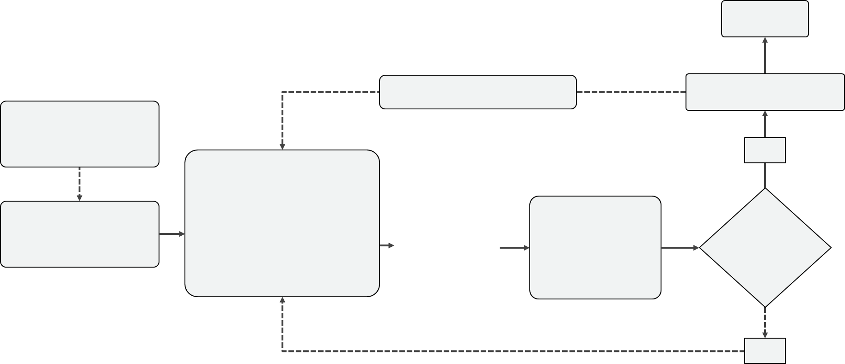

ML lifecycle: Mitigating bias during algorithm selection
Select algorithms that are explainable or that can be trained in certain ways (for example, apply fairness constraints to objective function).
Notes:
When selecting an algorithm, it is important to consider the needs of your stakeholders. Some algorithms are easily explainable but might not have very high performance, while others perform really well but are hard to explain. Keep in mind that sometimes it may be very important to be able to provide explanations for why a certain prediction was given. Another consideration during algorithm selection is whether it is possible to modify the algorithm to train in a certain way, by adding additional constraints. Not every type of algorithm will be modifiable in that way.

Slide 22
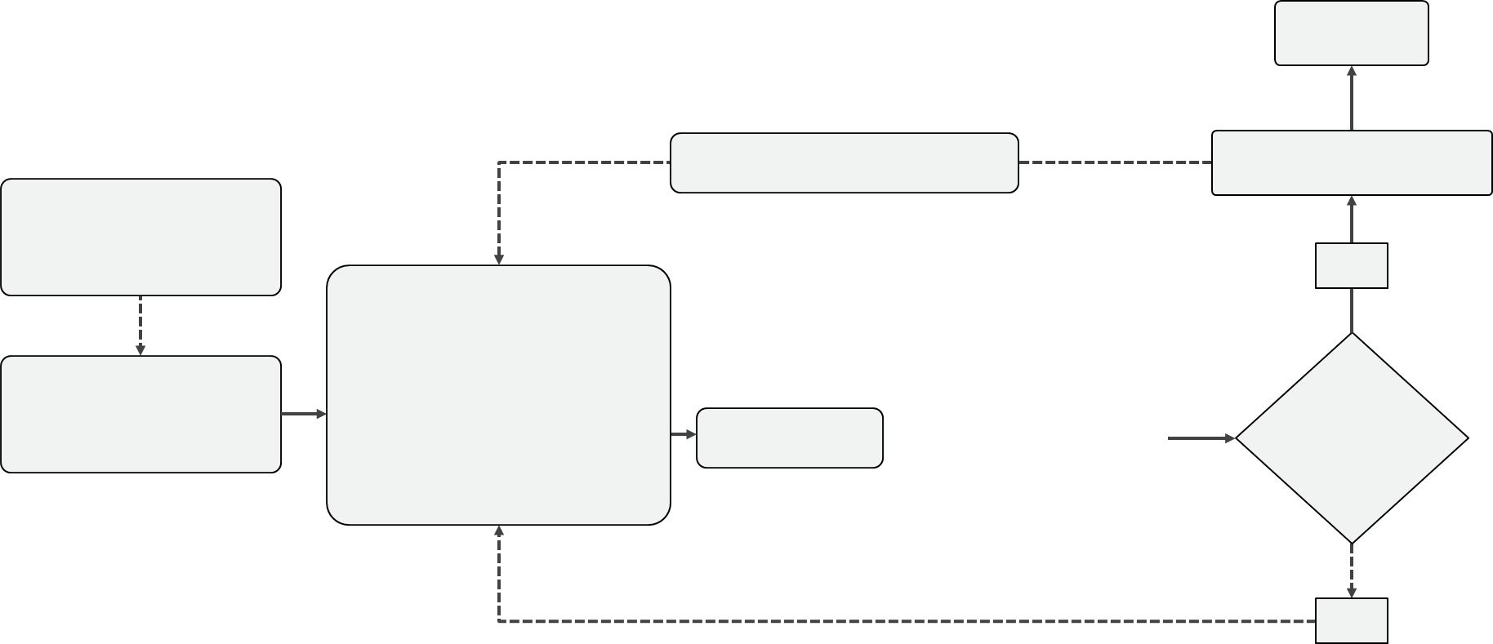
ML lifecycle: Model training and tuning
Use bias mitigation techniques for model training and tuning.
Different techniques work for different problem types.
Notes:
Many different bias mitigation techniques exists, and it is possible to use them at different stages. You can mitigate bias by constraining the way that the model learns (this includes tuning) or by modifying the results of the model.

Slide 23
ML lifecycle: Model testing
Use bias metrics to determine how fair the outcomes are.
Make sure to also include confidence intervals per group.
Notes:
During the testing stage, it’s important to keep testing how fair the model is. Different measures are available for this. One approach is to use general ML metrics but split them by group. Another important step could be to include confidence scores. A confidence score is an estimation of the confidence or certainty of any prediction. A confidence score is usually expressed in the form of a probability.

Slide 24
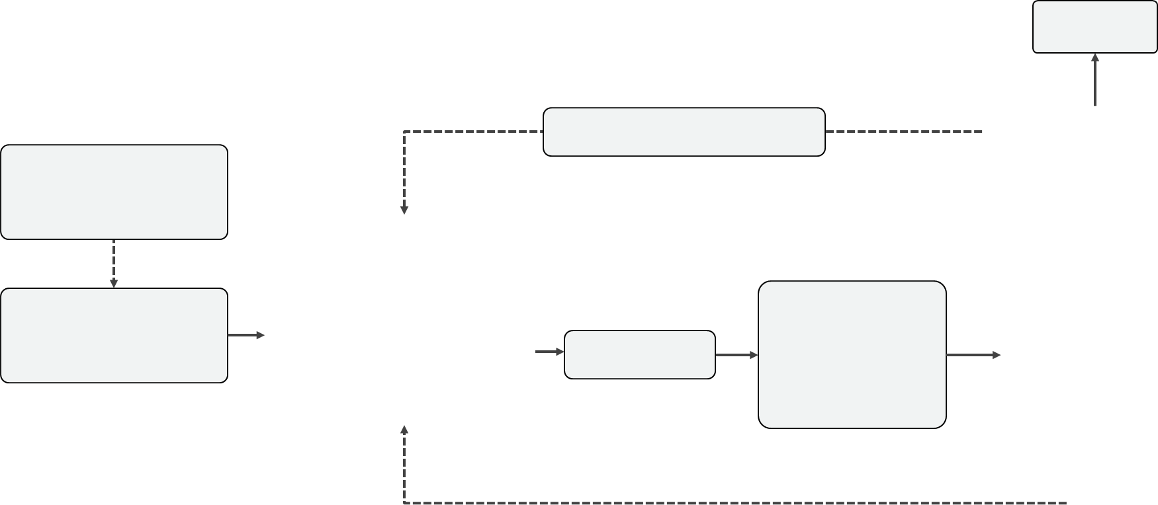
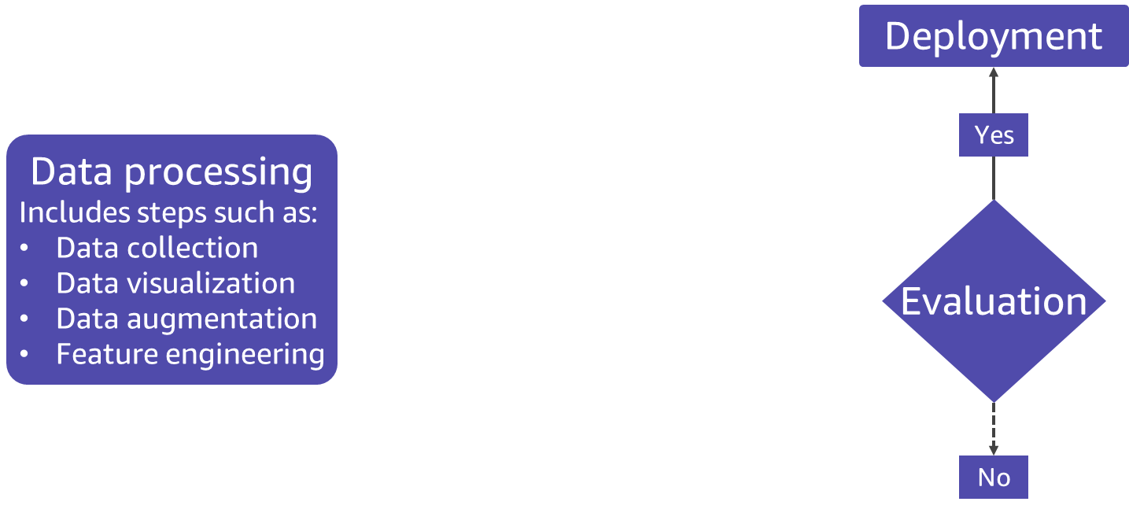
ML lifecycle: Key question for model evaluation
Has the model been evaluated using relevant fairness metrics?

Slide 25
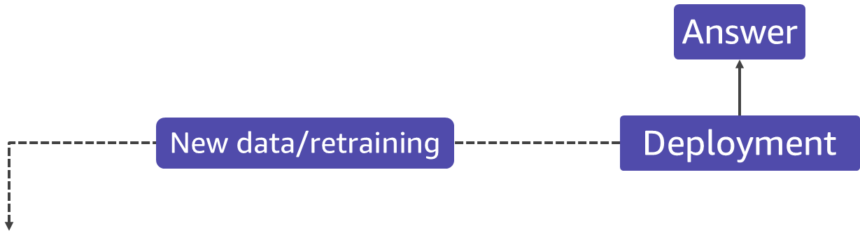
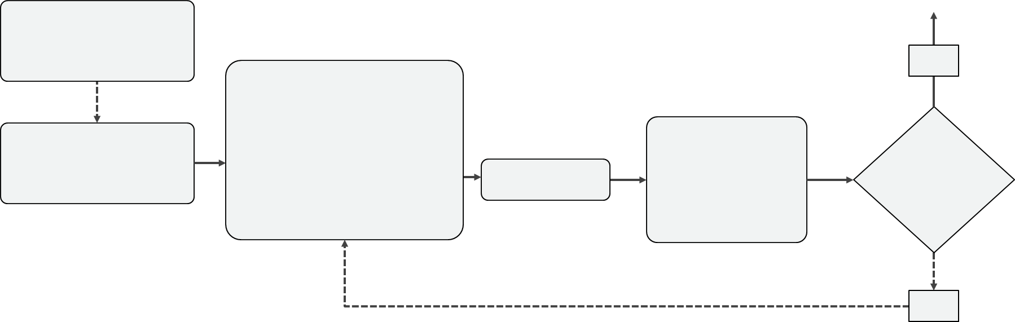
ML lifecycle: Deployment and maintenance
Check for model drift (the world evolves).
Ensure that the model is used as intended (for example, a model trained on US data should be used in the US).
Notes:
After a model is trained, you cannot assume that the model will continue to perform well over long periods of time after training. This is mostly because the world changes—and the distributions of the data change with it. Therefore, you need to check for model drift and make sure that the model is used in a location that it was built and trained for.

Slide 26
ML lifecycle: Inferencing
Offer end users a way to inquire about decisions that are made by using ML models for high-risk use cases (for example, through feedback or request forms).
Notes:
After a model is deployed, it will generate predictions for end users. End users don’t usually have visibility of the inner workings of a model, so it is important to offer them ways to enquire about the decisions that they receive. This will help end users understand and challenge the model if necessary.

Slide 27

Next lesson
The next lesson explores the following topics:
Designing fair models
Exploring data
Bias metrics

Slide 29
Image source slides (for curriculum development use only)

Slide 30



Source graphics: Example of a credit line increase
Credit line increase
Query the AI system
Request denied
Credit lending score = 0.3
Notes:
~Source for slide 9

Slide 31
Source graphic: How do you define groups?
7 +
9 -
Married
7 +
9 -
Single
Example: Credit line increase (positive or negative)
Notes:
~Source for slide 11

Slide 32
Source graphic: Intersectional fairness
Homeowners
Renters
Married
7 +
3 -
0 + 6 -
Single
0 + 6 -
7 +
3 -
Example: Credit line increase (positive or negative)
Notes:
~Source for slide 12

Slide 33
Source graphic: Where should you consider fairness?
Answer
New data/retraining
Deployment
Real-life problem
Yes
Data processing
Includes steps such as:
Data collection
Data visualization
Data augmentation
Feature engineering
Model
Training
Tuning
Testing
Evaluation
ML problem formulation
Algorithm
No
Notes:
~Source for slides 14–26

Slide 34
Source graphic: ML lifecycle
Notes:
~Source for slides 16–26

