Slide 1
Processing Text
Application of Deep Learning to Text and Image Data
Module 2 – Lesson 2

Slide 2
Today’s activities
Text preprocessing
Vectorization

Slide 3
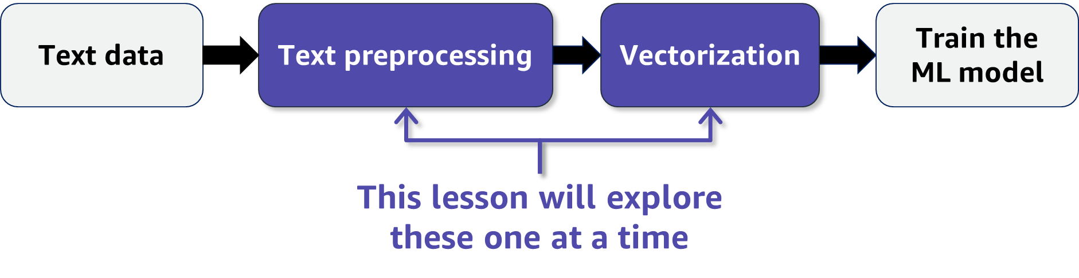
ML with text data
Text is a common data type in ML.
But ML models need well-defined numerical data.
How can that work?
Notes:
~Alt text: Process flow of using ML with text data. See details in notes.
~
Image description: Process flow with four steps. Text data points to text preprocessing, which points to vectorization. Vectorization points to train the ML model. Text preprocessing and vectorization are highlighted with a note that indicates this lesson will explore these elements one at a time. End description.
How can you use text data in ML? Text is text, but ML works with well-defined numerical data. The process involves taking text data, preprocessing it, vectorizing it, and then finally using it to train your ML model. This lesson will explore the text preprocessing and vectorization steps.

Slide 4
Text preprocessing
Notes:
Text preprocessing involves cleaning the raw text data before feature engineering.

Slide 5
Review: Cleaning text data
Problem: It’s more difficult to find patterns in unorganized text.
Preprocessing fix: Normalize text by removing noise (for example, convert to lowercase, remove white space, remove special characters, remove markup)
Example: The following sentences have similar meanings but might seem quite different to a text classifier (for example, a sentiment detector):
“The countess (Rebecca) considers\n the boy to be quite naïve.”
“countess rebecca considers boy naive”
Notes:
Let’s review how to clean text data.
Besides the preprocessing options that are listed on the slide, text processing libraries have quite a bit more to offer.
Simpler text data, simpler models, and smaller vocabularies are better. However, keep in mind that cleaning text data is truly task specific. For example, in sentiment analysis, some words might need to stay although you would otherwise remove them—such as quite in the example sentence on the slide.

Slide 6
Review: Tokenization
Breaks text apart by white space and punctuation
Helps interpret meaning by analyzing the sequence of words
Separates words or sentences
Example:
Sentence (Input) | Tokens (Output)
I don’t like eggs | I, do, n’t, like, eggs, .
The tokens are used in the next steps of text preprocessing.
Notes:
Let’s review tokenization.
Tokenization is a key part of text processing. Tokens are the smallest pieces of text data that are extracted from documents. This process produces tokens by splitting the text by white space and punctuation. Note that this is language specific—only English is being discussed here.

Slide 7
Review: Stop words
Words that frequently appear but don’t contribute to the overall meaning
Examples: a, the, so, is, it, at, in, this, there, that, my
Original Sentence | Sentence without Stop Words
There is a tree near the house | tree near house
Notes:
Let’s review stop words in text data.
After tokenization, you have tokens. The stop words removal process has a list of stop words, which are frequent words that don’t contribute much to the overall meaning of the text. You compare your tokens with the stop word list and remove the tokens that are on it.

Slide 8
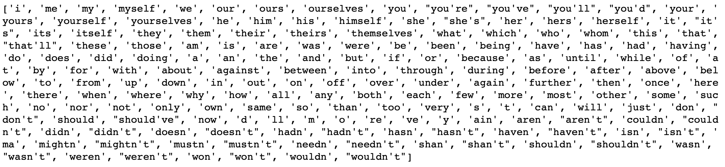
List of common stop words
Stop words from the Natural Language Toolkit (NLTK) library:
Is this a good list of stop words for a binary text classification of product reviews (positive or negative review)?
Notes:
~Alt text: List of stop words from the NLTK library. The first several words are i, me, my, myself, we, our.
~
The Natural Language Toolkit (NLTK) is a popular Python library to work with and model text. The toolkit has tools to load and clean text. NLTK also provides an extensive list of common stop words for a variety of languages. The image on the slide shows the common stop words for English.
Add stop words as needed or decide to allow some of these words in your text. The decision depends on your particular task. For example, against might be a meaningful word to have in a binary classification task for product reviews (positive or negative review).
You can print a list of stop words from the NLTK library. For more information, see the NLTK documentation at http://www.nltk.org.

Slide 9
Review: Stemming
Set of rules to reduce a string to a substring that usually refers to a more general meaning.
Goal: Remove word affixes (particularly suffixes), such as -s, -es, -ing, and -ed.
Example
playing
played
plays
The root of all three example words is "play"
Issue: Stemming doesn’t usually work with irregular forms, such as irregular verbs (for example, teach/taught and bring/brought).
Notes:
Let’s review stemming.
To further reduce the vocabulary and focus on the general meaning of the words, rather than deeper meaning, you can reduce words further by removing affixes—in particular, suffixes. For example, the words playing, played, and plays all reduce to play through the process of stemming.
Note that stemming doesn’t usually work with irregular forms, such as the irregular verbs taught and brought in English.
You can use your own text dataset to experiment with stemming rules and other lexicon-based cleaning options, such as lemmatization.
Note that the texts that have been shown so far are small and would be cleaned or processed quickly. Real text data is frequently long and messy—text preprocessing might take a while to complete.

Slide 10
Lemmatization
Reduces inflectional or variant forms to the base form
Uses a vocabulary and morphological analysis
Returns the base or dictionary form of the word, which is known as the lemma
Examples:
Variant Forms | Lemma
car, cars | car
bought | buy
taught | teach
am, are, is | be
Notes:
Lemmatization is an important aspect of natural language understanding (NLU) and natural language processing (NLP). Similar to stemming, lemmatization reduces inflection forms and sometimes derivationally related forms of a word to a common base word.
Stemming relies on a simple heuristic process to remove derivational affixes, but lemmatization transforms text by using a vocabulary and morphological analysis of the words. The objective is to obtain the base or dictionary form of a word, which is known as the lemma.
A lemmatizer performs full morphological analysis to accurately identify the lemma for each word. Doing a full morphological analysis produces modest benefits for retrieval.

Slide 11
Stemming compared to lemmatization
Both convert words into their base forms.
Stemming | Lemmatization
Uses a set of rules to reduce a string to a substring that usually refers to a more general meaning. | Finds the base form by using a vocabulary and morphological analysis (more advanced than stemming).
Effective on simple cases, such as teaching/teach, worked/work, and apples/apple. | Effective on simple cases.
Cannot be used on challenging cases where rules cannot be applied, such as taught, am, and better. | Handles challenging cases, such as taught/teach, am/to be, and better/good.
Notes:
This slide compares stemming and lemmatization. Both techniques convert words into their base forms, but they do so in different ways.
Stemming is a rule-based method that creates substrings that correspond to a simpler form of a given token. The process removes the extras from the start or end of the token.
Lemmatization is more involved. It uses a grammatical approach, so it can handle more difficult cases, such as irregular forms.
The goal of both methods is to produce simpler or more general meaning tokens.

Slide 12
Vectorization
Notes:
Vectorization involves transforming text features into numerical format.

Slide 13
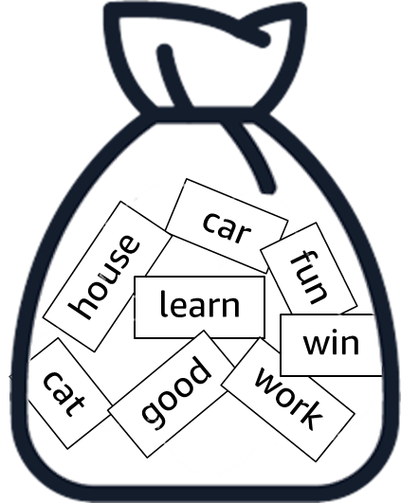
Review: Bag-of-words (BoW) method
Represent text as a set of its words (a bag), disregarding grammar and the order of the words.
Steps:
Construct or get a vocabulary.
For each text (bag), calculate occurrences of the vocabulary words:
Binary (present or not)
Frequencies
Notes:
Let’s review the bag-of-words (BoW) method to vectorize text.
The BoW method is a special technique to convert text data into numerical form. This method is usually considered less modern, but it’s still useful to learn.
This method represents the text as a bag of words, and disregards the grammar and order of words. The steps are as follows:
Create or borrow a vocabulary of words. If you don’t borrow a vocabulary, you can create one by using the training data.
Create simple numerical vectors by calculating the occurrences of words in your text data. The vectors can be binary (whether the word occurs), simple word counts, or frequencies, which are normalized according to the total number of words in the text.

Slide 14
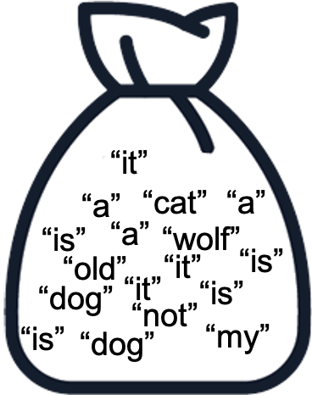
Bag-of-words example
Sentence | a | cat | dog | is | it | my | not | old | wolf
It is a dog. | 1 | 0 | 1 | 1 | 1 | 0 | 0 | 0 | 0
my cat is old. | 0 | 1 | 0 | 1 | 0 | 1 | 0 | 1 | 0
It is not a dog, it is a wolf. | 2 | 0 | 1 | 2 | 2 | 0 | 1 | 0 | 1
Notes:
Consider the example on this slide, which uses the following sentences:
It is a dog.
My cat is old.
It is not a dog, it is a wolf.
The binary bag-of-words method first looks at the text and creates a vocabulary of the words that were encountered across the text. The vocabulary for these example sentences is listed alphabetically in the top row of the table on the slide: a, cat, dog, is, it, my, not, old, wolf. This is a fixed-length vocabulary of nine words.
According to the position of words in this vocabulary, the binary method assigns to each sentence a nine-dimensional vector that is filled in with ones and zeroes, similar to one-hot encoding. The 1s and 0s indicate whether the respective word appears in the sentence.

Slide 15
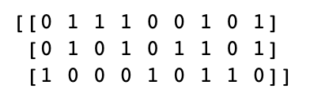
Bag of words in sklearn
CountVectorizer: This sklearn text vectorizer converts a collection of text documents to a matrix of token counts.
from sklearn.feature_extraction.text import CountVectorizer
countVectorizer = CountVectorizer(binary=True)
sentences = ['This is the first document.',
'This is the second document.',
'and the third one.',
]
X = countVectorizer.fit_transform(sentences)
print(X.toarray())
vocabulary =
{and, document, first, is, one, second, the, third, this}
Result:
Notes:
~Alt text: Output of the CountVectorizer command. Feature vectors for each sentence in the example as an array of ones and zeros.
~Code
~
The sklearn library offers easy-to-use tools to perform both tokenization and vectorization of text data.
The slide shows example code for the CountVectorizer. The code takes the following three sentences:
This is the first document.
This is the second document.
and the third one.
From these three sentences, CountVectorizer creates a nine-word vocabulary and then applies the transform function on the sentences. The sentences are vectorized, and the resulting array is displayed on the slide.
Note the binary=True parameter in the call to CountVectorizer in this example code. If binary=False were used, the vectorizer would produce word counts. In this case, the resulting array would probably be the same because none of the sentences have repeating words.

Slide 16
Term frequency (TF)
Increases the weight for common words in a document
$tf(term, doc)$= $\frac{\text{number} \text{of} \text{times} \text{the} \text{term} \text{occurs} \text{in} \text{the} \text{document}}{\text{total} \text{number} \text{of} \text{terms} \text{in} \text{the} \text{document}}$
Sentence | a | cat | dog | is | it | my | not | old | wolf
It is a dog. | 0.25 | 0 | 0.25 | 0.25 | 0.25 | 0 | 0 | 0 | 0
my cat is old. | 0 | 0.25 | 0 | 0.25 | 0 | 0.25 | 0 | 0.25 | 0
It is not a dog, it is a wolf. | 0.22 | 0 | 0.11 | 0.22 | 0.22 | 0 | 0.11 | 0 | 0.11
Notes:
~Equations
~
If you don’t want raw count numbers, you can normalize them. Term frequency (TF) does that. Normalizing input data for ML models has advantages for certain models.
To calculate term frequency, you take the number of occurrences for a term and divide it by the total number of words (or tokens) in the text or document. The term frequency value is larger for words that appear more frequently in the text.
You can pass the term frequency values into your numerical representation in a normalized way.

Slide 17

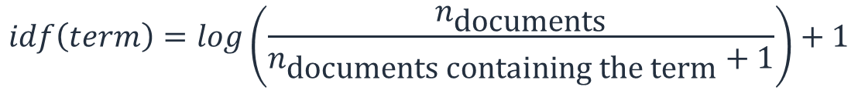
Inverse document frequency (IDF)
Increases the weights for words that are specific to a document that don’t frequently occur in other documents
Term | IDF
a | log(3/3)+1=1
cat | log(3/2)+1=1.18
dog | log(3/3)+1=1
is | log(3/4)+1=0.87
it | log(3/3)+1=1
my | log(3/2)+1=1.18
not | log(3/2)+1=1.18
old | log(3/2)+1=1.18
wolf | log(3/2)+1=1.18
$$idf\left(term\right)=\log\left(\frac{n_{\text{documents}}}{n_{\text{documents} \text{containing} \text{the} \text{term}}+1}\right)+1$$
Example: $idf\left("\text{cat}"\right)=1.18$
Notes:
~Equations
~
Now that you have seen how to convert text data into numerical data, one thing not yet discussed is the vocabulary words themselves. How frequently do you see the word “dog” or “plane” or “kid” across all documents? Why does this even matter? Sometimes, in text data rare words can be decisive about the overall meaning of a text.
For example, imagine that you want to differentiate between documents about sports. You have documents about baseball, basketball, and soccer. Some words are common across all the documents; for example, supporter, field, player, team, ball, sport, jersey. Those words won’t be helpful to identify a specific sport.
Some words aren’t common and can be useful to differentiate between the sports. For example, goalie for soccer, pitcher for baseball, and point guard for basketball. Another example is galaxy for soccer, dodgers for baseball, and lakers for basketball. With these words, you can almost automatically know which sport a document refers to.
Inverse document frequency (IDF) assigns a weight to each word, depending on how frequent that word is across all documents. The weight is large if the word is rare and small if the word is common. This method incorporates the idea of word importance into the bag-of-words method.
Math details
The logarithm term in the equation is used to prevent this term from getting too large. In the denominator, +1 ensures that the denominator is not zero, which would make the logarithm go to infinity. Similarly, the +1 outside the parentheses is used for cases where 0 would be produced from the logarithm term (only when n_doc=1 and n_doc_containing=0). This +1 makes it 1 instead of 0.

Slide 18
TF-IDF
Combines term frequency and inverse document frequency
$$tf_{idf}(term,doc)=tf\left(term, doc\right)∗idf(term)$$
Sentence | a | cat | dog | is | it | my | not | old | wolf
It is a dog. | 0.25 | 0 | 0.25 | 0.22 | 0.25 | 0 | 0 | 0 | 0
my cat is old. | 0 | 0.3 | 0 | 0.22 | 0 | 0.3 | 0 | 0.3 | 0
It is not a dog, it is a wolf. | 0.22 | 0 | 0.11 | 0.19 | 0.22 | 0 | 0.13 | 0 | 0.13
Notes:
~Equation
~
How do you use inverse document frequency (IDF) with term frequency (TF)? You can multiply the frequency (TF) of each word by the weight (IDF) of the word.
The result increases the values of the rare words while reducing the values of the words that are more common. This can help ML models to identify important words in text data.

Slide 19
Sklearn implementation
Term frequency (TF)
TfidfVectorizer(use_idf=False)
Term frequency-inverse document frequency (TF-IDF)
TfidfVectorizer(use_idf=True)
Notes:
~Code
~
You can use the sklearn library to perform TF vectorization as well as IDF vectorization with the same module.
For more information, see TfidfVectorizer in the sklearn documentation at https://scikit-learn.org/stable/modules/generated/sklearn.feature_extraction.text.TfidfVectorizer.html.

Slide 20
Tokenization
Break a given sample of text or speech into a sequence of n tokens:
Only considering single words (unigram)
Break apart compound words and some proper nouns
Can include n-grams in term frequencies
Sentence | 1-gram (unigram) | 2-gram (bigram) | 3-gram (trigram)
It is not a dog, it is a wolf | it, is, not, a, dog, it, is, a, wolf | it is, is not, not a, a dog, …. | it is not, is not a, not a dog, ….
Notes:
What if you want to capture some word forms? You shouldn’t break them because meaning could be lost—for example, ice cream and New York.
N-gram is a technique to increase the span of words that are considered. For example, with 2-gram, two consecutive words are considered as a single word, and the scores are calculated accordingly.
Note that if you apply this on regular single tokens, you might explode the number of features. Always check the shape of your bag-of-words features in your code.

Slide 21

Next lesson
You will learn about word embeddings and how they are obtained.

Slide 23
Image source slide (for curriculum development use only)

Slide 24
Source graphic: ML with text data
Text data
Text preprocessing
Vectorization
Train the ML model
This lesson will explore these one at a time
Notes:
~source for slide 3

Slide 25

Source graphic: Review: Bag-of-words method
car
house
fun
learn
win
cat
good
work
Notes:
~Source for slide 13

Slide 26

Source graphic: Bag-of-words example
“it”
“a”
“cat”
“a”
“is”
“a”
“wolf”
“old”
“it”
“is”
“dog”
“it”
“is”
“not”
“is”
“dog”
“my”
Notes:
~Source for slide 14

