Slide 1
Transformers
Application of Deep Learning to Text and Image Data
Module 2 – Lesson 6

Slide 2
Today’s activities
Sequence to sequence (Seq2seq) learning
Limitations of recurrent neural networks (RNNs)
Attention mechanism
Transformers

Slide 3
Sequence to sequence (Seq2seq) learning

Slide 4
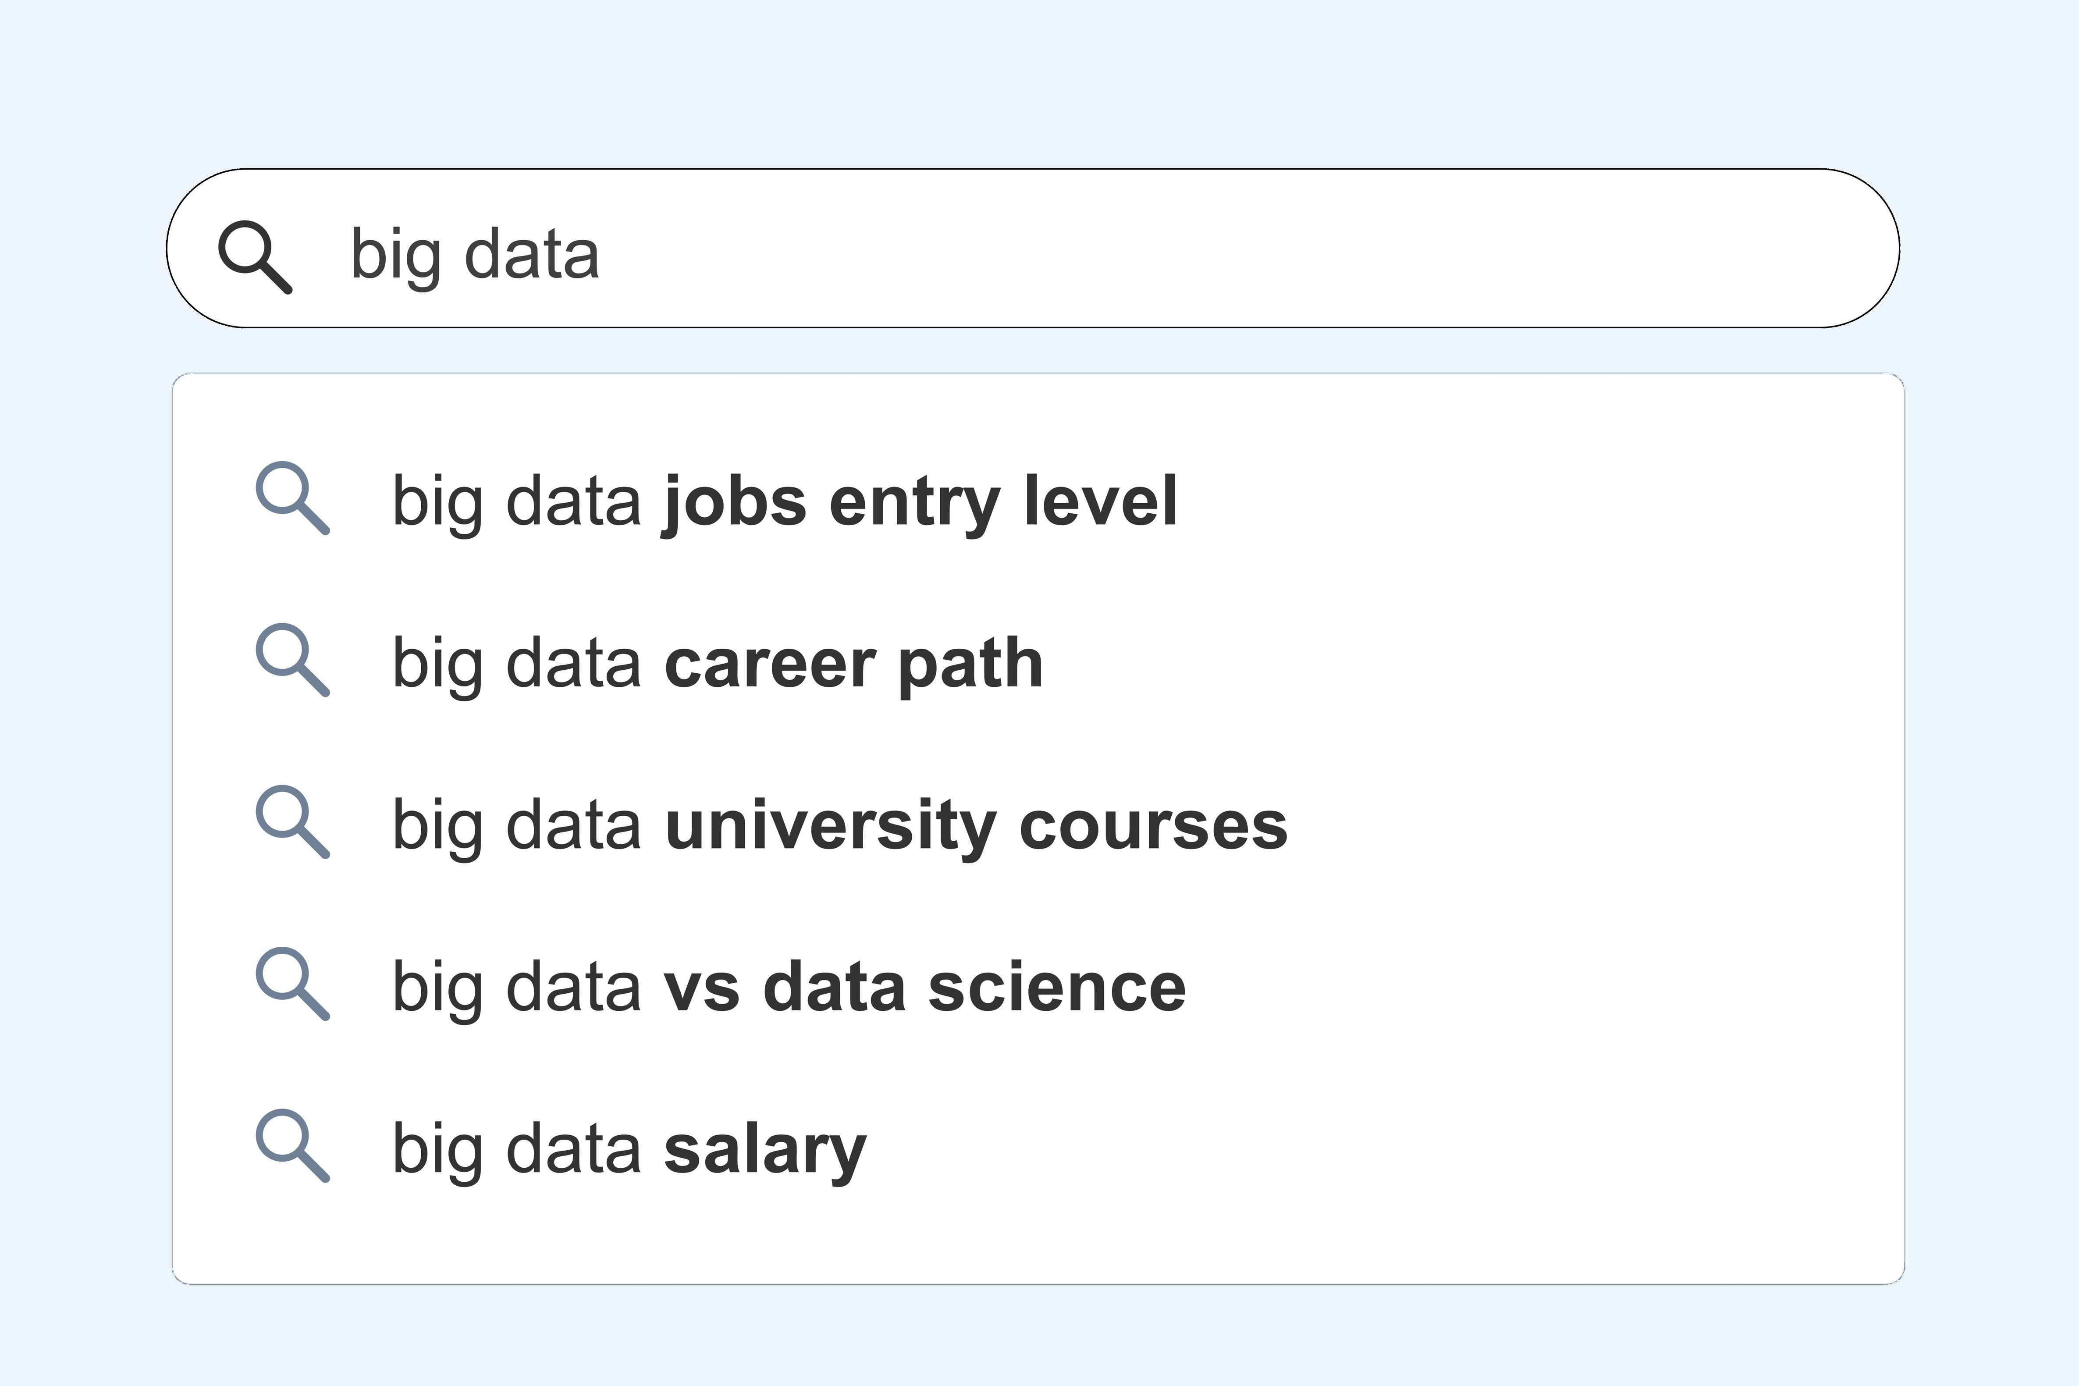
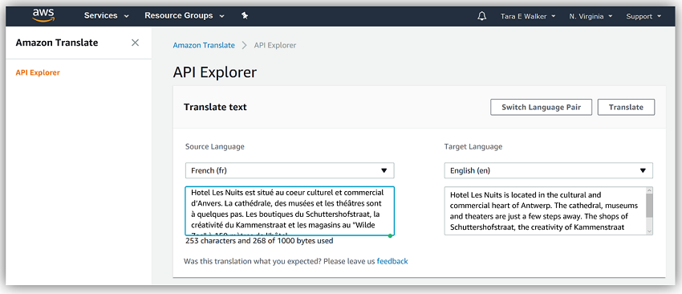
Seq2seq models
Use input sequences to produce output sequences:
The input and output are both variable-length sequences.
The following are examples of applications of these models:
Text completion (autocompletion)
Machine translation (Amazon Translate)
Notes:
~Alt text – text completion: Screenshot of potential search phrases automatically populating after a user begins to enter a query in a search box.
~Alt text – machine translation: Screenshot of Amazon Translate with an example text being translated from French to English.~
~Search autocomplete image source: https://stock.adobe.com/in/images/covid-19-topic-search-suggestions/503983472?prev_url=detail&asset_id=503983472
~Amazon Translate image: https://aws.amazon.com/blogs/aws/introducing-amazon-translate-real-time-text-language-translation/
~
A sequence to sequence (Seq2seq) model takes a sequence of items (such as words, letters, or time-series data) and outputs another sequence of items. For example, with machine translation, the input is a series of words, and the output is a translated series of words.
Unlike bag of words, term frequency-inverse document frequency (TF-IDF), or word2Vec—which are all vectorization techniques that produce fixed-length vectors without maintaining information about the sequence of words)—Seq2seq models allow variable-length inputs while preserving the sequence of words.
Earlier lessons discussed how recurrent neural networks (RNNs) can model variable-length inputs while maintaining the order.
The images on the slide show two common applications where Seq2seq models are used.

Slide 5
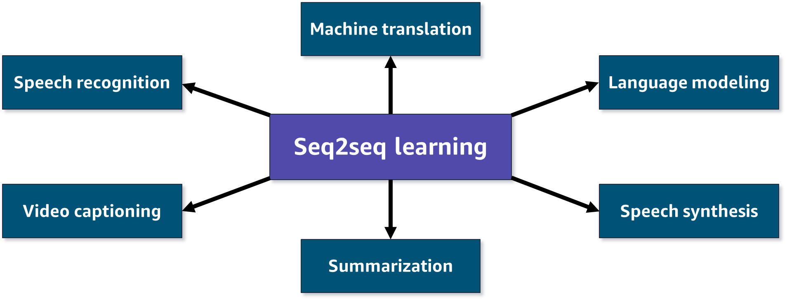
Seq2seq applications
Notes:
~Alt text: Hub and spoke diagram. See details in notes.
~
Image description: Hub and spoke diagram. The hub is labeled as seq2seq learning. Six arrows extend to the following spokes: machine translation, language modeling, speech synthesis, summarization, video captioning, and speech recognition.
Applications of sequence to sequence (Seq2seq) learning include the following:
Machine translation: Translating content from one language to another without any human input.
Language modeling: Predicting the next word or character in a document. You can use this technique to train language models that you can further apply to a range of natural language processing (NLP) tasks, such as text generation, text classification, and question answering.
Speech synthesis: Simulation of human speech by a computer or other device.
Summarization: Condensing a discourse or document into a shorter version while retaining the most important information and meaning.
Video captioning: Generating automatic descriptions from video.
Speech recognition: Processing human speech into a written format. Also known as automatic speech recognition (ASR), computer speech recognition, or speech-to-text.

Slide 6
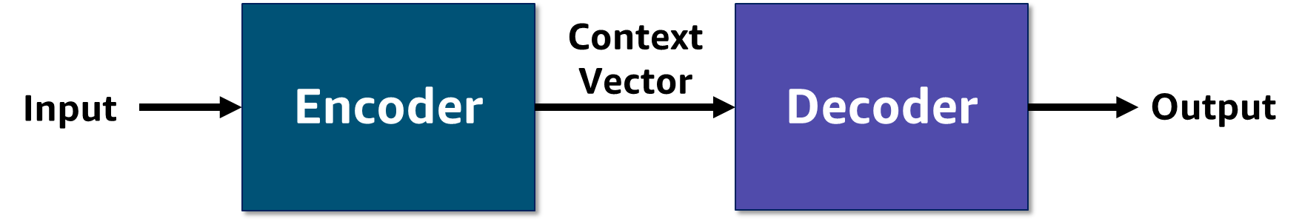
Encoder-decoder architecture
Encoder: Takes a variable length sequence as input and encapsulates the information into a context vector
Decoder: Reads the context vector and generates an output sequence
Notes:
~Alt text: Diagram of the encoder-decoder architecture. See detail in notes.
~
Image description: Diagram of the encoder-decoder architecture that is used for Seq2seq modeling. The encoder takes an input and generates a context vector. The context vector is then passed to the decoder, which then generates the target sequence token by token. End description.
The encoder processes each token in the input sequence. The encoder fits all the information about the input sequence into a vector of fixed length (the context vector). After going through all the tokens, the encoder passes this vector to the decoder.
The context vector is built to encapsulate the whole meaning of the input sequence and help the decoder make accurate predictions. Later, you will see that the context vector is the final internal state of the encoder block.
The decoder reads the context vector and predicts the target sequence token by token.

Slide 7
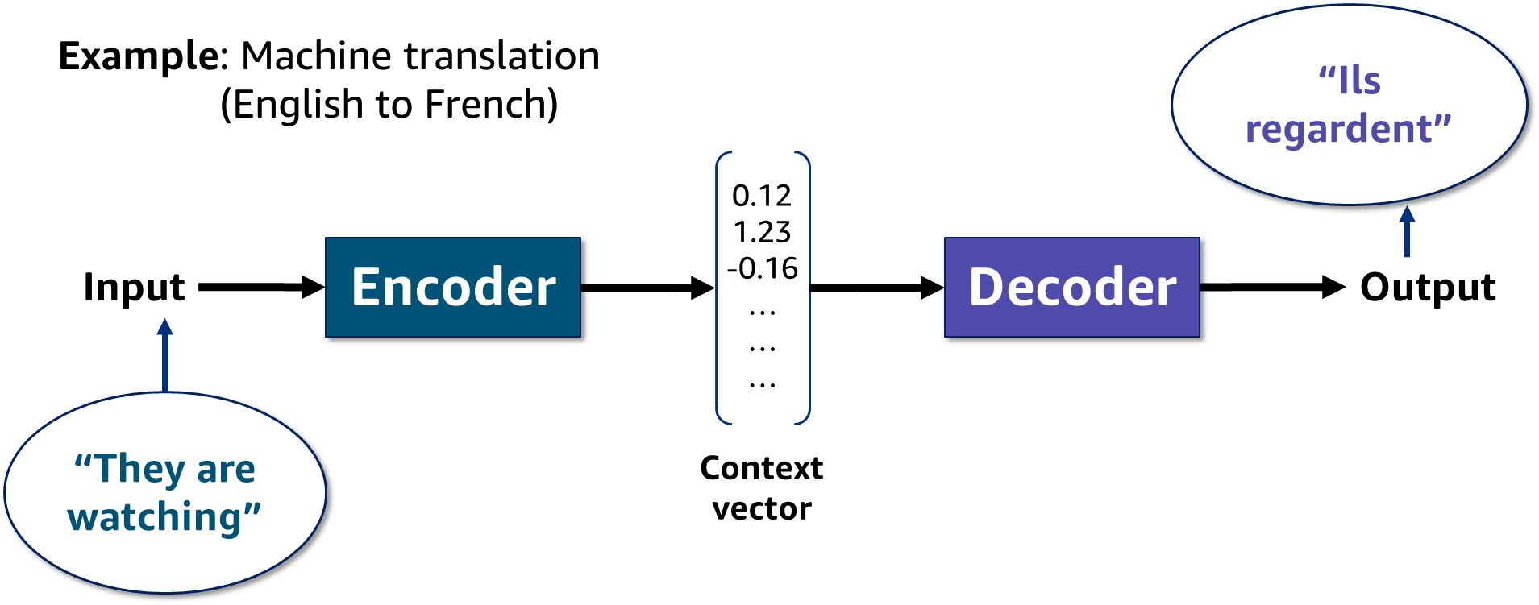
Encoder-decoder architecture example
Notes:
~Alt text: Example encoder-decoder architecture. See details in notes.
~
Image description: The English phrase "They are watching" is given as input to the encoder. The encoder converts the phrase into a context vector. The decoder reads the context vector and outputs the French phrase “Ils regardant.” End description.
Machine translation is a major problem domain for variable-length input and output sequences. To handle this type of input and output, you need to design an architecture with two major components. The first component is an encoder, which takes a variable-length sequence as the input and transforms it into a state with a fixed shape. The second component is a decoder, which maps the encoded state of a fixed shape to a variable-length sequence. This is called an encoder-decoder architecture.
The slide provides an example architecture for machine translation from English to French. Given an input sequence in English, “They are watching,” this encoder-decoder architecture first encodes the variable-length input into a state. Then, the architecture decodes the state to generate the translated sequence token by token as the output “Ils regardant.”
Note: The context vector summarizes all internal state information for all input elements to help the decoder make accurate predictions.

Slide 8
Limitations of RNNs

Slide 9
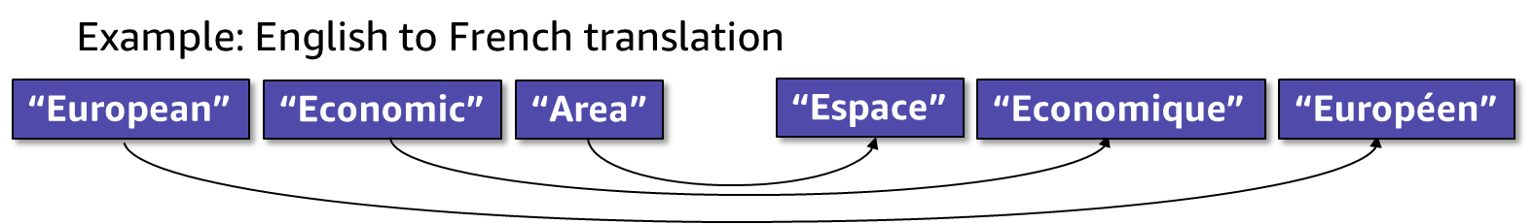
Limitations of RNNs for Seq2seq learning
Difficulty with long sequences
Potential of vanishing or exploding gradients
Inability to parallelize within a sequence
Inability to handle differences in source and target token order
Notes:
~Alt text: Example translation from English to French. See details in notes.
~
Image description: Example of a translation that requires a difference in word order between the source (English) and target (French) representations. The English phrase “European Economic Area” translates into French as “Espace Economique Européen,” which is equivalent to Area Economic European. End description.
RNNs often forget the inputs that are observed early in a sequence. Because the encoder is responsible for encoding the entire input sequence into a state vector, when an input sequence is long, the encoder has more difficultly effectively performing the encoding.
RNNs suffer from the matter of vanishing gradients. The gradients carry information that is used in the RNN, and when the gradient becomes too small, the parameter updates become insignificant. This makes the training of long data sequences difficult. While training a neural network, if the slope tends to grow exponentially rather than decaying, this is often called an exploding gradient. This problem arises when large error gradients accumulate, which leads to large updates to the neural network model weights during the training process.
Because the sequence is processed one token at a time, RNNs don’t offer easy parallel computation. This limitation prevents the algorithm from exploiting compute resources but also increases training time.
Despite its ability to process inputs sequentially, learning language is quite challenging. A lot of research goes into language modeling, and an RNN’s many-to-many architecture is sometimes limiting because the sequence of words in one language might not directly translate word to word in another.

Slide 10
Attention mechanism

Slide 11
Attention motivation
Compare these examples:
The animal didn’t cross the street because it was too tired.
The animal didn’t cross the street because it was too wide.
How can the network know what “it” refers to?
Notes:
Is the entire input sequence (or sentence) important at every time step during encoding? How can you know which words are important for the decoder to generate accurate predictions?
Humans often focus on the words that matter most in the message prior to responding. This principle can apply for text modeling too. Attention weights indicate the importance of a particular token for the output at a given time step.
In the given examples, the same token, it, refers to different entities as the context changes. The context can now be understood by using attention.

Slide 12
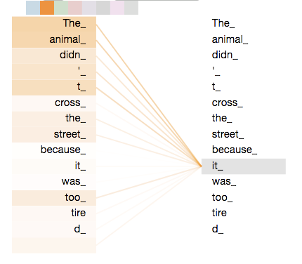
Attention
The animal didn’t cross the street because it was too tired.
The context must encode the part of the input that the output must pay attention to.
Attention scores indicate which tokens are the most relevant for the given output.
Notes:
~Alt text: Graph of word correlation. See details in notes.
~
Image description: Graph that shows how strongly the word "it" in the sentence correlates to other words in the sentence. “It” is found to be more relevant to “animal” than “street.” End description.
What does it in this sentence refer to? Does it refer to the street or the animal? It’s a simple question to a human, but it’s not as simple to an algorithm. When the model processes the word “it”, self-attention allows it to associate it with animal. By using attention, the context can encode which tokens the decoder must focus on during prediction at any given time step.
As observed from the image on the slide, higher attention weights are assigned to animal, and lower attention weights have been assigned to street. This indicates that it is most relevant with animal, and this context would be considered during predictions.
This page contains an image generated by TensorFlow and licensed under the Creative Commons Attribution 4.0 License with code samples licensed under the Apache 2.0 License. TensorFlow is a trademark of Google, Inc.
Notebook to generate the image on the slide: https://github.com/tensorflow/tensor2tensor/blob/master/tensor2tensor/notebooks/Transformer_translate.ipynb

Slide 13
Attention and importance
Attention mechanisms help language models to focus on a particular part of the observed context at each time step.
Attention distribution over tokens indicates the importance of a token for specific output.
Notes:
The attention mechanism, which was originally proposed by Bahdanau et al. in 2015, allows a language model to focus on parts of the sequence that relate most at each time step. Each time a model that uses this mechanism predicts an output word, the model uses only those parts of the input where the most relevant information is concentrated instead of the entire sequence. In simpler terms, the model pays attention to only some input words.
Attention is an interface that connects the encoder and decoder, and provides the decoder with information from every encoder hidden state. With this framework, the model is able to selectively focus on valuable parts of the input sequence and hence, learn the association between them. This helps the model to cope efficiently with long input sentences.

Slide 14
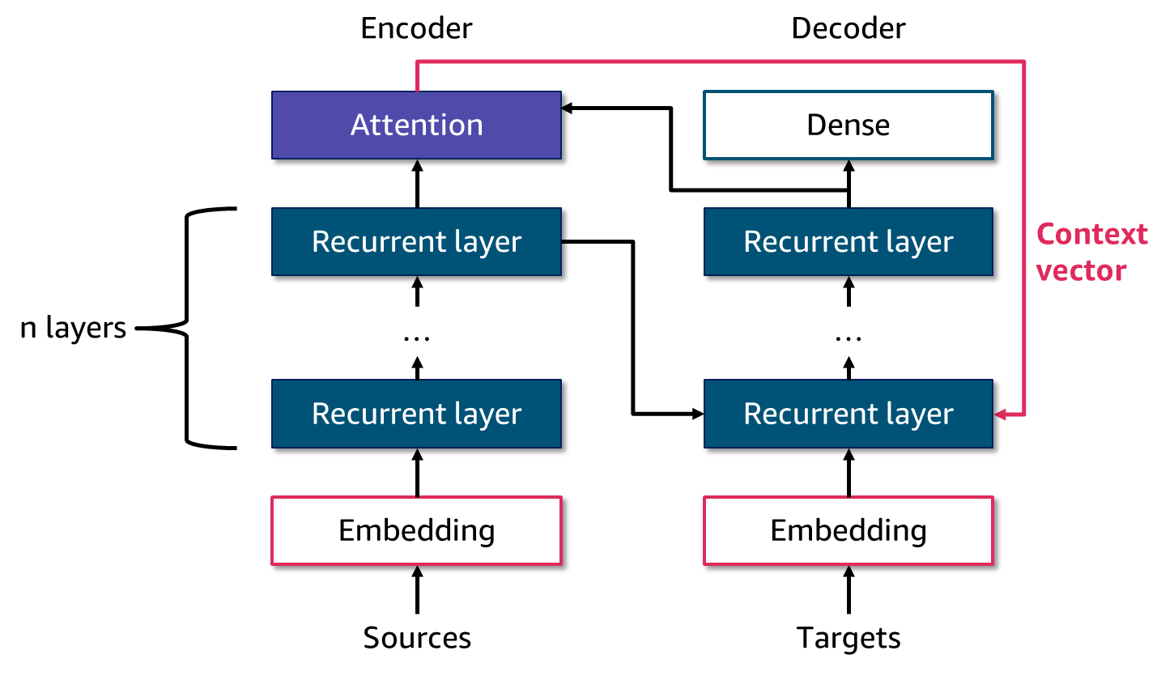
Seq2seq with attention
Notes:
~Alt text: Diagram of an encoder-decoder model. See notes for more details.
~
A Seq2seq model with attention works as follows:
In the encoder-decoder model, the input is encoded as a single fixed-length vector. The attention model requires access to the output from the encoder for each input time step.
The decoder outputs one value at a time, which might be passed to more layers, before finally outputting a prediction for the current output time step. The alignment model scores how well each encoded input matches the current output of the decoder.
The alignment scores are normalized using a softmax function. The normalization of the scores allows them to be treated like probabilities, indicating the likelihood of each encoded input time step being relevant to the current output time step.
Each normalized score is multiplied by the annotation weights to produce a new attended context vector from which the current output time step can be decoded.
Decoding is then performed as in the encoder-decoder model, but decoding uses the attended context vector for the current time step.

Slide 15
Attention overview
Solves the bottleneck problem: Allows the decoder to look directly at the source or input
Helps with the vanishing gradient problem: Attention provides weights even for tokens that were observed at the beginning of a long sequence
Provides some interpretability: Attention weights help analyze what the decoder focuses on
Integrates easily with RNNs
Notes:
Attention resolves the bottleneck problem to an extent by allowing the decoder to seek the relevant input during prediction.
This approach also mitigates the vanishing gradient problem by assigning attention weights for tokens even if they were observed at the beginning of a long sequence. Attention mechanisms allow the Seq2seq model to parse longer sequences effectively.
The attention weights can help analyze which parts of the input sequence the decoder focuses on most when producing outputs. This offers some interpretability to this model.
Attention mechanisms can integrate easily with RNNs and instantly overcome several limitations of RNNs, such as the bottleneck problem and vanishing gradient problem.

Slide 16
Transformers

Slide 17
Self-attention
Connects each element to every other element
Relates different positions of a single sequence to compute a representation of the same sequence
Converts each element into query, key, and value from input embeddings
Attention is all you need!
Notes:
Self-attention takes into consideration the relationship between words within the same sentence. Self-attention compares all input sequence members with each other and modifies the corresponding output sequence positions. In other words, self-attention layer searches the input sequence for each input and adds results to the output sequence.
The query, key, and value are concepts from information retrieval. Consider an example of searching for a video on the internet. The text that is typed in the search bar is the query. The results that appear are the key, and the content of the results is the value.

Slide 18
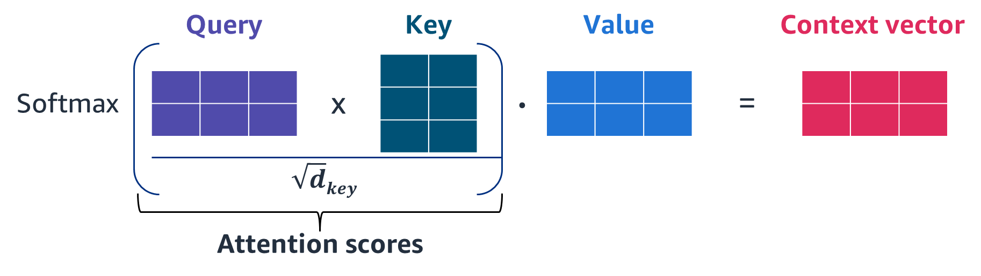
Self-attention mechanism
Create three vectors from each of the encoder’s input values: query, key, and value.
Calculate a score for how much attention to assign to each token of input.
Notes:
~Alt text: Illustration of computing the context vector. See details in notes.
~
Image description: Illustration of how query, key, and value vectors can be used to compute the context vector. The query and key vectors are combined to compute normalized attention scores. End description.
Attention is calculated as follows:
Take the query vector for a word and calculate its dot product with the transposition of the key vector of each word in the sequence (including itself). This is the attention score (also called the attention weight).
Divide each of the results by the square root of the dimension of the key vector. This is the scaled attention score.
Pass them through a softmax function so that values are contained between 0 and 1.
Take each of the value vectors and calculate the dot product with the output of the softmax function.
Add all the weighted value vectors together.

Slide 19
Transformers
The transformer model was developed as an encoder-decoder architecture.
Multi-head attention generates richer representation by using the self-attention mechanism several times in parallel.
Both the encoder and decoder use multi-head attention modules.
Positional encoding is concatenated to the inputs.
Notes:
Transformers are also based on the encoder-decoder architecture. However, they differ from Seq2seq by replacing the recurrent layers in Seq2seq with self-attention layers.
Reference: Ashish Vaswani, Noam Shazeer, Niki Parmar, Jakob Uszkoreit, Llion Jones, Aidan N. Gomez, Lukasz Kaiser, and Illia Polosukhin. “Attention Is All You Need.” Paper presented at the 31st Annual Conference on Neural Information Processing Systems (NIPS), Long Beach, CA, December 2017. https://doi.org/10.48550/arXiv.1706.03762.

Slide 20
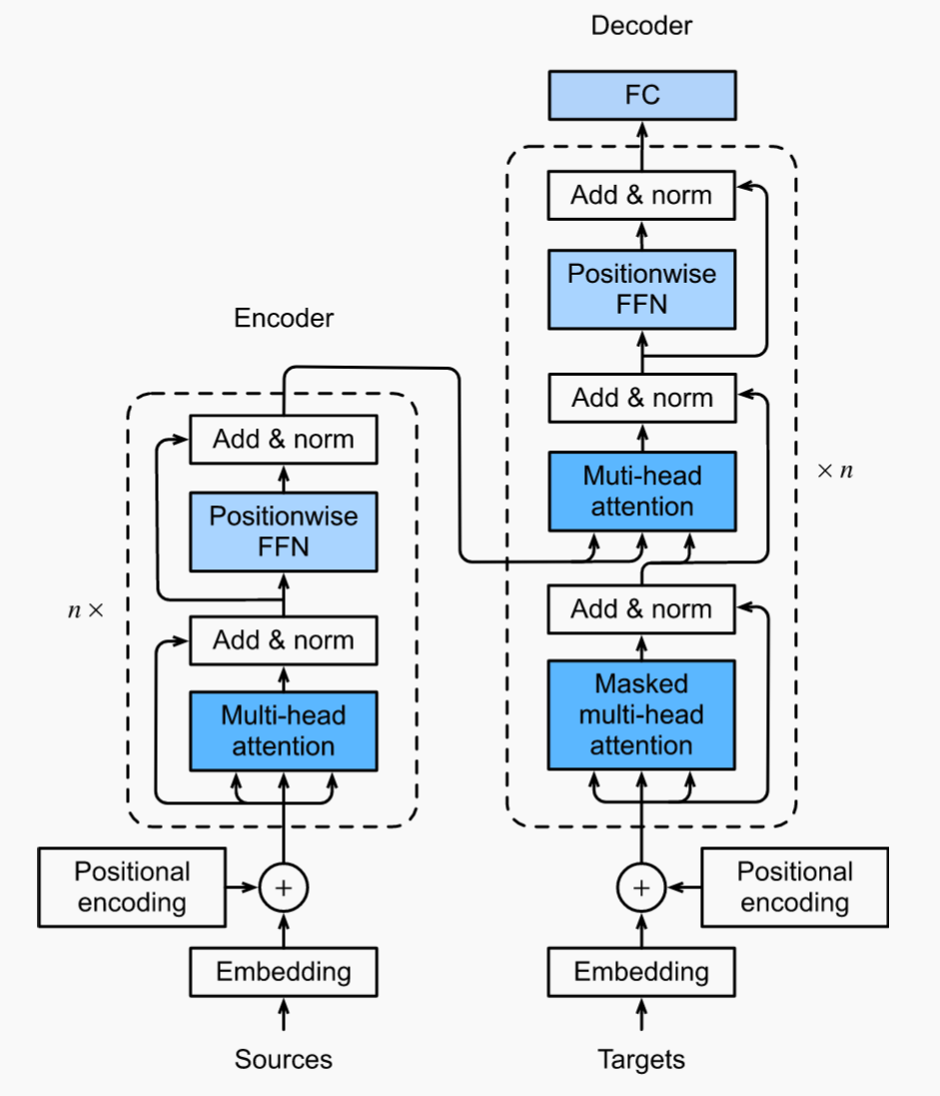
Transformers example
“It is five”
Example of a conversational chat:
Input: “what time is it”
Output: “It is five”
The encoder learns to extract information from the input data.
The decoder learns to produce output.
“what time is it”
Notes:
~Alt text – what time is it arrow: Arrow going from "what time is it" to the inputs part of the transformer diagram.
~Alt text – it is five arrow: Arrow going from the outputs part of the transformer diagram to "It is five.“
~
The transformer processes the data as follows:
The input sequence is converted into embeddings (with position encoding) and fed to the encoder.
The stack of encoders processes this and produces an encoded representation of the input sequence.
The target sequence is prepended with a start-of-sentence token, converted into embeddings (with position encoding), and fed to the decoder.
The stack of decoders processes this along with the encoder stack’s encoded representation to produce an encoded representation of the target sequence.
The output layer converts it into word probabilities and the final output sequence.
The transformer’s loss function compares this output sequence with the target sequence from the training data. This loss is used to generate gradients to train the transformer during backpropagation.
The encoder’s inputs first flow through a self-attention layer, which helps the encoder look at other words in the input sentence as it encodes a specific word. The outputs of the self-attention layer are fed to a feed-forward neural network. The same feed-forward network is independently applied to each position. The decoder has both layers, but between them is an attention layer that helps the decoder focus on relevant parts of the input sentence.
The image on this slide is from work created and shared by D2L, https://d2l.ai, and is used according to terms described in the Creative Commons 4.0 Attribution License.

Slide 21
Transformers overview
Transformers provide a state-of-the art deep learning architecture for natural language processing (NLP) tasks.
Transformers can process the input data in parallel (fast), unlike the recurrent networks which process in sequence (slow).
Self-attention mechanisms model interdependencies between all words, regardless of position.
Transformers typically undergo self-supervised learning.
Labels are generated automatically from unlabeled data.
Examples include BERT and GPT-3.
They are increasingly popular in computer vision (CV) tasks too.
Notes:
Self-supervised learning is an ML process where the model trains itself to learn one part of the input from another part of the input. The process involves generating labels automatically from an unlabeled dataset, followed by modeling the task as a supervised learning problem. Self-supervised learning is often perceived as an intermediate between unsupervised and supervised learning. The pretrained model that is trained using self-supervised training can be fine-tuned on a small dataset for downstream tasks, such as sentiment analysis and language modeling.
Bidirectional Encoder Representations from Transformers (BERT) are pretrained large language models that were developed by researchers at Google by using the transformer architecture trained on a large amount of text data by using self-supervised learning. The self-attention mechanism allows BERT to learn latent representations of words and sentences in context. When BERT was published, it achieved state-of-the-art performance on a number of NLP tasks.
Another example of a pretrained large language model is GPT-3, which OpenAI developed.
Transformers compete with convolutional neural networks (CNNs) in the field of computer vision (CV). Vision transformers (ViTs) benefit from self-supervised learning strategies, similar to language models.
References:
Jacob Devlin, Ming-Wei Chang, Kenton Lee, and Kristina Toutanova. “BERT: Pre-training of Deep Bidirectional Transformers for Language Understanding.” arXiv (May 2019). https://doi.org/10.48550/arXiv.1810.04805.
Tom B. Brown, Benjamin Mann, Nick Ryder, Melanie Subbiah, Jared Kaplan, Prafulla Dhariwal, Arvind Neelakantan et al. “Language Models Are Few-Shot Learners.” arXiv (July 2020). https://doi.org/10.48550/arXiv.2005.14165.

Slide 22

Next module
You will be introduced to handling image data.

Slide 24
Image source slide (for curriculum development use only)

Slide 25
Source graphic: Seq2seq applications
Machine translation
Speech recognition
Language modeling
Seq2seq learning
Video captioning
Speech synthesis
Summarization
Notes:
~Source for slide 4

Slide 26
Source graphic: Encoder-decoder architecture example
“Ils regardent”
Example: Machine translation
(English to French)
0.12
1.23
-0.16
…
…
…
Encoder
Decoder
Input
Output
“They are watching”
Context vector
Notes:
~Source for slide 7

Slide 27
Source graphic: Limitations of RNNs for Seq2seq learning
Example: English to French translation
“European”
“Economic”
“Area”
“Espace”
“Economique”
“Européen”
Notes:
~Source for slide 9

Slide 28
Source graphic: Seq2seq with attention
Encoder
Decoder
Attention
Dense
Recurrent layer
Recurrent layer
Context vector
n layers
…
…
Recurrent layer
Recurrent layer
Embedding
Embedding
Sources
Targets
Notes:
~Source for slide 14

Slide 29

Source graphic: Self-attention mechanism
Query
Key
Value
Context vector
.
Softmax
x
=
$$\sqrt{d}key$$
Attention scores
Notes:
~Source for slide 18

