Slide 1
ResNet: The Trade-Offs of Depth and Model Performance
Application of Deep Learning to Text and Image Data
Module 3 – Lesson 4

Slide 2
Today’s activities
The trade-offs of depth and residuals
ResNet
Batch normalization

Slide 3
The trade-offs of depth and residuals

Slide 4
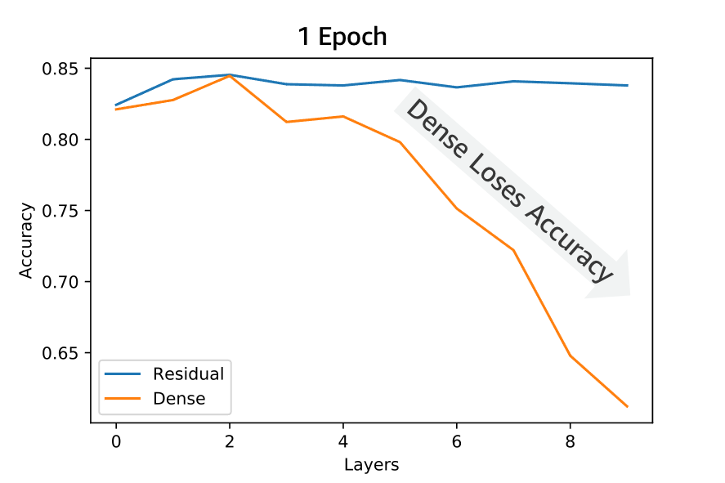
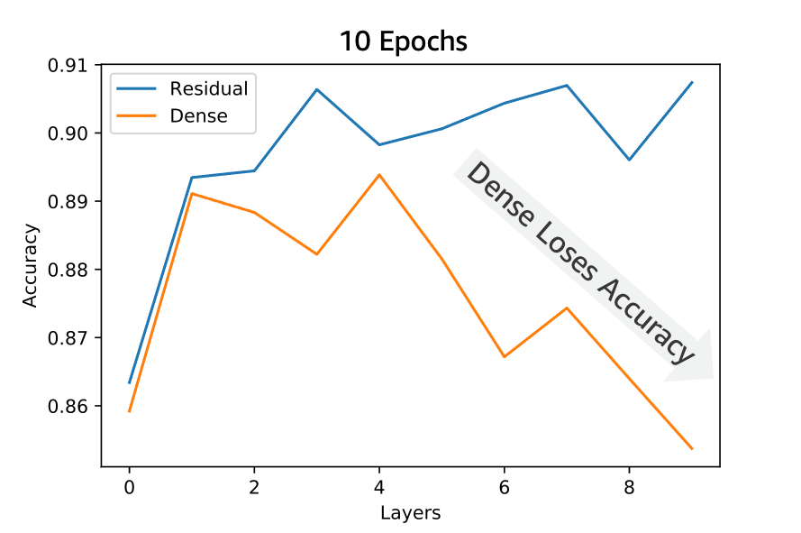
An issue with deep models
The story of deep learning is one of learning a hierarchy of layers, each of which represents increasingly abstract features of data. Deeper models should always perform better (at least in terms of training accuracy). However:
Introduce a new method (residual layers) to ensure improved performance.
Notes:
~Alt text – 1 epoch: Training accuracy plot for one epoch. See details in notes.
~Alt text – 10 epochs: Training accuracy plot for ten epochs. See details in notes.
~
Image description – 1 epoch: Training accuracy plot for one epoch. For the dense layer, the accuracy drops rapidly after four layers. For the residual layer, the accuracy is stable at around 84 percent as the number of layers increases. End description.
Image description – 10 epochs: Training accuracy plot for ten epochs. For the dense layer, the accuracy drops after four layers (with some fluctuating between two and four layers). For the residual layer, the accuracy is more stable (only fluctuating a bit) at around 90 percent even as the number of layers increases. End description.
Increased depth can improve the performance of a neural network, but it can also make the training process more time-consuming.
Deeper neural networks might be able to learn more complex patterns and representations in data, but they might also be more susceptible to overfitting.
Increasing the depth of a neural network can improve its ability to generalize to new data, but it can also make the network more sensitive to small changes in the input data.
One issue with deep models could be the vanishing gradient problem, which can occur when you train deep neural networks with many layers.

Slide 5
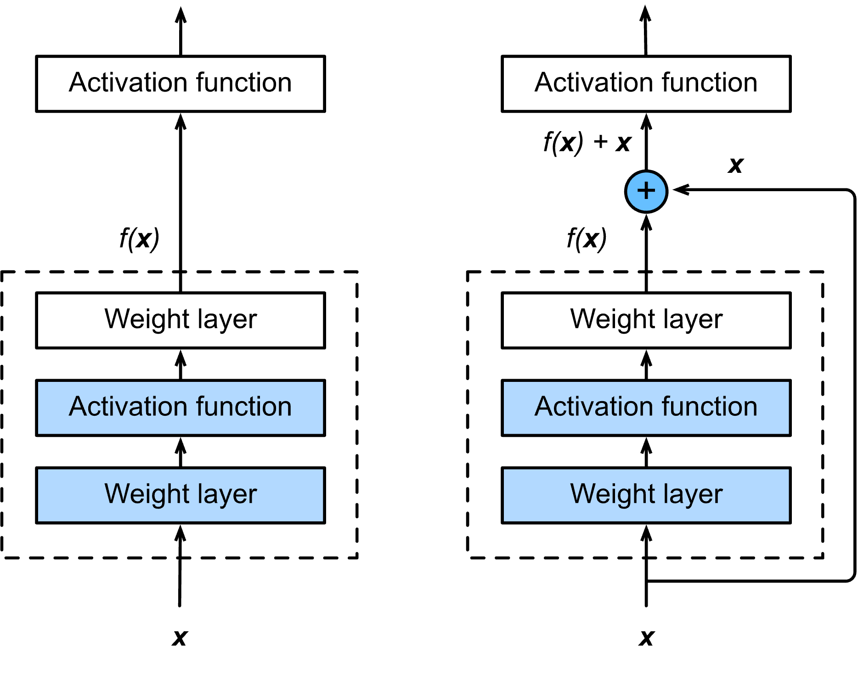
Solution: Residual layers
In this solution, you ensure that every layer that is added to the function has the option to be bypassed by a skip connection.
Rather than transforming the data, the layers provide a term to add to change existing data.
This means that layers can be bypassed if needed.
With residual blocks, inputs can forward propagate faster through the residual connections across layers.
Residual connection (or shortcut connection)
Notes:
~Alt text: Diagram of residual layers. See notes for description.
~
Residual layers tend to maintain accuracy better than dense layers in a deep network. This is because residual layers allow the network to learn more complex functions, while dense layers tend to overfit and might become less effective as the network becomes deeper.
By using residual connections, data can skip layers and reach later parts of the network. The plus (+) operation is a simple element-wise addition of x to the transformed output f(x) from the network layer.
Residual layers result in easier convergence in neural networks and mitigate the issue of vanishing and exploding gradients. The exact reason why residual connections work is still being researched, but some theories support the results. The reasons are covered in the following slides.
The slide shows an example of a regular block and an example of a residual block. In the regular block, the portion within the dotted-line box must directly learn the mapping f(x). In the residual block, the portion within the dotted-line box needs to learn the residual mapping g(x)=f(x)−x, which makes the identity mapping f(x)=x easier to learn.

Slide 6
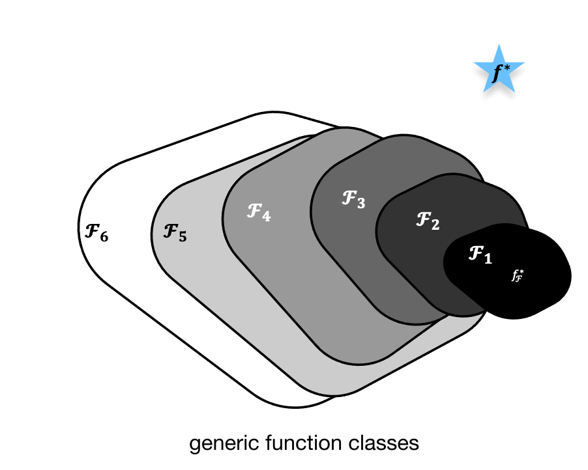



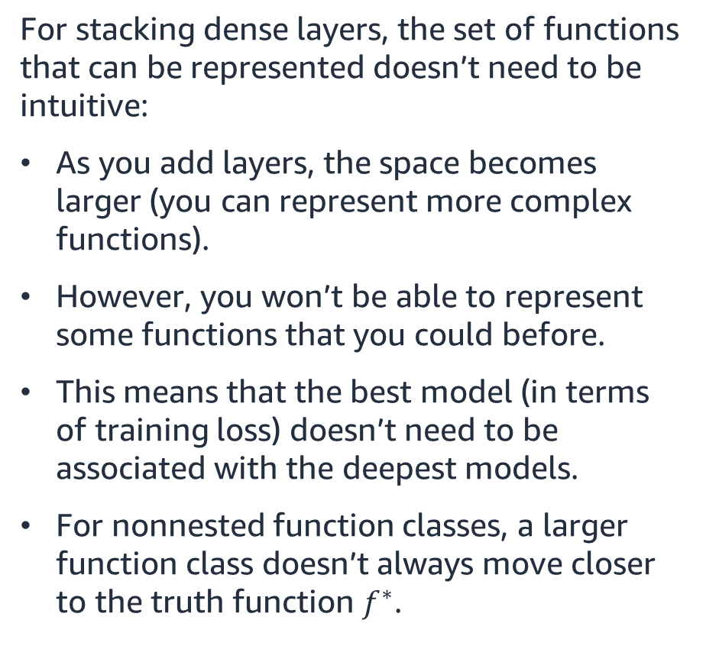
Schematic of function spaces: Nonresiduals
$f_{ℱ}^{∗}$are the best bet within $ℱ$
For stacking dense layers, the set of functions that can be represented doesn’t need to be intuitive:
As you add layers, the space becomes larger (you can represent more complex functions).
However, you won’t be able to represent some functions that you could before.
This means that the best model (in terms of training loss) doesn’t need to be associated with the deepest models.
For nonnested function classes, a larger function class doesn’t always move closer to the truth function $f^{∗}$.
${ 𝓕}_{3}$is closer to 𝑓∗ than $𝓕_{1}$
${ 𝓕}_{6}$ moves away, and there is no guarantee that further increasing the complexity can reduce the distance from 𝑓∗
Notes:
~Alt text: Nonnested function classes. Increasing layers leads to functions moving from F1 to F6.
~Equations
~
Consider F, which is the class of functions that a specific network architecture (together with learning rates and other hyperparameter settings) can reach. That is, for all 𝑓∈F, there exists some set of parameters (such as weights and biases) that can be obtained through training on a suitable dataset.
Assume that the desired underlying mapping that you want to obtain by learning is 𝑓*. Adding layers doesn’t guarantee that the next function class is a superset of the function class that is represented by the previous layer. In other words, it’s possible for the function class to move away from the initial function class at is represented by prior layers. This shift can restrict the expressiveness of the network and cause instability.

Slide 7
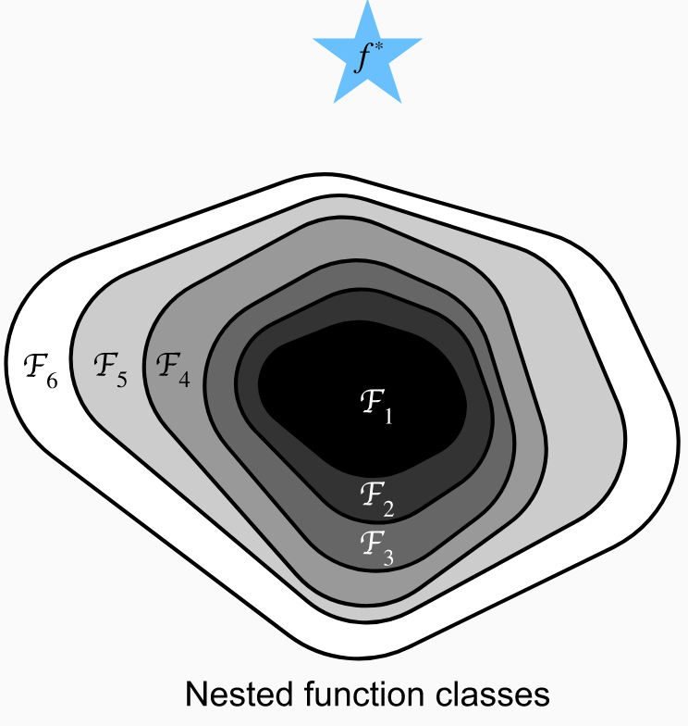
Schematic of function spaces: Residuals
For stacking residual layers, the set of functions is better behaved:
As you add layers, the space becomes larger (you can represent more complex functions).
You can still easily represent every function that you could represent with fewer layers (set the last layer to all zeros).
This means that the best model (in terms of training loss) must be the deepest one (ignoring optimization).
Notes:
~Alt text: Nested function classes. Increasing layers leads to functions moving from F1 to F6.
~𝓕1 ⊆…⊆ 𝓕6
~
Thus, only if larger function classes contain the smaller ones is it guaranteed that increasing them will strictly increase the expressive power of the network. For deep neural networks, if training the newly added layer into an identity function 𝑓(𝐱)=𝐱, the new model will be as effective as the original model. Because the new model might get a better solution to fit the training dataset, the added layer might make it easier to reduce training errors.
Residual connections provide the skip layer with the inputs provided to the layer before. This allows the skip layer to represent a larger function class, which includes the class of functions that is represented by the previous layer.
With nested function classes, function n (𝓕n) is a subset of function (n+1) (𝓕n+1). This means that function 3 is a subset of function 4 (𝓕3 ⊆ 𝓕4), you can avoid the previously discussed from the nonnested function classes.

Slide 8
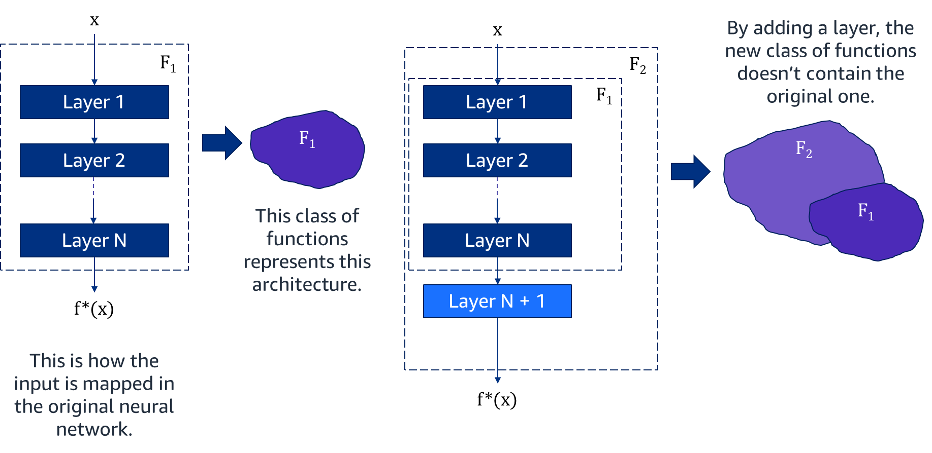
Nonresidual schematic
Notes:
~Alt text: Diagram of a neural network. See notes for description.
~
Image description: Diagram of a neural network that has N layers. The network architecture represents a class of functions, F₁. A second diagram shows that an additional layer has been added to the network, which results in N+1 layers. The class of functions, F₂, that is represented by the deeper network spans a different space than F₁. This shift represents how deeper networks can result in a shift in the space that span the functions. It’s common for the new space F₂ to fail to capture all the functions that are represented by the old network architecture, F₁. End description.
By adding a layer, you risk losing the benefits from the original layers in the training process. Adding an extra layer doesn’t guarantee that performance will improve. This happens because, in the function space, the new class of functions that represent the new architecture is not fully contained in the original function space.

Slide 9
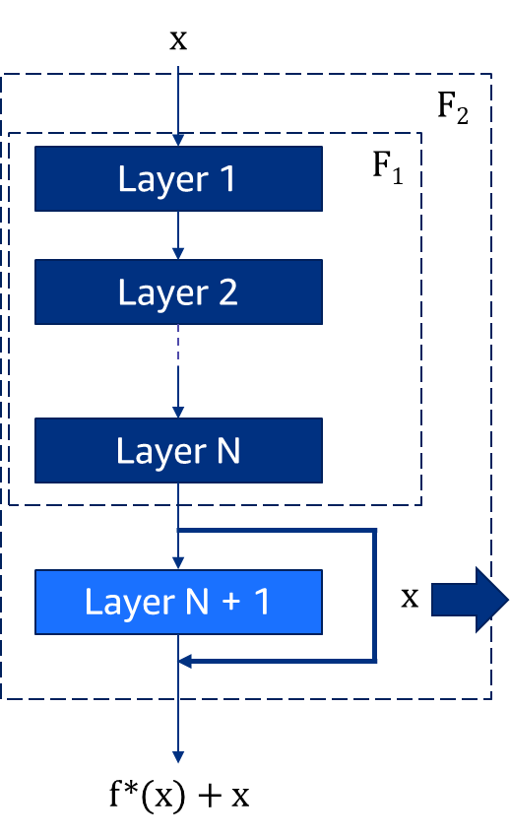
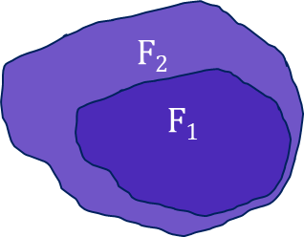
Residuals schematic
A residual network effectively creates a shortcut connection that allows the network to bypass some of the layers. This preserves what the model learned in previous layers.
The outcome is that larger function classes now contain the smaller ones, and this guarantees that increasing them strictly increases the expressive power of the network.
Notes:
~Alt text – left image: Diagram of neural network. See description in notes.
~Alt text – right image: Diagram of function classes. See description in notes.
~
Image description – network: Diagram of a network that is similar to the one on the previous slide but with skip or residual connections. The skip connections ensure that the span of functions that are represented by the deeper network with N+1 layers, F₂, also contain all the functions that are represented by the network with only N layers. End description.
Image description – function classes: Diagram of two concentric shapes to represent how the larger function classes (F₂) that result from using residual connections contain the smaller function classes (F₁), thereby increasing the representation power of the network. End description.
If you add a skip connection, the larger function classes contain the smaller ones. This guarantees that increasing the number of layers strictly increases the expressive power of the network. For deep neural networks, if you train the newly added layer into an identity function 𝑓(𝐱)=𝐱, the new model will be as effective as the original model. Because the new model might get a better solution to fit the training dataset, the added layer might make it easier to reduce training errors.

Slide 10
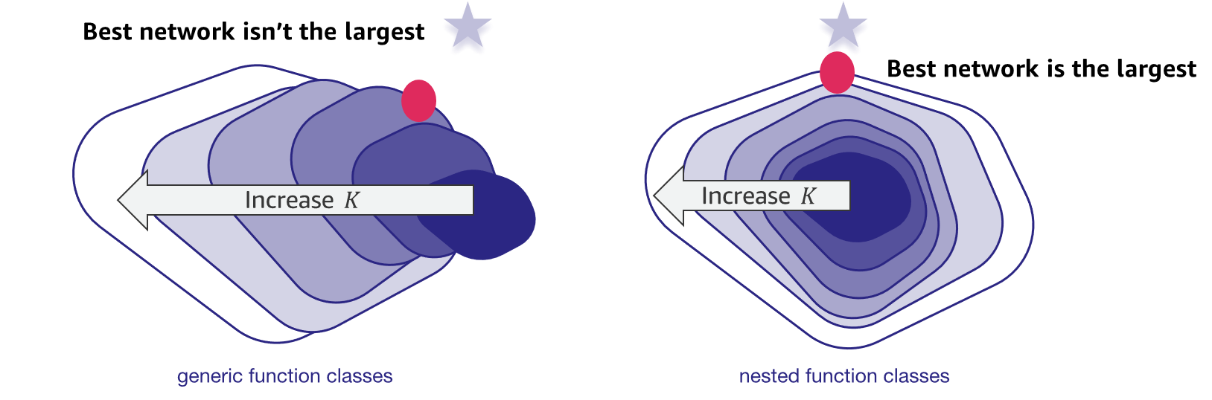

Residual layers: Creating nested function families
Residual layers provide skip connections that bypass layers.
You can represent the space of all functions by using a $K+1$ layer neural network, which is a strict superset of those represented by a $K$ layer network.
Notes:
~Alt text: Figure of generic function classes and figure of nested function classes. See description in notes.
~Equations
~
Image description: The first figure represents the region that spans all the functions that are represented by a generic network architecture. As k, the number of layers, increases, the resulting region shifts further away from the optimal point. This is because, as k increases, the new region doesn’t contain all the functions that are represented by the previous network. Therefore, the deepest network often fails to be the better solution.
The second figure represents a network that uses skip or residual connections. When a layer is added, all the functions of the previous network architecture are contained in the new region. Therefore, increasing the number of layers results in a better performing model. End description.
For nonnested function classes, a function class that is larger (by area) doesn’t guarantee that the function will get closer to the truth function (f∗). This doesn’t happen in nested function classes.
For deep neural networks, if you train the newly added layer into an identity function 𝑓(𝐱)=𝐱, the new model will be as effective as the original model. Because the new model might get a better solution to fit the training dataset, the added layer might make it easier to reduce training errors.
This is the question that He et al. (2016) considered when working on deep computer vision (CV) models. At the heart of their proposed residual network (ResNet) is the idea that every additional layer should more easily contain the identity function as one of its elements. These considerations are rather profound, but they led to a surprisingly simple solution: a residual block. With it, ResNet won the ImageNet Large Scale Visual Recognition Challenge in 2015. The design had a profound influence on how to build deep neural networks.
Reference: Kaiming He, Xiangyu Zhang, Shaoqing Ren, and Jian Sun. “Deep Residual Learning for Image Recognition.” Paper presented at the 2016 IEEE Conference on Computer Vision and Pattern Recognition (CVPR), Las Vegas, NV, June 2016. https://doi.org/10.1109/CVPR.2016.90.

Slide 11
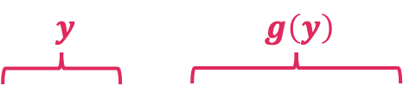
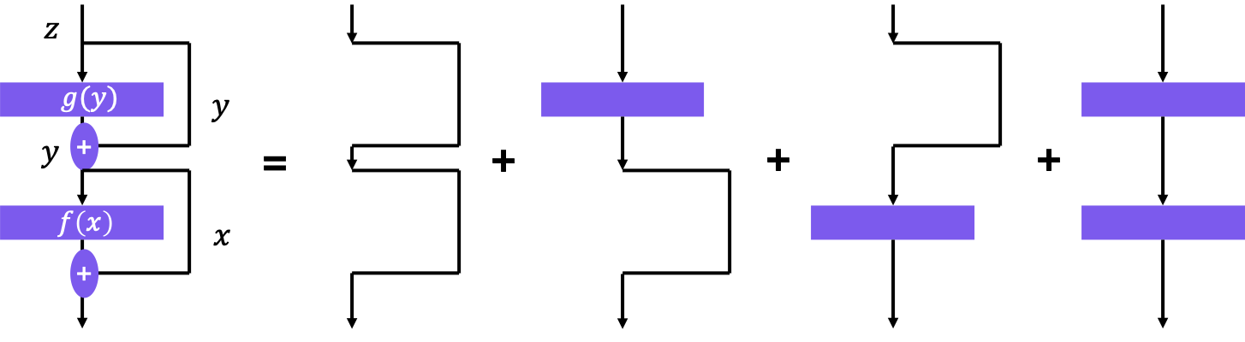

Gradient flow through residual layers
An additional benefit can be observed by considering gradients of these layers. Because of the residual connections, the sum can be expanded:
$$y=x+f\left(x\right), z=y+g\left(y\right) ⇒ z=x+f\left(x\right)+g\left(x\right)+g\left(f\left(x\right)\right)$$
The gradient will hit each layer separately as well as in all combinations.
Notes:
~Alt text – equation labels: x + f(x) is y. g(x) + g(f(x)) is g(y).
~Alt text – gradient flow: Diagram of gradient flow. See description in notes.
~Equations
~
Image description: During back propagation, the gradient will flow through each layer of the neural network separately, updating the weights and biases of that layer based on the gradient. However, because the output of each layer is typically used as the input to the next layer, the gradient will also flow through all the layers in combination, affecting the weights and biases of all layers that the output of the current layer is connected to. End description.
In the case of residual layers, the gradient can flow directly from the output of the layer to the input of the layer, bypassing the intermediate layers. This can improve the flow of gradients and prevent the vanishing gradient problem.
The gradient will still hit each layer separately, as well as in all combinations. This is because the gradient is computed for each layer individually, using the chain rule to propagate the gradient backward through the network.

Slide 12
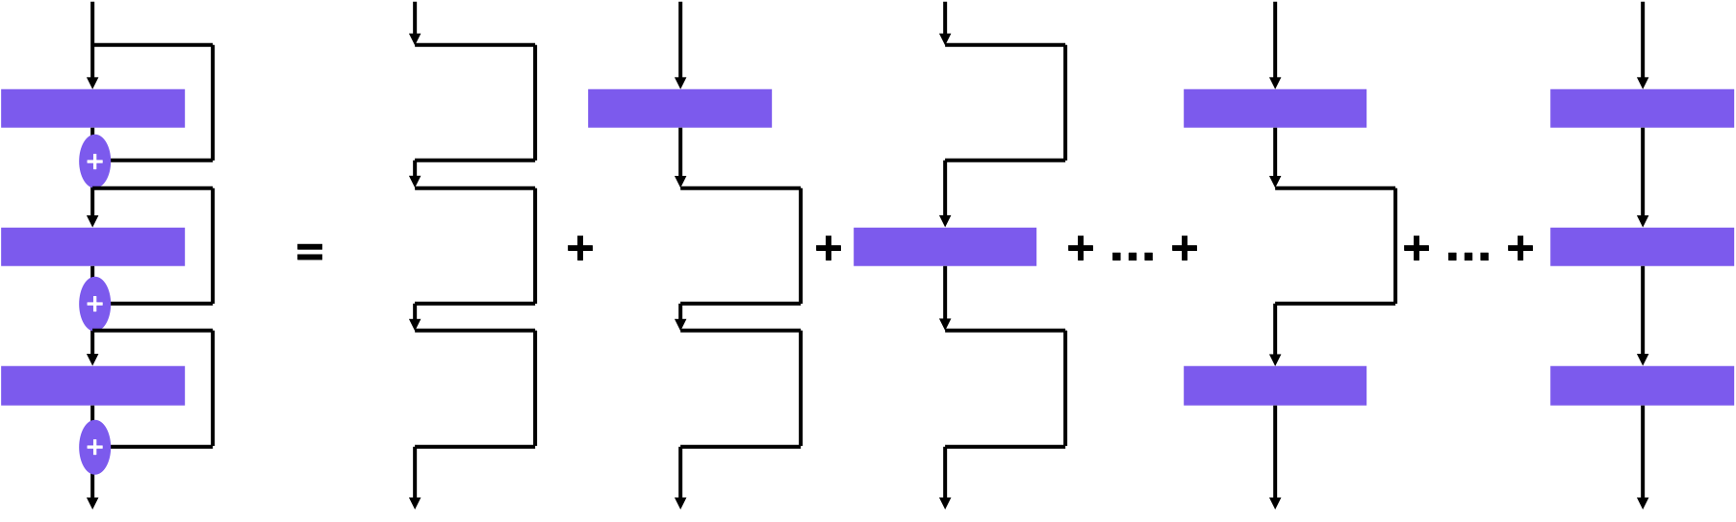
Gradient flow through residual layers (more layers)
The same is true at any depth. No matter how deep the network is, contributions will always occur from passing through each layer individually.
Notes:
~Alt text: Diagram of gradient flow through residual layers. See description in notes.
~
Image description: Diagram of the gradient flow through a network with three layers and three skip connections. Similar to the example from the previous slide, the image demonstrates all combinations of gradients passing though the connections and layers. The addition of more layers and residual connections results in more combinations than the network from the previous slide. End description.
The gradient will still hit each layer separately, as well as in all combinations. This is because the gradient is computed for each layer individually, using the chain rule to propagate the gradient backward through the network.
The use of residual connections doesn’t change this basic principle of backpropagation.
In deep networks with many residual layers, the gradient might hit each layer multiple times through different paths, depending on the specific architecture of the network.
This can be beneficial for training deep networks because it allows the gradient to flow more freely and reduces the risk of the vanishing gradient problem.

Slide 13
Deeper theory of residual layers
The theory of residual layers and their benefits is quite extensive. The following are a few good papers to read:
“Dynamical Isometry Is Achieved in Residual Networks in a Universal Way for Any Activation Function”: Shows that any activation function can be successfully used in residual networks of arbitrary depth.
“Fixup Initialization: Residual Learning without Normalization”: Shows that arbitrarily deep networks of residual layers can be trained without the need for normalization layers with proper initializations.
“Batch Normalization Biases Residual Blocks towards the Identity Function in Deep Networks”: Shows that residual layers combine well with batch normalization, which leads to a residual network that focuses on pathways through the network with fewer nonlinearities rather than more.
Notes:
References:
Wojciech Tarnowski, Piotr Warchoł, Stanisław Jastrzębski, Jacek Tabor, and Maciej A. Nowak. “Dynamical Isometry Is Achieved in Residual Networks in a Universal Way for Any Activation Function.” Proceedings of the 22nd International Conference on Artificial Intelligence and Statistics (AISTATS), Okinawa, Japan, 2019. https://doi.org/10.48550/arXiv.1809.08848.
Hongyi Zhang, Yann N. Dauphin, and Tengyu Ma. “Fixup Initialization: Residual Learning without Normalization.” Paper presented at the 7th International Conference on Learning Representations (ICLR), New Orleans, LA, 2019. https://doi.org/10.48550/arXiv.1901.09321.
Soham De and Samuel L. Smith. “Batch Normalization Biases Residual Blocks towards the Identity Function in Deep Networks.” 34th Conference on Neural Information Processing Systems (NeurIPS), Vancouver, Canada, 2020. https://doi.org/10.48550/arXiv.2002.10444.

Slide 14
Ways that residual connections can help
Regularize a neural network and prevent overfitting, but they might also introduce noise into the network
Reduce the vanishing gradient problem and improve the flow of information through a deep neural network, but they might also increase the memory requirements and computational complexity of the network
Improve the robustness of a neural network to variations in the input data, but they might also introduce new sources of error or instability
Simplify the training process and reduce the number of iterations that are required to achieve convergence, but they might also increase the risk of overfitting
Improve the interpretability and explainability of a neural network, but they might also make it more difficult to analyze and interpret the internal workings of the network
Notes:
The vanishing gradient problem is a challenge during the training process. The problem occurs when the gradients of the loss function (with respect to the parameters of the network) become very small, which makes it difficult for the model to learn.

Slide 15
Summary
Deep neural networks with dense linear layers aren’t always as effectively trained as shallower models because of the family of functions not being nested.
Families of functions are nested by adding residual connections, where a final layer can be bypassed with skip connections.
Gradient flow through such networks is improved because layers can be bypassed by following the skip connections.

Slide 16
ResNet

Slide 17
Motivation: Degradation
Degradation: With the network depth increasing, loss rebounds
How to address degradation?
A deep residual learning framework: ResNet
Notes:
~Alt text: Deep residual learning framework (ResNet) showing the use of skip connections in blocks to mitigate network degradation.
~
The degradation problem is believed to be caused by the vanishing gradient problem, where the gradients become too small to effectively update the parameters of the lower layers. This can make it difficult for the lower layers to learn useful representations and can ultimately result in a decrease in performance.
ResNet addresses this problem by introducing residual skip connections, which allow information to be directly passed between layers, bypassing some of the layers altogether. This means that even if the gradients become very small, the information can still flow through the network and be used to update the parameters.
The motivation behind ResNet is to create deeper neural networks that can learn more complex representations without being hindered by the degradation problem. By introducing residual connections, ResNet has been able to achieve state-of-the-art results on a range of computer vision (CV) tasks.
Reference: Kaiming He, Xiangyu Zhang, Shaoqing Ren, and Jian Sun. “Deep Residual Learning for Image Recognition.” Paper presented at the 2016 IEEE Conference on Computer Vision and Pattern Recognition (CVPR), Las Vegas, NV, June 2016. https://doi.org/10.1109/CVPR.2016.90.

Slide 18
Residual networks (ResNet)
Layers: Increase the complexity and expressiveness of the network
ResNet
Implements the identity function
Provides the ability to design networks where adding layers makes networks strictly more expressive rather than just different
Introduced residual connections, which enabled deeper networks and more flexible learning
Uses residual blocks to control function class growth for deeper networks
Uses residual connections to improve gradient flow through the network in backpropagation, which results in more efficient training
Notes:
In a traditional neural network, each layer applies a nonlinear transformation to the output of the previous layer. In contrast, a residual block in a ResNet contains a shortcut connection that bypasses one or more layers and adds the input directly to the output. This allows the network to learn the residual function—or the difference between the output and input—instead of trying to learn the full function from scratch.
The introduction of residual connections allows for the design of much deeper neural networks that can be trained more easily and effectively. With traditional networks, adding more layers can sometimes lead to worse performance due to the vanishing gradient problem, where the gradients become extremely small and the network stops learning. ResNet overcomes this issue by allowing gradients to flow directly through the shortcut connections, which helps to preserve the gradient magnitude and enables training of much deeper networks.

Slide 19
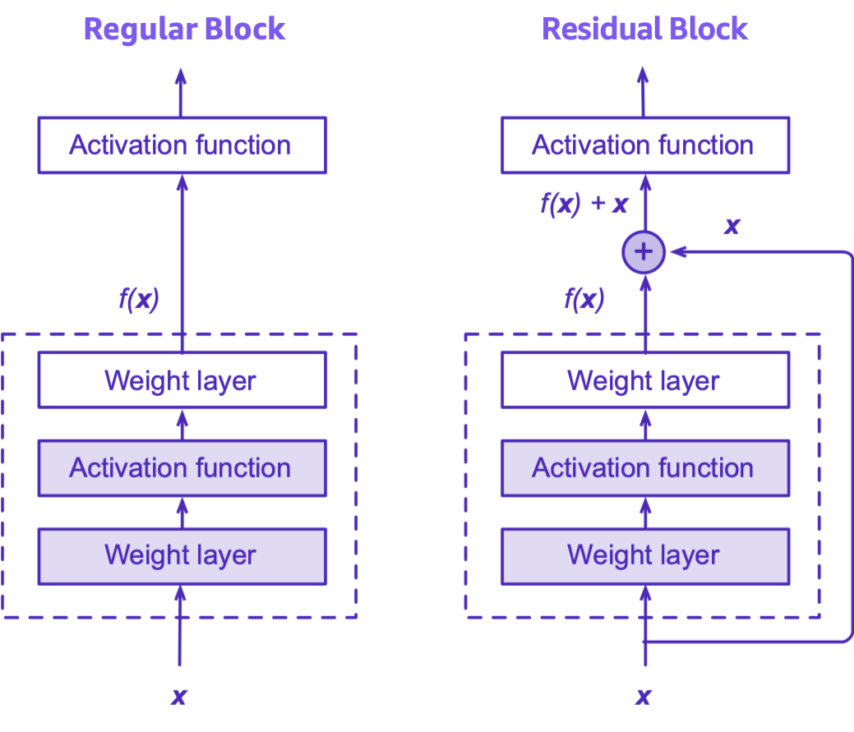
Residual blocks idea (1 of 2)
Adding connections between layers
Also called skip connections or short cuts
Taylor expansion style parametrization
Notes:
~Alt text: Comparison of a regular block and a residual block. The residual block adds connections between layers, which are called skip connections or shortcuts.
~
Residual skip connections, also known as residual connections, are a type of shortcut connection in deep neural networks. These connections allow the network to learn residual functions, which can help to improve the quality of learned features.
In a traditional neural network, the output of one layer is directly fed into the next layer as input. However, in a residual network, the output of a layer is added to the input of a later layer, effectively creating a shortcut connection that allows the network to bypass some of the layers. This connection is often called a skip connection.
For more information, see Residual Blocks in Dive into Deep Learning at http://d2l.ai/chapter_convolutional-modern/resnet.html#residual-blocks.

Slide 20
Residual blocks idea (2 of 2)
Skip connections
Work as a refinement step where the network can learn how to adjust the input features for higher quality features
Provide the ability to build deeper networks
Notes:
~Alt text: Same diagram from previous slide.
~
The intuition behind this approach is that when a neural network learns to approximate a complex function, it might be easier to learn the residual function (the difference between the output and the input) rather than directly learning the underlying function itself. By using skip connections, the network can learn to adjust the input features for higher quality features, which can improve the overall performance of the network.

Slide 21
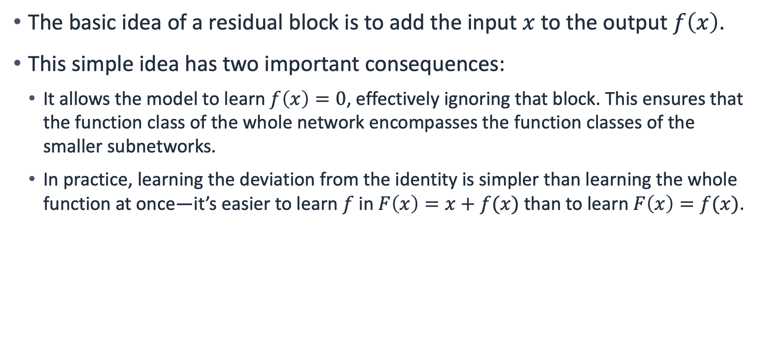
Residual blocks
The basic idea of a residual block is to add the input $x$ to the output $f\left(x\right)$.
This simple idea has two important consequences:
It allows the model to learn $f\left(x\right)=0$, effectively ignoring that block. This ensures that the function class of the whole network encompasses the function classes of the smaller subnetworks.
In practice, learning the deviation from the identity is simpler than learning the whole function at once—it’s easier to learn $f$ in $F\left(x\right)=x+f(x)$ than to learn $F\left(x\right)=f(x)$.
Notes:
~Equations
~
The function class of a whole network encompasses the function classes of the smaller subnetworks.
Because the shortcut connection directly connects the input to the output of the block, the function class of the entire network includes the function class of the subnetwork without the shortcut connection (the residual connection) as well as the function class of the subnetwork with the shortcut connection. This means that the network can learn more complex functions than it would be able to learn without the shortcut connection.
Learning the deviation from the identity is simpler than learning the whole function.
In a residual block, the residual connection attempts to learn the deviation from the identity function—or the difference between the input and output—rather than learning the entire function directly. This can make it easier for the network to learn more complex functions and avoid issues such as the vanishing gradient problem, which can occur when training deep neural networks.

Slide 22
ResNet summary
ResNet varies length by repeating residual blocks:
Example: ResNet 18, ResNet 34, ResNet 50, ResNet 101, ResNet 152
ResNet 18 has 18 convolution layers
The deeper the model, the higher the accuracy that it can achieve
Two pooling layers for dimensionality reduction
Batch normalization for capacity control
ResNet 18
Notes:
~Alt text: Diagram of a deep residual learning framework (ResNet).

Slide 23
Batch normalization

Slide 24
Motivation: Why do we need batch normalization?
Internal covariate shift: The distribution of input activations to each layer can shift during the training process. This can lead to slow convergence and instability.
Vanishing and exploding gradients: Deep neural networks with many layers can suffer from vanishing or exploding gradients. This can lead to slow or unstable training, and can ultimately prevent the network from learning.
Overfitting: The neural network becomes too specialized to the training data and fails to generalize well to new data. This can result in poor performance on the test data.

Slide 25
What can batch normalization help?
Internal covariate shift: Batch normalization addresses this by normalizing the input activations to each layer, ensuring that they have zero mean and unit variance, which leads to faster convergence.
Vanishing and exploding gradients: Batch normalization can mitigate these by normalizing the input activations to each layer, which can prevent the gradients from becoming too small or too large.
Regularization: The normalization process adds noise to the input activations of each layer, which helps to reduce the sensitivity of the network to small changes in the input.
Improving gradient glow: Batch normalization can help to improve the flow of gradients through the network during backpropagation, thus improving the stability of the training process.

Slide 26
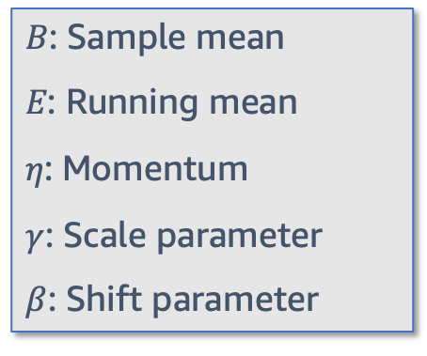
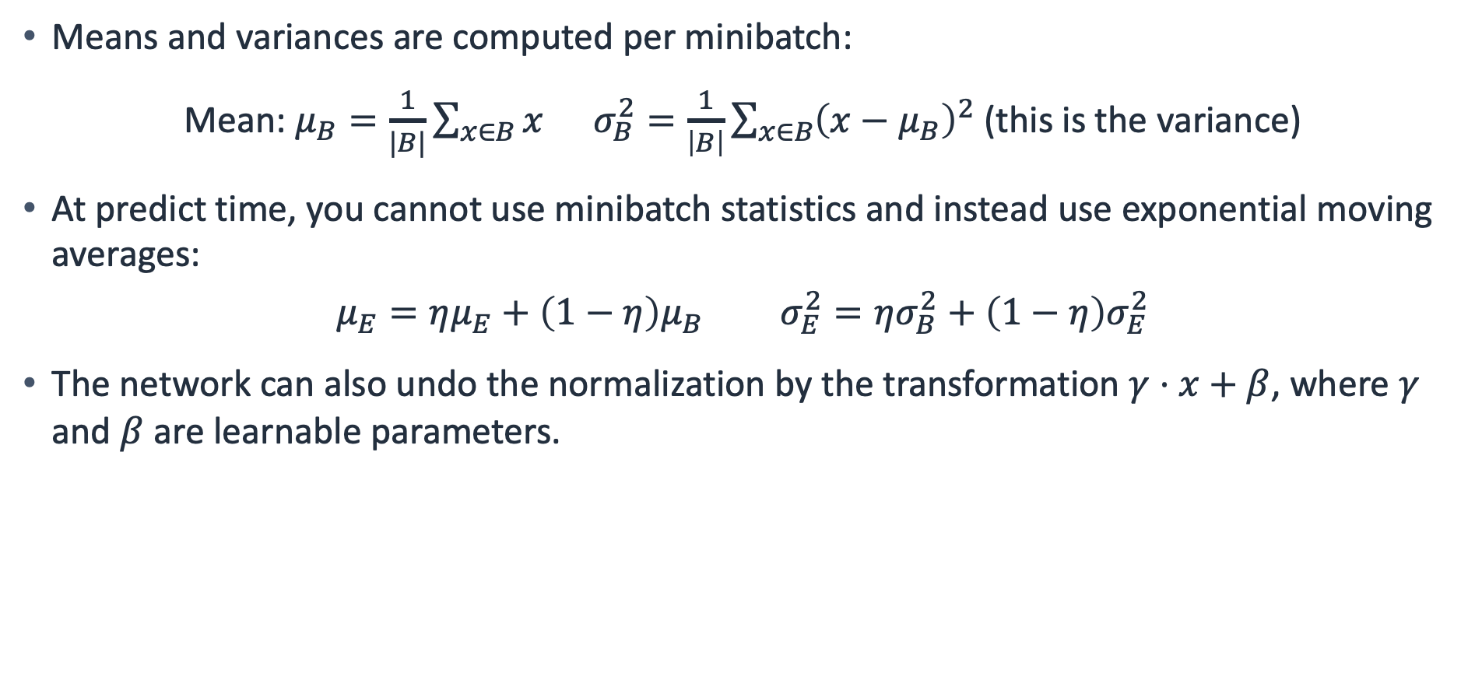
Batch normalization: Mean and variance
Means and variances are computed per minibatch:
Mean: $μ_{B}=\frac{1}{|B|}\sum_{x∈B}{x} σ_{B}^{2}=\frac{1}{\left|B\right|}\sum_{x∈B}{{\left(x−μ_{B}\right)}^{2}}$ (this is the variance)
At predict time, you cannot use minibatch statistics and instead use exponential moving averages:
$$μ_{E}=ημ_{E}+\left(1−η\right)μ_{B} σ_{E}^{2}=ησ_{B}^{2}+\left(1−η\right)σ_{E}^{2}$$
The network can also undo the normalization by the transformation $γ⋅x+β$, where $γ$ and $β$ are learnable parameters.
𝐵: Sample mean
𝐸: Running mean
𝜂: Momentum
$γ$: Scale parameter
$β$: Shift parameter
Notes:
~Equations
~
Note: The exponential moving averages are learned from training data.
Batch normalization is a technique that is used in deep learning to improve the training. The technique normalizes the output of each layer so that it has zero mean and unit variance. This makes it easier for the network to learn and leads to faster, more stable training.
Normalization is done by computing the mean and variance of the inputs over a batch of training examples, and then normalizing the inputs by using these statistics.
Batch normalization also includes two learnable parameters, scale and shift, which allow the network to learn the optimal scaling and shifting of the normalized inputs.

Slide 27
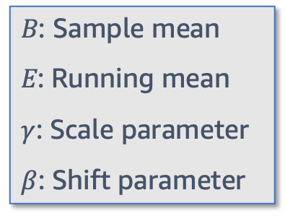
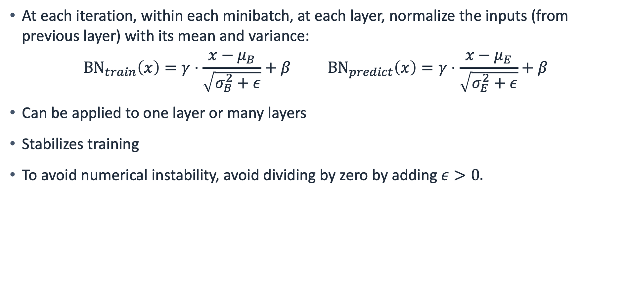
Applying batch normalization
At each iteration, within each minibatch, at each layer, normalize the inputs (from previous layer) with its mean and variance:
$${BN}_{train}\left(x\right)=γ⋅\frac{x−μ_{B}}{\sqrt{σ_{B}^{2}+ε}}+β {BN}_{predict}\left(x\right)=γ⋅\frac{x−μ_{E}}{\sqrt{σ_{E}^{2}+ε}}+β$$
Can be applied to one layer or many layers
Stabilizes training
To avoid numerical instability, avoid dividing by zero by adding $ε>0.$
𝐵: Sample mean
𝐸: Running mean
$γ$: Scale parameter
$β$: Shift parameter
Notes:
~Equations
~
Normalization is applied by subtracting the sample mean and dividing by the sample standard deviation. In the example on the slide, the sample is one batch. Scale and shift parameters are learned through the training process. These parameters allow the network to adjust the scale and mean of the normalization.
After applying standardization, the resulting minibatch has zero mean and unit variance. The choice of unit variance (compared to some other magic number) is an arbitrary choice. Recover this degree of freedom by including an elementwise scale parameter γ and shift parameter β. Both are parameters that need to be learned as part of model training.
Batch normalization typically behaves differently in training mode and prediction mode. First, the noise in the sample mean and the sample variance that arises from estimating each on minibatches isn’t desirable after the model is trained. Second, you might not have the luxury of computing per-batch normalization statistics. For example, you might apply the model to make one prediction at a time.
Typically, after training, you will use the entire dataset to compute stable estimates of the variable statistics and then fix them at prediction time. Consequently, batch normalization behaves differently during training and at test time. Recall that dropout also exhibits this characteristic.

Slide 28
Implementation
def batch_norm(X, gamma, beta, moving_mean, moving_var, eps, momentum):
if not torch.grad.is_enabled():
# If it is prediction mode, directly use mean and variance
# obtained by moving averages
X_hat = (X - moving_mean) / torch.sqrt(moving_var + eps
else:
# Calculate the mean and variance on the feature dimension
mean = X.mean(dim=0)
var = ((X - mean) ** 2).mean(dim=0)
# In training mode, the current mean and variance
X_hat = (X - mean) / torch.sqrt(var + eps)
# Update the mean and variance of the moving average
moving_mean = momentum * moving_mean + (1.0 - momentum) * mean
moving_var = momentum * moving_var + (1.0 - momentum) * var
Y = gamma * X_hat + beta # Scale and shift
return Y, moving_mean.data, moving_var.data
Notes:
To implement batch normalization from scratch, use the code that is provided on the slide.

Slide 29
Implementation with nn.Linear
class Residual(nn.Block):
def __init__(self, input_size, hidden_size, **kwargs):
super(Residual, self).__init__(**kwargs)
self.dense1 = nn.Linear(input_size, hidden_size)
self.dense2 = nn.Linear(hidden_size, hidden_size)
def forward(self, X):
return X + self.dense2(F.relu(self.dense1(X)))
Notes:
The residual class has two fully connected layers (self.dense1 and self.dense2) with rectified linear unit (ReLu) activation functions and adds the input tensor x to the output tensor of the residual layer.
The forward method takes a tensor as input and returns the output of the residual layer.

Slide 30
Implementation with BatchNorm
This can be extended with more complex layers, like this example that includes batch normalization:
class Residual(nn.Block):
def __init__(self, hidden_size, **kwargs):
super(Residual, self).__init__(**kwargs)
self.dense1 = nn.Linear(input_size, hidden_size)
self.dense2 = nn.Linear(hidden_size, hidden_size)
self.bn1 = nn.BatchNorm1d(hidden_size)
self.bn2 = nn.BatchNorm1d(hidden_size)
def forward(self, X):
return X + self.bn2(self.dense2(F.relu(self.bn1(self.dense1(X)))))
Notes:
The residual block has two 3×3 convolutional layers with the same number of output channels. Each convolutional layer is followed by a batch normalization layer and a ReLU activation function. Then, the two convolution operations are skipped, and the input is added directly before the final ReLU activation function. This kind of design requires that the output of the two convolutional layers is the same shape as the input so that they can be added together. If changing the number of channels is needed, introduce an additional 1×1 convolutional layer to transform the input into the desired shape for the addition operation.

Slide 31
Pros and cons of batch normalization
Pros
Improves training speed
Improves generalization
Reduces vanishing and exploding gradients
Cons
Increases memory usage
Depends on batch size
Slows inference time
Notes:
Pros
Improves training speed: Batch normalization can speed up the training of deep neural networks by reducing the effect of internal covariate shift and improving the flow of gradients during backpropagation.
Improves generalization: By reducing the sensitivity of the network to small changes in the input, batch normalization can help to prevent overfitting and improve the generalization of the network to new data.
Reduces vanishing and exploding gradients: Batch normalization can help to reduce the occurrence of vanishing and exploding gradients, which can make it difficult for deep neural networks to learn.
Cons
Increases memory usage: Batch normalization requires storing additional statistics for each layer during training, which can increase the memory usage of the network.
Dependency on batch size: Batch normalization statistics are computed over a batch of training examples, so the performance of batch normalization can be affected by the batch size that is used during training.
Slower inference: During inference, batch normalization requires computing the statistics over the entire test set, which can be slower than computing the output of each layer directly.

Slide 32

Next lesson
You will learn about modern architectures.

Slide 34
Image source slide (for curriculum development use only)

Slide 35
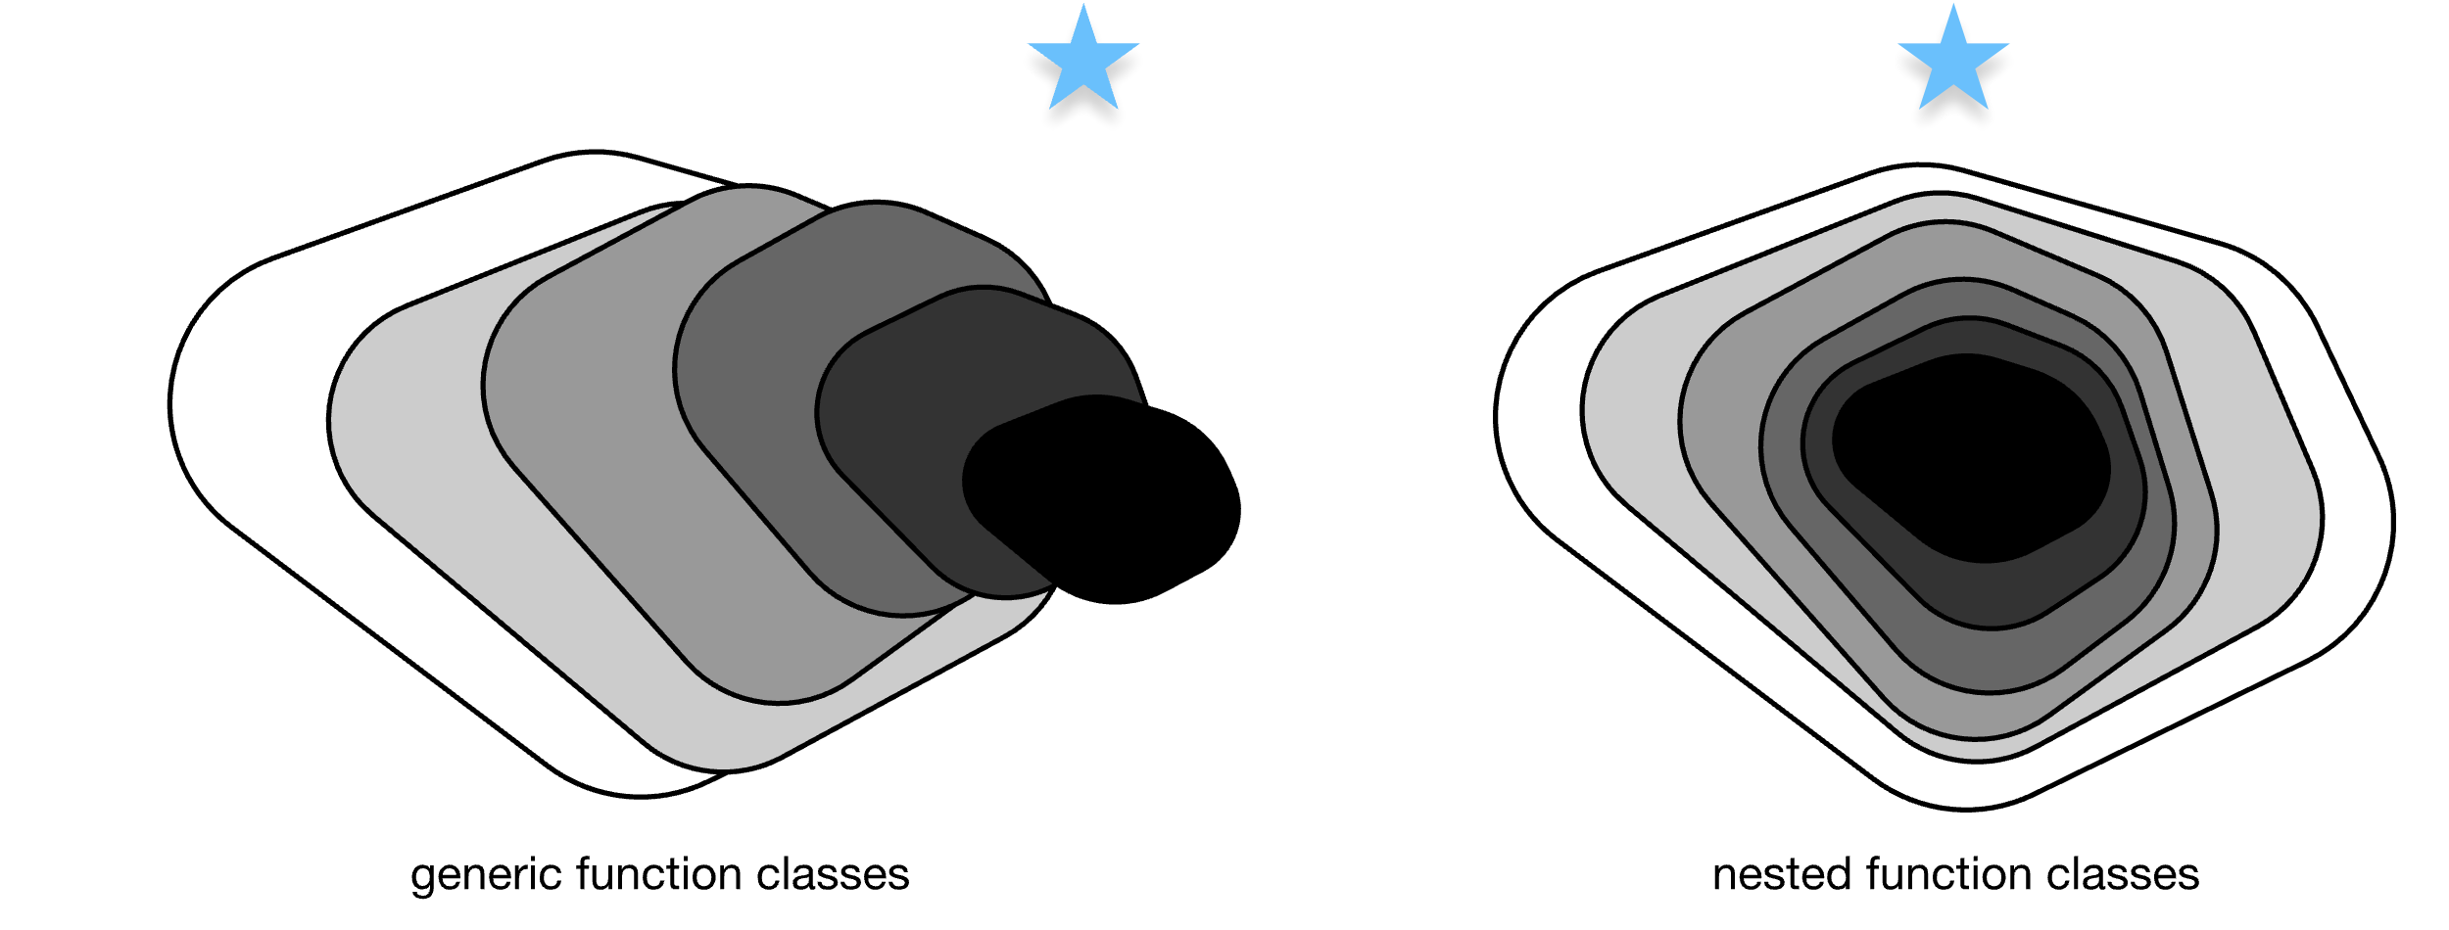



Source graphic: Schematic of function spaces: Residuals
$$f^{∗}$$
$𝓕_{3}$ is closer to 𝑓∗ than $𝓕_{1}$
$$𝓕_{6}$$

Slide 36
Source graphic: Schematic of function spaces: Nonresiduals
x
x
By adding a layer, the new class of functions doesn’t contain the original one.
F₁
F₂
Layer 1
Layer 1
F₁
F₁
F₂
Layer 2
Layer 2
F₁
This class of functions represents this architecture.
Layer N
Layer N
f*(x)
Layer N + 1
This is how the input is mapped in the original neural network.
f*(x)
Notes:
~Source for slide 8

Slide 37
Source graphic: Schematic of function spaces: Residuals
x
F₂
F₁
F₂
Layer 1
F₁
Layer 2
Layer N
Layer N + 1
x
f*(x) + x
Notes:
~Source for slide 9

Slide 38


Source graphic: Residual layers: Creating nested function families
Best network isn’t the largest
Best network is the largest
Increase $K$
Increase $K$
Notes:
~Source for slide 10

