Slide 1
Modern Architectures
Application of Deep Learning to Text and Image Data
Module 3 – Lesson 5

Slide 2
Today’s activities
Modern convolutional neural networks (CNNs)
LeNet review
AlexNet
ResNet review
ConvNeXt

Slide 3
Modern CNNs

Slide 4
Some important CNNs
CNNs for image classification tasks:
LeNet (1998)
AlexNet (2012)
ResNet (2015)
ConvNeXt (2022)
This lesson will examine each of these architectures.
Notes:
References:
Yann LeCun, Léon Bottou, Yoshua Bengio, and Patrick Haffner. “Gradient-Based Learning Applied to Document Recognition.” Proceedings of the IEEE 86, issue 11. (November 1998). https://doi.org/10.1109/5.726791.
Alex Krizhevsky, Ilya Sutskever, and Geoffrey E. Hinton. “ImageNet Classification with Deep Convolutional Neural Networks.” Advances in Neural Information Processing Systems (NIPS) 25, no. 2. (January 2012). http://dx.doi.org/10.1145/3065386.
Karen Simonyan and Andrew Zisserman. “Very Deep Convolutional Networks for Large-Scale Image Recognition.” Paper presented at the International Conference on Learning Representations (ICLR). (2015). https://doi.org/10.48550/arXiv.1409.1556.
Kaiming He, Xiangyu Zhang, Shaoqing Ren, and Jian Sun. “Deep Residual Learning for Image Recognition.” Paper presented at the 2016 IEEE Conference on Computer Vision and Pattern Recognition (CVPR), Las Vegas, NV, June 2016. https://doi.org/10.1109/CVPR.2016.90.

Slide 5
Modern CNNs (1 of 2)
Deep neural networks usually require a lot of data to outperform classical ML methods.
Before 2009, most benchmark datasets were small, with only hundreds to thousands of samples.
In 2009, the ImageNet image classification dataset was released.
Notes:
Deep neural networks usually require a lot of data to outperform classical ML methods. Before 2009, most benchmark datasets were small, with only a few thousand samples or less. In 2009, the ImageNet Image Classification dataset was released. For more information, see https://image-net.org.
Before the development of LeNet, several convolutional neural network (CNN) architectures were proposed for image processing, but they weren’t as successful as LeNet in achieving high accuracy in image recognition tasks. These early CNN architectures include the following:
Neocognitron: Kunihiko Fukushima proposed this neural network in in 1980. The neocognitron is considered one of the first neural networks to use a convolutional layer. The network was used for character-recognition tasks, and its architecture inspired later CNNs.
Convolutional pyramid network: Yann LeCun proposed this network in 1989, and it was used to recognize handwritten digits. The convolutional pyramid network was one of the earliest CNN architectures to use backpropagation for training.
LeNet-1: Yann LeCun proposed this neural network in 1990, and it was used to recognize handwritten digits. LeNet-1 had a simple architecture compared to later CNNs, but it was the first successful CNN to achieve high accuracy in image-recognition tasks.
LeNet-4: Yann LeCun proposed this more advanced version of LeNet-1 in 1998. LeNet-4 had more layers and was used to recognize handwritten characters and digits.
While these early CNN architectures weren’t as successful as later CNNs, they laid the foundation for the development of modern CNNs. The early CNNs introduced the concepts of convolutional layers, pooling layers, and backpropagation, which are essential components of modern CNNs.

Slide 6
Modern CNNs (2 of 2)
ImageNet image classification dataset:
1 million images
1,000 classes with 1,000 images from each class
Used Google Image Search to prefilter large candidate sets
Employed Amazon Mechanical Turk to confirm categories
Unprecedented scale
ImageNet Large Scale Visual Recognition Challenge (ILSVRC)
Notes:
The ImageNet dataset is a large-scale image classification dataset that has been widely used in computer vision (CV) research. The dataset consists of more than 1 million labelled images, and each image belongs to one of 1,000 object categories.
Researchers at Princeton University and Stanford University created the dataset in 2009. The researchers, led by Fei-Fei Li, used Google Image Search to prefilter large candidate sets for each category. They also employed the Amazon Mechanical Turk crowdsourcing pipeline to confirm whether each image belonged to the associated category. The scale of this process was unprecedented at the time, and it required significant computational resources to process and store the large dataset.
The ImageNet dataset has played a crucial role in advancing the field of CV, particularly in the development of deep learning algorithms, such as CNNs. In 2012, a team of researchers from the University of Toronto used a CNN architecture called AlexNet to achieve a significant breakthrough in image recognition accuracy. The team won the ImageNet Large Scale Visual Recognition Challenge (ILSVRC) with a top-5 error rate of 15.3 percent, which was significantly better than the next best algorithm at the time.
Since then, the ImageNet dataset has been used as a benchmark to evaluate the performance of image-recognition algorithms. The dataset has been expanded to include other tasks, such as object detection, segmentation, and localization. The dataset and the ILSVRC challenge have also inspired the creation of other large-scale visual recognition datasets and challenges, such as Common Objects in Context (COCO), PASCAL Visual Object Classes (VOC), and Open Images.

Slide 7
LeNet review

Slide 8
LeNet (1 of 2)
Part 1: Convolution block
Convolution layer to recognize the spatial patterns
5×5 kernel with the sigmoid activation function
Average pooling layer to reduce the dimensionality
Part 2: Fully connected layers block
3 fully connected layers with 120, 84, and 10 outputs, respectively
Notes:
~Dev note: Slide is similar to one from module 3, lesson 3

Slide 9
LeNet (2 of 2)
Among the first published CNNs to capture wide attention for its performance on computer vision (CV) tasks
Attributed as the first real CNN:
Learns kernels (features) from the data
Doesn’t use handcrafted filters or keypoint detectors
Demonstrated to recognize handwritten digits in images
Represented a decade of research and development
Notes:
LeNet was among the first published CNNs to capture wide attention for its performance on CV tasks. The model was introduced by (and named for) Yann LeCun, a researcher at AT&T Bell Labs at the time. The model was used to recognize handwritten digits in images. This work represented the culmination of a decade of research to develop the technology.
In 1989, LeCun published the first study to successfully train CNNs through backpropagation.
References:
Y. LeCun, B. Boser, J. S. Denker, D. Henderson, R. E. Howard, W. Hubbard, and L. D. Jackel. “Backpropagation Applied to Handwritten Zip Code Recognition.” Neural Computation 1, issue 4. (December 1989). https://doi.org/10.1162/neco.1989.1.4.541.
Yann LeCun, Léon Bottou, Yoshua Bengio, and Patrick Haffner. “Gradient-Based Learning Applied to Document Recognition.” Proceedings of the IEEE 86, issue 11. (November 1998). https://doi.org/10.1109/5.726791.

Slide 10
AlexNet

Slide 11
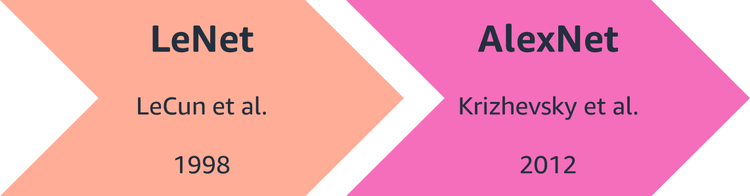
AlexNet (2012)
Its features are hierarchically composed with multiple learned layers, each with learnable parameters.
The model had excellent performance in the 2012 ImageNet challenge.
Representation is learned by the model.
It has about 60 million parameters.
Notes:
~Alt text: Timeline showing that LeCun et al. published the LeNet paper in 1998, and Krizhevsky et al. published the AlexNet paper in 2012.
~
AlexNet is a deeper CNN model that Alex Krizhevsky, Ilya Sutskever, and Geoffrey Hinton developed in 2012. It has a much deeper architecture with eight layers, including five convolutional layers and three fully connected layers.
In 2012, AlexNet became the first CNN model to win the ILSVRC, achieving a significant breakthrough in image-recognition accuracy. AlexNet was the only model to achieve an error rate of less than 25 percent. Following the competition, many researchers followed the deep CNN idea and have developed better-performing models year after year.
AlexNet also introduced several novel techniques that weren’t used in LeNet. These include the use of rectified linear unit (ReLU) activation functions, overlapping pooling, and data augmentation. These techniques, along with the larger architecture and dataset, contributed to the significant improvement in performance that AlexNet achieved.
LeNet and AlexNet were both significant contributions to the development of deep learning and CV. LeNet was an early pioneering work in the field of CNNs, while AlexNet represented a significant breakthrough in the field, with its larger architecture, innovative techniques, and use of a much larger dataset.

Slide 12
AlexNet: Architecture
Is an 8-layer convolutional architecture that is similar to LeNet
Is much deeper than LeNet networks
Has ten times more convolution channels than LeNet
Was originally trained on two GPUs with parameters split between them
Has an input resolution of 224x224
Notes:
For more information about the architecture of the AlexNet model, see “Deep Convolutional Neural Networks (AlexNet)” in Dive into Deep Learning at https://d2l.ai/chapter_convolutional-modern/alexnet.html.

Slide 13
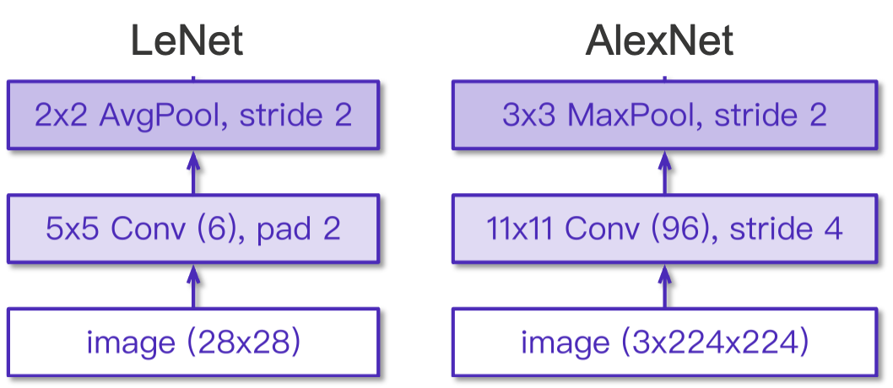
AlexNet: Pooling
Max pooling
Larger pooling size
Larger kernel size and stride because of the increased image size
More output channels
Notes:
~Alt text: Diagram of LeNet and AlexNet pooling differences, which are also described in the slide notes.
~
Compared to the LeNet architecture, which was designed to recognize small, handwritten digits, AlexNet was designed to handle much larger and more complex images. As a result, several changes were made to the architecture to improve its performance on this task.
One of the main changes was the use of max pooling instead of average pooling. Max pooling is a form of nonlinear downsampling that helps to reduce the spatial dimensions of the output feature maps. This helps to reduce the number of parameters in the model and can also help to prevent overfitting. Additionally, larger pooling sizes, such as 3x3, were used in AlexNet compared to LeNet, which used smaller pooling sizes, such as 2x2.
Another change was the use of larger kernel sizes, such as 11x11, in the first convolutional layer. This allowed the model to capture larger-scale features in the input images. In addition, the use of a stride of 4 in the first convolutional layer helped to reduce the spatial dimensions of the output feature maps, which reduced the computational cost of the subsequent layers.
AlexNet also had more output channels than LeNet, which allowed it to learn more complex representations of the input images.

Slide 14
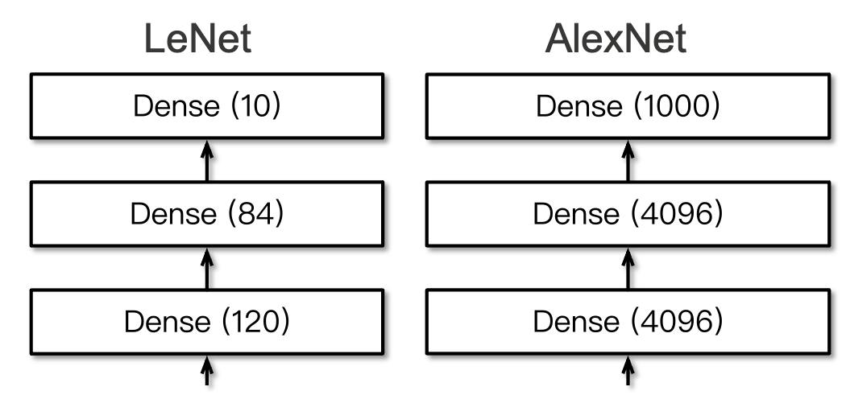
AlexNet: Output
1,000 classes output
Increased hidden size from 120 to 4096, with dropout
Notes:
~Alt text: Diagram of the fully connected layers in LeNet and AlexNet. See details in notes.
~
Image description: Diagram showing the fully connected layers of LeNet and AlexNet. LeNet has 3 fully connected layers with 120, 84, and 10 neurons for each layer. AlexNet has 3 fully connected layers with 4096, 4096, and 1000 neurons for each layer. End description.
AlexNet was trained for 1,000 classes, while LeNet was trained for 10 classes. AlexNet also used more units in the dense layers.

Slide 15
AlexNet: Learning representation
Two key factors were missing before 2012:
Data
Large amounts of data were required.
Datasets usually only had hundreds to a few thousand labelled images.
Images had been captured in unnatural settings with low resolution.
Hardware
Deep learning models need a lot of compute resources.
Training can take hundreds of epochs.
Each iteration requires passing data through many layers of computationally expensive linear algebra operations.
Notes:
The success of AlexNet was because of two key factors that were missing before 2012: data and hardware.
The availability of large amounts of data was a critical factor in the success of AlexNet. Prior to 2012, few large-scale image datasets were available to train deep neural networks. The ImageNet dataset, which was used to train AlexNet, contained over 1 million images with 1,000 object categories. This provided a much larger and more diverse training set than what had been available previously. By using the larger dataset, the model was able to learn more representative and robust features, which contributed to its improved performance.
Hardware was another critical factor in the success of AlexNet. Deep learning models require a significant amount of computational resources. Training can take hundreds of epochs, with each iteration requiring data to be passed through many layers of computationally expensive linear algebra operations. The development of graphical processing units (GPUs) provided a significant increase in compute power, which enabled faster and more efficient training of deep neural networks. AlexNet was trained on two GPUs, which allowed for the training time to be reduced significantly compared to previous deep learning models.

Slide 16
AlexNet: Summary
AlexNet is a larger and deeper LeNet architecture.
The paper was one of the most influential papers on computer vision (cited more than 60,000 times).
Dropout, rectified linear unit (ReLU), and preprocessing were key steps in achieving excellent performance.
A max pooling layer (works well with ReLU) was added between convolutional layers.

Slide 17
ResNet review

Slide 18
Motivation
Degradation: With the network depth increasing, loss rebounds
How to address degradation?
A deep residual learning framework: ResNet
Notes:
~Dev note: This slide is similar to one from module 3, lesson 4.
~
The degradation problem is believed to be caused by the vanishing gradient problem, where the gradients become too small to effectively update the parameters of the lower layers. This can make it difficult for the lower layers to learn useful representations and can ultimately result in a decrease in performance.
ResNet addresses this problem by introducing residual skip connections, which allow information to be directly passed between layers, bypassing some of the layers altogether. This means that even if the gradients become small, the information can still flow through the network and be used to update the parameters.
The motivation behind ResNet is to create deeper neural networks that can learn more complex representations without being hindered by the degradation problem. By introducing residual connections, ResNet has been able to achieve state-of-the-art results on a wide range of CV tasks.
The Xavier initialization (Glorot et al., 2010) and the He initialization (He et al., 2015) are some techniques to perform robust weight initialization, which mitigates degradation in deep neural networks.
References:
Xavier Glorot and Yoshua Bengio. “Understanding the Difficulty of Training Deep Feedforward Neural Networks.” Proceedings of Machine Learning Research 9: 249-256. (2010). https://proceedings.mlr.press/v9/glorot10a.html.
Kaiming He, Xiangyu Zhang, Shaoqing Ren, and Jian Sun. “Delving Deep into Rectifiers: Surpassing Human-Level Performance on ImageNet Classification.” Paper presented at the 2015 IEEE International Conference on Computer Vision (ICCV), Santiago, Chile, December 2015. https://doi.org/10.1109/ICCV.2015.123.

Slide 19
ResNet
Implements the identity function
Provides the ability to design networks where adding layers makes networks strictly more expressive rather than just different
Uses connections between layers
Allows skip connections to build deeper networks
Uses two pooling layers for dimensionality reduction
Uses batch normalization for capacity control

Slide 20
ConvNeXt

Slide 21
ConvNeXt (2022)
Was released in March 2022
Was created in response to the recent success of transformer models in vision problems
Considers some recent advancements from both vision-based transformers and CNNs, and applies them to improve recent CNN architectures, such as ResNet
Notes:
Introduced in late 2018, transformers completely revolutionized the natural language processing (NLP) field. Their success in NLP also made them popular architecture choices for other areas, including CV. Vision transformers aren’t covered in this class.
ConvNeXt is a popular CNN model that combines ideas from multiple recent developments in vision-based transformers and other recent CNNs. This model isn’t a transformer-based model. It uses traditional CNN modules that have been updated based on recent developments in CV.
Reference: Zhuang Liu, Hanzi Mao, Chao-Yuan Wu, Christoph Feichtenhofer, Trevor Darrell, and Saining Xie. “A ConvNet for the 2020s.” Paper presented at the 2022 IEEE/CVF Conference on Computer Vision and Pattern Recognition (CVPR), New Orleans, LA, June 2022. https://doi.org/10.1109/CVPR52688.2022.01167.

Slide 22
Spatial resolution of the input images
Is the number of pixels in the image, along with its width and height dimensions
Determines the level of detail and sharpness that can be seen in the image
Can vary depending on the application and dataset that are used
Notes:
Spatial resolution determines the level of detail and sharpness that can be seen in an image. For example, an image with a spatial resolution of 1280x720, which is 1280 pixels wide and 720 pixels high, has more pixels and higher resolution than an image with a spatial resolution of 640x480, which is 640 pixels wide and 480 pixels high.
The spatial resolution of input images can vary depending on the application and dataset that are used. For example, in the case of image classification tasks that use the CIFAR-10 dataset, the input images have a spatial resolution of 32x32 pixels. However, in the case of image classification tasks that use the ImageNet dataset, the input images have a spatial resolution of 224x224 pixels.

Slide 23
Nonoverlapping convolutions
Generally, the first set of convolutions are responsible for reducing the spatial resolution of the input images.
ResNet uses a 7x7 convolution with stride 2 and max pool afterward at the beginning. This shrinks the height and width to one-fourth of the original size.
Recent transformer models achieved success by applying convolutions in a nonoverlapping way—partitioning the input image into separate patches.
Notes:
ConvNeXt uses nonoverlapping convolutions to reduce the spatial resolution of feature maps.

Slide 24
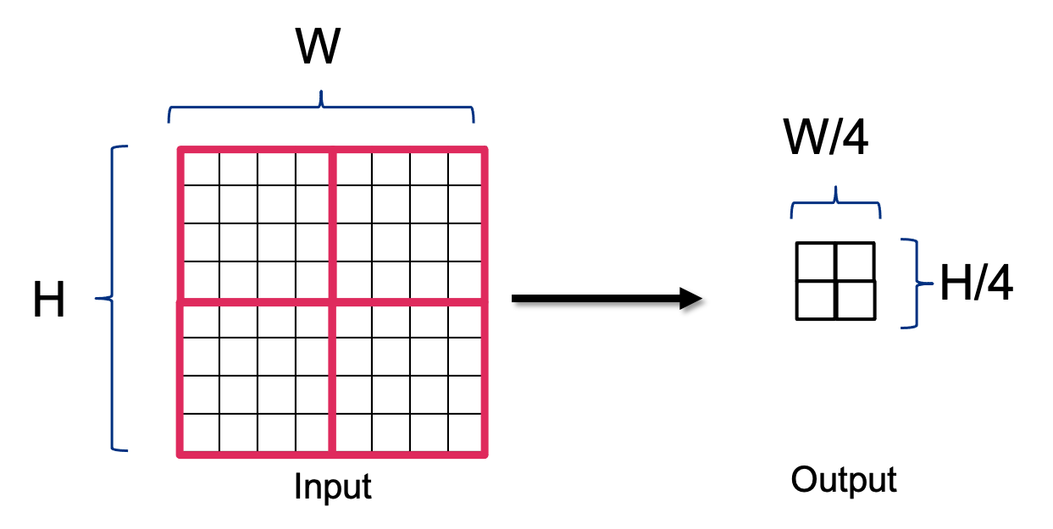
ConvNeXt and nonoverlapping convolutions
ConvNeXt follows this idea with 4x4 convolutions and stride 4.
This uses a smaller number of weights (4x4 compared to 7x7 kernel) and is computationally more efficient.
Notes:
~Alt text: Figure of nonoverlapping convolution. See details in notes.
~
Image description: Figure showing nonoverlapping convolution. An 8x8 input turns into a 2x2 output after the convolution. A 4X4 convolution with stride 4 reduces the output to one-fourth of the original size. End description.
Benefits of the nonoverlapping convolution:
4x4 saves some weights compared to 7x7 convolutions of ResNet.
Stride 4 is more efficient than stride 2, and the convolution operation is applied fewer times.

Slide 25
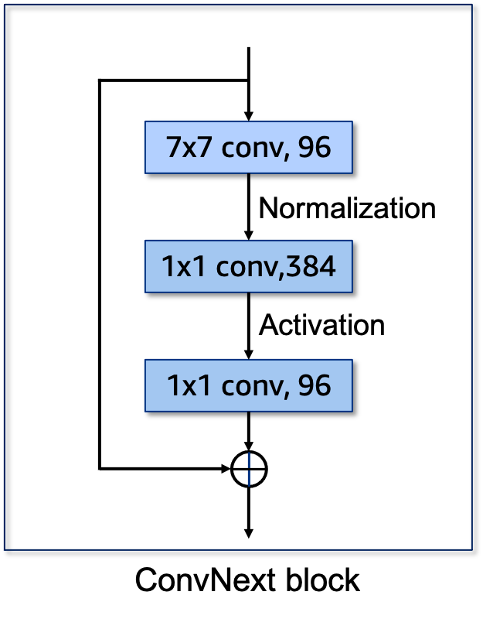
ConvNeXt block
Each block consists of one 7x7 and two 1x1 convolutions with a residual connection.
Depth-wise convolution: A 7x7 convolution is applied to each input channel separately. This avoids channel and spatial mixing.
In contrast to traditional CNN designs, fewer activations are used in the blocks (only between the 1x1 convolution).
1x1 convolutions control the number of channels.
Notes:
~Alt text: ConvNeXt block made of one 7x7 convolution and two 1x1 convolutions with a residual connection.

Slide 26
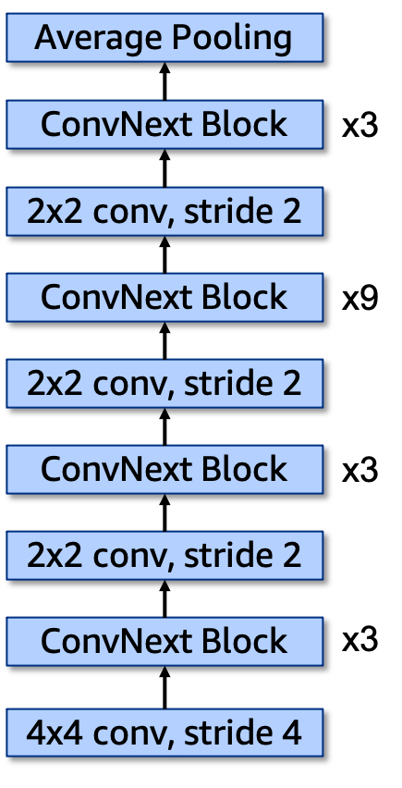
ConvNeXt architecture
ConvNeXt comes in multiple sizes: tiny, small, base, and large.
ConvNeXt – tiny is shown on the slide:
ConvNeXt blocks are repeated multiple times: 3 and 9 here.
The first 4x4 convolution with stride 4 and the following 2x2 convolution with stride 2 are nonoverlapping convolutions to reduce feature map resolutions.
Notes:
~Alt text: Diagram of the ConvNeXt – tiny architecture. See details in notes.
~
Image description: A ConvNeXt model has multiple blocks connected in series. The layers from start to finish are a 4x4 convolution layer, a ConvNeXt block repeated 3 times, a 2x2 convolution layer, a ConvNeXt block repeated 3 times, a 2x2 convolution layer, a ConvNeXt block repeated 9 times, a 2x2 convolution layer, a ConvNeXt block repeated 3 times, and an average pooling layer. End description.

Slide 27
Model comparisons
This table shows how the covered models compare with each other on the ImageNet 1k dataset.
Model Name | Number of Weights (Million) | Top-5 Test Accuracy (Percent)
AlexNet | 61.1 | 79.1
ResNet 50 | 25.6 | 94.8
ResNet 101 | 44.5 | 95.4
ResNet 152 | 60.2 | 95.5
ConvNeXt – tiny | 28.6 | 96.1
ConvNeXt – small | 50.2 | 96.7
ConvNeXt – base | 88.6 | 96.9
ConvNeXt – large | 197.8 | 97.0
Notes:
Let’s compare the models that have been covered so far. From one architecture to the next, a lot of progress occurs in terms of the reduction in the number of weights that are used to achieve the same or better performance.
The top-5 test accuracy scores are reported on the ImageNet 1K dataset (test split). Top-5 accuracy is measured by comparing the labels of the images with the top 5 predictions from the models.

Slide 28

Next lesson
You will learn about fine-tuning and transfer learning.

Slide 30
Image source slide (for curriculum development use only)

Slide 31
Source graphic: AlexNet (2012)
LeNet
LeCun et al.
1998
AlexNet
Krizhevsky et al.
2012
Notes:
~Source for slide 11

Slide 32
Source graphic: Nonoverlapping convolutions
W
W/4
H
H/4
Input
Output
Notes:
~Source for slide 24

Slide 33
Source graphic: ConvNeXt block
7x7 conv, 96
Normalization
1x1 conv,384
Activation
1x1 conv, 96
ConvNeXt block
Notes:
~Source for slide 25

Slide 34
Source graphic: ConvNeXt architecture
4x4 conv, stride 4
ConvNeXt Block
2x2 conv, stride 2
ConvNeXt Block
2x2 conv, stride 2
ConvNeXt Block
2x2 conv, stride 2
ConvNeXt Block
Average Pooling
x3
x3
x9
x3
Notes:
~Source for slide 26

