Slide 1
Transfer Learning
Application of Deep Learning to Text and Image Data
Module 3 – Lesson 6

Slide 2
Today’s activities
Introduction to transfer learning
Advantages of transfer learning
Steps of transfer learning
Using pretrained models

Slide 3
Introduction to transfer learning
Transfer learning is a popular process to transfer the knowledge that is learned while solving one problem to a new problem.
The process has two main datasets:
Source dataset: The original dataset that is used to train the model
Target dataset: The dataset that corresponds to the new problem
Typically, the source dataset is larger (or more general) than the target dataset.
Notes:
The transfer learning process is also commonly called fine-tuning because the model is tuned and repurposed to solve a different problem.
The next slide shows an example of how the source and target datasets are used in this process.

Slide 4
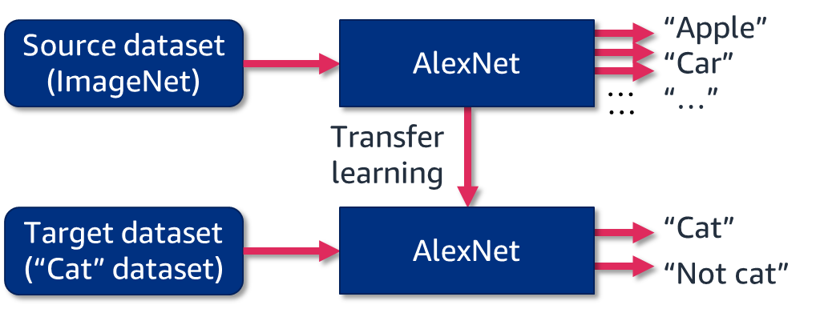
Transfer learning example: Train a “cat” classifier
Take a convolutional neural network (CNN), such as AlexNet, that was previously trained on the ImageNet dataset (1.3 million images with 1,000 classes).
Keep its weights and retrain it with a source dataset (10,000 images with 2 classes) to classify images to “cat” or “not cat” categories.
Notes:
~Alt text: Figure of transfer learning. See notes for description.
~
Image description: Figure of transfer learning. First, an AlexNet model is trained with the source dataset. This creates a pretrained model. Then, this pretrained model is trained on the target dataset. End description.
This example of transfer learning uses an AlexNet model that was previously trained on the ImageNet dataset and retrains it on a target dataset. The source dataset has 1,000 classes, whereas the target dataset has 2. The model’s output layer is changed to have a shape of two to make this work.
The steps in transfer learning will be described in more detail later in this lesson.

Slide 5
Transfer learning: Advantages (1 of 2)
It’s efficient:
Knowledge transfer happens through the reuse of weights and the model architecture that came from training on the source dataset.
Training from scratch on large source datasets is expensive and takes a long time.
Download a pretrained model as the starting point. Many of these models are publicly available.
Notes:
Transfer learning is efficient. The original weights that are learned from the source dataset are used as a starting point.

Slide 6
Transfer learning: Advantages (2 of 2)
It creates high-quality models:
The models that were previously trained on a large source dataset tend to learn universal feature representations well.
The universal representations are:
General features, such as the overall shapes and edges of objects in the images
Good starting points to learn specific problems
With transfer learning, the new model uses this knowledge and learns the target dataset.
Notes:
Transfer learning produces high-quality models. The models that are trained on large source datasets learn universal feature representations well. These models learn how to handle many images from many categories. These learned universal representations are passed to the model that is trained with the target dataset through the use of the weights.

Slide 7
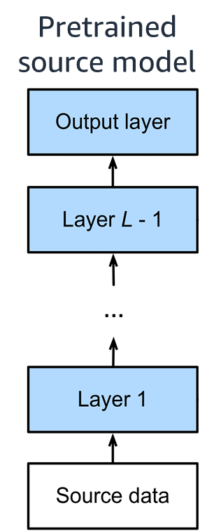
Transfer learning: Step one
Get a pretrained model (or pretrain it on the source dataset).
Notes:
~Alt text: Multilayer network that is pretrained on a source dataset.
~
The transfer learning process has four main steps.
The first step is to get a pretrained model. Many pretrained models are available to download.
Reference: Aston Zhang, Zack C. Lipton, Mu Li, and Alex J. Smola. “Fine-Tuning.” Chapter 14.2 in Dive into Deep Learning. 2021. https://d2l.ai.

Slide 8
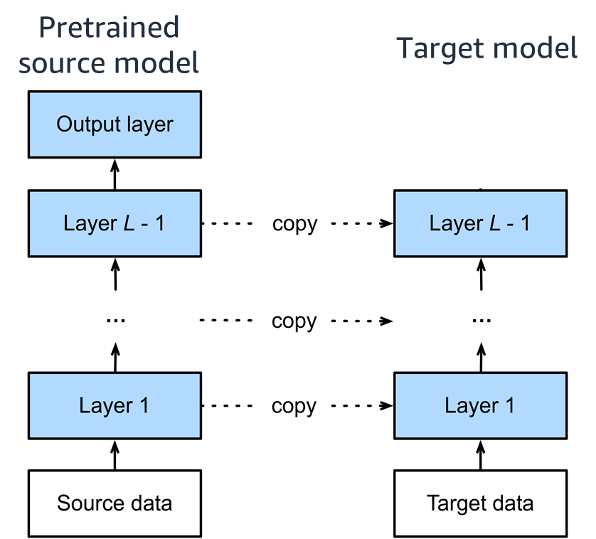
Transfer learning: Step two
Create a target neural network architecture and copy the trained parameters.
Notes:
~Alt text: Figure to demonstrate this step. See details in notes.
~
Image description: Figure of a model that is pretrained on the source dataset and a target model. The weights from the layers—except the output layer—of the source model are copied to the target model. End description.
The second step is to create a target network and copy the trained parameters.

Slide 9
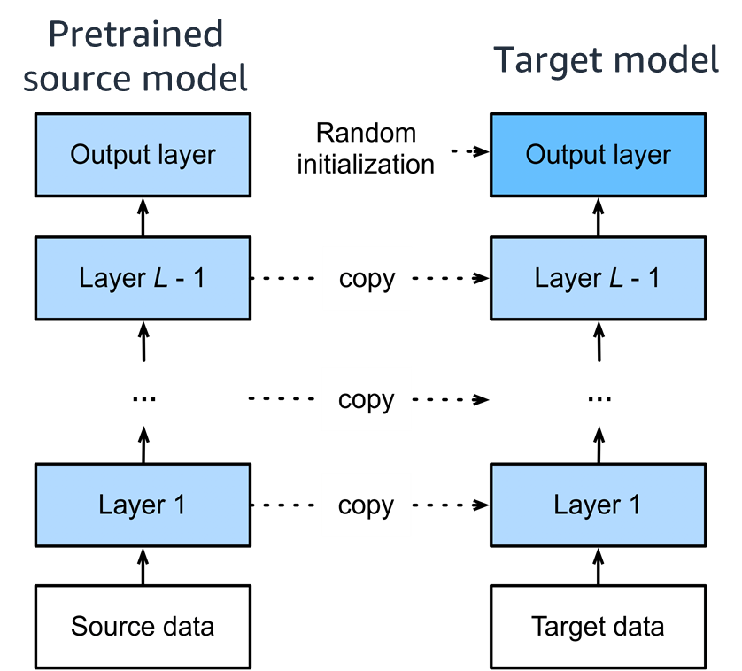
Transfer learning: Step three
Create and randomly initialize the output layer.
Notes:
~alt text: Figure to demonstrate this step. See details in notes.
~
Image description: Figure from the previous slide with the target model’s output layer added. The figure now has two complete networks. The target model’s output layer is randomly initialized. End description.
The third step is to create and randomly initialize the output layer.
Example: Recall the “cat” classifier example. The original model has 1,000 classes, which means it will have 1,000 outputs. The target problem has only two classes. In this step, the last layer is initialized as an output layer with two outputs.

Slide 10
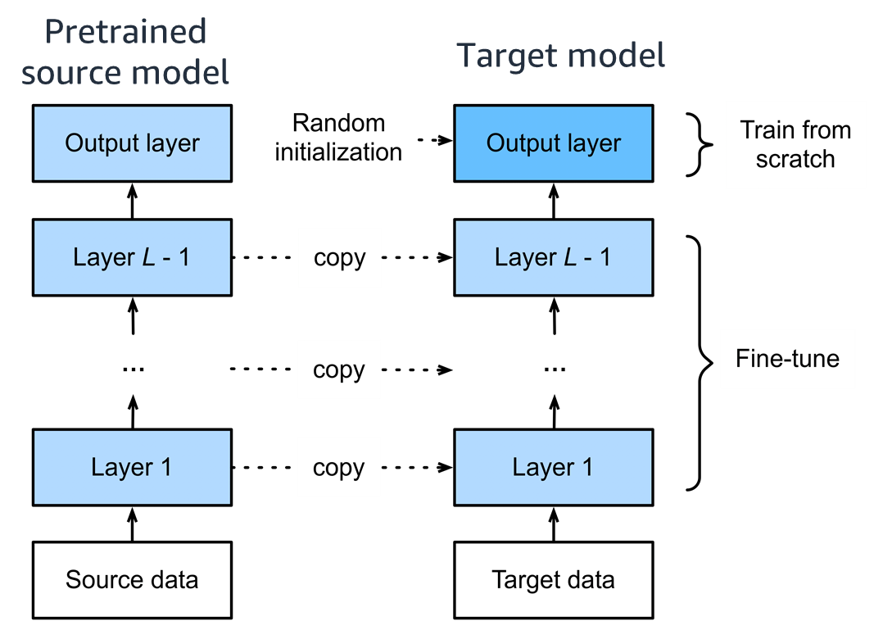
Transfer learning: Step four
Train from scratch (output) and fine-tune (the rest).
Notes:
~alt text: Figure to demonstrate this step. See details in notes.
~
Image description: The last layer starts with random weights (train from scratch), and the other layers start from the weights from the pretrained model (fine-tune). End description.
The fourth step is to train the network. The weights of each layer of the pretrained network, excluding the output layer, are copied into the target model weights. The hidden layers of the target model are now identical to the hidden layers of the pretrained source model. The weights of the output layer of the target model are initialized randomly (or using a form of weight initialization). The target model is now trained on the target dataset. During training, the weights of the output layer are trained from scratch, and the pretrained weights in the hidden layers are fine-tuned to specialize to the dataset.

Slide 11
Review: Transfer learning steps
Get a pretrained model (or pretrain it on the source dataset).
Create a target neural network architecture and copy the trained parameters.
Create and randomly initialize the output layer.
Train from scratch (output) and fine-tune (the rest).

Slide 12
Transfer learning: Best practices
Train (or fine-tune) with strong regularization:
Smaller learning rate
Fewer epochs
Use a more diverse source dataset.
Know what pretrained models to use.
Notes:
Usually, training under transfer learning conditions is done with strong regularization, such as a smaller learning rate and fewer epochs.
The more samples that are in the source dataset, the better it can prepare the model for different use cases.
It’s important to be familiar with the pretrained models that are available because they each have different properties.

Slide 13
Torchvision models
Pretraining is expensive. Pretrained models are available to download and use.
The torchvision package contains pretrained computer vision (CV) models for the following tasks:
Image classification
Object detection
Semantic segmentation
Notes:
Pretraining is usually expensive. A common practice is to download a previously trained model and use it for transfer learning.
The torchvision package provides pretrained models for different computer vision (CV) problems. For more information, see “Torchvision” in the PyTorch documentation at https://pytorch.org/vision/stable/index.html.

Slide 14
Examples of pretrained torchvision models
This table compares the performance of some pretrained models on the ImageNet dataset.
Model Name | Number of Weights (Million) | Top 5 Accuracy (Percent)
AlexNet | 61.1 | 79.1
ResNet 50-v1 (v2) | 25.6 | 92.9 (95.4)
ResNet 101-v1 (v2) | 44.5 | 93.5 (95.8)
ResNet 152-v1 (v2) | 60.2 | 94.0 (96.0)
ConvNeXt – tiny | 28.6 | 96.1
ConvNeXt – small | 50.2 | 96.7
ConvNeXt – base | 88.6 | 96.9
ConvNeXt – large | 197.8 | 97.0
Notes:
This data is from “Models and Pre-trained Weights” in the PyTorch documentation at https://pytorch.org/vision/stable/models.html.

Slide 15
Using pretrained models
You can use a pretrained model in multiple ways (ordered from least costly to most costly):
Using as a fixed pretrained model (no training)
Training only the last layer (in other words, freezing the other pretrained feature layers)
Fine-tuning the layers end to end (retrain all layers)
Training from scratch using the target dataset

Slide 16
Notes:
Some images in the course were reproduced from work created and shared by D2L, https://d2l.ai, and used according to terms described in the Creative Commons 4.0 Attribution License.

Slide 17
Image source slide (for curriculum development use only)

Slide 18
Source graphic: Transfer Learning - example
Source dataset (ImageNet)
AlexNet
“Apple”
“Car”
…
“…”
…
Transfer learning
Target dataset (“Cat” dataset)
AlexNet
“Cat”
“Not cat”
Notes:
~Source for slide 4

Slide 19
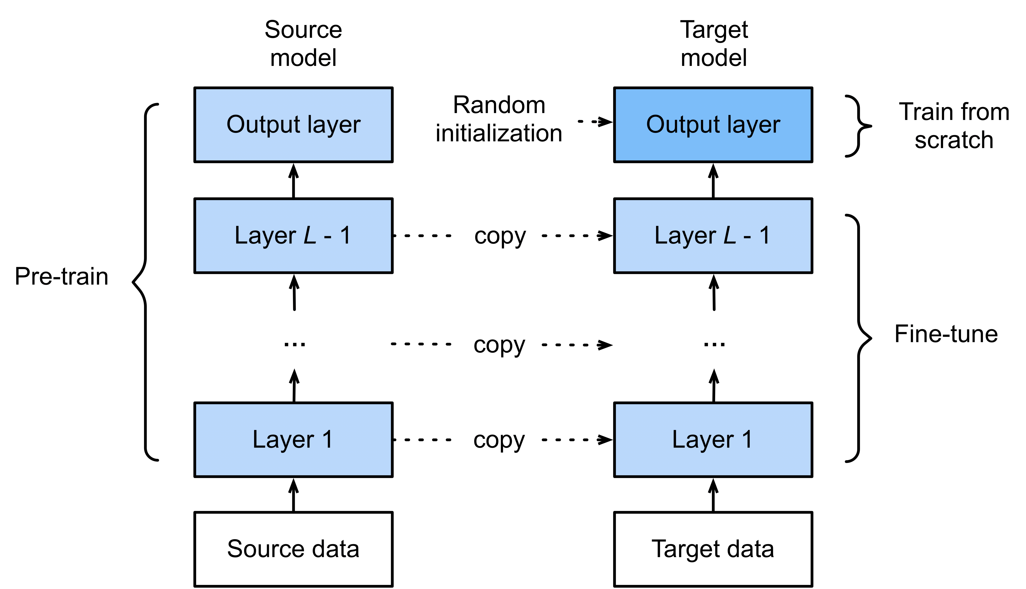
Source graphic: Transfer learning – four main steps
Pretrained source model
Notes:
~Source for slide 7

Slide 20
Source graphic: Transfer learning – four main steps
Pretrained source model
Target model
Notes:
~source for slide 8

Slide 21
Source graphic: Transfer learning – four main steps
Pretrained source model
Target model
Notes:
~source for slide 9

Slide 22
Source graphic: Transfer learning – four main steps
Pretrained source model
Target model
Notes:
~Source for slide 10

