Slide 1
Ensembling
Machine Learning through Application
Module 2 – Lesson 6

Slide 2
Today’s activities
Combining models to make a better model
Ensemble learning methods
Sampling with replacement (bagging)
Boosting
Stacking

Slide 3
Combining models to make a better model

Slide 4
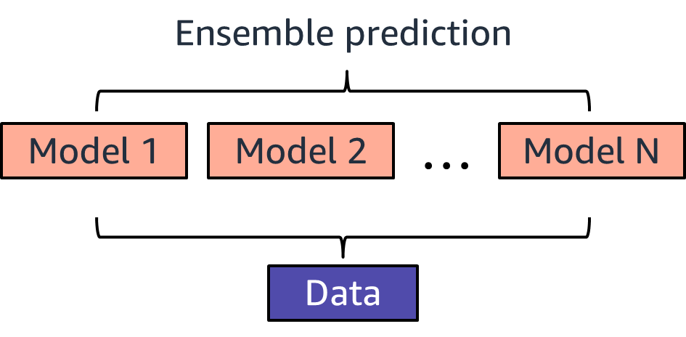
Ensemble methods
Create a model by combining the predictions of multiple models (base estimators, such as a decision tree).
Notes:
~Alt text: Diagram to show how an ensemble is a combination of N weak learners.
~
The goal of ensemble methods is to combine the predictions of several weak models for a single dataset to improve over a single model. Ensembling works by taking a particular ML problem and dataset, choosing an algorithm (for example, a decision tree), and making a model. When the model predictions do not meet the requirements, you decide to build more models by using the same dataset and combining the models to get better predictions.

Slide 5
Advantages of ensemble learning
Advantages:
Many are better than a few (an ensemble prediction averages out the instability of individual models).
Models that learn differently can boost accuracy, even if they are not great individually.

Slide 6
Disadvantages of ensemble learning
Disadvantages:
Takes longer to train (each model learns separately)
Requires more resources (compute and time)
Is difficult to interpret
Notes:
Disadvantages:
Instead of training a single model, ensembling results in multiple models being trained. Some of these training jobs can be parallelized depending on the ensemble technique that is used.
Ensemble methods result in longer training jobs or multiple training jobs, which increases compute resources and cost.
Multiple models make it challenging to interpret. Ensemble models comprise several models. Even though a decision tree or random forest is fairly interpretable on its own, they do not have the same level of interpretability after ensembling.

Slide 7
Ensemble learning method 1: Sampling with replacement (bagging)

Slide 8
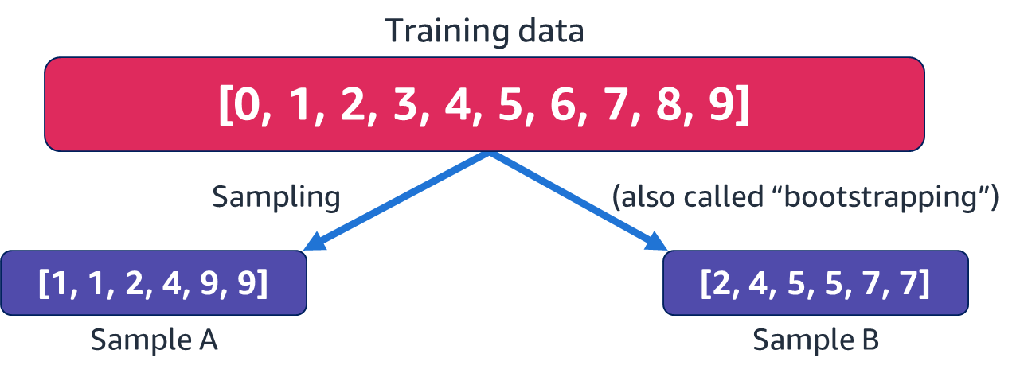
Sampling with replacement
Sampling: Randomly pulling some samples out of your dataset to create a subset
Replacement: Using a sample more than once in the same subset
Notes:
~Alt text: Diagram of training data split into two samples. See details in notes.
~
Image description: Diagram of a set of training data that contains the numbers 0 through 9. The training data is split into two subsets, sample A and sample B. Sample A contains six numbers: 1, 1, 2, 4, 9, 9, and sample B contains six numbers: 2, 4, 5, 5, 7, 7. End description.
Several methods are available to train multiple different models from the same dataset.
One method is to first resample the data multiple times by bootstrapping (sample with replacement) from the original dataset. You take sample data points from the full dataset until you have a new dataset of the desired size. Because you are taking samples from the full dataset each time (replacing the sample back into the pool), you will have repeated data points in your new dataset. Usually, about 63 percent of the original dataset will be in the sample; the remaining data points will be repeated. The result is multiple datasets. Once you have multiple datasets, you train your model on each dataset. Finally, you vote across all models (use statistics to calculate a value, such as the mean) to make a prediction.
Important note: why does it need to be with replacement? Sampling data while ensuring the same data distribution within samples is hard to achieve. Certain attributes might be slightly overrepresented or underrepresented. You want to understand the range of possibilities, so you want to build many slightly different models. Sampling with repetition helps you do that. This method also provides variability in samples even when you take a large sample—100 percent sample size is typical. If you tried that with no repetition, you would not have variability. Without repetition, you need to throw out a lot of data to get reasonable diversity in sample datasets.

Slide 9
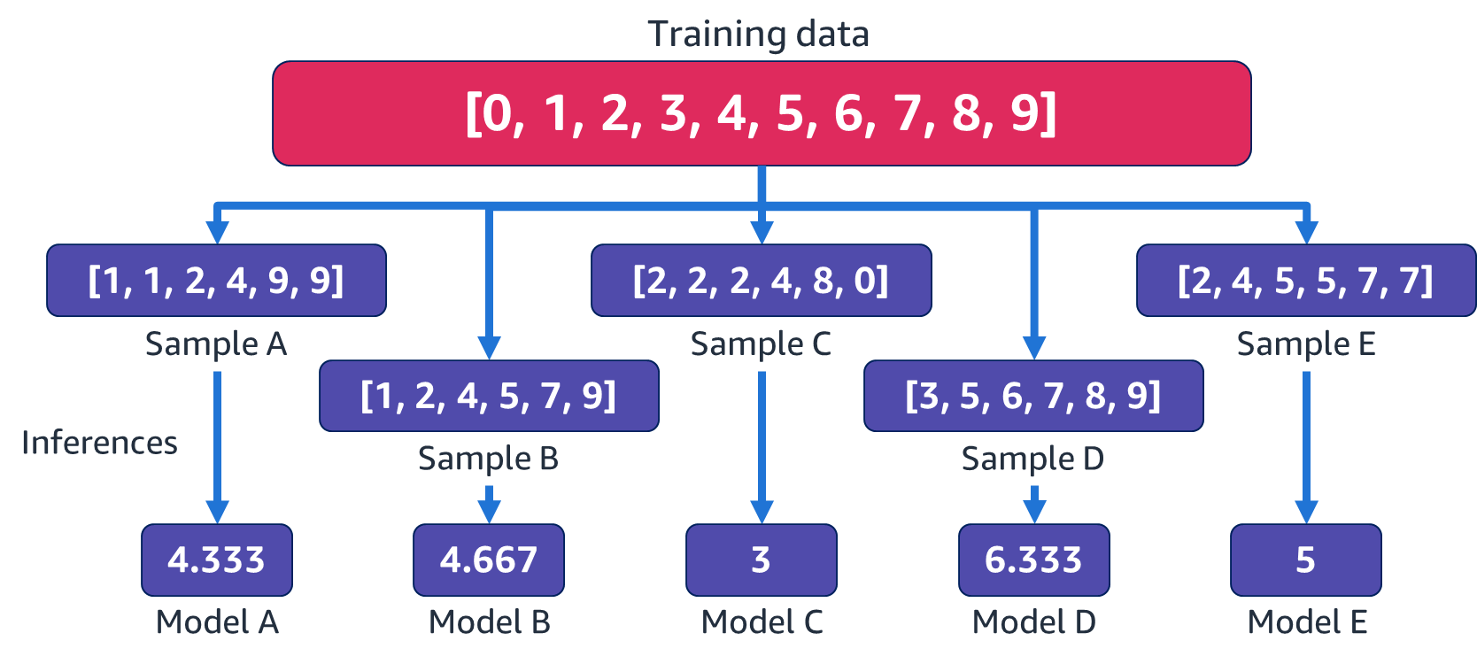
Bootstrapping example: With weak models
Notes:
~Alt text: Diagram of training data split into five samples. See details in notes.
~
Image description: Diagram of a set of training data that contains the numbers 0 through 9. The training data is split into five samples by randomly selecting numbers from the training data pool. A model is created from each data pool, and inference is used to get an output value. The output values are model A = 4.333, model B = 4.667, model C = 3, model D = 6.333, and model E = 5. End description.
Consider an example with five samples instead of two. This creates a diverse selection of subsets of the data. Sample A creates model A, sample B creates model B, and so forth.
In this simplified example, you take the average of the samples to produce inferences for each model. These models are commonly called weak models or weak learners. They are less likely to have an overfitting problem because they have only samples of the larger dataset to train on.

Slide 10
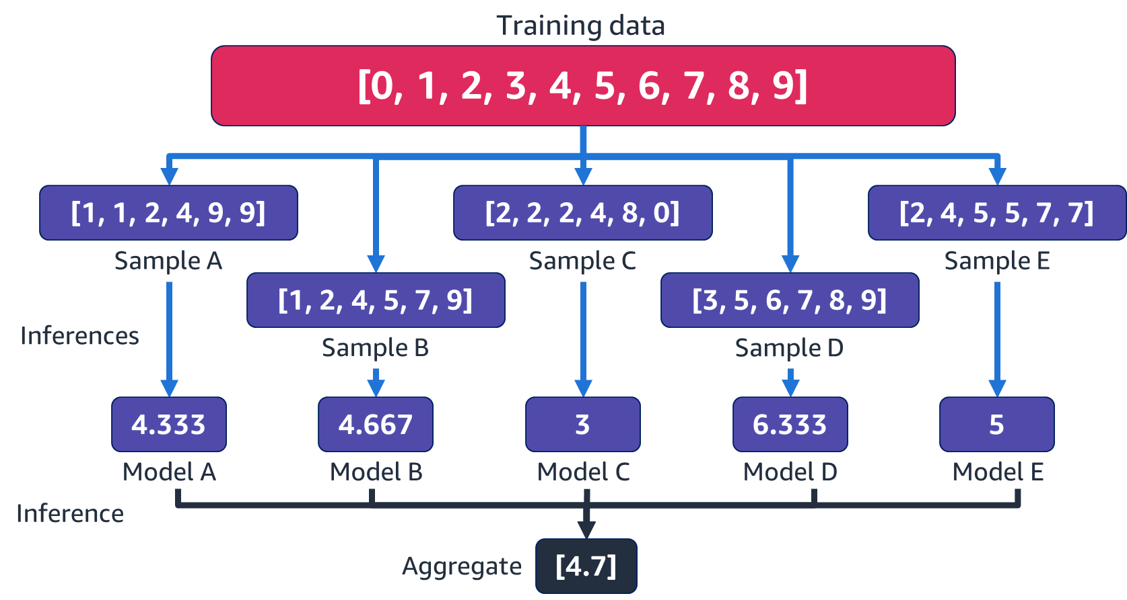
Bagging (bootstrap aggregating) example
Notes:
~Alt text: Diagram from the previous slide now shows an aggregate value of 4.7, as calculated from the inference values for each model.
~
When it is time to make a prediction, you aggregate all the inferences from all the models in some way to produce one final result, which is your final inference.

Slide 11
Bagging (bootstrap aggregating) details
Randomly draw N samples of a fixed size from the training set by using the bootstrap technique. For creating an ensemble, each estimator uses a different sample.
Build independent estimators of the same type on each subset. This reduces variance.
Use majority vote or average the predictions from all estimators.
Notes:
Bagging, which is short for bootstrap aggregating, works by taking a given task or dataset, and choosing a simple ML algorithm or weak model. The process starts by bootstrapping multiple datasets from the original dataset. Sampling with replacement is used. This results in independent estimators, which implies that you could easily parallelize bagging for speed and functionality. You can bag any estimators, but the most popular bagging model is bagging trees, known as random forest.
Bagging is useful when you have estimators that have a variance problem. You can identify this when your training errors are much lower than the validation or test error. Bagging reduces the variance, does not increase bias, and therefore causes the test error to go down.

Slide 12
BaggingClassifier in sklearn
General interface for bagging
Provide any base_estimator
# Example of bagging classifier code
BaggingClassifier(base_estimator=None, n_estimators=10, max_samples=1.0, bootstrap=True)
The BaggingClassifier can be used with .fit() and .predict().
Full interface is larger
Notes:
~Code
~
Sklearn has a general interface for bagging. You can provide any base_estimator—a classifier or a regressor.
When bootstrap = True and random subsets of the dataset are drawn with replacement, bagging is being implemented. The number of samples to draw from X to train each base estimator: max_samples, default=1.0, and with replacement is the default.
For more information, see the sklearn bootstrapping documentation at
https://scikit-learn.org/stable/modules/generated/sklearn.ensemble.BaggingClassifier.html#sklearn.ensemble.BaggingClassifier.

Slide 13
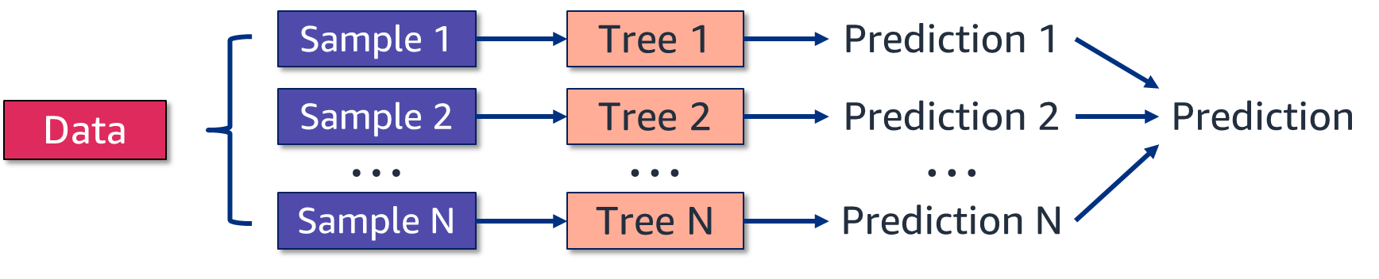
Bagging method: Random forest
Builds a decision tree on each bootstrapped subset.
Additionally, uses a randomly selected feature subset for each tree [sqrt(# of features)].
Combines predictions from each tree for the final prediction
Notes:
~Alt text: Diagram of a random forest broken into samples. See details in notes.
~
Image description: Diagram of a random forest, with data broken into multiple samples. Each sample is turned into a decision tree. Each tree produces a prediction, and then the predictions are combined into one final prediction. End description.
Bagging decision trees
Random Forest is an example of bagging, by using a combination of multiple trees.
It is implements the bagging algorithm:
Step 1: Draw random subsets (with replacement) from the original dataset: generating N datasets, Data 1, Data 2, and so on…
Step 2: Build a decision tree on each bootstrapped subset
Step 3: Combine metrics from each tree for final prediction

Slide 14
Why should you use random forest for a decision tree?
Decision trees that are trained to the optimal depth typically have low bias.
Combine multiple decision trees with high variance. This typically lowers variance.
Notes:
How does random forest help improve performance?
Random forest is a combination of decision trees. Decision trees typically have low bias because they are usually allowed to grow in depth until the training error is sufficiently low. The challenge with decision trees is high variance, which leads to overfitting tendencies. Bagging helps reduce variance by combining multiple trees that are trained on bootstrapped datasets. Bootstrapping helps create an ensemble of usefully varied decision trees. Combining the predictions of the decision trees reduces the variance of the overall predictor. This helps random forest to overcome the high variance problem that comes from using bagging with decision trees.

Slide 15
RandomForestClassifier in sklearn
The ensemble module provides a random forest classifier and a random forest regressor.
# Example of random forest classifier code
RandomForestClassifier(n_estimators=100, max_samples=None, max_features='auto', criterion='gini', max_depth=None, min_samples_split=2, min_samples_leaf=1, class_weight=None)
The RandomForestClassifier can be used with .fit() and .predict().
The full interface is larger.
Notice the mix of bagging-specific and tree-specific parameters.
Notes:
~Code
~
Sklearn’s ensemble module has random forest classifier and regressor functions. There are a mix of bagging-specific and tree-specific parameters.
Bagging-specific parameters:
n_estimators (default 100) = the number of trees to be modeled
max_samples (default None) = the number of samples to draw from the original data to train each tree (the size of the bootstrapped subsets)
Tree-specific parameters:
criterion (gini) = how to decide the splits (entropy as well)
max_depth (None) = The maximum depth of a tree. Used to control overfitting because higher depth will allow the model to learn relations that are specific to a particular sample.
min_samples_split (2) = Defines the minimum number of samples (or observations) that are required in a node to be considered for splitting. Used to control overfitting because higher values prevent a model from learning relations that might be highly specific to the particular sample that is selected for a tree. Values that are too high can lead to underfitting; therefore, it should be tuned using cross-validation.
min_samples_leaf (1) = Defines the minimum samples (or observations) that are required in a terminal node or leaf.
Used to control overfitting, similar to min_samples_split.
Generally, choose lower values for imbalanced class problems because the regions in which the minority class will be in majority will be small.
class_weight (None) = Weights associated with classes in the form: {class_label: weight}. The balanced mode uses the values of y to automatically adjust weights inversely proportional to class frequencies in the input data.

Slide 16
Ensemble learning method 2: Boosting

Slide 17
Boosting
Boosting builds multiple weak models sequentially.
Each subsequent model attempts to boost performance overall by overcoming or reducing the errors of the previous model.
This method reduces bias.
Notes:
Ensemble methods try to train multiple weak models to improve the prediction on a given task. However, these weak models need to be different because if the dataset is the same, and the model is the same, all the models will make the same predictions. This is not very useful and doesn’t serve the goal.
How and what can you change to train and get different (still weak) models while using the same source dataset and same algorithm, while improving the prediction for the task? You want something better than bagging. Bagging is trained on different subsets of the original dataset, but it basically averages the predictions of weak learners (with the same frozen hyperparameters).
What if you modify the weak learners to become better, so the ensemble becomes better at making predictions that are closer to the true target values?
Boosting is an ensemble method that creates a strong model by combining the predictions of multiple weak models that are built with a given dataset and a given learning algorithm. Specifically, boosting builds multiple weak models sequentially. Each subsequent model attempts to boost performance overall by reducing the errors of the previous model.

Slide 18
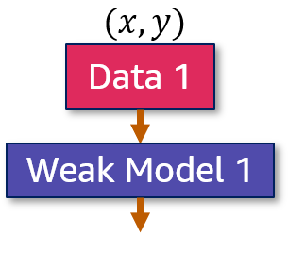

Boosting: Weak model 1 training
Weak Model 1 trains on data with features $x$ and target $y$.
Notes:
~Equation text
~Alt text: Boosting diagram. Data 1 (x, y) is used in Weak Model 1.
~
Consider an example where the first weak learner, Weak Model 1, trains on the given dataset, Data 1, with features x and target y.

Slide 19
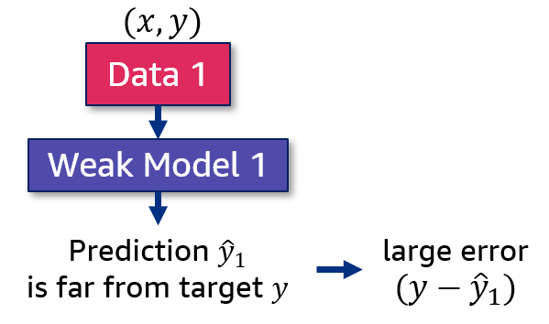
Boosting: Weak model 1 predictions
Weak Model 1 trains on data with features $x$ and target $y$.
Notes:
~Equation text
~Alt text: Boosting diagram. Weak Model 1 predictions are far from target y, which leads to a large error.
~
Next, Weak Model 1 is used to make prediction y_hat_1, which is far from target y. The large difference between y and y_hat_1 indicates a large error, which will need to be addressed.

Slide 20
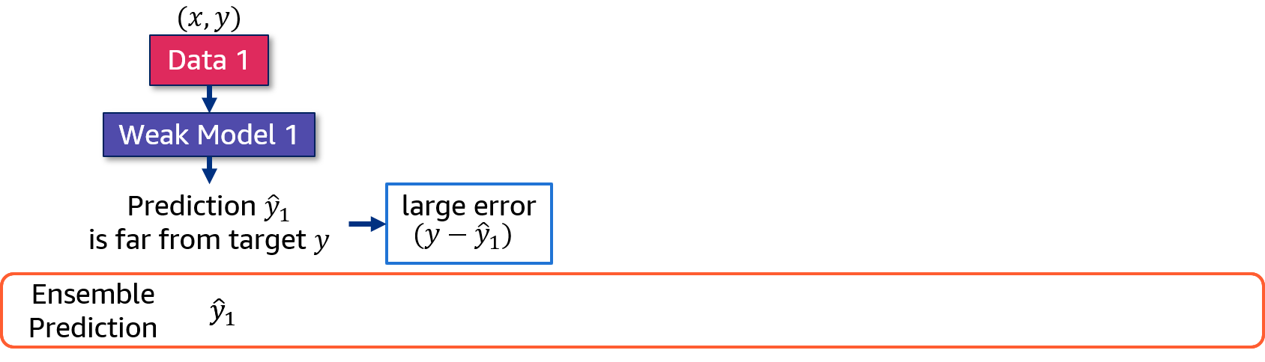

Boosting: Weak model ensemble prediction
Weak Model 1 trains on data with features $x$ and target $y$.
So far, the ensemble predicts ${\hat{y}}_{1}$.
Notes:
~Equation text
~Alt text: Boosting diagram. Weak Model 1 predictions are saved as the y_hat_1 ensemble prediction.
~
For this ensemble, you need to keep track of the ensemble prediction (for now, y_hat_1) because that’s what Weak Model 1 gave. The plan is to build the next model in the ensemble such that the prediction of the ensemble is closer to the target y.

Slide 21
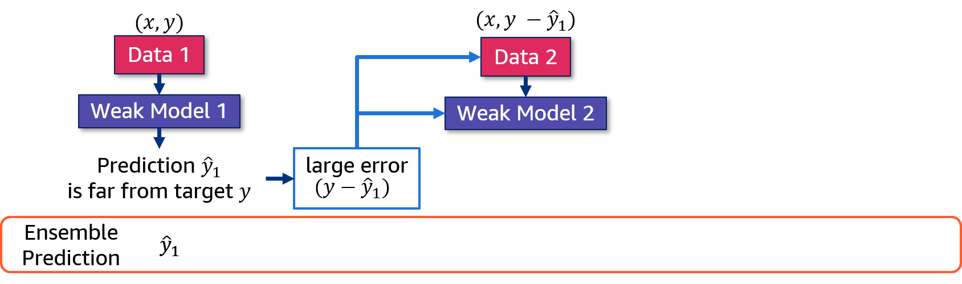
Boosting: Weak model 2
Next, the model focuses on this error (the residual of the previous model).
The error becomes the target for Weak Model 2.
Hyperparameters are adjusted and informed by the error.
Notes:
~Alt text: Boosting diagram. Weak Model 2 is added. Data 2 (x, y-y_hat_1) is used in Weak Model 2.
~
The plan is to slightly adjust the dataset and algorithm to focus on the large error. The general idea is to work to minimize the error, so the ensemble becomes a better learner overall. The key idea of boosting is to have the next model focus on this error—the residual of the previous model. The residuals are the data samples that the previous model found difficult to predict.
To do this, Weak Model 2 focuses so much on Weak Model 1’s error that this error becomes its target. Keep in mind that, while the algorithm in principle stays the same—if Weak Model 1 was a tree, Weak Model 2 will still be a tree—Weak Model 2’s hyperparameters are adjusted as informed by the error. Essentially, both the initial training dataset and the initial weak model are adjusted according to the previous error to build this new model. The new model is added to the ensemble with the goal of improving the ensemble’s prediction and minimize the overall errors.

Slide 22
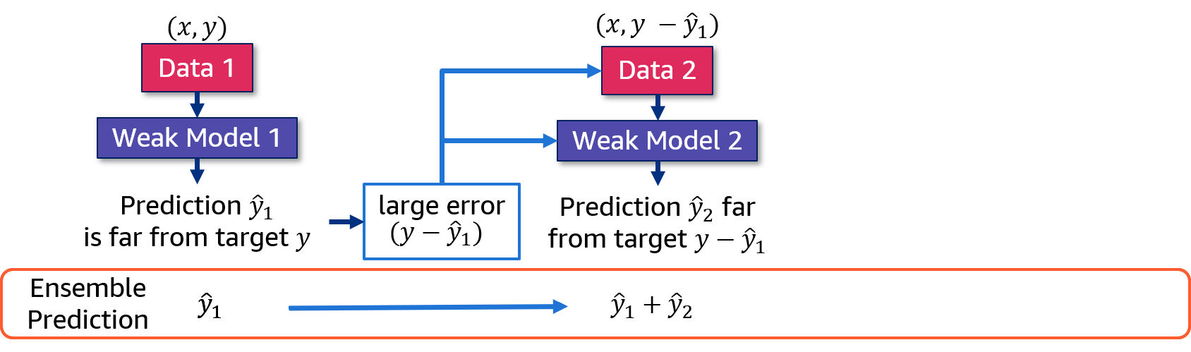
Boosting: Weak model 2 predictions
Next, the model focuses on this error (the residual of the previous model).
The error becomes the target for Weak Model 2.
Hyperparameters are adjusted and informed by the error.
Notes:
~Alt text: Boosting diagram. See details in notes.
~
Image description: Boosting diagram. Weak Model 2 predictions (y_hat_2) are far from the target (y-y_hat_1). The ensemble prediction is now y_hat_1 + y_hat_2. End description.
Weak Model 2 trains on Data 2, which has the same features x but a new target, y - y_hat_1. Weak Model 2 makes prediction y_hat_2. Overall, the ensemble got a bit bigger, so you need to keep track of the ensemble prediction, which is now y_hat_1 + y_hat_2.

Slide 23
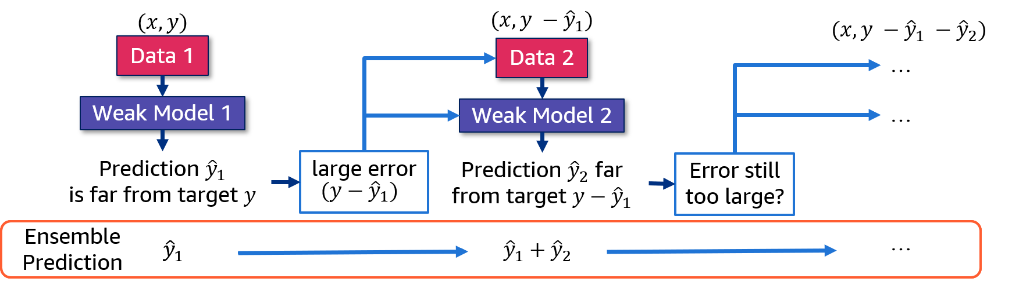
Boosting: Are more iterations needed?
If the error is still too large, continue iterating.
Does this remind you of anything from a recent lesson?
Notes:
~Alt text: Boosting diagram. See details in notes.
~
Image description: Boosting diagram. If error from Weak Model 2 is still too large, more model iterations are added. Data follows the pattern (x, y - y_hat_1 - y_hat_2 - ... - y_hat_n). The ensemble prediction takes the form (y_hat_1 + y_hat_2 + ... + y_hat_n). End description.
With a focus on the initial target y, if there’s still a large error between the target y and the ensemble prediction y_hat_1 + y_hat_2 (y – y_hat_1 – y_hat_2), you need to continue to build more weak models for other hard-to-predict residuals, adding more weak models to the ensemble. Again, make adjustments to predict better on this error, focusing on this last error, to the extent of making it closer to the target y.
By adding each new weak model to the ensemble sequentially, you are trying to overcome or reduce the errors of the previous model. You might notice that the boosting method sounds a bit like gradient descent.

Slide 24
GBM: Boosting trees
Train a weak model on the given data, and make predictions with it.
Iteratively create a new model to learn to overcome prediction errors of the previous model (use the previous prediction error as the new target).
Notes:
The boosting ensemble is typically constructed from decision tree models. Trees are added one at a time to the ensemble and fit to correct the prediction errors that prior trees made. Subsequent trees are fit using a (differentiable) loss function and gradient descent optimization algorithm.
The technique is known as gradient boosting machine (GBM). Because decision trees are typically used as the weak learners in GBM, this technique is also known as gradient tree boosting or gradient boosting. Gradient boosting is an effective ML algorithm and is often the main, or one of the main, algorithm that is used to win ML competitions (such as Kaggle) on tabular data and similarly structured datasets.

Slide 25
Gradient boosting in Python
sklearn GBM algorithms:
GradientBoostingClassifier (Regressor)
HistGradientBoostingClassifier (Regressor) – Faster, experimental
Additional third-party libraries provide computationally efficient alternate GBM implementations, with better results in practice:
XGBoost (Extreme Gradient Boosting): Efficient compute, memory
LightGBM: Much faster
CatBoost (Category Gradient Boosting): Fast, supports categoricals
Notes:
The most used boosting implementation comes from sklearn.
Additional third-party libraries provide computationally efficient alternate GBM implementations that often achieve better results in practice. The following are a few examples:
XGBoost (Extreme Gradient Boosting): XGBoost is engineered for efficiency of compute time and memory resources. XGBoost is free open-source software that you can import in your Jupyter notebooks.
LightGBM (Light Gradient Boosted Machine): LightGBM is a library developed at Microsoft that provides an efficient, fast implementation of the gradient boosting algorithm. You can also install the LightGBM library in Python. The LightGBM library also provides wrapper classes so that you can use the efficient algorithm implementation with the scikit-learn library—specifically through the LGBMClassifier and LGBMRegressor classes.
CatBoost (Category Gradient Boosting): CatBoost has the primary benefit of support for categorial input variables along with computational speed improvements. You can install the CatBoost library in Python. The library provides wrapper classes so that you can use the efficient algorithm implementation with the scikit-learn library—specifically through the CatBoostClassifier and CatBoostRegressor classes.

Slide 26
GradientBoostingClassifier in sklearn
The ensemble module provides a boosting classifier and a boosting regressor.
# Example of gradient boosting classifier code
GradientBoostingClassifier(n_estimators=100, learning_rate=0.1, min_samples_split=2, min_samples_leaf=1, max_depth=3)
The GradientBoostingClassifier can be used with .fit() and .predict().
The full interface is larger.
Notice the mix of boosting-specific and tree-specific parameters.
Notes:
~Code
~
Parameter explanations:
n_estimators: The number of sequential trees to be modeled
Lower values are generally preferred because they make the model robust to the specific characteristics of trees and thus allow the model to generalize well.
learning_rate: Determines the impact of each tree on the final outcome
Lower values would require a higher number of trees to model all the relations and will be computationally expensive.

Slide 27
Ensemble learning method 3: Stacking

Slide 28
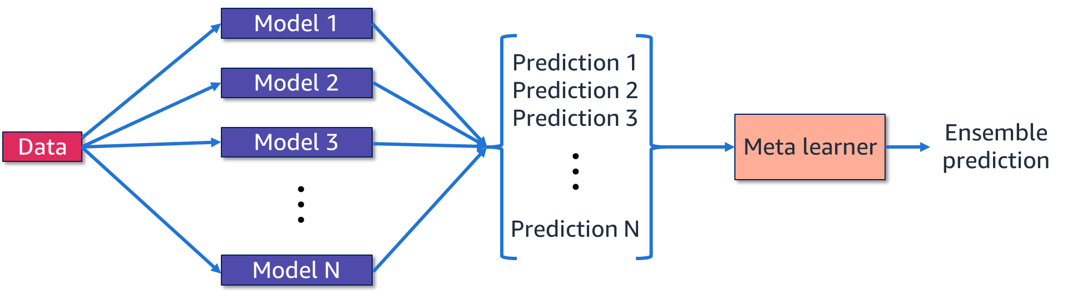
Stacking (1 of 2)
Stacking is a way to generalize the ensembling approach to combine outputs of various types of models. This method improves on the combination as well.
Notes:
~Alt text: Stacking diagram. See details in notes.
~
Image description: Diagram of a dataset producing multiple models, which produce multiple predictions. The predictions are fed to a metalearner, which leads to an ensemble prediction. End description.
Stacking is a way to ensemble multiple classification or regression models. The idea is to solve the prediction problem with different types of models that can learn some part of the problem but not the whole space of the problem. You can build multiple different predictors, build an intermediate list of predictions, and use a metalearner to learn from these predictions to predict the final outcome. Stacking often results in a prediction score that is better than any of the individual models.

Slide 29
Stacking (2 of 2)
Stacking might use different models (such as a mixture of logistic regression models or decision trees) to form its ensemble, unlike the bagging or boosting methods.
Notes:
With bagging, multiple similar models with high variance are averaged to decrease variance. With boosting, multiple incremental models are built to decrease the bias, while keeping variance small.
Stacking is a different paradigm. It explores multiple models for the same problem and combines their individual predictions to build a stacked model that can make a better prediction. Stacking allows all models to be different, unlike bagging, and models in a layer can be trained in parallel, unlike boosting.

Slide 30
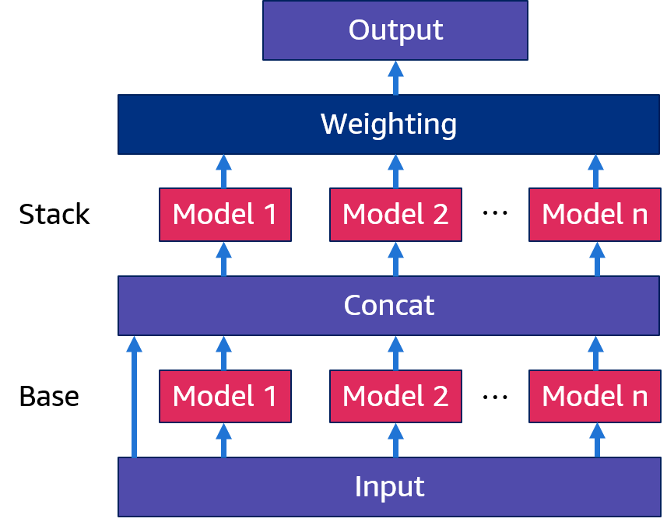
AutoGluon: Multilayer stacking
AutoGluon uses multilayer stacking to achieve high-quality results.
Stacker models can act as base models to other stacker models.
A diverse set of base models are used.
Notes:
~Alt text: AutoGluon's stacking architecture.
~
AutoGluon can make high-quality predictions by using a multilayer stacking solution. You can extend stacking to more than one layer by using the stacker models as base models for other stacker models.
Note that the input features are also concatenated along with the base models’ predictions to enrich the data that is used to train the stacker models in the next layer.
To make the most of stacking, it is good practice to use a diverse set of models where each is capable of handling the problem in a different way. Combining the predictions of these models significantly improves performance.

Slide 31
Review of ensemble methods
Bagging | Boosting | Stacking
Build independent estimators and average their predictions The combined estimator usually has lower variance than its components Particularly useful for estimators that have a variance problem | Build sequential estimators that try to reduce the bias of the previous (combined) estimator Particularly useful for estimators that have a bias problem | Train different independent estimators and use a metalearner to combine their predictions Very flexible and general method Multilayer stacking can improve performance (be careful of overfitting)

Slide 32
Next lesson
In this lesson, you learned how to combine ML models to allow them to make more powerful predictions.
Combined with the previous lectures, you now understand many of the core technologies that make up AutoGluon.
Next, you will learn about responsible AI/ML practices to ensure that you approach ML problems responsibly.

Slide 34
Source slides for curriculum developers only

Slide 35
Source graphic: Ensemble methods
Ensemble prediction
Model 1
Model 2
…
Model N
Data
Notes:
~Source graphic for slides 4-6

Slide 36
Source graphic: Sampling with replacement
Training data
[0, 1, 2, 3, 4, 5, 6, 7, 8, 9]
Sampling
(also called “bootstrapping”)
[1, 1, 2, 4, 9, 9]
[2, 4, 5, 5, 7, 7]
Sample A
Sample B
Notes:
~source graphic for slide 8

Slide 37
Source graphic: Bootstrapping example: With weak models
Training data
[0, 1, 2, 3, 4, 5, 6, 7, 8, 9]
[1, 1, 2, 4, 9, 9]
[2, 2, 2, 4, 8, 0]
[2, 4, 5, 5, 7, 7]
Sample A
Sample C
Sample E
[1, 2, 4, 5, 7, 9]
[3, 5, 6, 7, 8, 9]
Inferences
Sample B
Sample D
4.333
4.667
3
6.333
5
Model A
Model B
Model C
Model D
Model E
Notes:
~Source for slide 9 and the next slide

Slide 38
Source graphic: Bagging (bootstrap aggregating) example
Training data
[0, 1, 2, 3, 4, 5, 6, 7, 8, 9]
[1, 1, 2, 4, 9, 9]
[2, 2, 2, 4, 8, 0]
[2, 4, 5, 5, 7, 7]
Sample A
Sample C
Sample E
[1, 2, 4, 5, 7, 9]
[3, 5, 6, 7, 8, 9]
Inferences
Sample B
Sample D
4.333
4.667
3
6.333
5
Model A
Model B
Model C
Model D
Model E
Inference
Aggregate
[4.7]
Notes:
~Source for slide 10; also related to slide 9

Slide 39
Source graphic: Bagging method: Random forest
Sample 1
Tree 1
Prediction 1
Data
Sample 2
Tree 2
Prediction 2
Prediction
…
…
…
Sample N
Tree N
Prediction N
Notes:
~Source for slide 13-14

Slide 40

Source graphic: Boosting: Weak model 1 training
$$(x, y)$$
Data 1
Weak Model 1

Slide 41
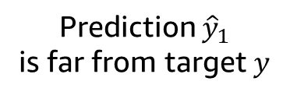

Source graphic: Boosting: Weak model 1 predictions
$$(x, y)$$
Data 1
Weak Model 1
Prediction ${\hat{y}}_{1}$
is far from target $y$
$$(y−{\hat{y}}_{1})$$

Slide 42

Source graphic: Boosting: Weak model ensemble prediction
$$(x, y)$$
Data 1
Weak Model 1
Prediction ${\hat{y}}_{1}$
is far from target $y$
large error
$$(y−{\hat{y}}_{1})$$
Ensemble Prediction
$${\hat{y}}_{1}$$
$${\hat{y}}_{1}$$

Slide 43



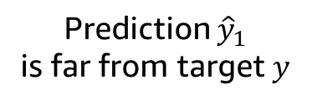

Source graphic: Boosting: Weak model 2
$$(x, y)$$
$$(x, y −{\hat{y}}_{1})$$
Data 1
Data 2
Weak Model 1
Weak Model 2
Prediction ${\hat{y}}_{1}$
is far from target $y$
large error
$$(y−{\hat{y}}_{1})$$
Ensemble Prediction
$${\hat{y}}_{1}$$
$${\hat{y}}_{1}$$

Slide 44


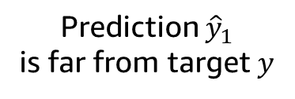

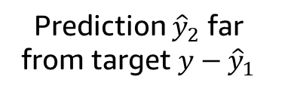


Source graphic: Boosting: Weak model 2 predictions
$$(x, y)$$
$$(x, y −{\hat{y}}_{1})$$
Data 1
Data 2
Weak Model 1
Weak Model 2
Prediction ${\hat{y}}_{1}$
is far from target $y$
large error
Prediction ${\hat{y}}_{2}$ far from target $y−{\hat{y}}_{1}$
$$(y−{\hat{y}}_{1})$$
Ensemble Prediction
$${\hat{y}}_{1}$$
$${\hat{y}}_{1}+{\hat{y}}_{2}$$
$${\hat{y}}_{1}$$

Slide 45

Source graphic: Boosting: Are more iterations needed?
$$(x, y)$$
$$(x, y −{\hat{y}}_{1})$$
$$(x, y −{\hat{y}}_{1} −{\hat{y}}_{2})$$
Data 1
Data 2
…
Weak Model 1
Weak Model 2
…
Prediction ${\hat{y}}_{1}$
is far from target $y$
large error
Prediction ${\hat{y}}_{2}$ far from target $y−{\hat{y}}_{1}$
Error still too large?
$$(y−{\hat{y}}_{1})$$
Ensemble Prediction
…
$${\hat{y}}_{1}$$
$${\hat{y}}_{1}+{\hat{y}}_{2}$$
$${\hat{y}}_{1}$$

Slide 46
Source graphic: Stacking (1 of 2)
Model 1
Prediction 1
Prediction 2
Prediction 3
Prediction N
Model 2
Meta learner
Ensemble prediction
Data
Model 3
…
…
Model N
Notes:
~Source for slides 28-29

Slide 47
Source graphic: AutoGluon: Multilayer stacking
Output
Weighting
Stack
Model 1
Model 2
…
Model n
Concat
Base
Model 1
Model 2
…
Model n
Input

