Slide 1
Fairness Criteria
Machine Learning through Application
Module 3 – Lesson 3

Slide 2
Today’s activities
Fairness criteria
Probability basics
Fairness criteria deep dive
Independence
Separation
Sufficiency

Slide 3
How can you achieve fairness?

Slide 4
Fairness criteria in ML
Fairness in ML can be achieved by mitigating unwanted bias, which are harmful disparities in system behavior or downstream impacts on subpopulations.
Fairness criteria describe the connection between sensitive attributes and true and predicted labels, or both mathematically.
Notes:
Quantitative definitions of what is fair and unfair have been introduced in multiple disciplines for well over 50 years, including in education, hiring, and ML. These definitions are necessary because they help you to implement certain techniques (bias mitigation) that will change the predictions that a model makes with the goal of reducing disparity in outcomes or performance.
Reference:
Solon Barocas and Moritz Hardt. “Fairness in Machine Learning.” Tutorial presented at the 31st Annual Conference on Neural Information Processing Systems (NIPS), Long Beach, CA, December 2017. https://fairmlbook.org/tutorial1.html.

Slide 5
How to satisfy fairness criteria
Fairness criteria help you understand how to prepare data, modify the way that models learn, or adjust model predictions with the goal of reducing unwanted bias.
Use fairness criteria to measure or mitigate bias or both at different stages of the ML lifecycle:
Preprocessing
Model training (in-processing)
Postprocessing
Notes:
After the fairness criteria are defined, you can use them at different parts in the ML pipeline. It’s possible to mitigate bias by transforming the input data during preprocessing, before the model trains. It’s also possible to use the fairness criteria to influence the way that a model is trained directly. Finally, fairness criteria can also be used as a final postprocessing step to adjust the outputs of a model that has already been trained.

Slide 6
A quick recap of probability basics

Slide 7
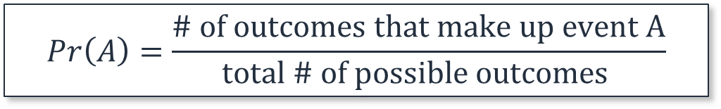

Probability basics
The probability, $\operatorname{Pr}{(A)}$, of an event, A, is the number of favorable outcomes divided by the total number of possible outcomes.
$$\operatorname{Pr}\left(A\right)=\frac{\text{\# }\text{of} \text{outcomes} \text{that} \text{make} \text{up} \text{event} \text{A}}{\text{total}\text{ \# }\text{of} \text{possible} \text{outcomes} }$$
Notes:
~Equations
~
To measure fairness, a common approach is to look at the probabilities of certain outcomes for different groups. Therefore, it is important to be aware of basic probability calculations.

Slide 8


Probability example
The probability, $\operatorname{Pr}{(A)}$, of event, A, is the number of favorable outcomes divided by the total number of possible outcomes.
$$\operatorname{Pr}\left(A\right)=\frac{\text{\# }\text{of} \text{outcomes} \text{that} \text{make} \text{up} \text{event} \text{A}}{\text{total}\text{ \# }\text{of} \text{possible} \text{outcomes} }$$
What is the probability for a coin toss to yield heads (H)?
$$\operatorname{Pr}\left(H\right)=\frac{\text{1}}{\text{2}}=0.5=50\%$$
Notes:
~Equations

Slide 9
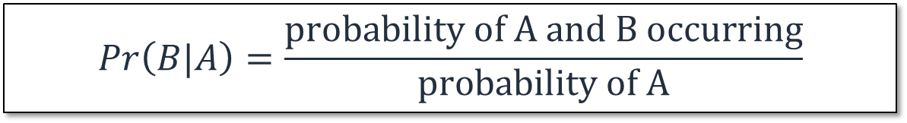

Conditional probability
The conditional probability, $\operatorname{Pr}{(B|A)}$, of an event, B, is the probability that event B will occur given the knowledge that event A has already occurred.
$$\operatorname{Pr}\left(B|A\right)=\frac{\text{probability} \text{of} \text{A} \text{and} \text{B} \text{occurring}}{\text{probability} \text{of} \text{A}}$$
Notes:
~Equations

Slide 10

Conditional probability example
The conditional probability, $\operatorname{Pr}{(B|A)}$, of an event, B, is the probability that event B will occur given the knowledge that event A has already occurred.
$$\operatorname{Pr}\left(B|A\right)=\frac{\text{probability} \text{of} \text{A} \text{and} \text{B} \text{occurring}}{\text{probability} \text{of} \text{A}}$$
In a deck of cards, if you draw a red card (event A), what is the probability that the card is an ace?
$$\operatorname{Pr}\left(B|A\right)=\frac{2}{26}≈0.08=8\%$$
Notes:
~Equations
~
The probability of events A and B occurring is 2/52 because a standard deck of 52 cards includes 2 red aces (ace of hearts and ace of diamonds).
The probability of event A occurring is 26/52 because a standard deck of 52 cards has 26 red cards (13 hearts and 13 diamonds).

Slide 11
Independence

Slide 12
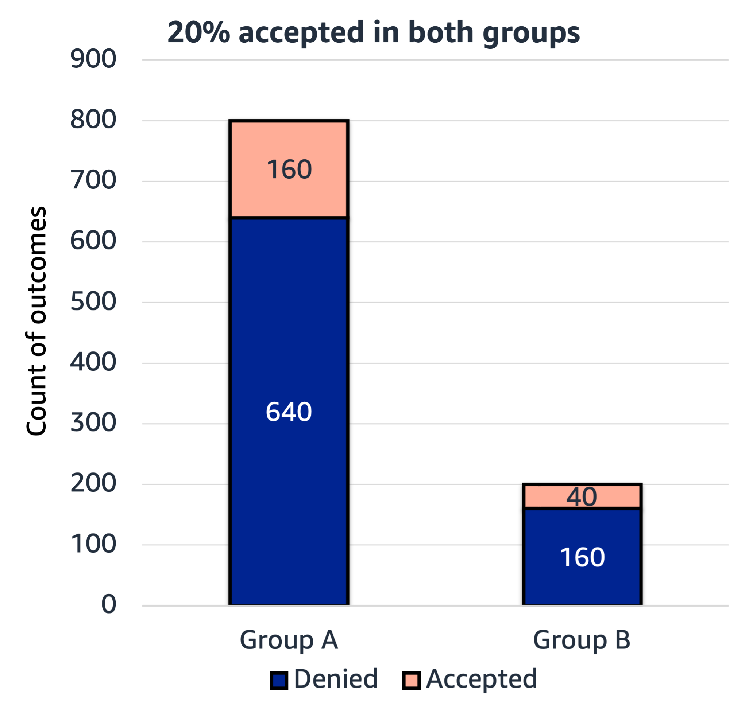
Independence (equality of outcomes)
The outcome is independent of the sensitive attribute.
Example: Model that predicts university acceptance:
According to independence criteria, the acceptance rate needs to be the same in all groups.
The outcomes can be seen as unfair if two groups naturally have different qualifications and one group should see more acceptance than the other.
Notes:
~Alt text: Bar chart of denied and accepted outcomes for groups A and B. Twenty percent of both groups have the accepted outcome.
~
The independence criteria states that the outcome is independent of the sensitive attribute. Models or transformations that adhere to the independence criteria will produce results where the rates of acceptance (or denial) are the same across all groups.

Slide 13
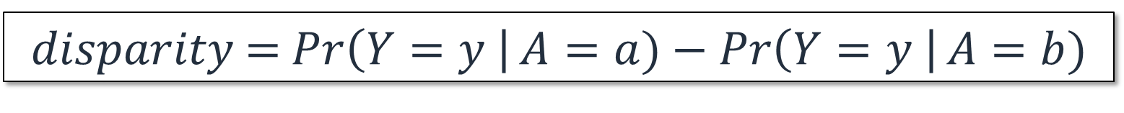

Independence: Demographic parity
Demographic parity: A certain true (or predicted) outcome, Y (or $\hat{Y}$), is not dependent on the attribute, A.
Independence is achieved when the probability for positive (or negative) true outcomes for two groups is equal:
$$\operatorname{Pr}\left(Y=y \right|A=a)=\operatorname{Pr}\left(Y=y \right|A=b)$$
Measure the bias of a dataset (or predictions):
$disparity$ = $\operatorname{Pr}\left(Y=y \right|A=a)−\operatorname{Pr}\left(Y=y \right|A=b)$
Notes:
~Equations
~
Two events, A and B, are independent if and only if P(A n B) = P(A)*P(B). According to the conditional probability rule, the probability of A happening given B is P(A|B) = P(A n B) / P(B). Replace P(A n B) to get P(A|B) = P(A)*P(B)/ P(B) = P(A), and you can see that A is not dependent on B.
By rearranging the equation, you can measure the amount of disparity (bias) in the distribution of the labels or predictions of a model.

Slide 14
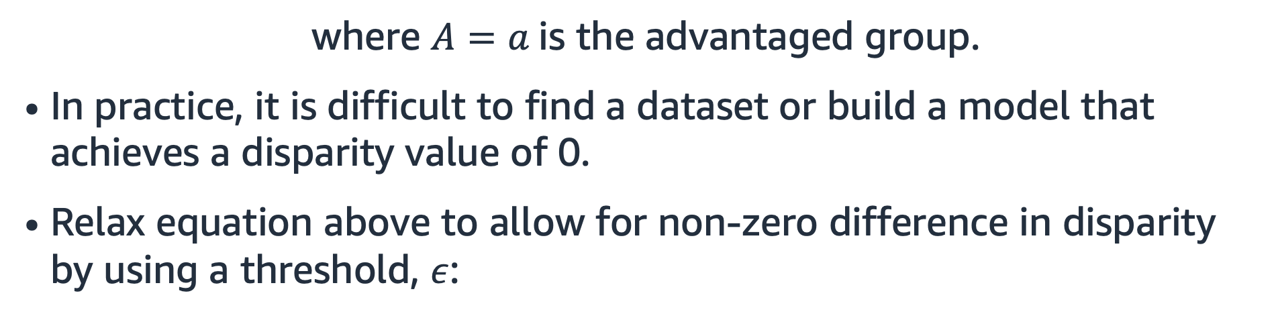
Difference in demographic parity
There is no disparity if:
$$\operatorname{Pr}\left(Y=y \right|A=a)−\operatorname{Pr}\left(Y=y \right|A=b)=0$$
where $A=a$is the advantaged group.
In practice, it is difficult to find a dataset or build a model that achieves a disparity value of 0.
Relax equation above to allow for non-zero difference in disparity by using a threshold, $ε$:
$$|Pr\left(Y=y \right|A=a) −\operatorname{Pr}\left(Y=y \right|A=b)|≤ε$$
Notes:
~Equations
~
To reduce bias according to the independence criteria, you need to find transformations or adjust the model outputs so that the difference in probabilities becomes zero.
In reality, this will be difficult to achieve because there’s a trade-off with model performance. To simplify, you can consider a relaxed version of the equation that requires the difference in probability to be below a certain threshold (rather than zero).

Slide 15


Independence: Disparate impact
Another variation using the ratio of probabilities and the threshold $ε$is called disparate impact (DI):
$$\frac{\operatorname{Pr}\left(Y=y \right|A=b)}{\operatorname{Pr}\left(Y=y \right|A=a)}≥1−ε$$
where $A=a$is the advantaged group.
Notes:
~Equations
~
Another way to rearrange the independence equation is to look at the ratio (instead of the difference). Again, in practice, the equation can be relaxed to make it easier to meet the criteria. Generally, you want the disparate impact (DI) value to be as close to 1 as possible.
One rule related to DI states that for every five individuals with successful outcomes in the favored group, four in the disfavored group should have a successful outcome too. This is the four-fifths or 80 percent rule.
Note that this isn’t a legal definition. DI has a specific meaning in legal jargon and is restricted to certain domains.
Reference:
Michael Feldman, Sorelle Friedler, John Moeller, Carlos Scheidegger, and Suresh Venkatasubramanian, “Certifying and Removing Disparate Impact,” arXiv (December 2014). https://doi.org/10.48550/arXiv.1412.3756.

Slide 16
Independence: Regression
For regression, consider score ranges (prediction scores, r, should be statistically independent of the sensitive attribute):
$$|Pr\left(R≥r \right|A=a) −\operatorname{Pr}\left(R≥r \right|A=b)|≤ε$$
Notes:
~Equations
~
The same logic that works for classifiers can also be used for regression problems. Again, you want the difference to be below a certain threshold (rather than demanding that the difference needs to be exactly 0).

Slide 17
Difference in mean
Difference in mean predictions per group:
$$mean\left({\hat{y}}_{A=0}\right)−mean({\hat{y}}_{A=1})$$
The closer to zero, the fairer an outcome.
Notes:
~Equations
~
The difference in mean predictions per group should be close to zero.

Slide 18
Separation

Slide 19
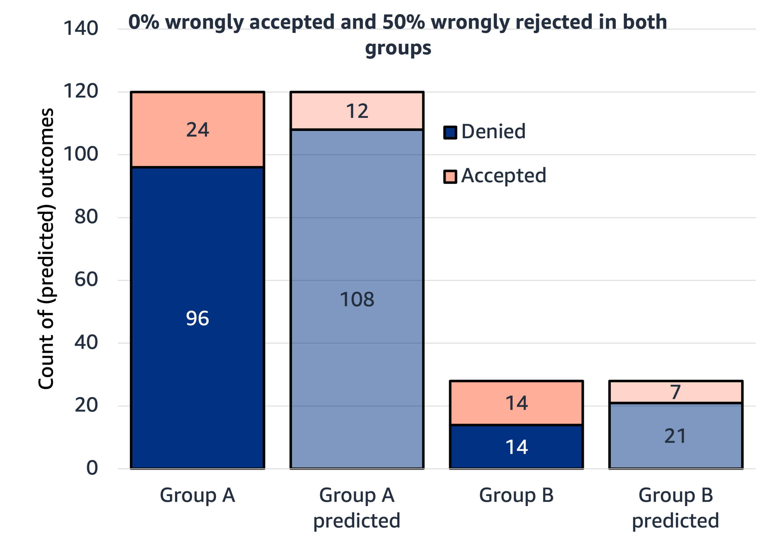
Separation (equality of errors)
Separation is about equalizing the chance of getting it wrong. The criteria compares the prediction to the ground truth.
Example: Model that predicts university acceptance:
According to this criteria, the model will be fair if the error rates (wrong rejection and wrong acceptance) are the same for both groups.
Usually only one type of error rate is set to be equal as it can be too hard to find a solution where wrong rejections and wrong acceptances are both exactly equal.
Notes:
~Alt text: Bar plot of actual and predicted acceptance outcomes for groups A and B. The error rates are the same for both groups.
~
The separation criteria enforces changes to the data, model training, or output adjustment that lead to equalizing the chance of getting it wrong. This criteria considers the merit of different groups and compares predictions to the ground truth.

Slide 20
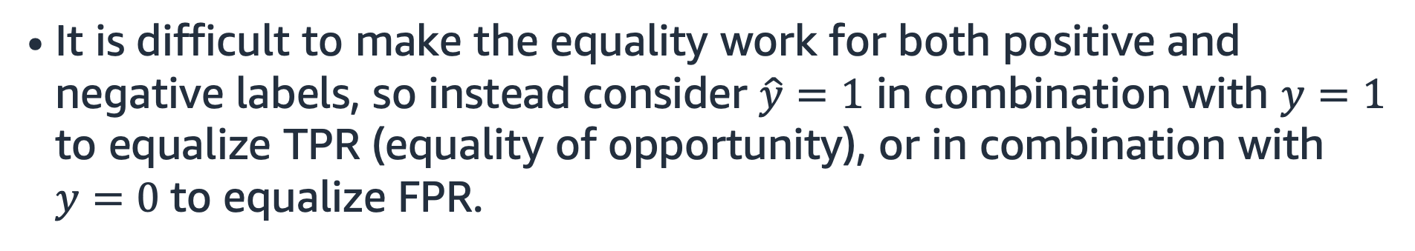

Equality of odds
Equality of odds states that the prediction, $\hat{Y}$, is conditionally independent of the attribute, $A$, given the true outcome, $Y$.
To achieve equality of odds, the true positive rate or false positive rate must be equal for both attribute values, $A=a$and $A=b$:
$$\operatorname{Pr}\left(\hat{Y}=\hat{y} \right|A=a,Y=y)=\operatorname{Pr}\left(\hat{Y}=\hat{y}\right|A=b,Y=y)$$
It is difficult to make the equality work for both positive and negative labels, so instead consider $\hat{y}=1$ in combination with $y=1$ to equalize TPR (equality of opportunity), or in combination with $y=0$to equalize FPR.
Notes:
~Equations
~
TPR – True positive rate
FPR – False positive rate
Separation is also known as equalized odds. It factors in the model’s outcome (the prediction). Separation requires the same rate of true positives and false positives across two groups or two distinct attribute values.
Unlike demographic parity (independence), equalized odds allows Y to depend on A (but only through the target variable Y). As such, the definition prohibits abusing A as a proxy for Y.
Equalized odds enforces the accuracy being equally high in all demographics and punishes models that perform well only on the majority.
Equalized odds can be used as in-processing and post-processing method by either adapting the loss function or by directly adjusting outcomes.

Slide 21
Sufficiency

Slide 22
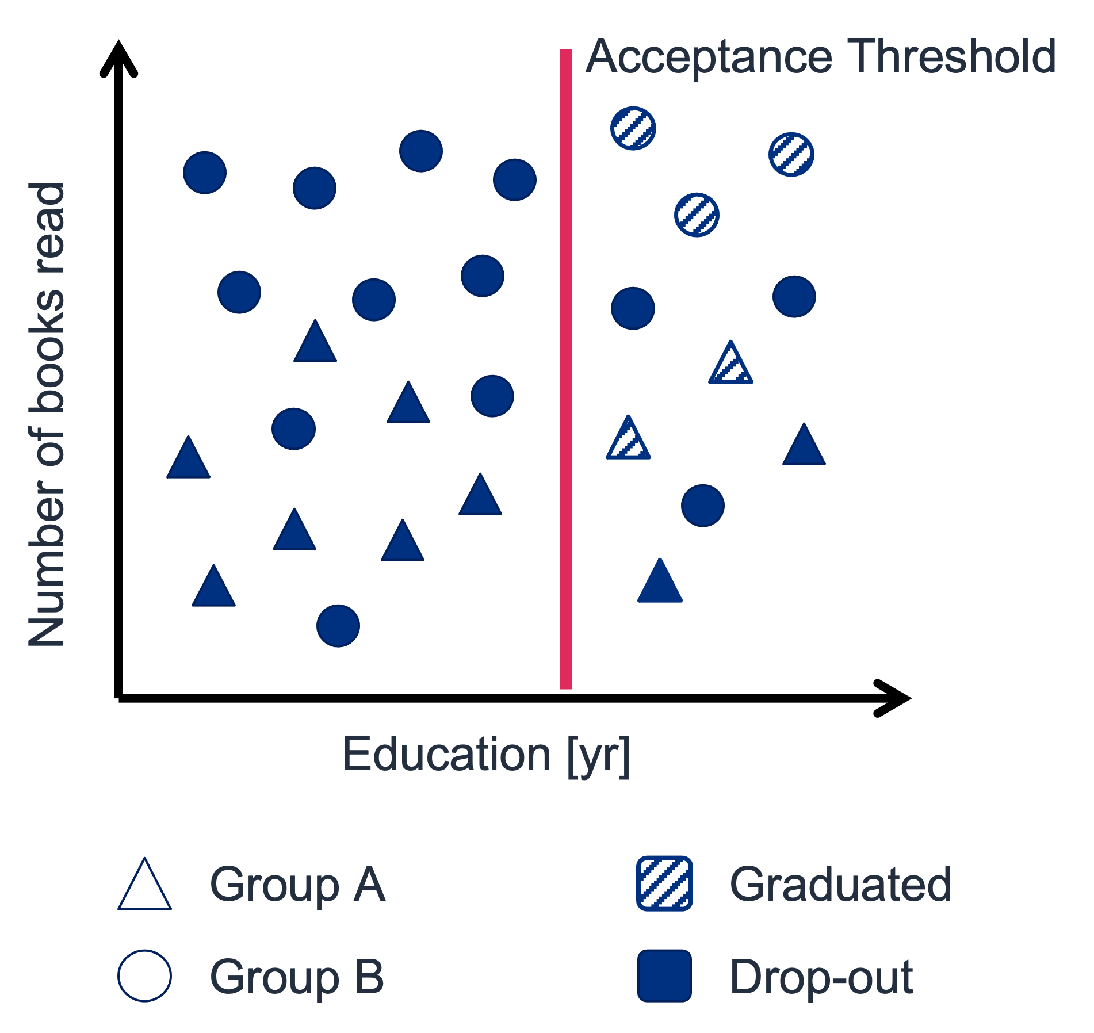
Sufficiency (equality of predictive value)
Sufficiency is about equalizing positive or negative predictive values for different subpopulations.
Predictive value is the proportion of positive or negative predictions that are true positives or true negatives respectively.
Example: Model that predicts university acceptance:
The sufficiency criteria (for positive predictive values) equalizes the chance of success, given positive predictions. This means graduation rates have to be equal across groups of admitted students.
In this example, 50 percent of the applicants that are above the acceptance threshold graduated (in both groups).
Notes:
~Alt text: Scatter plot. See details in notes. ~
Image description: The scatter plot shows amount of education and outcomes (graduated or drop-out) for groups A and B. The chart shows a threshold for a particular level of education, above which students are accepted. For individuals above the threshold, 50 percent had a favorable outcome (graduation) in both groups. End description.
The sufficiency criteria for positive outcomes (also known as positive predictive value parity or PPV-parity) tries to achieve fairness by equalizing the chance of success, given a positive prediction. In the admissions example, sufficiency requires graduation rates to be equal across groups (of admitted students).

Slide 23
General limitations of all fairness criteria

Slide 24
General limitations
Optimizing for one criteria can lead to making another criteria worse.
Potential legal considerations exist for use of sensitive attributes. In some domains, you are not allowed to consider sensitive attributes.
Some fairness criteria require sensitive attributes to be known to perform transformations.
Under certain conditions, fairness criteria can produce so-called lazy solutions that are actually random guesses.
Notes:
Consider the following example for insufficiency (with independence). An ill-intentioned decision-maker splits applications into two groups, A and B. For group A, they diligently review applications and eventually approve 10 percent. For group B, they carelessly approve applications at the same rate (10 percent). Even though the acceptance rates in both groups are identical, it is far more likely that unqualified applicants were selected in group B. As a result, in hindsight, it will appear that members of group B performed worse than members of group A, thus establishing a negative track record for group B.

Slide 25

Next lesson
The next lesson discusses bias mitigation during preprocessing, model training, and postprocessing.

Slide 27
Image source slides (for curriculum development use only)

Slide 28
Source graphic: Independence: Equality of outcomes
Notes:
~Source graphic for slide 12

Slide 29
Source graphic: Separation (equality of errors)
Predicted denied
Predicted accepted
Notes:
~Source graphic for slide 19

Slide 30
Source graphic: Sufficiency (equality of predictive value)
Acceptance Threshold
Number of books read
Education [yr]
Group A
Graduated
Group B
Drop-out
Notes:
~Source graphic for slide 22

