Slide 1
Introduction to Neural Networks: Layers and Activations
Application of Deep Learning to Text and Image Data
Module 1 – Lesson 1

Slide 2
Today’s activities
Deep learning context
Single-layer neural networks

Slide 3
Deep learning context

Slide 4
Deep learning or neural network?
Neural networks emulate the behavior of the human brain:
They help recognize patterns and solve common problems in ML.
They are built by stacking layers of neurons.
The term deep learning is frequently used for the name of a neural network model that contains several of those layers.

Slide 5
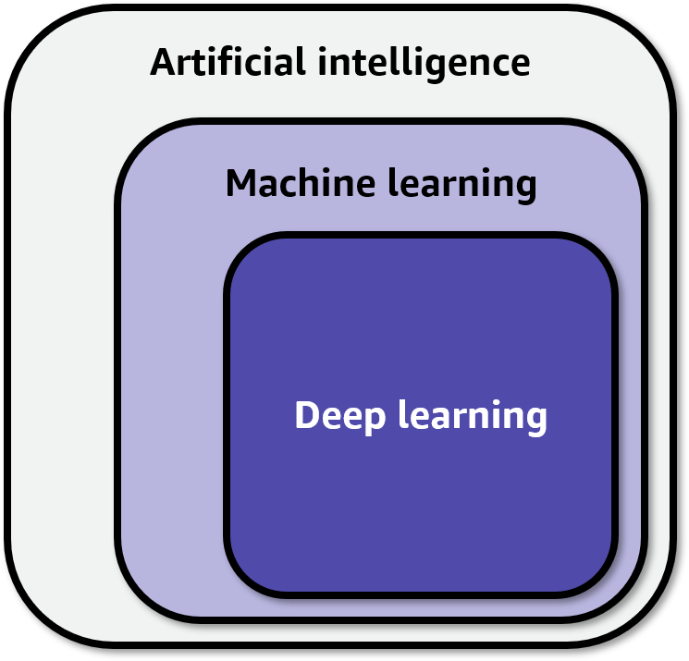
Where does deep learning fit in with AI/ML?
AI: Making machines act in ways that are similar to how humans act
ML: Giving machines the ability to learn from examples
Deep learning: Learning hierarchies of features from data
Notes:
~Alt text: Deep learning is a subset of ML, which is a subset of AI.
~Able to use? Deep learning figure 1.4 ~http://www.deeplearningbook.org/contents/intro.html

Slide 6

How does deep learning differ from classical ML?
Deep learning learns by constructing hierarchies of features (deep representation).
In deep learning, features emerge as relevant to predictions. Features aren’t built by hand.
Classical ML
Deep learning
Notes:
~Alt text – Classical ML: Flow diagram for classical ML. Starts with raw data and goes to handmade features and then learned model. Ends with final predictions.
~Alt text – Deep learning: Flow diagram for deep learning. Starts with raw data and goes to a series of learned feature steps. Ends with a learned model that is used to make final predications.
~
Deep learning aims to learn ML models by constructing hierarchies of features (a deep representation), rather than shallow ML models that are built on hand-constructed features. These features emerge as relevant to predictions from the data and are not built by hand.
Classical ML refers to models that don’t use deep learning architectures. With classical ML, you need to manually prepare and manipulate the features (perform feature engineering) before you can offer the dataset to train the model.
While classical ML learns how to predict classes or numbers from labeled datasets, deep learning models can learn the features, which means that the model can learn internal representations from the features. The term hierarchies of features is related to the fact that different layers in a deep learning model can learn different representations from the features in the dataset. The hierarchy is related to which type of representation each layer learns.
The representation concept here is not intuitive and can be better understood via examples.
Examples of representations include the following:
In natural language processing (NLP) model words, simple combinations of characters can represent real and abstract entities, such as cat, dog, and love.
In computer vision (CV) model images, simple combinations of pixels can represent real objects, such as cats, cars, and people.

Slide 7
Learning hierarchies of representations
Repeated across many different ML domains:
Computer vision (CV)
Natural language processing (NLP)
Notes:
~Alt text – CV example: Flow diagram for CV processing. See description in notes.
~Alt text – NLP example: Flow diagram for NLP processing. See description in notes.
~
The concept of learning hierarchies of representations can be repeated across many different domains of ML.
CV example
In this example, the first box on the left represents the input data (raw pixels) to the deep learning model. The last box on the right represents the output or prediction from the model (for example, the objects to predict in the image, such as cats or dogs).
The intermediate boxes represent the different layers of the deep learning model. The first layer of the model specializes in learning about edges in the image data. The second layer specializes in learning corners and curves, the next layer learns basic shapes, and so on. The last layer learns how to identify coherent objects.
The hierarchy of representation is expressed by how each layer specializes to a particular level of abstraction of the representation. The hierarchy starts with low-level representations in the image, such as edges and corners, and moves through higher-level representations until the last layer, in which the model can learn to detect coherent objects. This is the hierarchy that the previous slide referred to.
NLP example
In this example, the first box on the left represents the input data (for example, text from product reviews) to the deep learning model. Again, the last box on the right represents the output or prediction from the model (for example, whether the sentiment expressed in a review is positive or negative).
The intermediate boxes represent the different layers of the deep learning model. The first layer of the model specializes in learning about word meanings in the text data. The second layer specializes in learning phrase meanings, the next layer learns sentence meanings, and so on. The last layer learns how to identify full document meanings.
For this example, the hierarchy of representation is also expressed by how each layer specializes to a particular level of abstraction of the representation. The hierarchy starts with low-level representations in the text, such as word and phrases meanings, and moves through higher level representations until the last layer, in which the model can learn full document meanings.

Slide 8
Deep learning: Encoding domain knowledge
Neural networks allow for incorporation of domain knowledge into network design. This eases the learning process.
For example, adding knowledge about the following:
Linguistics to deal with NLP
Image processing for CV problems
Notes:
Neural networks are distinguished in the world of ML by the fact that you can engineer them rather easily.
Deep learning models allow for the incorporation of domain knowledge into the network design itself, which makes the learning process easier (use the network architecture as a form of prior). For example, you can bring knowledge about linguistics to handle a natural language process or bring knowledge about image processing for CV-related problems.
Particular deep learning architectures can be fitted to incorporate domain characteristics, such as a recurrent neural network (RNN) for the NLP domain or a convolutional neural network (CNN) for the CV domain.
For more information about image priors, see Deep Image Prior at https://dmitryulyanov.github.io/deep_image_prior.

Slide 9
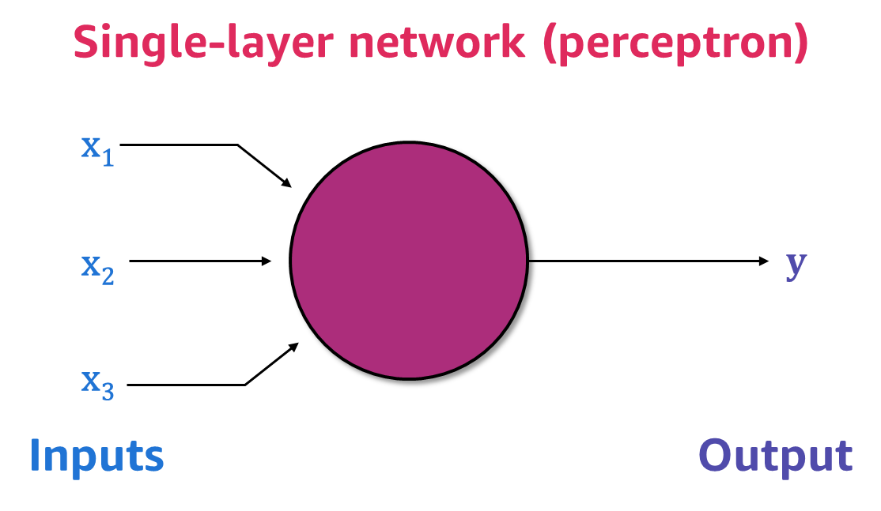
Basic neural networks: Single-layer models
A neural network is typically made of many stacked layers of interconnected components.
A single-layer model is designed to mirror the behavior of a single neuron and is also known as a perceptron.
Notes:
~Alt text: Single-layer network with an input dimension of 3 and output dimension of 1.
~
As seen previously, neural networks are typically made of many stacked layers or interconnected components. However, let’s start small to understand the basic theory with a single-layer network.
In terms of biological motivation, this type of model was originally designed to mirror the behavior of a single neuron (although it’s now known that biological neurons are quite sophisticated).
For more information about biological neurons, see the following resources:
“Dendritic Action Potentials and Computation in Human Layer 2/3 Cortical Neurons” in Science, Vol. 367, No. 6473 at https://doi.org/10.1126/science.aax6239
“Single Cortical Neurons as Deep Artificial Neural Networks” in Neuron, Vol. 109, No. 17 at https://doi.org/10.1016/j.neuron.2021.07.002

Slide 10
Single-layer neural networks

Slide 11
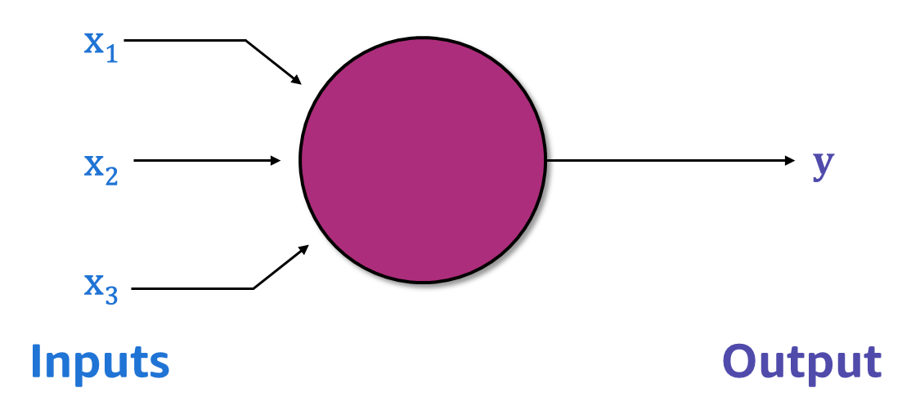
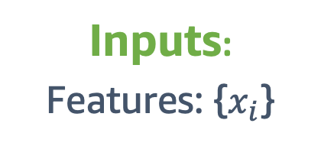
Artificial neural networks: Elements
Inputs:
Features: {$x_{i}$}
These inputs are the features that you learned previously.
Notes:
~Equations
~Image marked as decorative because it’s a duplicate from the previous slide.
~
Loss functions quantify the distance between the real and predicted values of the target. An optimization problem seeks to minimize a loss function.
An artificial neuron (also sometimes referred to as a perceptron) is the fundamental unit of an artificial neural network. A typical artificial neuron consists of input values, biases that are applied to those inputs, and an output value.

Slide 12
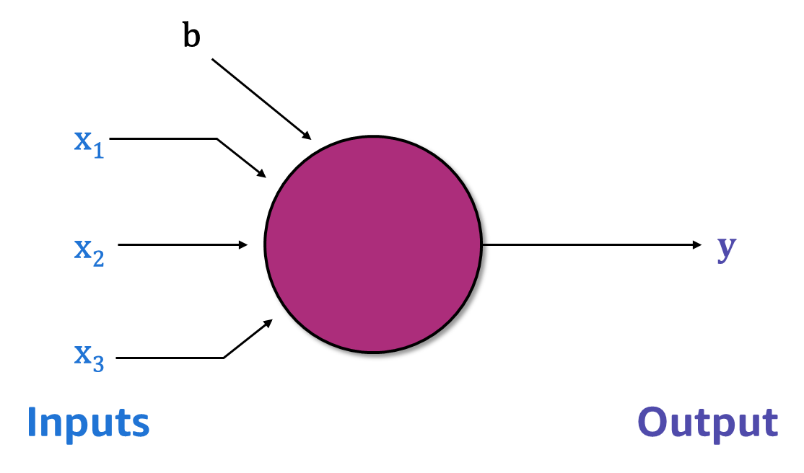
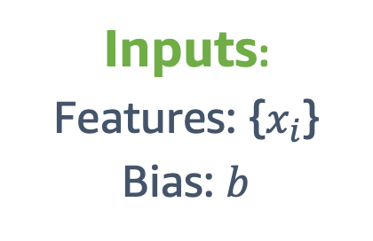
Artificial neural networks: Bias
Inputs:
Features: {$x_{i}$}
Bias: $b$
b is called the bias term.
It’s a constant input, usually 0 or 1.
You will learn more about bias later.
Notes:
~Equations
~Alt text: Single-layer network that was displayed previously. A bias term was added.

Slide 13

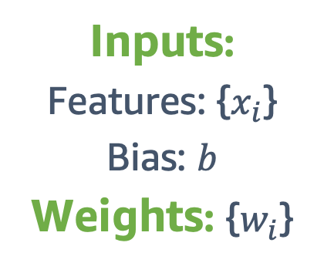
Artificial neural networks: Weights
Inputs:
Features: {$x_{i}$}
Bias: $b$
Weights: {$w_{i}$}
These are the same weights that you learned about previously.
Notes:
~Equations
~Alt text: Single-layer network that was displayed previously. Weights are now associated with each connection.

Slide 14
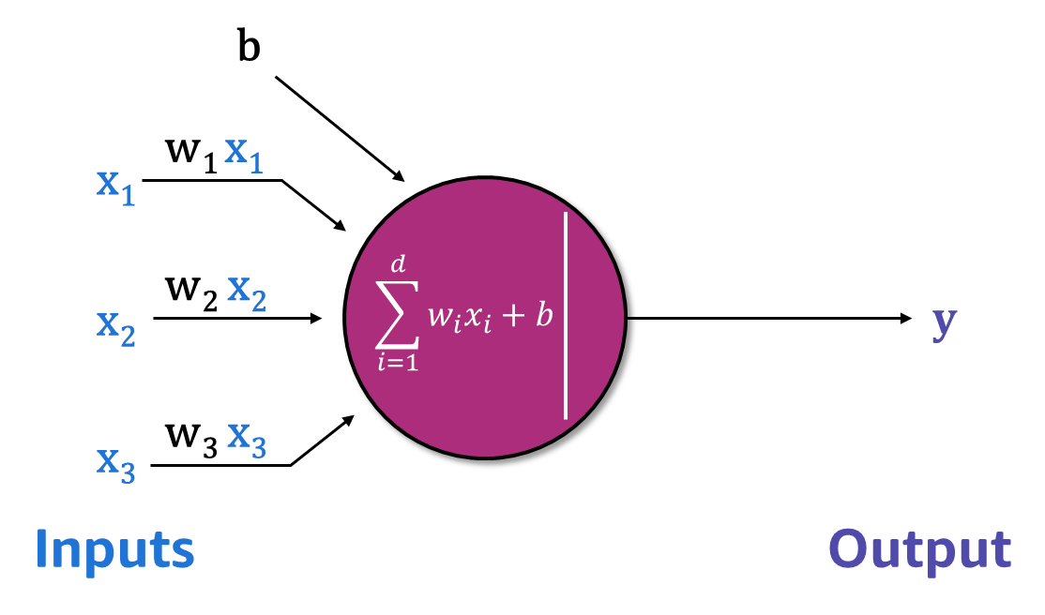
Artificial neural networks: Input
Inputs:
Features: {$x_{i}$}
Bias: $b$
Weights: {$w_{i}$}
The perceptron’s input is a weighted sum of the inputs and the weights, plus the bias term (left side of the line inside the neuron).
Notes:
~Equations
~Alt text: Single-layer network that was displayed previously. The weights and inputs are combined linearly.
~
The line in the neuron (circle) is separates the input from the output.

Slide 15
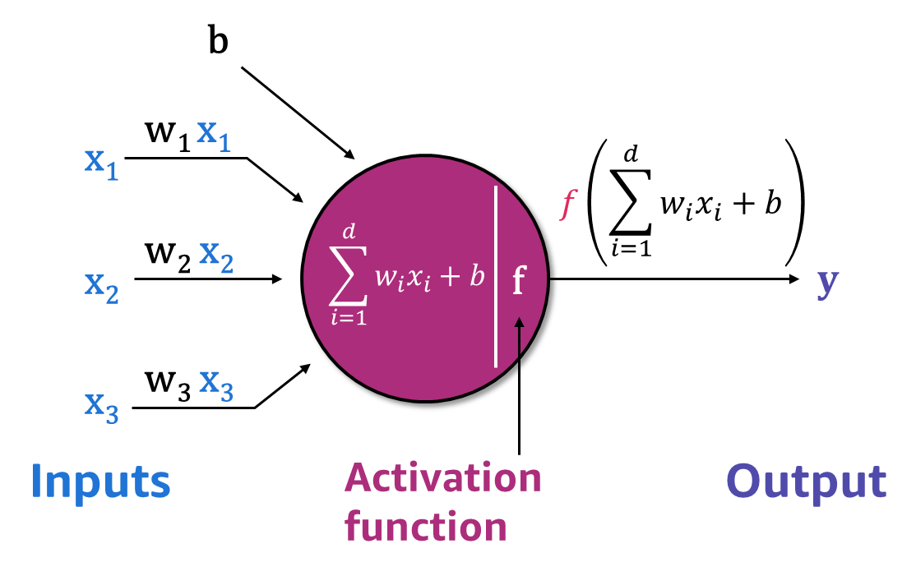

Artificial neural networks: Activation function
Inputs:
Features: {$x_{i}$}
Bias: $b$
Weights: {$w_{i}$}
Activation function: $f$
You will learn more about activation functions in the next module.
For now, consider it to be a function that receives the neuron input and transforms it into the neuron output (right side of the line inside the neuron).
Notes:
~Equations
~alt text: Single-layer network that was displayed previously. The activation function transforms the weighted sum of features and produces the neuron output.

Slide 16

Artificial neural networks: Loss function
Recall that the loss function is a function of the weights.
The same kind of function you have seen previously.
Inputs:
Features: {$x_{i}$}
Bias: $b$
Weights: $\left\{w_{i}\right\}$
Activation function: $f$
Loss function: $L(w_{i})$
Notes:
~Equations

Slide 17


Linear regression (neuron representation)
Given {$x_{i}$}, {$w_{i}$}, and $b$, predict linear regression outputs:
$$\hat{y}=w_{1}x_{1}+w_{2}x_{2}+…+w_{d}x_{d}+b$$
Activation function:
$$f\left(x\right)=x$$
Given ground truth label $y$, find weights and bias so that:
$y≈w_{1}x_{1}+w_{2}x_{2}+…+w_{d}x_{d}+b$
Loss function:
$$L\left(y,\hat{y}\right)=\frac{1}{n}\sum_{i=1}^{n}{{\left(y_{i}−{\hat{y}}_{i}\right)}^{2}}$$
Notes:
~Equations
~Alt text: Single-layer network that was displayed previously with the activation function.
~
Linear regression: Pass the weighted sum to the neuron unit, and then apply the activation function to generate output, y.
Dimension, which is the number of input features, is represented as d (in x_{d} and w_{d}).

Slide 18
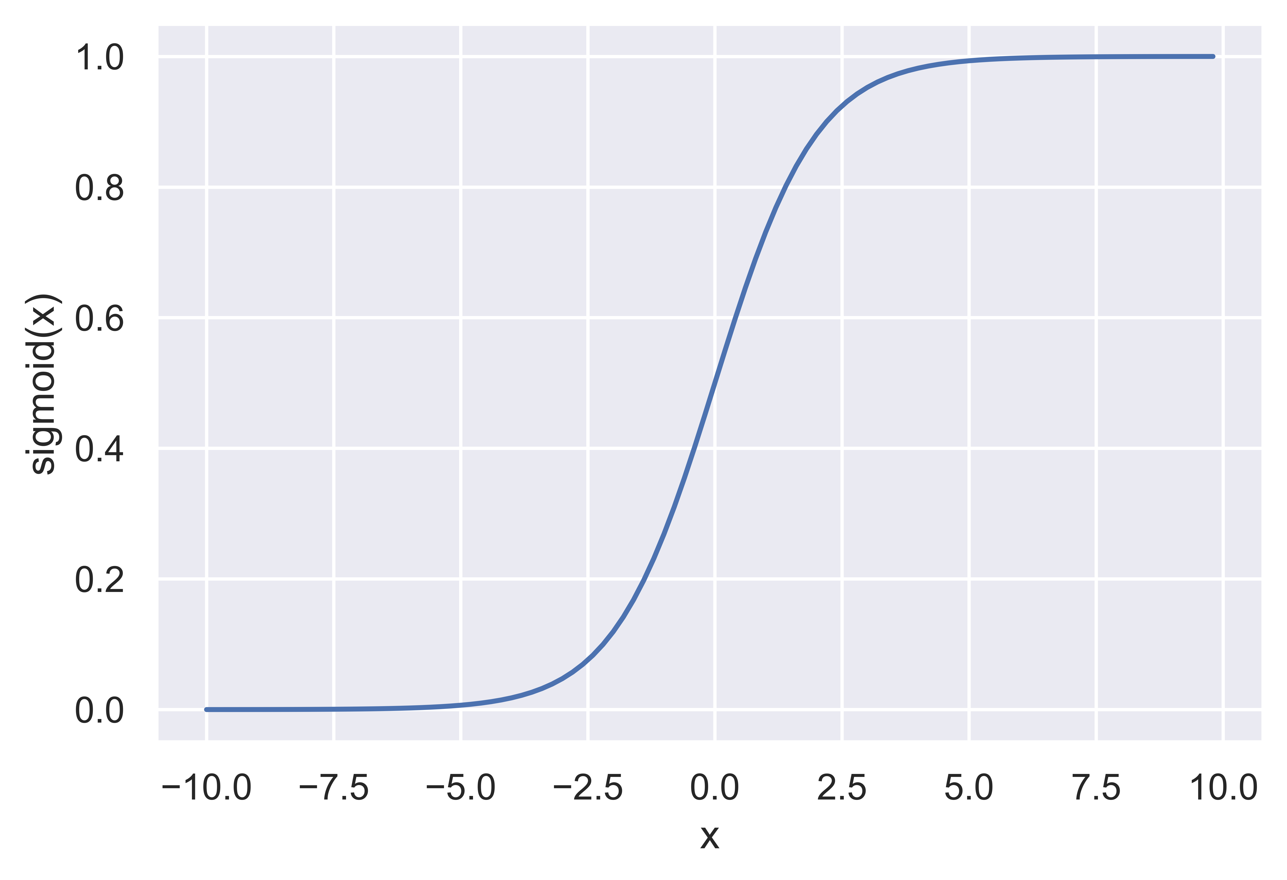
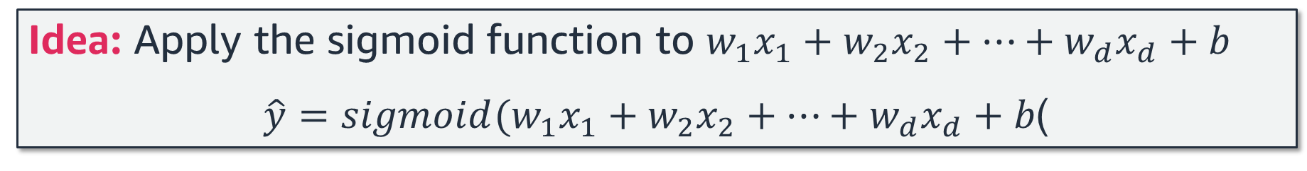
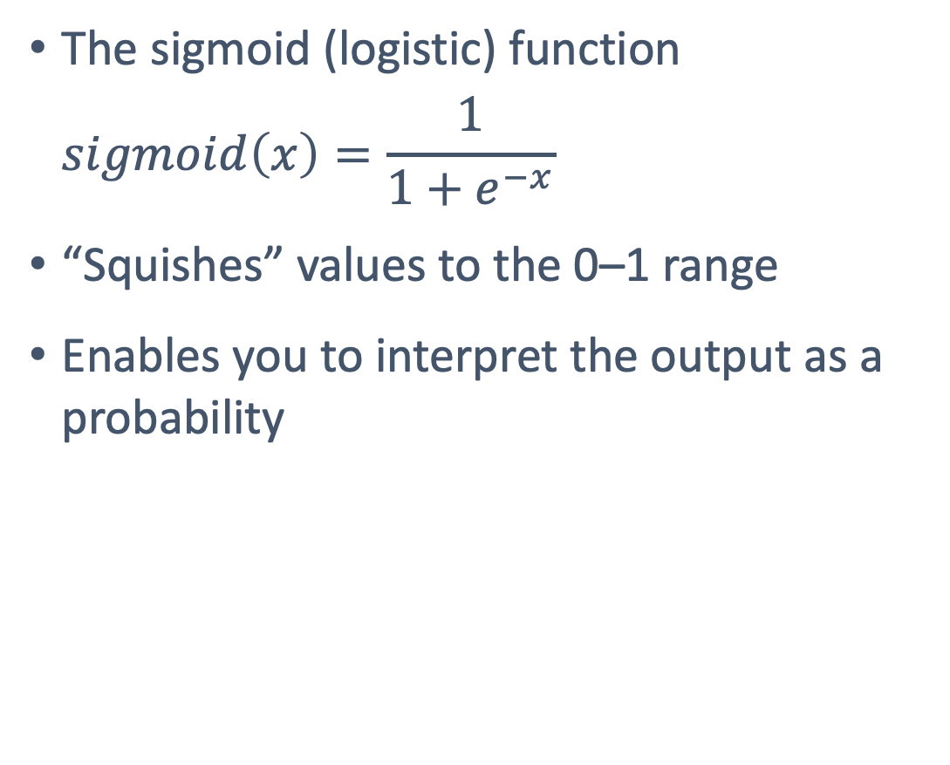
Recall logistic regression
The sigmoid (logistic) function
$$sigmoid\left(x\right)=\frac{1}{1+e^{−x}}$$
“Squishes” values to the 0–1 range
Enables you to interpret the output as a probability
Idea: Apply the sigmoid function to $w_{1}x_{1}+w_{2}x_{2}+…+w_{d}x_{d}+b$
$\hat{y}={sigmoid(w}_{1}x_{1}+w_{2}x_{2}+…+w_{d}x_{d}+b$)
Notes:
~Equations
~\hat{y} = w_1 x_1 + w_2 x_3 + ... + w_d x_d + b
~Alt text: Plot of the sigmoid function.

Slide 19
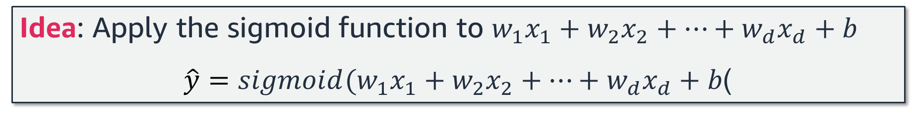
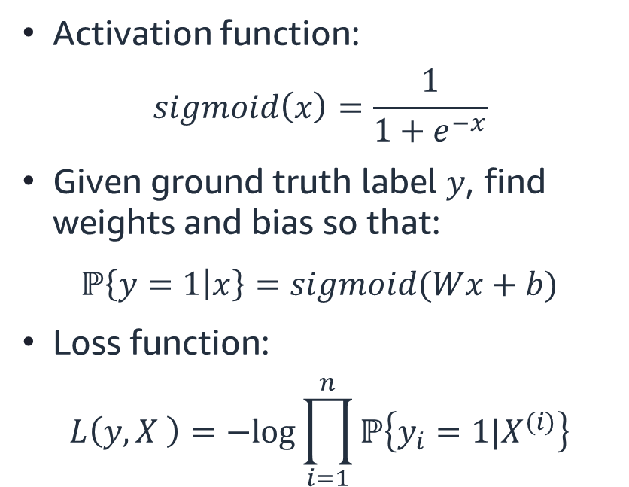
Logistic regression (neuron representation)
Idea: Apply the sigmoid function to $w_{1}x_{1}+w_{2}x_{2}+…+w_{d}x_{d}+b$
$\hat{y}={sigmoid(w}_{1}x_{1}+w_{2}x_{2}+…+w_{d}x_{d}+b$)
Activation function:
$$sigmoid\left(x\right)=\frac{1}{1+e^{−x}}$$
Given ground truth label $y$, find weights and bias so that:
$ℙ\left\{y=1 | x\right\}=sigmoid(Wx+b)$
Loss function:
$$L\left(y,X \right)=−log⁡\prod_{i=1}^{n}{ℙ\left\{y_{i}=1|X^{(i)}\right\}}$$
Notes:
~Equations
~Image marked as decorative because it’s a duplicate from previous slides.

Slide 20

Next lesson
How does a neural network learn?

Slide 22
Image source slide (for curriculum development use only)

Slide 23
Source graphic: Where does deep learning fit in with AI/ML?
Artificial intelligence
Machine learning
Deep learning
Notes:
~Source for slide 5

Slide 24
Source graphic: How does deep learning differ from classical ML?
Raw
data
Handmade features
Learned
model
Final predictions
Raw
data
Learned
features
Learned
features
Learned
features
…
Learned model
Final predictions
Notes:
~Source for slide 6

Slide 25
Source graphic: Learning hierarchies of representations
Raw
pixels
Edge features
Corners and curves
Basic shapes
Coherent objects
Final predictions
…
Raw
text
Word meanings
Phrase meanings
Sentence meanings
Document meanings
Final predictions
…
Notes:
~Source for slide 7

Slide 26

Source graphic: Basic neural networks: Single-layer models
Single-layer network (perceptron)
x₁
x₂
$$y$$
x₃
Inputs
Output
Notes:
~Source graphic for slide 9

Slide 27
Source graphic: Artificial neural networks: Elements
x₁
x₂
$$y$$
x₃
Inputs
Output
Notes:
~Source for slide 11

Slide 28
Source graphic: Artificial neural networks: Bias
b
x₁
x₂
$$y$$
x₃
Inputs
Output
Notes:
~Source for slide 12

Slide 29
Source graphic: Artificial neural networks: Weights
b
w₁
x₁
w₂
x₂
$$y$$
w₃
x₃
Inputs
Output
Notes:
~Source for slide 13

Slide 30

Source graphic: Artificial neural networks: Input
b
w₁ x₁
x₁
w₂ x₂
$$\sum_{i=1}^{d}{w_{i}x_{i}}+b$$
x₂
$$y$$
w₃ x₃
x₃
Inputs
Output
Notes:
~Source for slide 14

Slide 31

Source graphic: Artificial neural networks: Activation function
b
w₁ x₁
x₁
$$f\left(\sum_{i=1}^{d}{w_{i}x_{i}+b}\right)$$
w₂ x₂
$$\sum_{i=1}^{d}{w_{i}x_{i}}+b$$
x₂
f
$$y$$
w₃ x₃
x₃
Inputs
Activation
function
Output
Notes:
~Source for slides 15, 17, and 19

