Slide 1
First Examples of Neural Networks
Application of Deep Learning to Text and Image Data
Module 1 – Lesson 3

Slide 2
Today’s activities
Applying the gradient descent method in different ways
Full-batch
Stochastic
Mini-batch
Using regularization methods to prevent overfitting
Early stopping
Weight decay
Dropout

Slide 3
Applying the gradient descent method in different ways

Slide 4
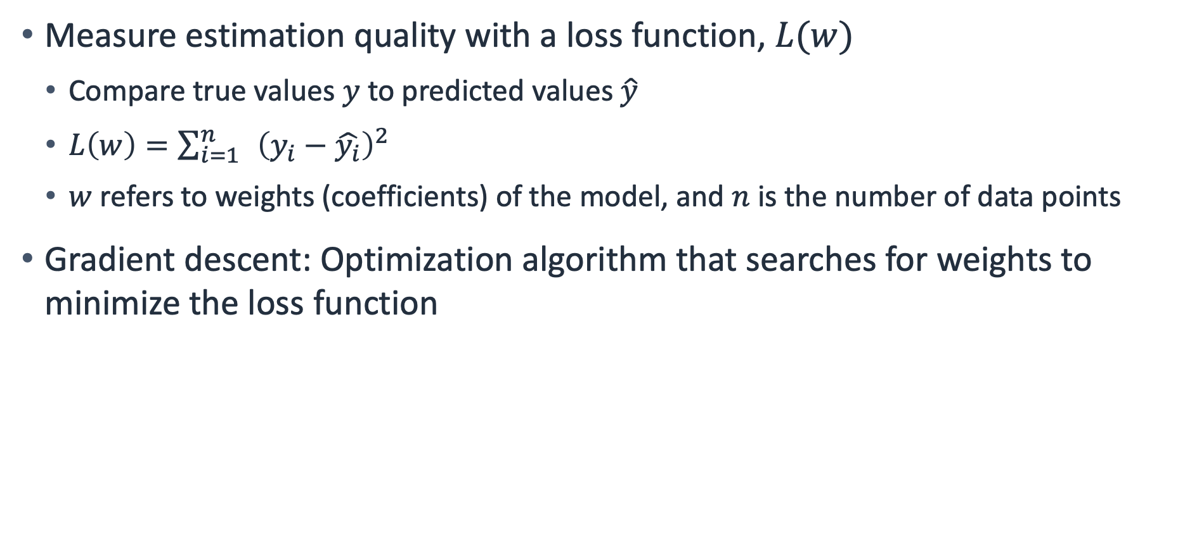
Review: Loss functions and gradient descent
Measure estimation quality with a loss function, $L(w)$
Compare true values $y$ to predicted values $\hat{y}$
$L\left(w\right)=\sum_{i=1}^{n}{ }{\left(y_{i}−\hat{y_{i}}\right)}^{2}$
$w$ refers to weights (coefficients) of the model, and $n$ is the number of data points
Gradient descent: Optimization algorithm that searches for weights to minimize the loss function
Notes:
~Equations
~
Remember: To measure the estimation quality of a network, compare the true values $y$ to the predicted values $\hat{y}$by defining a loss function L(w).

Slide 5
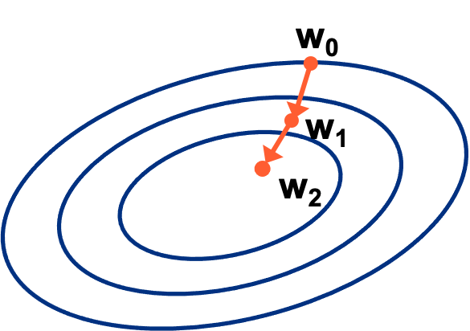
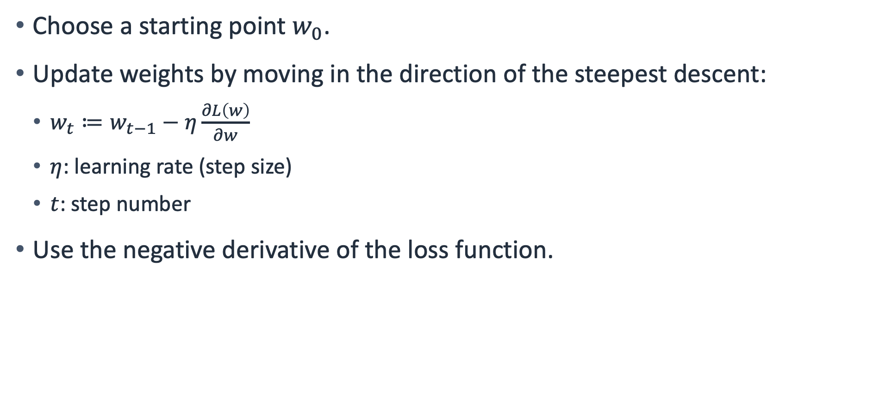
How gradient descent works
Choose a starting point $w_{0}$.
Update weights by moving in the direction of the steepest descent:
$w_{t}≔w_{t−1}−η\frac{∂L\left(w\right)}{∂w}$
$η$: learning rate (step size)
$t$: step number
Use the negative derivative of the loss function.
Notes:
~Equations
~Alt text: Plot of a gradient descent algorithm with iterative weights being applied to it.
~
The learning rate hyperparameter $η$ specifies the step size. It starts at 1 and increases with each step. After each update, the loss gets smaller and smaller.
The negative derivative of the loss function will be used in the equation (the negative sign in the weight update equation). This allows it to move in the opposite direction of the increase.

Slide 6
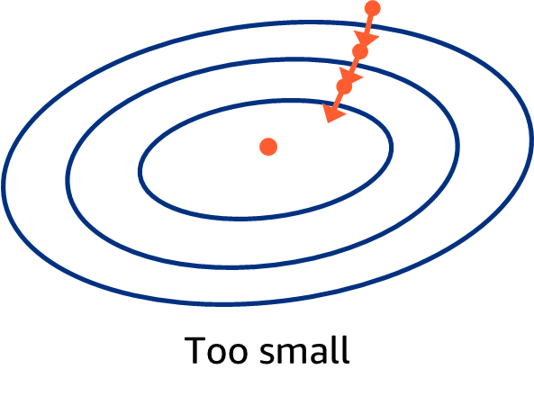
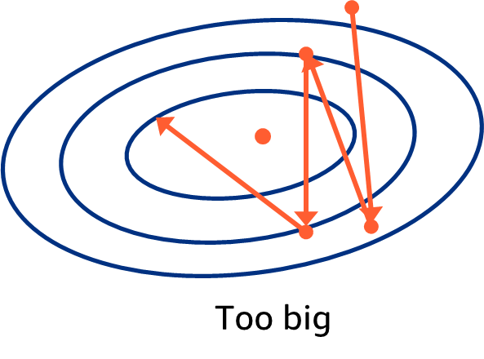
Learning rate
You can manually set the learning rate 𝜂:
Too small: Might not get to the optimal solution within the training time that is available
Too large: Might overshoot the optimal solution
Notes:
~Alt text – too small: Plot of gradient descent algorithm with a small learning rate step size. The optimal solution is never reached.
~Alt text – too big: Plot of gradient descent algorithm with a large learning rate step size. The optimal solution is missed.
~
The algorithm designer can set the learning rate 𝜂:
Too small: Updates slowly, requiring more iterations to get a better solution; risk of not getting to the optimal solution
Too large: Might overshoot the optimal solution

Slide 7
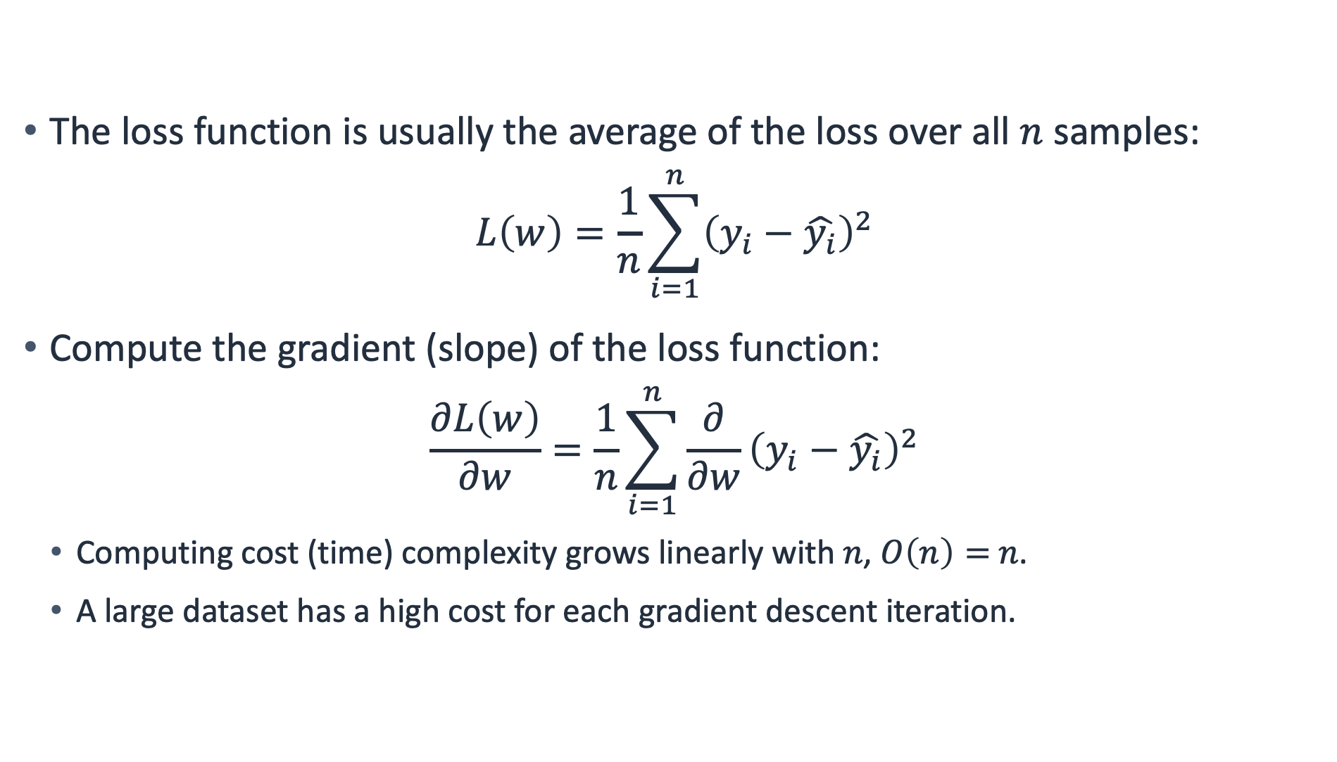
Full-batch gradient descent
The loss function is usually the average of the loss over all $n$ samples:
$$L\left(w\right)=\frac{1}{n}\sum_{i=1}^{n}{{\left(y_{i}−\hat{y_{i}}\right)}^{2}}$$
Compute the gradient (slope) of the loss function:
$$\frac{∂L\left(w\right)}{∂w}=\frac{1}{n}\sum_{i=1}^{n}{\frac{∂}{∂w}}{\left(y_{i}−\hat{y_{i}}\right)}^{2}$$
Computing cost (time) complexity grows linearly with 𝑛, $O\left(n\right)=$ 𝑛.
A large dataset has a high cost for each gradient descent iteration.
Notes:
~Equations
~
The objective function is usually the average of the loss functions for each example in the training dataset. For a dataset with n examples, the computing cost for each gradient descent iteration is O(𝑛), which grows linearly with 𝑛. When the training dataset is large, the cost of gradient descent for each iteration is high.
Big O notation
O(n) is big O notation and refers to the complexity of a given algorithm. The n value refers to the size of the input—in this case, it's the number of items in a list.
O(n) means that the algorithm will take on the order of n operations to insert an item (for example, looping through the list once) (or a constant number of times, such as twice or only looping through half).
O(1) means it takes a constant time, which isn’t dependent on how many items are in the list.
O(n^2) means that, for every insert, it takes n*n operations (for example, 1 operation for 1 item, 4 operations for 2 items, and 9 operations for 3 items). As you can see, O(n^2) algorithms become inefficient to handle large numbers of items.
For more information, see Big O Notation on Wikipedia at https://en.wikipedia.org/wiki/Big_O_notation.

Slide 8
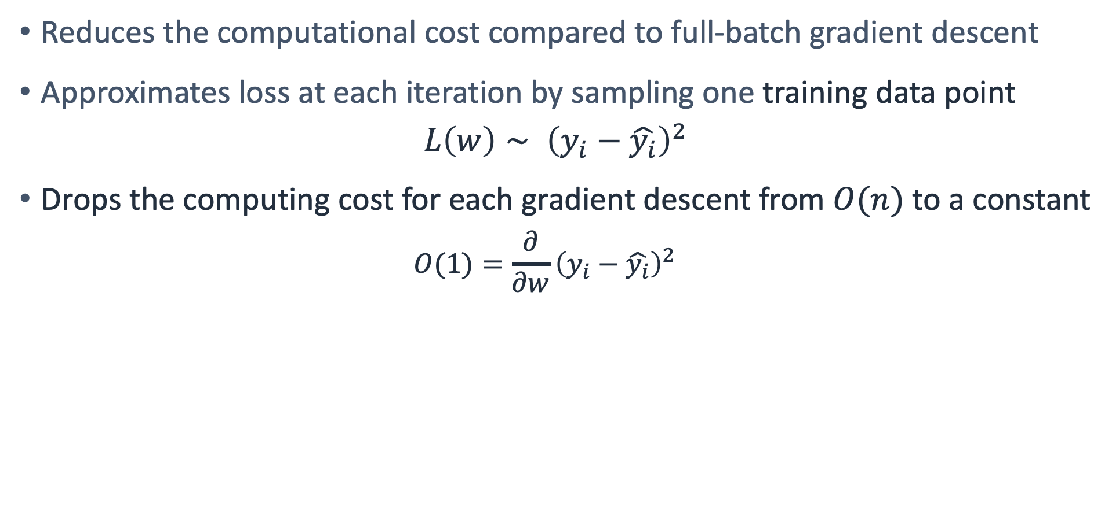
Stochastic gradient descent (1 of 2)
Reduces the computational cost compared to full-batch gradient descent
Approximates loss at each iteration by sampling one training data point
$$L\left(w\right)∼ {\left(y_{i}−\hat{y_{i}}\right)}^{2}$$
Drops the computing cost for each gradient descent from $O(n)$ to a constant
$$O(1)=\frac{∂}{∂w}{\left(y_{i}−\hat{y_{i}}\right)}^{2}$$
Notes:
~Equations
~
Stochastic gradient descent, which is sometimes abbreviated as SGD, reduces computational cost by randomly sampling only one training data instance to approximate the loss function at each iteration. In these formulas, the i represents the training data instance.
This approach improves the computational cost, but it requires you to update the weights to consider only a single data point instead of the whole training dataset (and averaging). Therefore, it’s more likely to cause a noisier weight update process (meaning more fluctuations in the loss value while training progress).

Slide 9
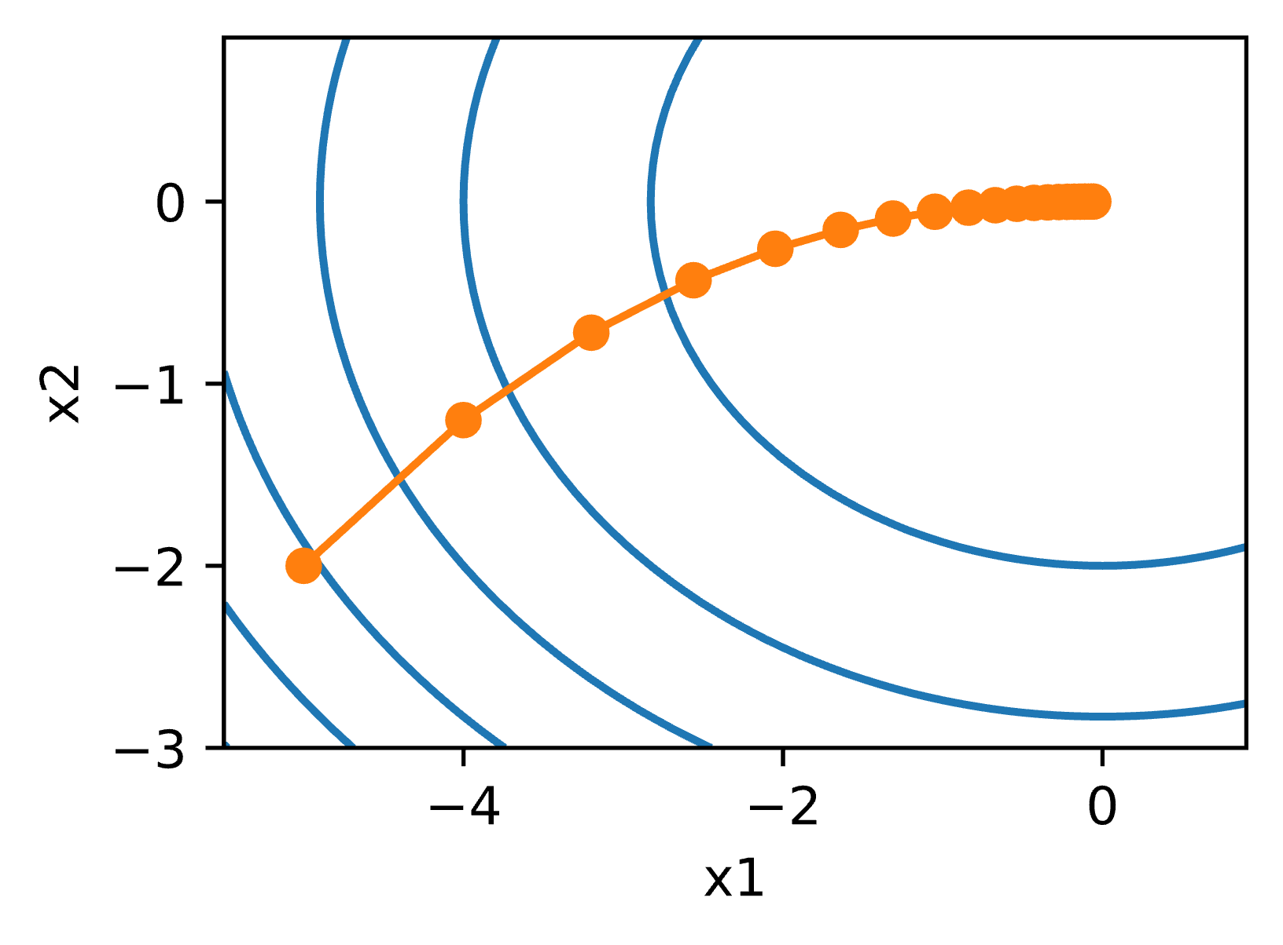
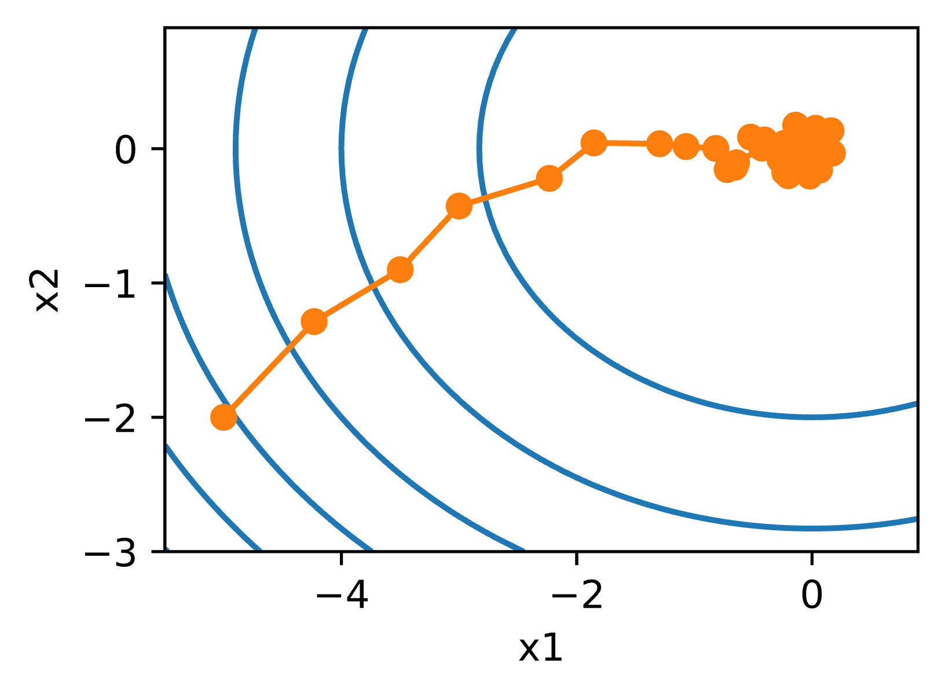
Stochastic gradient descent (2 of 2)
Much noisier than full-batch gradient descent
Full-batch gradient descent
Stochastic gradient descent
Notes:
~Alt text – full-batch: Plot showing full-batch gradient descent as a smooth process.
~Alt text – stochastic: Plot showing stochastic gradient descent as a noisier process than full-batch gradient descent.
~
Stochastic gradient descent is likely to cause a noisier weight update process because of the lack of data points that are considered in the process. Full-batch gradient descent uses a whole dataset and averages the outcome, which removes the noise. Noise here refers to the path that is not too smooth in the stochastic gradient descent compared to the full-batch counterpart.
In the figures on the slide, x1 and x2 refer to the axes for the two weights that are being updated. Think of each dot as w1 and w2. When moved from one dot to another, both w1 and w2 change.

Slide 10
Comparing full-batch and stochastic gradient descent
Full-Batch Gradient Descent | Stochastic Gradient Descent
Uses the full dataset to compute gradients and update parameters | Processes one observation at a time
Pro: Smooth optimization path | Pro: Faster computation
Drawback: Slow; not efficient when data samples are similar | Drawback: Not computationally efficient; noisy optimization path
Notes:
Is another option available? The next slide helps to address this.

Slide 11
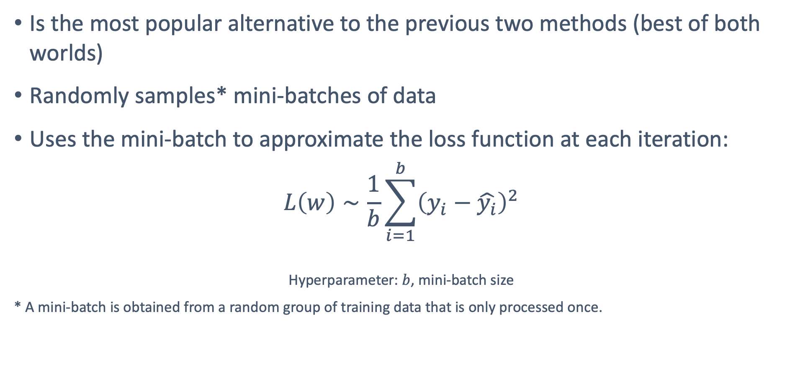
Mini-batch stochastic gradient descent
Is the most popular alternative to the previous two methods (best of both worlds)
Randomly samples* mini-batches of data
Uses the mini-batch to approximate the loss function at each iteration:
$$L\left(w\right)∼\frac{1}{b}\sum_{i=1}^{b}{{\left(y_{i}−\hat{y_{i}}\right)}^{2}}$$
Hyperparameter: $b$, mini-batch size
* A mini-batch is obtained from a random group of training data that is only processed once.
Notes:
~Equations
~
Mini-batch stochastic gradient descent increases computational efficiency by randomly sampling a mini-batch of training data instances to approximate the loss function at each iteration. A mini-batch is obtained by a random permutation of the training data—in other words, each observation is processed only once, although in random order. The gradient update over a single observation is replaced by one over the mini-batch, which stabilizes the optimization path.
The number of batches is equal to the number of iterations in one epoch. For example, if you have 2,000 training examples, you can divide the dataset of examples into batches of 500. Then, it would take 4 iterations to complete 1 epoch.
Note: Most of the time mini-batch stochastic gradient descent is referred to as mini-batch gradient descent for short.

Slide 12
Mini-batch size (b)
Can be manually set
Too small: Small workload, won’t fully utilize compute resources (such as fast matrix multiplications in weight calculations)
Too large: Large workload, memory issues, wastes compute resources when the samples in the batch are identical
Should be set large enough to offer good compute efficiency without causing memory issues

Slide 13
Using regularization methods to prevent overfitting

Slide 14
Regularization
Regularization helps train ML models that generalize better beyond their training datasets.
The following are the three main methods:
Early stopping
Weight decay
Dropout
Notes:
Neural networks are prone to overfitting, especially when layers are added and neurons are added to layers.

Slide 15
Regularization method: Early stopping
ML models pass through phases during training:
If training stops too early, the model will be unchanged from random initialization (underfit).
If training doesn’t stop too early or too late, the model will learn patterns that generalize (good fit).
If training takes too long, the model will start to learn the noise in the training set (overfit).
When trained too long, the performance (accuracy, average errors) on the unseen sets, such as validation or test sets, might start to degrade.

Slide 16
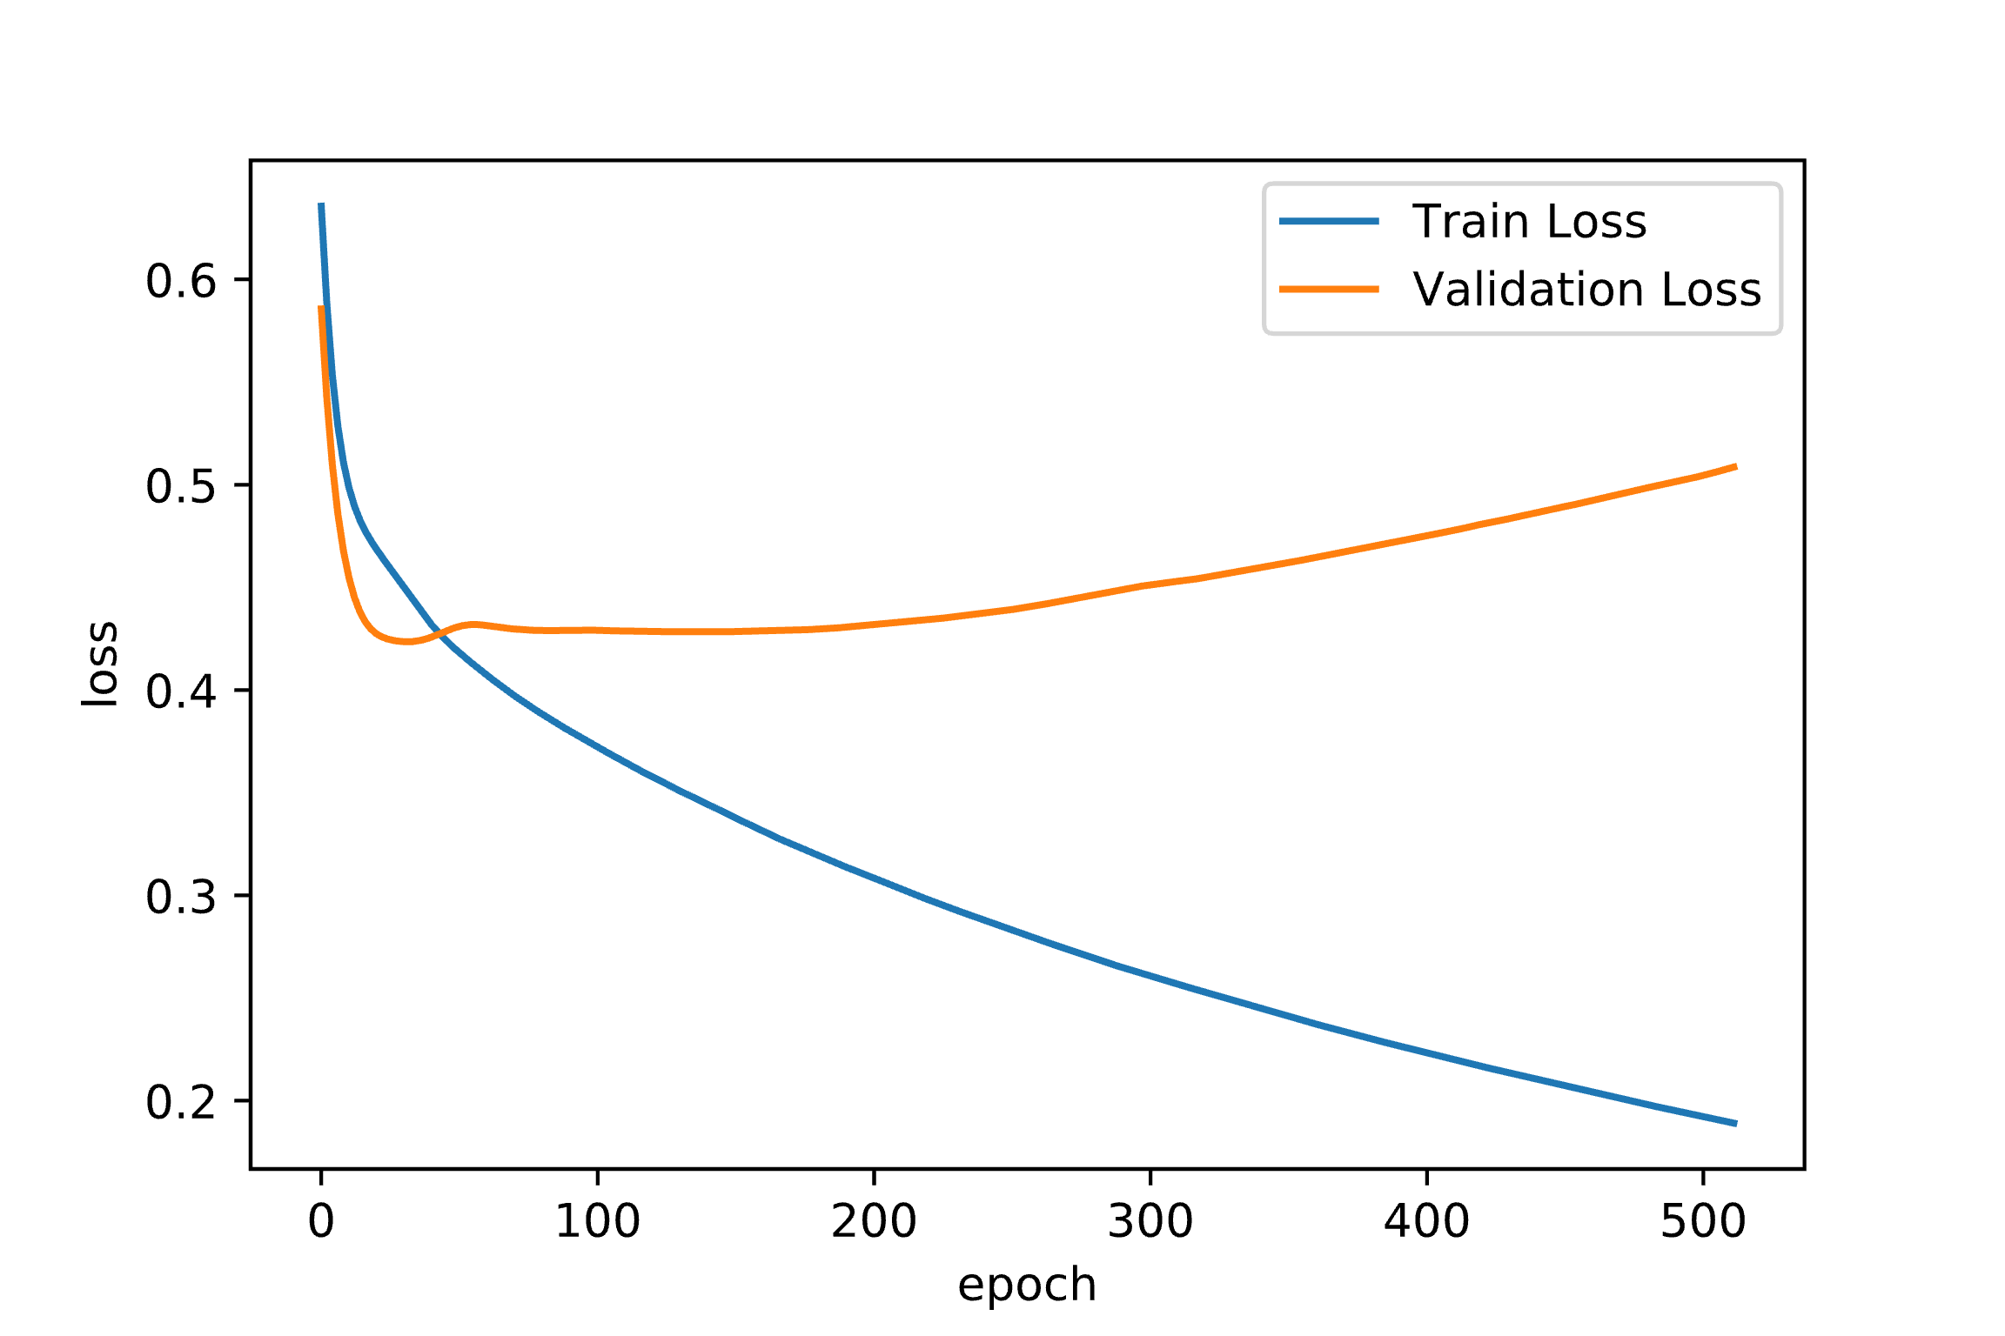
Early stopping example
Assume that you trained an ML model for 500 epochs:
Validation loss is minimized before 50 epochs.
Training should be stopped at that time.
Training loss continues to decrease while validation loss increases (overfit).
Best fit
Notes:
~Alt text – plot: Plot of training and validation against epoch. Over 500 epics, the best fit is reached before the fiftieth epoch.
~Alt text – arrows: Arrow indicating the point where validation loss is the smallest, which indicates the best fit.
~
The figure on the slide shows training and validation loss as a function of epoch for a small example network. Note that the validation loss is minimized before 50 epochs, so training should be stopped at that time. Meanwhile, the training loss continues to decrease.

Slide 17
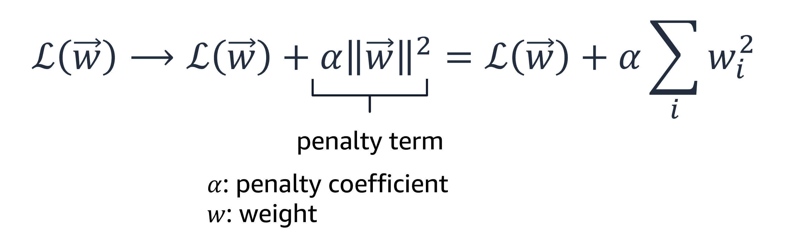
Regularization method: Weight decay
Overfitting sometimes can be associated with rapidly shifting values in predictions.
Large weights can lead to these rapid output changes in the network.
You can partially control overfitting by penalizing large values. Add a large term to the loss function when the weights are large:
Notes:
~Alt text: Loss function with labels. See details in slide notes.
~
Large weights make the network unstable. Although the weight will be specialized to the training dataset, minor variation or statistical noise on the expected inputs will result in large differences in the output. Generally, you can refer to this model as having a large variance and a small bias. In other words, the model is sensitive to the statistical noise in the training dataset.
A model with large weights is more complex than a model with smaller weights. It’s a sign of a network that might be overly specialized to training data. In practice, it’s preferred to choose the simpler models (models with smaller weights) to solve a problem.
With weight decay, you can keep the weights under control. The added term has a penalty coefficient and summation of squared weights. When weights change quickly and in large amounts, the model can overfit the data. An added penalty term makes it more difficult to overfit.

Slide 18
Regularization method: Dropout
The classical generalization theory suggests that simple models can help reduce overfitting. Therefore, aim for simple models.
One way to achieve simple models is to simplify a given architecture by randomly removing some neurons from it.
Due to its randomness, this process also forces the network to not easily memorize the training samples.
Notes:
Dropout is one of the most popular regularization methods when training neural networks. This method randomly disables or removes neurons from a network.

Slide 19
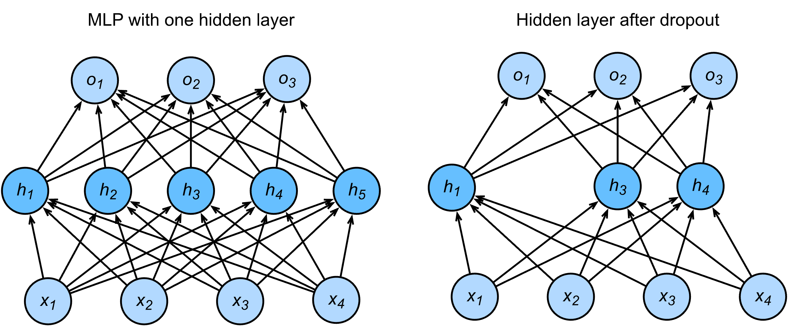
Dropout example
Notes:
~Alt text: Diagram of a network before an after dropout. See details in slide notes.
~
Image description: Diagram of a multilayer network before and after dropout. Before dropout, the network has an input layer with four features, a hidden layer with five neurons, and an output layer with three neurons. After dropout, the input and output layers are the same, but the hidden layer has only three neurons. End description.
See the contrast between the two networks that are shown on the slide. When dropout is used, some neurons are randomly removed.

Slide 20
Dropout in practice
During training: Set a retention probability for your layer to specify the probability that a unit (neuron) isn’t dropped.
For example: If you set the retention probability to 0.8, the units (neurons) in that layer have an 80 percent chance of remaining active and a 20 percent chance of being dropped.
During validation and test: Don’t apply dropout. Use the whole neural network.
Notes:
To apply dropout, you need to set a retention probability for each layer. The retention probability specifies the probability that a unit is not dropped. For example, if you set the retention probability to 0.8, the units in that layer have an 80 percent chance of remaining active and a 20 percent chance of being dropped.
Dropout is only used during training to make the network more robust to fluctuations in the training data. At test time, however, you want to use the full network. You shouldn’t use dropout with the test data or during inference in production because, as you disable neurons randomly, your network will have different outputs every (sequences of) activation. This undermines consistency.

Slide 21
Regularization: Review
Early stopping
Stops training when performance degrades on the validation set
Mitigates memorization
Weight decay
Penalizes weights for becoming too large
Mitigates overfitting by controlling how quickly the loss function changes
Dropout
Randomly removes neurons or input features
Mitigates overfitting from false correlations

Slide 22

Next lesson
You will learn about different neural network architectures, such as the following:
Convolutional neural networks (CNNs)
Recurrent neural networks (RNNs)

Slide 24
Image source slide (for curriculum development use only)

Slide 25
Source graphic: How gradient descent works
w₀
w₁
w₂
Notes:
~Source for slide 5

Slide 26
Source graphic: Learning rate
Too small
Too big
Notes:
~Source for slide 6

Slide 27
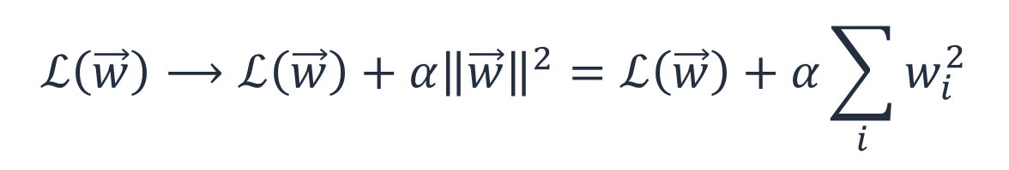
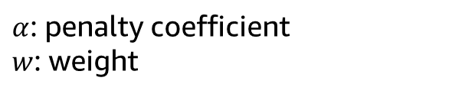
Source graphic: Regularization method: Weight decay
$$ℒ\left(\vec{w}\right)⟶ℒ\left(\vec{w}\right)+{α\left\|\vec{w}\right\|}^{2}=ℒ\left(\vec{w}\right)+α\sum_{i}{w_{i}^{2}}$$
penalty term
$α$: penalty coefficient
$w$: weight
Notes:
~Source for slide 17

