Slide 1
Word Embeddings
Application of Deep Learning to Text and Image Data
Module 2 – Lesson 3

Slide 2
Today’s activities
Semantics in linguistics
Handling words numerically

Slide 3
Semantics in linguistics

Slide 4
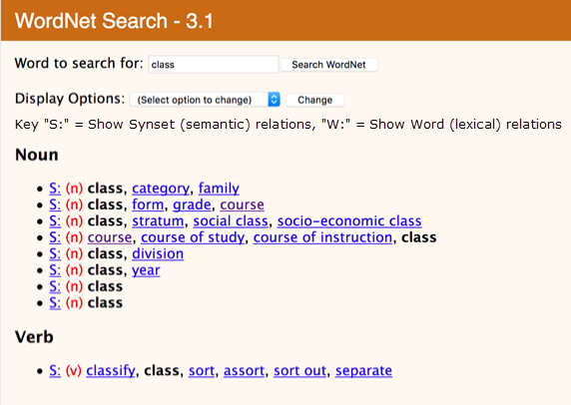
Word semantics
Semantics is the relationship between the form and meaning of words.
Denotational semantics are hard to represent computationally.
WordNet is a hierarchically organized lexical database of semantic relations.
Notes:
In linguistics, semantics is the subfield that studies meaning. Semantics can address meaning at the levels of words, phrases, sentences, or larger units of discourse. One topic that unites different approaches to linguistic semantics is that of the relationship between form and meaning.
WordNet is a lexical database of semantic relations between words in more than 200 languages. WordNet links words into semantic relationships including synonyms, hyponyms, and meronyms.
For the definition of hyponym, see the Cambridge Dictionary at https://dictionary.cambridge.org/us/dictionary/english/hyponym. For the definition of meronym, see Dictionary.com at https://www.dictionary.com/browse/meronym.

Slide 5
Types of word relationships
Term | Example
Synonymy | “class” and “category”
Antonymy | “dark” vs. “light”
Homonymy | “their” and “they’re” and “there”
Polysemy | “bank fees” and “river bank”
Hyponymy | “car” is an instance of “vehicle”
Hypernymy | “vehicle” is a category for “car”
Holonymy | “table” includes “legs”
Meronymy | a “leg” is a part of a “table”
Entailment | If it is a “car” it is also a “vehicle”
Notes:
The slide lists linguistic concepts and relationships that commonly studied in semantics. Each term represents a different way that words can be related to each other:
Synonym: Word that has the same or a similar meaning.
Antonym: Word with the opposite meaning.
Homonym: Word that is spelled or pronounced the same way but has a different meaning.
Polysemous word: Word that has multiple meanings.
Hyponym: Word that denotes a specific instance of a more general class.
Hypernym: Word that describes a set of items more broadly.
Holonym: Word that denotes a whole.
Meronym: Word that denotes a part.
Entailment: Describes the relationship between words where the truth of one word implies the truth of another.
Reference: Daniel Jurafsky and James H. Martin. “Word Senses and WordNet.” Chap. 23 in Speech and Language Processing. 2023. https://web.stanford.edu/~jurafsky/slp3/23.pdf.

Slide 6
Difficulties with WordNet
It can miss nuanced meanings.
It might not have all the words that you need.
Existing words can have meanings that evolve faster than WordNet can keep up.
It doesn’t include phrases.
It doesn’t work as well with verbs and adjectives (less structured hypernymy).
Similarity between words can be difficult for WordNet to compute.
Why is similarity important?
Notes:
Missing nuance: WordNet is a relatively coarse-grained resource that might not capture subtle distinctions in meaning between words. For example, WordNet might equate proficient with good, but these words aren’t interchangeable in all contexts.
Missing words: WordNet might not include all words in a language and might not keep pace with neologisms and changes in usage.
Evolving meanings: WordNet might not capture the full range of meanings and connotations of existing words as they evolve over time. For example, covid might have acquired new meanings and associations since its emergence in late 2019.
No phrases: WordNet is focused on individual words and doesn’t include phrases or multiword expressions.
Limited structure for verbs and adjectives: The hypernymy relationships between verbs and adjectives in WordNet can be less structured and less well-defined than those for nouns.
Difficulty computing similarity: Although WordNet provides a measure of similarity between words, it might not always accurately reflect the semantic relatedness between words in context.
Why is similarity important? Quantifying similarity between the words can help build a better understanding of text data.

Slide 7
Difficulties with the meaning of words
Polysemy
He had a stroke and is in critical condition.
He was critical of many U.S. welfare programs.
Word relations are contextual
Red and green are primary colors. (similar meaning)
Go if the traffic signal turns green, and stop if it is red. (opposite meaning)
Can meaning be defined in a different way?
Notes:
Polysemy: Multiple possible meanings for a word or phrase.
Can meaning be defined in a different way? For example, by using numerical representations?

Slide 8
Handling words numerically

Slide 9
Types of word embeddings
Convert the text into a vector of numerical values. The dimensions differ for each model.
Two types of word embeddings:
Contextless word embeddings
Term frequency-inverse document frequency (TF-IDF)
word2vec
GloVe
Context-driven word embeddings
ELMo
OpenAI GPT
BERT, RoBERTa, ALBERT, ELECTRA, DistilBERT
XLNet
Notes:
Contextless word embeddings
This type of embedding focuses more on the statistical part of the sentence structure rather than the context.
Term frequency-inverse document frequency (TF-IDF) gives priority based on how often (the frequency) a word is included in a piece of content.
word2vec is a neural network-based technique to generate word embeddings that capture the semantic relationships between words.
GloVe is another neural network-based technique to generate word embeddings that capture semantic relationships.
word2vec and GloVe are widely used for a range of natural language processing (NLP) tasks, including text classification, sentiment analysis, and language translation.
Context-driven word embeddings
These word embeddings consider the context in which the word appears.
Popular examples include ELMo, OpenAI GPT, BERT, RoBERTa, ALBERT, ELECTRA, DistilBERT, and XLNet.
They have been shown to improve the performance of many NLP tasks.

Slide 10
Review: TF-IDF
Combines term frequency (TF) and inverse document frequency (IDF)
For example:
$$tf_{idf}(term,doc)=tf\left(term, doc\right)∗idf(term)$$
$$tf_{idf}\left(“cat”,doc\right)=0.25∗1.18=0.30$$
Sentence | a | cat | dog | is | it | my | not | old | wolf
It is a dog. | 0.25 | 0 | 0.25 | 0.22 | 0.25 | 0 | 0 | 0 | 0
My cat is old. | 0 | 0.3 | 0 | 0.22 | 0 | 0.3 | 0 | 0.3 | 0
It is not a dog, it is a wolf. | 0.22 | 0 | 0.11 | 0.19 | 0.22 | 0 | 0.13 | 0 | 0.13
Notes:
~Equations

Slide 11
Word embedding
Word embeddings are used as the inputs of a neural network and aggregated to form sequence representations.
word2vec was the first well-known algorithm, and others improved on it.
Notes:
~Alt text: None. Marked as decorative.
~
word2vec is a popular algorithm to create word embeddings. It was introduced in 2013 by Tomas Mikolov et al. The algorithm uses a neural network to create word embeddings by predicting a word's context from its position in a text corpus.
GloVe, which is short for global vectors for word representation, was introduced by Jeffrey Pennington et al. It’s a method to create word embeddings that considers the co-occurrence probabilities of words in a corpus.
FastText, which Facebook introduced, is an extension of the word2vec algorithm. It considers subword information, which provides the ability to handle out-of-vocabulary (OOV) words and rare words more effectively.
The Transformer architecture was introduced by Vaswani et al. and is a type of neural network that is effective for modeling sequences.
Bidirectional Encoder Representations from Transformers (BERT) is a pretraining technique to create contextualized word embeddings. It considers the surrounding context of a word.
ELMo, which is short for Embeddings from Language Models, is another pretraining technique that creates word embeddings by training a neural network to predict the next word in a sequence.
OpenAI introduced Generative Pre-trained Transformer 2 (GPT-2), which is a language model that uses the transformer architecture and is capable of generating coherent and natural language text. OpenAI introduced GPT-3 as a larger and more powerful version of GPT, and has been lauded for its ability to generate highly coherent and contextually relevant text.

Slide 12
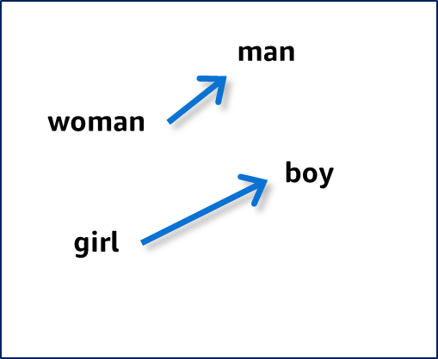

Word vectors, embeddings, and representations
Words that share a similar relationship will be separated from one another in the same direction.
Use: relationship = direction
$$v_{man}−v_{woman}≈v_{boy}−v_{girl}$$
Notes:
~Alt text: Rendering of a linear algebraic relationship. See details in notes.
~Equation
~
Image description: Rendering of the linear algebraic relationship between masculine-feminine pairs. The vector between woman and man is similar to the vector between girl and boy. End description.
Words that are semantically similar will have some similar word vectors. When you examine word vectors for certain words, you can see this relationship. For example, when you take the difference for the word vectors between man and woman or boy and girl, the resulting vectors are similar to each other.

Slide 13
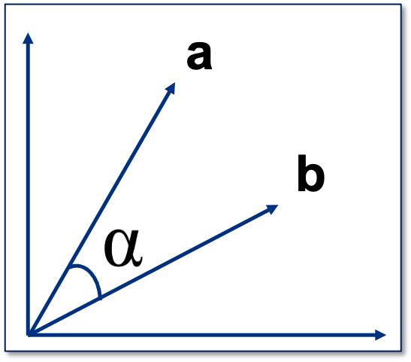
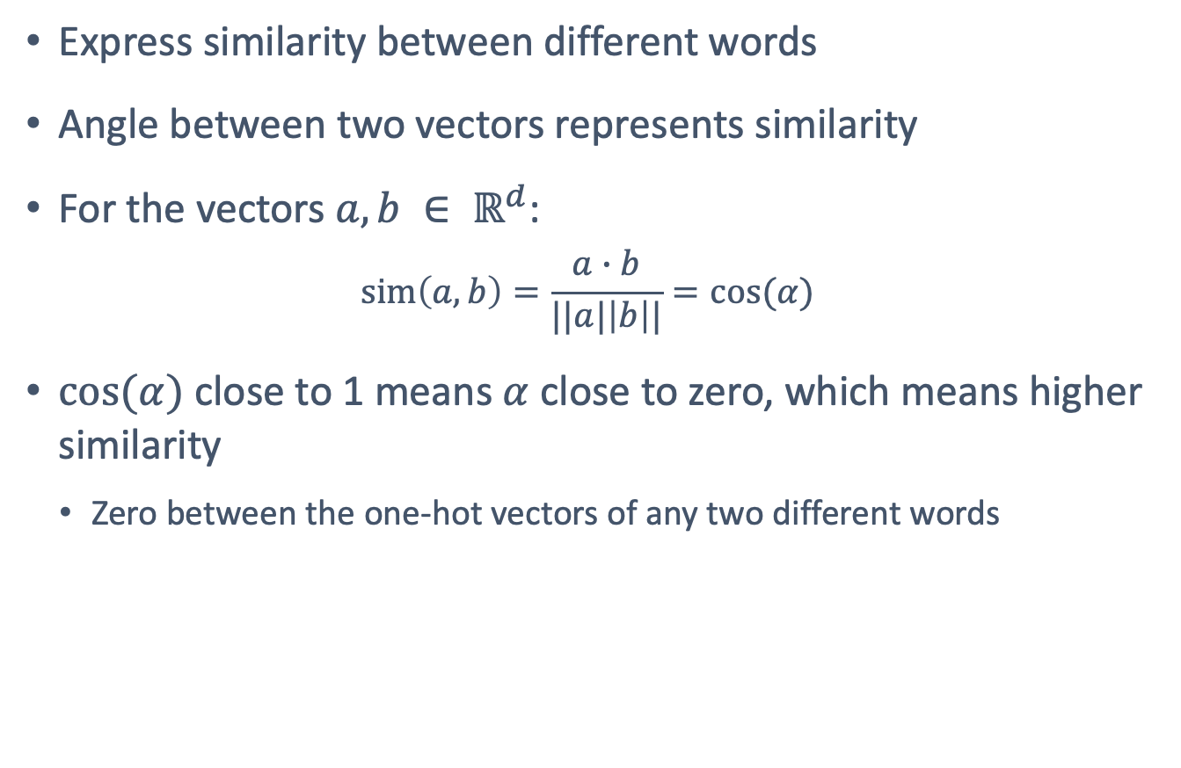
Cosine similarity
Express similarity between different words
Angle between two vectors represents similarity
For the vectors $a, b ∈ ℝ^{d}$:
$$\text{sim}\left(a,b\right)=\frac{a∙b}{||a|\left|b\right||}=cos⁡(α)$$
$cos⁡(α)$ close to 1 means $α$ close to zero, which means higher similarity
Zero between the one-hot vectors of any two different words
Notes:
~Equations
~Alt text: Representation of cosine similarity between two word vectors, a and b.
~
Cosine similarity is a way to measure similarity between two vectors. It is calculated by using the dot product (numerator) and magnitudes (denominator) of the vectors. The result is between -1 and 1. The value -1 means that they are the exact opposite of each other, +1 means that they are exactly the same, and 0 means that they are orthogonal to each other.

Slide 14
Word representations overview: Sparse or dense
Sparse
Dense
 | animal | fluffy | dangerous | spooky
aardvark | 0.97 | 0.03 | 0.15 | 0.04
red | 0.07 | 0.01 | 0.20 | 0.10
cat | 0.98 | 0.98 | 0.45 | 0.35
duvet | 0.01 | 0.84 | 0.12 | 0.02
zombie | 0.74 | 0.05 | 0.98 | 0.93
aardvark | 1 | 0 | 0 | … | 0 | 0 | 0
red | 0 | 0 | … | 1 | … | 0 | 0
cat | 0 | 0 | … | 1 | … | 0 | 0
duvet | 0 | 0 | … | 1 | … | 0 | 0
zombie | 0 | 0 | 0 | … | 0 | 0 | 1
Most of the elements are zero.
Words are represented by a binary value based on whether the word appears.
Most of the elements are nonzero.
Similar words are represented by vectors, and dissimilar words are represented by dissimilar vectors.
Notes:
It’s important to distinguish between sparse and dense representations.
In sparse representations, most of the elements are zero. A sparse word representation is a way to represent text data, such as documents or sentences, in which each word is represented by a binary or count value that indicates whether the word is present in the text. This representation is called sparse because the majority of the values in the representation are zero—most words don’t appear in a given text.
Dense representations are the opposite. Most of the elements are nonzero. Dense representations have several advantages over traditional sparse representations because dense vectors can capture more subtle relationships between words and are more efficient to compute with. The goal of dense word representation is to capture the semantic and syntactic information of words in a continuous vector space, where similar words are represented by similar vectors and dissimilar words are represented by dissimilar vectors.
The graphic on the right side of the slide shows a dense representation of the words aardvark, red, cat, duvet and zombie. Each word can be represented as a vector of length 4, with each value representing the weight for a feature: animal, fluffy, dangerous, and spooky. These weight values are normalized to a range [0,1]. You might notice that the word cat has a high weight on animal and fluffy features but low weight on dangerous and spooky features. The word zombie is the opposite.
Dense representation can help to capture semantic relationships and enable transfer learning.
A common question here is what are these values? The answer is they are learned through training with a text corpus.

Slide 15
Word representations overview: Examples
Sparse
Dense
word2vec
Bag of words
BERT
ELMo
Notes:
A bag of words is a type of sparse word representation that simply counts the occurrence of each word in the text and ignores the order that the words appear in.
Word vectors provide dense representations. word2Vec is a popular technique to generate dense representations of words, also known as word embeddings. This lesson will shows how these values are learned by using word2vec. Some other examples of dense embeddings are BERT embeddings, ELMo, and GPT.

Slide 16
Why is word2vec needed?
One-hot encoding and bag of words limitations:
Only contains identity information, not semantic meaning
Requires a large amount of memory
Notes:
One-hot encoding is an example of identity but not semantic meaning: The first word in the vocabulary is [1, 0, 0, 0..], the second is [0, 1, 0, ..], and so forth.
Similarly, the bag-of-words method doesn’t capture any semantic information about the words in the text. The method has limited representational power for tasks that require understanding the meaning of phrases or sentences.
In addition to these representational limitations, one-hot encoding and bag of words can require a large amount of memory to store the vectors or matrices that are used to represent text, especially for large vocabularies or large datasets.
To address these limitations, researchers have developed more advanced techniques to generate dense word embeddings, such as word2Vec, GloVe, and FastText. These techniques can capture semantic meaning and are more memory efficient than one-hot encoding or bag of words.

Slide 17
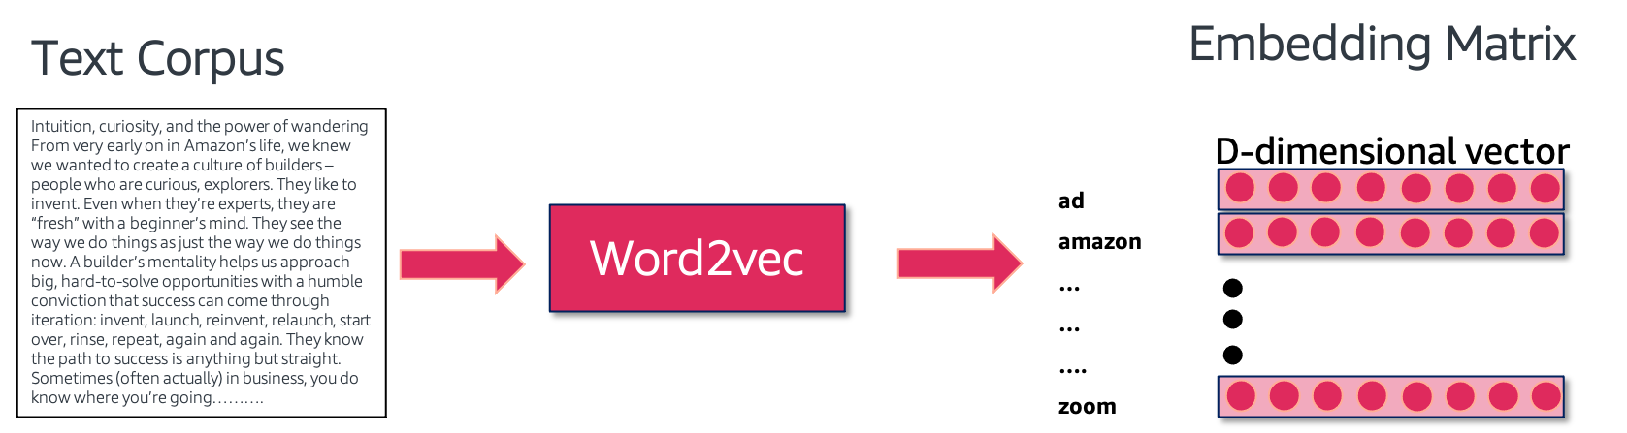
What is word2vec?
A two-layer neural network that outputs word vectors:
Produces similar vectors for semantically similar words
Builds a probability model
Maximizes the likelihood function to learn the model
Notes:
~Alt text: Diagram of the word2vec model. See detail in notes.
~
Image description: Diagram showing that the input to the word2vec model is the text corpus, and the output is a D-dimensional embedding matrix. In the matrix, each row represents the word in the vocabulary generated from a text corpus. End description.
As the name suggests, word2vec gets vectors for the words that are used. One-hot encoding doesn’t contain any semantic information. You have a single 1 at a location that is usually decided based on the place in the vocabulary. For example, the first word in the vocabulary is [1, 0, 0, 0..], the second is [0, 1, 0, ..], and so forth. word2vec learns the word vectors using a simple two-layer technique. This technique produces similar word vectors for semantically similar words. It does this by building a probability model.

Slide 18
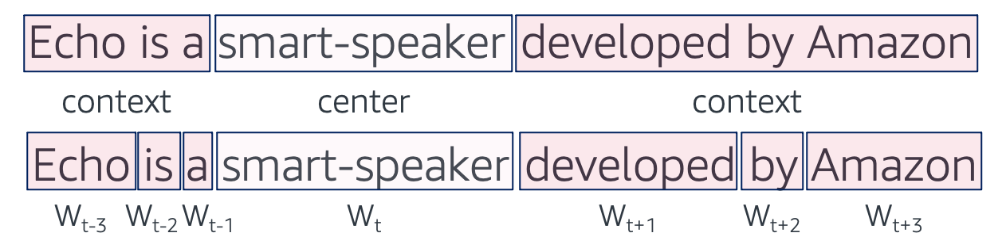
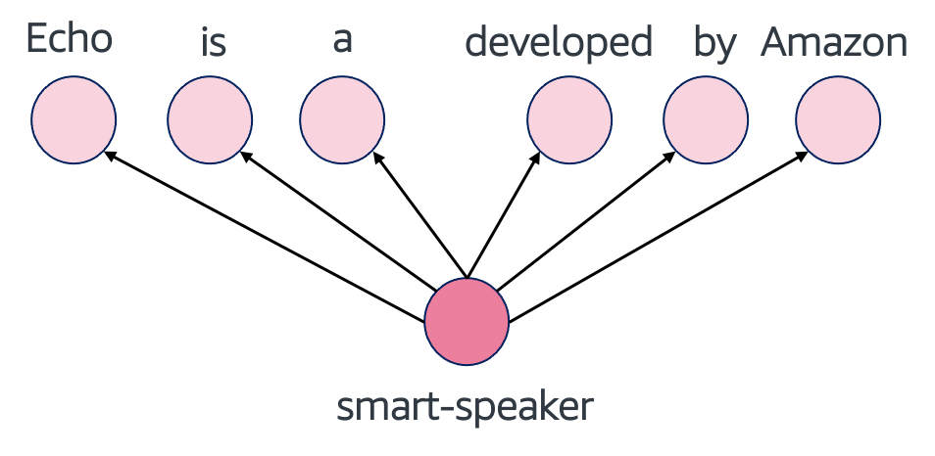
word2vec: Skip-gram
Tries to predict context words from a given center word
Notes:
~Alt text – top image: Sentence diagram. See details in notes.
~Alt text – bottom image: Diagram of the relationship between words. Detail in notes.
~
Image 1 description: Two examples of the sentence “Echo is a smart-speaker developed by Amazon.” In the first example, “smart-speaker” is identified as the center word, and the phrases “Echo is a” and “developed by Amazon” are context words. In the second example, the context words in the sentence are represented as W_(t-3), W_(t-2), W_(t-2), W_(t+1), W_(t+2), W_(t+3). “Smart-speaker” is the center word and is represented as W_(t). End description.
Image 2 description: Figure showing that the center word (smart-speaker) is used to predict the context words (Echo, is, a, developed, by, Amazon). End description.
Skip-gram tries to predict context words from a given center word.

Slide 19
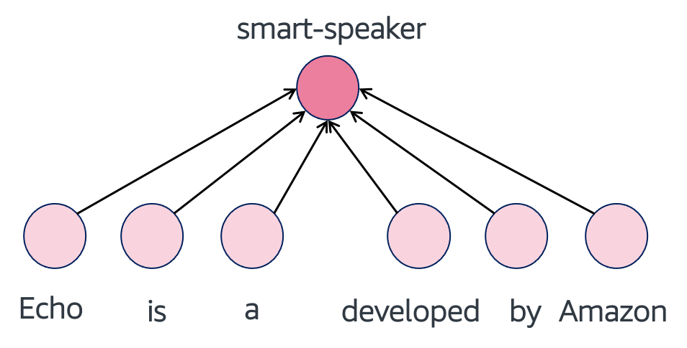
word2vec: CBOW
Tries to predicts the center word from given context words
Notes:
~Alt text – top image: Same sentence diagram from the previous slide.
~Alt text – bottom image: Diagram of the relationship between words. Detail in notes.
~
Image description: Figure showing that the context words (Echo, is, a, developed, by, Amazon) are used to predict the center word (smart-speaker). End description.
The continuous bag-of-words method (CBOW) predicts the center word from given context words. The algorithm takes a set of context words as input and predicts the target word. The context words are represented as one-hot vectors, and the algorithm uses a neural network to learn a distributed representation (embedding) of each word. The goal is to minimize the difference between the predicted target word and the actual target word by using techniques such as negative sampling or hierarchical softmax.
In contrast, in Skip-gram, the algorithm takes a target word as input and predicts the context words around it. The target word is represented as a one-hot vector, and the context words are sampled from a window around the target word. The algorithm then uses a neural network to learn a distributed representation (embedding) of each word. The goal is to maximize the likelihood of the observed context words by using techniques such as negative sampling or hierarchical softmax.
The key difference between CBOW and Skip-gram is the direction of the prediction. CBOW predicts the target word from the context, while Skip-gram predicts the context words from the target word. Additionally, CBOW tends to be faster to train and performs well on frequent words, while Skip-gram is better suited for infrequent words and performs well on syntactic and semantic relationships.
For more information, see Word Embedding (word2vec) in Dive into Deep Learning at https://d2l.ai/chapter_natural-language-processing-pretraining/word2vec.html.

Slide 20
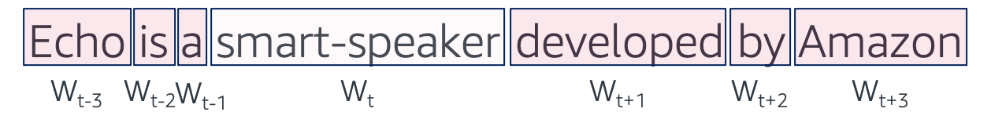
word2vec algorithm
For each token:
Randomly initialize n-dimensional (for example, n=300) vectors as initial embeddings.
Take pairs of words that co-occur as positive examples.
Take pairs of words that don't co-occur as negative examples.
Positive examples
Center Word | Context
smart-speaker | echo
smart-speaker | amazon
smart-speaker | developed
Negative examples
Center Word | Context
smart-speaker | hello
smart-speaker | world
smart-speaker | garden
Notes:
The word2Vec algorithm uses a neural network with a single hidden layer. The input layer contains one-hot vectors that represent the context words, while the output layer contains one-hot vectors that represent the target word or context words. The hidden layer contains the word embeddings, which are learned through backpropagation.

Slide 21
word2vec algorithm: Negative samples
How many negative samples?
5–20 for smaller datasets
2–5 for larger datasets
How to choose negative samples?
Draw from the distribution of counts.
Boost rarer frequencies by raising to a power less than one.
Negative examples
Center Word | Context
smart-speaker | hello
smart-speaker | world
smart-speaker | garden
Notes:
The number of negative samples to use in the word2vec algorithm can depend on the size of the dataset. Typically, for smaller datasets, the recommendation is to use a large number of negative samples, such as 5–20, while a small number of negative samples, such as 2–5, might be sufficient for larger datasets.
Choosing the negative samples is an important part of the word2vec algorithm. One common method is to draw the negative samples from the distribution of word counts in the corpus. This means that more frequent words are more likely to be sampled as negative examples than less frequent words. Another technique is to boost the frequency of rarer words by raising their counts to a power less than 1. This can help to give more weight to rare words and improve their representation in the embedding space.
The choice of the number of negative samples and the method of choosing them can have a significant impact on the performance of the word2vec algorithm. Therefore, it’s important to experiment and choose the best approach for a specific dataset and task.

Slide 22
word2vec algorithm: Prediction tasks
Set a prediction task as one of the following:
skip-gram: Predict the surrounding context words of a given center word.
CBOW: Predict the center word from the given surrounding context words.
Train a shallow neural network:
Maximize the objective function.
Slowly adjust embeddings to improve it.
Use the hidden layer as embeddings.
Notes:
Reminder: An objective function is a real-valued function whose value is to be either minimized or maximized over the set of feasible alternatives.

Slide 23
Comparison of word2vec architectures
Architecture | Predicts | Relative Strength
Skip-gram | Context words from a given target word | Better for a smaller corpus Represents rare words well
CBOW | Target word from given context words | Multiple times faster Represents frequent words slightly better

Slide 24
GloVe for word representation
GloVe captures both global and local statistics of a corpus to create word vectors.
Example corpus: It is not a dog, it is a wolf.
A co-occurrence matrix counts the number of times that each word appears within a fixed window (1) of the other words in the corpus.
Word | it | is | not | a | dog | wolf
it | 0 | 2 | 0 | 0 | 1 | 0
is | 2 | 0 | 1 | 1 | 0 | 0
not | 0 | 1 | 0 | 1 | 0 | 0
a | 0 | 1 | 1 | 0 | 1 | 1
dog | 1 | 0 | 0 | 1 | 0 | 0
wolf | 0 | 0 | 0 | 1 | 0 | 0
Notes:
GloVe is a type of word embedding technique that is used to represent words as vectors of numerical values in a high-dimensional space. The algorithm is based on the idea that words that appear frequently together in a corpus of text are likely to be related in meaning.
GloVe uses matrix factorization techniques to learn the relationship between words by examining the co-occurrence matrix of a corpus of text. The co-occurrence matrix represents the frequency of each word that appears in the same context as every other word in the corpus.
In the table on the slide, each row represents a word in the corpus, and each column represents the count of adjacent occurrences of the other words in the corpus within a fixed window of 1. For example, the value in the is row and not column is 1, which indicates that these words appear next to each other once in the corpus. The table is symmetric, so the value in the not row and is column is also 1.

Slide 25
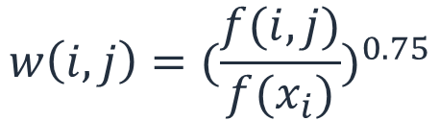
GloVe for word representation: Application
Next, apply the GloVe weighting function to each entry in the co-occurrence matrix.
Use a weighting exponent of 0.75:
Word | it | is | not | a | dog | wolf
it | 0 | 0.6369 | 0 | 0 | 0.3364 | 0
is | 0.6369 | 0 | 0.5239 | 0.5239 | 0 | 0
not | 0 | 0.5239 | 0 | 0.5239 | 0 | 0
a | 0 | 0.5239 | 0.5239 | 0 | 0.5239 | 0.5239
dog | 0.3364 | 0 | 0 | 0.5239 | 0 | 0
wolf | 0 | 0 | 0 | 0.5239 | 0 | 0
$$w\left(i, j\right)={(\frac{f(i, j)}{f(x_{i})})}^{0.75}$$
Notes:
Next, apply the GloVe weighting function to each entry in the co-occurrence matrix. The co-occurrence matrix X will be a V x V matrix, where the i th row and j th column of X, X_ij denotes how many times word i has co-occurred with word j.
For example, use a weighting exponent of 0.75: w(i,j) = (f(i,j) / f(x_i)) ^ 0.75
The weighting function gives more weight to the co-occurrences that are less frequent (those that occur in fewer contexts) than to those that are more frequent. This helps to prevent common words, such as the and and, from dominating the resulting word embeddings. The exponent of 0.75 is a commonly used value in practice, but it can be tuned for specific tasks and corpora.

Slide 26
GloVe for word representation: Loss function
Next, calculate the GloVe word embeddings by minimizing a loss function that measures the difference between the dot product of two word vectors and the log of their co-occurrence count.
The resulting word embeddings are shown in the table.
GloVe embeddings are 3-D vectors. In practice, they often have many more dimensions (for example, 100 dimensions or more). The values in each dimension represent different aspects of the word's meaning, which are learned through the optimization process.
Word | GloVe Embedding (Dimension=3)
it | (0.2189, -0.0685, -0.2283)
is | (-0.1911, 0.2048, -0.0452)
not | (0.0183, 0.2643, -0.2541)
a | (-0.2165, 0.1745, -0.1995)
dog | (0.0847, -0.2329, -0.0416)
wolf | (-0.1146, -0.0842, 0.0189)
Notes:
To generate word embeddings from the weighted co-occurrence matrix, you first need to choose a dimensionality for the embeddings. Assume that you want 3-dimensional embeddings. You can use singular value decomposition (SVD) to factorize the weighted co-occurrence matrix into three matrices: a left singular matrix U, a diagonal matrix Σ, and a right singular matrix V^T. Then, use the left singular matrix U to represent each word as a vector of length 3 in the table.
The table on the slide shows the word embeddings for it, is, not, a, dog, and wolf based on the co-occurrence matrix and GloVe weighting function. Note that these embeddings aren’t necessarily directly comparable to embeddings that are generated by using other methods or different parameters.

Slide 27
GloVe for word representation: Summary
Controls the influence of rare and frequent words: loss for each pair (w, c) is weighted through:
Rare events being penalized
Frequent events not being overweighted
Is based on a co-occurrence matrix that captures the frequency of which words appear together in a corpus of text
Differs from word2Vec because the embeddings consider both the frequency of word co-occurrences and the probabilities of those co-occurrences
Provides fast training, scalability, and good performance even with a small corpus and lower dimensionality
Notes:
GloVe uses a weighting function to control the influence of rare and frequent words in the co-occurrence matrix. The weighting function assigns a weight to each pair (w, c) based on the frequency of their co-occurrence. The function is designed to penalize rare events and prevent frequent events from being overweighted.
GloVe embeddings are based on a co-occurrence matrix that captures the frequency with which words appear together in a corpus of text. The co-occurrence matrix is factorized using SVD to generate a low-dimensional representation of the words in the corpus.
GloVe embeddings are different from other word embeddings, such as word2Vec, because they consider both the frequency of word co-occurrences and the probabilities of those co-occurrences. GloVe embeddings have been shown to perform well on a variety of NLP tasks, including sentiment analysis, language modeling, and named entity recognition.
GloVe embeddings can be pretrained on large corpora of text, such as Wikipedia or Common Crawl, and then fine-tuned on specific tasks by using smaller datasets. GloVe embeddings are widely used in industry and academia, and are available in popular ML libraries, such as TensorFlow and PyTorch.

Slide 28
Motivation for FastText (subword embedding)
Overcome the shortcoming of word2vec:
word2vec ignores a word’s morphological structure.
Example: dogs, dog, and dogcatcher are represented by different vectors without capturing the morphological relationship between the words that share the same root, dog.
Notes:
In the context of NLP, the term morphological typically refers to the structure of words and how they can be modified through the addition or removal of affixes. For example, in English, the word jumping is formed by adding the suffix -ing to the verb jump. The word unhappy is formed by adding the prefix un- to the adjective happy.
One shortcoming of word2vec is that it treats each word as a discrete unit and doesn’t explicitly model the morphological structure of words. This can make it difficult for word2vec to capture the full range of meaning that is associated with a word. This occurs particularly in languages with complex morphology where words can take on many forms depending on their role in a sentence or the affixes that are attached to them.
For more information about FastText, see the FastText site at https://fasttext.cc.

Slide 29
FastText is an extension of the word2vec model
Represents each word as a bag of character n-grams
Was designed to solve the out-of-vocabulary (OOV) issue
Each center word is represented as a set of subwords:
“where” using n-gram
n=3: <wh, whe, her, ere, re>
Useful for long but infrequent words, such as pneumonoultramicroscopicsilicovolcanoconiosis
Notes:
Out-of-vocabulary (OOV) terms aren’t part of the normal lexicon that is found in an NLP environment. When a word that isn’t in the training set occurs in real data, this causes a problem.

Slide 30
Word embedding comparison
Model | Advantages | Limitation
TF-IDF | Easy to compute the similarity between two documents Common words don’t affect the results because of IDF | Doesn’t capture position in text Doesn’t capture meaning in text
word2vec | Captures the position of words in the text (syntactic) Captures meaning in the words (semantics) | Cannot capture the meaning of the word from the text (cannot capture polysemy) Cannot capture OOV words
GloVe (pretrained) | (Same as word2vec) Trained on a huge corpus | (Same as word2vec) Memory consumption for storage
GloVe (trained) | Straightforward Performs better than word2vec Lower weight for highly frequent word pairs, such as stop words like am and is | (Same as GloVe pretrained) Needs a huge corpus to learn
FastText | Works for rare words (rare in their character n-grams, which are still shared with other words) Solves OOV words with n-gram in character level | Fails to capture polysemy Memory consumption for storage Larger dictionary for more model parameters Higher computational complexity (sum of all n-grams vectors)

Slide 31
Word embedding applications summary
Efficacy on downstream natural language processing (NLP) tasks:
FastText:
Naturally handles OOV words
Better with morphologically rich languages, such as German
Better at syntactic similarity because of character n-grams (great and greater are similar)
Better at a larger corpus
word2vec: Better at semantic similarity, such as brother: sister
Notes:
In the context of NLP, downstream typically refers to tasks that use pretrained models or features, such as word embeddings. Downstream is used to distinguish between the initial pretraining phase, in which the word embeddings are learned, and the subsequent phase. In the subsequent phase, the word embeddings are used as input features for downstream NLP tasks, such as text classification, named entity recognition, and sentiment analysis.
The efficacy of different word embedding methods can depend on the specific downstream NLP task and the specific dataset that is being used.
FastText's use of character n-grams helps it to better handle OOV words and capture morphological information. This feature makes it well suited for tasks such as named entity recognition and text classification in languages with complex morphology. FastText’s performance tends to improve with larger training corpora.
word2Vec tends to excel at capturing semantic relationships between words. This makes it well suited for tasks such as word analogy and semantic similarity.
Of course, the relative performance of these methods can depend on a wide range of factors, including the specific dataset, choice of hyperparameters, and evaluation metrics that are used. In practice, it's often a good idea to try multiple embedding methods and compare their performance on the specific task and dataset.

Slide 32
Word embedding applications summary: Efficiency
Efficiency (training time, from least to most):
CBOW < Skip-gram < FastText
Notes:
In general, FastText is slower than both CBOW and Skip-gram because FastText involves training on character n-grams in addition to word embeddings.
Between CBOW and Skip-gram, CBOW is generally faster because it involves predicting the target word from the context words. Skip-gram involves predicting the context words from the target word. The larger the context window size, the slower that CBOW and Skip-gram become.
However, the actual training time can vary depending on several factors, such as the size of the training corpus, size of the embedding vectors, number of training epochs, and hardware that is used for training. Therefore, it's difficult to give a definitive answer about the relative efficiency of these methods without specific details about the training setup.

Slide 33

Next lesson
You will learn about recurrent neural networks (RNNs).

Slide 35
Image source slide (for curriculum development use only)

Slide 36
Source graphic
word2vec 2013
GloVe 2014
FastText 2016
Transformer 2017
BERT 2018
ELMo 2018
GPT-2 2019
GPT-3 2020
Notes:
~Source for slide 11

