Slide 1
Jupyter and SageMaker
Machine Learning through Application
Module 1 – Lesson 1

Slide 2
Today’s activities
Introduction to Jupyter notebooks
Using SageMaker to host and manage Jupyter notebooks

Slide 3
Introduction to Jupyter notebooks

Slide 4
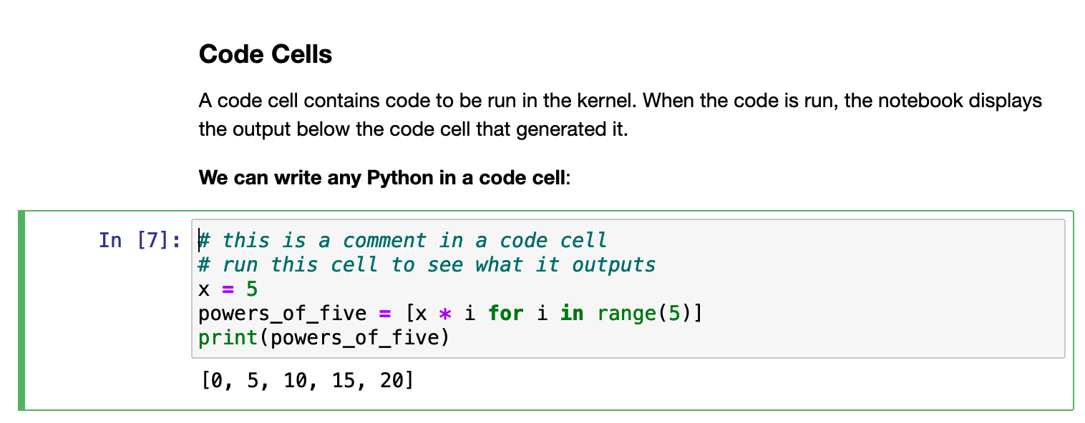
What is a notebook?
A notebook integrates code and its output into a single document.
A notebook combines the following:
Visualizations
Narrative text
Mathematical equations
Charts and plots
Other rich media
Screenshot from a notebook that you will use later in a lab
Notes:
A notebook is a software development environment (SDE).

Slide 5
Why are notebooks important for ML?
If you want to work in data science, notebooks are critical tools to learn and be able to use.
A notebook can do the following:
Accelerate your workflow to work with data because it offers great tools to explore and prepare data
Make it easier to communicate and share your results
Notes:
Using notebooks is now a major part of the data science workflow at companies across the globe.

Slide 6
Introduction to Jupyter Notebook
Jupyter Notebook is an open-source project that implements notebooks.
Jupyter is a reference to the three core languages that the project supports: Julia, Python, and R.
Kernels are available that make Jupyter compatible with dozens of languages, including Ruby, PHP, JavaScript, SQL, and Node.js.
Notes:
For more information about Project Jupyter, see the Jupyter website at https://jupyter.org. You can download the Jupyter Notebook application from the Jupyter website at https://jupyter.org/install. You can also download the application as part of the Anaconda data science toolkit from the Anaconda website at https://www.anaconda.com/products/distribution.
Although you can use many programming languages in Jupyter Notebook, this course will focus on Python, which is the most common use case.
Among R users, RStudio is a more popular choice. For more information, see Tutorial: Getting Started with R and RStudio at https://www.dataquest.io/blog/tutorial-getting-started-with-r-and-rstudio.

Slide 7
What is the Jupyter Notebook application?
Jupyter Notebook is a server-client application.
You can edit and run your notebook by using a web browser.
You can run the application on a PC without internet access.
You can install Jupyter Notebook on a remote server and access it through the internet.

Slide 8
Main components of Jupyter Notebook
Kernel:
A kernel is a program that runs and inspects the user’s code.
The Jupyter Notebook application has a kernel for Python code.
Dashboard: Use the dashboard to manage both the notebooks and the kernels.
Notes:
A kernel is a program that runs and inspects the user’s code. The Jupyter Notebook application has a kernel for Python code, but kernels are also available for other programming languages.
The dashboard shows you the notebooks that you have made and can open, and you can also use the dashboard to manage your kernels. You can see which notebooks are running and shut them down if necessary.

Slide 9
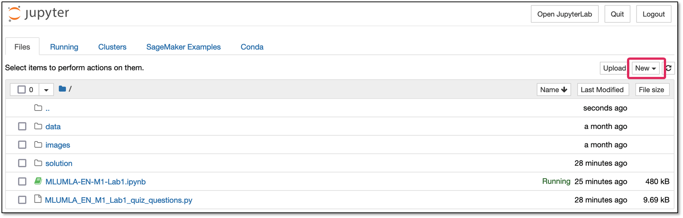
Creating a Jupyter notebook
On the dashboard, choose New.
Notes:
~Alt text: Screenshot of the Jupyter Notebook dashboard. The New button is highlighted in the upper-right corner.
~
To create a new Jupyter notebook and select a kernel, choose New in the upper-right corner of the dashboard.

Slide 10
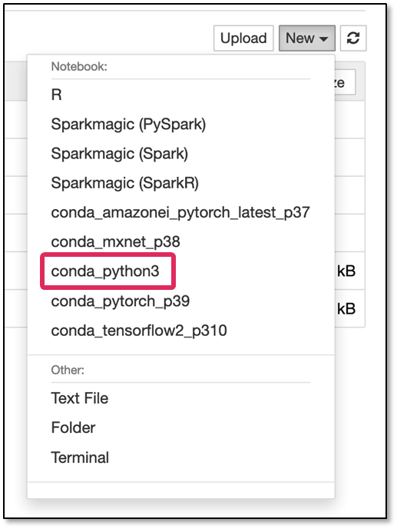
Selecting the kernel
Select the kernel that you need. A new, empty notebook opens.
For example, you can select a Python 3 kernel.
Notes:
~Alt text: Screenshot of the New menu, which displays a dropdown list of kernel types. conda_python3 is highlighted.
~
After you choose New, select the kernel that you need. A new, empty notebook opens.

Slide 11
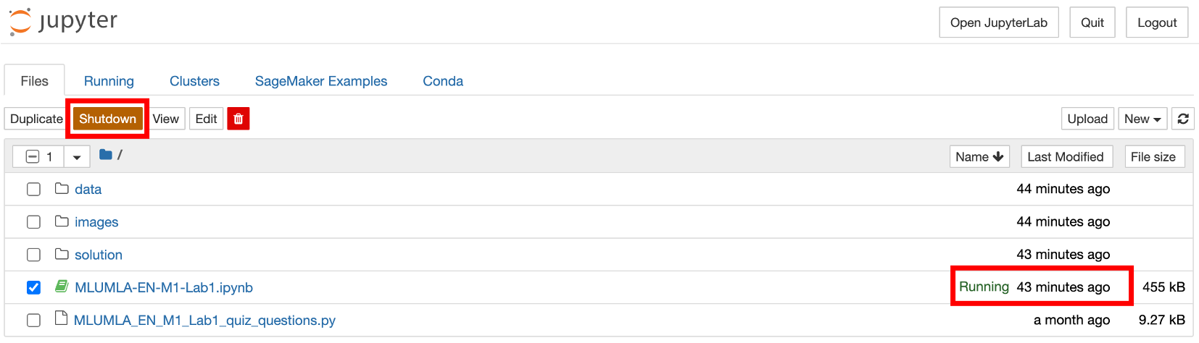
Managing a Jupyter notebook kernel
On the dashboard, you can also manage the kernels of existing notebooks.
Shut down the kernel.
See which notebooks are running.
Notes:
~Alt text: Screenshot of notebooks listed on dashboard. The Shutdown button is highlighted. One notebooks shows the “Running" status.
~
On the dashboard, you can also manage the kernels of existing notebooks. You can see which ones are running and shut them down if necessary.

Slide 12
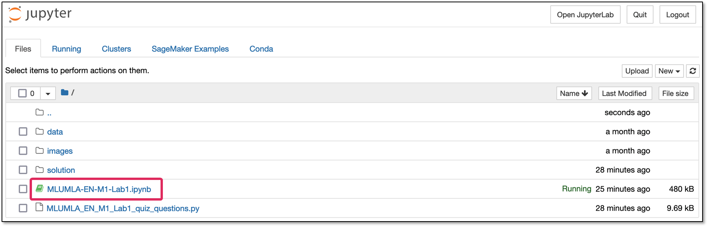
Opening an existing Jupyter notebook
On the dashboard, choose the link for the notebook name.
Notes:
~Alt text: Screenshot of the dashboard with a highlight on the name link for a notebook.
~
To open an existing Jupyter notebook from the dashboard, choose the link for the notebook name.

Slide 13
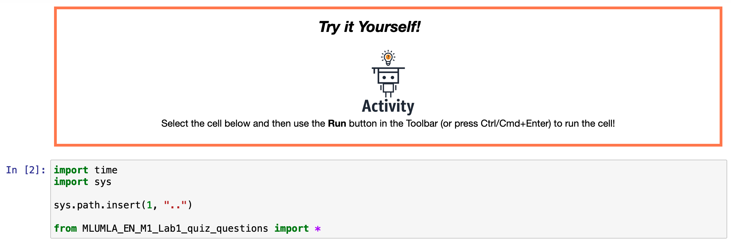
Inside a Jupyter notebook
In the next two labs, you will learn how a Jupyter notebook works.
Notes:
After you open a notebook, you can start to build! In the next two labs for this module, you will learn how a Jupyter notebook works.

Slide 14
Using SageMaker to host and manage Jupyter notebooks

Slide 15

Introduction to SageMaker
Amazon SageMaker is a fully managed service for Jupyter notebooks:
Handles provisioning and hosting of notebooks and their required compute resources (instances) for you
Uses instances that are optimized for ML
Replaces failed hardware automatically
Notes:
Amazon SageMaker is a fully managed service that is based on Jupyter notebooks. For more information, see the Amazon SageMaker page at https://aws.amazon.com/pm/sagemaker. With the service, you can prepare data and build, train, and deploy ML models for any use case with fully managed infrastructure, tools, and workflows.

Slide 16
SageMaker is serverless
Data scientists don’t need to handle low-level environment setups.
You can focus on the fun part: developing, training, and deploying ML models.
In the labs of this course, you will learn how to use this great tool to manage your ML projects.
Notes:
Because SageMaker is serverless, you can focus on developing, training, and deploying ML models.

Slide 17

Next: Labs
Lab 1: Review fundamental skills for using Jupyter
Lab 2: Learn more advanced skills for Jupyter

Slide 18
Next lesson
What are the different types of ML
What kinds of problems is ML best used for
Notes:
In the next lesson, you will learn what AutoML is. You will also learn how to use Jupyter notebooks with SageMaker to implement an AutoML tool that is called AutoGluon to solve an ML problem.

Slide 20
Image source slide (for curriculum development use only)

Slide 21
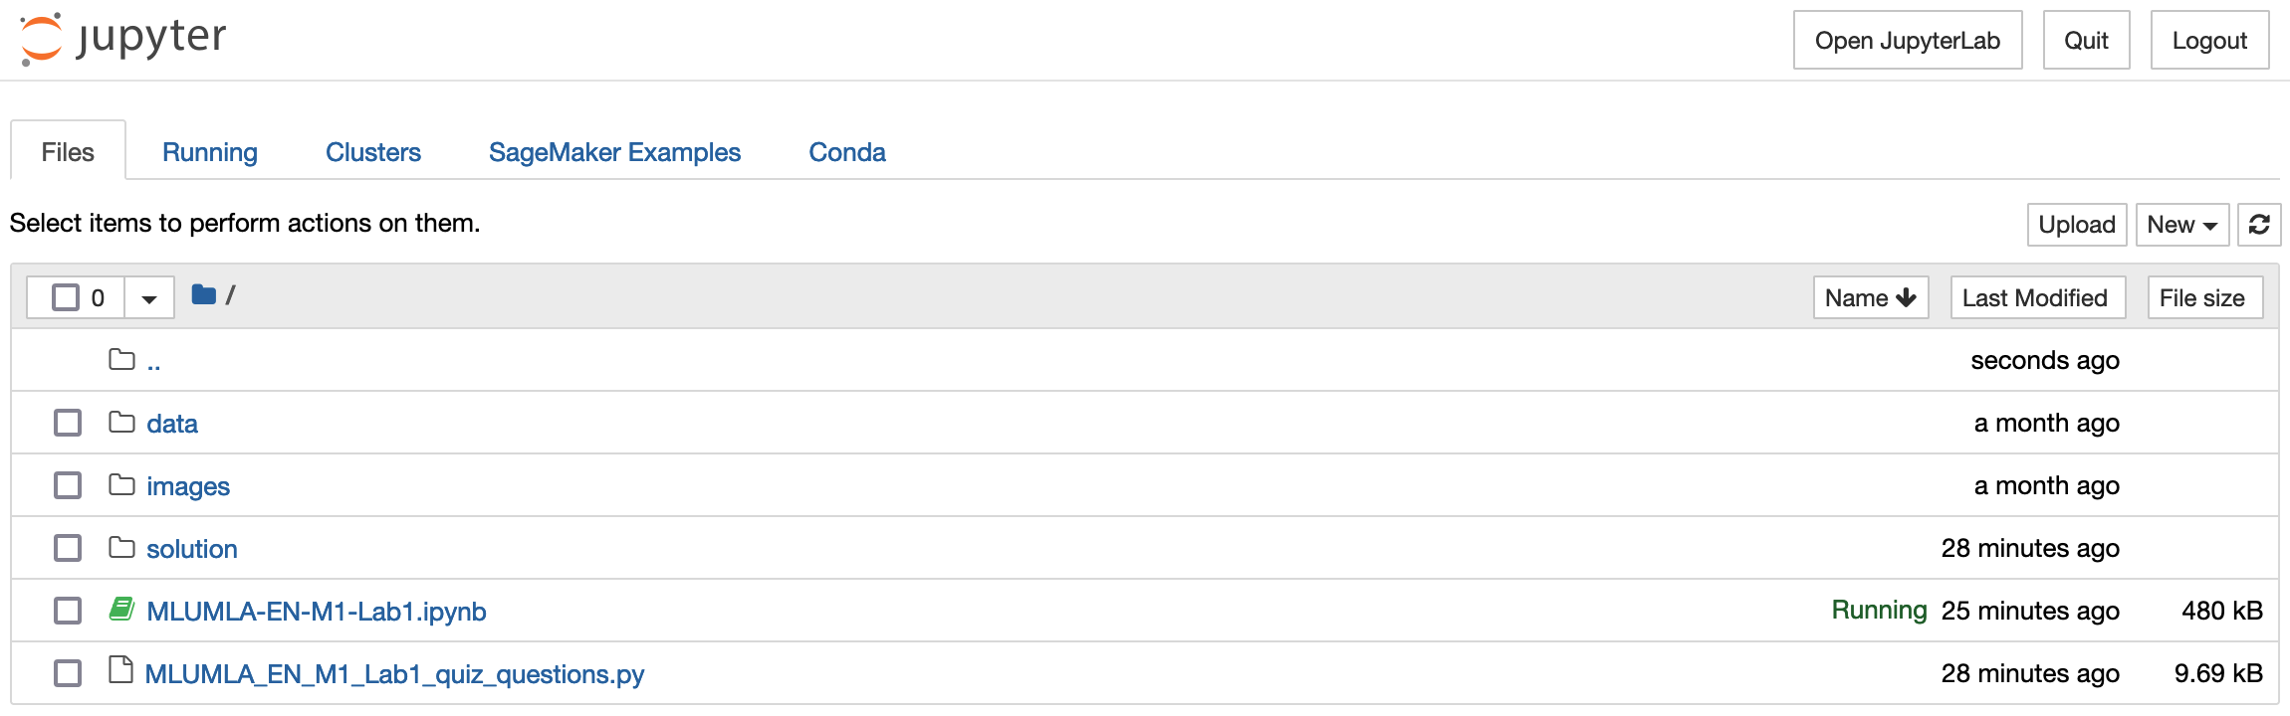
Source graphic: Creating a Jupyter notebook
Notes:
~Source graphic for slide 9

Slide 22
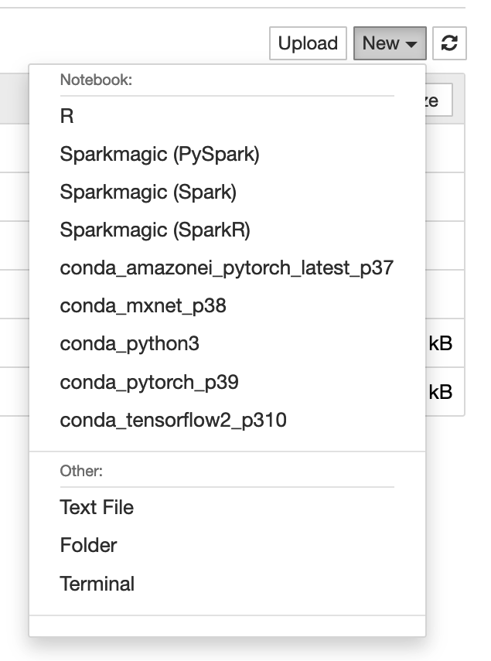
Source graphic: Selecting the kernel
Notes:
~Source graphic for slide 10

Slide 23
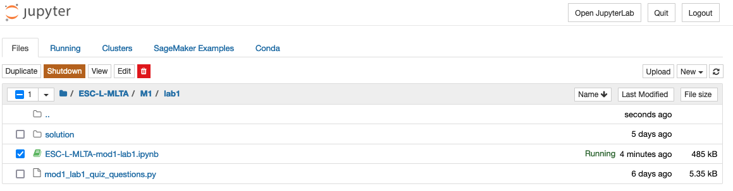
Source graphic: Managing a Jupyter notebook kernel
Notes:
~Source graphic for slide 11

Slide 24
Source graphic: Opening an existing Jupyter notebook
Notes:
~Source graphic for slide 12

