Slide 1
The ML Lifecycle, and Overfitting and Underfitting
Machine Learning through Application
Module 1 – Lesson 4

Slide 2
Today’s activities
Introduction to the ML lifecycle
How to evaluate ML models

Slide 3
Introduction to the ML lifecycle

Slide 4
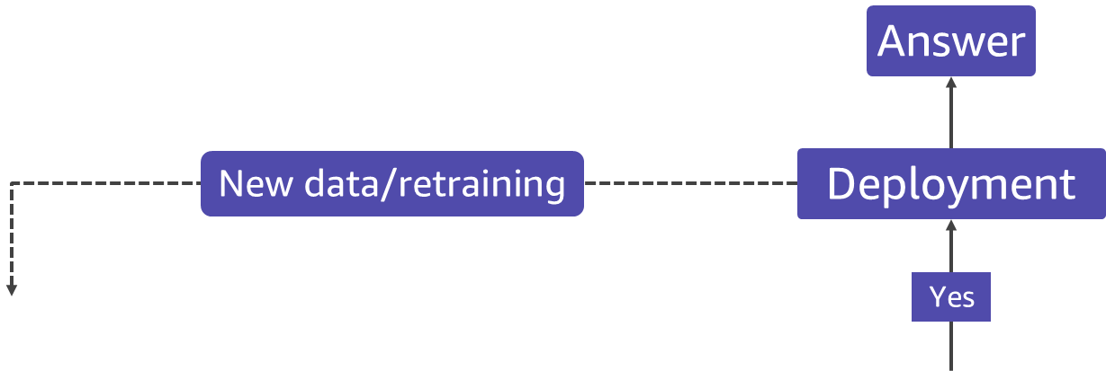
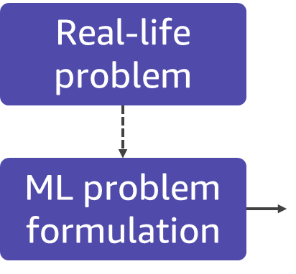
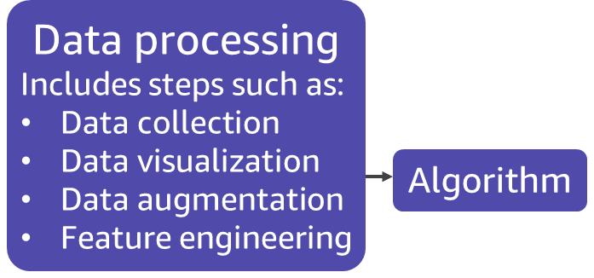
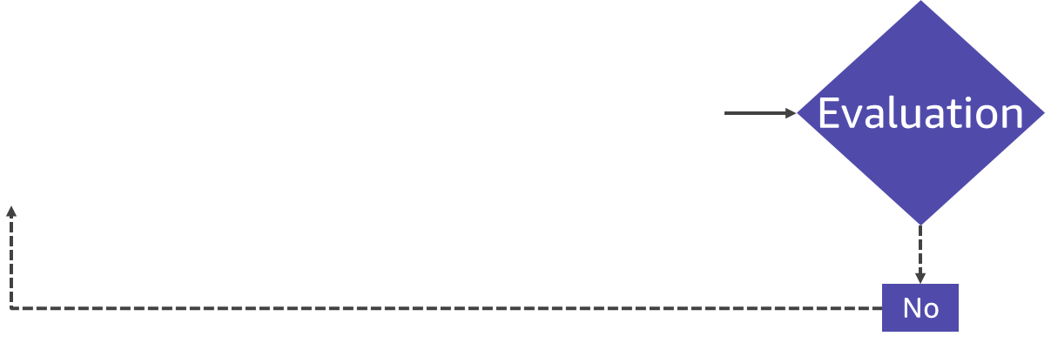
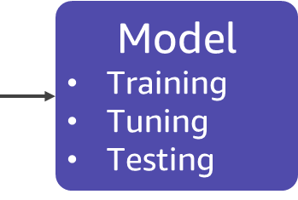
ML lifecycle
Notes:
~Source for this graphic is in module 3, lesson 1 slides
~Alt text – problem: The ML lifecycle starts with formulating the ML problem from a real-life problem.
~Alt text – processing: After ML problem formulation, data is collected and prepared for ML, and an algorithm is selected for the ML model.
~Alt text – modeling: The prepared data and selected algorithm are used to build, train, tune, and test an ML model.
~Alt text – evaluate: The model is evaluated, and more iterations of data processing and modeling occur if it is not ready to deploy.
~Alt text – deploy: When ready, the model is deployed to deliver answers in production. Production data is used to continually retrain the model.
~
With access to data, compute, and algorithms, how do you do ML? What steps do you follow?
This slide shows the ML lifecycle and provides a preview of how much work is ahead.
As mentioned, the lifecycle starts by identifying a real-life problem and formulating the ML problem. Don’t take this step lightly because it will impact most of the downstream tasks. Ask pointed questions such as the following:
What are the business outcomes that you want to achieve?
What does success look like?
What business metric should you define?
After you settle the ML problem, the next step is data processing. This is a time-consuming step. In this step, you get all the relevant data in one place, cleaned and processed, in a format that is friendly for ML. To be ML friendly, all the data needs to be numerical, so you will need to process nonnumerical features. You also might need to remove some nonrelevant features or add some relevant ones in.
With ML friendly data and the correct choice of ML algorithm, then you train, tune, and validate an ML model. The goal is a model that you can deploy and use in production to produce the desired outcomes. If the model doesn’t meet your business goals, you can adjust it until it meets your needs.

Slide 5
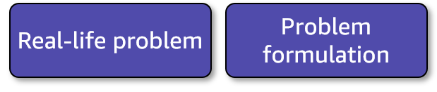
Defining the problem
Define the objective:
A specific outcome that you want to use ML to achieve. For example, to help someone achieve something or some business goal.
Translate the objective to an ML problem:
Express the objective in ML terms; for example, predicting or calculating the probability.
Increase revenue by ensuring all products in catalog have prices & can be surfaced to customer.
Predict the price (continuous numerical value) for all products in the catalog where the price is missing.

Slide 6
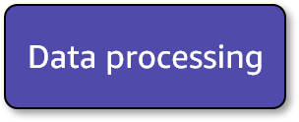
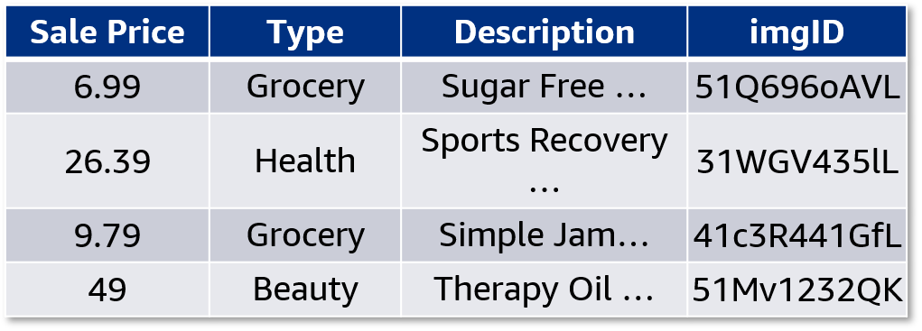
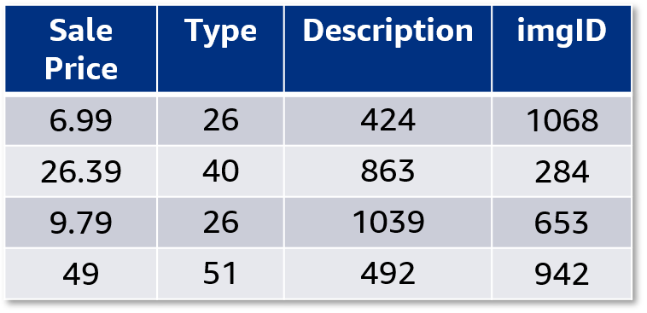
Data processing: Preparing the data
Merge files from different sources.
Clean data (for example, deal with missing values or skews).
Convert all values to numbers (computers don’t understand text).
Tables 1 and 2: Example of conversion from an original dataset to only numerical values
Notes:
~Alt text – table 1: Table 1. Description in notes.
~Alt text – table 2: Table 2. Description in notes.
~
Image 1 description: Table with four columns: Sale Price, Type, Description, and imgID. The Sale Price column has numerical data, the Type column contains tabular data, the Description column contains text data, and the imgID column contains image data. End description.
Image 2 description: Table with the same four columns as the first. However, the Type, Description, and imgID features have been encoded as numerical values. End description.

Slide 7
Data processing: Splitting datasets
Split the prepared dataset into training, validation, and test sets.
Training set
(used to train the model)
Prepared dataset
Validation set
(used for unbiased evaluation of the model)
Test set
(used for final evaluation of the model)
Notes:
After you prepare the data, you split it into training, validation, and test sets.

Slide 8
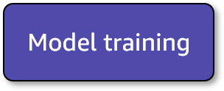
Model training
Supervised models: Train (learn) by comparing the error between predictions and true values (labels).
Unsupervised models: Train (learn) by comparing the results of grouping similar things together. Similarity can be defined in different ways; for example, distance or intersections of features.
Notes:
Another interesting thing about ML is the variety of algorithms. Sometimes, multiple algorithms are available to solve the same type of problem.
While certain algorithms perform better than others with certain types of data, no single algorithm outperforms all others on all problems. This concept is called the no-free-lunch theorem.
For a given task or problem, choose a few algorithms that are known to work well for that type of data and problem. Then, select the best-performing one.
Narrow down the initial choices by dividing the ML algorithms into categories that are based on the task that they perform and how they perform it.
Animation for training: https://towardsdatascience.com/gradient-descent-animation-1-simple-linear-regression-e49315b24672

Slide 9
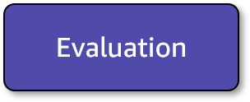
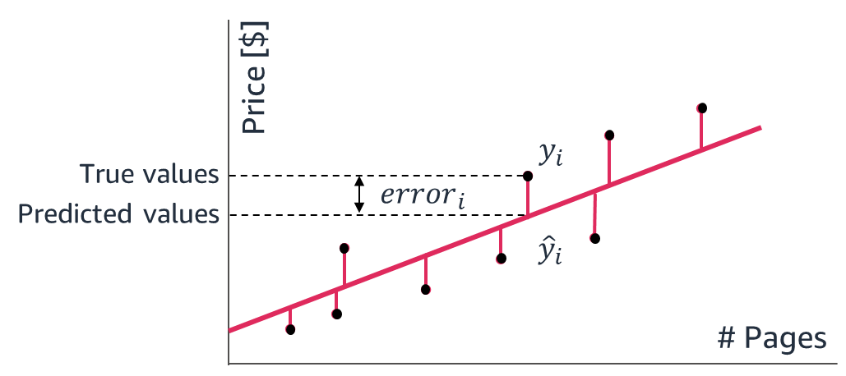
Evaluation: Regression step 1
Find the distance (squared, absolute, others) between your prediction and labels.
Notes:
~Alt text – graph: Graph of price compared to number of pages, with a line of best fit. See details in notes.
~
Image description: Graph of price compared to number of pages with a line of best fit (predicted value). The error for each data point (true value) is shown as a vertical line between the data point and the line of best fit. End description.
In ML, model evaluation is the process of assessing the performance of a trained model on a set of validation data. This involves comparing the model's predictions or decisions to ground truth labels or reference data, and using various metrics to quantify the model's performance.
Errors are the differences between the target values (y_i , which is represented on the graph by black dots) and the values that were predicted with the regression model (y_hat_i, which are the predictions that sit on the regression line).
Four regression metrics look at the overall model errors, and the next slide will describe these metrics. You can look at these errors as absolute values or squared values (so that the negative errors can contribute meaningfully to the overall sum).

Slide 10
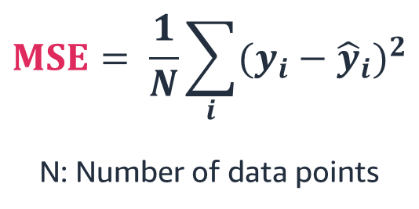
Evaluation: Regression step 2
Aggregate up into 1 value across the whole dataset to give the mean error across squared distances.
$$MSE= \frac{1}{N}\sum_{i}{{(y_{i}−{\hat{y}}_{i})}^{2}}$$
N: Number of data points
Notes:
~Equation
~
The first metric, mean squared error (MSE), is the average of the squared errors. Because MSE squares the error differences, it penalizes even the smallest errors, leading to overestimation of how bad the model is.
Another metric is root mean square error (RMSE), which is the square root of the MSE. This is widely used for regression tasks. While MSE reports errors in units squared, RSME reports errors in the original units, which makes it easier to interpret the error.
You can also look at the mean absolute error (MAE), which is the average of the absolute differences between the target values and the values that the model predicted. Being a linear score, all the individual differences are weighted equally, so MAE is more robust to outliers and does not penalize the errors as extremely as MSE.
Finally, you can use R², which helps compare the regression model with a constant average baseline model (it predicts averages for all data points). This metric tells how much better the regression is compared to the baseline model.
With other metrics, lower scores are desirable; R² is different. Assuming that the ML model will always perform better than the baseline (average) model, R² will take values between 0 and 1. If the model didn’t improve at all over the baseline model and produced the same errors, then R² is 0 (lowest). For the best regression model, which doesn’t have errors between the predicted and actual values (MSE = 0), R² will be 1 (highest).
While MSE is the most preferred metric for regression tasks, as with other areas of ML, there isn’t a clear choice of which metric to use. Best practice is to monitor a few, depending on the business problem and the dataset.
~~~~~~~~~~~~
LATEX
MSE = \frac{1}{n}\sum_{i=0}^{n}(y^{(i)}-\hat{y}^{(i)})^2
RMS = \sqrt{\frac{1}{n}\sum_{i=0}^{n}(y^{(i)}-\hat{y}^{(i)})^2}
MAE = \frac{1}{n}\sum_{i=0}^{n}|y^{(i)}-\hat{y}^{(i)}|
R^2 = 1 - \frac{\sum_{i=0}^{n}(y^{(i)}-\hat{y}^{(i)})^2}{\sum_{i=0}^{n}(y^{(i)}-\bar{y})^2}
\bar{y} = \frac{1}{n}\sum_{i=0}^{n}y^{(i)}
y^{(i)} \hat{y}^{(i)} \bar{y}

Slide 11
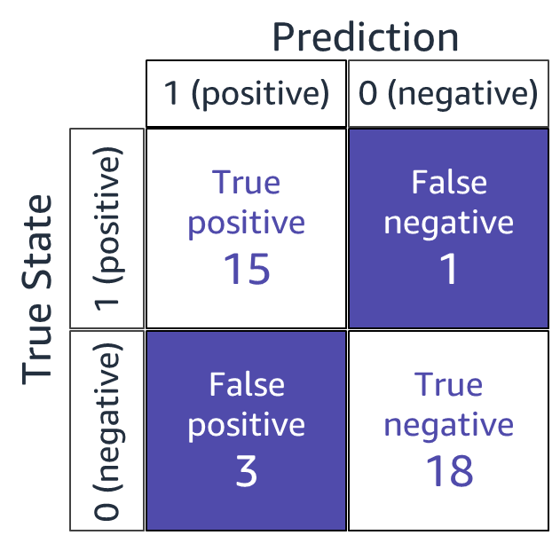
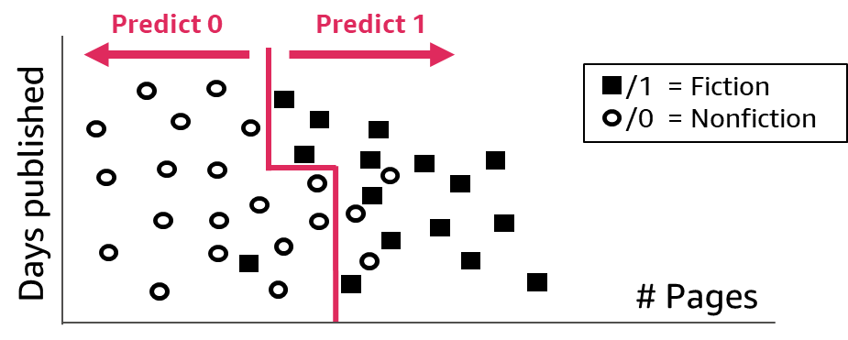
Evaluation: Classification step 1
Compare the true state to the predicted state.
Notes:
~Alt text – matrix: Confusion matrix that shows 15 true positives, 1 false negative, 3 false positives, and 18 true negatives.
~Alt text – scatterplot: Scatterplot. See details in notes.
~
Image description: Scatterplot with a mix of circles and squares. Days published is the y-axis, and number of pages is the x-axis. The circles represent nonfiction books, and the squares represent fiction books. The data is divided into multiple rectangular regions that represent each category. The left region is mostly circles, and the right region is mostly squares. The regions represent the way the model classifies data in this dataset. End description.
How do you evaluate a classification model? You can judge the performance of the model and its associated errors by examining correctly classified cases compared to incorrectly classified cases.
Consider a binary classification task to determine the genre of a book. You can compare the predicted results to the known values. Mark any correct prediction as true and any incorrect prediction as false. Record the results in a confusion matrix (the name reflects that the classifier is sometimes confused and makes mistakes).
In this binary classification example, the matrix has two rows and two columns. The columns represent the predicted class labels, and the rows represent the actual class labels. Each cell contains the number of predictions made by the classifier that fall into that cell.
This matrix makes it easier to observe relationships between the classifier outputs, and examining the confusion matrix usually indicates whether the classifier is bad or good. In this case, the classifier seems to have done a good job of assigning most data points to their correct classes. A perfect classifier would correctly predict all cases, so high numbers would stay on the diagonal that covers true positive and true negative areas and nothing would fall off this diagonal into the false/error tiles.

Slide 12
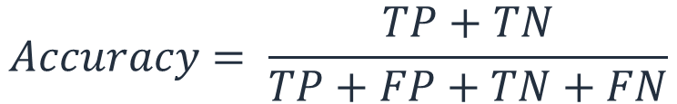
Evaluation: Classification step 2
Aggregate up into 1 value across the whole dataset by creating ratios. One example ratio is accuracy (all correct predictions over the total number of predictions).
$$Accuracy= \frac{TP+TN}{TP+FP+TN+FN}$$
Notes:
~Equation
~
While the confusion matrix contains all information of the outcomes of a classifier, it’s rarely used for reporting results because it’s difficult to compare and discuss. Instead, some overall numerical scores are extracted from the confusion matrix.
To calculate the accuracy of an ML model on a training set or validation set, you can use the following formula:
accuracy = (TP + TN) / (TP + FP + TN + FN)

Slide 13
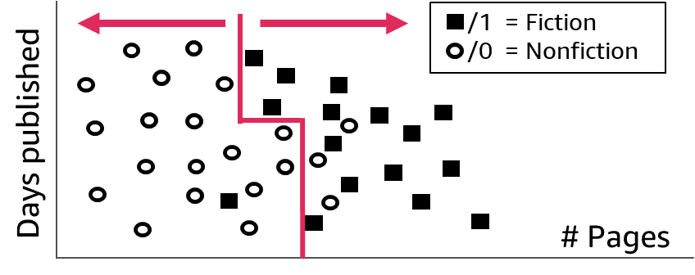
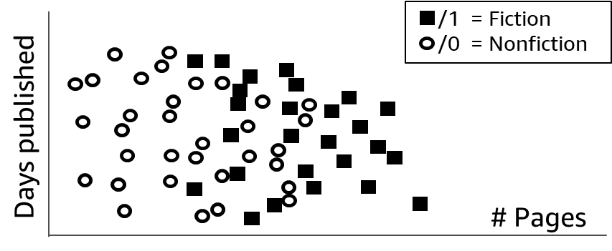
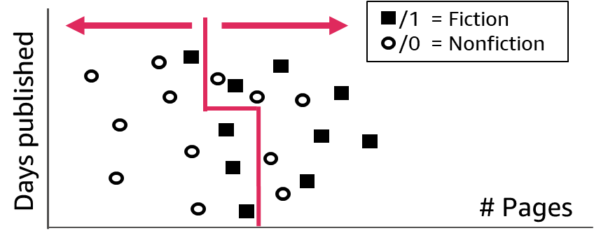
Evaluation: Comparing training and validation datasets
Training
Original dataset
Split
Validation
Notes:
~Alt text – original: Scatterplot of original dataset. Detail in notes.
~Alt text – training: Scatterplot of the training dataset. Detail in notes.
~Alt text – validation: Scatterplot of the validation dataset. Detail in notes.
~
Image 1 description: The original dataset scatterplot. This scatterplot has a mix of circles and squares. Days published is the y-axis and number of pages is the x-axis. The circles represent nonfiction books, and the squares represent fiction books. End description.
Image 2 description: The training scatterplot. This scatterplot is the same as the one on the classification step 1 slide. The plot contains some, but not all, of the data points from the original dataset. End description.
Image 3 description: The validation scatterplot. This scatterplot includes a subset of the original dataset. None of the points in this plot match the points that are used in the training scatterplot, which indicates that this is a different part of the original dataset. End description.
With the same classification problem, evaluate model performance on training and validation datasets. First, you need to split the original dataset for this purpose.
Plot the dataset by using the two features (number of pages and days published) and the label, which is shown as a circle (nonfiction) or square (fiction). Because this is a binary classification problem, you can use numerical values to represent labels: 1 for fiction and 0 for nonfiction.
The model is shown as the line on the training and validation plots. The model predicts that everything on the left is nonfiction (0), and everything on the right is fiction (1). You can see that, in both the training dataset and the validation dataset, some data points were predicted incorrectly.

Slide 14
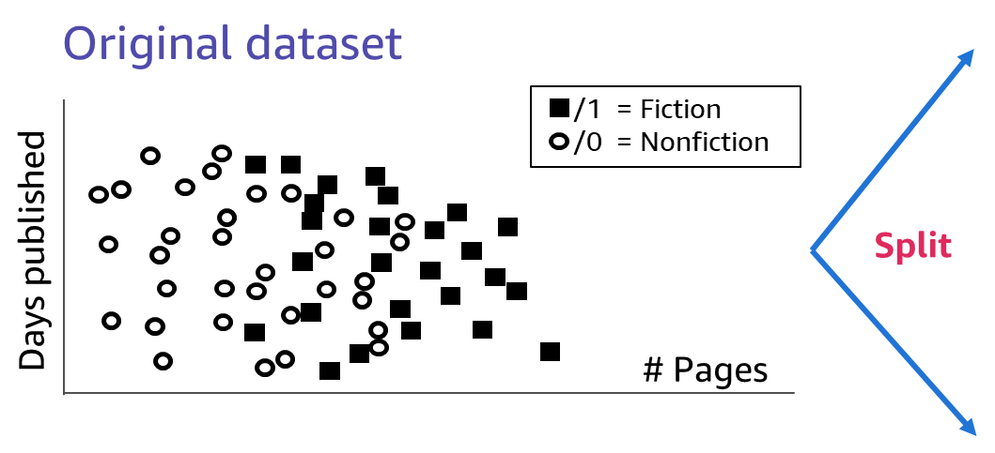
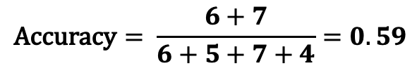
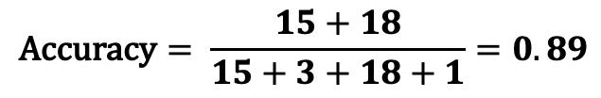
Evaluation: Comparing accuracies
Training
$$\text{Accuracy}= \frac{15+18}{15+3+18+1}=0.89$$
Validation
$$\text{Accuracy}= \frac{6+7}{6+5+7+4}=0.59$$
Notes:
~Equations
~
To calculate the accuracy of an ML model on a training set or validation set, you can use the following formula:
accuracy = (TP + TN) / (TP + FP + TN + FN)
In the formula, TP is the number of true positive predictions, TN is the number of true negative predictions, FP is the number of false positive predictions, and FN is the number of false negative predictions. On the slide, the values from the plots on the previous slide have been substituted into the formulas.
To calculate the accuracy of the model on the training set, you need to make predictions on the training set and then count the number of true positive, true negative, false positive, and false negative predictions. You can then substitute these values into the formula to compute the accuracy. To calculate the accuracy of the model on the validation set, you need to make predictions on the validation set and then follow the same process.
In this example, the accuracy for the training set is 89 percent, while the accuracy for the validation set is only 59 percent. What could be the issue?

Slide 15
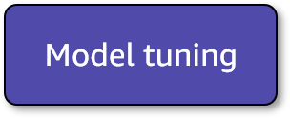
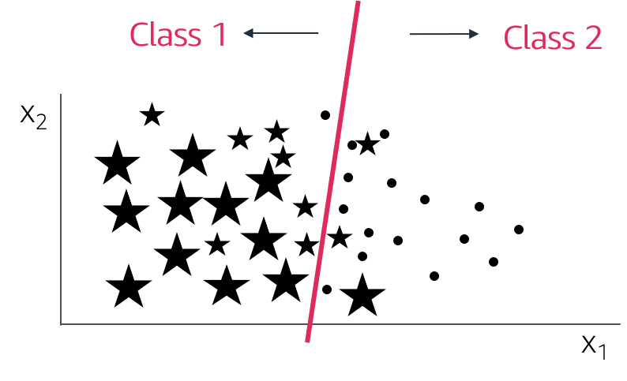
Model tuning: Underfitting
Underfitting: The model isn’t good enough to describe the relationship between the input data (x₁, x₂) and output y: {Class 1, Class 2}.
The model is too simple to capture important patterns of the training data.
The model will perform poorly on training data and validation (or test) data.
Corresponding to high bias, results show a systematic lack of fit in certain regions.
Notes:
~Alt text: Data points from two different classes are plotted, with a linear classifier that separates the two classes.
~
Low scores on the training dataset (high regression errors, R² that is negative or close to zero, or classification metrics close to 0) are indicators that the model didn’t learn much. It is not fit to do the task it is training for. The model is underfitting.
This means that the model did not capture the important patterns in the training dataset. An underfitting model does not perform well during training and is not expected to generalize to new data.
Here are several steps you can take to address underfitting:
Increase Model Complexity: One of the most common reasons for underfitting is using a model that is too simple to capture the complexity of the data. You can try using a more complex model, such as using a deeper neural network, increasing the number of layers, or using more features in traditional machine learning models
Feature Engineering: Sometimes, underfitting can occur because the features used for training the model are not informative enough. You can try adding more relevant features or transforming existing ones to make them more representative of the underlying data patterns.
Collect More Data: Insufficient data can lead to underfitting, as the model might not have enough examples to learn from.
Hyperparameter Tuning: Hyperparameters, such as learning rate, batch size, and the number of hidden units, can significantly impact the model's performance. Experiment with different hyperparameter settings to find the ones that work best for your specific problem.

Slide 16
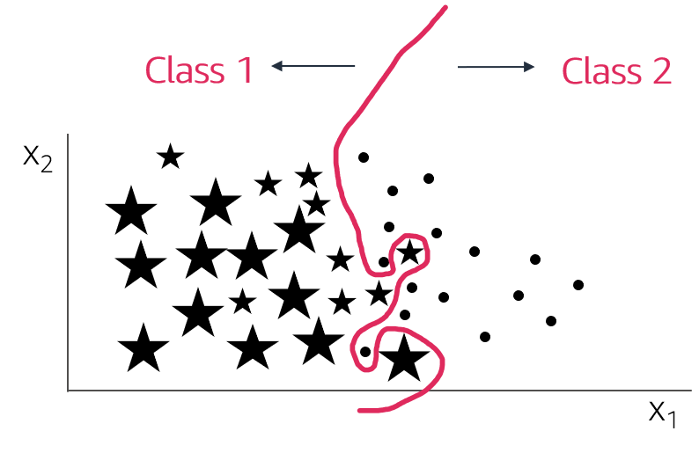
Model tuning: Overfitting
Overfitting: The model memorizes or imitates training data, and fails to generalize well on new “unseen” data (test data).
The model is too complex and picks up noise instead of the patterns of the training data.
The model will perform well on training data but poorly on validation (or test) data.
Corresponding to high variance, small changes in the data lead to big result changes.
Notes:
~Alt text: Data points from two different classes are plotted, with a complex classifier that separates the two classes.
~
At the other extreme, and more common in ML, is when the model works well on the training dataset but doesn’t work with the validation or test dataset.
How can this be? The model learns everything about the training data, including every detail and noise in the training data, but this can negatively impact the performance of the model on future data. All those details and noise that the model picked from the training data as rules might not apply to new data. The model didn’t find generalizable patterns, so the model might not be able to generalize.
This describes the trickiest but most common problem in ML: overfitting.
Several techniques are available to lessen the chance of, or amount of, overfitting. One method is to reduce the generalization gap that is observed between performance scores on training and validation datasets. At the very least, you need to ensure that you train and validate model performance on different datasets.
Here are several steps you can take to address overfitting:
Increase Training Data: More training data can help the model learn the underlying patterns of the data rather than fitting noise. If obtaining more data is feasible, this is often one of the most effective ways to combat overfitting.
Feature Selection/Engineering: Simplify the input features by selecting only the most relevant ones or by creating new features that capture the essential information. Removing irrelevant or redundant features can help the model focus on important patterns.
Reduce Model Complexity: Consider using simpler models with fewer layers, nodes, or features. This reduces the model's capacity to memorize the training data.
Regularization: Regularization techniques add a penalty term to the loss function, discouraging the model from fitting the noise in the data. Common regularization methods include L1 regularization (Lasso), L2 regularization (Ridge).
Cross-Validation: Use techniques like k-fold cross-validation to assess the model's performance on multiple validation sets.
Hyperparameter Tuning: Experiment with different hyperparameters, such as learning rate, dropout rate, and regularization strength.

Slide 17
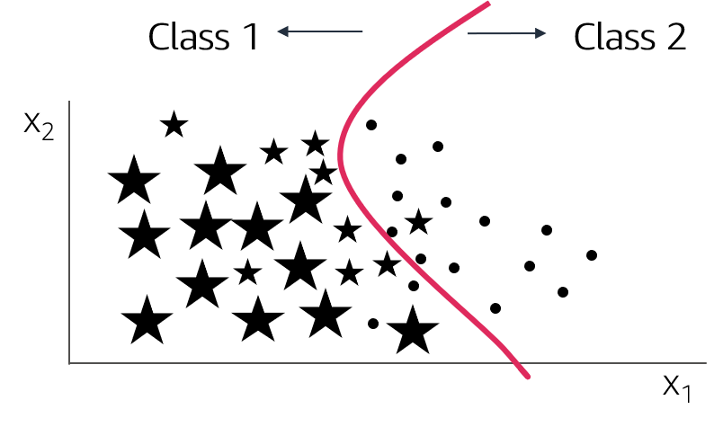
Model tuning: Appropriate fitting
Appropriate fitting: The model captures the general relationship between the input data (x₁, x₂) and output y: {Class 1, Class 2}.
The model isn’t too simple or too complex.
The model picks up the underlying relationship rather than noise in the training data.
The model will perform well enough on training data and validation (or test) data.
Bias-variance trade-off. Too simple model has high bias, too complex has high variance.
Notes:
~Alt text: Data points plotted. See details in notes.
~
Image description: Data points from two different classes are plotted. A curve separates them well (most classes are on the correct side of the line). End description.
Ideally, you want to build ML models that perform somewhere in between the two extremes of underfitting and overfitting. This ideal state is what a good (appropriate) fit would be.
To get an appropriate fit, you need to compromise on model performance on the training set so that the model pays less attention to the noise in the dataset and concentrates more on the patterns that can be generalized. This will help the model to successfully make predictions on future unseen data samples.
The validation set is helpful for the following reasons:
Building models on the training set and validating on the validation set
Monitoring performance metrics for validation in particular
Aiming for the model that performs “good enough” on both
Capturing the model that gives the best validation performance
Other than cross-validation, which you will learn about later, you can use many other ML techniques and ML algorithms to find appropriate-fit models. These techniques and algorithms include the following:
Early stopping: When you train an ML model iteratively, you can measure how well each iteration of the model performs. Until a certain number of iterations, new iterations improve the model. However, after that point, the model’s ability to generalize can weaken as it begins to overfit the training data.
Regularization: Regularization refers to a broad range of techniques for artificially forcing your model to be simpler.
Ensembling: Ensembles are ML methods to combine predictions from multiple separate models.

Slide 18
How do you help your model fit appropriately?
Give the model different (new) data
Adjust hyperparameters to help the model learn
Use regularization techniques
Preprocess the data
Use a different model architecture
Notes:
The following strategies are common ways that you can help an ML model to fit the data appropriately:
Give the model more data: One way to improve model performance is to give the model more data to learn from. This can help the model learn more about the underlying patterns in the data and make more accurate predictions.
Adjust hyperparameters: Hyperparameters are values that are set prior to training a model, and they control the learning process. By adjusting the values of the hyperparameters, you can affect the model's performance. Some common hyperparameters include the learning rate, batch size, and number of hidden layers in the model.
Use regularization techniques: Regularization techniques are used to prevent overfitting. Some common regularization techniques include adding a penalty term to the loss function or using dropout.
Preprocess the data: Preprocessing the data can also help improve model performance. This can include techniques such as normalizing the data, removing outliers, and handling missing values.
Use a different model architecture: Finally, you can try a different model architecture or a different type of model altogether. Different models can be better suited to different types of data and tasks.

Slide 19
Model tuning: Hyperparameters
What are hyperparameters?
Adjustable parameters in an algorithm that influence the training process— “options” or “settings” for the model training jobs.
ML models can have multiple hyperparameters.
Examples:
Dropout (number of features to use)
Time (allocated time for training)
Activation function (introduce nonlinearity in the model)
Notes:
In ML, hyperparameters are values that are set prior to training a model and that influence the model's behavior and performance. Examples of hyperparameters include the learning rate, batch size, number of hidden units, and regularization coefficient.
Hyperparameters are typically set based on experience or by using a search algorithm, such as grid search or random search. Adjusting the hyperparameters to improve the model's performance is known as hyperparameter optimization or model tuning.
Hyperparameters differ from the model's internal parameters, which are learned during training, based on the input-output pairs in the training data. The internal parameters are optimized to minimize the error between the model's predictions and the ground truth labels, while the hyperparameters are set based on the model's desired behavior and performance.

Slide 20
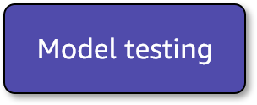
Model testing
Testing: The process of using a trained model to make predictions on a withheld dataset.
Given input, generate predictions based on a trained model.
You can evaluate future performance by comparing the model's predictions or decisions to ground truth labels on this data.
Notes:
With testing, you can assess how the model will perform on future data by showing the model data that it has never been trained on or tuned on in the past. You might overfit a model during training and tuning, and testing provides a final check—independent from all others—about how the model will perform.

Slide 21
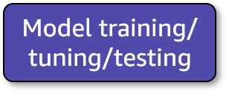
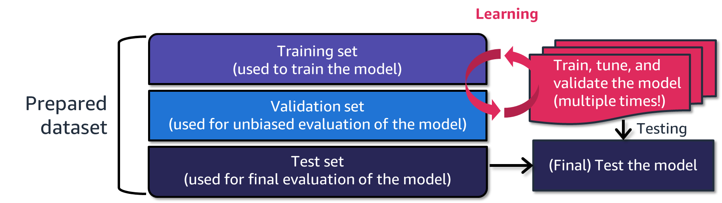
Model training and evaluation process
Notes:
~Alt text: Diagram that highlights how datasets are used during model training, tuning, and testing. See details in notes. ~
As the diagram illustrates, model tuning by using a training set, validation set, and test set typically involves the following steps:
Split the dataset into a training set, validation set, and test set. The training set is used to train the model, the validation set is used to tune the hyperparameters, and the test set is used to evaluate the final model.
Train the model by using the training set and a set of initial hyperparameter values.
Evaluate the model on the validation set and compute a performance metric.
Adjust the hyperparameters based on the performance on the validation set. This might involve using techniques such as grid search or random search to explore different combinations of hyperparameter values.
Repeat steps 2–4 until the model's performance on the validation set is satisfactory or until a maximum number of iterations has been reached.
Evaluate the final, tuned model on the test set and compute the performance metric.
By using a separate validation set to tune the hyperparameters, you can ensure that the model is not overfitted to the training data and that the model is able to generalize well to unseen data. The test set is used to provide an unbiased evaluation of the final model's performance on unseen data.
Additional notes:
Model tuning, also known as hyperparameter optimization, is the process of adjusting the hyperparameters of an ML model to improve its performance. This typically involves training the model multiple times with different hyperparameter values and evaluating the model's performance on a validation set.
The training set is a dataset that is used to train the model. It consists of input data and the corresponding ground truth labels or target values. The model is trained by adjusting its internal parameters based on the input-output pairs in the training set.
The validation set is a dataset that is used to evaluate the model during the training process. It is used to tune the hyperparameters of the model and to assess the model's generalization performance. The model is not trained on the validation set, but its performance on the validation set is used to select the best-performing model based on the hyperparameters that were used.
The test set is a dataset that is used to evaluate the final, tuned model. It is used to assess the model's performance on unseen data and to compare the model's performance to other models that have been trained on the same dataset. The model is not trained on the test set, and the test set is only used for evaluation after the model has been finalized.

Slide 22
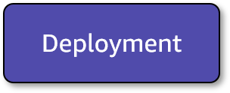
Deploying the model to production
Deployment
After model performance is satisfactory, move it to production.
Yes
Evaluation
Notes:
After you have evaluated the model, the next step is to deploy the model in a production environment where it can be used to make predictions or decisions on new, unseen data. This step is called model inference: given input (new, unseen data), generate predictions.
Consider the following when you deploy an ML model:
Model serving: The model must be deployed in a way that allows applications or other systems to access and use the model to make predictions or decisions. This might involve deploying the model as a web service or integrating it into an existing application.
Performance and scalability: The model must be able to handle the workload and processing demands of a production environment. This might involve optimizing the model for performance, using efficient data structures and algorithms, or using parallel processing techniques.
Monitoring and maintenance: The model must be monitored to ensure that it is functioning correctly and making accurate predictions or decisions. This might involve setting up alerts or monitoring dashboards, as well as regularly testing and retraining the model as needed.
Overall, the process of deploying an ML model involves ensuring that the model is accessible, high performing, well-maintained, and monitored in a production environment.

Slide 23
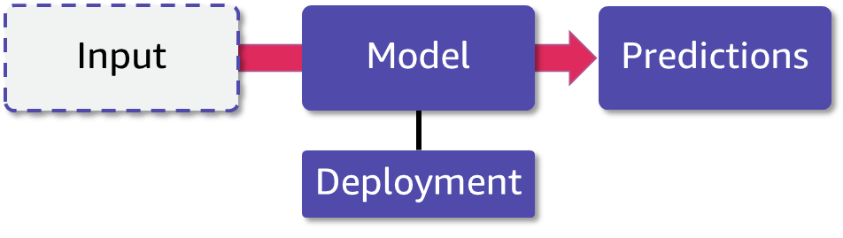
Using the model in production
Inference: The process of using a trained model to make predictions or decisions on new, unseen data.
Given input, generate predictions based on a trained model.
Predictions are then used to address your original problem by being shown to the user or being sent to another automated system.
Notes:
~Alt text: Flowchart of input going to deployed model and coming out as predictions.
~
The end result of inference is to have predictions that are consumed and that provide answers that are useful to solve problems.

Slide 24

Next lesson
What is AutoML?
How can you use AutoML with AutoGluon to solve an ML problem?
See you next time!

Slide 26
Image source slide (for curriculum development use only)

Slide 27
Source graphic: ML lifecycle
Real-life problem
Problem formulation
Data processing
Model training/ tuning/testing
Evaluation
Deployment
Real-life problem
Problem formulation
Data processing
Model training/ tuning/testing
Evaluation
Deployment
Notes:
~Source graphic for ML lifecycle on slides 5-22

Slide 28



Source graphic: Evaluation: Regression step 1
Price [$]
$$y_{i}$$
True values
$${error}_{ i}$$
Predicted values
$${\hat{y}}_{i}$$
# Pages
Notes:
~Source for slide 9

Slide 29
Source graphic: Evaluation: Classification step 1
Prediction
1 (positive)
0 (negative)
Predict 0
Predict 1
True positive
15
False negative
1
/1 = Fiction
/0 = Nonfiction
1 (positive)
True State
Days published
False positive
3
True negative
18
# Pages
0 (negative)
Notes:
~Source for slides 11 and 12

Slide 30
Source graphic: Evaluation: Comparing training and validation datasets
Training
/1 = Fiction
/0 = Nonfiction
Original dataset
Days published
/1 = Fiction
/0 = Nonfiction
# Pages
Days published
Split
Validation
/1 = Fiction
/0 = Nonfiction
# Pages
Days published
# Pages
Notes:
~Source for slides 13 and 14

Slide 31

Source: Model tuning: Overfitting
Class 1
Class 2
x₂
x₁
Notes:
~Source for slide 16

Slide 32
Source: Model tuning: Appropriate fitting
Model tuning
Class 1
Class 2
x₂
x₁
Notes:
~Source for slide 17

Slide 33
Source: Model training and evaluation process
Learning
Training set
(used to train the model)
Train, tune, and validate the model (multiple times!)
Original dataset
Prepared dataset
Validation set
(used for unbiased evaluation of the model)
Testing
Test set
(used for final evaluation of the model)
(Final) Test the model
Notes:
~Source for slide 21

Slide 34
Source: Using the model in production
Input
Model
Predictions
Deployment
Notes:
~Source for slide 23

