Slide 1
Exploratory Data Analysis
Machine Learning through Application
Module 2 – Lesson 1

Slide 2
Today’s activities
Understanding your data
Imbalanced datasets
Missing data

Slide 3
Understanding your data

Slide 4
EDA
Exploratory data analysis (EDA) is a series of operations to analyze a dataset and capture its main characteristics.
EDA involves the following:
Collecting or aggregating data
Performing initial investigations to discover patterns, spot anomalies, test hypotheses, and check assumptions
Summary statistics
Graphical and visual representations (such as histograms and plots)
Processing data to produce meaningful representations for the next steps
Notes:
Exploratory data analysis (EDA) is a common process to analyze a given dataset.

Slide 5
Dataset statistics
Dataset statistics provide insights about the main characteristics of the dataset.
Overall statistics including the following:
Number of instances (number of rows)
Number of features (number of columns)
# Examples of code for overall statistics
df.head()
df.shape
df.info()
Notes:
~Code block
~
Overall (or high-level) dataset statistics are helpful as a first step in statistics analysis. Some examples are number of instances and number of features.
The slide provides code examples that assume that your data is stored as a Pandas DataFrame that is named “df.”

Slide 6
Univariate statistics (single feature)
Category of Statistics | Example Python Code
Numerical features Mean Variance Histogram | df.describe(),df[feature].plot.hist()
Categorical features Bar plots Mode Most and least frequent values Percentage Number of unique values Histogram of values | df[feature].value_counts() df[feature].value_counts().plot.bar()
Target statistics Class distribution | df[target].value_counts() np.bincount(y)
Notes:
~Code

Slide 7
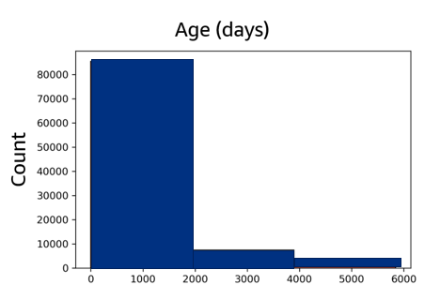
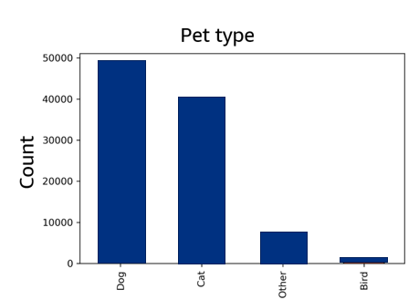
Univariate statistics: Histogram and bar plot
Categorical features – Bar plot
Numerical features – Histogram
# Example code for numerical features
import matplotlib.pyplot as plt
df[num_feature].plot.hist(bins=3)
plt.show()
# Example code for categorical features
import matplotlib.pyplot as plt
df[cat_feature].value_counts().plot.bar()
plt.show()
Notes:
~Code blocks
~Alt text – histogram: Histogram of numerical features showing counts of age in days.
~Alt text – bar plot: Histogram of categorical features showing counts of pet type for dog, cat, other, and bird.
~
The Pandas library provides easy-to-use functions to create histograms and bar plots. In the example plots on the slide, the y-axis (Count) shows how many data points belong to a certain section.
For numerical features, histograms can provide details about the overall distribution of values. The plot on the left side of the slide shows an example histogram (bins=3) with most of the values being smaller than 2,000.
Bar plots are useful for categorical features. The plot on the right side of the slide shows a bar plot for a categorical feature that is called “pet type”. The most populated categories are dog (close to 50,000) and cat (close to 40,000).

Slide 8
Multivariate statistics: More than one feature
Correlation is a measure of the association or dependence between two random variables (two features).
You can use the following:
Correlation coefficient
Visual inspection with a scatterplot
# Example code for correlation coefficient
df[[feature1, feature2]].corr()
# Example visual inspection
# with scatterplot code
df.plot.scatter(feature1, feature2)
Notes:
~Code blocks

Slide 9
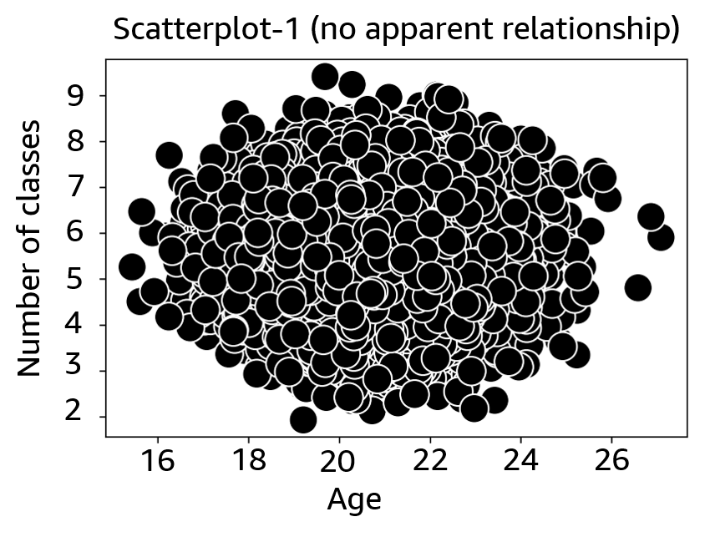
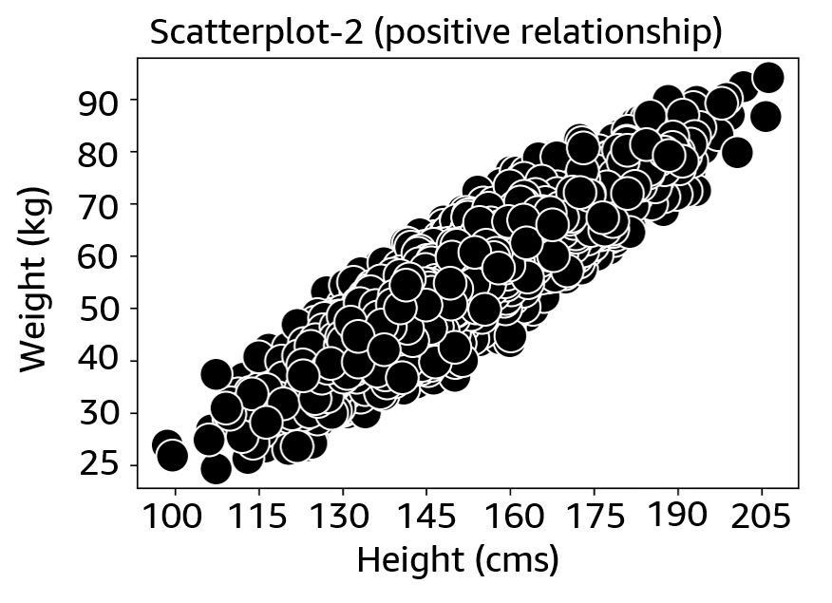
Multivariate statistics: Scatterplot
A scatterplot visualizes feature-target and feature-feature pairwise relationships.
# Example code for visual inspection with scatterplot
df.plot.scatter(feature1, feature2)
plt.show()
Notes:
~Code block
~Alt text – scatterplot-1: Scatterplot of data that shows no apparent relationship.
~Alt text – scatterplot-2: Scatterplot of data that shows a positive relationship.
~
Visual inspection with a scatterplot provides a quick look at the association or dependence between variables.
The first scatterplot on the slide shows no correlation between the features that are considered.
The second scatterplot shows two highly correlated features. They are correlated positively, which means that when one feature increases, the other one increases too. If this scatterplot had the opposite slope, where one feature increases as the other feature decreases, the features would be negatively correlated.

Slide 10
Multivariate statistics: Correlation matrices values
Correlation matrices:
Measure linear dependence between features.
Advantages: Easy to read and can be colored with heat maps.
Correlation values are between -1 and 1:
-1 means perfect negative correlation.
1 means perfect positive correlation.
0 means no relationship exists between the two variables.
# Example code for correlation value
cols = [feature1, feature2]
df[cols].corr()
Notes:
~Code block
~
If analyzing plots is not easy to assess correlations, you can use correlation matrices. Correlation matrices measure the linear dependence between features. The matrices are easy to read, and you can use heat maps to distinguish stronger correlations from weaker correlations.
The command to create correlation matrices is df[cols].corr().

Slide 11
Multivariate statistics: Correlation matrices
# Example code for correlation value
cols = [feature1, feature2]
df[cols].corr()
No strong relationship between features
Strong relationship between features
Name | Age | # of classes
Age | 1 | 0.013
# of classes | 0.013 | 1
Name | Height | Weight
Height | 1 | 0.88
Weight | 0.88 | 1
Notes:
~Code block
~
This slide shows correlation matrices that are associated with the scatterplots from a previous slide. The evaluation of the correlations from looking at the scatterplots was correct. The correlation score of the first pair of features is low (close to 0), and the correlation score of the second pair of features is high (close to 1) and a positive correlation.

Slide 12
Correlations
Features that are highly correlated (positive or negative) with each other might degrade the performance of some ML models (for example, linear or logistic regression).
Select one of the correlated features and discard others.
Other ML models, such as decision trees, are mostly immune to this problem.
However, features that are highly correlated (positive or negative) with the targets might improve the performance of linear and logistic regression models.
Notes:
Correlated features may degrade the performance of your model. Ideally, you want to identify highly correlated features and keep only one of the features. If the features are correlated, the ones that you drop are not very informative in the first place, so the algorithm might not suffer much from dropping the features. Dropping a feature or multiple features can improve the training speed and reduce the dimensionality of your model.
Simpler models (which are built on fewer features) are usually preferable because they are easier to interpret and implement.
However, highly target-correlated features (that is, correlated to the price of the book alone) might improve the performance of regression models.

Slide 13
Imbalanced datasets

Slide 14
Class imbalance
A dataset is imbalanced when the number of samples per class is not equally distributed.
ML models might not work well with classes that make up a small proportion of the dataset.
Examples:
Fraud detection
Anomaly detection
Medical diagnosis
Notes:
Class imbalance is a surprisingly common problem in ML (specifically in classification). Imbalance occurs in datasets with a disproportionate ratio of observations in each class—that is, the number of samples per class is not equally distributed.
The ML model might not work well for the infrequent classes because not enough samples are available to learn patterns from or it would be difficult for the classifier to identify or match those patterns. Most likely, a model might optimize on the dominant class because it might be sufficient to achieve good performance.
As an example, consider a dataset for fraud detection of credit cards. Most of the credit card transactions are not fraud, and very few classes are fraud transactions. This means a ratio similar to 50:1 between the fraud and nonfraud classes.

Slide 15
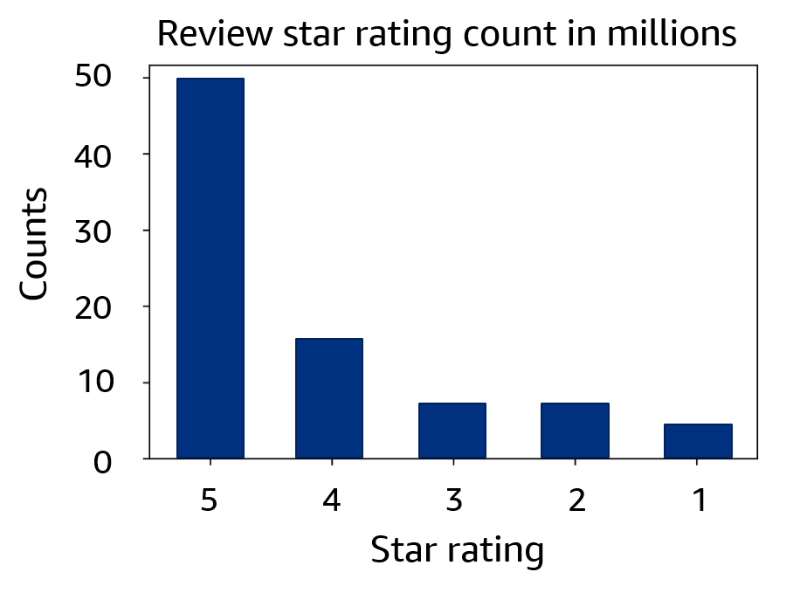
Class imbalance example
Example: Amazon product reviews dataset
The number of 5-star reviews almost equals the total of the other types of star reviews combined.
Learning how to classify for the other types is more difficult than for the 5-star reviews.
Notes:
~Alt text: Histogram of star ratings (1 to 5 stars) from product reviews. Most reviews are 5-star ratings.
~
The example histogram on this slide shows star rating counts for reviews in the Amazon Product Data dataset. The number of 5-star reviews almost equals the total of the other reviews combined.
Reference:
Julian McAuley, Christopher Targett, Qinfeng Shi, and Anton van den Hengel. “Image-Based Recommendations on Styles and Substitutes.” ACM Special Interest Group on Information Retrieval (SIGIR), 2015. https://cseweb.ucsd.edu/~jmcauley/datasets/amazon/links.html.

Slide 16
Downsampling and upsampling
Downsampling:
Reduce the size of the dominant or frequent class or classes.
Additional samples from the dominant class are omitted during training.
# Example of downsampling code
frequent_class = df.sample(n=len(rarer_class))
Upsampling:
Increase the size of the rare or small class or classes.
Duplicates are allowed during upsampling the rarer class or classes.
# Example of upsampling code
rarer_class = df.sample(n=len(frequent_class), replace=True)
Notes:
~Code blocks
~
Apart from changing performance metrics from accuracy to precision, recall, or F1 score, other ways to address class imbalance are related to balancing the dataset or the way ML learns from the dataset.
Downsampling the dominant class involves randomly removing observations from the dominant class to match the size of the rare class.
Upsampling the rare class is the process of randomly duplicating observations from the rare or small class to match the number of the dominant class. This can be done with resample with replacement.

Slide 17
Data generation and sample weights
Data generation:
Create new records that are similar but not identical.
Example: Synthetic Minority Oversampling Technique (SMOTE)
Sample weights:
For a model that uses a cost function, assign higher weights to the rare class or classes and lower weights to the dominant class or classes.
Example: Logistic regression
# Example of logistic regression code
LogisticRegression(penalty='l2', C=1.0, class_weight='balanced')
Notes:
~Code block
~
Data generation, or creating synthetic samples (data augmentation), is similar to upsampling. It involves resampling from the rare class while slightly perturbing feature values to create "new" samples. One technique to create synthetic data is the Synthetic Minority Oversampling Technique (SMOTE).
Sample weights:
Another tactic is to have the learning algorithm pay more attention to the rare class or classes by assigning higher weights to the rare class or classes and lower weights to the dominant class or classes. The logistic regression module by sklearn provides the class_weight parameter to assign weights to classes based on their frequencies.

Slide 18
Missing data

Slide 19
Different ways to fix missing data
Drop rows or columns that are missing values:
Fewer training data samples or fewer features can lead to overfitting or underfitting.
Impute (fill in) the missing values:
Average imputation
Common point imputation
Placeholder
Advanced imputation: Predict missing values from complete samples by using ML techniques.
For example, DataWig uses neural networks to predict missing values in tabular data.
# Example code to drop rows or columns
# with missing values
df.dropna()
# Example code for average imputation
df[column].fillna(df[column].mean())
# Example code for common point imputation
df[column].fillna(df[column].mode())
# Example code for placeholder
df[column].fillna(′missing′)
Notes:
~Code blocks
~
Because most ML algorithms don’t handle missing values, you might want to become familiar with a few techniques to handle data that is missing.
Depending on how many values are missing in the dataset, and how they are distributed across rows and columns, removing those rows or columns from the dataset might lead to fewer training data samples or fewer features to build your models. That can lead to overfitting or underfitting.
For more information about DataWig, see awslabs/datawig on GitHub at https://github.com/awslabs/datawig.

Slide 20
SimpleImputer in sklearn
Is an imputation transformer to complete missing values
Uses the fit and transform functions:
# Example code for fit and transform functions
.fit(), .transform()
Notes:
You can use sklearn’s SimpleImputer to perform most of the methods that were mentioned on the previous slide. For more information, see sklearn.impute.SimpleImputer at https://scikit-learn.org/stable/modules/generated/sklearn.impute.SimpleImputer.html.

Slide 21
SimpleImputer strategy parameter
SimpleImputer(missing_values=nan, strategy='mean', fill_value=None)
For numerical data:
strategy='mean': Replace missing values with the mean along each column.
strategy='median': Replace missing values with the median along each column.
For numerical or categorical data:
strategy='most_frequent': Replace missing values with the most frequent value along each column.
strategy='constant': Replace missing values with the specified fill_value.

Slide 22

Next lesson
In the next lesson you will learn how to process and convert features into a format that machines can understand and learn from.
Notes:
This lesson examined different types of features, such as categorical and numerical features.
You haven’t used these features with any ML model yet in this course. To use them, you need to process and convert these features into a format that machines can understand and learn from. You will learn about this process in the next lesson.

